Slide 1
Arc Scripts Tool Basics
Dr. Tateosian
GIS 540
North Carolina State University
Center for Geospatial Analytics

Slide 2
Topics
Executing scripts
  Windows command line
  Arc Python window
Script Tools
  A GUI pointer to a Python script
  Creating script tools and buttons
  Printing from script tools
  Relative paths strike again!

Slide 3

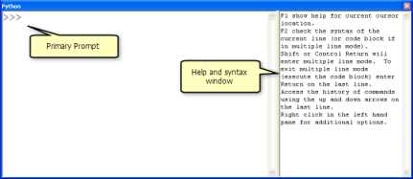
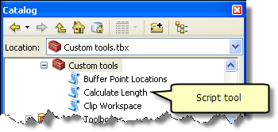
Executing a script
Outside ArcGIS (stand-alone scripts)
  Run from an IDE (PythonWin, IDLE…)
  Run from the command line
  Run from the Arc Python Window
Within ArcGIS (script tools)

Slide 4
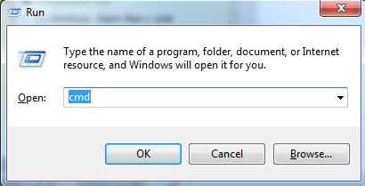
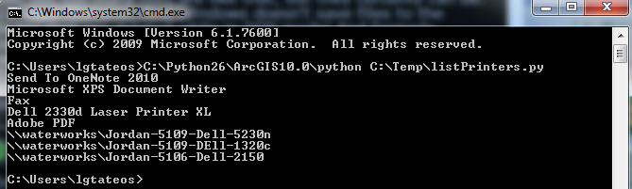
Command line
On Windows: Start>run>cmd>enter
Syntax:
path_to_python.exe path_to python_script arg1 arg2…
Example 1 (no args):
C:\Python27\ArcGIS10.2\python C:\Temp\listPrinters.py
Example 2 (one argument, a file name):
C:\Python27\ArcGIS10.2\python C:\Temp\listFields.py C:/Temp/Cover63p.shp
Example 3 (4 arguments, x1 y1 x2 y2):
C:\Python27\ArcGIS10.2\python C:\Temp\findSlope.py 1 0 4 3

Slide 5
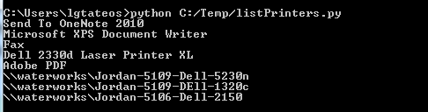
Setting the PATH to python
Allows you to use python as a command (no need to type full path to executable)
Computer > properties > Advanced system settings > Advanced tab > Environment Variables
Append ;C:\Python27\ArcGIS10.2 to the PATH variable

Slide 6
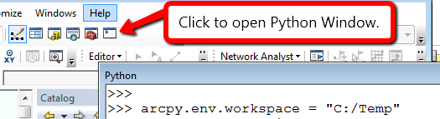

Arc Python Window
Open the Python scripting window in ArcMap.
Command prompt and help windows
Similar to the Interactive Window in PythonWin
  -- type commands at the command prompt and hit ‘Enter’ to execute
  -- Can autocomplete a selection using Tab
  -- Can’t use sys.argv. Use variables instead.
  -- Don’t need to import arcpy
  -- Can refer to current map:
  mxd = arcpy.mapping.MapDocument(“CURRENT”)

Slide 7
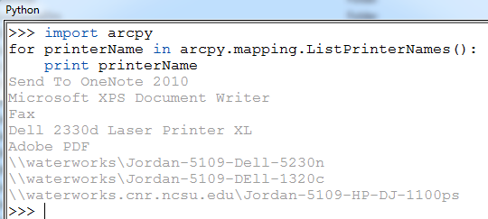
Two ways to run a previously saved script:
right-click > Load…> browse to script > Enter to run script
Copy and paste script at the prompt and hit “Enter”

Slide 8
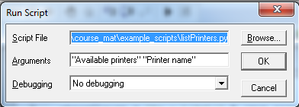
In class - Run scripts
listPrinters.py takes 2 arguments. Run it in PythonWin to see how it works.
Run listPrinters.py on the command line. C:\Python27\ArcGIS10.2\python C:\Temp\listPrinters.py "Available printers" "Printer name"
Run in Arcpy Python window (it breaks).
Modify to make it work in Arcpy Python Window.

Slide 9

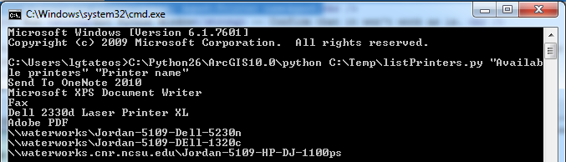
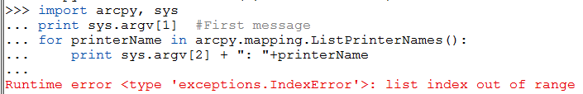
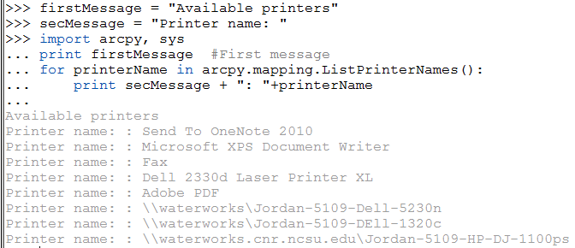
Run scripts followup

Slide 10
What’s a ‘script tool’?
‘script tool’ is an ESRI term
A custom GUI that points to a Python script.
TkFileDialog
  + Pro: Browse to files/directories
  + Pro: Good for simple apps.
  + Pro: No arcpy needed.
  -- Con: only input type files/directories.
  -- Con: Can’t get more than one file/directory at a time.
Other GUI libraries: wxPython, PyQT…
  + Pro: Powerful/flexible.
  + Pro: No arcpy needed.
  -- Con: Complex to learn
Script tools
  + Pro: Easy to create.
  + Pro: Can get many data types as input, include ArcGIS proprietary.
  + Pro: Can get more than one input at a time.
  -- Con: ArcGIS required. And need to know ArcGIS really well.
  -- Con: Some limitations (e.g., can’t make a wizard? Limited available widgets).

Slide 11
Create a script tool
To create a script tool, you need three things:
    A Python script.
    A custom toolbox.
    A list of desired script parameters and their types.
To create a Script Tool
  Browse to desired directory in ArcCatalog
  Right click > New > Toolbox
  In new toolbox, right click > Add > script
  Then follow the wizard…

Slide 12
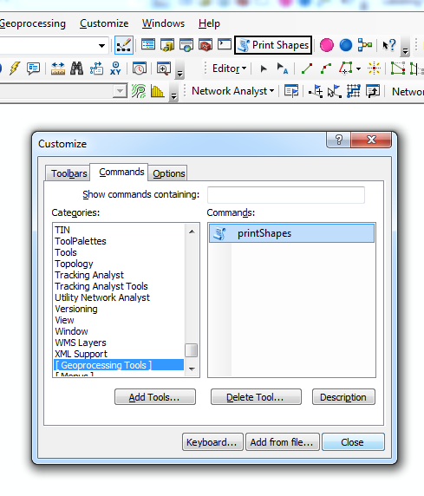
Adding script tool button to a map
To create a button on an ArcMap toolbar to launch a script tool
‘Customize’ > ‘Customize mode…’
‘Commands’ tab
Under Categories, scroll to select [Geoprocessing tool]
Add Tools… Browse to toolbox > Select script tool in toolbox > Add (Script tool appears under Commands )
Drag script tool from under Commands to an ArcMap toolbar
Before closing the ‘Customize’ dialog, right-click on the tool in the toolbar to display text and image and modify these as desired. (can also be done by reopening the customize dialog)
Notes:
http://resources.arcgis.com/en/help/main/10.1/index.html#//002400000005000000

Slide 13
In class –make your own script tool
Three things you need:
    A Python script (provided this time).
    A custom toolbox (you make it).
    A list of desired script parameters and their types. (this one doesn’t need any parameters.

Slide 14
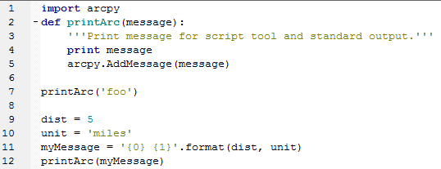
Printing from a script tool.
Where did ‘and I like pie!’ come from?
arcpy.AddMessage('And I like pie!')
>>> print ‘foo’ # doesn't display in the Geoprocessing Window
>>> arcpy.AddMessage(‘foo’) # doesn't print in the Interactive Window
Notes:
Import arcpy
def printArc(message):
'''Print message for script tool and standard output.'''
print message
arcpy.AddMessage(message)
printArc('foo')
dist = 5
unit = 'miles'
myMessage = '{0} {1}'.format(dist, unit)
printArc(myMessage)

Slide 15
Script tools in memory
Script Tools are pointers to Python scripts.
If you move the Python script it points to and change the script path in the Script Tool properties, it will no longer work!
Script Tools do NOT appear in Windows Explorer. They are part of a tbx file.
To share a Script Tool, you must copy the tbx file and the script, use relative path must be checked AND the script must be in the SAME relative position it was when set up.
Script tools are just a GUI interface for scripts.

Slide 16
In Class - Break a script tool
Browse to 'textLister.py' and open it. Add another message to 'textLister.py' and save the script:
arcpy.AddMessage('***I like kale***!')
Do you see a change?
Rename 'textLister.py' to 'textLister2.py' and run the script tool again. What happens?
Rename the script back to its original name, 'textLister.py' and run the script tool again. Is it working? Why?
Now move 'textLister.py' down one directory to 'C:\temp\toolboxes'. Run the script tool again. What happens?
Copy the toolboxes directory to your 'Documents' directory. Run the script tool again. Does it work? Why?
Move textLister.py to the 'Documents' directory. Run the script tool again. Does it work? Why?

Slide 17
Script tool concepts to remember
Script Tools do not appear in Windows Explorer. They are part of a tbx file.
Since a script tool points to a script, you can change the script and see the updates immediately when you run the tool.
If you rename, move, or remove the underlying script, the script tool will be broken.
For portability, check 'Store relative path names'. Then copy the toolbox and the script maintaining the relative path.
Script tools don't have a debugger, so it's important to test Python scripts thoroughly outside the script tool.
A simple way to maintain relative paths is to set up the script tools and scripts in the same directory and share that directory.

Slide 18
Summing up
Topics discussed
    Runnig Python – IDEs, command window, ArcGIS PythonWindow
    Script tools
      GUI front end for scripts
      Create script tool & menu button
      Print from a script tool (print & arcpy.AddMessage)
      Use relative paths & maintain them
Up next
    Script tools parameters
Additional topics
    wxPython, PyQT
Notes:
thanks for pic from http://twi-star.blogspot.com/2009/11/central-park-remember-me-set-stalking.html

