Slide 1
The arcpy mapping module part 2
Dr. Tateosian
GIS 540
North Carolina State University
Center for Geospatial Analytics

Slide 2
Topics
Manipulating elements and symbology

Slide 3
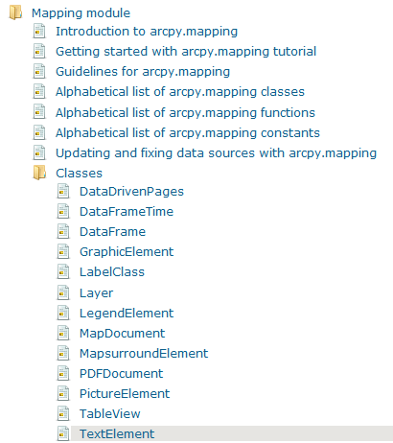
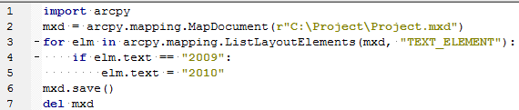
Managing layout elements
New layout elements can not be created with the mapping module, but a pre-prepared map can be used as a template for automating layout element manipulation.
ListLayoutElements (map_document, {element_type}, {wildcard})
element type -- optional but will not accept a place holder; must use a legitimate element type
List all layout elements objects:
elems = arcpy.mapping.ListLayoutElements(mxd)
pics = arcpy.mapping.ListLayoutElements(mxd, ‘PICTURE_ELEMENT')
horsePics = arcpy.mapping.ListLayoutElements(mxd, ‘TEXT_ELEMENT‘, ‘Foo*’)
'DATAFRAME_ELEMENT‘
'GRAPHIC_ELEMENT'
'LEGENT_ELEMENT‘
'MAPSURROUND_ELEMENT‘
'PICTURE_ELEMENT‘
'TEXT_ELEMENT'
Getting a layout element to modify its properties requires you to know the element name. When you add an element to a map document, it gets a name. However, for some elements, the default name is an empty string (e.g., text elements). For this reason, you need to make sure each element in your map template has a meaningful name.
Layout Workflow:
GET mapDocument object
GET layout element(s) of interest
MODIFY layout element property
SAVE the map
DELETE the mapDocument object

Slide 4
Explain what the code does…
Part 1:
>>> mxd = arcpy.mapping.MapDocument('CURRENT')
>>> arrow = arcpy.mapping.ListLayoutElements(mxd, 'MAPSURROUND_ELEMENT', '*Arrow*')[0]
>>> arrow.name
u'North Arrow'
Part 2:
>>> mxd = arcpy.mapping.MapDocument('CURRENT')
>>> elems = arcpy.mapping.ListLayoutElements(mxd)
>>> for e in elems:
... print e.name
Text Box
North Arrow
Legend
Title
Layers
>>> for e in elems:
... if 'Title' in e.name:
... title = e
>>> dfs = arcpy.mapping.ListDataFrames(mxd)
>>> df = dfs[0]
>>> title.elementPositionX = df.elementPositionX + (df.elementWidth*0.5) - (title.elementWidth*0.5)
>>> arcpy.RefreshActiveView( )
>>> title.elementPositionY = df.elementPositionY + df.elementHeight - title.elementHeight

Slide 5
Layer symbologyType
Layer objects have a ‘symbologyType’ property
>>> mxd = arcpy.mapping.MapDocument('CURRENT')
>>> dfs = arcpy.mapping.ListDataFrames(mxd)
>>> df = dfs[0]
>>> lyrs = arcpy.mapping.ListLayers(mxd)
>>> layerToModify = lyrs[0]
>>> layerToModify.symbologyType
u'OTHER'
Python can only modify the properties associated with certain symbology types. A Layer object has a 'symbologyType' property which has one of following values: 'GRADUATED_COLORS', 'GRADUATED_SYMBOLS', 'UNIQUE_VALUES', 'RASTER_CLASSIFIED ', or 'OTHER'.
If the symbologyType is ‘OTHER’, the layer has no ‘symbology’ property.
>>> layerToModify.symbology
NameError: The attribute 'symbology' is not supported on this instance of Layer.
Python can not change a layer’s symbologyType.
>>> layerToModify.symbologyType = 'GRADUATED_COLORS'
RuntimeError: LayerObject: Set attribute symbologyType does not exist
Data files that have an 'lyr' file extension are referred to as ‘Layer Files’. These files store the symbology for a dataset. When you add data to a map that is a Layer file, it uses the stored symbologyType; Otherwise, the default symbologyType is 'OTHER'. Depending on its symbologyType, a Layer object can have a 'symbology' class.

Slide 6
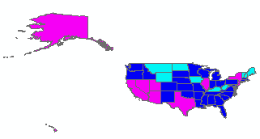
Modify symbology
modifying the symbologyType can be done using a preprepared 'lyr' file.
>>> srcLay = 'C:/temp/symbolTraining/gradColorsNE.lyr'
>>> srcLayObj = arcpy.mapping.Layer(srcLay)
>>> arcpy.mapping.UpdateLayer(df, layerToModify, srcLayObj)
>>> layerToModify.symbologyType
u'GRADUATED_COLORS‘
Now we can modify graduated color symbology properties, such as the value field for calculating the colors and the number of color classes:
>>> layerToModify.symbology.valueField
u'Category'
>>> layerToModify.symbology.valueField = 'AVE_FAM_SZ'
>>> arcpy.RefreshActiveView()
>>> layerToModify.symbology.numClasses
5
>>> layerToModify.symbology.numClasses = 3

Slide 7
Summing up
Topics discussed
    Working with symbology, Managing layout elements
Up next
    Script tools
Notes:
thanks for pic from http://twi-star.blogspot.com/2009/11/central-park-remember-me-set-stalking.html

