Slide 1

Calling tools with arcpy
Python capabilities in ArcGIS
Review dot notation
Environments settings
Calling tools
Online help
Spatial analyst
Dr. Tateosian

Slide 2
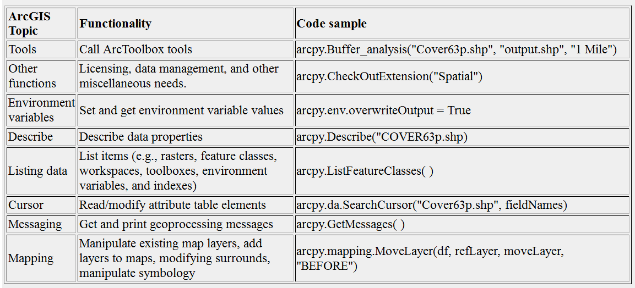
Python and ArcGIS
arcpy is the ArcGIS Python application programming interface (API)
To use it, import arcpy.
Not a standard Python module (no ArcGIS == no arcpy).

Slide 3
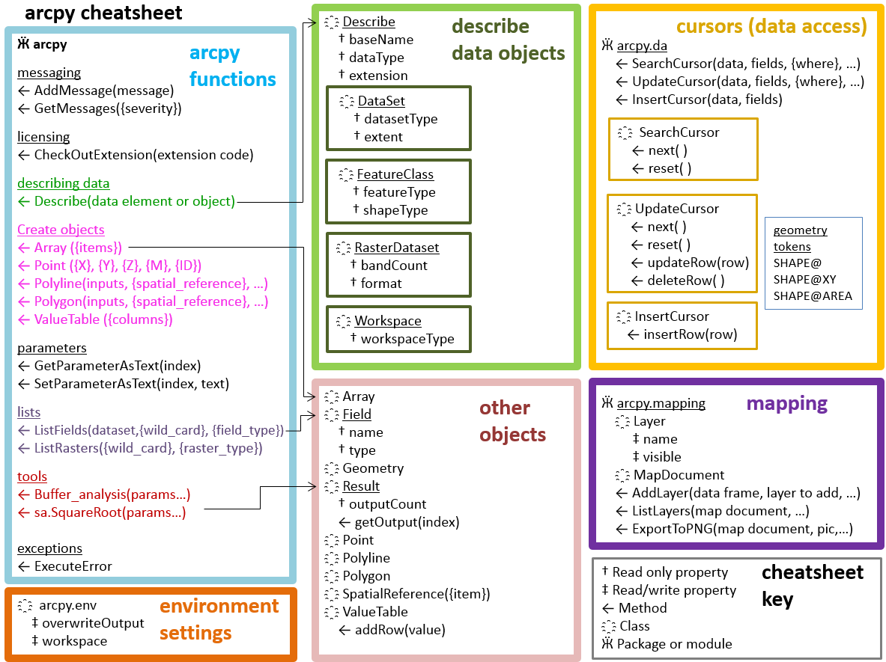
arcpy, the ArcGIS Python API
"C:\gispy\data\ch05\arcpyCheatSheet.pptx"

Slide 4
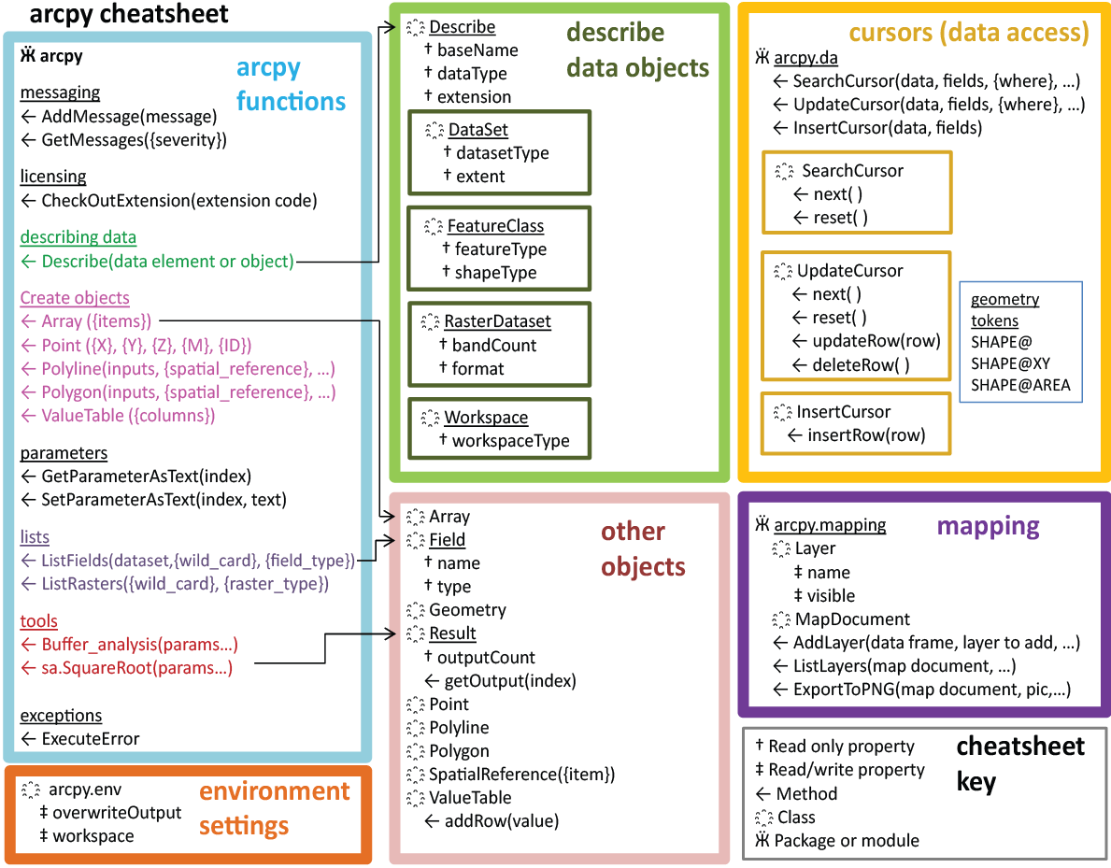
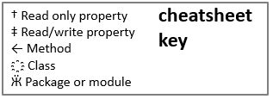
arcpy overview
Each part of the diagram has related functionality
  arcpy functions
  Describe objects
  Enumeration objects
  Cursor objects
  Other objects
  Mapping
Describe
Cursors
arcpy
functions
Enumerations
Other
Objects
Mapping
Need to import arcpy to access these properties & methods.
Notes:
Geoprocess object methods and properties allow you to access toolbox tools, set environment properties, get messages about processes, and a whole bunch of other things.
Describe objects allow you to get information about the datasets you're dealing with, such as what shapetype your feature class has, what the name of the OID field is.
Enumerations objects allow you to perform batch processing. They return objects which contain lists of featureclasses, or fields, or datasets, and so forth.
Cursor objects allow you to process in individual records in the data.
Other objects can be created. They will have the properties and/or methods specified in the pink box depending on which type of object they are.

Slide 5
9.1 versus 9.2 versus 9.3 versus 10.*
Creating a geoprocessor object in version 9.1
  import win32com.client
  gp = win32com.client.Dispatch('esriGeoprocessing.GpDispatch.1')
Creating a geoprocessor object in version 9.2
  import arcgisscripting
  gp = arcgisscripting.create()
Creating a geoprocessor object in version 9.3
  import arcgisscripting
  gp = arcgisscripting.create(9.3)
Using arcpy package in version 10.*
  import arcpy

Slide 6
OOP & dot notation
Everything in Python is an object.
Object-oriented programming (OOP): code revolves around objects; objects have methods and properties associated with them.
Object: an instance of a data type
x = 5 (x is an integer object)
Method: a set of code associated with an object that performs some action related to its object.
replace and lower are examples of string methods
Property: variable associated with an object
arcpy.env.workspace = 'C/:Temp'
arcpy.env.overwriteOutput = True
(workspace and overwriteOutput
are arcpy.env properties.)

Slide 7
Practice with objects you know already
Write Python code to create objects as described here:
Create a float object named 'x' with a value of 5.
x = 5.0
Create a string object named 'fileName', giving it a value of ‘park.shp'
fileName = 'park.shp'
Create a list object named 'mylist' that contains the integer objects 1, 2, and 3.
mylist = [1, 2, 3]

Slide 8
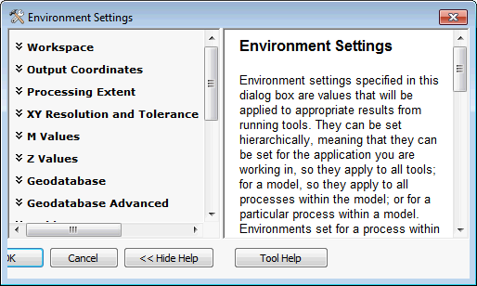
Environment Settings
ArcGIS > Geoprocessing menu > Environments…
>>> arcpy.ListEnvironments()
[u'newPrecision', u'autoCommit', u'XYResolution', u'XYDomain', u'scratchWorkspace', u'cartographicPartitions', u'terrainMemoryUsage', u'MTolerance', u'compression', u'coincidentPoints', u'randomGenerator', u'outputCoordinateSystem', u'rasterStatistics', u'ZDomain', u'transferDomains', u'resamplingMethod', u'snapRaster', u'projectCompare', u'cartographicCoordinateSystem', u'configKeyword', u'outputZFlag', u'qualifiedFieldNames', u'tileSize', u'parallelProcessingFactor', u'pyramid', u'referenceScale', u'extent', u'XYTolerance', u'tinSaveVersion', u'nodata', u'MDomain', u'spatialGrid1', u'cellSize', u'outputZValue', u'outputMFlag', u'geographicTransformations', u'spatialGrid2', u'ZResolution', u'mask', u'spatialGrid3', u'maintainSpatialIndex', u'workspace', u'MResolution', u'derivedPrecision', u'ZTolerance', u'scratchGDB', u'scratchFolder', u'packageWorkspace', u'addOutputsToMap']

Slide 9
Python for environment settings
'env' is a submodule that handles environment settings.
Double dot notation for 'env' properties. Format:
arcpy.env.property
Examples:
  >>> arcpy.env.cellSize
  u'MAXOF'
  >>> arcpy.env.nodata
  u'NONE'
  >>> arcpy.env.overwriteOutput = True
  >>> arcpy.env.workspace = 'C:/temp/data.mdb'
}
}
GET values.
SET values.
Use
assignment
statement.

Slide 10
Python for calling ArcToolbox tools
Python can call any tool in ArcToolbox (with one exception—Raster Calculator).
Arguments specified in parentheses give the tool input.
Example:
arcpy.Compact_management(filename)
???
object
method
Specifies the toolbox.
argument
object.method(argument1, argument 2, …)

Slide 11
Toolbox Aliases
Toolbox name alias
  Data Management Tools management
  Analysis Tools analysis
  Conversion Tool conversion
  Geocoding Tools location
  Coverage Tools arc
  ArcGIS Spatial Analyst Tools sa
  ArcGIS 3D Analyst Tools 3d
  … …
Which toolbox is it in?
  arcpy.Buffer_analysis('rds.shp', 'buff_rds.shp', '500 miles')
  Analysis tools
  arcpy.Buffer_arc('rd', 'rdbuf', 'line', '#', '#', '200', '0.5', 'round', 'full')
  Coverage tools
  arcpy.Buffer('rds.shp', 'buff_rds.shp', d)
  ??? We don't know.
  AttributeError: Object: Tool or environment <buffer> not found
Notes:
Tool names must be unique within Toolboxes and must not have spaces or use other restricted characters such as percent symbols or slashes.
Using the toolbox alias as a suffix when only a few tools are used.
Set the current toolbox by specifying the full toolbox path and the geoprocessor will look for the tool name in that location first…
Gp.AddToolbox = 'D:/ST_Johns/Path Tools.tbx'
Gp.Toolbox = 'D:/ST_Johns/Path Tools/tbx'
Gp.Workspace = 'D:/ST_Johns/data.mdb'
Gp.CalculatePath('start', 'destination', 'path')

Slide 12
Summary: use dot notation with arcpy
To assign a value to property Object.Property = value
  Example: arcpy.env.overwriteOutput = True
To get a value of a property Object.Property
  Example: print 'The workspace is', arcpy.env.workspace
  - Properties don't use parentheses
To use a method Object.Method(arg1, …)
  Examples:
  arcpy.Buffer_analysis ('Freeways', 'FreewaysBuffer', 100)
  arcpy.Exists('Freeways')
  arcpy.CheckOutExtension('Network')
  - parentheses around arguments
  - arguments separated by commas

Slide 13
Specify tool input/output files
env.workspace: specifies a default loc. for tool input/output
arcpy.env.workspace = 'C:/data.gdb'
arcpy.Buffer_analysis('pond', 'buff', '500 Feet')
arcpy.Buffer_analysis('C:/data.gdb/pond', 'C:/data.gdb/buff', '500 Feet')
For shapefiles, 'shp' extension required for input names.
>>> arcpy.Buffer_analysis('COVER63p', 'buff', '1 mile')
ERROR: Input Features: Dataset C:/Temp/COVER63p does not exist …
>>> arcpy.Buffer_analysis ('COVER63p.shp', 'buff', '1 mile')
<Result 'C:\\Temp\\buff.shp'>
To place output in a different location, specify path.
arcpy.env.workspace = 'C:/dataDir'
arcpy.Buffer_analysis ('lake.shp', 'C:/buffers/lakeBuff.shp', '1 mile')
arcpy.Buffer_analysis ('lake.shp', '/out/lakeBuff.shp', '1 mi')
Only use base name
(workspace set)
Use full path (workspace not set)
absolute path
relative path

Slide 14
Overwriting output
Run a tool twice, with the same output name give error (by default)
>>> arcpy.Buffer_analysis ('lakes.shp', 'buff.shp', '2 mi')
<Result 'C:\\Temp\\buff.shp'>
>>> arcpy.Buffer_analysis ('ponds.shp', 'buff.shp', '1 mi')
ERROR 000725: Output Feature Class: Dataset C:\Temp\buff.shp already exists.
Failed to execute (Buffer).
To allow files to be overwritten:
  arcpy.env.overwriteOutput = True
>>> arcpy.env.overwriteOutput = True
>>> arcpy.Buffer_analysis ('lakes.shp', 'buff.shp', '2 miles')
<Result 'C:\\Temp\\buff.shp'>
>>> arcpy.Buffer_analysis ('ponds.shp', 'buff.shp', '1 mile')
<Result 'C:\\Temp\\buff.shp'>
Persistence problem:
  Value of 'True' for rest of current session (unless set back to 'False'), but returns to default in a new session.
  Good idea to restart PythonWin and test again before sharing code with others.

Slide 15
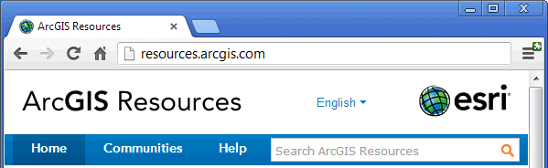

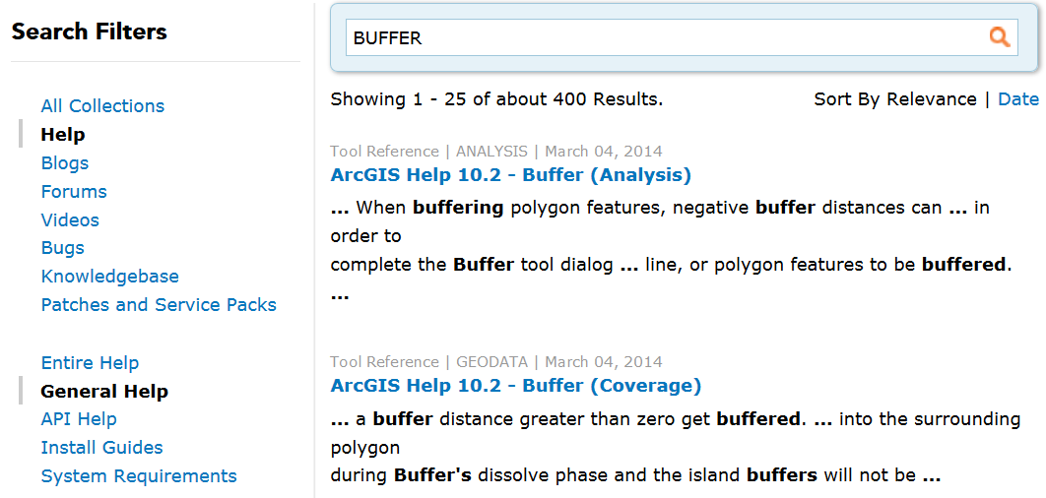
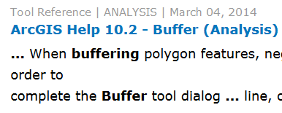
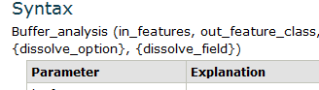
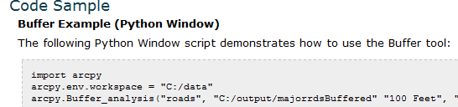
arcpy help
Search ArcGIS Resources
Select most relevant page
Scroll down to 'Syntax' and 'Code Sample'

Slide 16
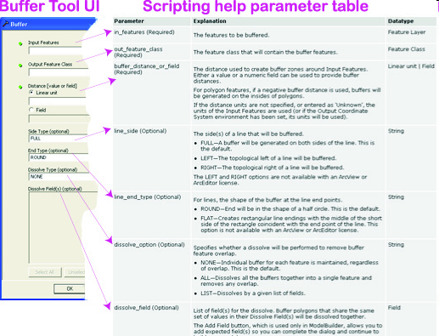
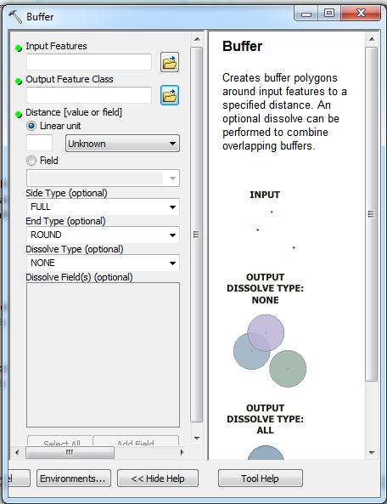
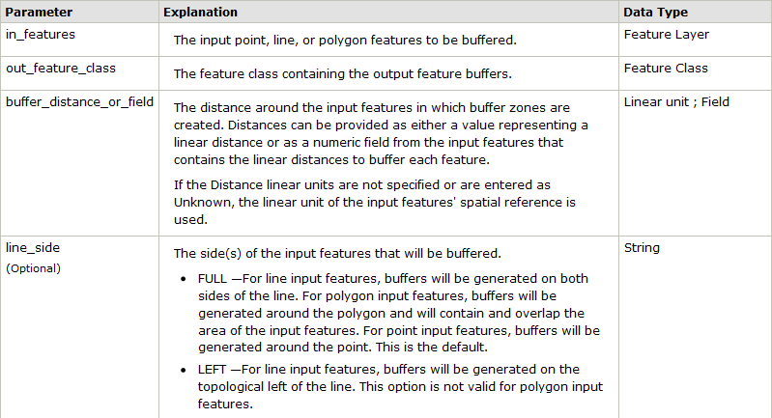
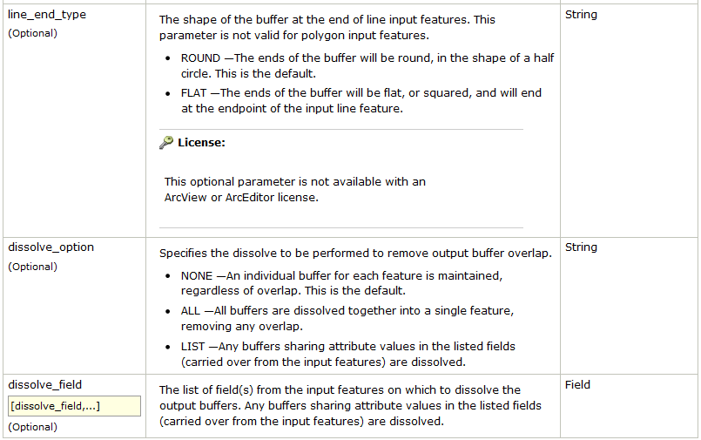

Slide 17
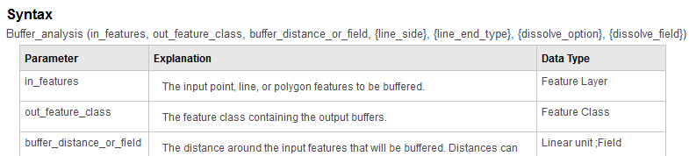

Tool template and parameter table
Parameters
  - Parameters are comma separated input to the tools.
  - Parameters provide the method with information about what to do.
  - Required params. are always 1st, followed by optional ones, shown with curly braces { } in template.
  To use some, but not all, optional parameters, use '#' as a placeholder.
  # Use default value for line_side, but set the value for line_end_type.
  arcpy.Buffer_analysis ('lake.shp', 'buff.shp', '1 mile', '#', 'FLAT')
template for the Python code
required
optional

Slide 18
Copy code snippet
Tip: you can run a tool with dialog box & copy code snippet:
Locate the tool in ArcToolbox.
Execute the tool using its dialog box.
Open the 'Results' window
(Geoprocessing menu > Results).
In the Results window, right-click on the tool name in the results listed there and select 'Copy as Python snippet'.
Paste the snippet into PythonWin and examine the syntax.

Slide 19
Typical geoprocessing script flow:
# 1. import arcpy & set environment, output directory
import arcpy
arcpy.env.workspace = 'C:/gispy/data/ch06/'
outputDir = 'C:/gispy/scratch/'
arcpy.env.overwriteOutput = True
# 2. Initialize parameters
inputRaster = 'getty_rast'
outputFile = outputDir + 'output.txt'
# 3. Call tool(s) using format
# object.method_toolboxAlias(arguments)
arcpy.RasterToASCII_conversion(inputRaster, outputFile)

Slide 20
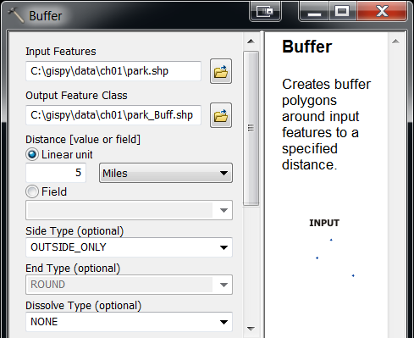
Distance or Areal parameters
A linear unit is an Esri data type for Euclidean distances (an areal unit measures area).
Specified as a string, with a number and optionally a unit of measure, separated by a space (e.g.,'5 miles').
Linear Units of Measure (not case sensitive):
centimeters | decimal degrees | decimeters | feet | inches | kilometers | meters | miles | millimeters | nautical miles | points | unknown | yards
Singular and plural both accepted (e.g., mile or miles).
If only a numeric value is specified and a distance unit is not specified (e.g., '5'), the tool uses the units of the input feature, unless the Output Coordinate System environment property has been set.

Slide 21
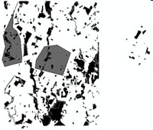
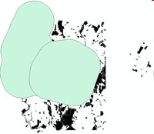
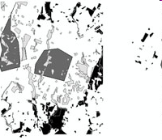
In class -- Wildfire Damage Assessment
Find the portion of a park which lies within 1 mile of the fire damage.
fire
1 mile fire buffer
(Clipped) Park region
close to fire
What feature is used to clip the park?
The buffer output.

Slide 22
Wildfire damage assessment
  # buffer_clip.py
  import arcpy
  arcpy.env.workspace = 'C:/gispy/data/ch06'
  outDir = 'C:/gispy/scratch/'
  arcpy.env.overwriteOutput = True
  fireDamage = 'special_regions.shp'
  fireBuffer = outDir + 'fire_buffer.shp'
  parkPolys = 'park.shp'
  clipOutput = outDir + 'park_damageBuff.shp'
# Buffer the fire region
arcpy.Buffer_analysis(fireDamage, fireBuffer, '1 mile')
# Clip the park on the buffer output
arcpy.Clip_analysis(parkPolys, fireBuffer, clipOutput)
output buffer
clip feature

Slide 23
Python expressions as input
Some tool parameters are “expressions”.
Example: Set every entry in the 'result' field of the 'data1.shp' shapefile to 5
>>> data = 'C:/gispy/data/ch06/data1.shp'
>>> fieldName = 'result'
>>> expression = 5
>>> arcpy.CalculateField_management(data, fieldName, expression, 'PYTHON')
The last parameter in that example indicates the type of the expression (The alternatives are 'PYTHON', 'PYTHON_9.3', or 'VB' and 'VB' is the default)
Example: Calculate the 'result' field as an expression of two times the value of the 'measure' minus the value of the 'coverage' field
>>> expression = '2*!measure! - !coverage!'
>>> arcpy.CalculateField_management(data, fieldName, expression, 'PYTHON')

Slide 24
Shape field in Python expressions
Feature class field calculation expressions can also use the 'shape' field
The shape field contains a set of arcpy Geometry objects.
arcpy Geometry objects have properties such as 'area' and 'length'.
Use these properties with dot notation on the 'shape' field in the expressions.
Example: Calculate a field named 'PolyArea' for the
'special_regions.shp' polygon shapefile:
>>> data = 'C:/special_regions.shp'
>>> fieldName = 'PolyArea'
>>> expression = '!shape.area!'
>>> arcpy.CalculateField_management(data, fieldName, expression, 'PYTHON')

Slide 25
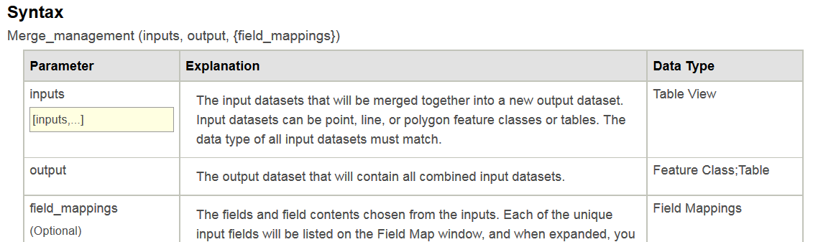
Multivalue inputs
Some tools accept multiple values as input for a single parameter.
For multi-value inputs, use a Python list or a semi-colon delimited string or an arcpy ValueTable object.
inputFiles = ['park.shp', 'special_regions.shp', 'workzones.shp'] # Python list
arcpy.Merge_management(inputFiles, 'mergedData.shp')
##-----------------------------
inputFiles = 'park.shp;special_regions.shp;workzones.shp‘# Semi-colon delimited string
arcpy.Merge_management(inputFiles, 'mergedData2.shp')
##-----------------------------
vt = arcpy.ValueTable( ) ‘# ValueTable object
vt.addRow('park.shp')
vt.addRow('special_regions.shp')
vt.addRow('workzones.shp')
arcpy.Merge_management(vt, 'mergedData3.shp')
Notes:
The merge example is a one-dimensional example. That is, it only has one item in each row. The true advantage of the ValueTable object is for dealing with higher dimensions of data. The ValueTable approach provides a convenient way to organize data when the input is a list of lists. As an example, the 'in_features' argument for the Intersect tool can be a list of input file names or alternatively, it can be a list of file names and priority rankings, as in the following example:
>>> inputFiles = [ ['park.shp', 2], ['special_regions.shp', 2], ['workzones.shp',1] ]
>>> arcpy.Intersect_analysis(inputFiles, 'intersectData.shp')
Instead of using a list of lists, you could use a ValueTable for the intersection example as follows:
>>> vt = arcpy.ValueTable( )
>>> vt.addRow('park.shp 2')
>>> vt.addRow('special_regions.shp 2')
>>> vt.addRow('workzones.shp 1')
>>> arcpy.Intersect_analysis(vt, 'intersectData.shp')

Slide 26
Spatial analyst (sa) tools
  arcpy.toolboxAlias.toolName(arg1, arg2, arg3,...)
  arcpy.toolName_toolboxAlias(arg1, arg2, arg3,...)
Call sa tools with double dot & tbx first
  outputRast = arcpy.sa.SquareRoot(inRast)
Need to check out the 'spatial' extension
  arcpy.CheckOutExtension('Spatial')
sa tools return a Raster object. Must save the raster to file to preserve it.
  outputRast.save('gettySqRoot')
Delete the Raster object(s) after saving the data.
  del outputRast

Slide 27
Spatial analyst example
import arcpy
arcpy.env.workspace = 'C:/gispy/data/ch06'
outDir = 'C:/gispy/scratch/'
arcpy.env.overwriteOutput = True
inRast = 'getty_rast'
outputRastName = outDir + 'gettySqRoot‘
arcpy.CheckOutExtension('Spatial')
  rastObject = arcpy.sa.SquareRoot(inRast)
  rastObject.save(outputRastName)
  del rastObject

Slide 28
sa raster calculator tool
Performs map algebra (operations on each cell).
arcpy.sa.RasterCalculator(a, b, sum)
Use sa math toolset instead
    outRast1 = arcpy.sa.Times(5, 'getty_rast')
    outRast2 = arcpy.sa.Minus(outRast1, 2)
    outRast2.save('equationRast')
Or create Raster Object and use operators
    rastObj = arcpy.Raster('getty_rast')
    outRast = 5*rastObj – 2
    outRast.save('equationRast2')

Slide 29
Importing spatial analyst
The ArcGIS Resources Spatial Analyst tool reference pages sometimes use a variation of the import statement in the code samples as in the following code:
>>> from arcpy.sa import * # not recommended
This statement creates a direct reference to the Spatial Analyst tool; It provides a shortcut so Spatial Analyst tools can be called without prepending arcpy.sa.
Can replace this statement:
>>> outputRast = arcpy.sa.SquareRoot(inRast)
with the following:
>>> outputRast = SquareRoot(inRast)
Confusing code:
>>> outputRast = Int(inRast) # Raster operation
>>> outputNum = int(myNum) # Built-in function call
Avoids ambiguities. Instead, use:
>>> import arcpy
>>> outputRast = arcpy.sa.SquareRoot(inRast)

Slide 30
arcpy tools return result
When tools are executed, they return a result.
>>> arcpy.Buffer_analysis('C:/x.shp', 'C:/out.shp', '5')
  <Result 'C:/out.shp'>
Results contain info. about the tool operation.
Result content varies from tool to tool.
Sometimes it is just the output dataset path.
Sometimes has a number or Boolean (True/False).
    >>> arcpy.GetCount_management('park.shp')
    <Result '426'>
Sometimes it contains multiple values.
In all cases, the return value is an object; a 'Result object' or a 'Raster' object

Slide 31
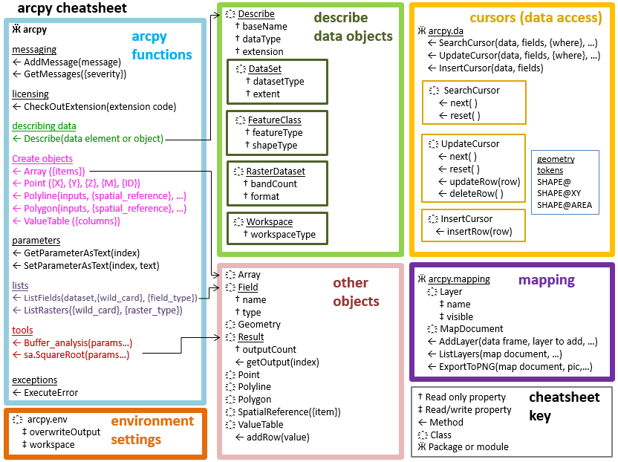
arcpy 'result' object
>>> pnResult = arcpy.PolygonNeighbors_analysis('parks.shp', 'PN.dbf ')
>>> type(pnResult) 'arcpy.arcobjects.arcobjects.Result'>
>>> pnResult.outputCount 1
>>> pnResult.getOutput(0) u'C:/Temp\PN.dbf'
҈ Result
† maxSeverity
† messageCount
† outputCount
† resultID
† status
← cancel ()
← getInput (index)
← getMapImageURL ({param_list},…)
← getMessage (index)
← getMessages ({severity})
← getOutput (index)
← getSeverity (index)
toolName_toolAlias (param1, param2, …): Result object
>>> print pnResult
C:/Temp\PN.dbf

Slide 32
Printing the results
If there is only ONE part to the results, only need print to print the results.
>>> rc = arcpy.Buffer_analysis('C:/x.shp', 'C:/out.shp', '5')
>>> print rc
C:\\out.shp
If the result is multi-part only ONE of results is printed with a print statement.
  >>> rc = arcpy.AverageNearestNeighbor_stats('C:/points.shp', 'Euclidean Distance')
>>> print rc
0.64632
Need to use outputCount and getOutput

Slide 33
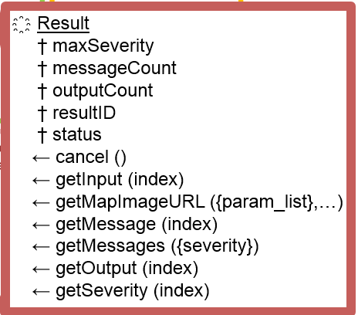
Using results objects
Use an assignment statement to store the result object.
rc = arcpy.AverageNearestNeighbor_stats('C:/points.shp',
'Euclidean Distance')
Check the outputCount property
  >>> rc.outputCount
  6
getOutput method and index number
  >>> rc.getOutput(0)
  u'0.64632' # nearest neighbor index
  >>> rc.getOutput(1)
  u'-4.27929' # z score
  >>> rc.getOutput(2)
  u'0.000019' # p-value

Slide 34
Summing up
Topics discussed
    Introduction to arcpy
    Review dot notation
    Environments settings
    Calling tools
    Using tool help
    Working with linear units
    Tools that take Python expressions as input
    Multivalue input objects
    The 'from arcpy.sa import *' gotcha
    Calling spatial analyst tools
    Raster calculator
    Results objects
Up next
    Pseudocode
    User arguments
Additional topics
    Calling custom tools (textbook, Section 6.8)

