Slide 1
Batch processing with arcpy 'list' methods
GIS 540
Center for Geospatial Analytics
North Carolina State University
Dr. Tateosian

Slide 2
Topics
Review dot notation, for loops, & geoprocessing methods.
List all feature classes or rasters in a workspace.
Batch geoprocess listed features.

Slide 3
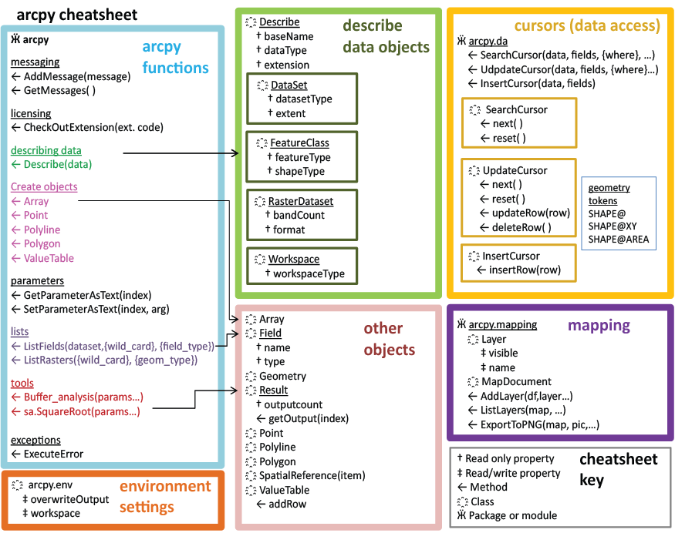
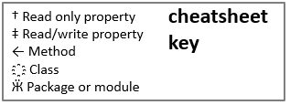
arcpy overview
Each part of the diagram has related functionality
  arcpy functions
  Describe objects
  Enumeration objects
  Cursor objects
  Other objects
  Mapping
Describe
Cursors
arcpy
functions
Enumerations
Other
Objects
Mapping
Need to import arcpy to access these properties & methods.
Notes:
Geoprocess object methods and properties allow you to access toolbox tools, set environment properties, get messages about processes, and a whole bunch of other things.
Describe objects allow you to get information about the datasets you're dealing with, such as what shapetype your feature class has, what the name of the OID field is.
Enumerations objects allow you to perform batch processing. They return objects which contain lists of featureclasses, or fields, or datasets, and so forth.
Cursor objects allow you to process in individual records in the data.
Other objects can be created. They will have the properties and/or methods specified in the pink box depending on which type of object they are.

Slide 4
Use split, join, rstrip, index, & startswith to…
Break this comma delimited string into a list, rList
>>> record = 'ID, name, latitude, longitude\t\n'
rList = record.split(',')
2. Join rList into a semicolon separated string.
>>> rList = ['ID', 'name', 'latitude', 'longitude\t\n']
semicolonRecord = ';'.join(rList)
Strip the white space from the right side of 'record'
>>> record = 'ID, name, latitude, longitude\t\n'
srecord = record.rstrip( )
Append the values 4 and 5 to 'myList'
>>> myList = ['a', 2, 'foo', 'bla', 'foo']
fooIndex = myList.index( 'foo' )
Check if 'fileName' starts with 'poly'. Store answer in a variable named 'isPolygon'
isPolygon = fileName.startswith('poly')

Slide 5
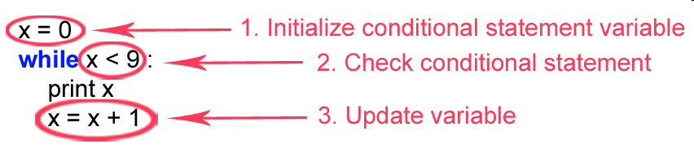
Use a loop to print 2, 4, 6, 8, 10
Use a WHILE-loop
Use a FOR-loop
  x = 2
  while x <= 10:
  print x
  x = x + 2
for x in range(2, 11, 2):
print x

Slide 6
Review: arcpy properties & methods
Set the geoprocessing workspace
  import arcpy
arcpy.env.workspace = 'C:/temp/data.mdb'
Get the data type of myfile
myfile = 'rduForest'
dsc = arcpy.Describe(myfile)
type = dsc.dataType
Call the ArcToolbox clip (analysis) tool
input = 'rivers.shp'
clipfile = 'cityLimits.shp'
output = 'studyRegion.shp'
arcpy.Clip_analysis(input, clipfile, output)
Notes:
The 'import' statement tells Python to point to the arcpy module.
Use ArcToolbox tools with Geoprocessor like any other objects.
System toolboxes are available by default
Any tool from a referenced toolbox can be called as a method.
If pathname has spaces, use r and one backslash
Environment settings are properties.
Always suffix the tool with the toolbox alias.
Must also check out the correct license:
# Check out any necessary licenses
gp.CheckOutExtension('spatial')
#Here is a complete list of the environment variables for ArcInfo 9.2
>>> newPrecision
XYResolution
XYDomain
scratchWorkspace
MTolerance
compression
coincidentPoints
randomGenerator
outputCoordinateSystem
rasterStatistics
ZDomain
projectCompare
cartographicCoordinateSystem
configKeyword
outputZFlag
qualifiedFieldNames
tileSizepyramid
referenceScale
extent
XYTolerance
MDomain
spatialGrid1
cellSize
outputZValue
outputMFlag
geographicTransformations
spatialGrid2
ZResolution
mask
spatialGrid3
workspace
MResolution
derivedPrecision
ZTolerance

Slide 7
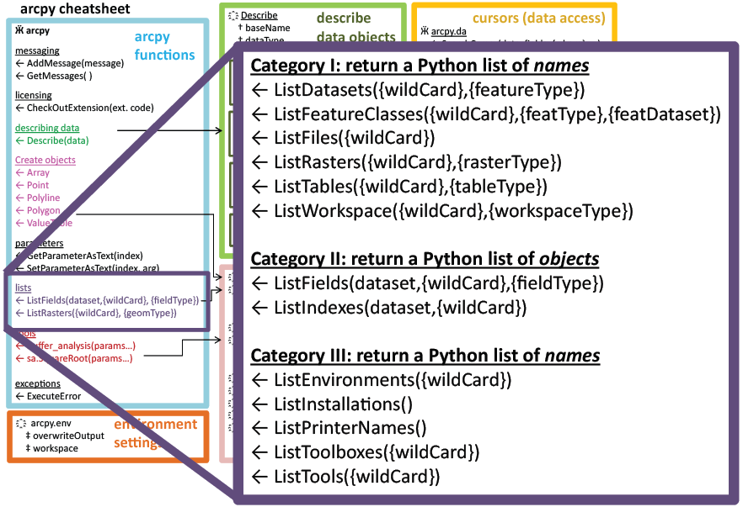
Enumeration Methods
arcpy methods that start with 'list'
Returns a Python list
Items in list are strings or field objects or index objects, depending on method called.
Set the workspace before calling an arcpy 'list' method
>>> arcpy.env.workspace = 'C:/Temp'
>>> fcList = arcpy.ListFeatureClasses ( )
>>> print fcList
[ 'COVER63p.shp', 'spec_feat.shp']

Slide 8
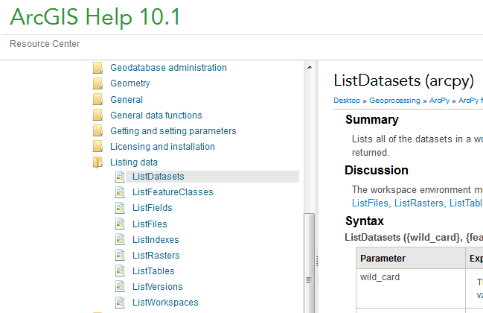
Enumeration Methods Help
ArcGis Resources (online help)
http://resources.arcgis.com/en/help/main/10.2/index.html
Search for 'ListDatasets arcpy'

Slide 9
Looping the results
arcpy workspace must be set first.
Print the feature classes in the workspace
import arcpy
arcpy.env.workspace = 'C:/Temp'
fcs = arcpy.ListFeatureClasses( ) # Return a list of strings.
for f in fcs:
print f
print 'All done.'

Slide 10
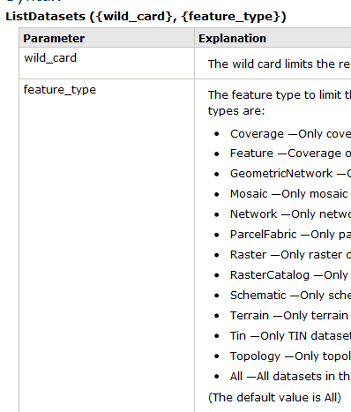
Batch geoprocessing example
Fill in the blanks so that the script deletes each dataset in the directory with an ArcToolbox tool (hint: use this)
import arcpy
arcpy.env.workspace = 'C:/Temp'
dsets = arcpy.ListDatasets( )
for d in dsets:
print 'All done.'
arcpy.Delete_management(d)

Slide 11
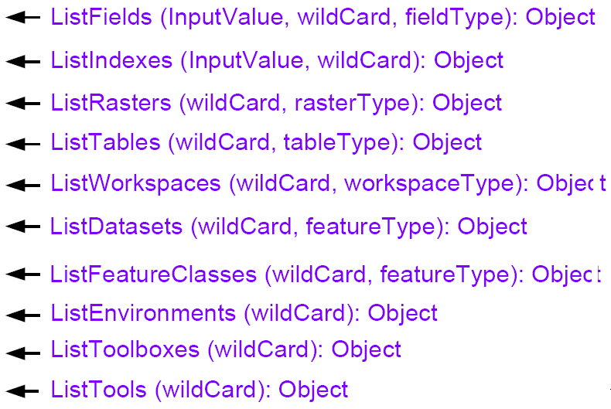
arcpy 'list' method parameters
wildCard parameter (optional)
    search for substrings in names
    only list files containing those substrings
    use '*' as a placeholder
featureType (optional)
    only list files of that Feature type
    import arcpy
    # Set the workspace.
    arcpy.env.workspace = 'C:/Data'
    # 1. List all of the feature classes
    fcs1 = arcpy.ListFeatureClasses( )
    # 2. List all of the feature classes that contain the string 'elev'
    fcs2 = arcpy.ListFeatureClasses('*elev*')
    # 3. List all polygon feature classes that start with 'veg'
    fcs3 = arcpy.ListFeatureClasses('veg*', 'Polygon')
    # 4. List all polygon feature classes
    fcs4 = arcpy.ListFeatureClasses('*', 'Polygon')

Slide 12
Types
Function | Types
ListDatasets(wild_card, feature_type) | Coverage, Feature, GeometricNetwork, Mosaic, Network, ParcelFabric, Raster, RasterCatalog, Schematic, Terrain, Tin, Topology…
ListFeatureClasses(wild_card, feature_type) | Annotation, ARC, Dimension, Edge, Junction, Label, Line, Multipatch, Node, Point, Polygon, Polyline, Region, Route, TIC…
ListFields(wild_card, field_type) | Date, Double, Geometry, GUID, Integer, OID, Raster, Single, SmallInteger, Single…
ListWorkSpaces(wild_card, workspace_type) | Access, Coverage, FileGDB, Folder, SDE…
ListTables(wild_card, table_type) | dBASE, INFO…
ListRasters(wild_card, raster_type) | BMP, GIF, GRID, IMG, JP2, JPG, PNG, TIFF…
Use online help for complete lists.

Slide 13
Rewrite using arcpy not os.listdir
# Print each shapefile in C:/Temp. Assume this directory only contains shapefiles and rasters.
import os
path = 'C:/Temp'
files = os.listdir(path)
for f in files:
if f.endswith('.shp'):
print f
import arcpy
arcpy.env.workspace = 'C:/Temp'
files = arcpy.ListFeatureClasses()
for f in files:
print f

Slide 14
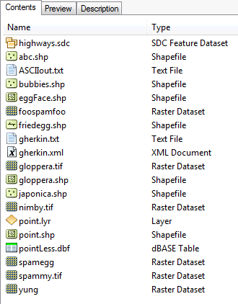
Enumeration wildcards
    import arcpy
    # Set the workspace.
    arcpy.env.workspace = 'C:/dater'
    L1 = arcpy.ListFeatureClasses('point')
    L2 = arcpy.ListRasters('*spam*')
    L3 = arcpy.ListFeatureClasses('egg*', 'line')
    L4 = arcpy.ListRasters('*', 'TIF')
    Which files will be in each list?
Notes:
import arcpy
# Set the workspace.
arcpy.env.workspace = 'C:/Temp'
L1 = arcpy.ListFeatureClasses('point')
L2 = arcpy.ListRasters('*spam*')
L3 = arcpy.ListFeatureClasses('egg*', 'line')
L4 = arcpy.ListRasters('*', 'TIF')
For each list, give an example of a file name that would be contained in the list.
Give an example of a file that would be contained in two of the lists, if possible.
Which of these lists contains all the point shapefiles in the workspace?
1. L1 would only list a feature class named 'point'.
L2 is a list the rasters in C:/Temp that contain the substring 'spam', such as spamBla.jpg
L3 is a list of all the feature classes in C:/Temp whose names start with egg and are line shape types.
L4 is a list of all the bitmap rasters in C:/Temp, such as bla.bmp.
2. 'spam.tif' and 'blaSpam.tif' would appear in both L2 and L4. No other lists pairs of lists could have common items.
3. None, unless there is only one Point type shapefile named 'point.shp'

Slide 15
Enumeration wildcards
    import arcpy
    # Set the workspace.
    arcpy.env.workspace = 'C:/dater'
    L1 = arcpy.ListFeatureClasses('point')
    [ ]
    L2 = arcpy.ListRasters('*spam*')
    [u'foospamfoo', u'spamegg', u'spammy.tif']
    L3 = arcpy.ListFeatureClasses('egg*', 'line')
    [ ]
    L4 = arcpy.ListRasters('*', 'TIF')
    [u'gloppera.tif', u'nimby.tif', u'spammy.tif']
Notes:
import arcpy
# Set the workspace.
arcpy.env.workspace = 'C:/Temp'
L1 = arcpy.ListFeatureClasses('point')
L2 = arcpy.ListRasters('*spam*')
L3 = arcpy.ListFeatureClasses('egg*', 'line')
L4 = arcpy.ListRasters('*', 'TIF')
For each list, give an example of a file name that would be contained in the list.
Give an example of a file that would be contained in two of the lists, if possible.
Which of these lists contains all the point shapefiles in the workspace?
1. L1 would only list a feature class named 'point'.
L2 is a list the rasters in C:/Temp that contain the substring 'spam', such as spamBla.jpg
L3 is a list of all the feature classes in C:/Temp whose names start with egg and are line shape types.
L4 is a list of all the bitmap rasters in C:/Temp, such as bla.bmp.
2. 'spam.tif' and 'blaSpam.tif' would appear in both L2 and L4. No other lists pairs of lists could have common items.
3. None, unless there is only one Point type shapefile named 'point.shp'

Slide 16
Topics in part 2 of the
Batch processing with arcpy 'list' methods slides
Some common mistakes in batch processing
Additional batch processing examples
The arcpy ListFields method
Stepping through code with the debugger

Slide 17
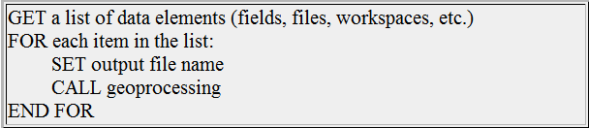
Batch geoprocessing
List the files, then perform geoprocessing on each file
Place geoprocessing command(s) inside a FOR loop through the input datasets.
Update output file names, or else…!
What's wrong with the following script?
A good approach:
  #Buffer all of the line feature classes in C:/Temp.
  import arcpy
  arcpy.env.workspace = 'C:/Temp'
  fcs = arcpy.ListFeatureClasses ('*', 'Line')
  for fc in fcs:
  arcpy.Buffer_analysis(fc, 'out.shp', '500 meters')

Slide 18
Update output based on input name
  #Buffer all of the line feature classes in C:/Temp.
  import arcpy
  arcpy.env.workspace = 'C://Temp'
  fcs = arcpy.ListFeatureClasses ('*', 'Line')
  outputDir = “C:/Temp/outputDr/”
  for fc in fcs:
  #insert 'out' into output name
  basename = os.path.splitext(fc)[0]
  output = outputDir + basename + 'Out.shp'
  #buffer input file by 500 meters. arcpy.Buffer_analysis(fc, output, '500 meters')

Slide 19
Exercise: List and copy
Goals:
List all the point feature classes in C:/Temp/tester.gdb whose names start with 's'.
Create a new file geodatabase:
arcpy.CreateFileGDB_management('C:/temp/', 'out.gdb')
Write copies of the point feature classes whose names start with 's' from C:/Temp/tester.gdb and copy them to C:/temp/out.gdb.
  Template: Copy_management (in_data, out_data, {data_type})
  The output data must be a dynamic name that changes each time you loop.
  The destination needs to have a slash between the wksp and filename.
  destination = destWorkspace + '/' + fc

Slide 20
Exercise – List and copy
  #copyEses.py
  #Copy feature classes from gdb to gdb.
  import arcpy
  arcpy.env.workspace = 'C:/Temp/tester.gdb'
  fcs = arcpy.ListFeatureClasses('s*','POINT')
  res = arcpy.CreateFileGDB_management('C:/Temp/', \ 'out.gdb')
  destWorkspace = res.getOutput(0)
  for fc in fcs:
  # Create output name with destination path
  destination = destWorkspace + '/' + fc
  # Copy the features to C:/Backup
    arcpy.Copy_management(fc, destination)

Slide 21
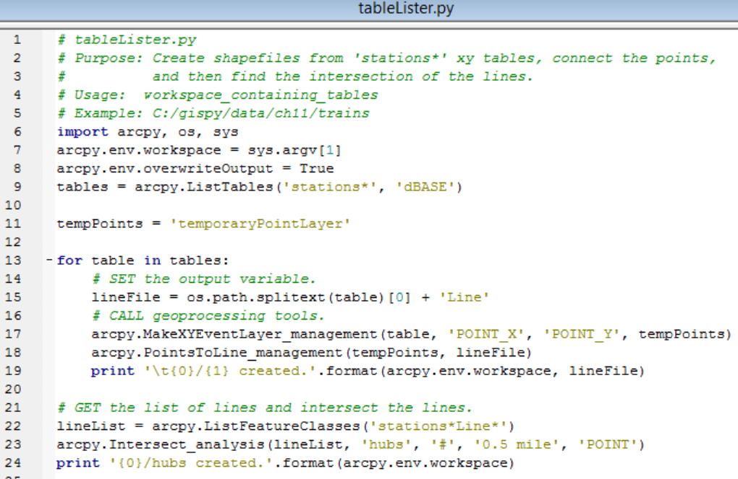

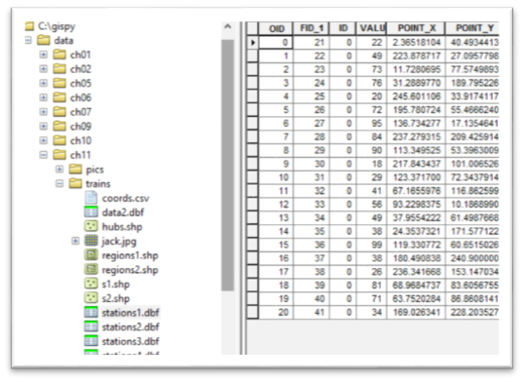
Multiple step batch processing

Slide 22
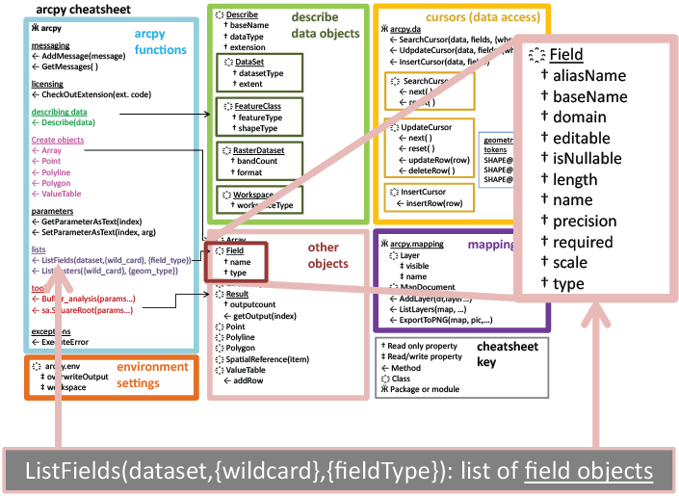
Listing fields
ListFields and List Indexes require InputValue (a data file)

Slide 23
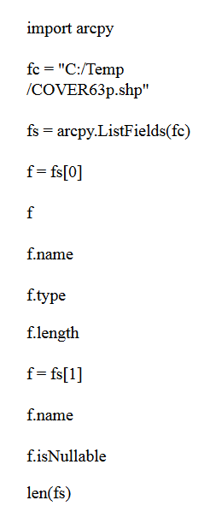
Demo - Exploring Field objects
Which one of these statements tells you how many fields the attribute table has?
Name four field properties.
How can you find the name of the 3rd field?

Slide 24
Exercise - Exploring Field objects
Which one of these statements tells you how many fields the attribute table has?
len(fs)
Name four field properties.
name, type, length,isNullable
How can you find the name of the 3rd field?
f = fs[2]
print f.name

Slide 25
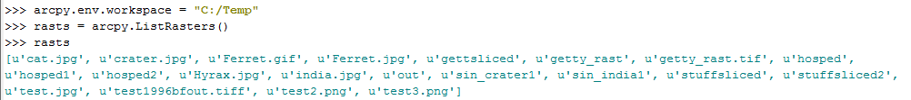
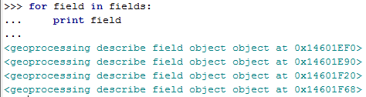
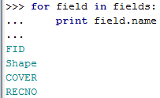
Field Objects vs. Field Names
arcpy.ListFields returns a list of field objects!
unlike listRasters and others, these are NOT string names!!
Often you want field name not field object.
instead

Slide 26

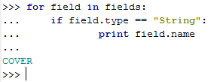
Looping through fields
# print all the attribute names
import arcpy
fc = 'C:/gispy/data/Ch11/park.shp'
fields = arcpy.ListFields( fc )
for field in fields:
print field.name
#print the field names for String type data fields
import arcpy
fc = 'C:/gispy/data/Ch11/park.shp'
fields = arcpy.ListFields( fc )
for field in fields:
if field.type == 'String':
print field.name
# print all the attribute types
import arcpy
fc = 'C:/gispy/data/Ch11/park.shp'
fields = arcpy.ListFields( fc )
for field in fields:
print field.type

Slide 27
In class - check4Field.py
Check if C:/gispy/data/Ch11/park.shp has a field named 'COVER'.
# check4Field.py
import arcpy
fc = 'C:/gispy/data/Ch11/park.shp'
…
Result:

Slide 28
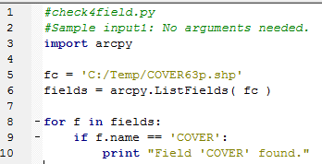
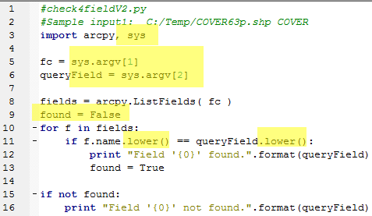
check4Field.py solutions
Modify check4Field.py to check if C:/Temp/COVER63p.shp has a field named 'COVER'
------V2 below------------------------
Notes:
#version 1
import arcpy
fc = 'C:/Temp/COVER63p.shp'
fields = arcpy.ListFields( fc )
for f in fields:
if f.name == 'COVER':
print "Field 'COVER' found.“
# OR --------------------
#version 2
import arcpy
fc = 'C:/Temp/COVER63p.shp'
fields = arcpy.ListFields( fc )
names = []
for f in fields:
names.append(f.name)
print 'Attribute names:', names
if 'COVER' in names:
print "Field 'COVER' found."

Slide 29
Debug: Step Through Code

Slide 30
Summing up
Topics discussed
    Listing feature classes, rasters, other data types
    Using wildcard and type to get subset of items
    Dynamic output names
    Listing fields
Up next
    Debugging
Additional topics
    Administrative 'List' methods
    Listing indexes

Slide 31
Appendix

Slide 32
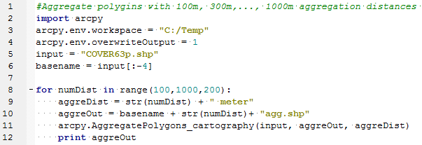
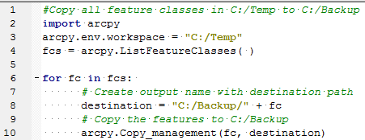
Updating output names
Why update?
  if output name is not updated, only one file created (overwritten n times, where n is the number of times looped)
When update?
  inside the loop before the analysis
Identify the output variable, and how it's updated in these examples:
What makes it unique?
numDist –the looping variable
What makes it unique?
fc – the looping variable

Slide 33
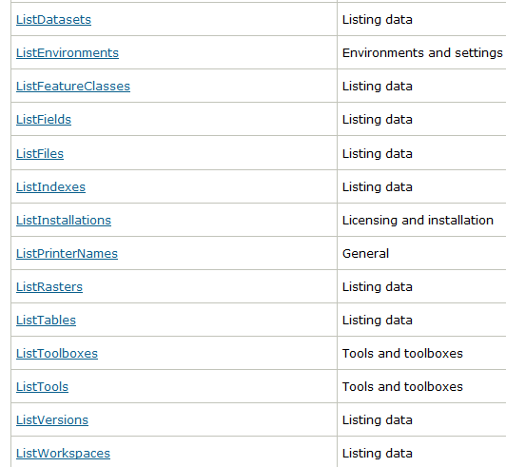
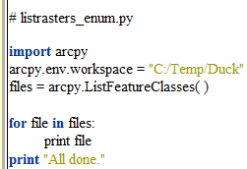
Exercise -- listrasters_enum.py
Currently the code prints the names of all feature classes in 'C:/Temp/Duck'
Write code to print a list of the raster datasets in:
'C:/Temp/ncrast_geodatabase/ncrast.mdb'.
Then modify the code to list only the rasters whose names start with 'land'

Slide 34
listrasters_enum.py
import arcpy
arcpy.env.workspace = 'C:/Temp/ncrast_geodatabase/ncrast.mdb'
rasts = arcpy.ListRasters('land*' )
for c in rasts:
print c
print 'All done.'

Slide 35
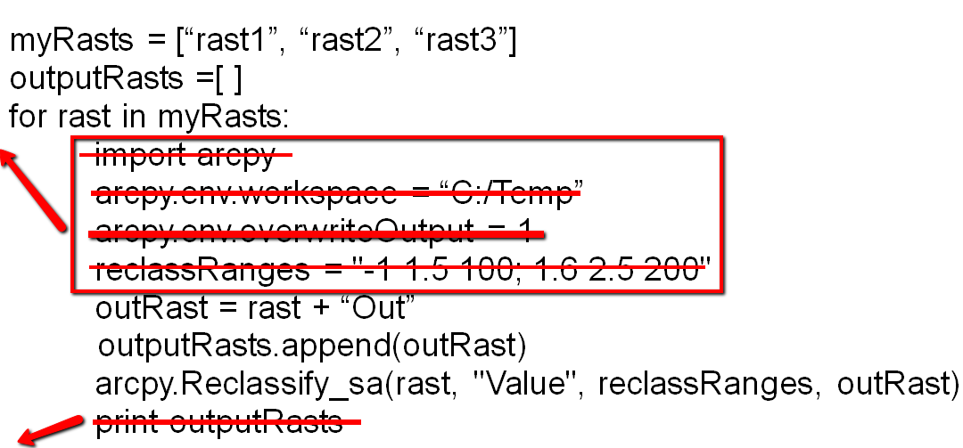
1. myList.append(4)
2. mystr = myList[2]
3. for f in fileNames:
if f.endswith('.xls'):
print f
4.

