Slide 1
Cursors – read/write GIS attribute table rows
Dr. Tateosian
GIS 540
North Carolina State University
Center for Geospatial Analytics

Slide 2
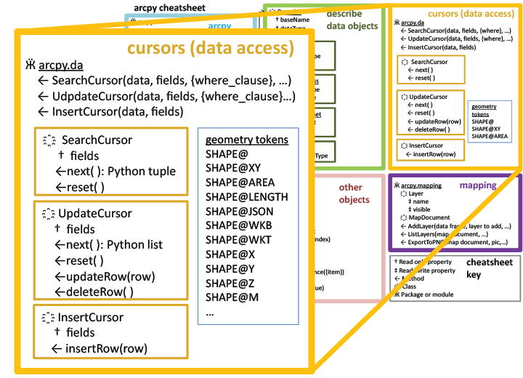
Topics
Using ArcGIS Resources (help pages)
Review procedures
Cursors: Looping through GIS table rows
    search, insert, update cursors
    geometry object
    where clauses
    deleting cursors
    the with keyword

Slide 3
Cursors
  A database cursor is a control structure that enables traversal over the records in a database
  Purpose: looping through GIS table rows
  Three types of cursors
  search cursor: look at the rows (no changes)
  2. update cursor: change values in existing rows or delete rows
  3. insert cursor: add rows

Slide 4
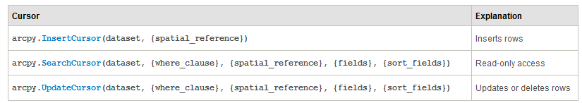
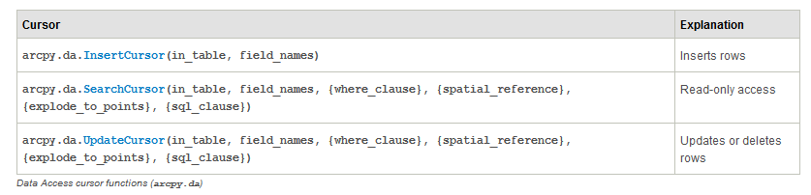
Classic Cursors vs. Data access cursors
Classic cursors (Arc <=10.1)
Data access cursors (new in Arc 10.1)
  ----da significantly faster performance than classic
Notes:
http://resources.arcgis.com/en/help/main/10.2/index.html#//002z0000001q000000
Legacy:
ArcGIS 10.1 added a new data access module (arcpy.da). The previously existing cursors (that are still listed under arcpy) are still functional and valid; however, the new arcpy.da cursors include significantly faster performance.

Slide 5
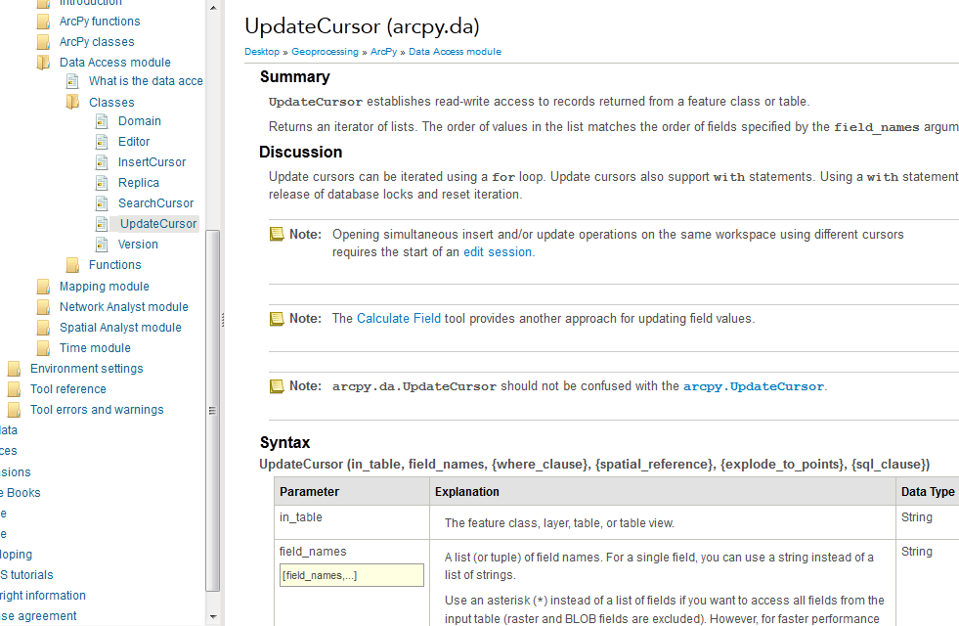
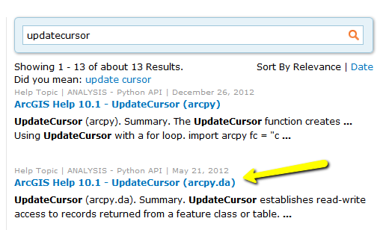
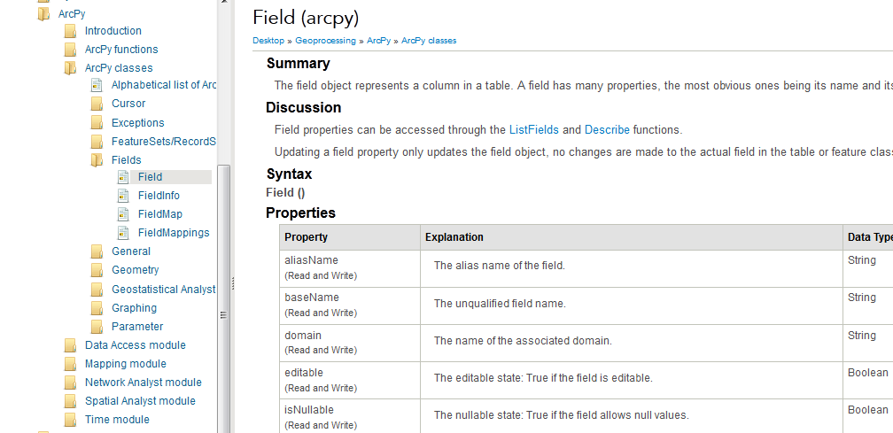
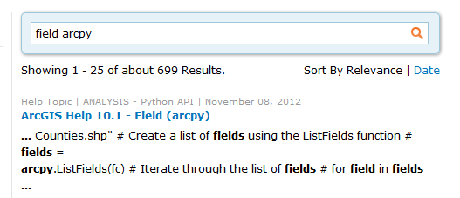
Arc Help for Functions & Classes
List the input parameters for the UpdateCursor function, list which are optional, and describe what it returns.
List three properties a field object has.
-- List the possible field types.
Notes:
List the input parameters for the UpdateCursor function.
in_table, field_names, {where_clause}, {spatial_reference}, {explode_to_points}, {sql_clause}
--Which parameters are optional?
{where_clause}, {spatial_reference}, {explode_to_points}, {sql_clause}
--What does it return?
Returns an iterator of lists. The order of values in the list matches the order of fields specified by the field_names argument.
2. List three properties a field object has.
aliasName, baseName, domain, …
Field types: SmallInteger, Integer, Single, Double, String, Date, OID, Geometry, Blob.

Slide 6
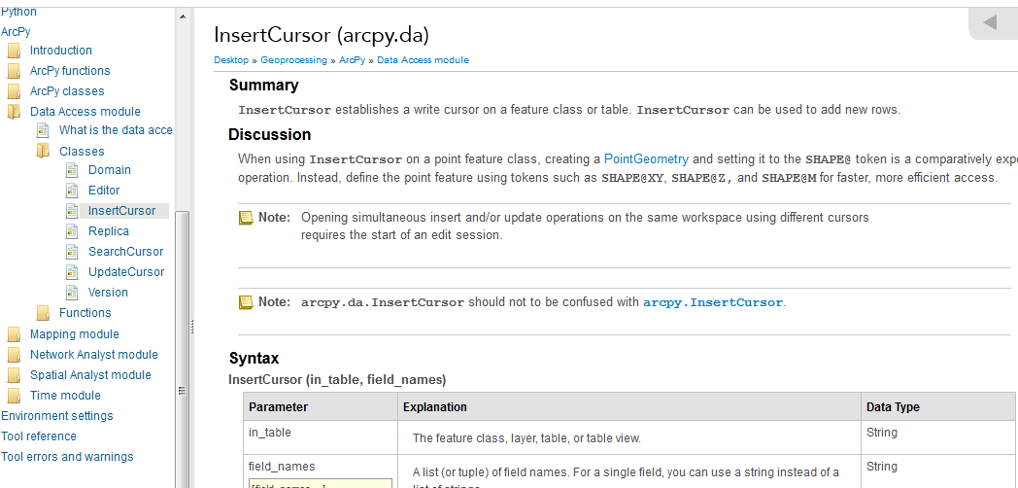
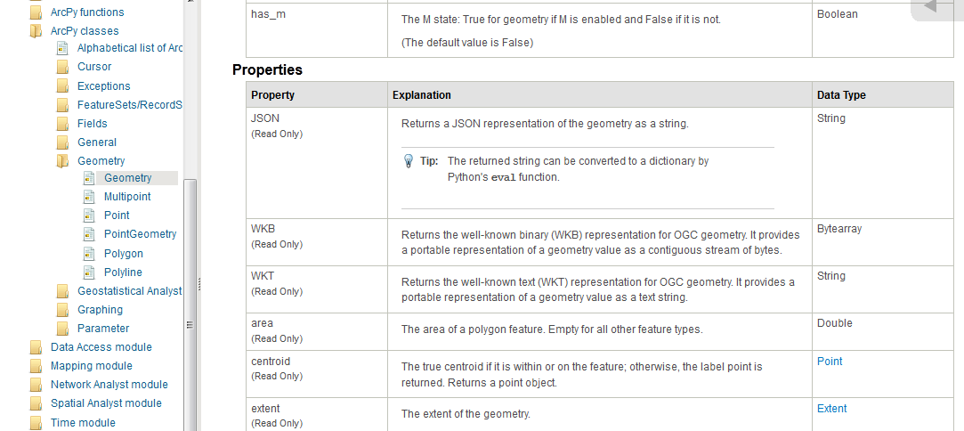
In class - Using ArcGIS Help
List the input parameters for the da.InsertCursor function, list which are optional, and describe what it returns.
List three properties a geometry object has.
Notes:
List the input parameters for the InsertCursor function, list which are optional, and describe what it returns.
in_table, field_names --both required
It returns a cursor object.
2. List three properties a geometry object has.
JSON, area, centroid, extent, ….

Slide 7
Procedures refresher
Syntax:
def procedureName(arg1, arg2, …):
```Procedure documentation’’’
<do stuff>
return <return_value>
Write a procedure named add2 that adds 2 to the argument you pass it.
Call add2, pass in the number 5, and store the return value in a variable x
Print the docstring
Notes:
def add2(num):
```Adds 2 to the given number and returns the result.
num: a number to add to’’’
return num + 2
x = add2(5)
print x
help(add2)
---or only the docstring:
print add2.__doc__

Slide 8
Documentation strings
def add2(num):
```Adds 2 to the given number and returns the result.
num: a number to add to’’’
return num + 2
print add2.__doc__
Adds 2 to the given number and returns the result
num: a number to add to
http://docs.python.org/tutorial/controlflow.html#tut-docstrings

Slide 9
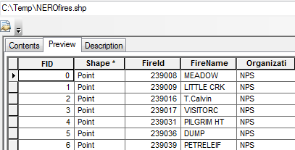
Getting started with da cursors
Methods return a cursor objects
  #Get a search cursor object
  data = "C:/Temp/NEROFires.shp”
  fieldNames = [ "Fireid", "FireName“ ]
  sc = arcpy.da.SearchCursor( data, fieldNames )
  #Point at the first row
  row = sc.next()
  print row[0]
  print row[1]
  >>> 239008.0
  u'MEADOW'

Slide 10
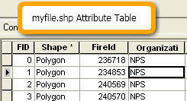
Looping with a search cursor
  #Get a search cursor
  sc = arcpy.da.SearchCursor(“myfile.shp“, [‘FID’, ‘Organizati’])
  # Print the FID, orgs. of each record
  for row in sc:
  print row[0] # print FID’s
  print row[1] # print organizations
  del sc # Delete cursor object to avoid locking issues

Slide 11
In class - Exploring cursor objects (Part 1)

Slide 12


In class followup
What is row?
sc.reset()?
Area of a polygon?
del sc
sc = arcpy.da.SearchCursor(fc, "*","COVER = 'orch'") ??
<> in a where_clause
FID is 22. RECNO = ?
If you have a row tuple, how can you find the value of the COVER field for that row?
Notes:
What is row? a tuple
sc.reset( ) resets the pointer to the beginning of the list.
Area of a polygon?
fieldNames = ["SHAPE@"]
sc = arcpy.da.SearchCursor(fc, fieldNames)
for row in sc: print row[0].area
del sc: keyword del deletes the object it’s used on. del sc deleted the search cursor we were using. So sc.next() threw an error.
--------------- Upcoming slides will address the rest
5. sc = arcpy.da.SearchCursor(fc, "*","COVER = 'orch'") only select records with COVER type orch (stands for orchard)
6. <> is SQL for ‘not equal to’
sc = arcpy.da.SearchCursor(fc, "*", "COVER <> 'woods'") selects the non-woods cover type records.
7. row FID is 22 --> row RECNO is 23
sc = arcpy.da.SearchCursor(fc, "*", "FID = 22")
row = sc.next()
print row[0]
print row[3]
8. If you have a row tuple, how can you find the value of the COVER field for that row?
That depends on how you created your search cursor.
Examples:
sc = arcpy.da.SearchCursor(fc, "*")
row = sc.next()
row[2]
sc = arcpy.da.SearchCursor(fc, [“COVER"])
row = sc.next()
row[0]

Slide 13
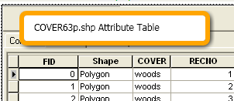
Accessing fields
fc = "C:/Temp/COVER63p.shp"
If you have a row tuple, what will be the index for the COVER field?
Depends on how you created the search cursor!
  sc = arcpy.da.SearchCursor(fc, "*")
  row = sc.next()
  row[2]
  del sc
  sc = arcpy.da.SearchCursor(fc, ["RECNO", "COVER"])
  row = sc.next()
  row[1]
  del sc
  fieldNames = ["RECNO", "COVER"]
  sc = arcpy.da.SearchCursor(fc, fieldNames, query)
  covIndex = fieldNames.index("COVER")
  row = sc.next()
  print row[covIndex]
  del sc

Slide 14
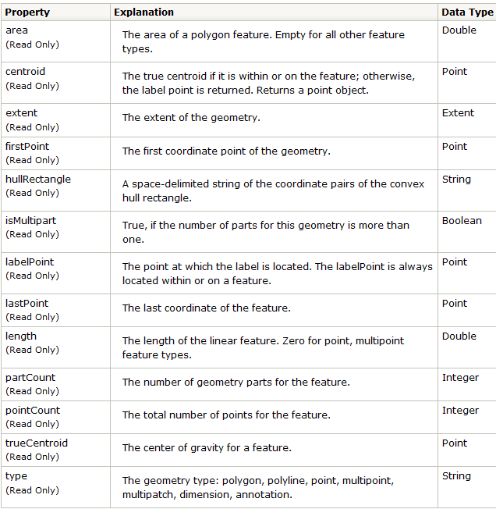
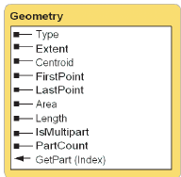
Geometry Object
sc = arcpy.da.SearchCursor("C:/COVER63p.shp“, “SHAPE@”)
row = sc.next()
del sc
>>> row[0].type
'polygon‘
>>> row[0].area
600937.092

Slide 15
where_clause parameter: SQL Query
sql query
Example sql queries:
  "COVER = ‘other’ ” # single quotes on inner strings
  “COVER <> 'woods’” # not equal to woods
  "FID > 200” # no inner quotes for numeric field value
  >>> query = "FID > 200”
  >>>sc = arcpy.da.SearchCursor("C:/COVER63p.shp", [‘FID’], query)
  >>> row = sc.next()
  >>> row[0]
  201
  See ArcGIS Desktop sql expression help

Slide 16
where_clause with variable
>>> fs = arcpy.listFields("C:/COVER63p.shp“)
>>> f = fs[0]
>>> f.name
'FID’
>>> query = “{0} > 200" .format(f.name) # string formatting
sc = arcpy.da.SearchCursor("C:/COVER63p.shp", [f.name],query)
>>> row = sc.next()
>>> row[0]
201
Read more about Python string formatting on the course site under printing strings.

Slide 17

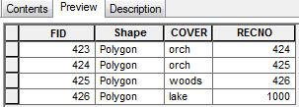
In class - Exploring cursor objects (Part 2)

Slide 18
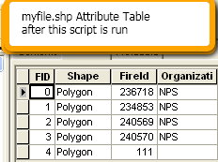
Update cursor (incomplete)
  fc = "C:/Temp/COVER63p.shp"
  #Get an update cursor
  uc = arcpy.da.UpdateCursor(fc, "*")
  # Update specified records
  for row in uc:
  if row[2] == "lake":
  row[3] = 1000
  del uc # Delete cursor object
  # to avoid locking issues
before
after

Slide 19
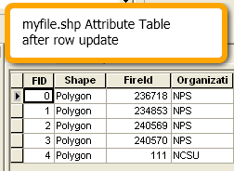
updateRow (complete)
  fc = "C:/Temp/COVER63p.shp"
  #Get an update cursor
  uc = arcpy.da.UpdateCursor(fc, "*")
  # Update specified records
  for row in uc:
  if row[2] == "lake":
  row[3] = 1000
  uc.updateRow(row)
  del uc # Delete cursor object
  # to avoid locking issues
NO changes are made to the data attribute table until the change is committed with the updateRow method.
before
after
Notes:
NO changes are made to the data attribute table until the change is committed with the updateRow method.

Slide 20
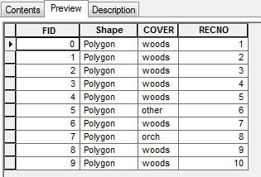
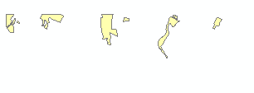
DeleteRow
  #Get an update cursor
  uc = arcpy.da.UpdateCursor(“myfile.shp“, ‘*’)
  # Get first row
  row = uc.next()
  # Deletes the current row.
  uc.deleteRow()
  del uc # Delete cursor object to avoid locking issues
  uc = arcpy.da.UpdateCursor(fc, "*", “RECNO > 10”)
  for row in uc:
  uc.deleteRow()
  del uc

Slide 21
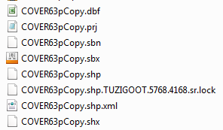
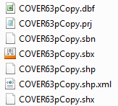
Deleting the cursor object
fc = "C:/Temp/COVER63pCopy.shp"
cursor = arcpy.da.InsertCursor(fc, ‘*’)
del cursor
occurs for da search, insert, and update cursors

Slide 22
deleteRow vs. using del
  # Deletes a record in the attribute table
  uc.deleteRow()
  #Deletes the row and cursor objects to avoid locking issues
  del uc #deletes a Python cursor object
Can delete any Python variable, such as a list or dictionary. However, you rarely need to delete native Python variables.
Mainly used for deleting non-native variables, such as geoprocessing cursors obtained from the cursor.
When you delete a cursor, all pending changes to the data (caused by an update or insert cursor) are flushed and all locks on the dataset are removed.
Always delete cursors and rows obtained from the cursor.

Slide 23
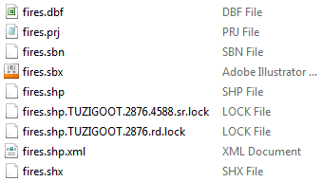
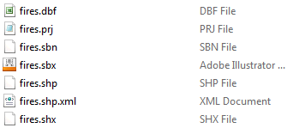
The with … as statement
  fc = "C:/Temp/fires.shp"
  sc = arcpy.da.SearchCursor(fc, “FID")
  for row in sc:
  print row[ 150 ]
  del sc
  >>> Traceback (most recent call last):
  File "<interactive input>", line 2, in <module>
  IndexError: tuple index out of range
  fc = "C:/Temp/fires.shp"
  with arcpy.da.SearchCursor(fc, “FID") as sc:
  for row in sc:
  print row[ 150 ]
  According to the documentation, all locks are released by the with statement even if an exception occurs—but this is not true for stand-alone scripts.

Slide 24
Error handling and removing locks
  import arcpy, trackback
  fc = "C:/Temp/fires.shp"
  sc = arcpy.da.SearchCursor(fc, “FID")
  try:
  for row in sc:
  print row[ 150 ]
  del sc
  except:
  print 'An error occurred‘
  traceback.print_exc( )
  del sc

Slide 25
Summing up
Topics discussed
    search and update cursors
    geometry object
    where clauses
    deleting cursors
    the with keyword
    handling exceptions with try/except
Up next
    Python dictionaries
Additional topics
    Insert cursors
    the SpatialReference object

Slide 26
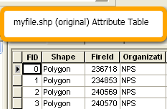
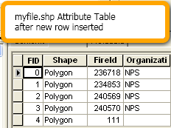
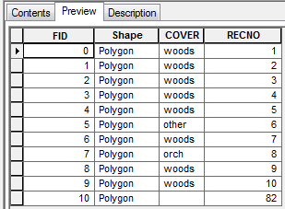
Insert cursor
  Create a new row object
  Set the values of the fields for the new row object.
  Insert the new row.
  #Get an insert cursor
  ic = arcpy.da.InsertCursor(“myfile.shp“, [“RECNO”])
  # Insert new record
  ic.insertRow( [ (82) ] )
  # Delete cursor and row to avoid locking issues
  del ic

Slide 27
Set the Shape field
  Setting the ‘Shape’ field requires
  an extra step– setting up
  a Geometry object first….
Geometry object types
  point, polyline, polygon, etc.
  Point example:
    myPoint = arcpy.Point(-70.1, 42.07) #create Point object
Line example:
array = arcpy.Array([arcpy.Point(459111.6681, 5010433.1285), arcpy.Point(472516.3818, 5001431.0808), arcpy.Point(477710.8185, 4986587.1063)])
polyline = arcpy.Polyline(array)

Slide 28
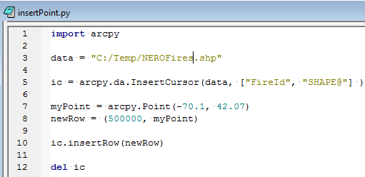
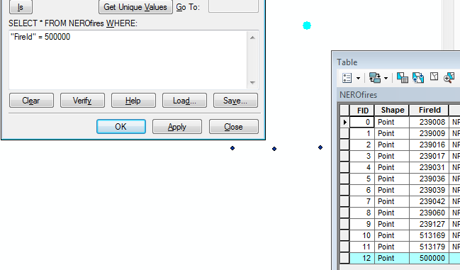
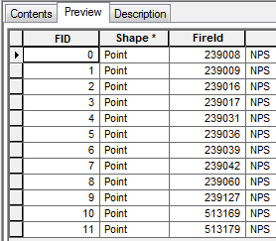
Inserting a point
The results of this script
AFTER
BEFORE

Slide 29
More looping
  # Delete in a loop
  fc = "C:/Temp/COVER63p.shp"
  uc = arcpy.da.UpdateCursor(fc, ["*"], "RECNO > 10")
  for row in uc:
  uc.deleteRow( )
  del uc
  # Enumerate with cursors
  sc = arcpy.da.SearchCursor(fc, "*")
  for i, row in enumerate(uc):
  if i < 5:
  print row[0]
  del sc

Slide 30
Find 6 mistakes
#It’s supposed to update the record where typeID is ‘regular’ by adding 15 to that record’s length, but it doesn’t.
import arcpy
# Get a update cursor
uc = arcpy.da.updatecursor(“myfile.shp“, [‘typeID’, ‘length’])
# find the rows with typeID “regular” and add 15 to the length
for row in uc
if row[3] = “regular”:
# Change the length
row[1] = row[1] + 15
Notes:
updatecursor should be UpdateCursor
need to set the workspace
missing colon
single = should be double
row[3] should be row[0]
missing uc.updateRow(row)
missing del uc

Slide 31
Update a field based on another field
import arcpy
# Get a update cursor
arcpy.env.workspace = ‘C:/Temp’
uc = arcpy.da.UpdateCursor(“myfile.shp“, [‘typeID’, ‘length’])
# find the rows with typeID “regular” and add 15 to the length
for row in uc:
if row[0] == “regular”:
# Change the length
row[1] = row[1] + 15
uc.updateRow(row)
del uc

Slide 32
Spatial Reference object
The coordinate system, tolerance, and resolution used to store a spatial dataset.
prjFile = “C:/Program Files/ArcGIS/Desktop10.0/Coordinate Systems/Projected Coordinate Systems" + \ "/Continental/North America/USA Contiguous Equidistant Conic.prj"
# Create a spatial reference object using a projection file
sr = arcpy.SpatialReference(prjFile)

