Slide 1
Debugging
GIS 540
Center for Geospatial Analytics
North Carolina State University
Dr. Tateosian

Slide 2
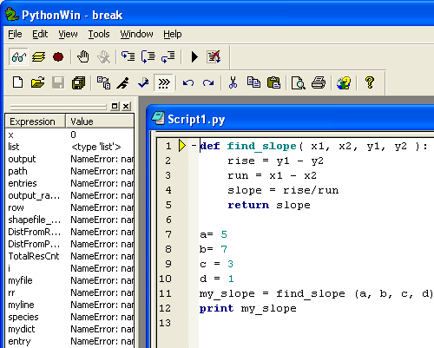
Outline
Syntax errors
Exceptions
Debugging

Slide 3

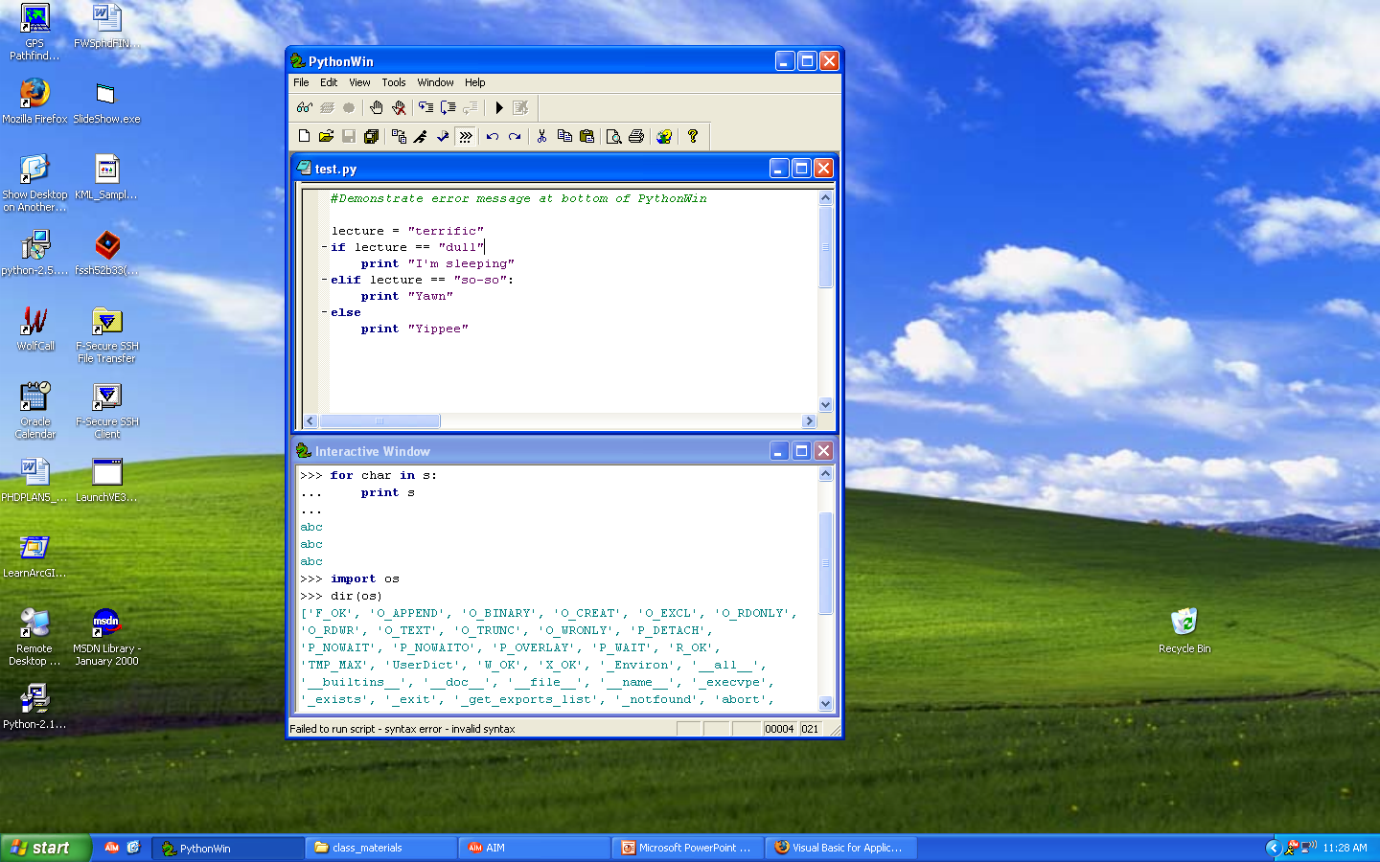
3 Types of errors
syntax (spelling or punctuation)
    Script won’t run.
    Cursor jumps to line with 1st syntax error.
    Not always EXACTLY at error.
2. exceptions
    The code is wrong or the code doesn’t handle the current use case.
    e.g., Some spelling mistakes generate exceptions.
    Script runs, but not all the way.
logic
    Script runs all the way, but doesn't do what it’s supposed to do.

Slide 4
Can you spot the 7 syntax mistakes?
#buggyCode1.py
import os sys
outputDir == os.path.dirname(sys.argv(1)) + '\outputFiles/
if NOT os.path.exists( outputDir )
os.mkdir( outputDir )
Notes:
Line 2: missing comma
Line 3: == should be =
Line 3: (1) should be [1] because sys.argv is a list.
Line 3: missing endquote
Line 4: NOT should be not
Line 4: missing colon
Line 5: should be indented

Slide 5
Syntax errors
Usually easy to fix once you figure out what they are.
error messages are often not helpful. common: SyntaxError: invalid syntax and SyntaxError: invalid token.
Cursor jumps (close to) where the problem occurred (where Python noticed a problem -- not necessarily where the error is --often on preceding line).
Common syntax errors:
  -Not using a Python keyword for a variable name.
  -Missing colon at the end of code block header lines, like while, if, and for statements.
  -Inconsistent indentation. You may indent with either spaces or tabs but don’t mix. Each level should be nested the same amount.
  -String literals have mismatched quotation marks.
  -An unclosed bracket – (, {, or [ – makes Python continue with the next line as part of the current statement. Generally, an error occurs almost immediately in the next line.
  -Check for the classic = instead of == inside a conditional.
  Reference: http://openbookproject.net/thinkcs/python/english2e/app_a.html (Read for more good tips)

Slide 6
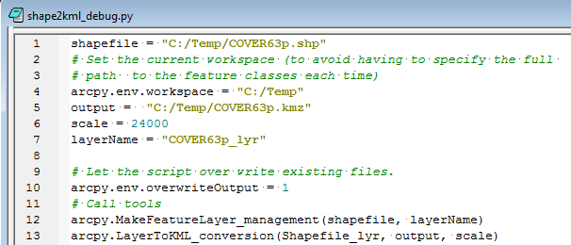
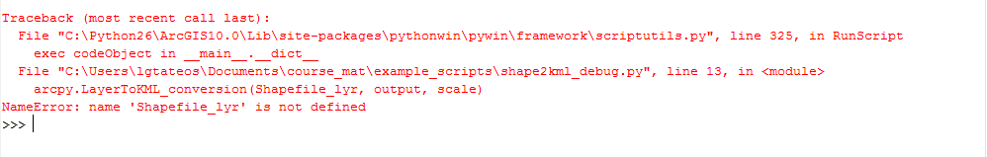
Exceptions. Seen them?
(a.k.a. buggyScript.py)
Say whut?!
This is called an “exception”.
Exception: error detected during script execution (running)
If something goes wrong while the script is running, Python prints a message that includes the name of the exception, the line of the program where the problem occurred, and a traceback.
Some exceptions can and should be ‘handled’ (with try/except) --up coming lesson.
Traceback identifies the function that is currently running, and then the function that invoked it, and then the function that invoked that, and so on. Traces the path of function invocations that got you to where you are. And gives the line number in your file where each of these calls occurs.
Notes:
1. Where did the exception occur?
"C:\Users\lgtateos\Documents\course_mat\example_scripts\shape2kml_debug.py", line 13
arcpy.LayerToKML_conversion(Shapefile_lyr, output, scale)
2. What is the exception?
NameError: name 'Shapefile_lyr' is not defined
3. Why?
Variable used but not assigned a value.

Slide 7
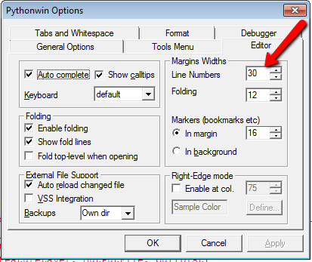
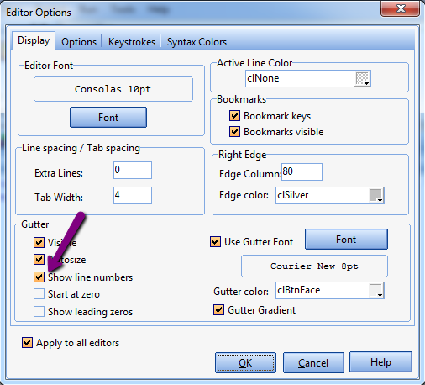
IDE Line numbers
PythonWin: View > Options > Editor > Line numbers --> 30
PyScripter: Tools > Options > Editor Options > Display > Show line numbers

Slide 8
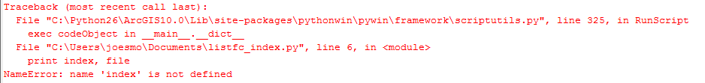
Traceback: where, what, and why
the traceback stack
file and line where error occurred
erroneous line
exception name and explanation
Important points:
Where the exception occurred: test.py, line 6: print index,file
What exception occurred:
NameError, name ‘index’ not defined.
Why the exception occurred:
The variable is index is used without being assigned a value.

Slide 9
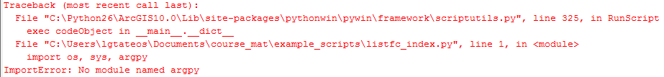
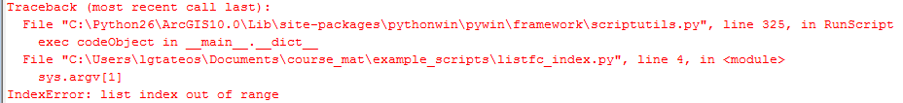
In class – read these tracebacks
1. Where did the exception occur?
2. What exception occurred?
3. Why did the exception occur?
Example 1
Example 2
1. "C:\...listfc_index.py", line 1: import os, sys, argpy
2. ImportError: No module named argpy
3. argpy is a typo, there’s no module by that name.
1. " C:\...listfc_index.py ", line 4: sys.argv[1]
2. IndexError: list index out of range
3. The user didn't pass in any arguments, but the script is trying to access the first user argument. The list only has length 1, so, trying to access the 2nd element causes an error.

Slide 10
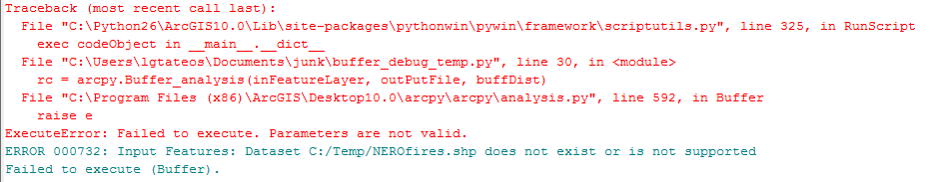
Tool exception thrown by Arc
1. Where did the exception occur?
"C:\buffer_debug_temp.py", line 30
rc = arcpy.Buffer_analysis(inFeatureLayer, outPutFile, buffDist)
2. What is the exception?
ExecuteError: Failed to execute. Parameters are not valid.
ERROR 000732: Input Features: Dataset C:/Temp/NEROfires.shp does not exist or is not supported
Failed to execute (Buffer).
3. Why did the exception occur?
Possible reasons: Filename spelled wrong. Data in wrong directory. File format not right for this tool. File is corrupted.

Slide 11
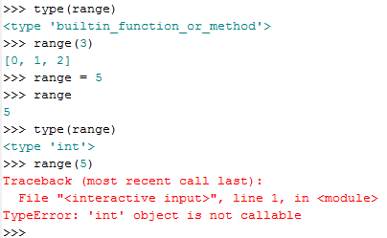
Exceptions in Interactive Window
1. Where did the exception occur?
2. What exception occurred?
3. Why did the exception occur?
The line just above the exception.
TypeError: 'int' object is not callable
Because we overwrote the range function and made it into an integer variable name.
Don’t use built-in functions as variable names.
Print the list of built-in functions:
>>> dir(__builtins__)
['ArithmeticError', 'AssertionError', 'AttributeError', 'BaseException', …

Slide 12
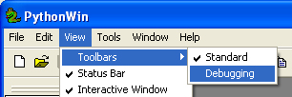
Debugging Toolbar
Make the debugger toolbar visible:
View> Toolbars > Debugging (checkmark)
Debugging toolbar:
only use “step over” for now!!!
step (in) step over step out
STOP running.
(Stop debugging session)
watch toggle stepping GO
variables breakpoint (Run to first break point)
Notes:
Yellow icon turns on call stack.
Red dot turns on break point list. You can set conditions here.
Hand toggles current breakpoint.
Hand with X turns off all breakpoints.

Slide 13
Debugging view
step in step over step out
watch
window
current
line has
yellow
arrow-
head

Slide 14

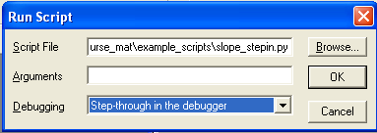

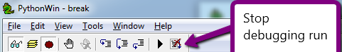
Stepping through & watching variables
Run to first line
Execute one line at a time, stepping over functions (including ones not in the current script)
Don’t use this unless you want to look inside a function. If you do, use this to get out.
Variable watch window
Stop running when debugging

Slide 15
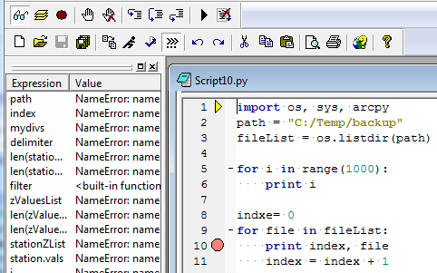
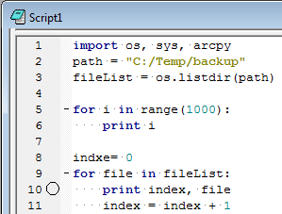


Breakpoints
Useful if you know generally where the problem is.
Run to next breakpoint
execution stops at a breakpoint until you tell it to move on.
PythonWin: set by clicking on that line of code and then
PyScripter: click in margin left of code
PythonWin: set breakpoint conditions (e.g., stop at breakpoint 1 when x== 5)
Breakpoint when code is not running yet
Breakpoint when running
Notes:
breakpointDemo:
http://courses.ncsu.edu/nr595d/common/scripting_topics/pseudocode.html#exercises #12
for i in range(100):
print "Hello"
if i > 49:
print i%2

Slide 16
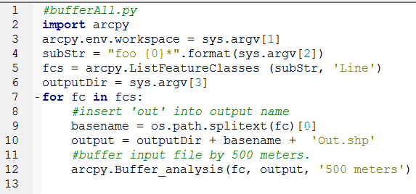
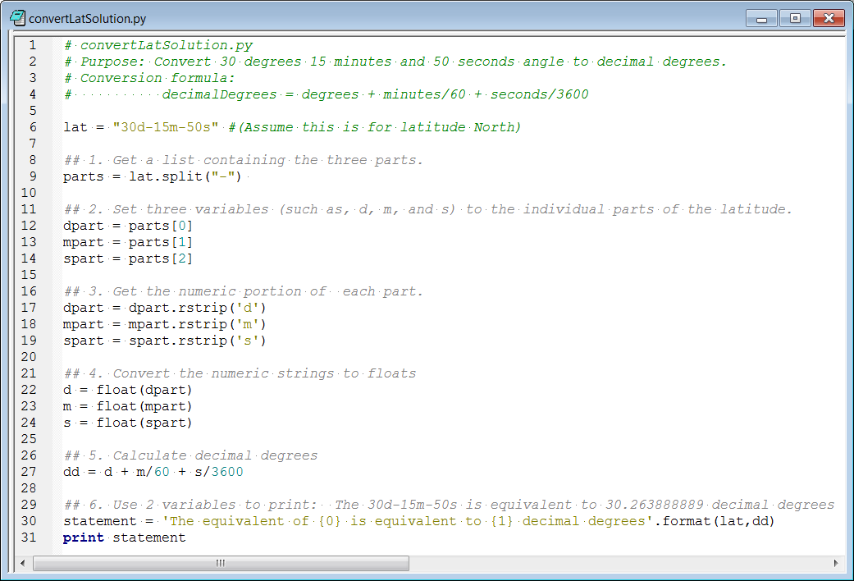
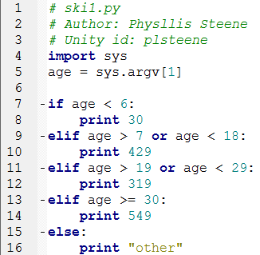
Which variables to watch?
The usual suspects:
Iterating variables
Input values
Lists
Variables in conditional statements
Conditions
Variables created by concatenation, string formatting, or other string manipulation methods
File paths, directories
Variables that appear in traceback message error descriptions

Slide 17
Where to put breakpoints?
Beyond the code that you know works
  Line 8 (Script1.py)
Inside conditional blocks
  Lines 8,10,12,14,16 (ski1.py)
Inside conditional blocks
Line 10 (Script1.py)
Inside user-defined functions
  Upcoming lesson
Inside other block constructs
Upcoming lessons: try, except, with
A few lines before the code that breaks.

Slide 18
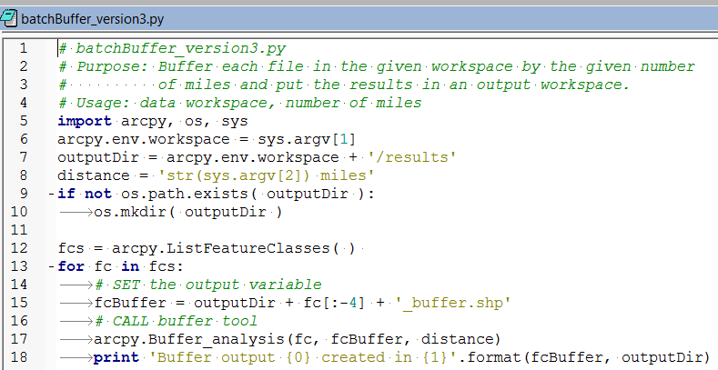
Demos - Do try this at home
Stepping through & watching variables
  batchBuffer_version3.py
Breakpoints
  buggyFreq.py

Slide 19
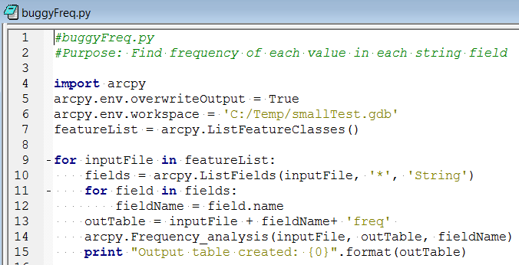

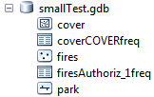
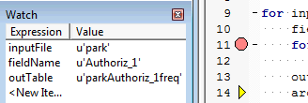

Break & watch demo
b
Frequency tool -- creates a frequency table, a tally of the number of times each value occurs in a field.
As is, this script creates 2 frequency tables, one for the 'cover' feature class ('coverCOVERfreq') and one for the 'fires' feature class ('firesAuthoriz_1 freq')
But then it crashes with the following error:
ERROR 000728: Field Authoriz_1 does not exist within table
Failed to execute (Frequency).
cover
Has 1 string field, ‘COVER’.
fires
Has 3 string fields, ‘'FireName', 'SizeClass', and 'Authoriz_1'.
park
Has NO string fields.

Slide 20
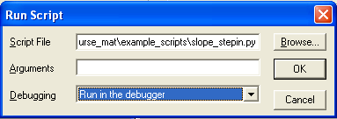
PythonWin: Ways to run in debug mode
Run to first line
Run to first line.
Run to first breakpoint.
Runs entire script if there are no breakpoints.
Run to first breakpoint.
Notes:
1 and 3 are same.
2 and 4 are same.
Can switch modes if stepping or stopped at breakpoint.

Slide 21

PyScripter: Ways to run scripts
Click in the margin next to the line of code where you want a breakpoint.
what does this do if there are no breakpoints?
Run to first line.
Run to cursor.
Run to breakpoint.
Run entire script (Ctrl + F9)

Slide 22
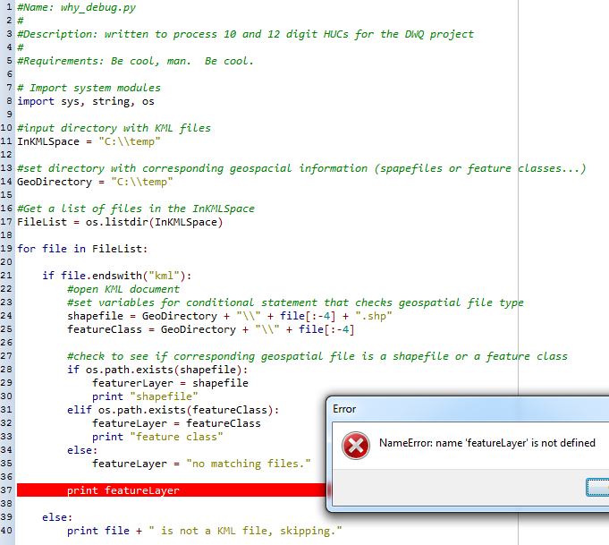

Demo (linked to “in class” page)

Slide 23
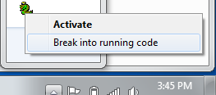
IDEs and infinite loops
PythonWin, stop non-responsive programs:
Right-click the icon on the bottom right of screen
Choose “break into running code”
PyScripter, stop non-responsive programs:
  Ctrl + F2

Slide 24
Other Debugging Practices
Use small test files
Test on multiple files
Use the watch window to see if variables are changing
Place breakpoints inside blocks of code (loops, conditional blocks)
ArcCatalog can interfere
Sometimes you may need to restart the IDE.

Slide 25
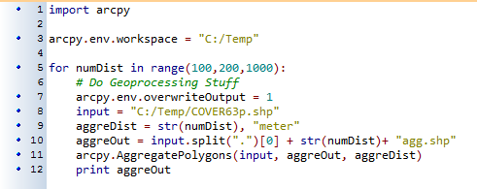
In class - agg_debug1.py

Slide 26
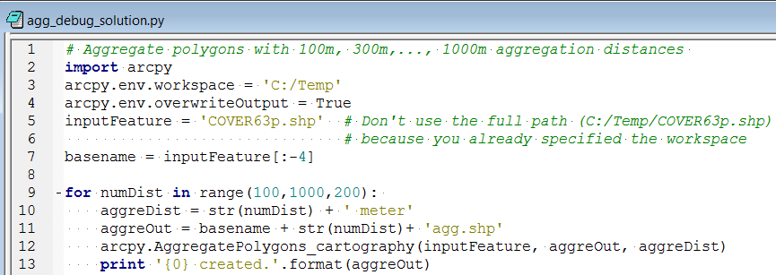
agg_debug1_solution.py
Notes:
Line 11 arcpy.AggregatePolygons(input, aggreOut, aggreDist) missing toolbox alias
Line 9 creates a tuple. Must use concatenation instead. (don’t forget the blank!)
Line 8 range parameters should be start, stop, increment (wrong order!)
Style… lines 4,5,6 should be outside the loop. Since they don’t change, they should each only happen once.

Slide 27
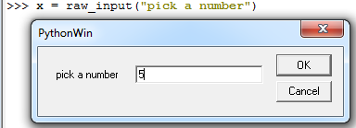

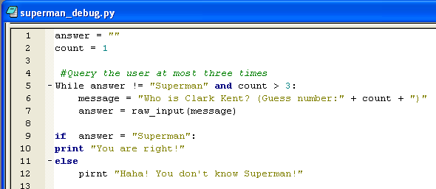
In class - superman_debug.py
raw_input takes one string argument, the message to the user. Returns whatever the user types in the box (as a string)
Notes:
syntax errors:
line 5 While
line 9 =
line 10 dedented
line 11 missing :
line 12 pirnt
exceptions:
line 6 Typeerror : Need to cast count to string. str(count)
logic errors:
line 5 count > 3

Slide 28
Summing up
Topics discussed
    Syntax errors
    Built-in exceptions
    Interpret traceback messages
    Logic errors
    Stepping through code in the debugger
    Setting breakpoints and breakpoint conditions
    Breaking in to running code
Up next
    More looping essentials
Additional topics
    Call stack

Slide 29
Use a loop to print 1 through 13, odd
  x = 1
  while x < 15:
  print x
  x = x + 2
for x in range(1,15,2):
print x

Slide 30
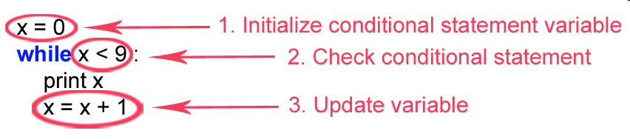
while/for loop review
Count by fives from 10 to 50. Use a for loop
  x = 10
  while x < 55:
  print x
  x = x + 5
for x in range(10,55,5):
print x

