Slide 1

Error handling
GIS 540
Center for Geospatial Analytics
North Carolina State University
Dr. Tateosian

Slide 2
Topics
Intro. to handling exceptions
try/except keywords
Code flow with try/except blocks
Named errors
Printing tracebacks
Looping (using exceptions)

Slide 3
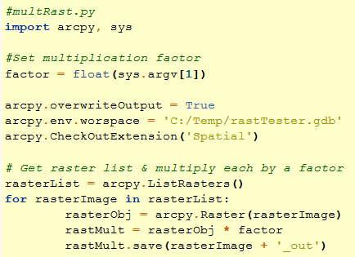
Sample script with errors
Purpose: multiply every raster in the workspace by a factor given by the user
Throws the following exception:
for rasterImage in rasterList:
TypeError: 'NoneType' object is not iterable
Run this script with an argument "0.001 meters“
factor = float(sys.argv[1])
ValueError: invalid literal for float(): 0.001 meters

Slide 4
Two types of causes for exceptions
  Errors in the script that should be corrected.
  Example:
  arcpy.env.worspace = 'C:/Temp/rastTester.gdb'
  for rasterImage in rasterList:
  TypeError: 'NoneType' object is not iterable
  Errors due to conditions that should be handled.
  Usually:
  --User input
  --Data locked, corrupted, missing
  Example:
  Run multRasts.py with an argument "0.001 meters“
  factor = float(sys.argv[1])
  ValueError: invalid literal for float(): 0.001 meters

Slide 5
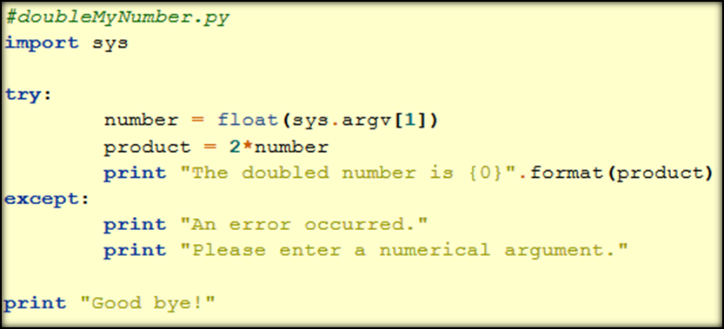
‘Handling’ exceptions
Use try/except
keywords and
indentation
How it works:
  If an exception occurs in the try block, the rest of the try block is skipped and execution jumps to the except block. E.g., input is "5 meters“:
  >>> An error occurred.
  Please enter a numerical argument.
  Good bye!
  If no exceptions occur, the except block is skipped entirely. E.g., the input is 5, the script prints the following:
  >>> The doubled number is 10.0
  Good bye!

Slide 6
Error handling syntax
For every try, there must be at least one except.
Use at least one line of indented code after try.
Use at least one line of indented code after except.
Put ‘code that may cause an error’ inside try block.
Put ‘what to do in case of error’ inside except block.
Colon after try. Colon after except.
Code dedented after except block occurs no matter what.
Optionally, the except block can specify an exception name...
# currency.py
amount = sys.argv[1] #required (script will crash if not provided)
try:
currency = sys.argv[2] #optional
except IndexError:
currency = “US”
print "Usage: <amount(required)> <currency unit(optional>"
print "No unit provided. Default value:“, currency, “being used.”
# perform conversions …
Notes:
# Import system modules
import sys, string, os, arcpy
# Create the Geoprocessor object
gp = arcpy.create()
# Load required toolboxes...
gp.AddToolbox("C:/Program Files/ArcGIS/ArcToolbox/Toolboxes/Analysis Tools.tbx")
# Script arguments...
distance = sys.argv[1]
if distance == '#':
distance = "5 Feet" # provide a default value if unspecified
input = sys.argv[2]
if input == '#':
input = "C:\\Documents and Settings\\lgtateos.wt\\My Documents\\python_materials\\class_materials\\from_tom\\pyexer05\\COVER63p.shp" # provide a default value if unspecified
# Local variables...
output = "C:\\Temp\\export_example\\COVER63p_Buffer.shp"
# Process: Buffer...
gp.Buffer_analysis(input, output, distance, "FULL", "ROUND", "NONE", "")
-------------------------------------
# ---------------------------------------------------------------------------
# buffer_model.py
# Created on: Tue Oct 02 2007 12:57:15 PM
# (generated by ArcGIS/ModelBuilder)
# Usage: buffer_model <distance> <input>
# ---------------------------------------------------------------------------
# Import system modules
import sys, string, os, arcpy
# Create the Geoprocessor object
gp = arcpy.create()
# Load required toolboxes...
gp.AddToolbox("C:/Program Files/ArcGIS/ArcToolbox/Toolboxes/Analysis Tools.tbx")
arcpy.env.overwriteOutput = 0
# Script arguments...
try:
distance = sys.argv[1]
input = sys.argv[2]
except IndexError:
distance = "#"
input = "#"
print "Usage: distance input"
print "No parameters provided. Default values being used"
#distance = sys.argv[1]
if distance == '#':
distance = "200 Feet" # provide a default value if unspecified
#input = sys.argv[2]
if input == '#':
input = "C:\\Documents and Settings\\lgtateos.wt\\My Documents\\python_materials\\class_materials\\from_tom\\pyexer05\\COVER63p.shp" # provide a default value if unspecified
# Local variables...
output = "C:\\junk\\COVER63p_Buffer3.shp"
rc = ""
try:
# Process: Buffer...
rc = gp.Buffer_analysis(input, output, distance, "FULL", "ROUND", "NONE", "")
except:
print "An buffering did not work properly:"
print gp.MessageCount
for i in range(0,gp.MessageCount):
print "Message", i, "=", arcpy.GetMessage(i)
print arcpy.GetMessages()
if rc:
gp.AddMessage("The buffer returned" + rc)
print "The buffer returned" + rc

Slide 7
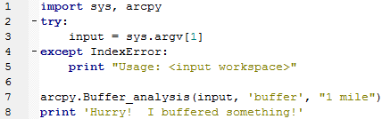
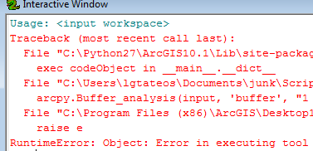
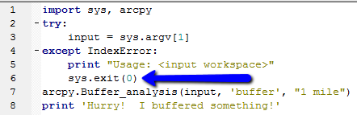

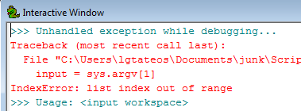
Flow after the exception….
Unless the script exits explicitly the script continues.
sys.exit(0) exits the script.
Use inside except clause, as appropriate.
When stepping through in the debugger, exceptions are still printed.

Slide 8
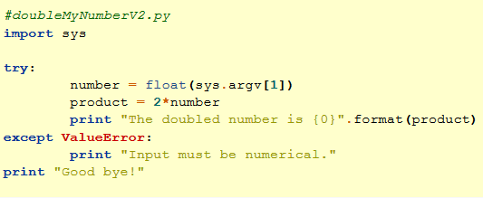
Using named exceptions
  Traceback errors report the name of the exception
  TypeError: 'NoneType' object is not iterable
  ValueError: invalid literal for float(): 0.001 meters
Named exception: handles only the exceptions with the name given behind the except keyword.
How it works:
  This code catches ValueError exceptions. E.g., input is "5 meters“:
  >>> Input must be numerical.
  Good bye!
  The code doesn’t catch any other exception types. If the user does not supply an argument:
    number = float(sys.argv[1])
    IndexError: list index out of range

Slide 9
Exception names
Use named exceptions when you know a certain type of error may occur. e.g. IndexError, TypeError, ArithmeticError, IOError
Python Library Reference
How to know what name to use?
Example: Dividing by zero is a no-no.
    How to determine the name of the except that occurs if you divide by zero?
    >>> a = 1
    >>> b = 0
    >>> c = a/b
    ZeroDivisionError: integer division or modulo by zero

Slide 10
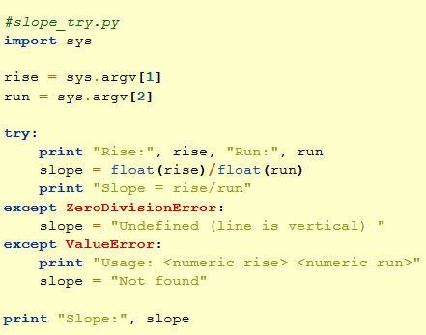
Multiple except blocks
Any number of named except blocks can be used with one try block.
At most one unnamed except block can be used with a single try block.
An unnamed except block can be used along with named except blocks.
When an unnamed except block is used with named except blocks, the unnamed except is placed last.
A try block needs at least one except block (or a finally block can be used as an alternative to an except block. The finally keyword is covered in an upcoming chapter).

Slide 11
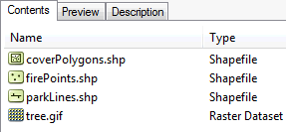
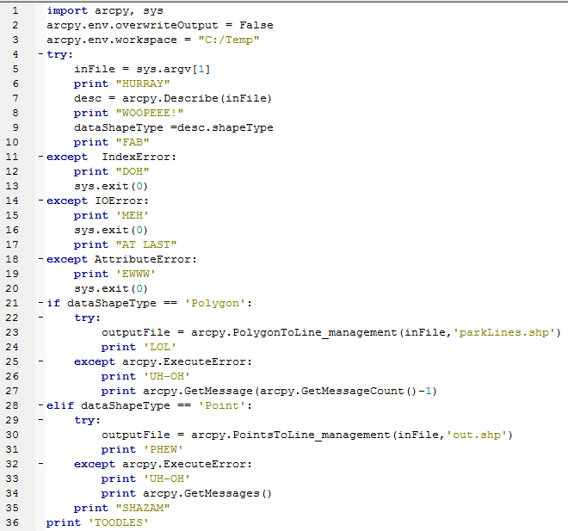
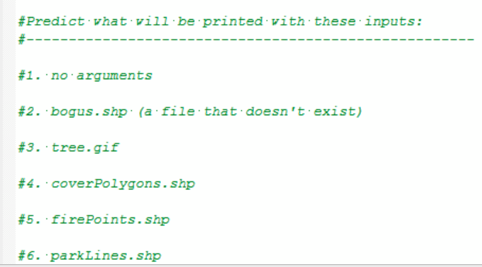
try/except block flow
If an exception does not occur in the try clause, execution of the try clause is finished and the except clause is skipped.
If an exception does occur during execution of the try clause, the rest of the try clause is skipped and execution jumps to the matching except clause.
predictTry.py
In class
Notes:
DOH
HURRAY MEH
HURRAY WOOPEEE! EWWW
HURRAY WOOPEEE! FAB UH-OH
Failed at Tue Feb 18 09:33:56 2014 (Elapsed Time: 0.00 seconds) TOODLES
HURRAY WOOPEEE! FAB PHEW SHAZAM TOODLES
HURRAY WOOPEEE! FAB TOODLES

Slide 12
In class - Flow with named exceptions
If an exception occurs during execution of the try clause, the rest of the clause is skipped. Then if its type matches the exception named after the except keyword, the except clause is executed, and then execution continues after the try statement.
If an exception occurs which does not match the exception named in the except clause, it is passed on to outer try statements; if no handler is found, it is an unhandled exception and execution stops with a Traceback message.
# slope_try.py
import sys
rise = sys.argv[1]
run = sys.argv[2]
try:
print "Rise:", rise, "Run:", run
slope = float(rise)/float(run)
print "Slope = rise/run"
except ZeroDivisionError:
slope = "Undefined (line is vertical) "
except ValueError:
print "Usage: <numeric rise> <numeric run>"
slope = "Not found"
print "Slope:", slope

Slide 13
Named exception for arcpy
arcpy.ExecuteError catches errors thrown by tools.
Call arcpy.GetMessages() inside the except block to print tool error.
import arcpy, sys
arcpy.overwriteOutput = True
inputFile = sys.argv[1]
try:
output = os.path.splitext(input)[0] + "_buffer.shp”
arcpy.Buffer_Analysis(inputFile, output, "1 mile")
print "Buffer", output, "created.”
except arcpy.ExecuteError:
print arcpy.GetMessages( )
print “Exiting the script now.”

Slide 14
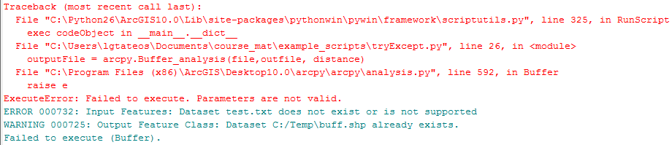
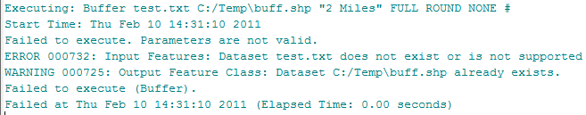
Traceback error vs. GetMessages
buffer = “buff.shp“
arcpy.Buffer_Analysis(inputFile, buffer, “2 miles")
try:
buffer = “buff.shp”
arcpy.Buffer_Analysis(inputFile, buffer, “2 miles")
except arcpy.ExecuteError:
print arcpy.GetMessages( )

Slide 15
The traceback module
try:
1/0 # This throws a ZeroDivisionError exception
except:
print “hey that was fun.”
import sys, traceback
try:
1/0 # This throws a ZeroDivisionError exception
except:
if sys.exc_info()[0]:
print "Unexpected error:", sys.exc_info()[0]
print
traceback.print_exc( )
>>> hey that was fun.
Unexpected error: <type 'exceptions.ZeroDivisionError'>
Traceback (most recent call last):
File "C:\try_make_mistake.py", line 8, in <module>
1/0 # This throws a ZeroDivisionError exception
ZeroDivisionError: integer division or modulo by zero
Use sys.exe_info()[0] or traceback.print_exc() in unnamed exception blocks, particularly during code development.

Slide 16
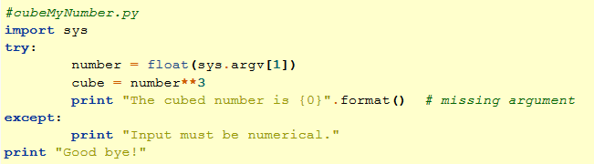

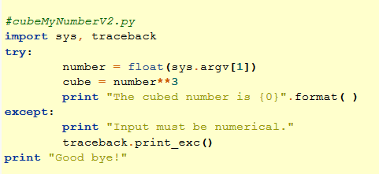
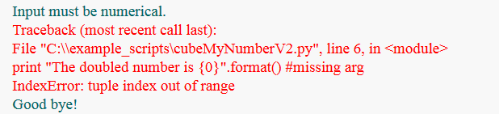
Error handling gotchas
Sometimes ‘except’ can hide the true error

Slide 17
Looping and exceptions
For tool calls inside loops
Place both the try and except blocks inside the loop
while loops should update the looping variable last, outside the except block
inclass–
buffer_loop_try.py
buffer_loop_try2.py

Slide 18
For loops & exceptions
# buffer_loop_try.py
import arcpy, sys
arcpy.env.overwriteOutput = False
arcpy.env.workspace = "C:/Temp"
fcs = arcpy.ListFeatureClasses()
for fc in fcs:
try:
buffer = fc[:-4] + "_buffer.shp"
arcpy.Buffer_analysis(fc, buffer, "1 mile")
print "Created: ", buffer
except arcpy.ExecuteError :
print arcpy.GetMessage( )

Slide 19
while loop and try/except blocks
# buffer_loop_try2.py
import arcpy, sys
arcpy.env.overwriteOutput = True
arcpy.env.workspace = "C:/Temp"
fc = ‘COVER63p.shp’
dist = 1
while dist <= 10:
try:
buffer = fc[:-4]+ str(dist) + "_buffer.shp“
buffDist = str(dist) + “ mile"
arcpy.Buffer_analysis(fc, buffer, buffDist)
print "Created: ", buffer
except arcpy.ExecuteError:
print arcpy.GetMessage( )
dist = dist + 1

Slide 20
Summing up
Topics discussed
    fixable vs. handleable exceptions
    try/except keywords and flow
    named exceptions
    ‘traceback’ module
Up next
    User-defined functions
Additional topics
    assert, raise, finally keywords
    User-defined errors

Slide 21
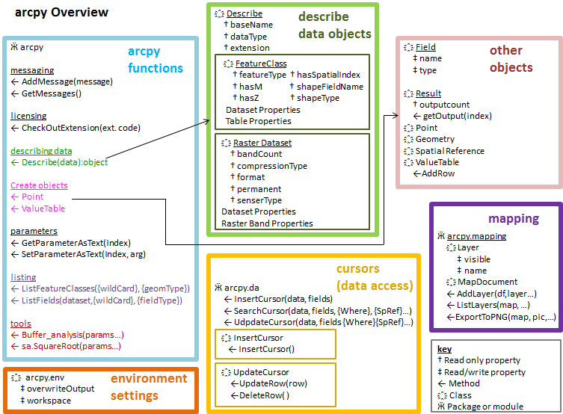
Looking back
strings, lists
calling arcpy tools
conditional structures
looping
describing Arc files
arcpy ‘List’ functions
debugging
more looping
handling errors

Slide 22
Upcoming
cursors
code reuse:
  procedures
  modules
  classes
dictionaries
file input/output
html/kml parsing
Python File GUI’s

Slide 23
Project information
Important dates http://courses.ncsu.edu/gis540/common/homework.html
Project guidelines http://courses.ncsu.edu/gis540/common/project.html
1. Proposal evaluation
http://courses.ncsu.edu/gis540/common/project.html#draft
Don’t obfuscate. Explain yourself clearly!
2. Project requirements
http://courses.ncsu.edu/gis540/common/project.html#requirements
3. Submission format
http://courses.ncsu.edu/gis540/common/project.html#format
4. How to submit
http://courses.ncsu.edu/gis540/common/project.html#submission

Slide 24

Appendix

Slide 25
In class - Finding exception names
Explore exceptions using
# fileOpen.py
import sys
filename = sys.argv[1] # Get filename
file = open(filename,"r") # Open file to read
print file.readlines( ) # Read file and print

Slide 26
Named exception: IOError
# fileOpen.py
import sys
try:
filename = sys.argv[1] # Get filename from user
file = open(filename,"r") # Open file for reading
print file.readlines( ) # Read file and print
except IOError:
print "Warning: could not open:", filename
print "Usage: <full path file name>”
sys.exit(0)
except:
print "Unexpected error:", sys.exc_info()[0]
sys.exit(0)
forces the script to exit. no lines of code are
executed after this is called.

