Slide 1
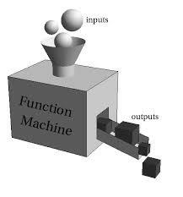
User-defined functions
User-defined functions
Arguments
Returning values
Doc Strings
Dr. Tateosian

Slide 2
Review - Describe these functions.
What arguments do they take?
What do they return?
Are they methods or built-in functions?
myStr = myStr.capitalize()
myList.append(5)
myList.sort()
myList = range(1,11)
myCount = arcpy.GetCount_management(myFile)
myStr = “;”.join(myList)
Notes:
no args, returns a string (the capitalized version of original string) . It’s string method.
1 arg (the item to append), no return value (it’s alters the list itself). It’s an in place list method.
no arguments, no return value (it’s alters the list itself). It’s an in place list method.
takes 1, 2, or 3 arguments, returns a list of numbers. It’s a built-in function.
takes 1 argument (the input file), returns a results object. It’s an arcpy method.
takes 1 argument (the list of strings to be joined), returns a string. It’s string method.

Slide 3
Describe these functions.
What arguments do they take? What do they return? Are they methods or built-in functions?
myStr = myStr.capitalize()
no args, returns a string (the capitalized version of original string) . It’s string method.
myList.append(5)
1 arg (the item to append), no return value (it’s alters the list itself). It’s an in place list method.
myList.sort()
no arguments, no return value (it’s alters the list itself). It’s an in place list method.
myList = range(1,11)
takes 1, 2, or 3 arguments, returns a list of numbers. It’s a built-in function.
myCount = arcpy.GetCount_management(myFile)
takes 1 argument (the input file), returns a results object. It’s an arcpy method.
myStr = “;”.join(myList)
takes 1 argument (the list of strings to be joined), returns a string. It’s string method.
Notes:
no args, returns a string (the capitalized version of original string) . It’s string method.
1 arg (the item to append), no return value (it’s alters the list itself). It’s an in place list method.
no arguments, no return value (it’s alters the list itself). It’s an in place list method.
takes 1, 2, or 3 arguments, returns a list of numbers. It’s a built-in function.
takes 1 argument (the input file), returns a results object. It’s an arcpy method.
takes 1 argument (the list of strings to be joined), returns a string. It’s string method.

Slide 4
Define your own function
def printYears():
“““Print every five years
between 1980 and 2005. ”””
yrs = range(1980,2005,5)
for yr in yrs:
print yr
printYears( )
#output
1980
1985
1990
1995
2000
function definition.
Must come before (above)
function call in script
function call

Slide 5
Function syntax
What is a function?
Named sequence of statements that performs a desired operation.
Near synonyms: subroutines, functions, methods
To define: Use keyword def, colon and indentation
Name can’t start with a number or contain special chars.
Define first. Then call using name and parenthesis.
‘Calling’ makes the function execute
def functionName(arg1, arg 2,… ):
#Do stuff
#calling the function
functionName(a, b, … )

Slide 6
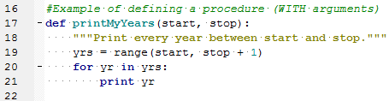
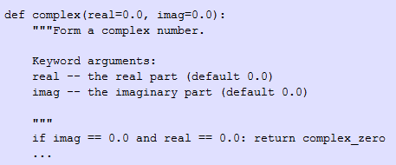

More syntax: the docstring
String literal that occurs as the first statement in the function definition
An concise explanation of function’s purpose
  - one line for obvious ones
  - if multi-line: use summary line (like a one-line docstring), followed by a blank line, followed by a more elaborate description.
Style notes:
  Triple quotes are used even though the string fits on one line.
  Use a full sentence with a period at the end.
  Write as a command, not a description: “Print every year…” not “Prints every year…”
print procName.__doc__ prints the document string.
Notes:
http://tovid.wikia.com/wiki/Python_tips/Docstrings
Notes:
Triple quotes are used even though the string fits on one line. This makes it easy to later expand it.
The closing quotes are on the same line as the opening quotes. This looks better for one-liners.
There's no blank line either before or after the docstring.
The docstring is a phrase ending in a period. It prescribes the function or method's effect as a command ("Do this", "Return that"), not as a description; e.g. don't write "Returns the pathname ...".
The one-line docstring should NOT be a "signature" reiterating the function/method parameters (which can be obtained by introspection). Don't do:
ng

Slide 7
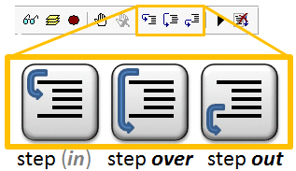
Stepping into functions
Demo

Slide 8
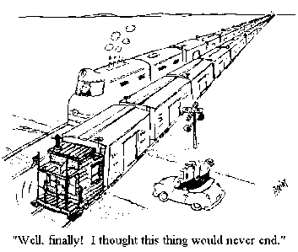
Why use functions
Save time
  Eliminates the need to rewrite code.
Modularizes
  By grouping a related set of code it makes your code re-useable.

Slide 9
Buffer/clip analysis code reuse example
#Buffer analysis
GET input feature.
GET buffer units.
GET buffer distance.
GET layerList.
CALL buffer on input feature.
FOR EACH layer in layerList:
SELECT features that fall within the buffer.
MAKE new feature layer from selection.
CALL read data.
CALL create html message.
CALL write HTML output.
CALL write Layer SelectionList.
CALL Zoom to selection
SET output features visible
SET non-output features not visible
CALL capture jpeg
#Clip analysis
GET input feature.
GET layerList.
CALL buffer on input feature.
FOR EACH layer in layerList:
CALL clip features that fall within the input polygon.
CALL read data.
CALL create html message.
CALL write HTML output.
CALL write Layer SelectionList.
CALL Zoom to selection
SET output features visible
SET non-output features not visible
CALL capture jpeg
Common blocks of code, such as ‘read data’ or ‘create html message’
should be written as functions so that it’s easy to reuse the code.

Slide 10
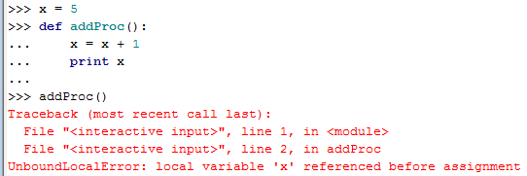
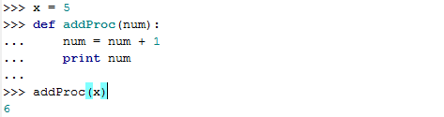
Scope: things defined outside
Need to pass variables in as a
Good practice: use different names for parameters than the variable passing in
Advanced topic: namespaces
  http://docs.python.org/release/1.5.1p1/tut/scopes.html

Slide 11
Function arguments
>>> def printMyYears(start, stop):
… ‘’’Print every year between start and stop’’’
... yrs = range(start, stop + 1)
... for yr in yrs:
... print yr
...
>>> printMyYears(1920,1926)
1920
1921
1922
1923
1924
1925
1926
Notes:
DEMO 13: DEFINING & USING FUNCTIONS
***********************************
>>> # function definition
>>> def printYears():
... yrs = range(1980,2005,5)
... for yr in yrs:
... print yr
...
>>> printYears()
1980
1985
1990
1995
2000
>>> def printMyYears(start, stop, step=1):
... yrs = range(start, stop + 1, step)
... for yr in yrs:
... print yr
...
>>> printMyYears(1920,1926)
1920
1921
1922
1923
1924
1925
1926

Slide 12
In Class – printFunctions.py
The given script contains 2 function definitions and calls these functions (as examples).
1. A list of file names is given in the code (testList = ['a.shp', 'a.txt', 'cRaster']). Write code to loop through testList and print only names that end with .shp.
2. When that is working, put the looping code that you wrote for #1 inside a function definition. Pass a list in as an argument.
3. Write a line of code to call the function using testList. (The idea is to replace the code you wrote for #1 with a function definition and call.)
Notes:
>>> def myPrint(myList):
for i in myList:
if i.endswith('shp'):
print i
>>> test = ['a.shp', 'a.txt', 'cRaster']
>>> myPrint(test)
a.shp

Slide 13
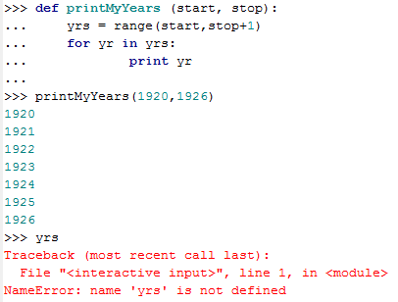
Scope: things defined inside
context in which values are associated with a variable
yrs is not defined outside the function.
need to return a value

Slide 14
Returning a value
Use return keyword.
When calling, use an assignment statement.
def functionName(arg1, arg 2,… ):
‘’’Do stuff’’’
return result
#Calling the function
x = functionName(a, b, …)

Slide 15
Example returning a value
import sys
rise = float(sys.argv[1])
run = float(sys.argv[2])
def findSlope(lineRise, lineRun):
```Return the slope of a string.’’’
lineSlope = lineRise/lineRun
return lineSlope
slope = findSlope(rise, run)
print slope

Slide 16
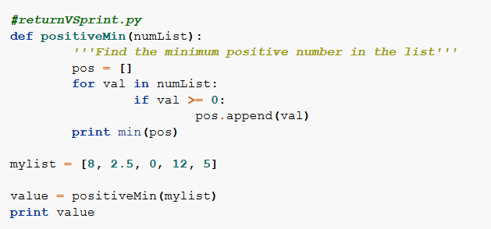
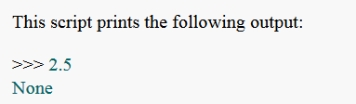
A common mistake: ‘none’
If a script prints a mysterious 'None', it often means that it is printing the return value of a function which does not contain an explicit return statement.

Slide 17
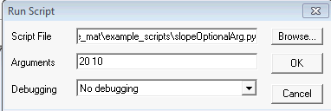
Function arguments vs. script arguments
# no arguments
def findSlope():
“““Return the …”””
lrise = 3
lrun = 4
lslope = lrise/lrun
return lslope
slope = findSlope()
print slope
# function arguments only
import sys
def findSlope(lrise, lrun):
“““Return the …”””
lslope = lrise/lrun
return lslope
rise = 8
run = 16
slope = findSlope(rise, run)
print slope
# script arguments AND function arguments
import sys
rise = float(sys.argv[1])
run = float(sys.argv[2])
def findSlope(lrise, lrun):
“““Return the …”””
lslope = lrise/lrun
return lslope
slope = findSlope(rise, run)
print slope
script arguments / function arguments – which is which?

Slide 18
In class – add5
Add another function to your script. Name the function add5. The purpose is to add five to the numeric argument passed into it and returns the result.
Call the function using an argument of 10 and set x to the result. Then print x.
Set a variable z to a float value and call the function using y as the argument and set y to the result. Then print y.
Notes:
>>> def add5( num ):
num = num + 5
return num
>>> x = add5(10)
>>> print x
15
>>> z = 3.4
>>> y = add5(z)
>>> y
8.4000000000000004

Slide 19
Optional arguments
Function arguments can be made optional.
Make options optional by assigning a default value in argument list.
Required arguments must come before optional ones.
# Define a function with optional arguments
def procName(arg1, arg2, arg3 = defaultVal1, arg4 = defaultVal2):
…
# Call a function with optional arguments
procName(a, b, c, d) #Call with 4 args
procName(a, b, c) #Or call with 3 args (defaultVal2 will be used for the last arg)
procName(a,b) #Or call with 2 args (defaultVal1 used for arg3 and defaultVal2 used for arg4)

Slide 20
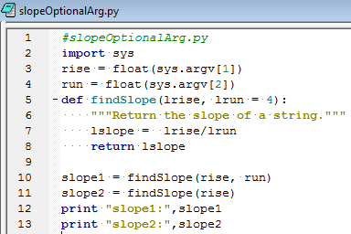

Slope Example with optional argument
optional
required
calling with 2 args
calling with 1 arg

Slide 21
In class
Modify zipAll.py so that it is a function.
The function should take one argument: the directory whose contents are to be zipped.
Call the method.

Slide 22
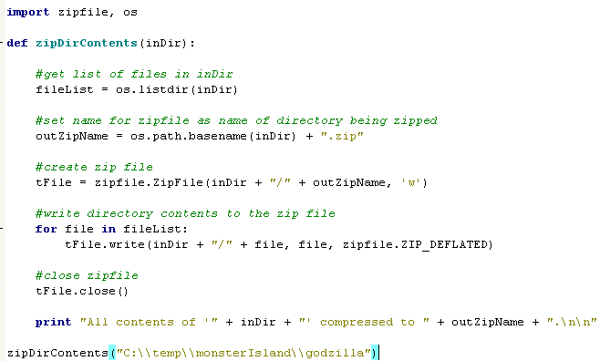

Slide 23
Amend your script…
Amend zipAllFunction so that it returns the name of the archive file that was created.

Slide 24
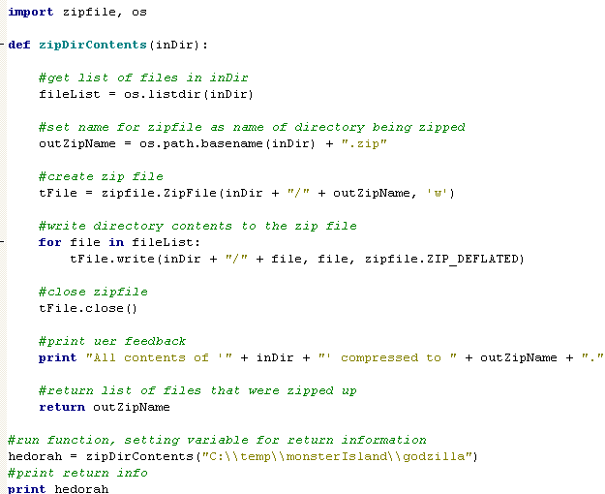

Slide 25
Summing up
Topics discussed
    Function definition syntax (def keyword).
    Calling functions.
    Functions that take arguments.
    Functions that return values.
    Script arguments vs. function arguments.
Up next
    cursors
Additional topics
    optional arguments

Slide 26
Optional Arguments
It is possible to set some input arguments as optional by using default values.
def diffTimeReturn( start, end, message= "Time elapsed:"):
difference = end - start
weeks, days = divmod(difference.days, 7)
minutes, seconds = divmod(difference.seconds, 60)
hours, minutes = divmod(minutes, 60)
print message
print “””%d weeks, %d days, %d:%d:%d" %
(weeks, days, hours, minutes, seconds)”””

Slide 27
Calling the Function
>>> diffTimeReturn(begin,stop)
Time elapsed:
0 weeks, 0 days, 0:0:1
>>> mymessage = “Mothra’s travel time:
>>> diffTimeReturn(begin,stop,mymessage)
Mothra’s travel time:
0 weeks, 2 days, 0:0:6
def diffTimeReturn( start, end, message= "Time elapsed:"):
difference = end - start
weeks, days = divmod(difference.days, 7)
minutes, seconds = divmod(difference.seconds, 60)
hours, minutes = divmod(minutes, 60)
print message
print “””%d weeks, %d days, %d:%d:%d" %
(weeks, days, hours, minutes, seconds)”””

Slide 28
Optional Arguments
Amend your zipAll.py function so that it has an optional loop to delete all the original files after it creates the archive file

Slide 29
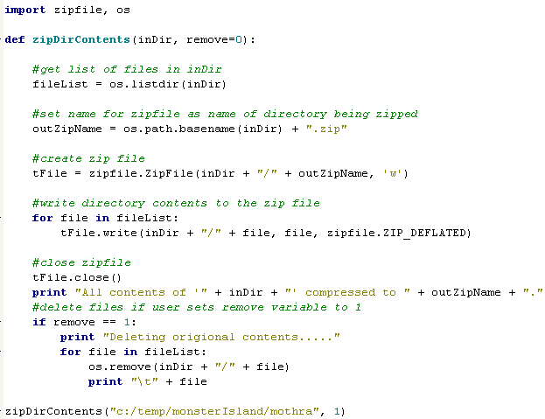

Slide 30
Returning Multiple Values
What if you need to return multiple values from a function?
def diffTimeReturn( start, end, message= "Time elapsed:"):
difference = end - start
weeks, days = divmod(difference.days, 7)
minutes, seconds = divmod(difference.seconds, 60)
hours, minutes = divmod(minutes, 60)
print message
print “””%d weeks, %d days, %d:%d:%d" %
(weeks, days, hours, minutes, seconds)”””
return [weeks, days, hours, minutes, seconds]

Slide 31
Returning Multiple Values
Define a function that returns the extent of a shapefile before it is clipped, clips it based on a smaller file, then returns the size of the new file
Call this function, printing each extent as follows:
    Old extent of in feature: xxxxxxxxxxxx
    New extent of in feature: xxxxxxxxxxxx

Slide 32
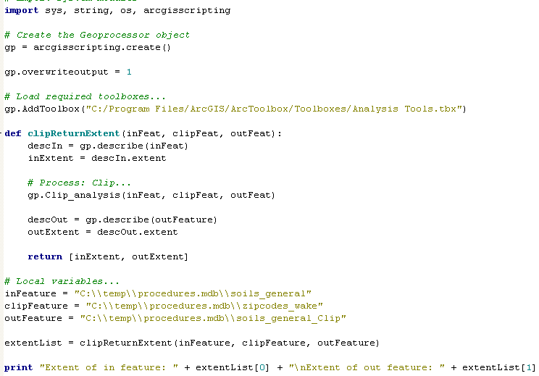

Slide 33
In class
Write a Python method that will print a given message both in PythonWin and in the geoprocessing Window when it’s called from ArcGIS
The function should take one argument: the string message to be printed
Call the method.

Slide 34
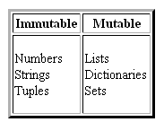
Scope: Argument values
def augment( mylist, myint ):
mylist.sort()
myint = myint + 1
>>> alist = [3,1,2]
>>> num = 5
>>> print alist
[3,1,2]
>>> print num
5
>>> augment(alist, num)
>>> print alist
[1,2,3]
>>> print num
5

Slide 35
Scope
scope: context in which values are associated with a variable
import datetime, time
x = 5
def reportTime( ):
#Report the current time
x = x + 1
t = datetime.datetime.now( ) # Get a datetime object
print t.ctime( ) # Print the date time
print x
reportTime( )
>>> 5
Traceback (most recent call last):
UnboundLocalError: local variable 'x' referenced before assignment

Slide 36
Scope: NameError
designates the context in which values are associated with a variable
import datetime, time
z = 5
def reportTime(x):
#Report the current time
x = x + 1
t = datetime.datetime.now( ) # Get a datetime object
print t.ctime( ) # Print the date time
reportTime(z)
print t
>>> Traceback (most recent call last):
NameError: name 't' is not defined

Slide 37
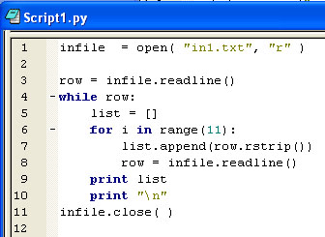
Review
List the line numbers that call functions
Decide if the function is a built-in function, a string method, a list method, or other
Notes:
1 open is a built-in function
3 readline is a file method
6 range is a built-in function
7 append is a list method; rstrip is a string method
8 readline is a file method
11 close is a file method

Slide 38
Review
Capitalize myStr (a Python string)
Append 5 to myList (a Python list)
Sort myList (a Python list)
Find the record count of myFile (a full path shapefile name). Store the result in a variable named myCount. Assume arcpy is already imported.
Notes:
myStr = myStr.capitalize()
myList.append(5)
myList.sort()
myCount = arcpy.GetCount_management(myFile)

