Slide 1
How to submit the course project

Slide 2
Where to submit
Too much for wolfware
Submission hosted on another machine
\\wishbone.oit.ncsu.edu\ceo$\classes\GIS540
From off-campus, must use a virtual private network (VPN)
Place files in your project directory as specified

Slide 3
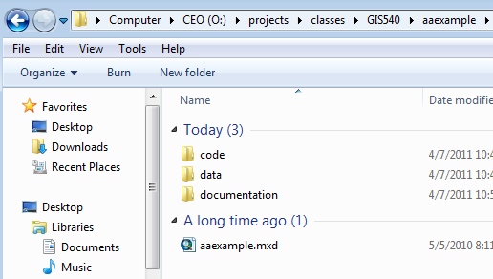
unityID directory
unityID == aaexample
contains: code, data, documentation folders
main python script or map document

Slide 4
Documentation directory
<=2 page write-up: Title, abstract, data, processing description, pseudocode, keywords, readme
video (distance ed. only)
powerpoint (or other visual used for presentation)
thumbnail

Slide 5
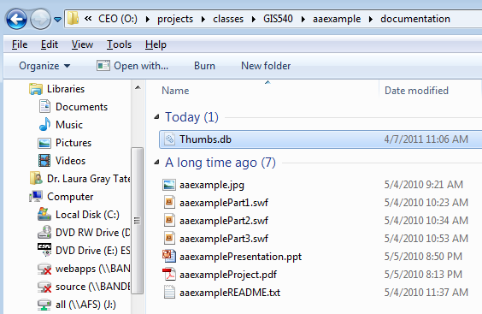
Documentation directory

Slide 6
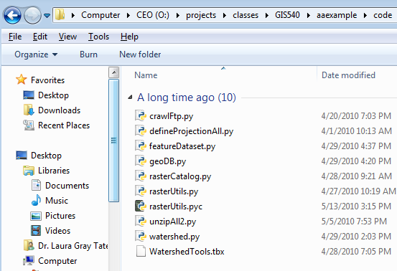
Code directory

Slide 7
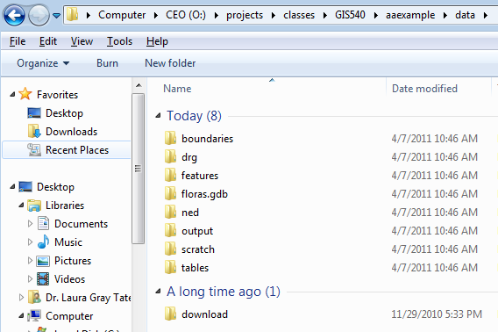
Data directory

Slide 8
In class
Browse here:
\\wishbone.oit.ncsu.edu\ceo$\classes\GIS540
make documentation, data, code directories.
copy existing project there

Slide 9
Using the vpn access
Click on vpn.ncsu.edu, and follow the instructions
In Windows Explorer (NOT Internet Explorer!)
Browse to
\\wishbone.oit.ncsu.edu\ceo$\classes\GIS540
3. When prompted for username and password
Use WOLFTECH\unityid and unity password

