Slide 1


Beginning Python
geoprocessing
why this course uses Python
where to write code
input to scripts
basic Python code components
Dr. Tateosian

Slide 2
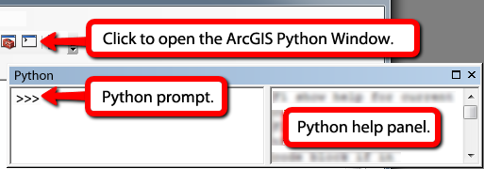
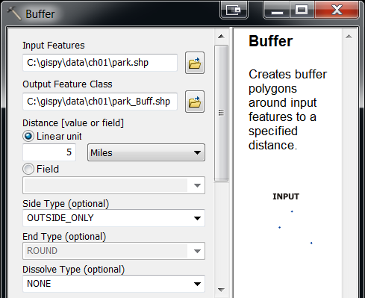
In-class exercise
“Simple buffer” goals:
  Get immediate feedback from Python
  Run a Python geoprocessing statement
  Understand the connection between Python code and ArcGIS tools.
arcpy.env.workspace = 'C:/gispy/data/ch01/‘
arcpy.Buffer_analysis('park.shp', 'C:/gispy/scratch/parkBuffer.shp', '0.25 miles', 'OUTSIDE_ONLY', 'ROUND', 'ALL')
Notes:
Answer to question in the last step of ‘Simple buffer’ (code vs. GUI)
Code: arcpy.Buffer_analysis('park.shp', 'C:/gispy/scratch/parkBuffer.shp', '0.25 miles', 'OUTSIDE_ONLY', 'ROUND', 'ALL')
Input file paths (park.shp vs C:\gispy\data\ch01\park.shp)
output file names (C:/gispy/scratch/parkBuffer.shp versus C:\gispy\data\ch01\park_Buff.shp)
the buffer distances (0.25 miles versus 5 miles)
the dissolve types (ALL versus NONE)

Slide 3
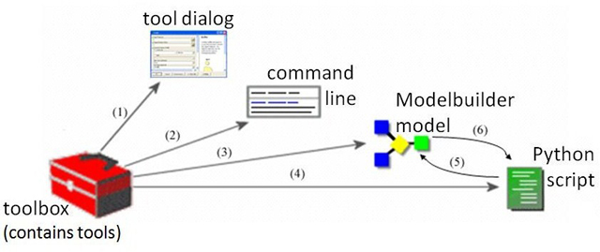
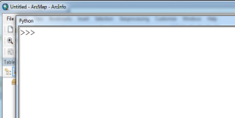
ESRI Geoprocessing
Multiple ways to conduct geoprocessing in ArcGIS
Python
Export models to scripts
Call scripts from models
Image modified from Prof. Piotr Jankowski at http://geography.sdsu.edu/People/Pages/jankowski/public_html/web683/lectures683.htm

Slide 4
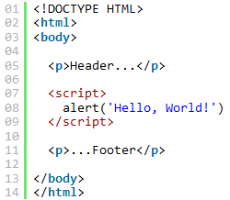


Why Use Python?
Good ‘starter language’
Automate tasks.
Batch processing.
Schedule processes.
Intuitive syntax.
Installed with ArcGIS 10.x and examples are given.
Coverity report:
  http://wpcme.coverity.com/wp-content/uploads/2013-Coverity-Scan-Spotlight-Python.pdf
JavaScript Python

Slide 5
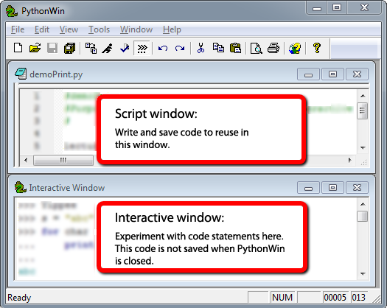
Where to write code?
Any text editor or the ArcGIS Python Window; However, IDE’s have more.
Integrated development environment (IDE)
    Interactive.
    Write/save/run scripts.
    Color coding
    Tab completion
    Syntax checking
    Debugging
Python IDEs:
  PythonWin & PyScripter (for Windows OS)
  Wingware (for Linux/Mac OS)
  iPythonNotebook (online IDE)

Slide 6
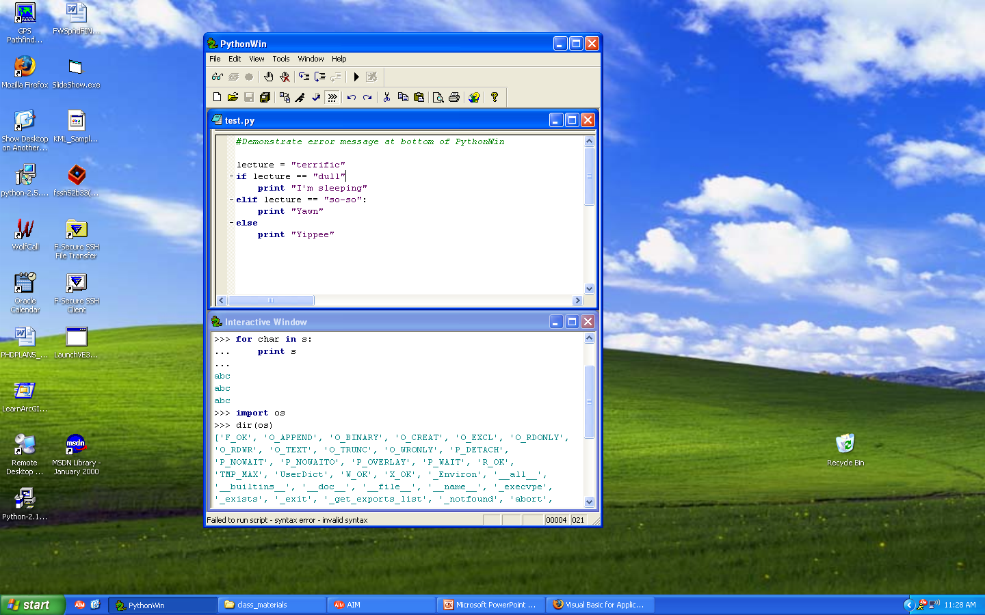
PythonWin Interface
Menus
Toolbars
debugging, standard
Script window
  Write and save code
  (permanent)
Interactive window
  Test lines of code
  Report messages
  (temporary)
Feedback
Syntax error or success

Slide 7
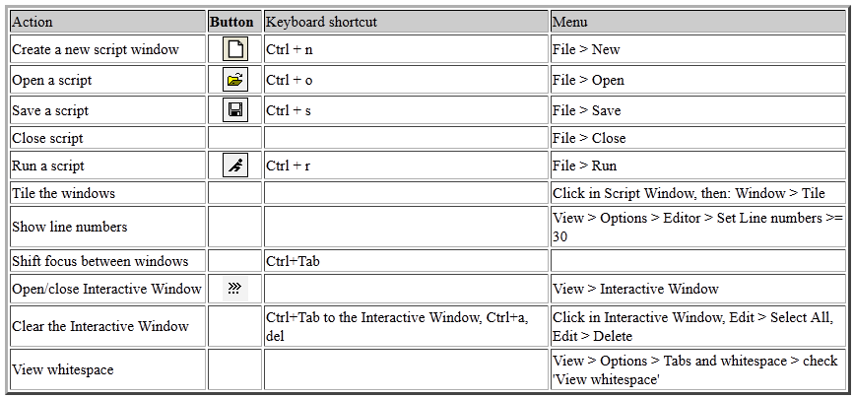
PythonWin standard toolbar
Standard toolbar

Slide 8
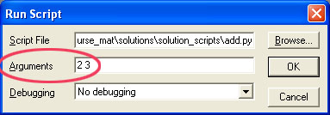
‘add.py’ example, line by line
# add.py adds two input numbers.
import sys
a = int(sys.argv[1])
b = int(sys.argv[2])
c = a + b
print “The sum is”, c
Concepts:
# means what follows on that line is a comment just for human readers
import sys (lets you use things from the sys module)
variables (a and b are variables; they are assigned values with “=“ )
sys.argv (argument vector; the list of things you send in when you run it)
int (converts a string to an integer)
print

Slide 9
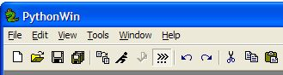
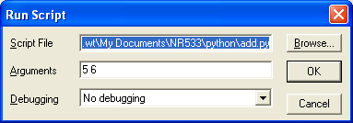
In-class: Run add.py in PythonWin
Open the program add.py
Run the program or Ctrl+R
Pass arguments (with space between arguments)
Uncomment the bottom
Output:
The sum is 11
Output:
The sum is 11
sys.argv[1] + sys.argv[2] = 56 WHY?
sys.argv[0] = C:\<my directory path>\add.py
sys.argv[1] = 5
sys.argv[2] = 6
Select and click (Alt + 4)
Run again.

Slide 10
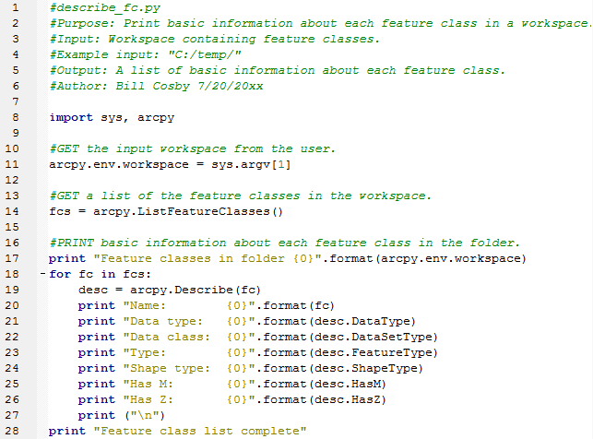
What do you see?

Slide 11
Python components
Variables
Comments
Keywords
Modules
Indentation
Objects
Functions
Built-ins
Assignment statements
Data structures
Syntax highlighting:
text color/font based on code features

Slide 12
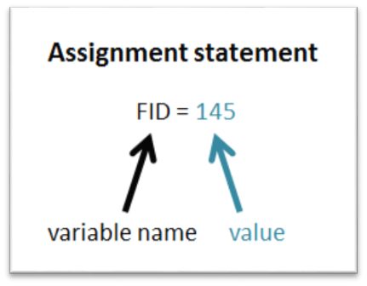
Basic building blocks
Variable is a name that represents a value:
    Is bound to a value.
    Value is not stored in variable; Variable just refers to (points to) a value stored somewhere in memory.
Expression is a value (number or string)
    Examples: 2+2
    ‘My string’
Statement is an instruction (does something or changes something)
    Examples: print “Hello world”
    FID = 145
Assignment statement sets the value of a variable.

Slide 13
Commenting code
# conditional_addfield.py
# Purpose: Add a field, if it does not already exist.
# Usage: field_name
# Example input: “bridges”
# Output: A shapefile with the new field added, if it didn’t already exist.
# Author: Donald Duck 8/22/2065
# Modified: Silvester 3/06/2080 to run in PythonWin
# GET input field name
# SET field name to input field name
# IF field exists THEN
#Reset values to zero
# ELSE
# CALL add field
# ENDIF
Header
(documentation
comments)
Body
(explanatory
comments)

Slide 14
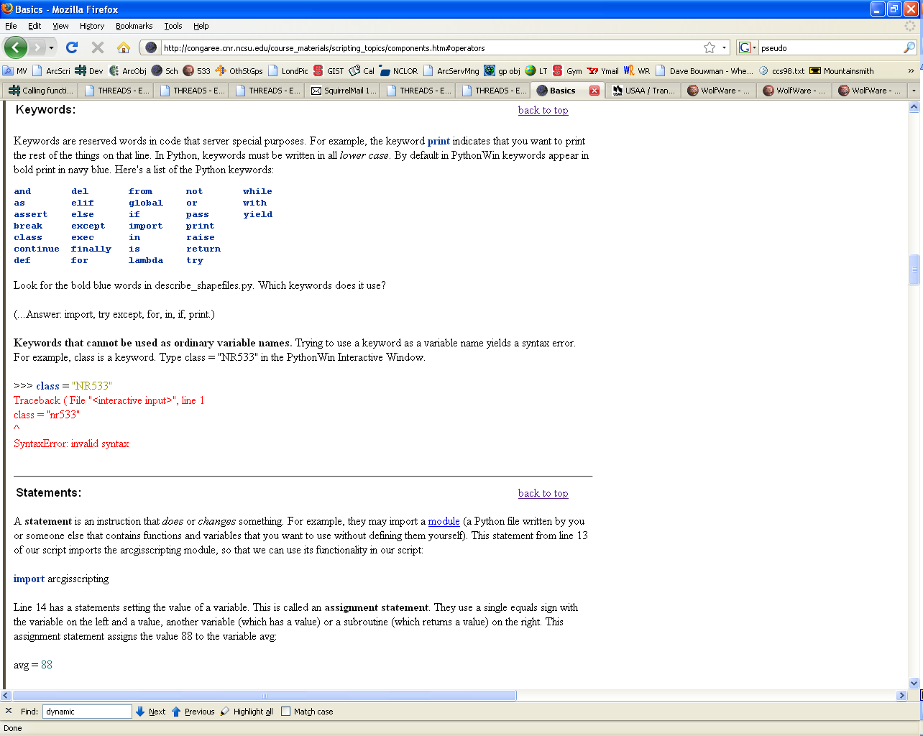
Python Keywords
have special meaning in Python
may not be used as variable names:
>>> exec = “python.exe"
Traceback ( File "<interactive input>", line 1
exec = “python.exe"
^
SyntaxError: invalid syntax
case sensitive, so use if not IF or If

Slide 15



Standard modules
A Python module is a set of related code.
Python has a set of standard modules automatically installed.
Examples: math, os, sys, shutils, winsound, time
Import a module to use the functions & variables (properties) it contains.
Import statements use keyword import followed by 1 or more module name.
  import sys, os, arcpy
After import, use dot notation to utilize module functions and properties.
  moduleName.functionName(argument1, argument2, …)
  Examples:
  ‘radians’ is a ‘math’ module function:
  ‘argv’ is a ‘sys’ module property:
  ‘listdir’ is an ‘os’ module function:

Slide 16
Variable naming rules & conventions
Variables are case sensitive
  freeways = “Freeways.shp”
  Freeways = 20000
Avoid special characters in names ( / \ & % # ! , . ; : and so forth)
Names can not start with numbers
Case conventions
  First word lower case, capitalize each successive word
  (Lower camel case)
  tableFieldName = “Street”
  Acronym at the beginning, use lower case letters
  gdbPath = “C:\\testerData.mdb”
  Acronym in the middle or at the end, use upper case letters
  inputFC = “streets.shp”
When practical, use descriptive variable names
  sa = s * s
  squareArea = side * side
hypothenuse = math.sqrt(adjacent**2 + opposite**2)
r = math.sqrt(dx**2 + dy**2)
Notes:
DEMO1: VARIABLES TYPING & USER INPUT ************************************
>>> var = "string"
>>> type(var)
<type 'str'>
>>> var = 1
>>> type(var)
<type 'int'>
>>> var = 1.0
>>> type(var) <type 'float'>

Slide 17
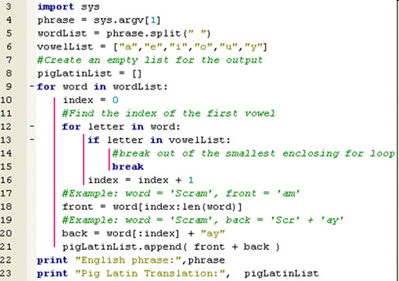


Indentation
Block of code: related code inside of a control structure
  Examples: FOR block, IF block, WHILE block
  Code inside a block is indented to the same level
View > whitespace
Notes:
GET tree inventory dataset
GET list of spread sheets
FOR each spread sheet in the list
FOR EACH tree record in the current spread sheet
IF tree record is not in the database THEN
ADD tree record to the database
END IF
END FOR
END FOR

Slide 18
Python Objects
Everything in Python is an Object
Each object has:
  A value data item represented by an object
  An Identity unique identifier, similar to a memory address
  A Type specifies what kind of values an object can hold and which operations are allowed
>>> river = "Arno“
>>> river
'Arno‘
>>> id(river)
15446688
>>> type(river)
<type 'str'>
>>> river = 96
>>> type(river)
<type ‘int’>
Dynamically typed variables
Notes:
-----------------------------------------------------------
DEMO5: EVERYTHING IS AN OBJECT
******************************
>>> strg ="A String of Words"
>>> id(strg)
1075848016
>>> type(strg)
<type ’str’>
>>> strg
’A String of Words’
-----------------------------------------------------------
>>> # identity
>>> x = y = [1,2,3]
>>> x is y
True
>>> y is x
True
>>> z = [1,2,3]
>>> z is x
False
>>> z == x
True

Slide 19
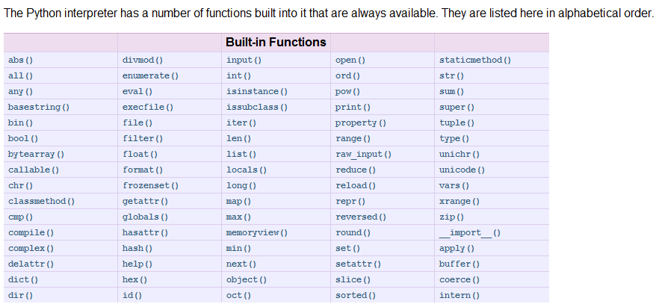
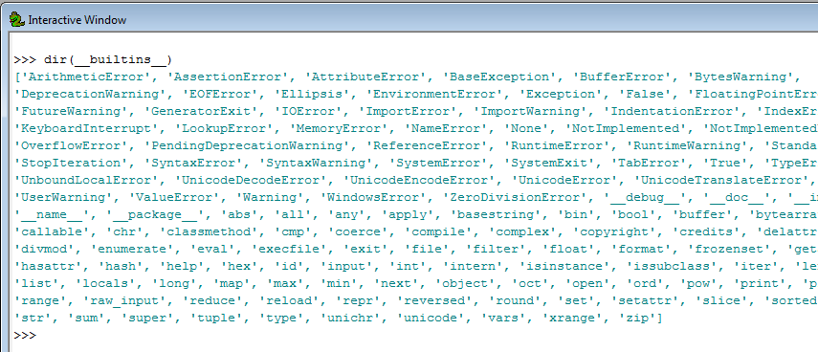
Python built-in Functions
Don’t use built-ins
as variable names!

Slide 20
Functions
  >>> round(1.7) >>> min(1, 2, 3)
  2.0 1
function – a named set of code that performs a task
Examples: round, min, help, int, print…
built-in function – a function supplied by Python
Examples: type, id, round, min, help, int, print…
function call -- a code statement that invokes a function
  For example, we called the round function, then we called the min function.
Passing arguments -- providing input for a function
  Example: 1.7 is passed into the round function
Return value – information returned from a function
e.g., the round function returned a 2; the min function returned a 1.
But the help function doesn’t return anything. It just prints something.

Slide 21
The help function
shows how the function can be used
prints a template (a signature)
the arrow points to what it gives you as a return value
>>> help(round)
Help on built-in function round in module __builtin__:
round(...)
round(number[, ndigits]) -> floating point number
>>> help(min)
Help on built-in function min in module __builtin__:
min(...)
min(iterable[, key=func]) -> value
min(a, b, c, ...[, key=func]) -> value
With a single iterable argument, return its smallest item. With two or more arguments, return the smallest argument.

Slide 22
Parameter vs. argument
the built-in help function prints a template (a signature).
the signature lists the parameters
parameter – piece of info. passed in to a function
>>> help(round)
Help on built-in function round in module __builtin__:
round(...)
round(number[, ndigits]) -> floating point number
argument -- the expression being passed into the function
  >>> round(1.7) >>> min(1, 2, 3)
returned by the function
signature
parameters
argument
arguments

Slide 23
Built-in constants
  Values assigned as soon as Python is launched
  Examples: True, False, None
>>> type(True)
<type 'bool'>
>>> True
True
Geoprocessing example:
>>> import arcpy
>>> arcpy.env.overwriteOutput = True

Slide 24
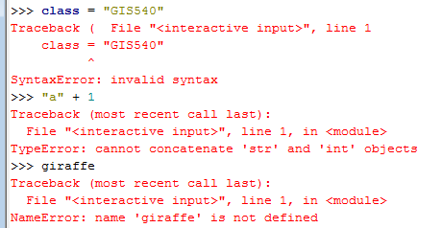
Built-ins exceptions
  Exceptions: common errors that Python can identify automatically.
  An exception is thrown when one of these errors is detected.
  A traceback message is generated and printed in the Interactive Window
  The ‘bad’ script will stop running when an exception is printed.
  Examples: SyntaxError, TypeError, NameError

Slide 25
In class: tryMe
learn how to execute single lines of Python code interactively
call functions
throw exceptions
type each code statement one at a time in the interactive window
before running each statement, predict the results
select the return (or enter) to run each line of code
how accurate were your predictions?

Slide 26
‘tryMe’ take home lessons
Variable names are case-sensitive.
Python dynamically changes the data type when you assign values to a variable.
Don’t use keywords or built-ins as variable names!
>>> type(min)
<type 'builtin_function_or_method'>
>>> min(1, 2, 3)
1
>>> min = 5
>>> min(1, 2, 3)
Traceback (most recent call last):
File "<interactive input>", line 1, in <module>
TypeError: 'int' object is not callable
>>> type(min)
<type 'int'>

Slide 27
Summing up
Topics discussed
    Why use Python
    Integrated development environments (IDEs)
    Passing arguments into scripts
    Basic Python code components: naming & initializing variables, comments, keywords, modules, indentation, objects, functions, built-ins functions, constants, exceptions, assignment statements, data structures
Up next
    Data structures: integers, floats, strings, lists, tuples…
Additional topics (see Appendix)
    how to install PythonWin
    exporting scripts from Modelbuilder

Slide 28
Appendix

Slide 29
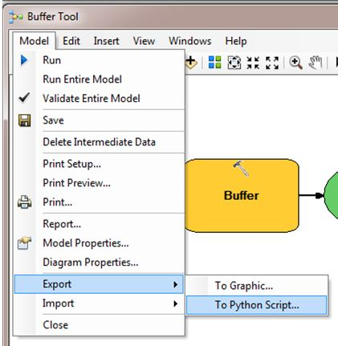
Extra exercise – Exporting a module
ModelBuilder models can be exported to Python scripts.
Right click on Model >
Model menu > Export > To Python Script…
Run the script in PythonWin
with 700 ft
Arguments: “700 feet”
Look at the feedback bar!
Check for the buffer output

Slide 30
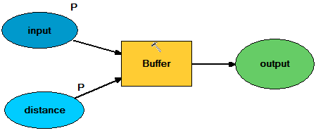
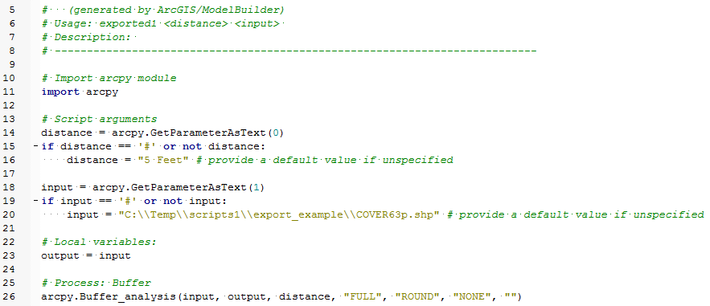
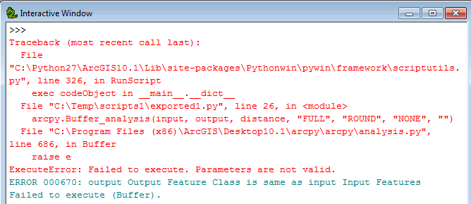
Export from original model
exported1.py
Line 23 sets the output name to be the same as the input name!

Slide 31
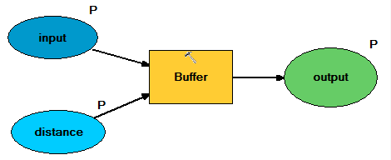
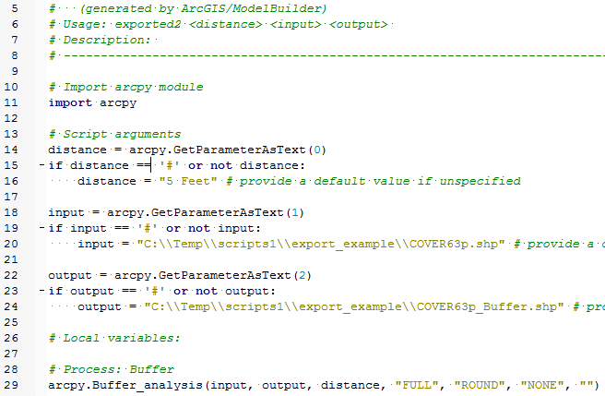

Export from modified model
exported2.py
It runs successfully once, but throws an expection the second time!
Once the output has been created, it won’t overwrite it, unless told to do so as follows:
arcpy.overwriteOutput = True
‘Exporting a model’ exercise take home message: Yes, you can export them, but you still need to know what you’re doing with Python.

