Slide 1
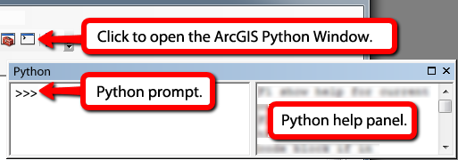
Warm up exercise
“Simple buffer” goals:
  Get immediate feedback from Python
  Run a Python geoprocessing statement
  Understand the connection between Python code and ArcGIS tools.
Notes:
Answer to question in the last step of ‘Simple buffer’
File path (C:/Temp/data1 vs C:/Temp)
Output file name (COVER63p_buffer.shp vs buffered_COVER63p.shp)
Buffer distance (.25 mi vs 5 mi)
Dissolve type (Round vs none)

Slide 2



GIS PROGRAMMING FUNDAMENTALS (WITH PYTHON)
Instructor Teaching assistants
Dr. Laura Tateosian Matt Dusch Reza Amindarbari

Slide 3
Course topic
GIS programming (through the use of the Python programming language)
  General programming concepts, as well as Python syntax and Python language elements for programming ArcGIS.
  Processing/analyzing data, performing batch processing and manipulating map elements.
  ESRI script tools to create graphical user interfaces.

Slide 4
Course Website
courses.ncsu.edu/gis540
Links:
  Homepage
  Message board
  Gradebook
  Submissions
No textbook --instead there are assigned readings linked to the schedule

Slide 5
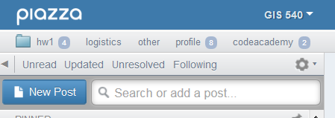
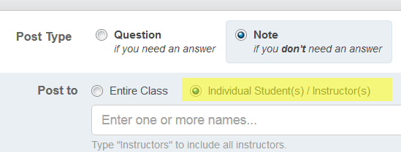
Message board
piazza.com
Post To: public or private
Post Type: question or note

Slide 6
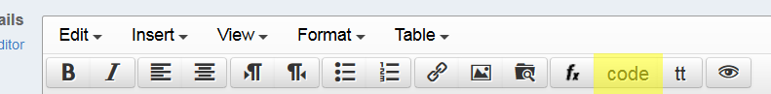
Posting questions on forums
Make questions as specific and focused on one particular problem.
Post the error message and what you’re trying to do.
Use the section title where the homework question comes from.
Use the ‘code’ button to post code.
No ‘flaming’.

Slide 7
Grading
Two midterm exams (30% each)
Project (25%)
Homework (15%)
Homework late policy:
  penalty =10*2^{(r-1)}% where r is the number of 24-hour periods late
  Submit late work in the MISC folder and post a private message to inform us.
Homework submissions
  Deadlines are given in EST
  Scripts should be named as specified.
  Put your unityID and name in each script.
  Don’t zip submissions.

Slide 8
Grade changes
Check your grades and comments.
Grade change requests must be submitted within one week of being returned.
Submit grade change requests via private (to instructors) note on Piazza. Be sure to provide the assignment number and question name and briefly explain the issue.

Slide 9
Academic integrity
Material challenging -> utilize teaching staff help. Otherwise, homework assignments must be completed alone.
University policy is strict. Read the NCSU policy overview and Sections 8 and 9 of the Code of Student Conduct.
Building fundamental skills in this class. Group work not allowed unless specified.
Study groups can discuss code from in-class exercises, slides, and assigned reading, but not from homework.

Slide 10
Academic integrity policy cont’d.
Not allowed:
  Copying.
  Talking someone through the solution.
If you need more help go to office hours, Skype with TAs, or use private posts on the message board.
Otherwise, the work you submit for homework must be entirely your own.

Slide 11
Course schedule
1st Quarter
Intro to Python basics, PythonWin development environment, data structures, ArcGIS API, decision making, looping
2nd Quarter
Batch processing, debugging, error handling, functions, cursors
3rd Quarter
Dictionaries, reading and writing text files, file GUI’s, modules, classes, Reading
and writing HTML and KML
4th Quarter
Mapping with Python, script tools, additional modules, project work

Slide 12
Topic outline
Introduction
Where to write code
Input to scripts
Basic Python code components

Slide 13
Course learning outcomes
Students will be able to…
  interpret basic Python syntax (indentation, context highlighting)
  write Python scripts in an integrated development environment (PythonWin)
  use Python to construct code using core data structures (strings, lists, …)
  call ArcGIS tools with Python (arcpy.buffer…)
  handle contingencies within Python (if, else…)
  construct basic batch processing Python code (looping)
  do more…

Slide 14
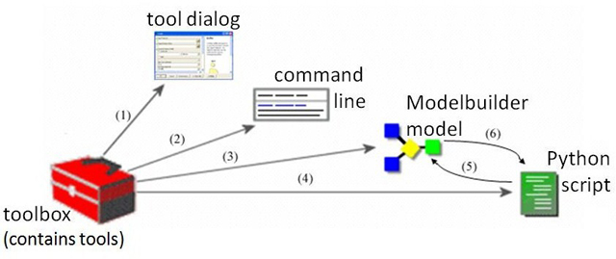
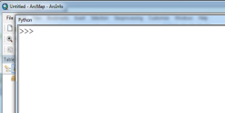
ESRI Geoprocessing
Multiple ways to conduct geoprocessing in ArcGIS
Python
Export models to scripts
Call scripts from models
Image modified from Prof. Piotr Jankowski at http://geography.sdsu.edu/People/Pages/jankowski/public_html/web683/lectures683.htm

Slide 15
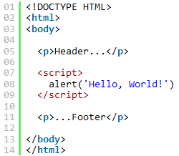


Why Use Python?
Good ‘starter language’
Automate tasks.
Batch processing.
Schedule processes.
Intuitive syntax.
Installed with ArcGIS 10.x and examples are given.
Coverity report:
  http://wpcme.coverity.com/wp-content/uploads/2013-Coverity-Scan-Spotlight-Python.pdf
JavaScript Python

Slide 16
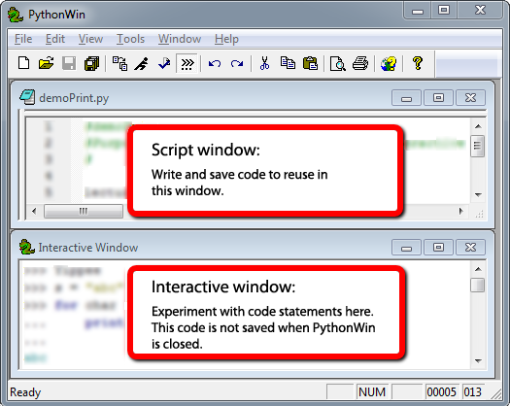
Where to write code?
Any text editor or the ArcGIS Python Window; However, IDE’s have more.
Integrated development environment (IDE)
    Interactive.
    Write/save/run scripts.
    Color coding
    Tab completion
    Syntax checking
    Debugging
  Python IDEs:
  PythonWin & PyScripter (for Windows OS)
  Wingware (for Linux/Mac OS)
  iPythonNotebook (online IDE)

Slide 17
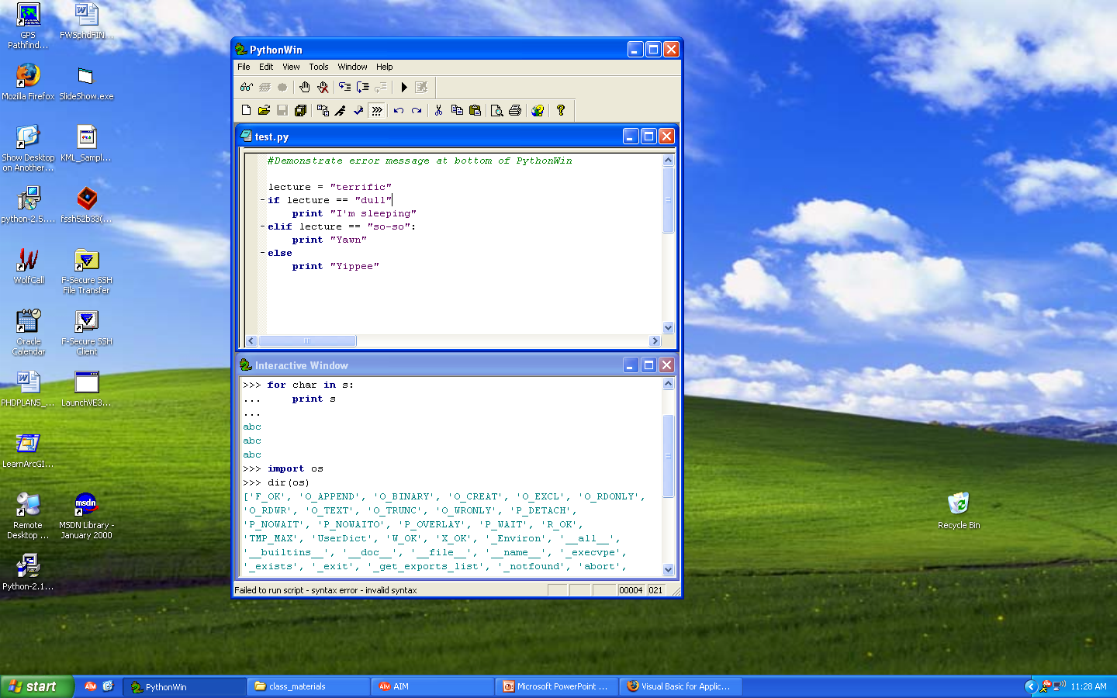
PythonWin Interface
Menus
Toolbars
debugging, standard
Script window
  Write and save code
  (permanent)
Interactive window
  Test lines of code
  Report messages
  (temporary)
Feedback
Syntax error or success

Slide 18

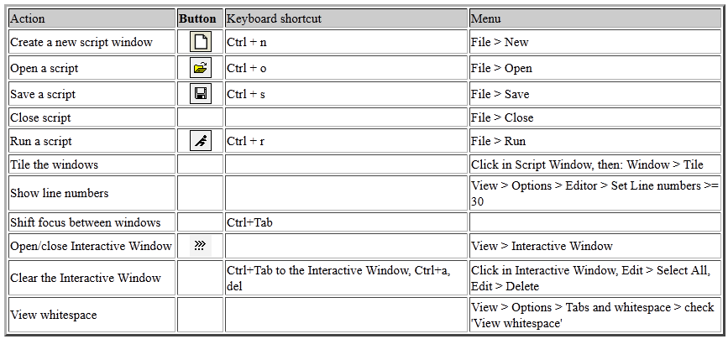
PythonWin standard toolbar
Standard toolbar

Slide 19
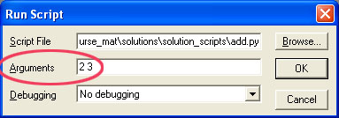
‘add.py’ example, line by line
# add.py adds two numbers given as arguments
import sys
a = int(sys.argv[1])
b = int(sys.argv[2])
c = a + b
print “The sum is”, c
Concepts:
# means what follows on that line is a comment just for human readers
import sys (lets you use things from the sys module)
variables (a and b are variables; they are assigned values with “=“ )
sys.argv (argument vector; the list of things you send in when you run it)
int (converts a string to an integer)
print

Slide 20
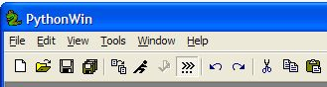
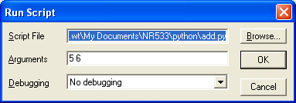
Exercise: Run add.py in PythonWin
Open the program add.py
Run the program or Ctrl+R
Pass arguments (with space between arguments)
Uncomment the bottom
Output:
The sum is 11
Output:
The sum is 11
sys.argv[1] + sys.argv[2] = 56 WHY?
sys.argv[0] = C:\<my directory path>\add.py
sys.argv[1] = 5
sys.argv[2] = 6
Select and click (Alt + 4)
Run again.

Slide 21
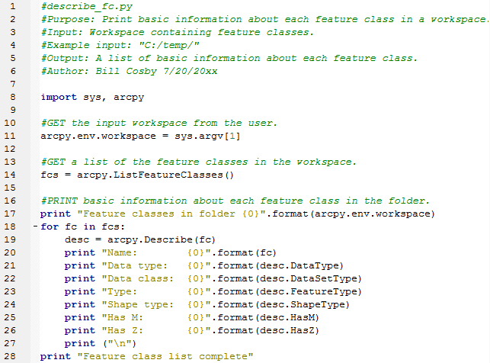
What do you see?

Slide 22
Python components
Variables
Comments
Keywords
Modules
Indentation
Objects
Functions
Built-ins
Assignment statements
Data structures
Syntax highlighting:
text color/font based on code features

Slide 23
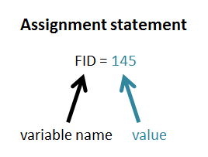
Basic building blocks
Variable is a name that represents a value:
    Is bound to a value.
    Value is not stored in variable; Variable just refers to (points to) a value stored somewhere in memory.
Expression is a value (number or string)
    Examples: 2+2
    ‘My string’
Statement is an instruction (does something or changes something)
    Examples: print “Hello world”
    FID = 145
Assignment statement sets the value of a variable.

Slide 24
Commenting code
#conditional_addfield.py
#Purpose: Add a field, if it does not already exist.
#Input: field name
#Example input: “bridges”
#Output: A shapefile with the new field added, if it didn’t already exist.
#Author: Dan Patterson 8/22/xxxx
#Modified: Bill Cosby 3/06/xxxx to run in PythonWin
#GET input field name
#SET field name to input field name
#IF field exists THEN
#do nothing
#ELSE
#CALL add field
#ENDIF
Header
(documentation
comments)
Body
(explanatory
comments)

Slide 25
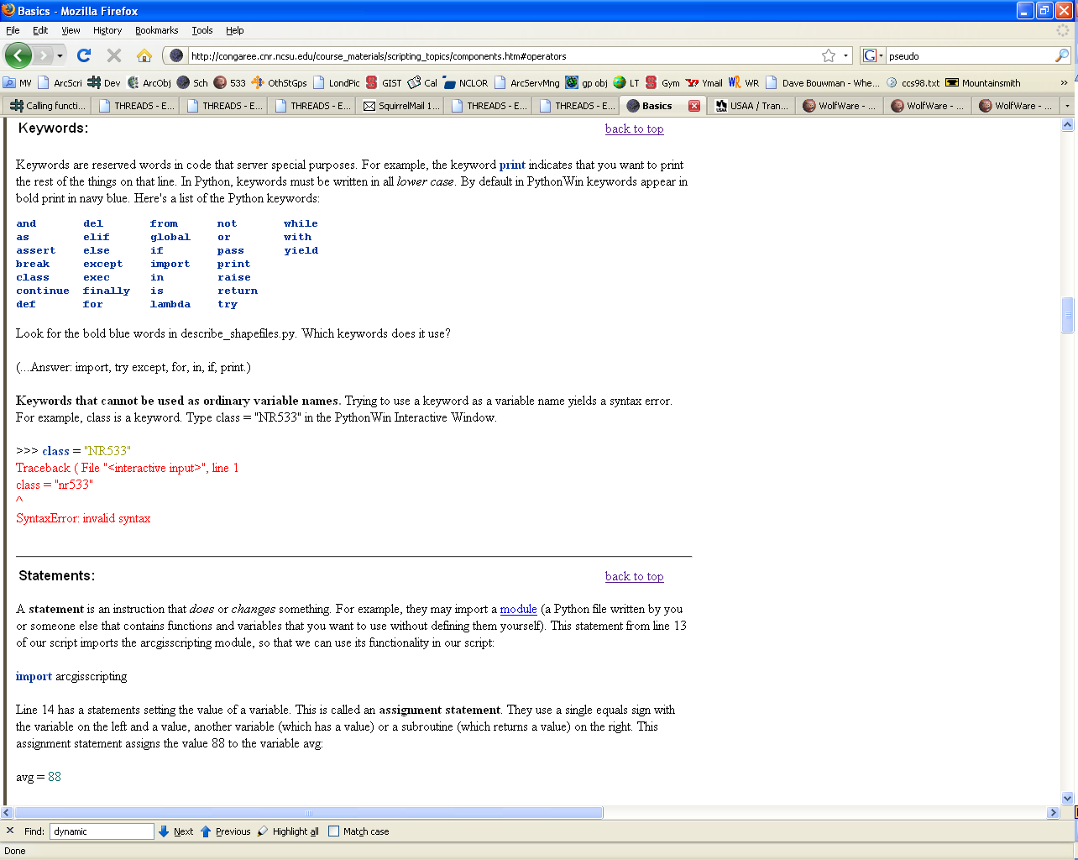
Python Keywords
Complete list of Python keywords:
Keywords may not be used as variable names:
>>> exec = “python.exe"
Traceback ( File "<interactive input>", line 1
exec = “python.exe"
^
SyntaxError: invalid syntax
Keywords are case sensitive, so use if not IF If

Slide 26



Standard modules
A Python module is a set of related code.
Python has a set of standard modules automatically installed.
Examples: math, os, sys, shutils, winsound, time
Import a module to use the functions & variables (properties) it contains.
Import statements use keyword import followed by 1 or more module name.
  import sys, os, arcpy
After import, use dot notation to utilize module functions and properties.
  moduleName.functionName(argument1, argument2, …)
  Examples:
  ‘radians’ is a ‘math’ module function:
  ‘argv’ is a ‘sys’ module property:
  ‘listdir’ is an ‘os’ module function:

Slide 27

Variable naming rules & conventions
Variables are case sensitive
  fc = “Freeways.shp”
  Fc = 20000
Avoid special characters like ( / \ & % # ! and so forth … )
Case conventions
  - First word lower case, capitalize each successive word
  (Lower camel case)
  tableFieldName = “Street”
  - Acronym at the beginning, use lower case letters
  gdbPath = “C:\\testerData.mdb”
  - Acronym in the middle or at the end, use upper case letters
  inputFC = “streets.shp”
When practical, use descriptive variable names
  sa = s * s
  squareArea = side * side
hypothenuse = math.sqrt(adjacent**2 + opposite**2)
r = math.sqrt(dx**2 + dy**2)
Notes:
DEMO1: VARIABLES TYPING & USER INPUT ************************************
>>> var = "string"
>>> type(var)
<type 'str'>
>>> var = 1
>>> type(var)
<type 'int'>
>>> var = 1.0
>>> type(var) <type 'float'>

Slide 28
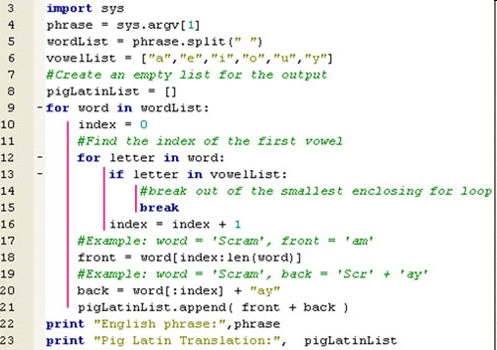


Indentation
GET tree inventory dataset
GET list of spread sheets
FOR each spread sheet in the list
FOR EACH tree record in the current spread sheet
IF tree record is not in the database THEN
ADD tree record to the database
END IF
END FOR
END FOR
Block of code: related code inside of a control structure
  Examples: FOR block, IF block, WHILE block
  Code inside a block is indented to the same level
View > whitespace

Slide 29
Python Objects
Everything in Python is an Object
Each object has:
  A value data item represented by an object
  An Identity unique identifier, similar to a memory address
  A Type specifies what kind of values an object can hold and which operations are allowed
>>> river = "Arno“
>>> river
'Arno‘
>>> id(river)
15446688
>>> type(river)
<type 'str'>
>>> river = 96
>>> type(river)
<type ‘int’>
Dynamicly typed variables
Notes:
-----------------------------------------------------------
DEMO5: EVERYTHING IS AN OBJECT
******************************
>>> strg ="A String of Words"
>>> id(strg)
1075848016
>>> type(strg)
<type ’str’>
>>> strg
’A String of Words’
-----------------------------------------------------------
>>> # identity
>>> x = y = [1,2,3]
>>> x is y
True
>>> y is x
True
>>> z = [1,2,3]
>>> z is x
False
>>> z == x
True

Slide 30
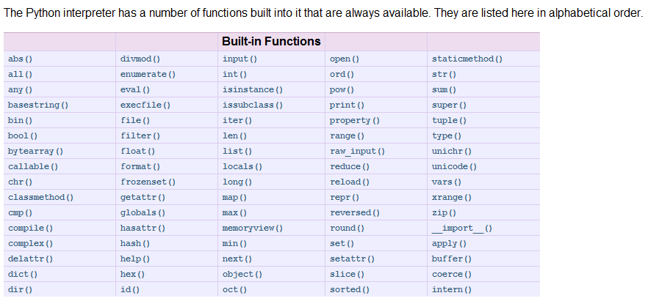
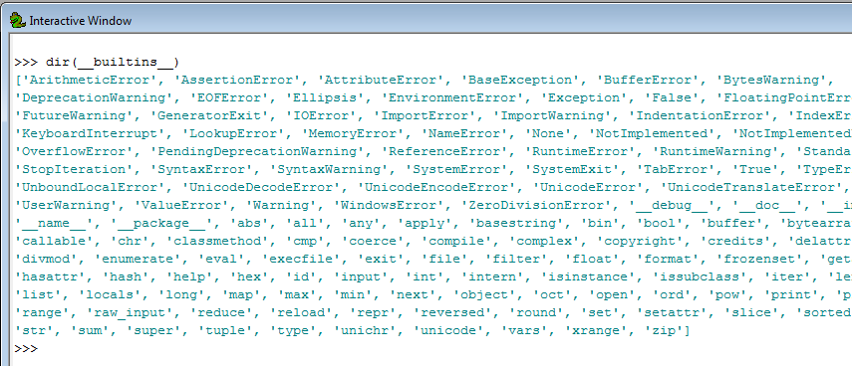
Python built-in Functions
Don’t use built-ins
as variable names!

Slide 31
Functions and related terms
  >>> round(1.7) >>> min(1, 2, 3)
  2.0 1
function – a named set of code that performs a task
Examples: round, min, help, int, print…
  built-in function – a function supplied by Python
  Examples: type, id, round, min, help, int, print…
function call -- A code statement that invokes a function
  For example, we called the ‘round’ function, then we called the ‘min’ function.
Passing arguments -- providing input for a function
  Example: 1.7 is passed into the round function
Return value – information returned from a function
e.g., the round function returned a 2; the min function returned a 1.
But the help function doesn’t return anything. It just prints something.

Slide 32
The ‘help’ function
The built-in ‘help’ function prints a template (a signature).
>>> help(round)
Help on built-in function round in module __builtin__:
round(...)
round(number[, ndigits]) -> floating point number
>>> help(min)
Help on built-in function min in module __builtin__:
min(...)
min(iterable[, key=func]) -> value
min(a, b, c, ...[, key=func]) -> value
With a single iterable argument, return its smallest item. With two or more arguments, return the smallest argument.

Slide 33
Parameter vs. argument
The built-in ‘help’ function prints a template (a signature).
The signature lists the parameters
  parameter – piece of info. passed in to a function
  …
  …
>>> help(round)
Help on built-in function round in module __builtin__:
round(...)
round(number[, ndigits]) -> floating point number
argument -- the expression being passed into the function
  >>> round(1.7) >>> min(1, 2, 3)
returned by the function
signature
parameters
argument
arguments

Slide 34
Built-in constants
  Values assigned as soon as Python is launched
  Examples: True, False, None
>>> type(True)
<type 'bool'>
>>> True
True
Geoprocessing example:
>>> import arcpy
>>> arcpy.env.overwriteOutput = True

Slide 35
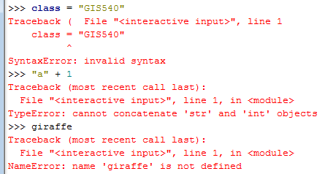
Built-ins exceptions
  Exceptions: common errors that Python can identify automatically.
  An exception is thrown when one of these errors is detected.
  A traceback message is generated and printed in the Interactive Window
  The ‘bad’ script will stop running when an exception is printed.
  Examples: SyntaxError, TypeError, NameError

Slide 36
Exercise: ‘Try me’
Download tryMe.rtf from the “In class” page.
tryMe.rtf contains code statements.
They use built-in functions
…and some generate built-in exceptions.
Type each code statement in the Interactive Window, one at a time and explain the results using the Python terms defined on these slides.
Before running each statement, predict the results.

Slide 37
‘tryMe’ take home lessons
Variable names are case-sensitive.
Python dynamically changes the data type when you assign values to a variable.
Don’t use keywords or built-ins as variable names!
>>> type(min)
<type 'builtin_function_or_method'>
>>> min(1, 2, 3)
1
>>> min = 5
>>> min(1, 2, 3)
Traceback (most recent call last):
File "<interactive input>", line 1, in <module>
TypeError: 'int' object is not callable
>>> type(min)
<type 'int'>

Slide 38
Summing up
Topics discussed
    Why use Python
    Integrated development environments (IDEs)
    Passing arguments into scripts
    Basic Python code components: naming & initializing variables, comments, keywords, modules, indentation, objects, functions, built-ins functions, constants, exceptions, assignment statements, data structures
Up next
    Data structures: integers, floats, strings, lists, tuples…
Additional topics (see Appendix)
    how to install PythonWin
    exporting scripts from Modelbuilder

Slide 39
Appendix

Slide 40
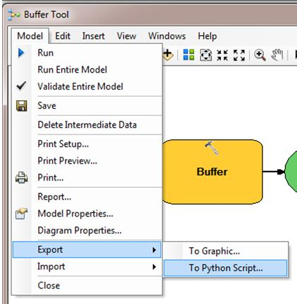
Exercise – Exporting a module
ModelBuilder models can be exported to Python scripts.
Right click on Model >
Model menu > Export > To Python Script…
Run the script in PythonWin
with 700 ft
Arguments: “700 feet”
Look at the feedback bar!
Check for the buffer output

Slide 41
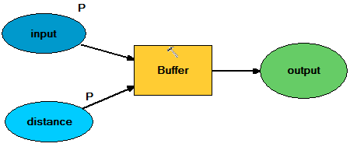
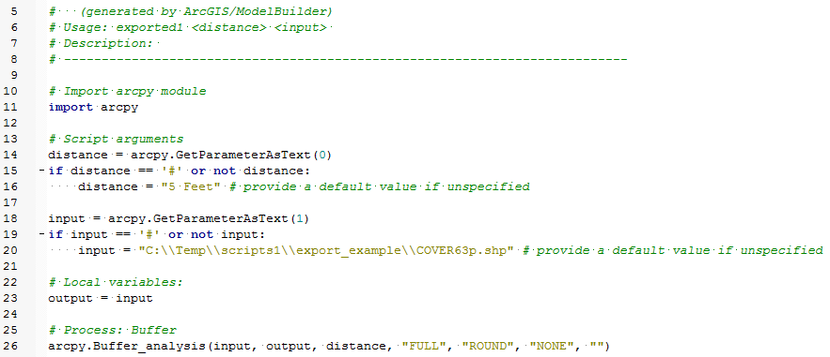
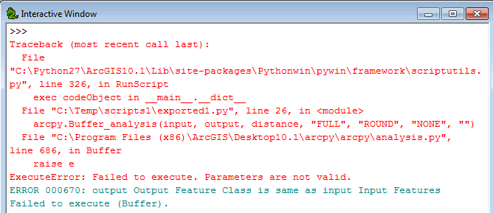
Export from original model
exported1.py
Line 23 sets the output name to be the same as the input name!

Slide 42
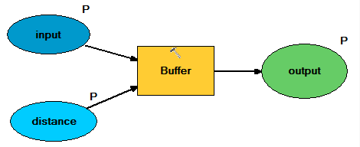
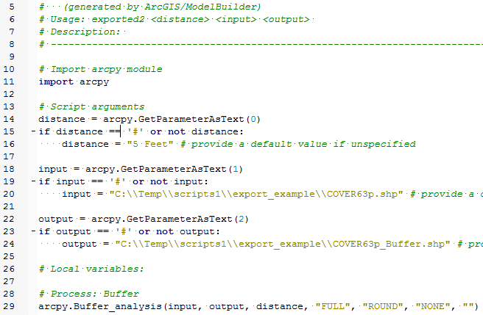

Export from modified model
exported2.py
It runs successfully once, but throws an expection the second time!
Once the output has been created, it won’t overwrite it, unless told to do so as follows:
arcpy.overwriteOutput = True
‘Exporting a model’ exercise take home message: Yes, you can export them, but you still need to know what you’re doing with Python.

Slide 43
Software you need to install
  ArcGIS 10.1
  PythonWin for Python 2.7
    Python 2.7 is automatically installed with ArcGIS 10.1
    PythonWin is not.
  Test if Pythonwin is installed correctly
    Type this at the prompt in the PythonWin Interactive Window:
      import arcpy
    If you don’t get an error message, you’ve got it.
  Pyscripter is another easy to install and use IDE has some advantages over PythonWin (e.g., tabbed script windows and immediate tab completion) but has a slightly sharper learning curve than PythonWin

Slide 44
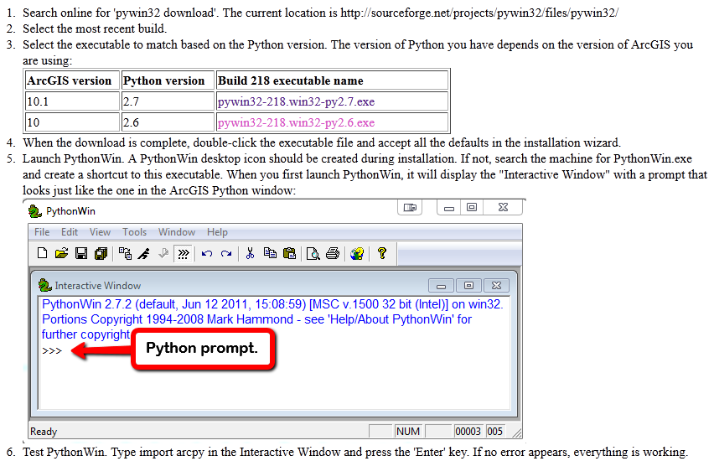
Install PythonWin

