Slide 1

More looping
Laura Tateosian

Slide 2

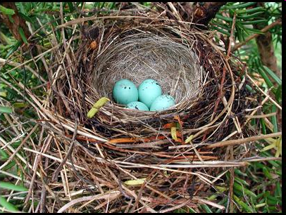

Topics
Loop-ish shortcuts
  - string join
  - list comprehension
Nested looping concepts
Built-in iteration functions
  - enumerate
  - zip
os.walk

Slide 3
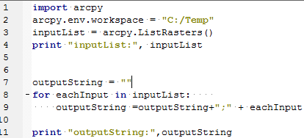


Use ‘join’ to avoid the loop
Problem: need to collect string names in a semicolon delimited string. One solution:
Better solution: String join method
Predict the value of mystring:
To get a delimited string from a list, use the string ‘join’ method.
Notes:
'1bla2bla3'

Slide 4
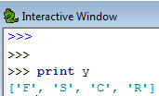

Create a list based on another list
Example situations:
  Get a list of field names from a list of field objects
  Replace all of the hyphens with underscores in a list of strings
Example: Make a list, B, of the first initials of each item in A
A = ['FID', 'Shape', 'COVER', 'RECNO']
B = [ ]
for item in A:
temp = item[0]
B.append(temp)
Approach:
  1. make a new empty list, B
2. loop through list A
3. make new value from current value in A
4. append new value to list B

Slide 5
In class: Generate a list from a list
Example: Make a list, y, of the first initials of each item in x
x = ['FID', 'Shape', 'COVER', 'RECNO']
y = [ ]
for i in x:
temp = i[0]
y.append(temp)
print y
Make a list, z, of the length of each string in x
z = [ ]
for i in x:
temp = len(i)
z.append(temp)
print z

Slide 6

Python list comprehension
com·pre·hen·sion 1: the act of grasping with the intellect 2: the act or process of comprising (being made up of)
concise way to generate a list out of another list.
1 line alternative to looping for this purpose
Syntax: [ expression for var in originalList ]
Example: Make a list, y, of all caps string of each item in x.
x = ['FID', 'Shape', 'COVER', 'RECNO']
#for loop technique
y = [ ]
for i in x:
temp = i.upper()
y.append(temp)
# list comprehension
y = [ i.upper() for i in x ]
`
expression that uses x

Slide 7
In class - list comprehension
>>> x = ['FID', 'Shape', 'COVER', 'RECNO']
>>> y = [ i[:3] for i in x ]
['FID', 'Sha', 'COV', 'REC']
Make an all lowercase version of x
>>> y = [ i.lower() for i in x ]
>>> y
['fid', 'shape', 'cover', 'recno']
Make a list in which all C’s are replaced with D’s.
>>> y = [ i.replace("C","D") for i in x]
>>> y
['FID', 'Shape', 'DOVER', 'REDNO']

Slide 8
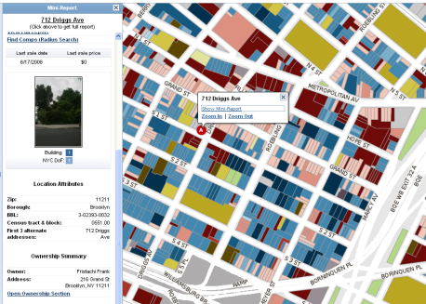
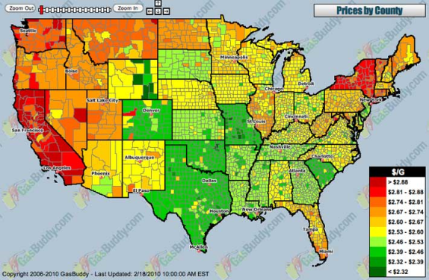
Nested looping Concepts
Example: Get the value of each building on each parcel of land.
Hierarchy: parcels contain buildings.
If there are n parcels: 1 list of parcels, n lists of buildings.
  Suppose the average number of buildings is m.
  How many values to calculate?
  Ans: n*m
Other examples:
  Find the area of each county in each state in each region.
  Read each line in each file in a directory.
  Count each word in each line in each file in each subdirectory in a directory.
  Read the name of each friend of each of your fb friends.
  Which of these examples has 4 layers of nesting?
Notes:
Find the area each county in each state in each region
Read each line in each file in a directory
Count each word in each line in each file in each subdirectory in a directory
Read the name of each friend of each of your fb friends
How many ‘layers’ of nesting in each example?
What hierarchical relationships exist?
3 layers (county, state, region) regions contain states, states contain counties
3 layers (line, file, directory) directories contain files, files contain lines.
4 layers (word, line, file, subdirectory) subdirectories contain files, files contain lines, lines contain words
2 layers (fiends, friends of friends) friends have their own friends lists.

Slide 9

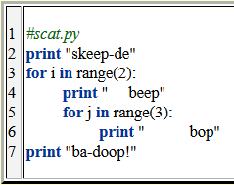
What will this script print?
Notes:
skeep-de
beep
bop
bop
bop
beep
bop
bop
bop
ba-doop!

Slide 10
Nested Looping Pseudocode
Each layer gets an indented for loop
Example 1: Update entire calender.
        FOR each month of the year
        FOR each week of the month
        FOR each day of the week
        write important events
        ENDFOR
        ENDFOR
        ENDFOR
Example 2: Print each row of each table in the current directory
        FOR each table in the directory
        FOR each row in the table
        PRINT the row
        ENDFOR
        ENDFOR

Slide 11
In class - Use a nested FOR loops to print: 10 11 12 20 21 22 30 31 32 40 41 42 50 51 52
0 1 2
10 20 30 40 50
for y in range(3):
print y,
for x in range(10, 60, 10):
print x,

Slide 12
In class - Use a nested FOR loops to print: 10 11 12 20 21 22 30 31 32 40 41 42 50 51 52
0 1 2
10 20 30 40 50
for x in range(10, 60, 10):
  for y in range(0, 3):
  print x + y,
for y in range(3):
print y,
for x in range(10, 60, 10):
print x,

Slide 13
In class – Modify this pseudocode to:
Print each value in each row of each table in the current directory
        FOR each table in the directory
        FOR each row in the table
        PRINT the row
        ENDFOR
        ENDFOR
        FOR each table in the directory
        FOR each row in the table
        FOR each value in the row
        PRINT the value
        ENDFOR
        ENDFOR
        ENDFOR

Slide 14
In class – write in pseudocode
For each shapefile in a directory, print the value of each field for each row of the shapefile
        FOR each shapefile in the directory
        FOR each row in the shapefile table
        FOR each field in the row
        PRINT the value
        ENDFOR
        ENDFOR
        ENDFOR
Notes:
import arcpy
arcpy.env.workspace = "C:/Temp"
myfc = arcpy.ListFeatureClasses()
for fc in myfc:
print fc
sc = arcpy.SearchCursor(fc)
fields = arcpy.ListFields(fc)
for row in sc:
if row.FID < 5: # only printing first few
for field in fields:
print " ", field.name, ":" , row.getValue(field.name)
print "\n"

Slide 15
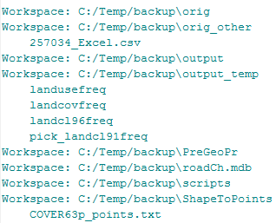
In class – Nested tables
For each table in each workspace in a directory, print the file name of the table.
        FOR each workspace in the directory
        FOR each table in the workspace
        PRINT the table name
        ENDFOR
        ENDFOR
Notes:
import arcpy
arcpy.env.workspace = "C:/Temp/backup"
ws = arcpy.ListWorkspaces("*", "Access")
for workspace in ws:
arcpy.env.workspace = workspace
rasters = arcpy.ListTables()
for r in rasters:
print r

Slide 16
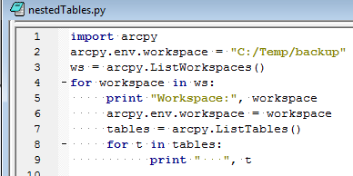
In class – nestedTables.py
For each table in each workspace in a directory, print the file name of the table.
        FOR each workspace in the directory
        FOR each table in the workspace
        PRINT the table name
        ENDFOR
        ENDFOR
Notes:
import arcpy
arcpy.env.workspace = "C:/Temp/backup"
ws = arcpy.ListWorkspaces("*", "Access")
for workspace in ws:
arcpy.env.workspace = workspace
rasters = arcpy.ListTables()
for r in rasters:
print r

Slide 17
In class – lineLength.py
  Some rules of thumb in good programming practice
    Procedures should be no longer than 75 lines of code (see without scrolling)
    Code should have no more than 5 levels of indentation (such as nested looping)
    No single line of code should exceed 80 chars. – easier for human reading capability and allows reader to have multiple windows open simultaneously
  Task: Check the length of each line in each Python file in a directory and each of its subdirectory in a directory
  What lists are involved? How many levels of nesting?
    List of lines
    List of Python files
    List of subdirectories

Slide 18
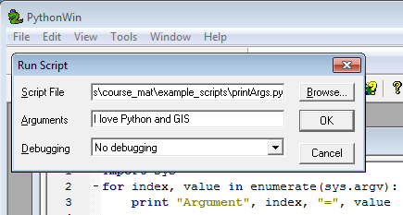
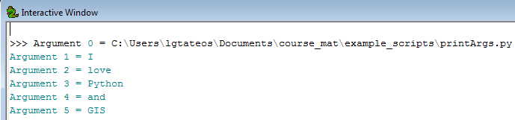
enumerate (refresher)
built-in function
for looping through sequences (strings, lists,…)
returns an iterator with 2 items: current index and current value
Example:
  import sys
  for index, value in enumerate(sys.argv):
  print “Argument”, index, “=“, value

Slide 19

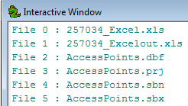
Use enumerate to print each index & val
>>> x = ['FID', 'Shape', 'COVER', 'RECNO']
for index, value in enumerate(x):
print index, valie
Use os.listdir() and enumerate to print a numbered list of files in C:/Temp
import os
files = os.listdir(“C:/Temp”)
for index, value in enumerate(files):
print “File”, index, “:”, value

Slide 20
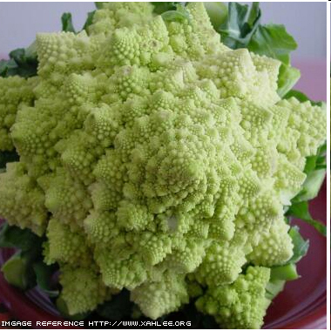
os.walk()
Does a recursive descent down a directory tree, stopping in each subdirectory to perform user-coded actions.
Returns three lists: a list of root directories, a list of directories that live in the corresponding root, and a list of files that live in the corresponding root
for root, dirs, files in os.walk( mydir ):
  print root, dirs, files

Slide 21
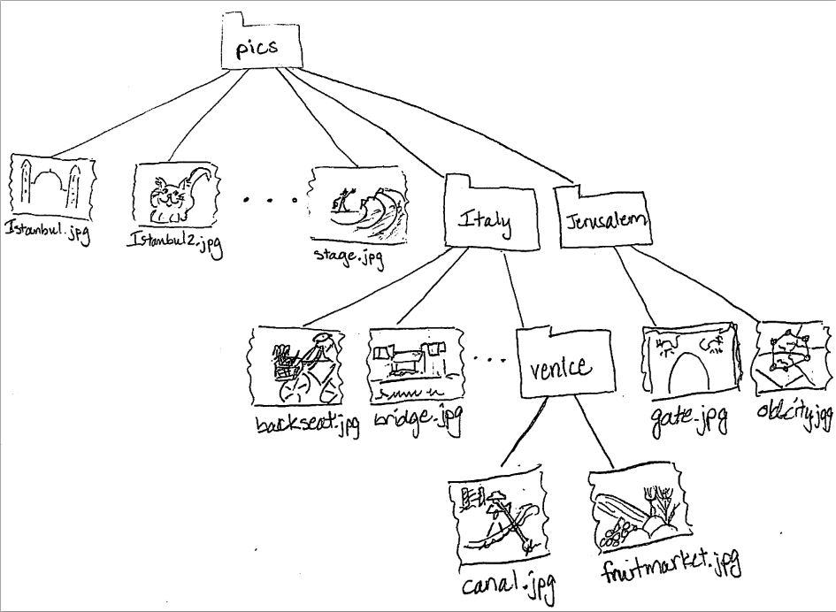
C:/pics
['italy', 'jerusalem']
['istanbul.jpg', 'istanbul2.jpg', 'marbleRoad.jpg', 'spice_market.jpg', 'stage.jpg']
C:/pics\italy
['venice']
['backSeat.JPG', 'bridge.JPG', 'ct.JPG', 'florence.JPG']
C:/pics\italy\venice
[]
['canal.JPG', 'fruitMarket.JPG']
C:/pics\jerusalem
[]
['gate.JPG', 'old_city.JPG']
for root, dirs, files in os.walk( mydir ):
  print root
  print dirs
  print files
  print

Slide 22
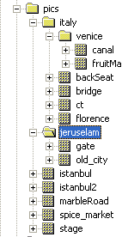
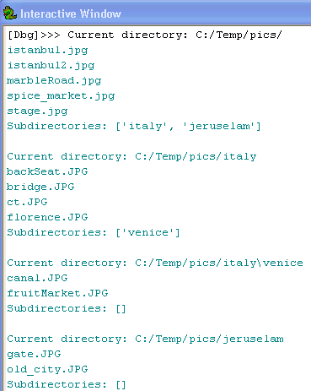
os.walk pics example
import os
mydir = "C:/Temp/pics/"
for root, dirs, files in os.walk( mydir ):
print "Current directory:", root
for picname in files:
print picname
print "Subdirectories:", dirs, '\n‘

Slide 23
Basic geoprocessing with os.walk
import arcpy, os, sys
mydir = "C:/Temp"
#Walk through directories
for root, dirs, files in os.walk( mydir):
for f in files:
# do stuff to current file
print root + "/"+ f
f only holds the filename, so you have to add root if you need the full path!

Slide 24
Basic geoprocessing with os.walk
import arcpy, os
mydir = "C:/Temp"
#Walk through directories
for root, dirs, files in os.walk( mydir):
arcpy.env.workspace = root
for f in files:
# do geoprocessing stuff on current file
print f
f only holds the filename, so you need to update the workspace each time!

Slide 25
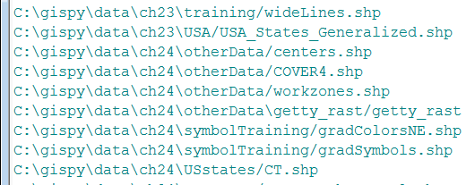
The arcpy walk method
arcpy.da.Walk (top, {topdown}, {onerror}, {followlinks}, {datatype}, {type})
Example 1
for root,dirs,files in arcpy.da.Walk(‘C:/pics’, datatype=‘RasterDataset’, type=‘GIF’):
arcpy.env.workspace(root)
for f in files:
arcpy.Delete_management(f)
Example 2
import arcpy, os
workspace = "c:/data"
walk = arcpy.da.Walk(workspace, datatype="FeatureClass", type="Polygon")
for dirpath, dirnames, filenames in walk:
for filename in filenames:
feature_classes.append(os.path.join(dirpath, filename))
for fc in feature_classes:
count = arcpy.GetCount_management(fc)
print ‘{0} has {1} records’.format(fc, count)
Creates a list of full path file names.

Slide 26
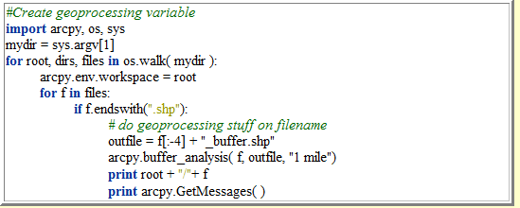
Modify this script list all feature classes, not just those that end in shp
Hint: use listfeatureclasses, instead of endswith.

Slide 27
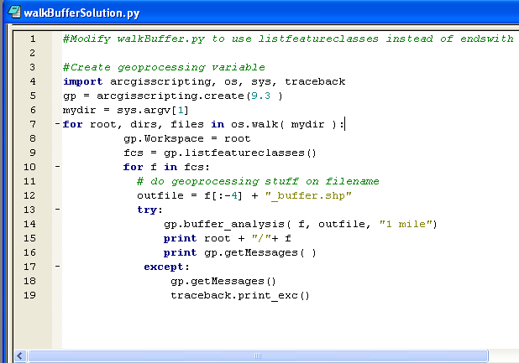
List all feature classes

Slide 28
Use a loop to print 0 1 2
  y = 0
  while y <= 2:
  print y,
  y = y + 1
  x = 10
  while x <= 50:
  print x,
  x = x + 10
for y in range(0, 3):
print y,
Use a loop to print 10 20 30 40 50
for x in range(10, 60, 10):
print x,

Slide 29
Use a WHILE loop to print: 10 11 12 20 21 22 30 31 32 40 41 42 50 51 52
  y = 0
  while y <= 2:
  print y,
  y = y + 1
0 1 2
  x = 10
  while x <= 50:
  print x,
  x = x + 10
10 20 30 40 50
  x = 10
  while x <= 50:
  y = 0
  while y <= 2:
  print x + y
  y = y + 1
  x = x + 10
Notes:
x = 10
while x <= 50:
y = 0
while y <= 2:
print x + y,
y = y + 1
x = x + 10

Slide 30
In class – Replace loop with list comprehension
How would you check if a shapefile has a field named 'COVER‘ ( in 9.3)?
import arcpy
fc = “C:/Temp/COVER63p.shp”
fs = arcpy.ListFields( fc )
for f in fs:
if f.Name == “COVER”:
#Set the value for the field and exit loop
print “Field ‘COVER’ found.”
Notes:
>>> import arcpy
>>> fc = "C:/Temp/COVER63p.shp"
>>> x = arcpy.ListFields( fc )
>>> y = [ i.name for i in x]
>>> if “COVER” in y:
print “Field ‘COVER’ found.”

