Slide 1

Messaging
Laura Tateosian
References
Notes by Arika Ligmann-Zielinska & Piotr Jankowski, Geog683, Fall 2006
The Quick Python Book by Daryl Harms and Kenneth McDonald
http://nrm.salrm.uaf.edu/~dverbyla/arcgis_python/index.html -Dave Verbyla, University of Alaska
Python Programming on Win32 by Mark Hammond and Andy Robinson

Slide 2
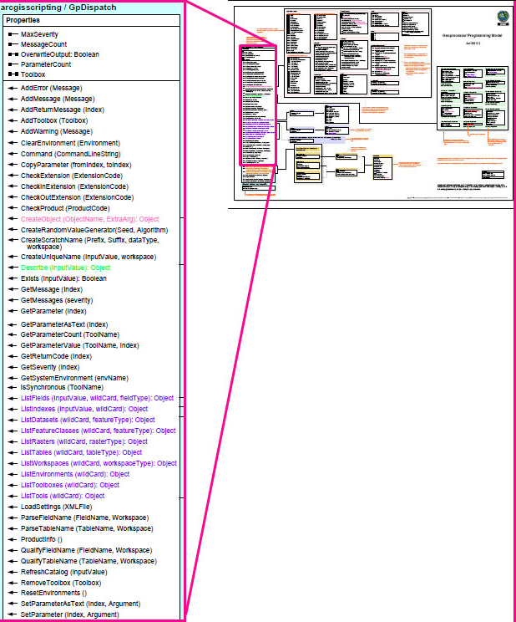
Topics
Messaging
    Introduction
    AddMessage
    GetMessages
    SetParameterAsText

Slide 3
Messaging
info from user
info to user
info from models
info to models
# Native Python messaging
import sys
path = sys.argv[1]
print path
# arcpy messaging
import arcpy
path=arcpy.GetParametersAsText()
arcpy.AddMessage( )

Slide 4
arcpy Messaging
Methods | Properties
Add Error AddMessage AddReturnMessages AddWarning GetMessage GetMessages GetParameter GetParameterAsText GetParameterCount GetParmeterValue GetSeverity SetParameterAsText SetParameter | Max Severity MessageCount ParameterCount

Slide 5

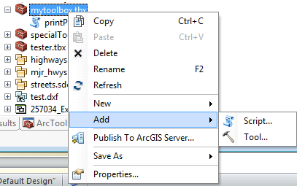
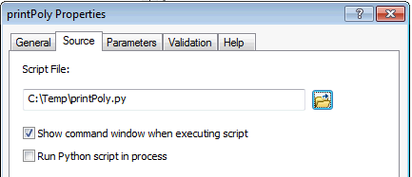
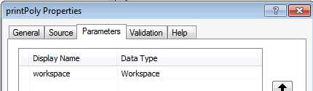
Script Tools
Script tools can be created in Toolboxes (right-click on toolbox ->Add->Script)
A script tool points to a Python script
Script tool properties: name, label, source, relative path, parameter list, show command window (or not)

Slide 6
In class -printPoly.py part 1
Write a script printPoly.py
Run the a script in an IDE (e.g. PythonWin)
Create a script tool which points to printPoly.py
Run the script tool from ArcToolbox.
Compare script vs. script tool behavior.

Slide 7
AddMessage(“Bla bla bla”)
  Set output messages for user.
  only displayed if user runs script in ArcGIS app!!!
  Pythonwin will NOT display these.
  ArcGIS apps will NOT display print statements
  solution? Use both

Slide 8
print vs. AddMessage
import os, arcpy
dir = "C:/Temp"
filelist = os.listdir(dir) # Lists all the files in the given directory
# Prints in the interactive window (and DOS window)
print "Directory", directory, "contains", len(filelist), "files.“
# Prints in ArcGIS window only and does not accept comma formatting
AddMessage takes one string argument → concatenate and cast.
arcpy.AddMessage("Directory " + directory + " contains " + str(len(filelist)) \
+ " files.")
# Output
Directory C:/Temp contains 381 files.

Slide 9
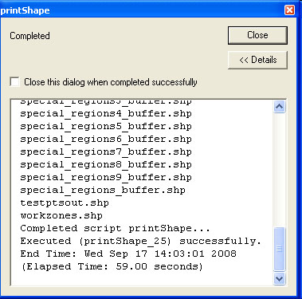
In class - printList.py part 2
Add a line of code to the script so that it prints the output in both the Pythonwin Intermediate window and the geoprocessing window.

Slide 10
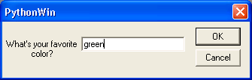
raw_input( <prompt>)
built-in Python function
Gets input from user while script is running
>>> color = raw_input(“What’s your favorite color?”)
>>> print color
‘green’
Returns the user’s response to color.

Slide 11
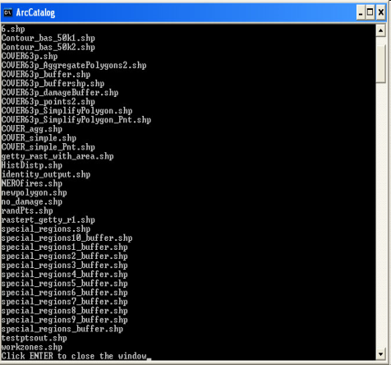
Command Window
Python print statements show in
command window
To show the command window:
  Right-click on the script in ArcToolbox
  Select properties.
  Check the script source tab property:
  “Show command window when executing the script”
  Add this to the last line of the script:
  raw_input(“Press ENTER to close the window")

Slide 12

In class -printList.py part 3
Set script tool to display command window.
Modify script so that the command window remains open until the user clicks a key.

Slide 13
Try, Except
try:
#stuff that may give error
except:
#what to do in case of error
…# assume arcpy has been import and workspace set
try:
arcpy.Buffer_analysis(“fireDamage.shp”, “buff.shp”, "1 km")
arcpy.Clip_analysis(“park.shp”, “buff.shp”, “parkClip.shp”)
except:
print arcpy.GetMessages( )
Notes:
# Import system modules
import sys, string, os, arcpy
# Script arguments...
distance = sys.argv[1]
if distance == '#':
distance = "5 Feet" # provide a default value if unspecified
input = sys.argv[2]
if input == '#':
input = "C:\\Documents and Settings\\lgtateos.wt\\My Documents\\python_materials\\class_materials\\from_tom\\pyexer05\\COVER63p.shp" # provide a default value if unspecified
# Local variables...
output = "C:\\Temp\\export_example\\COVER63p_Buffer.shp"
# Process: Buffer...
arcpy.Buffer_analysis(input, output, distance, "FULL", "ROUND", "NONE", "")
# ---------------------------------------------------------------------------
# buffer_model.py
# Created on: Tue Oct 02 2007 12:57:15 PM
# (generated by ArcGIS/ModelBuilder)
# Usage: buffer_model <distance> <input>
# ---------------------------------------------------------------------------
# Import system modules
import sys, string, os, arcpy
# Script arguments...
try:
distance = sys.argv[1]
input = sys.argv[2]
except IndexError:
distance = "#"
input = "#"
print "Usage: distance input"
print "No parameters provided. Default values being used"
#distance = sys.argv[1]
if distance == '#':
distance = "200 Feet" # provide a default value if unspecified
#input = sys.argv[2]
if input == '#':
input = "C:\\Documents and Settings\\lgtateos.wt\\My Documents\\python_materials\\class_materials\\from_tom\\pyexer05\\COVER63p.shp" # provide a default value if unspecified
# Local variables...
output = "C:\\junk\\COVER63p_Buffer3.shp"
rc = ""
try:
# Process: Buffer...
rc = arcpy.Buffer_analysis(input, output, distance, "FULL", "ROUND", "NONE", "")
except:
print "An buffering did not work properly:"
print arcpy.MessageCount
for i in range(0,arcpy.MessageCount):
print "Message", i, "=", arcpy.GetMessage(i)
print arcpy.GetMessages()
if rc:
arcpy.AddMessage("The buffer returned" + rc)
print "The buffer returned" + rc

Slide 14
GetMessages() Example
import arcpy
arcpy.env.workspace = “C:/Temp”
try:
arcpy.Clip_analysis(“roads”,“urb_area”,“urban_roads”)
except:
print arcpy.GetMessages()
Executing: Clip roads urban_area C:/Temp\urban_roads.shp #
Start Time: Wed Oct 17 20:11:12 2007
Failed to execute. Parameters are not valid.
Input Features: Dataset roads does not exist
Clip Features: Dataset urb_area does not exist
Failed to execute (Clip).
End Time: Wed Oct 17 20:11:12 2007 (Elapsed Time: 0.00 seconds)
Notes:
Executing: Clip roads urban_area C:/Temp\urban_roads.shp
#Start Time: Wed Oct 17 20:11:12 2007Failed to execute. Parameters are not valid.Input Features: Dataset roads does not existClip Features: Dataset urban_area does not existFailed to execute (Clip).End Time: Wed Oct 17 20:11:12 2007 (Elapsed Time: 0.00 seconds)

Slide 15
GetMessages( )
Gets messages from geoprocessing tools
  whenever a tool is executed, a set of messages are generated
  Messages include
    time a tool started/finished, output data characteristics, tool results, errors, etc.
  GetMessages() returns these messages as a string.
  >>> print arcpy.GetMessages()
  Executing: GetCount COVER63p.shp 0
  Start Time: Wed Sep 17 15:55:36 2010
  Row Count = 425
  Executed (GetCount) successfully.
  End Time: Wed Sep 17 15:55:36 2010 (Elapsed Time: 0.00 seconds)

Slide 16
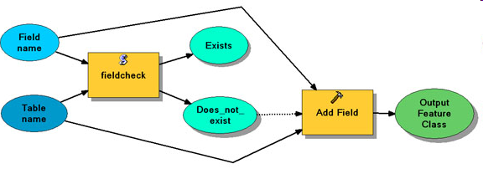
Setting Output for Models

Slide 17
SetParameterAsText(index, string)
Sends arguments to models.
Takes two arguments: index, string
index is zero-based. (1st parameter is parameter 0, 2nd parameter is parameter 1, and so forth.)
string is the value to be passed back to the model
arcpy.SetParameterAsText(0, “True")
arcpy.SetParameterAsText(1, “False")
arcpy.SetParameterAsText(2, “COVER63p_buffer.shp")

Slide 18
fieldCheck.py
import arcpy, sys
tableName = sys.argv[1] # Or use arcpy.GetParameterAsText(0)
fieldName = sys.argv[2] # Or use arcpy.GetParameterAsText(1)
print "Checking table:", tableName
print "For fieldname", fieldName
# Using two arguments( InputValue, wildCard ) so that the
# numerator will either return 1 or 0 fields. Since no "*" is used,
# at most one field will exactly match the wildcard.
fields = arcpy.ListFields(tableName, fieldName)
if fields: # if the fieldName is already a field in the table, set exists to true and does_not_exist to false
print "Field", fieldName, "found in", tableName
arcpy.AddMessage("Field " + fieldName + " found in " + tableName)
arcpy.SetParameterAsText(2, "True") # Sets the 3rd parameter, Exists, to true (0-based)
arcpy.SetParameterAsText(3, "False") # Sets the 4th parameter, Does_Not_Exist, to false (0-based)
else: # else the fieldName is not yet a field in the table,so set exists to false and does_not_exist to true
print"Field", fieldName, "NOT found in", tableName
arcpy.AddMessage("Field " + fieldName + " NOT found in " + tableName)
arcpy.SetParameterAsText(2, "False") # Sets the 3rd parameter, Exists, to false
arcpy.SetParameterAsText(3, "True") # Sets the 4th parameter, Does_Not_Exist, to true
raw_input("Click ENTER to close the window")

Slide 19
In class – fieldCheck script tool
Save the script fieldCheck.py
Add a script tool to the mytoolbox.tbx
Test the new script tool.
Build a model following the steps on the messaging page for the SetParameterAsText example.

Slide 20
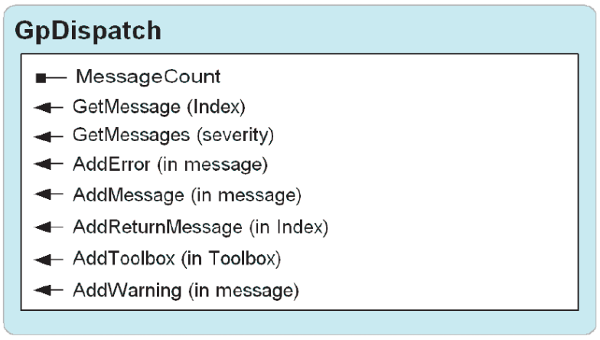
GetMessage vs GetMessages
GetMessages() – Returns a single string containing all the messages from the tool that was last executed.
GetMessage (message_index) – Returns a string with a single message in it.
>>> print arcpy.GetMessages()
Executing: RasterToPolygon C:/getty_rast C:/myshape.shp SIMPLIFY #
Start Time: Wed Feb 11 15:19:43 2009
Executed (RasterToPolygon) successfully.
End Time: Wed Feb 11 15:19:46 2009 (Elapsed Time: 3.00 seconds)
>>> print arcpy.GetMessage(2)
Executed (RasterToPolygon) successfully.

Slide 21
More about Getting Messages
Get messages from geoprocessor (such as error messages)
    Information Messages (severity level 0)
    Warning Messages (severity level 1)
    Error Messages (severity level 2)
Error Messages generate a system error which may be caught with try and catch keywords
  try:
  arcpy.Buffer_analysis (in, out, distance)
  except:
  #print the first message
  index = 0
  print arcpy.GetMessage(index)
  #print all error messages
  severity = 2
  print arcpy.GetMessages(severity)
  #print the current number of messages
  print arcpy.MessageCount
required argument
optional argument
Notes:
Did not go over the rest of these pages in class. These messaging methods may be useful for some, though I rarely use them.
Information Message – Severity Level 0; they require no action from the user or script.
Warning Message – Severity Level 1; action can be taken by the user or script; if none is the results may not be what the user expects.
Error Message – Severity Level 2; indicate a critical event has taken place that will prevent the tool from executing. If the error is not caught by an error handling routine in the script it will fail immediately.

Slide 22
Using the Message Array
try:
arcpy.Clip_analysis(input, clipfile, output)
#print the start time
print arcpy.Getmessage(1)
#print the completion time
index = arcpy.MessageCount - 1
print arcpy.GetMessage(index)
Start Time: Wed Oct 17 20:33:14 2007
End Time: Wed Oct 17 20:33:14 2007 (Elapsed Time: 0.00 seconds)
Notes:
Example warning message:
Start Time: Wed Oct 17 20:33:14 2007
Warning empty output generated
Executed (Clip) successfully.
End Time: Wed Oct 17 20:33:14 2007 (Elapsed Time: 0.00 seconds)

Slide 23
Messages, Warnings, and Errors --Oh my!
Three types:
AddMessage(string)
AddWarning(string)
AddError(string)
All take a required string argument
Examples:
#Let the user know something.
mystr = “Tool completed execution.”
  arcpy.AddMessage(mystr)
  print mystr
  #Warn the user of a potential problem
  mystr = “No input found. Default value used”
  arcpy.AddWarning(mystr)
  print mystr
  #script will stop running if it gets one of these
  mystr = “Buffering failed.”
  arcpy.AddError(mystr)
  print mystr
prints message in ArcMap
prints message in PythonWin

