Slide 1

Getting user input
https://www.explainxkcd.com/wiki/index.php/1666:_Brain_Upload
Get input for flexibility
Hard-coding vs. soft-coding
sys.argv
IndexError
Use of quotation marks
GetParameterAsText
What sys.argv[0] holds
Handling file paths with os module
Dr. Tateosian
Notes:
myList.append( 4 )
mystr.endswith(“shp”)
arcpy.env.overwriteOutput = 1
arcpy.compact_management(filename)
rc = arcpy.AverageNearestNeighbor_stats("C://points.shp", "Euclidean Distance")
a. print rc.outputcount
b. print rc.getOutput(0)

Slide 2
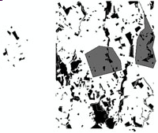
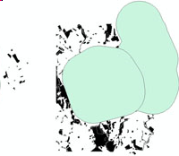
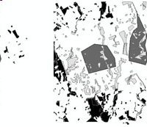
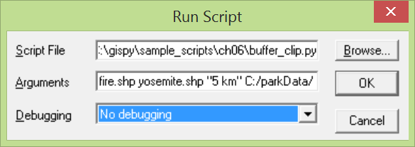
Write reusable code--get user input
# buffer_clip.py hard-coded values
fireDamage = 'special_regions.shp'
park = 'park.shp'
bufferDist = '5 miles'
arcpy.env.workspace = 'C:/Temp/'
# soft-coded variables
fireDamage = sys.argv[1]
park = sys.argv[2]
bufferDist = sys.argv[3]
arcpy.env.workspace = sys.argv[4]
…
arcpy.buffer_analysis(fireDamage, fireBuffer, bufferDist)
arcpy.clip_analysis(park, fireBuffer, clipOutput )
# Example input: fire.shp yosemite.shp "5 km" C:/parkData/

Slide 3
Hard-coding versus soft-coding
Hard-coding: assigning a value in a program so that it can’t be changed without altering the code.
Hard-coding example
fireDamage = 'special_regions.shp'
string literal
Soft-coding: obtaining a value from an external source, such as user input.
Soft-coding example
fireDamage = sys.argv[1]

Slide 4
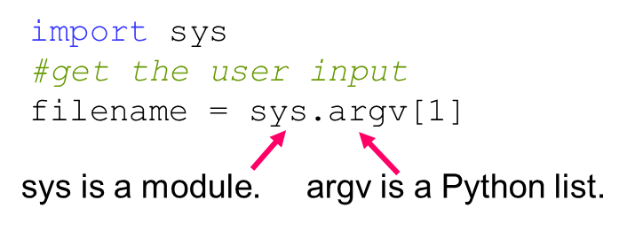
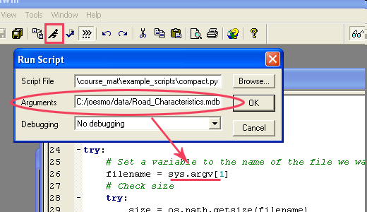
Get script arguments with sys.argv
sys is a built-in system module
sys.argv is a list.
argv is a sys module property
Populate the list using the Arguments text box of the RunScript Window.
Access the list using indexing.
>>> print sys.argv
['C:\\My Documents\\buffer_clip.py‘,
‘C:/joesmo/data/Road_Characteristics.mdb’]
>>> len(sys.argv)
2
The first item in sys.argv is the full path file name.
When you print len(sys.argv) in a script, what is the minimum value?
1

Slide 5
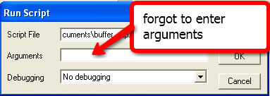
IndexError Exception
import sys
# buffer_clip.py arguments
fireDamage = sys.argv[1]
park = sys.argv[2]
bufferDist = sys.argv[3]
arcpy.env.workspace = sys.argv[4]
# Buffer and clip code below here…
…
If user does not enter enough arguments, an IndexError is thrown
>>> Traceback (most recent call last):
…
File "C:\My Documents\buffer_clip.py", line 3, in ?
fireDamage = sys.argv[1]
IndexError: list index out of range
>>> print sys.argv
['C:\\My Documents\\buffer_clip.py']
>>> print sys.argv[0]
'C:\\My Documents\\buffer_clip.py'

Slide 6
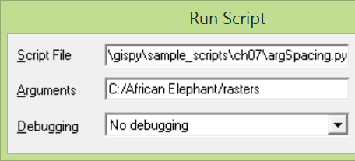

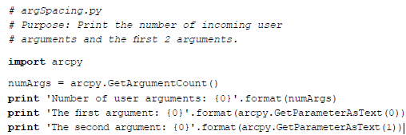
spacing in arguments
>>> Number of user arguments: 2
The first argument: C:/African
The second argument: Elephant/rasters
>>> Number of user arguments: 1
The first argument: C:/African Elephant/rasters
The second argument:
>>> Number of user arguments: 2
The first argument: 'C:/African
The second argument: Elephant/rasters'

Slide 7
Get script arguments with GetParameterAsText
# boundingGeomV2.py (soft-coded using arcpy)
# Purpose: Find the minimum bounding geometry
# of a set of features.
# Usage: workspace, input_features, output_features
# Example: C:/gispy/data/07 park.shp boundingBoxes.shp
import arcpy
arcpy.env.overwriteOutput = True
arcpy.env.workspace = arcpy.GetParameterAsText(0)
inputFeatures = arcpy.GetParameterAsText(1)
outputFeatures = arcpy.GetParameterAsText(2)
arcpy.MinimumBoundingGeometry_management(inputFeatures, \ outputFeatures)
Can not be used in scripts that don’t import arcpy.

Slide 8
Same example using sys.argv
# boundingGeomV3.py (soft-coded using sys)
# Purpose: Find the minimum bounding geometry of a set of features.
# Usage: workspace, input_features, output_features
# Example: "C:/Temp" "COVER63p.shp" "boundingBoxes.shp"
import arcpy, sys
arcpy.env.overwriteOutput = True
arcpy.env.workspace = sys.argv[1]
inputFeatures =sys.argv[2]
outputFeatures = sys.argv[3]
arcpy.MinimumBoundingGeometry_management(inputFeatures, \ outputFeatures)
What are the differences in this script from the arcpy.GetParam. approach?
Can be used: Good for stand-alone scripts and scripts that don’t require arcpy.

Slide 9
Handling file paths with os
>>> import os # operating system module
>>> p = 'D:/data/DelWaterGap.shp'
>>> theDir = os.path.dirname(p) # Returns the directory name
>>> theDir
'D:/data'
>>> theName = os.path.basename(p) # Returns the base name
>>> theName
'DelWaterGap.shp'
>>> os.path.exists(theDir + theName) # True if path exists.
False
>>> theDir + theName
'D:/dataDelWaterGap.shp'
>>> fullPathFileName = os.path.join(theDir, theName)
>>> fullPathFileName
'D:/data\\DelWaterGap.shp'

Slide 10
More path handling
# Splitting extensions
>>> myShapefile = ‘parks.shp’
>>> fp = os.path.splitext(myShapefile)
>>> fp
('parks', '.shp')
>>> fp[0]
'parks'
>>> os.path.splitext(myShapefile)[0]
'parks'
Common os.path manipulations
basename, dirname, exists, join, getsize, getmtime, abspath, relpath, isdir, isfile, normpath, splitext, split, splitdrive, walk,…
Python Reference Library

Slide 11
In class – List the files in my dir
Goal: Print a list of the files in the same directory as the script.
os.listdir(p) returns a list of all the files in p.
>>> import os
>>> os.listdir("C:/Temp")
['COVER63p.csv', 'COVER63p.dbf', 'COVER63p.kmz', 'COVER63p.prj', 'COVER63p.sbn', 'COVER63p.sbx', 'COVER63p.shp', 'COVER63p.shp.xml', 'COVER63p.shx']
Use sys.argv to get the full script path.
Use os.path.dirname to get the directory where the script resides.
Use os.listdir to get a list of the files in the directory.
Notes:
import os, sys
p = sys.argv[0]
d = os.path.dirname(p)
print os.listdir(d)

Slide 12
Summing up
Topics discussed
    User input for flexibility
    Hard vs. soft-coding
    sys.argv
    IndexError
    Use of quotation marks
    GetParameterAsText
    sys.argv[0] contents
    Path handling with os module
Coming up
    Pseudocode

