Slide 1
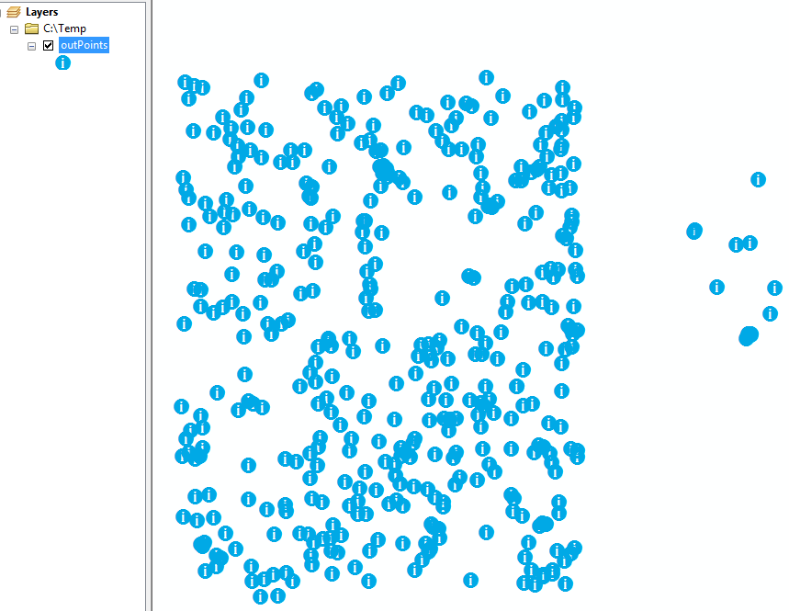
Script Tool Parameters Part 3
&
Progress Bars
Properties
  Obtained from
  Symbology
Progress bars
  ‘default’ progressor
  ‘step’ progressor
Dr. Tateosian

Slide 2
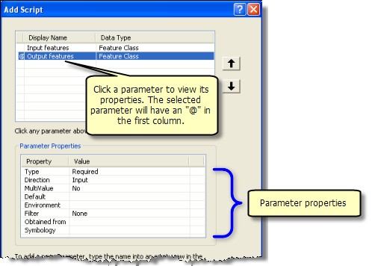
Setting script tool parameters
Property | Description
✓ Type | Required, Optional, or Derived.
✓ Direction | Input or output
✓ Multivalue | Yes, if you want to accept a list of values.
✓Default or Schema | The default value for the parameter. When the parameter data type is either feature set or record set, Default is replaced with Schema.
✓Environment | To set the default value of a parameter to an environment setting.
✓Filter | Restrict the values to be entered. 6 types of filters. Filter type depends on the data type.
Obtained from | For derived output parameters, ‘Obtained from’ can be set to the parameter containing the definition of the output. For input parameters, ‘Obtained from’ is set to the parameter containing the information needed for input.
Symbology | Use a layer file (.lyr) to set output symbology.

Slide 3
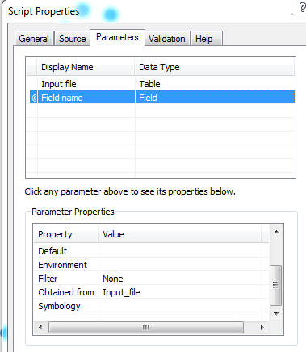
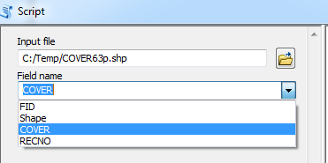
‘Obtained from’ Example
Set “Field name” to be ‘Obtained from’ “Input file”.
Parameter Label | Parameter DataType
Input file | Table
Field name | Field
Field names get automatically populated once the user selects an input file.

Slide 4
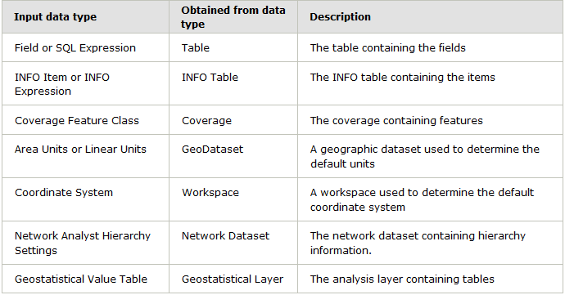
Obtained from enabled parameters
You can only set ‘Obtained from’ for certain input parameter data types, as shown in this table. If that type is eligible and if another parameter can provide needed info, it will appear in the ‘Obtained from’ dropdown.

Slide 5
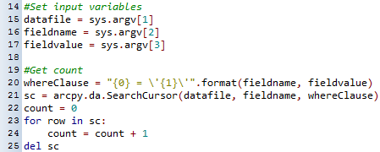
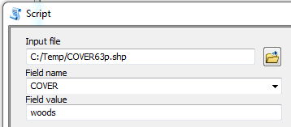
In class - countOccurances2.py
countOccurrences2.py: Counts the number of occurrences of a particular value of a particular field in a file. It takes 3 argument: a file name, a field name, and a field value.
1. Modify the script so that it prints the count in both the Interactive Window and the geoprocessing window.
2. Create a script tool with 3 args.
Notes:
import sys, arcpy, os
def printArc(message):
print message
arcpy.AddMessage(message)
#Check incoming arguments
for index, value in enumerate(sys.argv):
m = "Arg {0} = {1}".format(index, value)
print m
print
#Set input variables
datafile = sys.argv[1]
fieldname = sys.argv[2]
fieldvalue = sys.argv[3]
#Get count
whereClause = "{0} = \'{1}\'".format(fieldname, fieldvalue)
sc = arcpy.da.SearchCursor(datafile, fieldname, whereClause)
count = 0
for row in sc:
count = count + 1
del sc
#Print results
m = "The {0} field in {1} contains {2} occurances of {3}.".format( fieldname,
datafile,
count,
fieldvalue)
print m

Slide 6
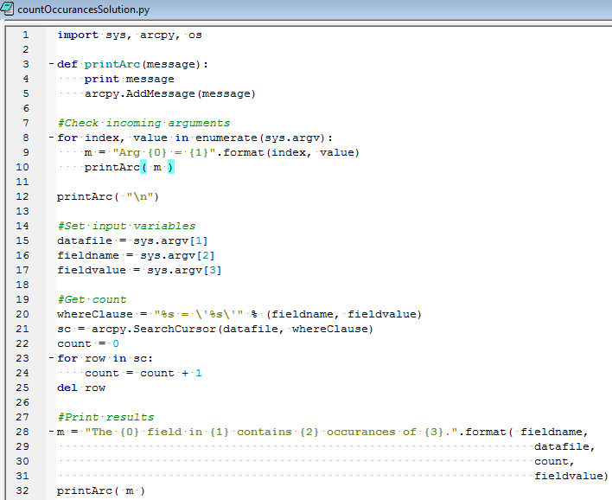
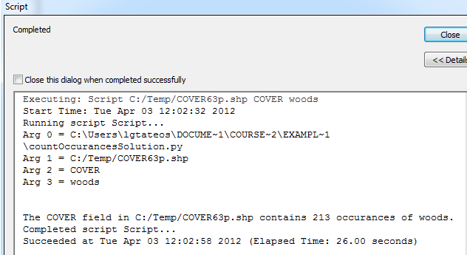
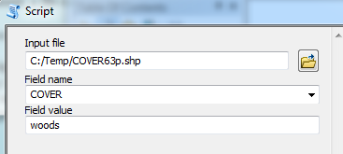
countOccurances.py followup
printArg(m)
Notes:
import sys, arcpy, os
def printArc(message):
print message
arcpy.AddMessage(message)
#Check incoming arguments
for index, value in enumerate(sys.argv):
m = "Arg {0} = {1}".format(index, value)
printArc( m )
printArc( "\n")
#Set input variables
datafile = sys.argv[1]
fieldname = sys.argv[2]
fieldvalue = sys.argv[3]
#Get count
whereClause = "%s = \'%s\'" % (fieldname, fieldvalue)
sc = arcpy.SearchCursor(datafile, whereClause)
count = 0
for row in sc:
count = count + 1
del row
#Print results
m = "The {0} field in {1} contains {2} occurances of {3}.".format( fieldname,
datafile,
count,
fieldvalue)
printArc( m )

Slide 7
Setting Script Tool parameters
Property | Description
✓Type | Required, Optional, or Derived.
✓Direction | Input or output
✓Multivalue | Yes, if you want to accept a list of values.
✓Default or Schema | The default value for the parameter. When the parameter data type is either feature set or record set, Default is replaced with Schema.
✓Environment | To set the default value of a parameter to an environment setting.
✓Filter | Restrict the values to be entered. 6 types of filters. Filter type depends on the data type.
✓Obtained from | For derived output parameters, ‘Obtained from’ can be set to the parameter containing the definition of the output. For input parameters, ‘Obtained from’ is set to the parameter containing the information needed for input.
Symbology | Use a layer file (.lyr) to set output symbology.

Slide 8
Setting symbology
Uses a training set.
Set symbology of output parameters added to map.
    Use ArcMap to predefine the desired symbology & export layer file (with an .lyr extension).
    Set symbology property of the output parameter to the locaton of the layer file.
When output is automatically added to the map, it has same symbology as the .lyr file.

Slide 9
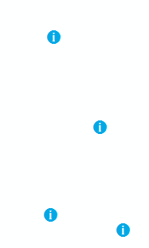
In class – Setting Symbology
Script finds the centroids of an input polygon feature class. Suppose there are information booths at these centroids and you want to display the centroids using a blue information symbol.
information.lyr encodes the symbology you want.
Script tool should have 2 arguments:
  required input feature class
  derived output feature class with symbology set to the full path file name of the layer file.
In the script: ##Set the output parameter
  Use SetParameterAsText to link it to the second parameter you set up in the script tool so that output file will be added to the map after the script tool is run.

Slide 10

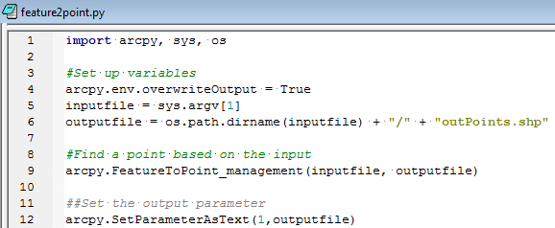
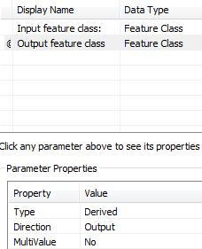
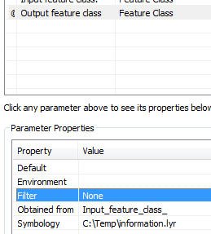
Setting symbology followup
Notes:
import arcpy, sys, os
#Set up variables
arcpy.env.overwriteOutput = True
inputfile = sys.argv[1]
outputfile = os.path.dirname(inputfile) + "/" + "outPoints.shp"
#Find a point based on the input
arcpy.FeatureToPoint_management(inputfile, outputfile)
##Set the output parameter
arcpy.SetParameterAsText(1,outputfile)

Slide 11
Symbology in script
Alternatively, call ApplySymbologyFromLayer tool
import arcpy
# Set layer to apply symbology to
outLayer = "sf_points.lyr"
# Set layer that output symbology will be based on
symLayer = “information.lyr"
# Apply the symbology from the symbology layer
arcpy.ApplySymbologyFromLayer_management(outLayer, symLayer")
Notes:
import arcpy, sys, os
#Set up variables
arcpy.env.overwriteOutput = True
inputfile = sys.argv[1]
arcpy.env.workspace = os.path.dirname(inputfile)
outputfile = "outPoints.shp"
#Find a point based on the input
arcpy.FeatureToPoint_management(inputfile, outputfile)
# Create layer file to apply symbology to
arcpy.MakeFeatureLayer_management(outputfile, "temp_lyr")
outlayer = outputfile[:-4] + ".lyr"
arcpy.SaveToLayerFile_management("temp_lyr", outlayer)
# Set layer that output symbology will be based on
##symLayer = "C:/Users/lgtateos/Documents/course_mat/example_data/information.lyr"
symLayer = "information.lyr"
# Apply the symbology from the symbology layer
arcpy.ApplySymbologyFromLayer_management(outlayer, symLayer)
##Set the output parameter
arcpy.SetParameterAsText(1,outlayer)

Slide 12
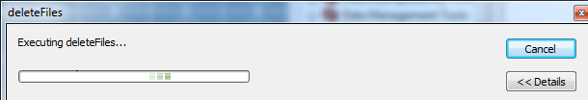

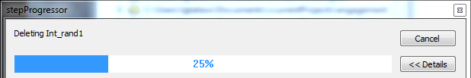
Display progress
Standard
“default”
arcpy.SetProgressor( 'default', 'Hello' )
arcpy.SetProgressorLabel('Deleting landc197_out')
“step”
arcpy.SetProgressor('step', 'Hello', 0, 4)
arcpy.SetProgressorLabel('Deleting Int_rand1')
arcpy.SetProgressorPosition()

Slide 13
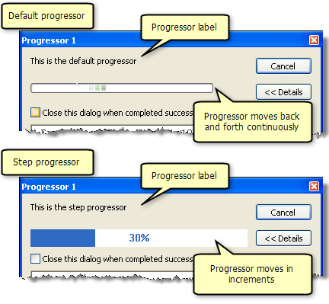
Arcpy Progressor Functions
Default
Step
arcpy Function | Description
SetProgressor | Sets the type and several optional parameters: default_or_step (required), {label}, {min.}, {max.}, {interval for step progressor} arcpy.SetProgressor("step", “Superduper", 0, 100, 10)
ResetProgressor | Resets the progressor arcpy.ResetProgressor()
SetProgressorPosition | Moves the step progressor by an increment arcpy.SetProgressorPosition(30)
SetProgressorLabel | Changes the label of the progressor arcpy.SetProgressorLabel(“This is the step progressor”)

Slide 14
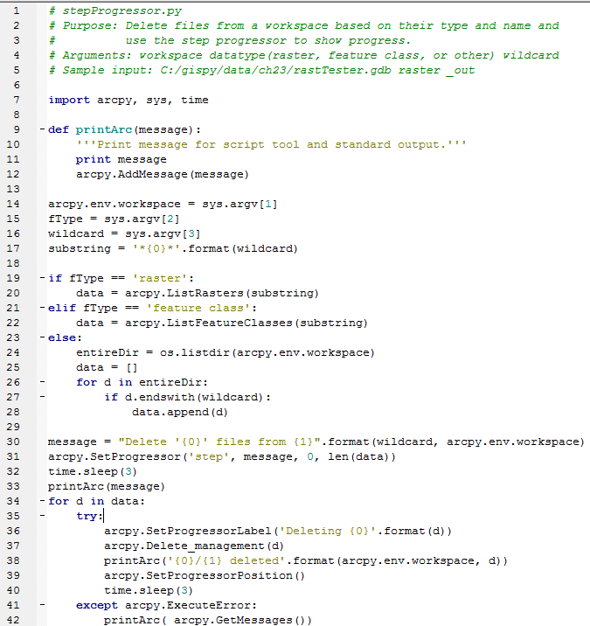
SetProgressor for “step” mode
SetProgressor parameters: default_or_step (required), {label}, {min.}, {max.}, {interval for step progressor}
arcpy.SetProgressor('step', message, 0, len(data))
Use step progressor when the number of steps in known in advance.
Usually use zero as minimum and # of steps as maximum.
Call ‘SetProgressorLabel’ before (or after) each step.
Call ‘SetProgressorPosition’ after each step is completed.
This script uses time.sleep(3) to stall. Take this part out for real applications.

Slide 15
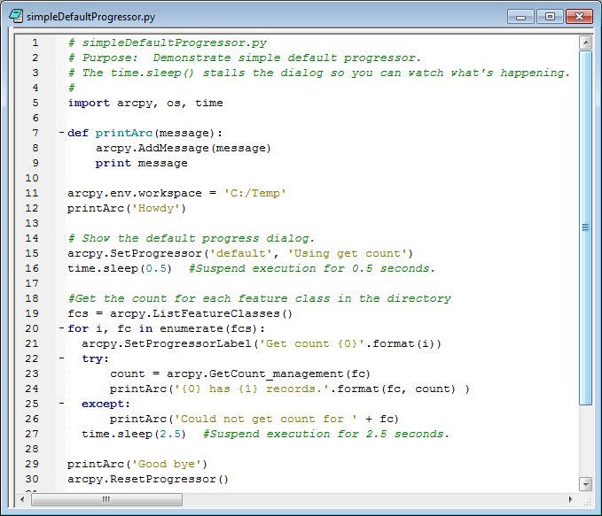
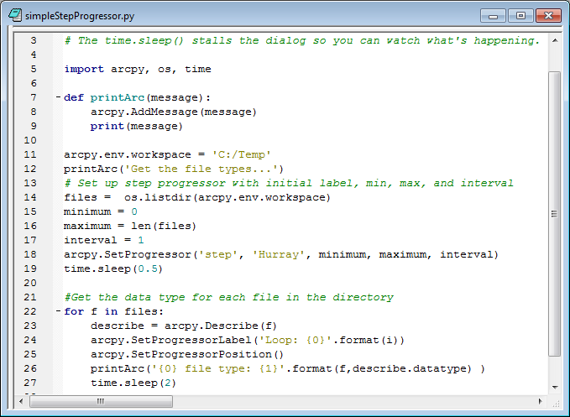
In class progressor examples
Create script tools for simpleDefaultProgressory.py & simpleStepProgressor.py
No arguments needed. Run the tools and answer the questions.
Notes:
simpleDefaultProgressor.py
What does time.sleep(5) do?
How can you change the progressor label to 'He he, ho ho'?
How do you print messages in the geoprocessing window?
How do you set the position of the default progressor?
simpleStepProgressor.py
How do you set the position of the step progressor?
What happens if you set your 'max' to 100*(len(files) - 1) instead of len(files) - 1 in the second script? Add time.sleep statements so that you can see what's going on.
What happens if you don't provide upper and lower bounds ('min' and 'max') or 'interval' when you set up the step progressor?
bigDemo.py
How do you count down with the step progressor? (See sample code in 'bigDemo.py' to inform this response.)

Slide 16
In class progressor discussion
simpleDefaultProgressor.py
What does time.sleep(5) do?
How can you change the progressor label to 'He he, ho ho'?
How do you print messages in the geoprocessing window?
How do you set the position of the default progressor?
simpleStepProgressor.py
How do you set the position of the step progressor?
What happens if you set your 'max' to 100*(len(files) - 1) instead of len(files) - 1 in the second script? Add time.sleep statements so that you can see what's going on.
What happens if you don't provide upper and lower bounds ('min' and 'max') or 'interval' when you set up the step progressor?
bigDemo.py
How do you count down with the step progressor? (See sample code in 'bigDemo.py' to inform this response.)
Notes:
simpleDefaultProgressor.py
What does time.sleep(5) do?
How can you change the progressor label to 'He he, ho ho'?
How do you print messages in the geoprocessing window?
How do you set the position of the default progressor?
simpleStepProgressor.py
How do you set the position of the step progressor?
What happens if you set your 'max' to 100*(len(files) - 1) instead of len(files) - 1 in the second script? Add time.sleep statements so that you can see what's going on.
What happens if you don't provide upper and lower bounds ('min' and 'max') or 'interval' when you set up the step progressor?
bigDemo.py
How do you count down with the step progressor? (See sample code in 'bigDemo.py' to inform this response.)

Slide 17
Summing up
Topics discussed
  Field names or other info for one param. ‘Obtained from’ another param.
  Output ‘Symbology’ from .lyr file.
  Default progressor (SetProgressorLabel)
  Step progressor (SetProgressorLabel and SetProgressorPosition)
Up next
    ToolValidator
Notes:
thanks for pic from http://twi-star.blogspot.com/2009/11/central-park-remember-me-set-stalking.html

Slide 18
Appendix

Slide 19
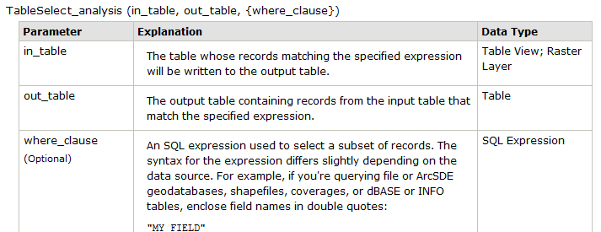
In class – selectOrchards.py
The park cover types in COVER63p.shp include woods, orchards, park, and others. Fruit farmers would like a table including only those polygons with a cover type of orch. Write a script to perform a Table Select that will generate this table. Call the output table orchards.dbf.

