Slide 1
Basic Python components and data types
Dr. Tateosian
GIS 540
North Carolina State University
Center for Geospatial Analytics

Slide 2
Topic outline
Introduction to built-in data types
Numbers
Strings
  types of strings
  operations
  methods
Lists
  operations
  methods
Print statements with multiple

Slide 3
Built-in data types
numbers
  int x = 5
  float x = 5.0
  complex x = 3+4j
sequences
  strings x = “Ken”
  tuples x = ( 8, “sky”, blue )
  lists x = [ name, “rule”, 2]
  dictionaries x = { 13 : “Joe”, 58 : “Ida”}
files x = open( “data.txt”, ‘r’)
specialized data types such as dates and times, fixed-type arrays, heap queues, synchronized queues, and sets.

Slide 4
Each data type has…
a set of possible values
    Integers: [-2147483647, 2147483647]
allowable operations (the same
>>> a = 5
>>> b = 6
>>> a + b #Addition operation
11
>>> b**2
36
>>> a = ‘5’
>>> b = ‘6’
>>> a + b #Concatenation operation
‘56’
>>> b**2
TypeError: unsupported operand type(s) for ** or pow(): 'str' and 'int'
other properties like mutability or immutability

Slide 5
Numeric data types
Types:
  (Long) Integers 5 -53,336 0
  Floating points 5.0 -0.4000 0.0
  Complex 5j 3 - 6j 0j
  others…
Mathematical operations
Operation Operator Example
Addition + 7 + 2 = 9
Subtraction - 7 - 2 = 5
Multiplication * 7 * 2 = 14
Division / 7 / 2 = 3
Exponentiation ** 7**2 = 9
Modulus division % 7 % 2 = 1
Dynamic typing
  If the value has a decimal, the var’s type is float
float vs. int division
  Caution: integer division truncates
# Example
>>> a = 7
>>> type(a)
<type 'int'>
>>> b = 7.0
>>> type(b)
<type 'float'>
>>> b / 2
3.5000005000000001
>>> a / 2
3
Notes:
-----------------------------------------------------------
DEMO6: NUMBERS
**************
>>> iNum = 7
>>> type(iNum)
<type 'int'>
>>> fNum = 7.0
>>> type(fNum)
<type 'float'>
>>> iNum == fNum
1
>>> fNum = 7.000001
>>> iNum == fNum
0
>>> fNum < iNum
0
>>> fNum > iNum
1
>>> int(fNum) == iNum
1
>>> float(iNum)
7.0
>>> float(iNum) == fNum
0
>>> fNum / 2
3.5000005000000001
>>> iNum / 2
3
>>> iNum / 2.
3.5
>>> divmod(iNum, 2)
(3, 1)
>>> round(fNum / 2) # rounds to the nearest int
4.0
>>> # if you always want to round down:
>>> from math import floor
>>> floor(40.9)
40.0
>>> # the same can be done with:
>>> int(40.9)
40
>>> 3**2
9
>>> 4**0.5
2.0
>>> 1 + 2
3
>>> 1 + 2 +
SyntaxError: invalid syntax
>>> 1 + 2 + \
3
6
-------------------------------------------------------
>>> # other goodies
>>> 1/2
0
>>> # int / int -> int
>>> # and rounds down
>>> # to make it more "natural":
>>> from __future__ import division
>>> 1/2
0.5
>>> # to get int / int -> int:
>>> 1//2
0
>>> # also with '//' we get float/float -> int:
>>> 1.0//2.0
0.0
>>> 0xA
10
>>> # with zero x leading indicates hexadecimals
>>> # Python handles large numbers
>>> 111111111111111111111
111111111111111111111L

Slide 6
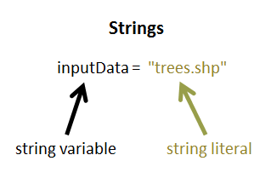
Strings
string: A data type for storing sequences of characters
string literal: A sequence of characters surrounded by quotations marks
string variable: A variable with a string literal value
The difference between these two terms is important, but both of these items are sometimes referred to simply as 'strings'.

Slide 7
Creating string literals
Can use single, double or triple quotation marks, as long as the opening and closing quotes match
    >>> ‘spam eggs’
    ‘spam eggs’
    >>> “spam eggs”
    ‘spam eggs’
Triple quotes can be used to create a string that spans more than one line.
  >>> output = 'a b c
  Traceback ( File "<interactive input>", line 1
  output = "a b c
  ^ SyntaxError: EOL while scanning string literal
  >>> output = """a b c
    ... d e f"""
    >>> print output
    a b c
    d e f

Slide 8
Line continuation character (\)
A backslash embedded in a string at the end of a line, allows a string to be written on more than one line, while preserving the single line spacing in the string literal value
Rule of thumb:
Limit the width of code text 80 chars (--easier to read.)
A string must have a matching quote or a line continuation character ( \) at the end of a line of code.
Preserves natural word wrapping in output.
output = 'a b c \
d e f \
g h i'
>>> print output
a b c d e f g h i
Line
continuation
char

Slide 9
Escape character (\)
Backslash in a string literal, when followed immediately by a character, signifies that what is to follow takes an alternative interpretation. ‘\n’ is an escape sequence.
>>> print "C:\national_data“
C:
ational_data
# Use / or \\ or r
>>> print "C:/national_data“ #preferred.
C:/national_data
>>> print "C:\\national_data“
C:\national_data
>>> print r"C:\national_data“ #raw string
C:\national_data
Escape sequence examples
\b backspace
\n new line
\t tab
\\ \
new line escape sequence

Slide 10
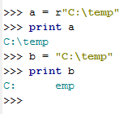
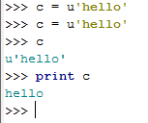

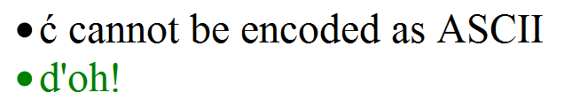
r or u before string literal
What does that little r mean?
  a is a raw string literal
  b is a string literal
  In a raw string literal,
  -a backslash, \, is taken as meaning "just a backslash
  -there are no "escape sequences" to represent newlines, tabs, backspaces, form-feeds, and so on.
What does that little u mean?
  c is a unicode string.
  --In Python 2.* most strings are ASCII
  --ASCII – created in 1963 as the American Standard Code for Information Interchange; each character is one byte; 128 possible characters.
  --Unicode demystified: http://farmdev.com/talks/unicode/
Unicode to the rescue!

Slide 11
Common string operations
indexing (zero-based) | >>> x = “abcde” >>> x[3] ‘d’
concatenation (from Latin com: together + catena: chain) | >>> y = “soup” >>> x + y ‘abcdesoup’
slicing | >>> x[1:4] ‘bcd’
Finding length | >>> len(x) 5
Checking for membership in | >>> ‘abc’ in y False

Slide 12
Casting (type conversion)
Change the type (if possible)
Built-in functions: int(x), float(x), str(x)
string to integer:
  print int(sys.argv[1]) + int(sys.argv[2]) # for arguments: 5 6
>>> 11
integer to string:
  >>> num = 5
  >>> str(num)
  ‘5’
Geoprocessing example:
Measurement inputs for tools like buffering, near feature analysis, etc.…
>>> num = 5
>>> unit = "miles”
>>> buf_dist = num + unit
... TypeError: unsupported operand type(s) for +: 'int' and 'str'
>>> str(num) + " " + unit
'5 miles'
Casts the number
to string so they can
be concatenated
Why use this?

Slide 13
String methods
Functions associated with strings
Examples: capitalize, upper, lower, count, find, replace, endswith, join, format, startswith,…
>>> bird = ‘Parrot’
>>> lowerBird = bird.lower( )
>>> lowerBird
‘parrot’
>>> food = bird.replace(‘P',‘C')
>>> food
‘Carrot’
>>> state = ‘Mississippi’
>>> state.count(‘s’)
4
object.method(argument 1, argument 2, …)
no arguments
object method
two arguments
one argument

Slide 14
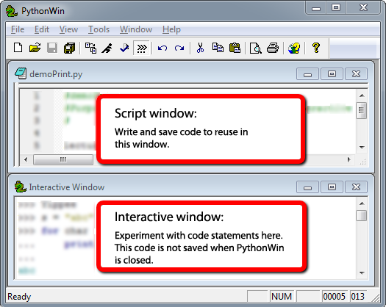
Script window vs. Interactive Wind.
Script Window
  Write code.
  Save code.
  Run code. (Code is not evaluated as soon as you click ‘Enter’)
  Close PythonWin and work is saved.
The interactive environment:
  User types a line of code in the interactive window (for example, 'print "Hello"').
  The user presses 'Enter' to indicate that the line of code is complete.
  The single line of code is run.
  Close PythonWin and all work is lost.
Heed Window Focus (the active window)!

Slide 15
PythonWin Interactive window
Interactive window command prompt: >>>
    Must be a space between prompt and code
    Hitting Return takes you to the right spot. Don’t space or backspace before typing.
In the Interactive window you can print variable value with or without ‘print’.
  >>> print FID
  145
  >>> FID
  145
  >>> print inputFile
  trees.shp
  >>> inputFile
  'trees.shp'
PythonWin stores session command history. To get previous commands:
Ctrl+ uparrow
If a command doesn’t work, hit return a few times, then type it again.
Shift focus to the script window before saving a script (else you’ll save Interactive Window contents).
A variable assigned a value during the current session keeps that value until it is assigned another value (demo)
Notes:
>>> print FID
>>> FID
>>> 145
>>> print fid

Slide 16
Exercise: Explore string operations
Try each statement in the Interactive Window & answer the questions.
x = “GIS”
x[0]
x[3]
“s” in x
len(x)
y = “rules”
x = x + y
len(x)
“s” in x
x[0:2]
x[:2]
x[2]
x[1:3]
x[-4:0]
x[-4:]
x
x[3]
1. Why does x[3] give an error the 1st time but not the 2nd time?
2. What does Python keyword in do? Does case matter?
3. How could you change the statement x = x+y to print “GIS rules”?
4. What’s the difference between x[:2], x[0:2], and x[2]?
5. What does x[-4] do?
6. Does x.lower() change the value of x? If so, how?

Slide 17
‘Explore string operations’ Q & A
1. Why does x[3] give an error the 1st time but not the 2nd time?
There’s no 4th character the first time (but there is the second).
2. What does Python keyword in do? Does case matter?
Checks for membership in. Yes, it’s case sensitive.
3. How could you change the statement x = x+y to print “GIS rules”?
x = x + “ ” + y
4. What’s the difference between x[:2] and x[2]?
x[:2] slices (returns the first 2 characters). x[0:2] does the same.
x[2] indexes (returns the 3rd character).
5. What does x[-4:] do?
Returns the last 4 characters.
6. Does x.lower() change the value of x? If so, how?
No! It returns an all lowercase version of x, but x itself is unchanged.
x = “GIS”
x[0]
x[3]
“s” in x
len(x)
y = “rules”
x = x + y
len(x)
“s” in x
x[0:2]
x[:2]
x[2]
x[-4:]
x[3]
x
>>> x.lower()
'gis‘
>>> x
'GIS'

Slide 18
‘Explore string ops’ take home messages
Indexing is zero-based.
Indexing throws an ‘IndexError’ exception if the index is greater than n-1, n = length_of_string.
Indexing & slicing look alike; but slicing uses a colon and (optionally) both start & end indices.
Spaces must be inserted explicitly in concatenation.
String methods do NOT alter the string itself. Instead, they ‘return’ the value.

Slide 19
Lists []
Flexible container objects: can hold numbers, strings, numbers and strings, etc. (any objects) or can be empty
>>> vec = [2, 4, 6] # I’m a list.
>>> mylist = [“roads”, “cities”, “states”, “countries”] # Me too.
>>> vec + mylist # List concatenation.
[2, 4, 6, “roads”, “cities”, “states”, “countries”]
Create an empty list:
mylist = [ ]
Notes:
#List comprehension
>>> vec = [2, 4, 6]
>>> [3*x for x in vec]
[6, 12, 18]
#Checking for membership
>>> 12 in vec
True

Slide 20
Common list operations
indexing | >>> mylist = ['a','b','c','d','e'] >>> mylist[3] ‘d’
concatenation | >>> vec = [2, 4, 6] >>> mylist = [“roads”, “cities”, “states”] >>> vec + mylist [2, 4, 6, “roads”, “cities”, “states”]
slicing | >>> mylist = ['a','b','c','d','e'] >>> mylist[1:4] ['b', 'c', 'd']
Finding length | >>> len(mylist) 5
Checking for membership in | ‘roads’ in mylist False

Slide 21
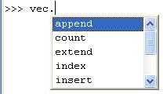
List Methods
Functions associated with lists.
Examples: append, extend, count, index, pop, insert, remove, reverse, sort
>>> vec = [2,4,6]
>>> vec.reverse()
>>> vec
[6, 4, 2]
>>> vec.append(55)
>>> vec
[6, 4, 2, 55]
>>> vec.insert(3, “GIS”)
>>> vec
[6, 4, 2, 'GIS', 55]
object.method(argument 1, argument 2, …)
no arguments
object method
one argument
two arguments

Slide 22
IN PLACE vs returning the result
IN PLACE methods change the original variable
  >>> vec = [’b’,’a’,’c’]
  >>> vec.sort()
  >>> vec
  [‘a’,’b’,’c’]
Return the results: Methods are not IN PLACE, perform the action but…
  They do not change the original variable
    >>> my_str = ‘GIS’
    >>> my_str.replace(‘IS’, ‘oose’ )
    ‘Goose’
    >>> my_str
    ‘GIS’
  To keep results must assign to a variable
  >>> new_str = my_str.replace(‘IS’, ‘oose’ )
    >>> new_str
    ‘Goose’
List methods are IN PLACE. String methods are not.

Slide 23


Print strings and numbers
Three methods:
  commas
  concatenation
  string formatting

Slide 24
String ‘format’ method
Mixing elements (heterogeneous content).
Curly braces with numbers inside are place holders in a string literal.
Place things to insert into the string comma separated inside the parentheses
>>> x = 5.3398
>>> unit = “miles”
>>> inFile = “trees.shp”
>>> print “File {0} was buffered with a {1:.2f} {2} buffer.”.format( inFile, x, unit)
File trees.shp was buffered with a 5.34 miles buffer.
>>> a = [1,2,3]
>>> b = “GIS”
>>> myStr = '{0} is as easy as {1}'.format(b, a)
>>> myStr
'GIS is as easy as [1, 2, 3]'
{1:.2f} returns two decimal places of a float
Notes:
DEMO7: STRINGS
*********************
>>> first_name = "Laura"
>>> last_name = "Tateosian"
>>> print first_name,last_name
Laura Tateosian
>>> mycat = "Jack“
>>> print mycat[0]
J
>>> print mycat[4]
Traceback (most recent call last): File "<interactive input>", line 1, in ?
IndexError: string index out of range
-----------------------------------------------------------
>>> # you can directly index any sequence which is returned by a function
>>> firstInitial = raw_input("Enter your name ")[0]
Enter your name Laura
>>> firstInitial
‘L'
print “””These triple quotations will preserve the
line breaks”””
print “otherwise you have to
hardcode line breaks”
print “You can do that with the \n carriage return special sequence”
>>> w1 = ‘dough’
>>> w2 = "nut”
>>> breakfast = w1+ w2
>>> print breakfast
doughnut
print “I wish I had a “ + breakfast + “I want a “ + breakfast
>>> w1 = “V”
>>> w2 = 8 #not a string
>>> breakfast = w1+ w2
>>> print breakfast
Typeerror
>>> myst = "candycane"
>>> myst[0:5]
'candy‘
>>> lastname = "Dangermond“
>>> mycat = mycat + lastname
>>> print mycatJackDangermond
#filename as string
------------------------------------------------------------
#Three ways that work:
>>>mydir = “c:/nr536“
>>>mydir = “c:\\nr536“
>>>mydir = r“c:\nr536“ #raw input mode does not convert \n to newline
#One that won’t work:
mydir = “c:\nr536“
>>> mydir ="c:\nr536“
>>> print mydir
c:
r536
-----------------------------------------------------------
>>> # string methods
>>> shapefile = "roads.shp"
>>> len(shapefile)
9
>>> from string import *
>>> capitalize(shapefile)
'Roads.shp'
>>> uppered = upper(shapefile)
>>> uppered
'ROADS.SHP'
>>> lowered = lower(uppered)
>>> lowered
'roads.shp'
>>> count(shapefile, "s")
2
>>> "shp" in shapefile
True
>>> find(shapefile, "shp")
6
>>> replace(shapefile, "roads", "rivers")
'rivers.shp'
>>> index(shapefile, ".")
5
>>> strg = "This is string"
>>> strg.endswith("ing")
True
>>> strg.endswith("ing", -2)
False
>>> space = " "
>>> space.isspace()
True
>>> not_space = "aaa"
>>> not_space.isspace()
False
-----------------------------------------------------------
#String Formatting
>>> print "%s is fabulous in %d and the temperature is %f degrees!" %("Raleigh, NC", 2007, 71.54)
Raleigh, NC is fabulous in 2007 and the temperature is 71.540000 degrees!
>>>print "%s is fabulous in %d and the temperature is %.2f degrees!" %("Raleigh, NC", 2007, 71.54)
Raleigh, NC is fabulous in 2007 and the temperature is 71.54 degrees!

Slide 25
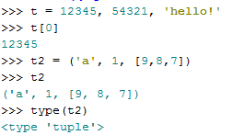
Tuples
consists of a set of values separated by commas and surrounded by round brackets (parentheses)
Some uses:
  (x, y) coordinate pairs
  employee records from a database
Tuples, like strings, are immutable:
  it is not possible to assign to the individual items of a tuple

Slide 26
Mutable vs immutable (changeable or not)
Mutable objects: individual elements of a mutable object are changeable one created
…and those of an immutable object are not.
Lists are mutable
>>> mylist = ['a','b','c']
>>> mylist[0] = 'z‘
>>> mylist
['z', 'b', 'c']
But strings aren't.
>>> mystr = ‘abc’
>>> mystr[0] = 'z‘
Traceback …TypeError: object does not support item assignment

Slide 27
In Class --convertLat.py:
Purpose: Convert degrees, minutes, seconds to decimal degrees.
Write one or more line of code for each double-hash (##) comment.
Use string methods 'split' and 'rstrip' to solve the problem. Here are some examples:
>>> path = "C:/Temp/buffer/output.shp“
>>> p = path.split("/")
>>> print p
['C:', 'Temp', 'buffer', 'output.shp']
>>> path.rstrip(‘.shp’)
'C:/Temp/buffer/output'
Notes:
['C:', 'Temp', 'buffer', 'output.shp'] # split output is a list

Slide 28
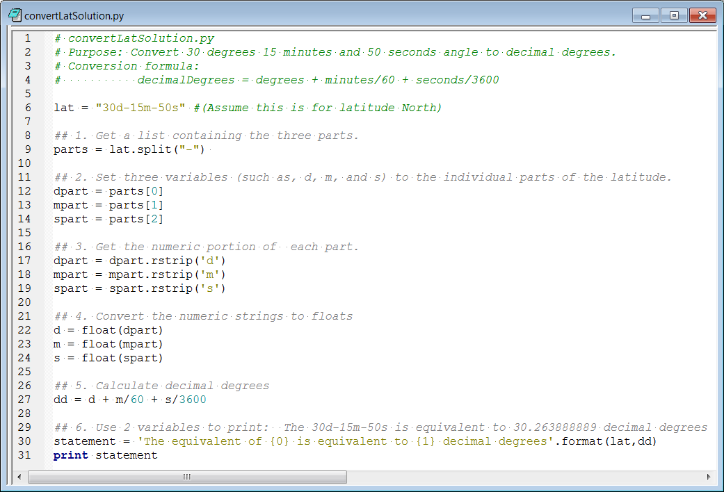

convertLatSolution.py

Slide 29
Summing up
Topics discussed
    Data types: integers, float, strings, lists, tuples
    Integer division
    String literal versus string variable
    String and list indexing, slicing, concatenation, len, ‘in’ keyword
    String line continuation, escape sequences, raw & unary strings
    In place (list) versus return value (string) methods
    Formatting print statements
Up next
    calling geoprocessing tools
Additional topics
    dictionaries
    file objects
    user defined objects

Slide 30
Appendix

Slide 31
Commas versus concatenation
>>> output = "park“
>>> count = 1
>>> print “Clip output file:", output, count, “.shp.”
Clip output file: park 1 .shp.
>>> print “Clip output file:” + output + count, “.shp.”
Typeerror…
>>> print “Clip output file:” + output + str(count) + “.shp.”
Clip output file:park1.shp.
>>> print “Clip output file:”, output + str(count) + “.shp.”
Clip output file: park1.shp.

Slide 32
Old school string formatting
Mixing elements (heterogeneous content)
% - conversion specifier
“…%format….” % (what_to_format)
String templates (Template)
>>> x = 5
>>> unit = “miles”
>>> inFile = “trees.shp”
>>> print “File %s was buffered with a %d %s buffer.” % ( inFile, x, unit)
File trees.shp was buffered with a 5 miles buffer.
%d integer
%s string
%f float
%.2f two digits float
Notes:
DEMO7: STRINGS
*********************
>>> first_name = "Laura"
>>> last_name = "Tateosian"
>>> print first_name,last_name
Laura Tateosian
>>> mycat = "Jack“
>>> print mycat[0]
J
>>> print mycat[4]
Traceback (most recent call last): File "<interactive input>", line 1, in ?
IndexError: string index out of range
-----------------------------------------------------------
>>> # you can directly index any sequence which is returned by a function
>>> firstInitial = raw_input("Enter your name ")[0]
Enter your name Laura
>>> firstInitial
‘L'
print “””These triple quotations will preserve the
line breaks”””
print “otherwise you have to
hardcode line breaks”
print “You can do that with the \n carriage return special sequence”
>>> w1 = ‘dough’
>>> w2 = "nut”
>>> breakfast = w1+ w2
>>> print breakfast
doughnut
print “I wish I had a “ + breakfast + “I want a “ + breakfast
>>> w1 = “V”
>>> w2 = 8 #not a string
>>> breakfast = w1+ w2
>>> print breakfast
Typeerror
>>> myst = "candycane"
>>> myst[0:5]
'candy‘
>>> lastname = "Dangermond“
>>> mycat = mycat + lastname
>>> print mycatJackDangermond
#filename as string
------------------------------------------------------------
#Three ways that work:
>>>mydir = “c:/nr536“
>>>mydir = “c:\\nr536“
>>>mydir = r“c:\nr536“ #raw input mode does not convert \n to newline
#One that won’t work:
mydir = “c:\nr536“
>>> mydir ="c:\nr536“
>>> print mydir
c:
r536
-----------------------------------------------------------
>>> # string methods
>>> shapefile = "roads.shp"
>>> len(shapefile)
9
>>> from string import *
>>> capitalize(shapefile)
'Roads.shp'
>>> uppered = upper(shapefile)
>>> uppered
'ROADS.SHP'
>>> lowered = lower(uppered)
>>> lowered
'roads.shp'
>>> count(shapefile, "s")
2
>>> "shp" in shapefile
True
>>> find(shapefile, "shp")
6
>>> replace(shapefile, "roads", "rivers")
'rivers.shp'
>>> index(shapefile, ".")
5
>>> strg = "This is string"
>>> strg.endswith("ing")
True
>>> strg.endswith("ing", -2)
False
>>> space = " "
>>> space.isspace()
True
>>> not_space = "aaa"
>>> not_space.isspace()
False
-----------------------------------------------------------
#String Formatting
>>> print "%s is fabulous in %d and the temperature is %f degrees!" %("Raleigh, NC", 2007, 71.54)
Raleigh, NC is fabulous in 2007 and the temperature is 71.540000 degrees!
>>>print "%s is fabulous in %d and the temperature is %.2f degrees!" %("Raleigh, NC", 2007, 71.54)
Raleigh, NC is fabulous in 2007 and the temperature is 71.54 degrees!

Slide 33
Old-school formatting examples
“…%format….” % (what_to_format)
num_parsels = 500
my_polygon = “RTP”
sentence = “%d parcels intersect with %s” %(num_parsels,my_polygon)
print sentence
>>> 500 parcels intersect with RTP
print num_parsels, “parcels intersect with”,my_polygon
>>> 500 parcels intersect with RTP
sentence = num_parsels, “parcels intersect with”,my_polygon
print sentence
>>>(5, 'parcels intersect with', 'selected region')
%d integer
%s string
Notes:
DEMO7: STRINGS
*********************
>>> first_name = "Laura"
>>> last_name = "Tateosian"
>>> print first_name,last_name
Laura Tateosian
>>> mycat = "Jack“
>>> print mycat[0]
J
>>> print mycat[4]
Traceback (most recent call last): File "<interactive input>", line 1, in ?
IndexError: string index out of range
-----------------------------------------------------------
>>> # you can directly index any sequence which is returned by a function
>>> firstInitial = raw_input("Enter your name ")[0]
Enter your name Laura
>>> firstInitial
‘L'
print “””These triple quotations will preserve the
line breaks”””
print “otherwise you have to
hardcode line breaks”
print “You can do that with the \n carriage return special sequence”
>>> w1 = ‘dough’
>>> w2 = "nut”
>>> breakfast = w1+ w2
>>> print breakfast
doughnut
print “I wish I had a “ + breakfast + “I want a “ + breakfast
>>> w1 = “V”
>>> w2 = 8 #not a string
>>> breakfast = w1+ w2
>>> print breakfast
Typeerror
>>> myst = "candycane"
>>> myst[0:5]
'candy‘
>>> lastname = "Dangermond“
>>> mycat = mycat + lastname
>>> print mycatJackDangermond
#filename as string
------------------------------------------------------------
#Three ways that work:
>>>mydir = “c:/nr536“
>>>mydir = “c:\\nr536“
>>>mydir = r“c:\nr536“ #raw input mode does not convert \n to newline
#One that won’t work:
mydir = “c:\nr536“
>>> mydir ="c:\nr536“
>>> print mydir
c:
r536
-----------------------------------------------------------
>>> # string methods
>>> shapefile = "roads.shp"
>>> len(shapefile)
9
>>> from string import *
>>> capitalize(shapefile)
'Roads.shp'
>>> uppered = upper(shapefile)
>>> uppered
'ROADS.SHP'
>>> lowered = lower(uppered)
>>> lowered
'roads.shp'
>>> count(shapefile, "s")
2
>>> "shp" in shapefile
True
>>> find(shapefile, "shp")
6
>>> replace(shapefile, "roads", "rivers")
'rivers.shp'
>>> index(shapefile, ".")
5
>>> strg = "This is string"
>>> strg.endswith("ing")
True
>>> strg.endswith("ing", -2)
False
>>> space = " "
>>> space.isspace()
True
>>> not_space = "aaa"
>>> not_space.isspace()
False
-----------------------------------------------------------
#String Formatting
>>> print "%s is fabulous in %d and the temperature is %f degrees!" %("Raleigh, NC", 2007, 71.54)
Raleigh, NC is fabulous in 2007 and the temperature is 71.540000 degrees!
>>>print "%s is fabulous in %d and the temperature is %.2f degrees!" %("Raleigh, NC", 2007, 71.54)
Raleigh, NC is fabulous in 2007 and the temperature is 71.54 degrees!

Slide 34
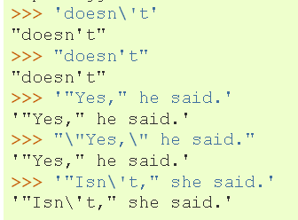
Appendix: Strings Quotation Matching
String ends where it finds the first matching quote.
use \ or combo of ‘ and “ to make a string which contains quotes.
  >>> 'doesn't‘
  Traceback ( File "<interactive input>", line 1 'doesn't'
  ^
  SyntaxError: invalid syntax
  >>> “He said, “I love GIS””
  Traceback ( File "<interactive input>", line 1
  "He said, "I love GIS""
  ^
  SyntaxError: invalid syntax
Python Tutorial

Slide 35
Appendix: Operations
int
>>> x = 1 # What type is x?
How can I make x a float?
x = 1.0 or x = float(x) #This casts x to a float
What is kind of statement is x = 1?
An assignment statement
What kind of statement is x == 1?
A conditional statement
x = y #What result does this yield?
If y is defined, it sets x equal to y. If not, it throws an exception.

Slide 36
String variable vs. string literal
output = “C:/data/clipped.shp”
Printing a string variable prints the value.
Printing a string literal prints that string literally.
Print statements can combine variables of any type and string literals by separating them with commas.
The print statement inserts one space for each separating comma.
print “The output file is:” , output
>>> The output file is: C:/data/clipped.shp
print “The output file is:”,output
>>> The output file is: C:/data/clipped.shp
>>> # Results are the same. Comma puts in a space.

