Slide 1
Error handling
try:
Primary code I want to run.
except X:
Code to run in case
of exception X.
Center for Geospatial Analytics
North Carolina State University
Dr. Tateosian

Slide 2
Topics
Why handle exceptions
Error handling syntax
Named vs. unnamed exceptions
Code flow with try/except blocks
arcpy & error handling
Printing tracebacks
Looping & error handling

Slide 3
Sample script with errors
Purpose: multiply every raster in the workspace by a factor given by the user
Throws the following exception:
for rasterImage in rasterList: TypeError: 'NoneType' object is not iterable
Run this script with an argument "0.001 meters"
factor = float(sys.argv[1]) ValueError: invalid literal for float(): 0.001 meters
# multRast.py
import arcpy, sys
# Set multiplication factor
factor = float(sys.argv[1])
arcpy.env.overwriteOutput = True
arcpy.env.worspace = "C:/gispy/data/ch14/rastTester.gdb"
arcpy.CheckOutExtension("Spatial")
outDir = "C:/gispy/scratch/"
# Get raster list & multiply each by a factor
rasterList = arcpy.ListRasters()
for rasterImage in rasterList:
rasterObj = arcpy.Raster(rasterImage)
rastMult = rasterObj * factor
rastMult.save(outDir + rasterImage)
del rastMult

Slide 4
Two types of causes for exceptions
Errors in the script that should be corrected.
arcpy.env.worspace = "C:/Temp/rastTester.gdb"
for rasterImage in rasterList: TypeError: 'NoneType' object is not iterable
Errors due to conditions that should be handled.
Often due to user input or external datasets (locked, missing, corrupt, etc.)
Run multRasts.py with an argument "0.001 meters"
factor = float(sys.argv[1]) ValueError: invalid literal for float(): 0.001 meters

Slide 5
‘Handling’ exceptions
# doubleMyNumber.py
import sys
try:
number = float(sys.argv[1])
product = 2*number
print(f"The doubled number is {product}")
except ValueError:
print("An error occurred.")
print("Please enter a numerical argument.")
print("Thank you for running me!")
How it works:
If an exception occurs in the try block, the rest of the try block is skipped and execution jumps to the except block. E.g., input is "5 meters": >>> An error occurred. Please enter a numerical argument. Thank you for running me!
If no exceptions occur, the except block is skipped entirely. E.g., the input is 5, the script prints the following: >>> The doubled number is 10.0 Thank you for running me!

Slide 7
Error handling syntax
For every try, there must be at least one except.
Use at least one line of indented code after try.
Use at least one line of indented code after except.
Colon after try. Colon after except.
Put ‘code that may cause an error’ inside try block.
Put ‘what to do in case of error’ inside except block.
Code dedented after except block is run no matter what.
The except block can specify an exception name... (recommended!)
# currency.py
amount = sys.argv[1] #required (script will crash if not provided)
try:
currency = sys.argv[2] #optional
except IndexError:
currency = "US"
print "Usage: <amount(required)> <currency unit(optional>"
print f"No unit provided. Default value: {currency} being used."
# perform conversions …
Notes:
# Import system modules
import sys, string, os, arcpy
# Create the Geoprocessor object
gp = arcpy.create()
# Load required toolboxes...
gp.AddToolbox("C:/Program Files/ArcGIS/ArcToolbox/Toolboxes/Analysis Tools.tbx")
# Script arguments...
distance = sys.argv[1]
if distance == '#':
distance = "5 Feet" # provide a default value if unspecified
input = sys.argv[2]
if input == '#':
input = "C:\\Documents and Settings\\lgtateos.wt\\My Documents\\python_materials\\class_materials\\from_tom\\pyexer05\\COVER63p.shp" # provide a default value if unspecified
# Local variables...
output = "C:\\Temp\\export_example\\COVER63p_Buffer.shp"
# Process: Buffer...
gp.Buffer_analysis(input, output, distance, "FULL", "ROUND", "NONE", "")
-------------------------------------
# ---------------------------------------------------------------------------
# buffer_model.py
# Created on: Tue Oct 02 2007 12:57:15 PM
# (generated by ArcGIS/ModelBuilder)
# Usage: buffer_model <distance> <input>
# ---------------------------------------------------------------------------
# Import system modules
import sys, string, os, arcpy
# Create the Geoprocessor object
gp = arcpy.create()
# Load required toolboxes...
gp.AddToolbox("C:/Program Files/ArcGIS/ArcToolbox/Toolboxes/Analysis Tools.tbx")
arcpy.env.overwriteOutput = 0
# Script arguments...
try:
distance = sys.argv[1]
input = sys.argv[2]
except IndexError:
distance = "#"
input = "#"
print "Usage: distance input"
print "No parameters provided. Default values being used"
#distance = sys.argv[1]
if distance == '#':
distance = "200 Feet" # provide a default value if unspecified
#input = sys.argv[2]
if input == '#':
input = "C:\\Documents and Settings\\lgtateos.wt\\My Documents\\python_materials\\class_materials\\from_tom\\pyexer05\\COVER63p.shp" # provide a default value if unspecified
# Local variables...
output = "C:\\junk\\COVER63p_Buffer3.shp"
rc = ""
try:
# Process: Buffer...
rc = gp.Buffer_analysis(input, output, distance, "FULL", "ROUND", "NONE", "")
except:
print "An buffering did not work properly:"
print gp.MessageCount
for i in range(0,gp.MessageCount):
print "Message", i, "=", arcpy.GetMessage(i)
print arcpy.GetMessages()
if rc:
gp.AddMessage("The buffer returned" + rc)
print "The buffer returned" + rc

Slide 8
Unnamed exception
try:
Code that may cause an error. (Primary code to run)
except:
Code to run in case
of ANY exception.

Slide 9
Unnamed exception example
# doubleMyNumber.py
import sys
try:
number = float(sys.argv[1])
product = 2*number
print(f"The doubled number is {product}")
except:
print("An error occurred.")
print("Please enter a numerical argument.")
print("Thank you for running me!")
More about this later...

Slide 10
Built-in exceptions have names
Traceback errors report the name of the exception TypeError: 'NoneType' object is not iterable
ValueError: invalid literal for float(): 0.001 meters

Slide 11
Using named exceptions
Traceback errors report the name of the exception TypeError: 'NoneType' object is not iterable
ValueError: invalid literal for float(): 0.001 meters
Named exception: place an exception name behind the except keyword.
# doubleMyNumber.py
import sys
try:
number = float(sys.argv[1])
product = 2*number
print(f"The doubled number is {product}")
except ValueError:
print("An error occurred.")
print("Please enter a numerical argument.") print("Thank you for running me!")

Slide 12
How to choose which name to use?
Use the names for a certain type of error that you know may occur. E.g., if you can't be sure an argument will be numeric and your code needs to cast it to float, you would use a ValueError
Built-in Exceptions (Python Library Reference): IndexError, TypeError, ArithmeticError, IOError, RuntimeError, UnicodeTranslateError, ValueError,...
Determine the name of the exception that occurs if you divide by zero.
>>> 1/0
ZeroDivisionError: integer division or modulo by zero

Slide 13
How named exceptions work
A named exception handles only the exceptions with that name.
This code catches ValueError exceptions. E.g., input is "5 meters": >>> An error occurred. Please enter a numerical argument. Thank you for running me!
The code doesn’t catch any other exception types. If the user does not supply an argument, a traceback is printed:
number = float(sys.argv[1]) IndexError: list index out of range
# doubleMyNumber.py
import sys
try:
number = float(sys.argv[1])
product = 2*number
print(f"The doubled number is {product}")
except ValueError:
print("An error occurred.")
print("Please enter a numerical argument.") print("Thank you for running me!")

Slide 14




Named vs unnamed
NAMED
except SomeException:
Only catches a specific type of exception.
Like someone that will only catch volleyballs and will ignore anything else.
UNNAMED
except:
Catches all exceptions (regardless of type).
Like someone who will catch all ball types, no matter what.
Notes:
except: catches all exceptions (regardless of type). This is the equivalent of someone catching all ball types, no matter what. If you can throw them a billiard ball, they'll catch it.
except SomeException: on the other hand only catches a specific type of exception (like someone that'll only catch baseballs and will ignore anything else).
Thanks! https://stackoverflow.com/questions/56942284/what-is-the-difference-between-raise-and-except

Slide 16
Multiple except blocks
Any number of named except blocks can be used with one try block.
At most one unnamed except block can be used with a single try block.
An unnamed except block can be used along with named except blocks.
When an unnamed except block is used with named except blocks, the unnamed except is placed last.
A try block needs at least one except block (or a finally block).
# slopeTry.py
import sys
rise = sys.argv[1]
run = sys.argv[2]
try:
print (f"Rise: {rise} Run: {run}")
slope = float(rise)/float(run)
print("Slope = rise/run")
except ZeroDivisionError:
slope = "Undefined (line is vertical) "
except ValueError:
print("Usage: <numeric rise> <numeric run>")
slope = "Not found"
print (f"Slope: {slope}")

Slide 17
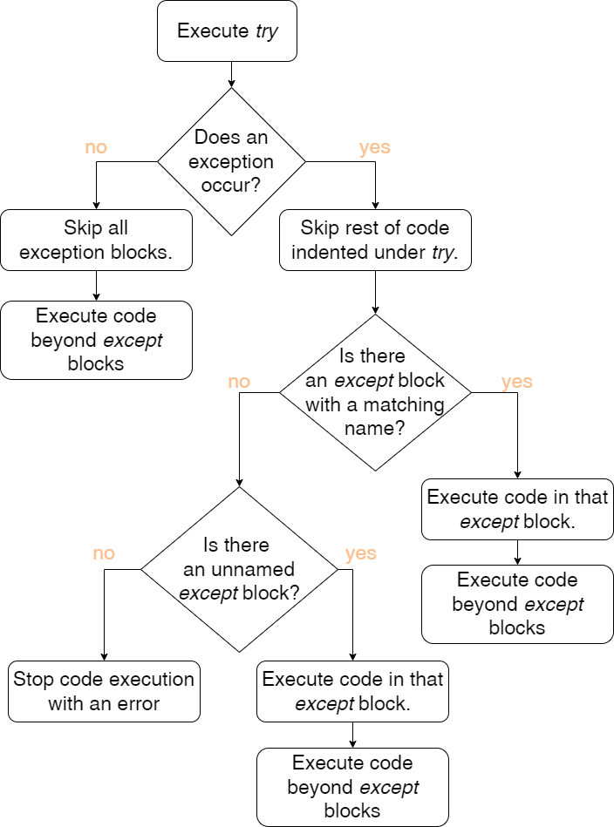
try and except process
# slopeTry.py
import sys
rise = sys.argv[1]
run = sys.argv[2]
slope = "Unknown"
try:
print (f"Rise: {rise} Run: {run}")
slope = float(rise)/float(run)
print("Slope = rise/run")
except ZeroDivisionError:
slope = "Undefined (line is vertical) "
except ValueError:
print("Usage: <numeric rise> <numeric run>")
slope = "Not found"
print (f"Slope: {slope}")

Slide 18
Flow description
If an exception occurs during execution of the try clause, the rest of the clause is skipped. Then if its type matches the exception named after the except keyword, the except clause is executed, and then execution continues after the try statement.
If an exception occurs which does not match the exception named in the except clause, it is passed on to outer try statements; if no handler is found, it is an unhandled exception and execution stops with a Traceback message.

Slide 19
Hands-on: Flow with named exceptions
Open sample script slopeTry.py
(C:\gispy\sample_scripts\ch14)
2. Step through in the debugger with four use cases (a-d below). Note the behavior in each case.
User arguments:
a) 12 6
b) 12 0
c) twelve six
d) 12
# slopeTry.py
import sys
rise = sys.argv[1]
run = sys.argv[2]
try:
print (f"Rise: {rise} Run: {run}")
slope = float(rise)/float(run)
print("Slope = rise/run")
except ZeroDivisionError:
slope = "Undefined (line is vertical) "
except ValueError:
print("Usage: <numeric rise> <numeric run>")
slope = "Not found"
print (f"Slope: {slope}")

Slide 20
slopeTry process
# slopeTry.py
import sys
rise = sys.argv[1]
run = sys.argv[2]
slope = "Unknown"
try:
print (f"Rise: {rise} Run: {run}")
slope = float(rise)/float(run)
print("Slope = rise/run")
except ZeroDivisionError:
slope = "Undefined (line is vertical) "
except ValueError:
print("Usage: <numeric rise> <numeric run>")
slope = "Not found"
print (f"Slope: {slope}")
a) print the slope
User arguments:
a) 12 6
b) 12 0
c) twelve six
d) 12
b) and c) print the slope

Slide 21
modified slopeTry process
# slopeTry.py
import sys
rise = sys.argv[1]
slope = "Unknown"
try:
run = sys.argv[2]
print (f"Rise: {rise} Run: {run}")
slope = float(rise)/float(run)
print("Slope = rise/run")
except ZeroDivisionError:
slope = "Undefined (line is vertical) "
except ValueError:
print("Usage: <numeric rise> <numeric run>")
slope = "Not found"
print (f"Slope: {slope}")
a) print the slope
User arguments:
a) 12 6
b) 12 0
c) twelve six
d) 12
b) and c) print the slope
d) Traceback (most recent call last): File "C:\gispy\slopeTry.py", line 8, ...

Slide 23
Example: Summarize within
import arcpy
arcpy.env.workspace = "C:/gispy/scratch/" campus_regions = "campus_region_polygons.shp"
arcpy.analysis.SummarizeWithin(campus_regions, "bikeRackPoints.shp", "racks.shp")
print("Hurray! I summarized the bike racks!")
Notes:
Suppose campus planners want to determine if certain parts of campus that have less bike racks than others. With the Summarize Within tool, you can summarize features within existing polygons. Think of Summarize Within as taking two layers, the input polygons and the input summary features, and stacking them on top of each other. After stacking these layers, it look down through the stack and count the number of input summary features that fall within the input polygons. The tool can calculate simple statistics about the attributes of the input summary features, such as sum, mean, minimum, maximum, and so on. You could use this tool to overlay campus regions and bike rack datasets.

Slide 24
An exit plan may be needed
Unless the script exits explicitly the script continues.
import arcpy try:
campus_regions = sys.argv[1]
except IndexError:
print("Usage: <input dataset>")
arcpy.analysis.SummarizeWithin(campus_regions,
"bikeRack.shp", "racks.shp")
print("Hurray! I summarize something!")
sys.exit(0) force the script to exit when it is executed.
Use inside except clause, as appropriate.
import arcpy, sys
try:
campus_regions = sys.argv[1]
except IndexError:
print("Usage: <input dataset>")
sys.exit(0)
arcpy.analysis.SummarizeWithin(campus_regions, "bikeRack", "racks.shp")
print("Hurray! I summarize something!")
>>> Usage: <input dataset>
Traceback (most recent call last): File "C:\gispy\scratch\summarizer.py", line 8, in <module> arcpy.analysis.SummarizeWithin(campus_regions,
"bikeRack.shp", "racks.shp")
NameError: name 'campus_regions' is not defined
>>> Usage: <input dataset>
Notes:
With the Summarize Within tool, you can summarize features within existing polygons. Think of Summarize Within as taking two layers, the input polygons and the input summary features, and stacking them on top of each other. After stacking these layers, it look down through the stack and count the number of input summary features that fall within the input polygons. The tool can calculate simple statistics about the attributes of the input summary features, such as sum, mean, minimum, maximum, and so on.

Slide 25
Named exception for arcpy
arcpy.ExecuteError catches errors thrown by tools.
Call arcpy.GetMessages() inside the except block to print tool error.
import arcpy, os
arcpy.overwriteOutput = True
census_data = sys.argv[1]
output = os.path.splitext(census_data)[0] + "_reduced.shp"
try:
# Reduce the number of population by age group fields # using principal components analysis.
arcpy.stats.DimensionReduction(census_data, output,
"age_group_1;age_group2;age_group_3;age_group_4;age_group_5")
print(f"Reduced data {output} created.")
except arcpy.ExecuteError:
print(arcpy.GetMessages( ))
print ("Exiting the script now.")
"C:/gispy/data/ch14/cover.shp" has no age group fields, use this as the input and the tool will throw an ExecuteError.
Notes:
The Dimension Reduction tool reduces the number of dimensions of a set of continuous variables by aggregating the highest possible amount of variance into fewer components using Principal Component Analysis (PCA) or Reduced-Rank Linear Discriminant Analysis (LDA).
import arcpy, sys
arcpy.overwriteOutput = True
inputFile = sys.argv[1]
output = os.path.splitext(input)[0] + "_buffer.shp"
try:
arcpy.Analysis.Buffer(inputFile, output, "1 mile") print(f"Buffer {output} created.")
except arcpy.ExecuteError: print(arcpy.GetMessages( ))
print ("Exiting the script now.")

Slide 26
Traceback error vs. GetMessages
arcpy.analysis.Buffer("test.txt", "buff.shp", "2 miles")
try:
arcpy.analysis.Buffer("test.txt", "buff.shp", "2 miles")
except arcpy.ExecuteError:
print(arcpy.GetMessages())
Traceback (most recent call last):
File "c:/gispy/scratch/myBufferScript.py", line 2, in <module>
arcpy.analysis.Buffer("test.txt", "buff.shp", "2 miles")
File "C:\Program Files\ArcGIS\Pro\Resources\ArcPy\arcpy\analysis.py", line 1349, in Buffer
raise e
File "C:\Program Files\ArcGIS\Pro\Resources\ArcPy\arcpy\analysis.py", line 1346, in Buffer
retval = convertArcObjectToPythonObject(gp.Buffer_analysis(*gp_fixargs((in_features, out_feature_class, buffer_distance_or_field, line_side, line_end_type, dissolve_option, dissolve_field, method), True)))
File "C:\Program Files\ArcGIS\Pro\Resources\ArcPy\arcpy\geoprocessing\_base.py", line 512, in <lambda>
return lambda *args: val(*gp_fixargs(args, True))
arcgisscripting.ExecuteError: Failed to execute. Parameters are not valid.
ERROR 000732: Input Features: Dataset test.txt does not exist or is not supported
Failed to execute (Buffer).
Start Time: Wednesday, October, 12 2:23:10 PM
Failed to execute. Parameters are not valid.
ERROR 000732: Input Features: Dataset test.txt does not exist or is not supported
Failed to execute (Buffer).
Failed at Wednesday, October 12, 2:23:10 PM (Elapsed Time: 0.00 seconds)

Slide 27
Fill in the blanks
If an exception ________(does/does not) occur in the try clause, the rest of the try clause is executed and the except clause is __________ (executed/skipped).
If an exception does occur during execution of the try clause, the rest of the try clause is _________ (executed/skipped) and execution jumps to the matching _________ (try/except) clause (if one is found).
Notes:
If an exception does not occur in the try clause, execution of the try clause is finished and the except clause is skipped.
If an exception does occur during execution of the try clause, the rest of the try clause is skipped and execution jumps to the matching except clause.

Slide 28
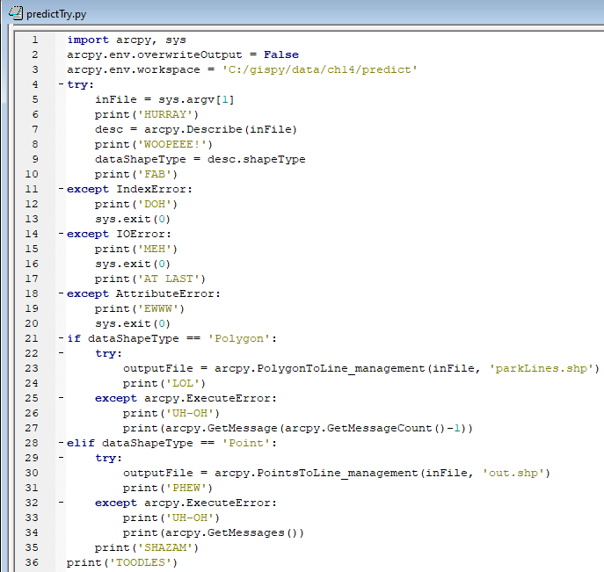
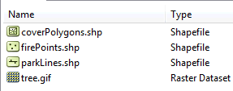
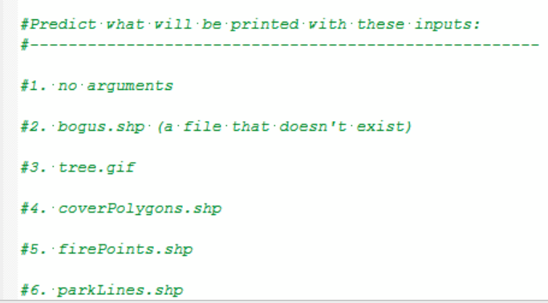
HANDS-ON: try it yourself
C:/gispy/data/ch14/predict
Note: bogus.shp does not exist. But assume the files in #3-6 do (including parkLines.shp)
Instructions: Inspect the script and predict what will be printed in various conditions.
Notes:
DOH
HURRAY MEH
HURRAY WOOPEEE! EWWW
HURRAY WOOPEEE! FAB UH-OH Failed at Tue Feb 18 09:33:56 2014 (Elapsed Time: 0.00 seconds) TOODLES
HURRAY WOOPEEE! FAB PHEW SHAZAM TOODLES
HURRAY WOOPEEE! FAB TOODLES

Slide 30
Unnamed exceptions catch ANY
try:
Code that may cause an error. (Primary code to run)
except:
Code to run in case
of ANY exception.

Slide 31

Error handling gotcha
Unnamed exceptions can hide the true error
# cubeMyNumber.py
import sys
try:
number = float(sys.argv[1])
cube = number**3
print('The cubed number is {0}'.format())
except:
print('Input must be numerical.')
print('Good bye!')

Slide 32
Error handling gotcha
Unnamed exceptions can hide the true error
# cubeMyNumber.py
import sys
try:
number = float(sys.argv[1])
cube = number**3
print('The cubed number is {0}'.format()) # missing argument
except:
print('Input must be numerical.')
print('Good bye!')

Slide 33
Printing exceptions
try:
1/0
except:
print("hey that was fun.")
>>> hey that was fun.
During code development, print the exceptions.

Slide 34
The traceback module
try:
1/0
except:
print("hey that was fun.")
import traceback
try:
1/0 # This throws a ZeroDivisionError exception
except:
traceback.print_exc()
>>> hey that was fun.
Use the traceback module to print exceptions during code development.
<type 'exceptions.ZeroDivisionError'> Traceback (most recent call last): File "C:\try_make_mistake.py", line 3, in <module> 1/0 ZeroDivisionError: integer division or modulo by zero

Slide 35
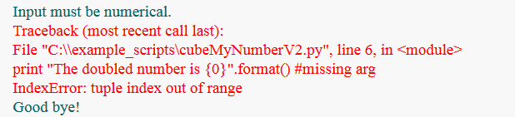
Printing the traceback
Print the true error with the traceback module
# cubeMyNumberV2.py
import sys, traceback
try:
number = float(sys.argv[1])
cube = number**3
print('The cubed number is {0}'.format()) # missing arg
except:
print('Input must be numerical.')
traceback.print_exc()
print('Good bye!')

Slide 37
Looping & error handling rule 1
For tool calls inside loops, place both the try and except blocks inside the loop.
for dataset in datasets:
try:
CALL tools on dataset.
except arcpy.ExecuteError:
Code to run in case
of exception.

Slide 38
FOR-loop & error handling
# buffer_loop_try.py
import arcpy, sys
arcpy.env.overwriteOutput = False
arcpy.env.workspace = "C:/Temp"
fcs = arcpy.ListFeatureClasses()
for fc in fcs:
try:
buffer = fc[:-4] + "_buffer.shp"
arcpy.Buffer_analysis(fc, buffer, "1 mile")
print("Created: ", buffer)
except arcpy.ExecuteError :
print(arcpy.GetMessage())

Slide 39
Looping & error handling rule 2
WHILE-loops should update the looping variable last, outside the except block.
while num < 10:
try:
CALL tools on dataset.
except arcpy.ExecuteError:
Code to run in case
of exception.
Update num

Slide 40
WHILE-loop & error handling
# buffer_loop_try2.py
import arcpy, sys
arcpy.env.overwriteOutput = True
arcpy.env.workspace = "C:/gispy/data/ch14/"
fc = "cover.shp"
dist = 1
while dist <= 10:
try:
buffer = fc[:-4]+ str(dist) + "_buffer.shp"
buffDist = str(dist) + " mile"
arcpy.Buffer_analysis(fc, buffer, buffDist)
print (f"Created: {buffer}")
except arcpy.ExecuteError:
print (arcpy.GetMessage())
dist = dist + 1
Notes:
# buffer_loop_try2.py
# import arcpy, sys
# arcpy.env.overwriteOutput = True
# arcpy.env.workspace = "C:/Temp"
# fc = ‘COVER63p.shp’
# dist = 1
while dist <= 10:
try:
buffer = fc[:-4]+ str(dist) + "_buffer.shp“
buffDist = str(dist) + “ mile"
arcpy.Buffer_analysis(fc, buffer, buffDist)
print ("Created: ", buffer)
except arcpy.ExecuteError:
print (arcpy.GetMessage( ) )
dist = dist + 1

Slide 41
Looping & error handling in-class
Step through the sample scripts in the debugger. Observe the behavior.
Hands–on
copy_try.py
smooth_loop_try.py

Slide 42
Summing up
Topics discussed
fixable vs. handleable exceptions
try and except syntax
named vs. unnamed exceptions
built-in exceptions & arcpy.ExecuteError
error handling flow
sys.exit(0)
looping
printing errors
arcpy.GetMessages( )
traceback.print_exc()
Additional topics
assert, raise, finally keywords
User-defined errors

Slide 44
Appendix

Slide 45
In class - Finding exception names
Explore exceptions using
# fileOpen.py
import sys
filename = sys.argv[1] # Get filename from user
file = open(filename,"r") # Open file for reading
print (file.readlines( )) # Read file and print

Slide 46
Named exception: IOError
# fileOpen.py
import sys, traceback
try:
filename = sys.argv[1] # Get filename from user
file = open(filename,"r") # Open file for reading
print (file.readlines( )) # Read file and print
except IOError:
print (f"Warning: could not open: {filename}")
print ("Usage: <full path file name>")
sys.exit(0)
except:
print( "Unexpected error:")
traceback.print_exc()
sys.exit(0)
Forces the script to exit. No lines of code are
executed after this is called.
Notes:
01| import sys, traceback
02| try:
03| filename = sys.argv[1] # Get filename from user
04| file = open(filename,"r") # Open file for reading
05| print (file.readlines( )) # Read file and print
06| except IOError:
07| print (f"Warning: could not open: {filename}")
08| print ("Usage: <full path file name>")
09| sys.exit(0)
10| except:
11| print( "Unexpected error:")
12| traceback.print_exc()
13| sys.exit(0)

Slide 47
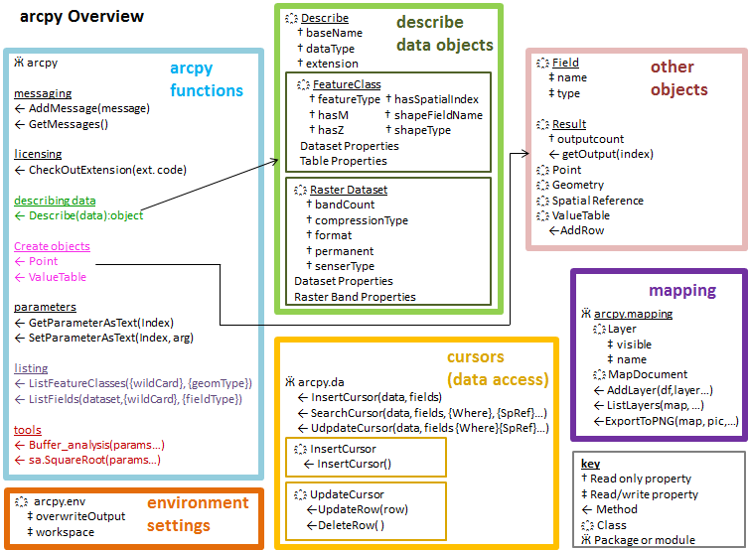
Looking back
strings, lists
calling arcpy tools
conditional structures
looping
describing Arc files
arcpy ‘List’ functions
debugging
more looping
handling errors

Slide 48
Upcoming
cursors
code reuse:
procedures
modules
classes
dictionaries
file input/output
html/kml parsing
Python File GUI’s

Slide 49
Project information
Important dates (See the schedule overview for dates)
Project guidelines (See the Moodle for details)
1. Proposal evaluation
Explain the project clearly for a novice in your domain.
2. Project requirements
3. Submission format
4. How to submit

Slide 50

Printing with Exception as e
Prints the only error description (not as helpful for debugging).
# cubeMyNumberV2.py
import sys
try:
number = float(sys.argv[1])
cube = number**3
print('The cubed number is {0}'.format()) # missing arg
except Exception as e:
print('Input must be numerical.')
print(e)
print('Good bye!')
Notes:
We can define an exception as an event, which, when raised, can alter the flow of the program.

