Slide 1

Getting user input
https://www.explainxkcd.com/wiki/index.php/1666:_Brain_Upload
Hard-coding vs. soft-coding with sys.argv
Single quotes 'gotcha'
Get the script's path
Handling file paths
Dr. Tateosian
Notes:
myList.append( 4 )
mystr.endswith(“shp”)
arcpy.env.overwriteOutput = 1
arcpy.compact_management(filename)
rc = arcpy.AverageNearestNeighbor_stats("C://points.shp", "Euclidean Distance") a. print (rc.outputcount) b. print(rc.getOutput(0))

Slide 2
Hard-coding versus soft-coding
Hard-coding: assigning a value in a program so that it can’t be changed without altering the code.
Hard-coding example
fireDamage = "fire.shp"
string literal
Soft-coding: obtaining a value from an external source, such as user input.
Soft-coding example
fireDamage = sys.argv[1]

Slide 3
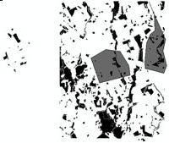
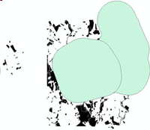
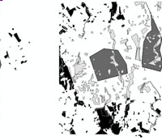
Hard-coded script uses literals
# buffer_clip.py (hard-coded version) # Purpose: Buffer a zone and use it to clip another file # Usage: No arguments needed. import arcpy arcpy.env.overwriteOutput = True arcpy.env.workspace = 'C:/gispy/data/ch06' outDir = 'C:/gispy/scratch/' # Set input values. fireDamage = 'fire.shp'
park = 'park.shp' bufferDist = '5 km' # Set output names. fireBuffer = outDir + fireDamage[:-4] + 'Buffer.shp' clipOutput = outDir + park[:-4] + 'DamageBuffer.shp' arcpy.Buffer_analysis(fireDamage, fireBuffer, bufferDist) print(f'{fireBuffer} created.')
arcpy.Clip_analysis(park, fireBuffer, clipOutput) print(f'{clipOutput} created.')

Slide 4
Remove hard-coding script
# buffer_clip.py (hard-coded version) # Purpose: Buffer a zone and use it to clip another file # Usage: No arguments needed. import arcpy arcpy.env.overwriteOutput = True arcpy.env.workspace = 'C:/gispy/data/ch06' outDir = 'C:/gispy/scratch/' # Set input values. fireDamage = 'fire.shp'
park = 'park.shp' bufferDist = '5 km' # Set output names. fireBuffer = outDir + fireDamage[:-4] + 'Buffer.shp' clipOutput = outDir + park[:-4] + 'DamageBuffer.shp' arcpy.Buffer_analysis(fireDamage, fireBuffer, bufferDist) print(f'{fireBuffer} created.')
arcpy.Clip_analysis(park, fireBuffer, clipOutput) print(f'{clipOutput} created.')

Slide 5
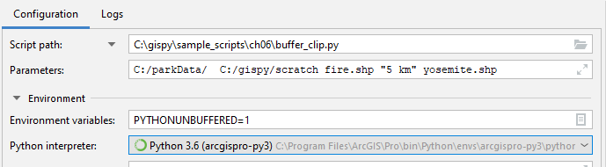
Soft-coded script uses arguments
# buffer_clip.py (soft-coded version) # Purpose: Buffer a zone and use it to clip another file # Usage: fire_zone park_name buffer_distance output_directory.
# Example input: C:/parkData/ C:/gispy/scratch fire.shp "5 km" yosemite.shp
import arcpy import sys arcpy.env.overwriteOutput = True arcpy.env.workspace = sys.argv[1]
outDir = sys.argv[2] # Set input values. fireDamage = sys.argv[3] bufferDist = sys.argv[4]
park = sys.argv[5] # Set output names.
fireBuffer = outDir + fireDamage[:-4] + 'Buffer.shp' clipOutput = outDir + park[:-4] + 'DamageBuffer.shp' arcpy.Buffer_analysis(fireDamage, fireBuffer, bufferDist) print(f'{fireBuffer} created.')
arcpy.Clip_analysis(park, fireBuffer, clipOutput) print(f'{clipOutput} created.')

Slide 6
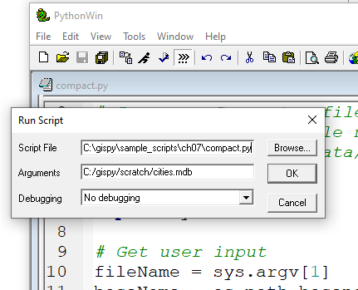
sys.argv automatically populated
sys
built-in module
sys.argv
A Python list
argv
A sys module property
Populate the list using the Arguments text box of the Run Script Window (in PythonWin).
Access the list using indexing.
import sys
# Get the user input.
filename = sys.argv[1]
sys is a module. argv is a Python list.

Slide 7

sys.argv automatically populated
sys
built-in module
sys.argv
A Python list
argv
A sys module property
Populate the list using the Parameters text box of the Configuration settings (in PyCharm).
Access the list using indexing.
import sys
# Get the user input.
filename = sys.argv[1]
sys is a module. argv is a Python list.

Slide 8
Script name, first item
import sys
# Get the user input.
filename = sys.argv[1]
argv is a Python list.
>>> print(sys.argv)
['C:/gispy/sample_scripts/ch07/compact.py','C:/gispy/scratch/cities.mdb']
>>> len(sys.argv)
2
The first item in sys.argv is the full path file name.
What is the minimum possible value of len(sys.argv)for any script?

Slide 9

Spacing in arguments
How many user arguments with this configuration?
Why?
Script arguments are space delimited.
So what?
File paths sometimes have spaces.
E.g., C:/African Elephant/rasters
Other arguments sometimes have spaces
E.g., 5 km

Slide 10

Handling spaces in arguments
Suppose you want to pass in this path: C:/African Elephant/rasters
How many user arguments?
2
First argument?
C:/African
Second argument?
Elephant/rasters

Slide 11
Handling spaces in arguments
Suppose you want to pass in this path: C:/African Elephant/rasters
How to fix this?
How many user arguments?
2
First argument?
C:/African
Second argument?
Elephant/rasters
How many user arguments?
1
The user argument?
C:/African Elephant/rasters

Slide 12
Handling spaces in arguments
Suppose you want to pass in this path: C:/African Elephant/rasters
How to fix this?
How about this?
How many user arguments?
2
First argument?
C:/African
Second argument?
Elephant/rasters
How many user arguments?
1
The user argument? C:/African Elephant/rasters
How many user arguments?
2
First argument?
'C:/African
Second argument?
Elephant/rasters'

Slide 13
Take home?
When you want to pass in this path: C:/African Elephant/rasters
DON'T DO THIS
DO THIS
DON'T DO THIS

Slide 14
You got the path, now what?
myRast = sys.argv[1]
print(myRast)
C:/African Elephant/rasters/2020.tif
Suppose you want to find out if the 2019 data is also in this directory.
Suppose you want to get the name of the file without the ".tif" extension, to use as your map name.

Slide 15

OS
Built-in module
os.path for common path manipulations
operating system

Slide 16
File paths terms
C:/African Elephant/rasters/2020.tif
full path file name (absolute path)

Slide 17
File paths terms
C:/African Elephant/rasters/2020.tif
full path file name (absolute path)
directory name

Slide 18
File paths terms
C:/African Elephant/rasters/2020.tif
full path file name (absolute path)
directory name
base name

Slide 19
File paths terms
C:/African Elephant/rasters/2020.tif
full path file name (absolute path)
directory name
base name

Slide 20
File paths terms
C:/African Elephant/rasters/2020.tif
full path file name (absolute path)
directory name
base name
2020.tif
stem
extension (suffix)

Slide 21
File paths terms
C:/African Elephant/rasters/2020.tif
full path file name (absolute path)
directory name
base name
2020.tif
stem
extension (suffix)

Slide 22
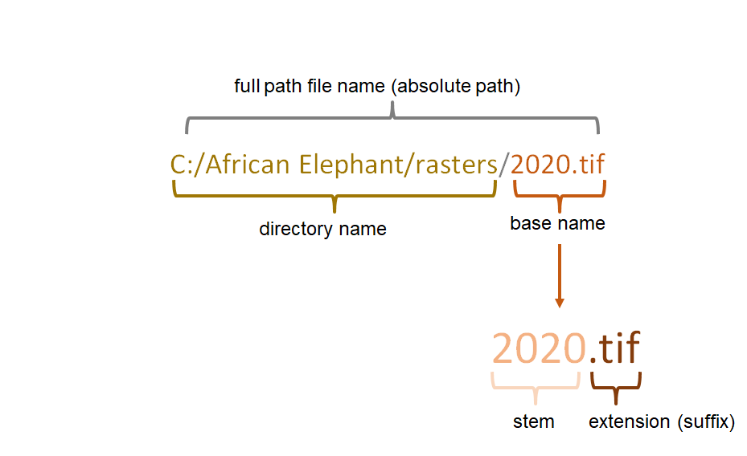
Break it down
p = "D:/data/DelWaterGap.shp"
Specify the following:
a) The full path file name of p
b) The directory name of p
c) The base name of p
d) The stem of p
e) The extension of p
Notes:
a) "D:/data/DelWaterGap.shp"
b) "D:/data"
c) "DelWaterGap.shp"
d) "DelWaterGap"
e) ".shp"

Slide 23
Returning to our questions…
myRast = sys.argv[1]
print(myRast)
C:/African Elephant/rasters/2020.tif
1) Suppose you want to find out if the 2019 is also in this directory.
2) Suppose you want to get the name of the file without the ".tif" extension, to use as your map name.

Slide 24
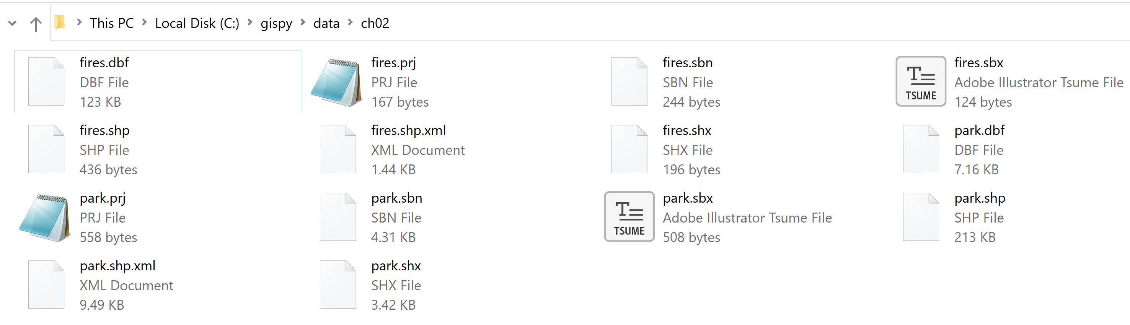
Getting a directory's contents
import os
files = os.listdir("C:\gispy\data\ch02")
print(files)
What will it print?
['fires.dbf', 'fires.prj', 'fires.sbn', 'fires.sbx', 'fires.shp', 'fires.shp.xml', 'fires.shx', 'park.dbf', 'park.prj', 'park.sbn', 'park.sbx', 'park.shp', 'park.shp.xml', 'park.shx']
os.listdir(p) returns a list of the files in p.

Slide 25
Getting the base name
import os
p = "D:/data/DelWaterGap.shp"
theBaseName = os.path.basename(p)
print(theBaseName)
What will it print?
'DelWaterGap.shp'
os.path.basename(p) returns the portion of p after the last slash.

Slide 26
Getting the directory name
import os
p = "D:/data/DelWaterGap.shp"
theDir = os.path.dirname(p)
print(theDir)
What will it print?
'D:/data'
os.path.dirname(p) returns the portion of p up to, not including, the last slash.

Slide 27
Answering question 1…
myRast = sys.argv[1]
print(myRast)
C:/African Elephant/rasters/2020.tif
1) Suppose you want to find out if the 2019 data is also in this directory.
import os
p = "C:/African Elephant/rasters/2020.tif"
theDir = os.path.dirname(p)
files = os.listdir(theDir)
print("2019.tif" in files)

Slide 28

Now for question 2…
myRast = sys.argv[1]
print(myRast)
C:/African Elephant/rasters/2020.tif
1) Suppose you want to find out if the 2019 is also in this directory.
2) Suppose you want to get the name of the file without the ".tif" extension, to use as your map name.

Slide 29
Get the stem and the extention
import os
p = "D:/data/DelWaterGap.shp"
split_output = os.path.splitext(p)
print(split_output)
What will it print?
('D:/data/DelWaterGap', '.shp')
os.path.splitext(p) splits the stem and extension apart and returns them in a tuple.
To get the stem, use index 0
>>> split_output[0]
'D:/data/DelWaterGap'
To get the extension, use index 1
>>> split_output[1]
'.shp'
Notes:
# Splitting extensions
myShapefile = 'parks.shp'
fp = os.path.splitext(myShapefile)
fp
('parks', '.shp')
>>> fp[0]
'parks'
>>> os.path.splitext(myShapefile)[0]
'parks'

Slide 30
Answering question 2…
myRast = sys.argv[1]
print(myRast)
C:/African Elephant/rasters/2020.tif
2) Suppose you want to get the name of the file without the ".tif" extension, to use as your map name.
import os
p = "C:/African Elephant/rasters/2020.tif"
the_basename = os.path.basename(p)
base_stem = os.path.splitext(the_basename)[0]
mapName = base_stem

Slide 31
Checking if a file or path exists
import os
p = "C:\gispy\data\ch02\park.shp"
response = os.path.exists(p)
print(response)
What will it print?
True
os.path.exists(p) returns a Boolean (True or False) depending on the existence of p.

Slide 32
Joining path parts
>>> import os
>>> p = "D:/data/DelWaterGap.shp"
>>> os.path.exists(p)
True
>>> theDir = os.path.dirname(p)
>>> theDir
'D:/data'
>>> the_basename = os.path.basename(p)
>>> the_basename
'DelWaterGap.shp'
>>> os.path.exists(theDir + the_basename)
False
>>> theDir + the_basename
'D:/dataDelWaterGap.shp'
>>> fullPathFileName = os.path.join(theDir, the_basename)
>>> fullPathFileName
'D:/data\\DelWaterGap.shp'
>>> os.path.exists(fullPathFileName)
True

Slide 33
Joining path parts
import os
theDir = "C:\gispy\data\ch02"
parkFile = "park.shp"
fullPath = os.path.join(theDir, parkFile)
print(fullPath)
What will it print?
'C:\\gispy\\data\\ch02\\park.shp'
os.path.join(part1, part2, part3, part4) creates a file path with part1 through part4 delimited by slashes)
Does not allow multiple drives in the path.

Slide 34
How large is the file?
import os
theFile = "C:\gispy\data\ch02\park.shp"
response = os.path.getsize(theFile)
print(response)
What will it print?
218808
os.path.getsize(p) returns the file size in bytes.

Slide 35
Which methods look at files?
os.path.basename
os.path.dirname
os.path.splitext
os.path.join
os.listdir
os.path.exists
os.path.getsize
os.path.getmtime
Only string operations.
These do not look at the data.
More than string operations.
These do look at the data.
Python Reference Library

Slide 36
os does not use arcpy.env.workspace
import arcpy, os
arcpy.env.workspace = "C:/gispy/data/ch02/"
theFile = "park.shp"
response = os.path.getsize(theFile)
print(response)
What will it print?
FileNotFoundError: [WinError 2]
The system cannot find the file specified: 'park.shp'
os methods do not use arcpy's workspace environment.
Provide the full path.
Notes:
import arcpy, os
arcpy.env.workspace = "C:/gispy/data/ch02/"
theFile = "park.shp"
theFile = os.path.join(arcpy.env.workspace, theFile)
response = os.path.getsize(theFile)
print(response)

Slide 37
In class – List the files in my dir
Goal: Print a list of the files in the same directory as the script (wherever you place it).
Suggest steps:
Use sys.argv to get the full script path.
Use os.path.dirname to get the directory where the script resides.
Use os.listdir to get a list of the files in the directory.
Notes:
import os, sys
p = sys.argv[0]
d = os.path.dirname(p)
print(os.listdir(d))

Slide 38
Summing up
Topics discussed
User input for flexibility
Hard vs. soft-coding
sys.argv
sys.argv[0] and script path
Avoid single quotes for args
os.path –string operations vs. file-dependent operations
Use the full path when working with the file-dependent ones
E.g. os.listdir which is very useful

Slide 39
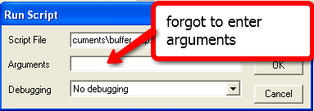
Insufficient args yields IndexError
import arcpy import sys arcpy.env.overwriteOutput = True arcpy.env.workspace = sys.argv[1]
outDir = sys.argv[2] # Set input values. fireDamage = sys.argv[3] bufferDist = sys.argv[4]
park = sys.argv[5] …
If user does not enter enough arguments, an IndexError exception is thrown
>>> Traceback (most recent call last):
…
File "C:\Documents\buffer_clip.py", line 5, in ?
arcpy.env.workspace = sys.argv[1]
IndexError: list index out of range
>>> print(sys.argv) ['C:\\My Documents\\buffer_clip.py']
>>> print(sys.argv[0]) 'C:\\My Documents\\buffer_clip.py'

Slide 40
Get script arguments with GetParameterAsText
# boundingGeomV2.py (soft-coded using arcpy) # Purpose: Find the minimum bounding geometry
# of a set of features. # Usage: workspace, input_features, output_features # Example: C:/gispy/data/07 park.shp boundingBoxes.shp import arcpy
arcpy.env.overwriteOutput = True arcpy.env.workspace = arcpy.GetParameterAsText(0) inputFeatures = arcpy.GetParameterAsText(1) outputFeatures = arcpy.GetParameterAsText(2)
arcpy.MinimumBoundingGeometry_management(inputFeatures, \ outputFeatures)
Can not be used in scripts that don’t import arcpy.

Slide 41
Same example using sys.argv
# boundingGeomV3.py (soft-coded using sys) # Purpose: Find the minimum bounding geometry of a set of features. # Usage: workspace, input_features, output_features # Example: C:/Temp park.shp boundingBoxes.shp import arcpy, sys
arcpy.env.overwriteOutput = True arcpy.env.workspace = sys.argv[1] inputFeatures =sys.argv[2] outputFeatures = sys.argv[3]
arcpy.MinimumBoundingGeometry_management(inputFeatures, \ outputFeatures)
What are the differences in this script from the arcpy.GetParam. approach?
Can be used: Good for stand-alone scripts and scripts that don’t require arcpy.

