Slide 1
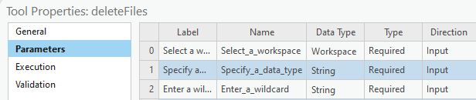
Script Tool Parameters
Parameters tab
Widgets
Parameter properties
Dr. Tateosian

Slide 2
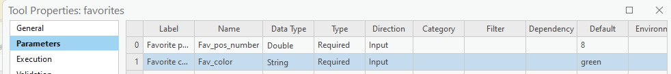
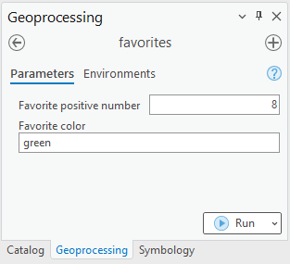
Parameter widget demo
Right click on Script tool > Properties > Parameters tab
The script tool generates a widget for each parameter in the list.

Slide 3
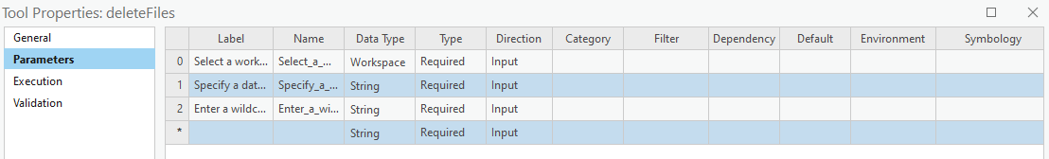
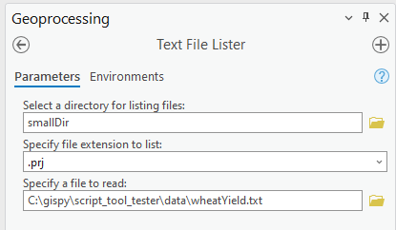
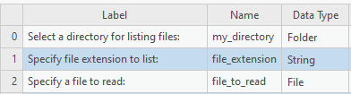
Parameter properties: Label
Label (for appearance only)
Appears on the interface.
Useful providing instructions.

Slide 4
Parameter properties: Name
Unique identifier for the parameter
Does not appear on the interface.
Cannot have spaces or special characters other than underscore.

Slide 5
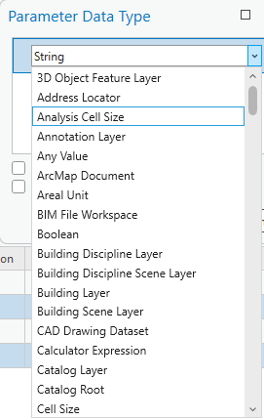
Parameter properties: Data Type
Restricts the type of the input
E.g., if you select Feature Layer, you can pick a layer from an active map or browse to a feature class.
Determines which widget appears on the tool.

Slide 6
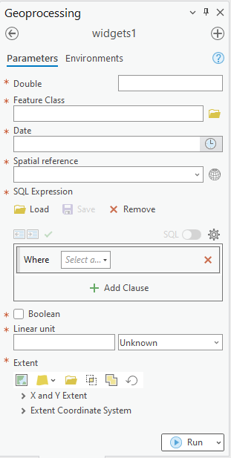
Widgets
User interface elements (e.g., text boxes, buttons, check boxes, combo boxes, and list boxes).
Help the user make input choices.
E.g., Browse to a file.
Constrains accepted input.
E.g., Restrict the file type.
Type of widget depends on the "Data Type".

Slide 7
Parameter data type examples
Target
integer
float
file geodatabase
shapefile
directory that is not a file geodatabase.
time of day
Data type for Script Tool Parameter
Long
Double
Workspace (by default the user could choose any type of workspace including local DBs, networked DBs, or just a regular folder)
Feature Class (or Shapefile if you don't want the user to have the flexibility to choose a shapefile OR a feature class)
Folder
Date (allows user to choose time, date, or both.)

Slide 8
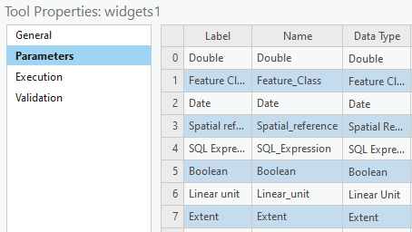
Test-Drive Data Types

Slide 9
First three columns (CHECK!)
Topics discussed
Label vs. Name
Data type vs. Parameter Type (Required, Optional, Derived)
What "widget" means

Slide 10

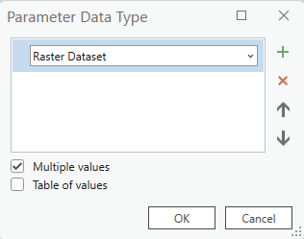
Parameter properties: Multivalue
Multivalue (checkbox)
User can select multiple items.
Most (but not all) data types have this option.
To set, select the Data Type > Click […] > Check the "Multiple values" box.
Notes:
multivalue property (checked or not)
Not all data types can have multiple values (e.g., Boolean parameters can not handle multiple values).

Slide 11
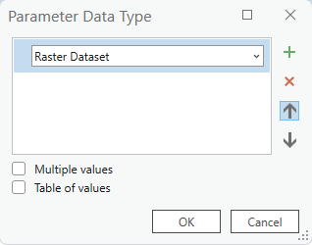


Square braces indicate Multivalue

Slide 12
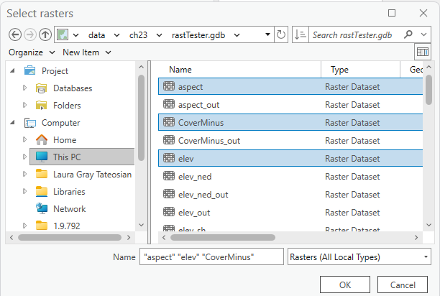
Multivalue input format
Multivalue input creates semicolon delimited string.
Value that comes into script:
C:\gispy\data\ch23\rastTester.gdb\aspect;C:\gispy\data\ch23\rastTester.gdb\CoverMinus;C:\gispy\data\ch23\rastTester.gdb\elev

Slide 13
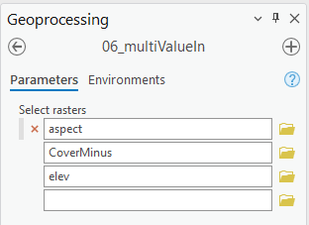
Handle multivalue input with script
Customize the Python script to handle multivalue input.
Split sys.argv[i] value on semicolon
Loop to use the values in the list.
0|
1|
2|
3|
4|
5|
6|
7|
8|
9|
10|
11|
# multiIn.py
# Purpose: Parse a semicolon delimited input string.
import reportSTargs, sys
inputString = sys.argv[1]
reportSTargs.printArc(f'Input string: {inputString}')
inputList = inputString.split(';')
for i in inputList:
reportSTargs.printArc(f'Input file: {i}')
Start Time: Friday, November 10, 20XX 4:20:01 PM
Input string: C:\gispy\data\ch23\rastTester.gdb\aspect;C:\gispy\data\ch23\rastTester.gdb\CoverMinus;C:\gispy\data\ch23\rastTester.gdb\elev
Input file: C:\gispy\data\ch23\rastTester.gdb\aspect
Input file: C:\gispy\data\ch23\rastTester.gdb\CoverMinus
Input file: C:\gispy\data\ch23\rastTester.gdb\elev
Succeeded at Friday, November 10, 20XX 4:20:01 PM (Elapsed Time: 0.32 seconds)

Slide 14
Additional controls on user input
Label vs. Name
Multivalue
Data type
Parameter Type (Required, Optional, Derived)
Category
Filter
Dependency
Drawing input features
Setting default data paths

Slide 15
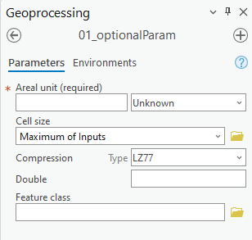
Parameter properties: Type
Type (of parameter)
Controls whether the user must enter a value.
Three choices (required, optional, or derived)
Required, the default, suffices for most purposes.
For more about optional & derived types, see slide appendix.
Required
Optional

Slide 16
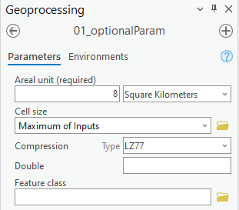
Examine what comes in
0|
1|
2|
3|
4|
5|
6|
7|
8|
9|
10|
11|
12|
13|
14|
15|
16|
# reportSTargs.py
# Purpose: Print the arguments passed into a script tool.
import arcpy, sys
def printArc(message):
'''Print message for script tool and standard output.'''
print(message)
arcpy.AddMessage(message)
def printArgs():
'''Print user arguments.'''
printArc(f"Number of arguments = {len(sys.argv)}")
for i, arg in enumerate(sys.argv):
printArc(f"Argument {i}: {arg}")
printArgs()
Argument 0: C:\gispy\sample_scripts\ch23\scripts\reportSTargs.py Argument 1: 8 SquareKilometers Argument 2: MAXOF Argument 3: LZ77 Argument 4: # Argument 5: #
Notes:
# reportSTargs.py
# Purpose: Print the arguments passed into a script tool.
# Arguments: Variable (can be used for any number of arguments)
import arcpy, sys
def printArc(message):
'''Print message for script tool and standard output.'''
print message
arcpy.AddMessage(message)
def printArgs():
'''Print user arguments.'''
printArc('Number of arguments = {0}'.format(len(sys.argv)))
for index, arg in enumerate(sys.argv):
printArc( 'Argument {0}: {1}'.format(index, arg) )
if __name__ == '__main__':
printArgs()

Slide 17
Parameter properties: Direction
Direction
Can only be set to Input or Output.
Most parameters will be Input.
Output direction can be used two ways.
Define output names.
Add output to a map (or send it to a model).
Input, the default, suffices for most purposes.
For more about direction, see slide appendix.
Notes:
Direction can only be set to Input or Output.
Input parameters are information the script needs to perform its tasks. E.g., a dataset or workspace to use.
Input parameters can be required or optional, but not derived.
‘Output’ direction for script tool parameters that represent output generated by the tool.
‘Output’ can be added to the map automatically.
Output examples:
--one or more datasets created by the tool.
--a modified preexisting dataset
--a Boolean value (True or False).
--numerical values resulting from script tool calculations.
Any types of results generated by standard ArcToolbox tools could be output from a custom script tool.
Like standard tools, custom script tools can be used as tools in ModelBuilder models. The output Boolean, numerical results, dataset would then be passed along to the output ovals in the models.

Slide 18
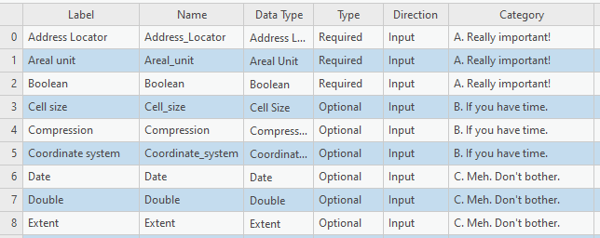
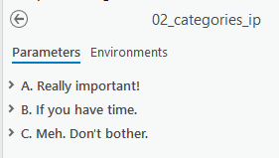
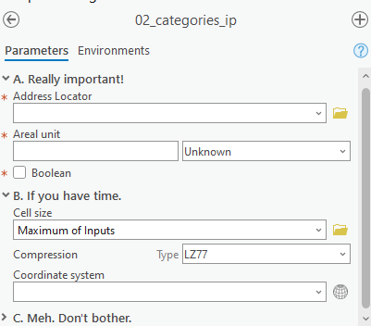
Parameter properties: Category
Category
Groups parameters.
Expand/collapse
For lengthy GUIs
Notes:
Direction can only be set to Input or Output.
Input parameters are information the script needs to perform its tasks. E.g., a dataset or workspace to use.
Input parameters can be required or optional, but not derived.
‘Output’ direction for script tool parameters that represent output generated by the tool.
‘Output’ can be added to the map automatically.
Output examples:
--one or more datasets created by the tool.
--a modified preexisting dataset
--a Boolean value (True or False).
--numerical values resulting from script tool calculations.
Any types of results generated by standard ArcToolbox tools could be output from a custom script tool.
Like standard tools, custom script tools can be used as tools in ModelBuilder models. The output Boolean, numerical results, dataset would then be passed along to the output ovals in the models.

Slide 19
So far...
Label vs. Name
Data type vs. Parameter Type (Required, Optional, Derived)
Direction (Input or Output)
Multivalue (checked or not)
Multivalue input (split(';'))
Type, Direction, Category

Slide 20
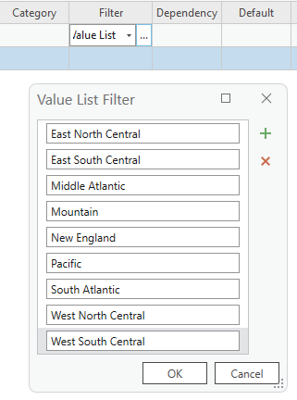
Parameter properties: Filter
Filter
Restrict accepted values.
Various types of filters.
Filter type depends on the data type.
Click in the filter box (to see if that type can be filtered)
Notes:
Direction can only be set to Input or Output.
Input parameters are information the script needs to perform its tasks. E.g., a dataset or workspace to use.
Input parameters can be required or optional, but not derived.
‘Output’ direction for script tool parameters that represent output generated by the tool.
‘Output’ can be added to the map automatically.
Output examples:
--one or more datasets created by the tool.
--a modified preexisting dataset
--a Boolean value (True or False).
--numerical values resulting from script tool calculations.
Any types of results generated by standard ArcToolbox tools could be output from a custom script tool.
Like standard tools, custom script tools can be used as tools in ModelBuilder models. The output Boolean, numerical results, dataset would then be passed along to the output ovals in the models.

Slide 21

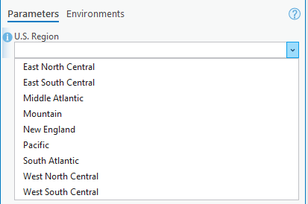
Value List Filter (for Strings)
Notes:
Direction can only be set to Input or Output.
Input parameters are information the script needs to perform its tasks. E.g., a dataset or workspace to use.
Input parameters can be required or optional, but not derived.
‘Output’ direction for script tool parameters that represent output generated by the tool.
‘Output’ can be added to the map automatically.
Output examples:
--one or more datasets created by the tool.
--a modified preexisting dataset
--a Boolean value (True or False).
--numerical values resulting from script tool calculations.
Any types of results generated by standard ArcToolbox tools could be output from a custom script tool.
Like standard tools, custom script tools can be used as tools in ModelBuilder models. The output Boolean, numerical results, dataset would then be passed along to the output ovals in the models.

Slide 22
ESRI Data Type review
ESRI data type equivalent of Python Integer?
A. Float
B. Long
C. Double
D. Integral
Notes:
B Long

Slide 23
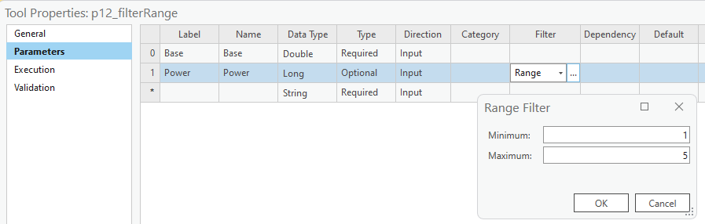
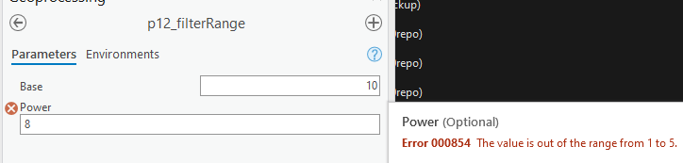
Range Filter (for Long or Double)
Notes:
Direction can only be set to Input or Output.
Input parameters are information the script needs to perform its tasks. E.g., a dataset or workspace to use.
Input parameters can be required or optional, but not derived.
‘Output’ direction for script tool parameters that represent output generated by the tool.
‘Output’ can be added to the map automatically.
Output examples:
--one or more datasets created by the tool.
--a modified preexisting dataset
--a Boolean value (True or False).
--numerical values resulting from script tool calculations.
Any types of results generated by standard ArcToolbox tools could be output from a custom script tool.
Like standard tools, custom script tools can be used as tools in ModelBuilder models. The output Boolean, numerical results, dataset would then be passed along to the output ovals in the models.

Slide 24
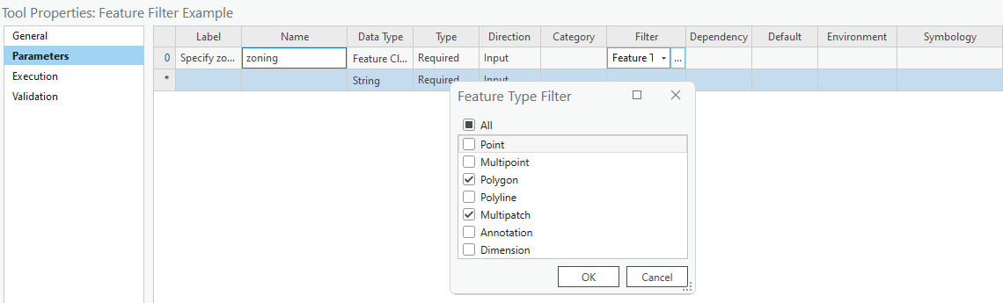
Feature Type Filter (for Feature Class data)
Notes:
Direction can only be set to Input or Output.
Input parameters are information the script needs to perform its tasks. E.g., a dataset or workspace to use.
Input parameters can be required or optional, but not derived.
‘Output’ direction for script tool parameters that represent output generated by the tool.
‘Output’ can be added to the map automatically.
Output examples:
--one or more datasets created by the tool.
--a modified preexisting dataset
--a Boolean value (True or False).
--numerical values resulting from script tool calculations.
Any types of results generated by standard ArcToolbox tools could be output from a custom script tool.
Like standard tools, custom script tools can be used as tools in ModelBuilder models. The output Boolean, numerical results, dataset would then be passed along to the output ovals in the models.

Slide 25
Various other filter types
Filter type | Values
Value List | A list of string or numeric values. Used with String, Long, Double, and Boolean parameter data types.
Range | A minimum and maximum value. Used with Long and Double data types.
Feature Class | A list of allowable feature class types: "Point", "Multipoint", "Polyline", "Polygon", "MultiPatch", "Sphere", "Annotation", "Dimension". More than one value can be supplied to the filter.
File | A list of file suffixes. Example: "txt; e00; ditamap".
Field | A list of allowable field types: "Short", "Long", "Single", "Double", "Text", "Date", "OID", "Geometry", "Blob", "Raster", "GUID", "GlobalID", "XML". More than one value can be supplied to the filter.
Workspace | A list of allowable workspace types: "File System", "Local Database", or "Remote Database". More than one value can be supplied.
Notes:
Direction can only be set to Input or Output.
Input parameters are information the script needs to perform its tasks. E.g., a dataset or workspace to use.
Input parameters can be required or optional, but not derived.
‘Output’ direction for script tool parameters that represent output generated by the tool.
‘Output’ can be added to the map automatically.
Output examples:
--one or more datasets created by the tool.
--a modified preexisting dataset
--a Boolean value (True or False).
--numerical values resulting from script tool calculations.
Any types of results generated by standard ArcToolbox tools could be output from a custom script tool.
Like standard tools, custom script tools can be used as tools in ModelBuilder models. The output Boolean, numerical results, dataset would then be passed along to the output ovals in the models.

Slide 26
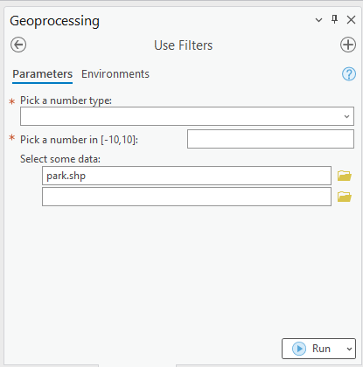
Hands-on – Use Filters
Write a script the prints the index and value of the arguments that it receives.
Create a script tool in C:\gispy\scratch and use filters to allow the user to:
Choose the word float or integer from a combobox.
Choose an integer value between [-10, 10].
Choose one or more polygon feature classes. Set the default value as the relative path to park.shp in the chapter 2 data directory in gispy.
Printed output should look something like this:
Argument 0: C:\printArgs.py
Argument 1: float
Argument 2: -4
Argument 3: C:\gispy\ch02\data\park.shp;C:\gispy\data\ch11\USA.shp

Slide 27
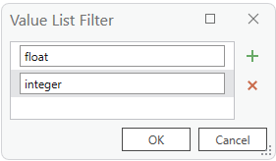
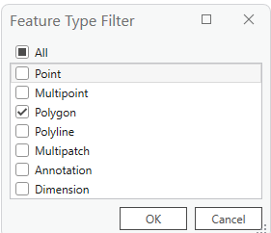
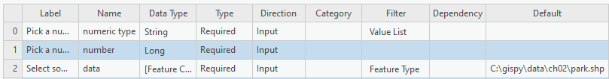
Use filters follow-up
# useFilters.py
# Purpose: Print user arguments
import arcpy, sys
def printArc(message):
"""Print message for script tool and standard output."""
print(message)
arcpy.AddMessage(message)
def printArgs():
"""Print user arguments."""
printArc(f"Number of arguments = {len(sys.argv)}")
for i, arg in enumerate(sys.argv):
printArc(f"Argument {i}: {arg}")
printArgs()

Slide 28
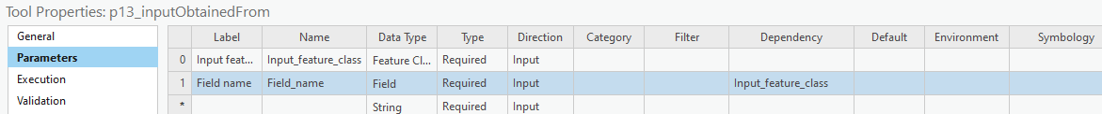
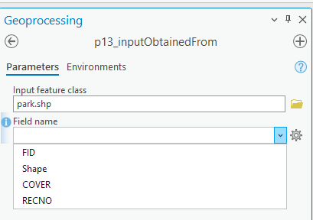
Parameter properties: Dependency
Dependency
Set values of a param. based on another param.
E.g., Set "Field name" to be dependent on Input feature class.
Select park.shp.
Field name gets park fields.

Slide 29
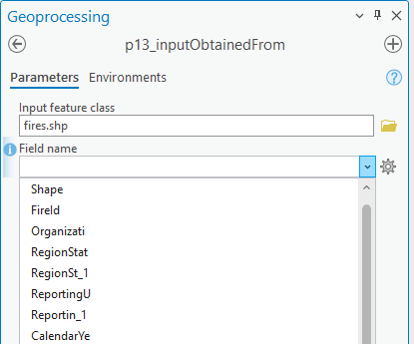
Parameter properties: Dependency
Dependency
Set values of a param. based on another param.
E.g., Set "Field name" to be dependent on Input feature class.
Select fires.shp.
Field name gets fire fields.

Slide 30
So far...
Label vs. Name
Data type vs. Parameter Type, Direction, Multivalue
Type, Direction, Category
Filter
Dependency

Slide 31
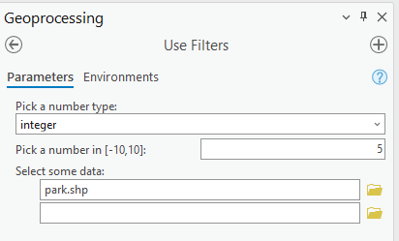
Parameter properties: Default
Default values
Provides prefilled options
Guides users
Improves usability/efficiency
??
integer
5

Slide 32

Data moves
What if we use data paths as defaults?
Not everyone will have a C:/lgtateos/parkProj folder.
Pro will update the paths based on the location of the project if you put the data inside the project folder!

Slide 33
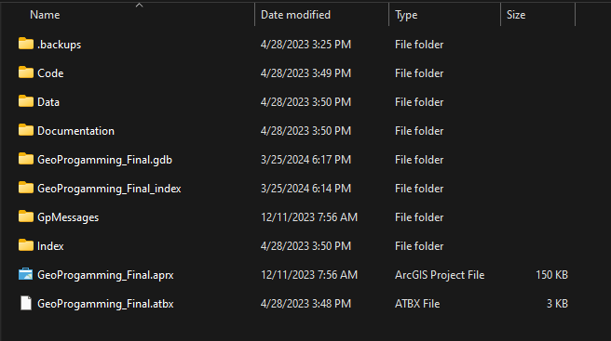
Portability and defaults
User may not have a C:\gispy\data\ directory
Place default data in a Data folder under your project folder
XX

Slide 34
Set initial default data paths
Place default data under your project folder
Set your default to the data's full path in a project subdirectory
Share entire project folder
Path will automatically update when the project is moved
XX

Slide 35
Special case default

Slide 36
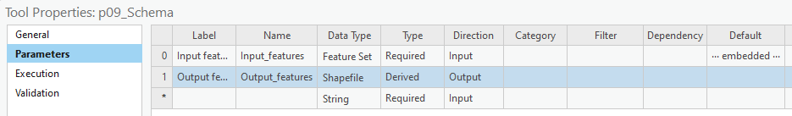
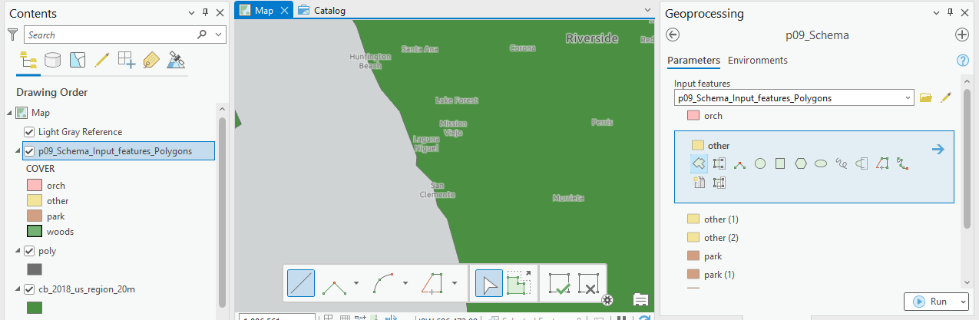
Special type of default "embedded"
Embed a default schema – a geometry & symbology
User can draw or select existing features

Slide 37
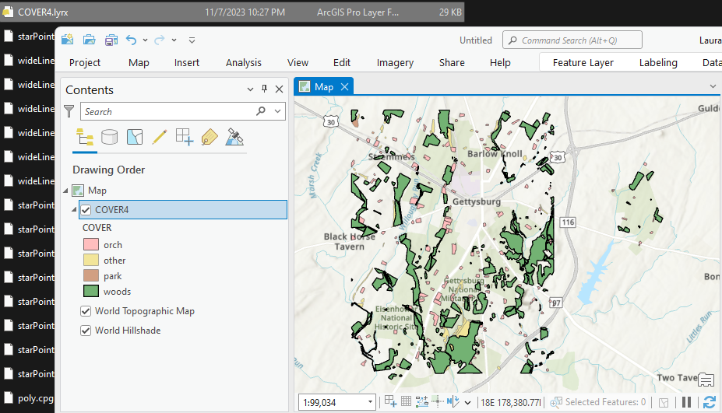
First step, create training data
Create training data: Save a layer file

Slide 38
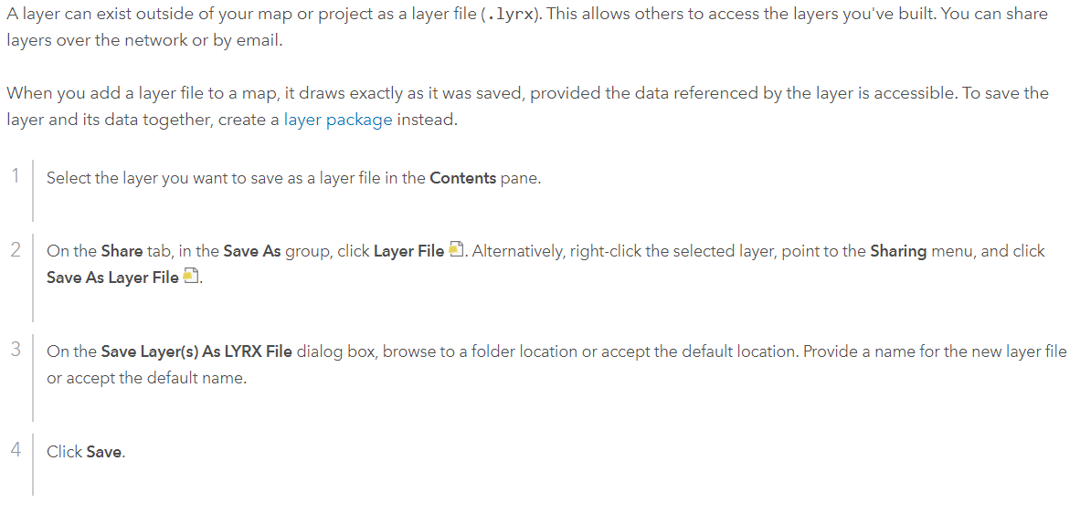
Save a layer file

Slide 39
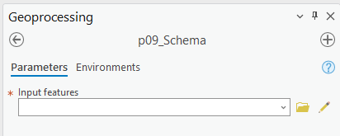
Enable user to draw features
Create training data.
Select Feature Set for Data Type.
Specify default as lyrx file.
C:\gispy\data\ch23\training\COVER4.lyrx

Slide 40
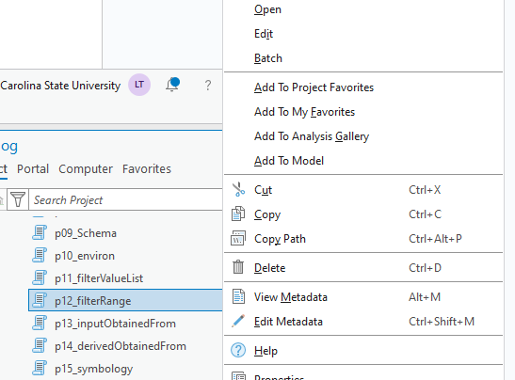
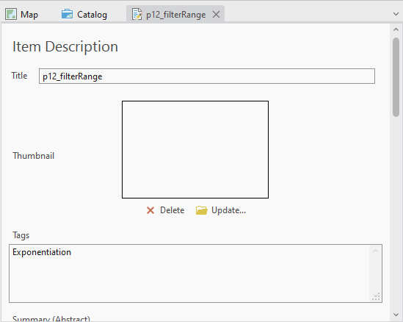
Edit tool help
Right-click Script Tool > Edit Metadata

Slide 41
Summing up
Label vs. Name
Data type vs. Parameter Type (Required, Optional, Derived)
Multivalue
Filter
Dependency
Drawing input features
Setting default data paths

Slide 42
Parameter FAQ
How can I remove a parameter? A: Right click on that row in the table and select delete.
I want to for the user to choose an integer. What data type to use? A: Long
I want to for the user to choose a float. What data type to use? A: Double
I want to force the user to choose a file geodatabase. What data type to use? A: Workspace + plus use a filter & check "local database"
I want to the user to choose a directory, but not a file geodatabase directory. What data type to use? A: Folder
Notes:
https://pro.arcgis.com/en/pro-app/latest/arcpy/geoprocessing_and_python/defining-parameter-data-types-in-a-python-toolbox.htm

Slide 43
Appendix I

Slide 44
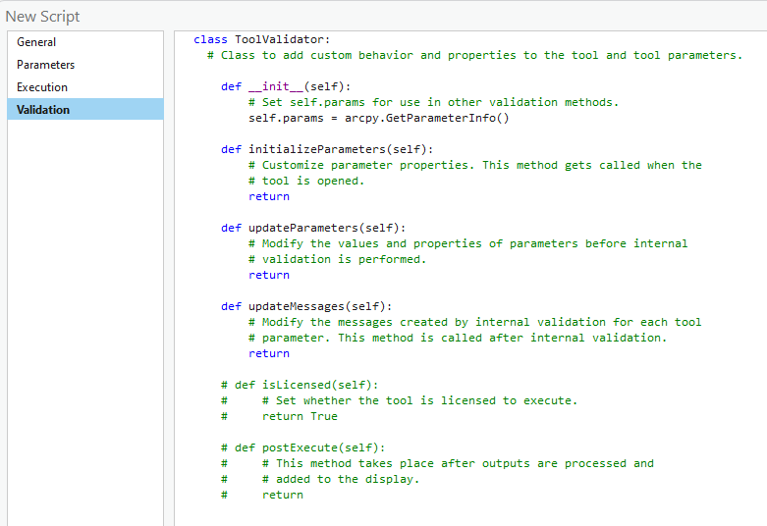
Four methods (functions in the class)

Slide 45
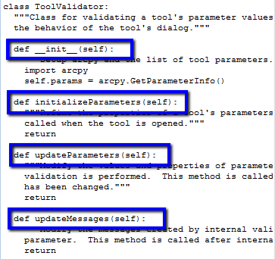
Tool validator methods
Method | Description
__init__ | Initializes the ToolValidator class. Perform import and initialize the object (self) properties.
initializeParameters | Called once when the tool dialog box first opens
updateParameters | Called each time the user changes a parameter. After returning from updateParameters, geoprocessing calls its internal validation routine.
updateMessages | Called after returning from the internal validation routine. You can change the messages created from internal validation.

Slide 46
self.params has Parameter objects
class ToolValidator:
def __init__(self):
# Set self.params for use in other validation methods.
self.params = arcpy.GetParameterInfo()
Get the Parameter objects with their properties as set in the table
Python list of Parameter objects

Slide 47
self.params zero based.
class ToolValidator:
def __init__(self):
# Set self.params for use in other validation methods.
self.params = arcpy.GetParameterInfo()
firstParam = self.params[0]
firstParam.value = 5

Slide 48
Parameters object properties
class ToolValidator:
def __init__(self):
"""Setup arcpy and the list of tool parameters."""
import arcpy
self.params = arcpy.GetParameterInfo()
Selected Properties | Read/Write | Value(s) | Description
name | Read only | String | Parameter name as defined on Parameters tab
direction | Read only | String: "Input", "Output" | Input/Output direction defined on Parameters tab
datatype | Read only | String | Data type as defined on Parameters tab.
parameterType | Read only | String: "Required", "Optional", "Derived" | Type as defined on the Parameters tab .
parameterDependencies | Read/write | Python List | A list of indexes of each dependent parameter.
value | Read/write | Value object | The value of the parameter.
enabled | Read/write | Boolean | False if the parameter is dimmed (unavailable).
altered | Read only | Boolean | True if the user has modified the value.
hasBeenValidated | Read only | Boolean | True if the internal validation routine has checked the parameter.
category | Read/write | String | The category of the parameter.
filter | Read only | GP Filter object | The filter to apply to values in the parameter.
symbology | Read/write | String | The pathname to a layer file (.lyr) used for drawing the output.
Notes:
For a complete list of properties:
http://help.arcgis.com/en/arcgisdesktop/10.0/help/index.html#/Programming_a_ToolValidator_class/00150000000v000000/

Slide 49
Edit a filter list
class ToolValidator:
def __init__(self):
# Set self.params for use in other validation methods.
self.params = arcpy.GetParameterInfo()
firstParam = self.params[0]
firstParam.value = 5
secondParam = self.params[1]
secondParam.filter.list = ["NorthEast", "SouthEast", "Northwest", "Southwest"]
secondParam.value = "Northeast"
Set the dropdown menu choices
Set the default

Slide 50
Can just use self.params[i]
class ToolValidator:
def __init__(self):
# Set self.params for use in other validation methods.
self.params = arcpy.GetParameterInfo()
self.params[0].value = 5
self.params[1].filter.list = ["NorthEast", "SouthEast", "Northwest", "Southwest"]
self.params[1].value = "Northeast"
Set the dropdown menu choices
Set the default

Slide 51
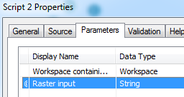
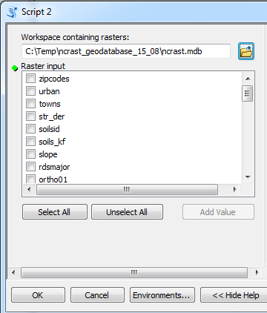
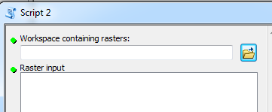
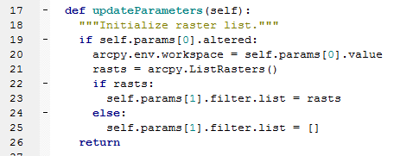
Updating parameters
Notes:
class ToolValidator:
"""Class for validating a tool's parameter values and controlling
the behavior of the tool's dialog."""
def __init__(self):
"""Setup arcpy and the list of tool parameters."""
import arcpy
self.params = arcpy.GetParameterInfo()
def initializeParameters(self):
"""Refine the properties of a tool's parameters. This method is
called when the tool is opened."""
return
def updateParameters(self):
"""Modify the values and properties of parameters before internal
validation is performed. This method is called whenever a parmater
has been changed."""
if self.params[0].altered:
arcpy.env.workspace = str(self.params[0].value)
rasts = arcpy.ListRasters()
self.params[1].filter.list = rasts
return
def updateMessages(self):
"""Modify the messages created by internal validation for each tool
parameter. This method is called after internal validation."""
return

Slide 52
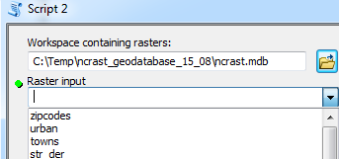
Updating parameters
parameter properties:
Line 19: altered -- returns true or false
Line 23: filter.list – A python list of choices available to user.
Multivalue yes, gives a set of check boxes.
Multivalue no, gives a combobox
Notes:
class ToolValidator:
"""Class for validating a tool's parameter values and controlling
the behavior of the tool's dialog."""
def __init__(self):
"""Setup arcpy and the list of tool parameters."""
import arcpy
self.params = arcpy.GetParameterInfo()
def initializeParameters(self):
"""Refine the properties of a tool's parameters. This method is
called when the tool is opened."""
return
def updateParameters(self):
"""Modify the values and properties of parameters before internal
validation is performed. This method is called whenever a parmater
has been changed."""
if self.params[0].altered:
arcpy.env.workspace = str(self.params[0].value)
rasts = arcpy.ListRasters()
self.params[1].filter.list = rasts
return
def updateMessages(self):
"""Modify the messages created by internal validation for each tool
parameter. This method is called after internal validation."""
return

Slide 53
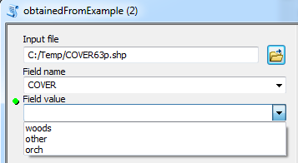
In class - getUniqueValues.py
Complete a script to get a list of unique values for a field in a GIS table.
Create a script tool (no need to point to an actual script). Set up 3 parameters.
Modify updateParameters in ToolValidator class so that the 3rd parameter is updated to a unique list of values in the selected field for the selected feature class.

Slide 54
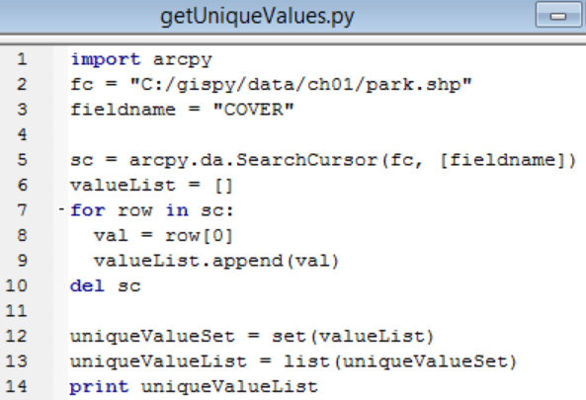
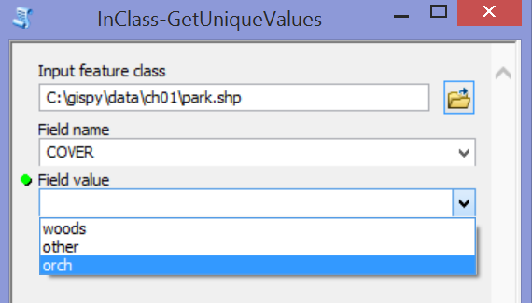
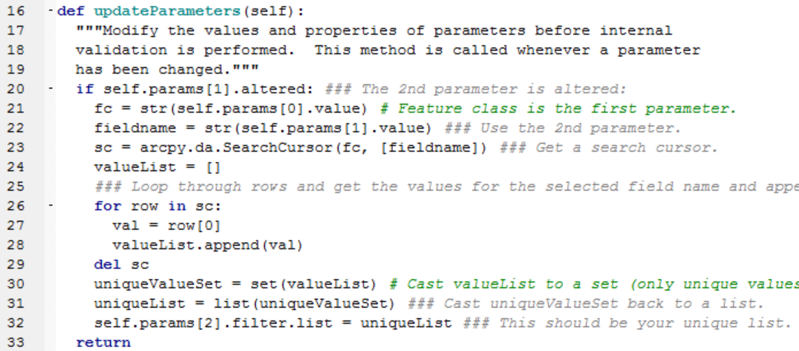
getUniqueValues followup
1
2
3
Notes:
import arcpy
fc = "C:/gispy/data/ch01/park.shp"
fieldname = "COVER"
sc = arcpy.da.SearchCursor(fc, [fieldname])
valueList = []
for row in sc:
val = row[0]
valueList.append(val)
del sc
uniqueValueSet = set(valueList)
uniqueValueList = list(uniqueValueSet)
print uniqueValueList
def updateParameters(self):
"""Modify the values and properties of parameters before internal
validation is performed. This method is called whenever a parameter
has been changed."""
if self.params[1].altered: ### The 2nd parameter is altered:
fc = str(self.params[0].value) # Feature class is the first parameter.
fieldname = str(self.params[1].value) ### Use the 2nd parameter.
sc = arcpy.da.SearchCursor(fc, [fieldname]) ### Get a search cursor.
valueList = []
### Loop through rows and get the values for the selected field name and append to valuelist.
for row in sc:
val = row[0]
valueList.append(val)
del sc
uniqueValueSet = set(valueList) # Cast valueList to a set (only unique values retained).
uniqueList = list(uniqueValueSet) ### Cast uniqueValueSet back to a list.
self.params[2].filter.list = uniqueList ### This should be your unique list.
return
##valueList = [row[0] for row in sc]

Slide 55
Parameter properties: Type
Type (of parameter)
Controls whether the user must enter a value.
Three choices (required, optional, or derived)
Required
Optional

Slide 56

Parameter properties: Type
Type (of parameter)
Controls whether the user must enter a value.
Three choices (required, optional, or derived)
Derived parameters don't appear in the GUI.
Derived Type is only used when the Direction property is set to Output…
Required
Optional

Slide 57
Examine what comes in
0|
1|
2|
3|
4|
5|
6|
7|
8|
9|
10|
11|
12|
13|
14|
15|
16|
# reportSTargs.py
# Purpose: Print the arguments passed into a script tool.
import arcpy, sys
def printArc(message):
'''Print message for script tool and standard output.'''
print(message)
arcpy.AddMessage(message)
def printArgs():
'''Print user arguments.'''
printArc(f"Number of arguments = {len(sys.argv)}")
for i, arg in enumerate(sys.argv):
printArc(f"Argument {i}: {arg}")
printArgs()
Argument 0: C:\gispy\sample_scripts\ch23\scripts\reportSTargs.py Argument 1: 8 SquareKilometers Argument 2: MAXOF Argument 3: LZ77 Argument 4: # Argument 5: #
Notes:
# reportSTargs.py
# Purpose: Print the arguments passed into a script tool.
# Arguments: Variable (can be used for any number of arguments)
import arcpy, sys
def printArc(message):
'''Print message for script tool and standard output.'''
print message
arcpy.AddMessage(message)
def printArgs():
'''Print user arguments.'''
printArc('Number of arguments = {0}'.format(len(sys.argv)))
for index, arg in enumerate(sys.argv):
printArc( 'Argument {0}: {1}'.format(index, arg) )
if __name__ == '__main__':
printArgs()

Slide 58
Optional parameters get values
0|
1|
2|
3|
4|
5|
6|
7|
8|
9|
10|
11|
12|
13|
14|
15|
16|
# reportSTargs.py
# Purpose: Print the arguments passed into a script tool.
import arcpy, sys
def printArc(message):
'''Print message for script tool and standard output.'''
print(message)
arcpy.AddMessage(message)
def printArgs():
'''Print user arguments.'''
printArc(f"Number of arguments = {len(sys.argv)}")
for i, arg in enumerate(sys.argv):
printArc(f"Argument {i}: {arg}")
printArgs()
Argument 0: C:\gispy\sample_scripts\ch23\scripts\reportSTargs.py Argument 1: 8 SquareKilometers Argument 2: MAXOF Argument 3: LZ77 Argument 4: # Argument 5: #
Notes:
# reportSTargs.py
# Purpose: Print the arguments passed into a script tool.
# Arguments: Variable (can be used for any number of arguments)
import arcpy, sys
def printArc(message):
'''Print message for script tool and standard output.'''
print message
arcpy.AddMessage(message)
def printArgs():
'''Print user arguments.'''
printArc('Number of arguments = {0}'.format(len(sys.argv)))
for index, arg in enumerate(sys.argv):
printArc( 'Argument {0}: {1}'.format(index, arg) )
if __name__ == '__main__':
printArgs()

Slide 59
Parameter properties: Direction
Direction
Can only be set to Input or Output.
Most parameters will be Input.
Output direction can be used two ways.
Define output names.
Add output to a map (or send it to a model).
Notes:
Direction can only be set to Input or Output.
Input parameters are information the script needs to perform its tasks. E.g., a dataset or workspace to use.
Input parameters can be required or optional, but not derived.
‘Output’ direction for script tool parameters that represent output generated by the tool.
‘Output’ can be added to the map automatically.
Output examples:
--one or more datasets created by the tool.
--a modified preexisting dataset
--a Boolean value (True or False).
--numerical values resulting from script tool calculations.
Any types of results generated by standard ArcToolbox tools could be output from a custom script tool.
Like standard tools, custom script tools can be used as tools in ModelBuilder models. The output Boolean, numerical results, dataset would then be passed along to the output ovals in the models.

Slide 60


Output direction for output names
Output use
#1
Required (or Optional) Type + Output Direction
User selects a name for output created by the script.
GUI will not let user select existing file.
Output data is added to the current map.
0|
1|
2|
3|
4|
5|
6|
7|
# copier.py
# Purpose: Make a copy of argument 1 with a name specified by argument 2.
import arcpy, reportSTargs, sys
reportSTargs.printArgs()
arcpy.Copy_management(sys.argv[1], sys.argv[2])

Slide 61

Return output from Script Tool
Output use
#2
Derived Type + Output Direction
Derived Type can not be Input Direction.
User does not enter a value.
Script can return a value, like built-in tools.
Use case examples:
One or more datasets created by the tool.
A modified preexisting dataset
A Boolean value (True or False).
Numerical values resulting from script tool calculations.

Slide 62
"Return" with SetParameterAsText
Output use
#2
SetParameterAsText
The script must use this to return the parameter.
arcpy method
Takes two arguments, an index and the returned items.
Example:
arcpy.SetParameterAsText(0, output)
parameter output file
index name

Slide 63
SetParameterAsText Example 1
Call at (or near) the end of the script.
Index based on position in the parameters table.
0|
1|
2|
3|
4|
5|
6|
7|
8|
9|
10|
11|
12|
# buffer1.py
# Purpose: Buffer a file and send the result to a script tool.
import arcpy
arcpy.env.overwriteOutput = True
fileToBuffer = 'C:/gispy/data/ch23/smallDir/randpts.shp'
distance = '500 meters'
outputFile = 'C:/gispy/scratch/randptsBuffer.shp'
arcpy.Buffer_analysis(fileToBuffer, outputFile, distance)
arcpy.SetParameterAsText(0, outputFile)

Slide 64

SetParameterAsText Example 2
Conventionally, Derived Output is the last parameter in the parameters table.
0|
1|
2|
3|
4|
5|
6|
7|
8|
9|
10|
11|
12|
13|
14|
15|
# buffer2.py
# Purpose: Buffer an input file by an input distance
# and send the result to a script tool.
import arcpy, os, sys
arcpy.env.overwriteOutput = True
fileToBuffer = sys.argv[1]
distance = sys.argv[2]
arcpy.env.workspace = os.path.dirname(fileToBuffer)
outputFile = 'C:/gispy/scratch/Buff'
arcpy.Buffer_analysis(fileToBuffer, outputFile, distance)
arcpy.SetParameterAsText(2, outputFile)
Notes:
# copy_to_gdb.py
# Purpose: Copy argument 1 into a file geodatabase names as specified by argument 2.
import arcpy, os, sys
arcpy.env.overwriteOutput = True
file_to_copy = sys.argv[1]
gdb_path = sys.argv[2]
out_folder_path = os.path.dirname(gdb_path)
gdb_name = os.path.basename(gdb_path)
if not arcpy.Exists(os.path.join(gdb_path)):
arcpy.management.CreateFileGDB(out_folder_path, gdb_name)
copied_data = os.path.splitext(os.path.basename(file_to_copy))[0]
arcpy.conversion.FeatureClassToFeatureClass(file_to_copy,gdb_path,copied_data)
arcpy.env.workspace = gdb_path
arcpy.SetParameterAsText(2, copied_data)

Slide 65

SetParameterAsText Example 3
Derived Output should be the last parameter in the parameters table.
0|
1|
2|
3|
4|
5|
6|
7|
8|
9|
10|
11|
12|
13|
14|
15|
16|
# copy_to_gdb.py
# Purpose: Copy a feature class (arg 1) into a file geodatabase (arg 2)
# Example input: C:\gispy\scratch\fires.shp C:\gispy\scratch\disasters.gdb
import arcpy, os, sys
arcpy.env.overwriteOutput = True
file_to_copy = sys.argv[1]
gdb_path = sys.argv[2]
out_folder_path = os.path.dirname(gdb_path)
gdb_name = os.path.basename(gdb_path)
copied_data = os.path.splitext(os.path.basename(file_to_copy))[0]
arcpy.conversion.FeatureClassToFeatureClass(file_to_copy,gdb_path,copied_data)
arcpy.env.workspace = gdb_path
arcpy.SetParameterAsText(2, copied_data)
Notes:
# copy_to_gdb.py
# Purpose: Copy argument 1 into a file geodatabase names as specified by argument 2.
# Example input1: C:\gispy\scratch\fires.shp C:\gispy\scratch\disasters.gdb
# Example input2: C:\gispy\scratch\getFeaturesOutput.shp C:\gispy\scratch\data.gdb
import arcpy, os, sys
arcpy.env.overwriteOutput = True
file_to_copy = sys.argv[1]
gdb_path = sys.argv[2]
out_folder_path = os.path.dirname(gdb_path)
gdb_name = os.path.basename(gdb_path)
if not arcpy.Exists(os.path.join(gdb_path)):
arcpy.management.CreateFileGDB(out_folder_path, gdb_name)
copied_data = os.path.splitext(os.path.basename(file_to_copy))[0]
arcpy.conversion.FeatureClassToFeatureClass(file_to_copy,gdb_path,copied_data)
arcpy.env.workspace = gdb_path
arcpy.SetParameterAsText(2, copied_data)

Slide 66


"Add multiple outputs to the map” with bug
Create a Derived, MultiValue parameter in the script tool.
In the Python script:
Collect the output names in a list
Create a semicolon delimited string from the list.
Use arcpy.SetParameterAsText
Can you spot the mistake?
Collect output names
Create delimited string
SetParameterAsText
Notes:
import arcpy
arcpy.env.overwriteOutput = True
arcpy.env.workspace = 'C:/gispy/scratch'
distance = '0.2 miles'
fcs = arcpy.ListFeatureClasses()
outList = []
for fc in fcs:
print('Processing: ' + fc)
output = fc[:-4] + '_buff.shp'
outList.append(output)
try:
arcpy.Buffer_analysis(fc, output, distance)
print('Created ' + output)
except:
print(arcpy.GetMessages())
results = ";".join(outList)
arcpy.SetParameterAsText(0, results)

Slide 67

“Add multiple outputs to the map” corrected
Create a Derived, MultiValue parameter in the script tool.
In the Python script:
Collect the output names in a list
Create a semicolon delimited string from the list.
Use arcpy.SetParameterAsText
Collect output names
Create delimited string
SetParameterAsText
Notes:
import arcpy
arcpy.env.overwriteOutput = True
arcpy.env.workspace = 'C:/gispy/scratch'
distance = '0.2 miles'
fcs = arcpy.ListFeatureClasses()
outList = []
for fc in fcs:
print('Processing: ' + fc)
output = fc[:-4] + '_buff.shp'
try:
arcpy.Buffer_analysis(fc, output, distance)
print('Created ' + output)
outList.append(output)
except:
print(arcpy.GetMessages())
results = ";".join(outList)
arcpy.SetParameterAsText(0, results)

Slide 68


Activity– Add derived output to a map
Place some data in scratch and test the script as is.
Modify script to take 2 arguments
Create script tool with 3 parameters
Two input
Folder type for the workspace parameter.
Linear Unit for the buffer distance.
One output to be added to map 3) A derived output multivalue Feature Class
Set input default values, C:/gispy/scratch and 0.2 miles
Test the script tool in ArcGIS Pro.

Slide 69


Add derived output to map -- followup
Notes:
# bufferAll.py
# Purpose: Buffer all the feature classes in an input folder by the input distance and
# send the output file names to script tool.
# Arguments: working_directory linear_unit
# Sample input: C:/gispy/data/ch23/smallDir "0.2 miles"
import arcpy, reportSTargs, sys
arcpy.env.overwriteOutput = True
arcpy.env.workspace = sys.argv[1]
distance = sys.argv[2]
fcs = arcpy.ListFeatureClasses()
outList = []
for fc in fcs:
reportSTargs.printArc('Processing: {0}'.format(fc))
outputFile = 'C:/gispy/scratch/' + fc[:-4] + 'Out.shp'
try:
arcpy.Buffer_analysis(fc, outputFile, distance)
reportSTargs.printArc('Created {0}'.format(outputFile))
outList.append(outputFile)
except arcpy.ExecuteError:
reportSTargs.printArc(arcpy.GetMessages())
results = ";".join(outList)
reportSTargs.printArc(results)
arcpy.SetParameterAsText(2, results)

Slide 70
Appendix II

Slide 71

Set initial default data paths here
Can set initial default data paths in Parameters settings.
Use Validation to override it.

Slide 72
Portability and defaults
Share entire project folder.
Use code to update defaults paths.
XX
But with the latest version of ArcGIS Pro, we no longer need to do this!
We can just put our data in a project folder or child of the project folder and set the default to these paths. Then if you share the full project, it will update automatically to the new location of the data.
That's why these slides are now in the appendix.

Slide 73
We can find a project's folder
import arcpy, os
# Get an ArcGIS Project object
aprx = arcpy.mp.ArcGISProject("CURRENT")
# Get the projects full path file name
aprxLocation = aprx.filePath
# Get the directory name
baseDir = os.path.dirname(aprxLocation)
E.g., C:\gispy\parks\nps.aprx
E.g., C:\gispy\parks

Slide 74
We can find a project's folder
But with the latest version of ArcGIS Pro, we no longer need to do this!
We can just put our data in a project folder or child of the project folder and set the default to these paths. Then if you share the full project, it will update automatically to the new location of the data.
That's why these slides are now in the appendix.
import arcpy, os
# Get an ArcGIS Project object
aprx = arcpy.mp.ArcGISProject("CURRENT")
# Get the projects full path file name
aprxLocation = aprx.filePath
# Get the directory name
baseDir = os.path.dirname(aprxLocation)
E.g., C:\gispy\parks\nps.aprx
E.g., C:\gispy\parks

Slide 75

Refer to parameters as self.params
Select Validation Tab
Edit initializeParameters function
Get project file path
Set data defaults using project file path.
1
2
3
4

Slide 76
Set default data paths in Validation tab
Select Validation Tab
Edit initializeParameters function
Get project file path
Set data defaults using project file path.
1
2
3
4

Slide 77
Get project's path
Get a project object for the current project with
aprx = arcpy.mp.ArcGISProject("CURRENT")
A project object has a filePath property
os.path.dirname to get the project's path (remove basename)

Slide 78
params
Validation refers to the list of parameter as
self.params
The first parameter is self.params[0]
To set the default value set self.params[0].self

Slide 79
Set default data paths in Validation tab
def initializeParameters(self):
# Customize parameter properties.
# This gets called when the tool is opened.
# Get the base directory by finding the location
# of the ArcGIS project (.aprx file)
aprx=arcpy.mp.ArcGISProject("CURRENT")
aprxLocation=aprx.filePath
baseDir=os.path.dirname(aprxLocation)
# Set three parameters so that they will update dynamically when # you move or rename your project folder.
# Set 1st parameter to a working directory
self.params[0].value = baseDir
# Set 2nd parameter to a tiff in the data subdirectory, # assuming the data folder is inside the base directory.
self.params[1].value = baseDir + "/data/elev.tiff"
# Set 3rd parameter to a shapefile in the data subdirectory
self.params[2].value = baseDir + "/data/park.shp"
return

Slide 80



Is this like arcpy.mapping.AddLayer?
Derived Output parameter + SetParameterAsText for adding data to the current map ==
AddLayer mapping module method with MapDocument object set to 'CURRENT' in a script that is being run by a Script Tool in an open map document.
# addLayerToCurrent.py
# Purpose: Add a data layer to the first data from of the current map.
# Input: No arguments required.
# Note: Run this script from a Script Tool in an open map document.
import arcpy
fileName = 'C:/gispy/scratch/USstates/MA.shp'
# Instantiate MapDocument and DataFrame objects.
mxd = arcpy.mapping.MapDocument('CURRENT')
dfs = arcpy.mapping.ListDataFrames(mxd)
# Get the first data frame.
df = dfs[0]
# Instantiate a Layer object.
layerObj = arcpy.mapping.Layer(fileName)
# Add the new layer to the map.
arcpy.mapping.AddLayer(df, layerObj)
# Delete the MapDocument object to release the map.
del mxd

