Slide 1
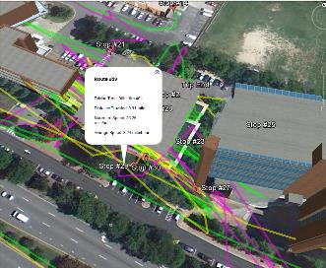
Working with HTML
Introduction markup languages
HTML syntax (tags, images, lists, tables)
Writing HTML with Python
GIS 540
Laura Tateosian

Slide 2
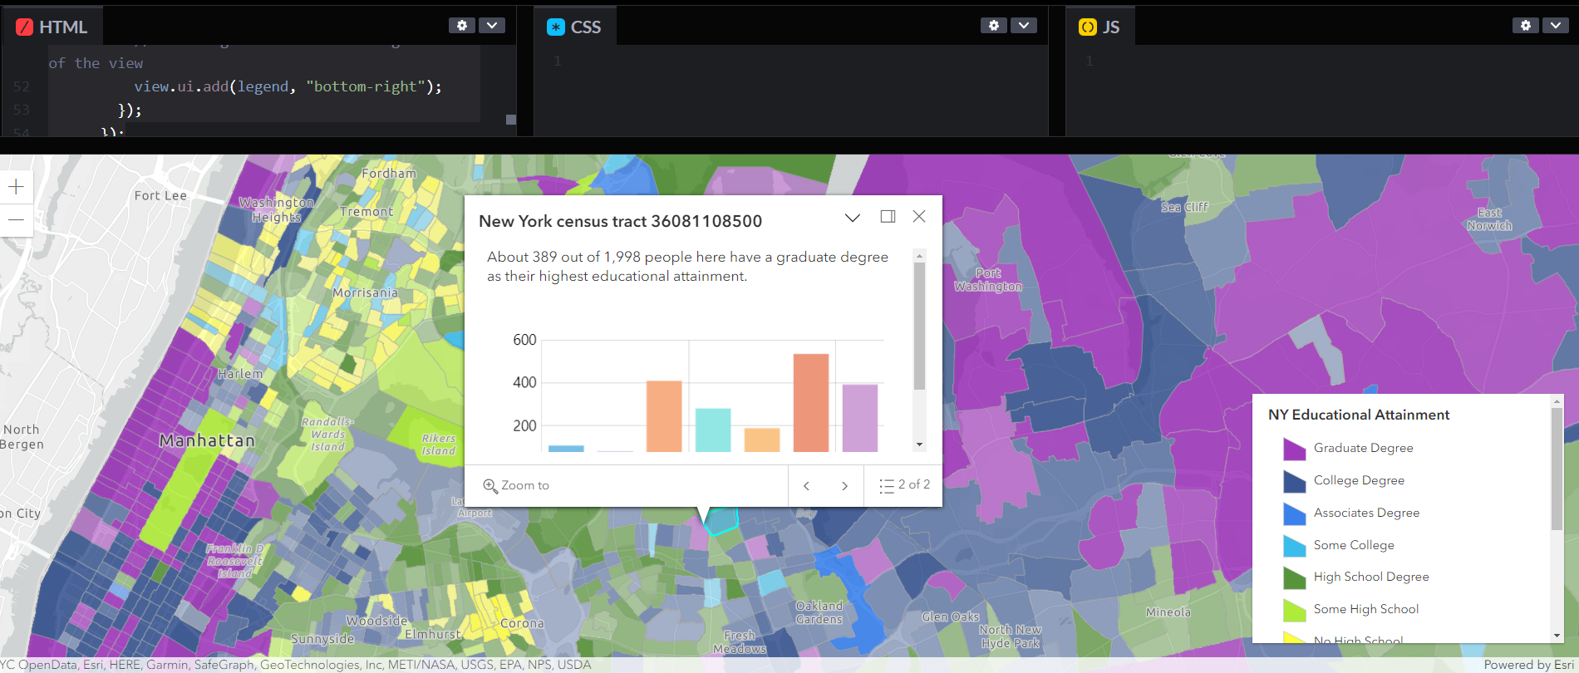
HTML + CSS + Javascript

Slide 3
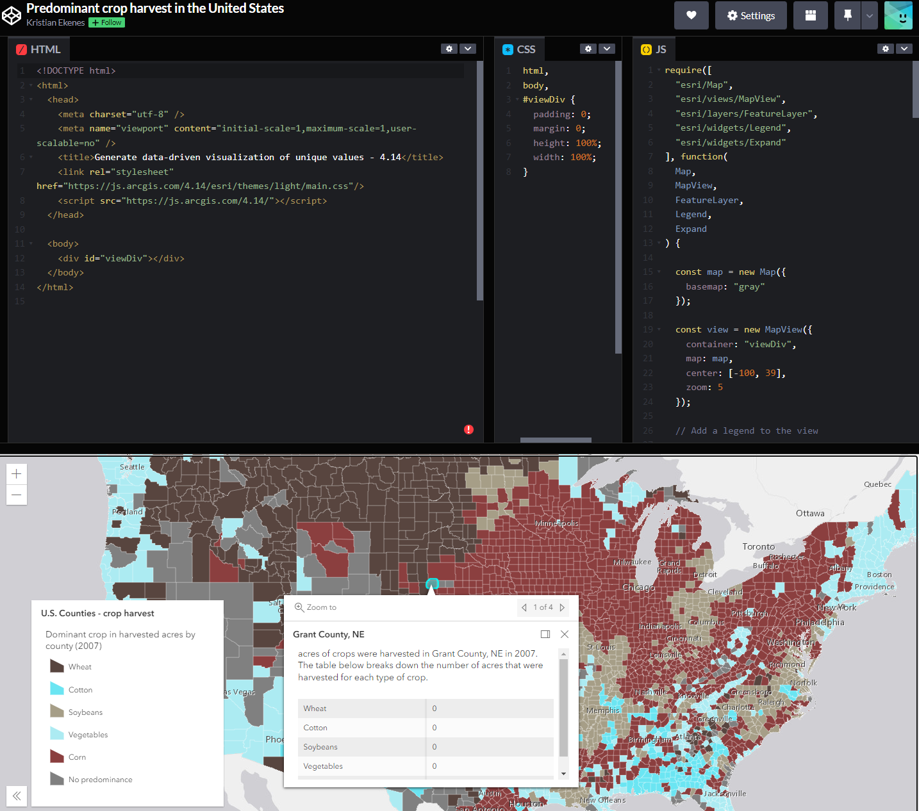
HTML, CSS, Javascript for web mapping

Slide 4
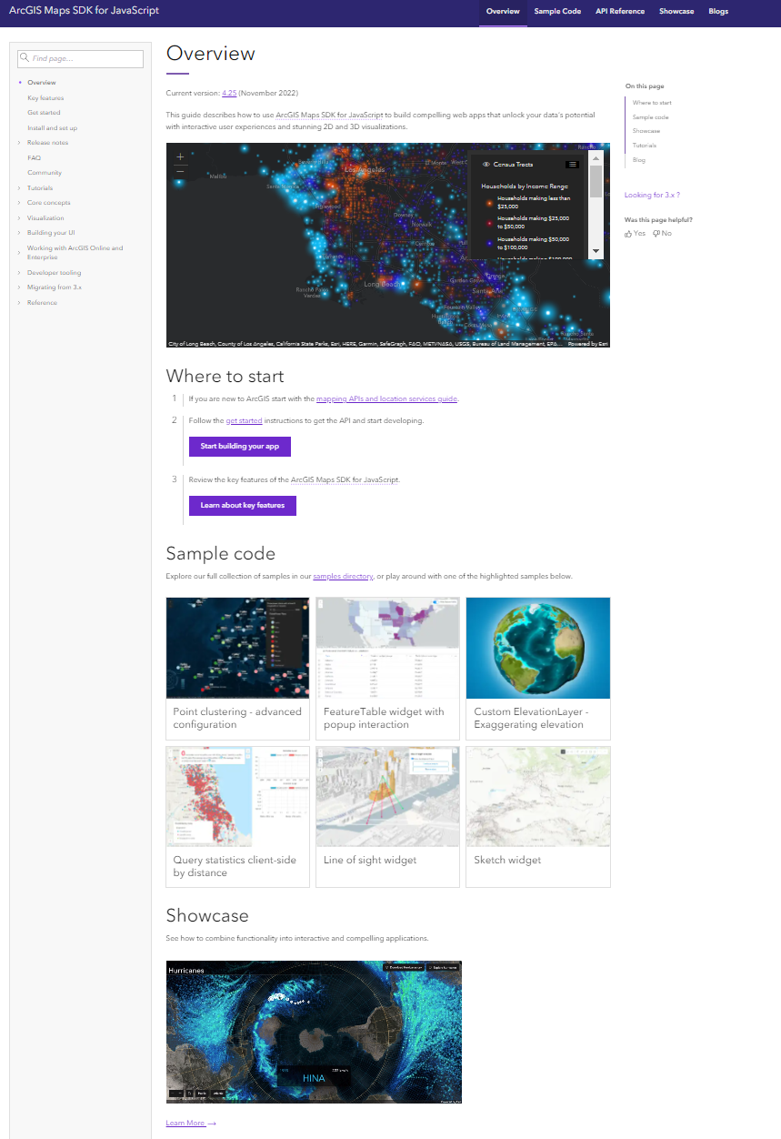
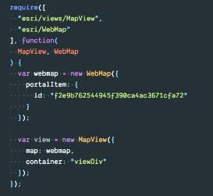
ArcGIS Maps SDK
for JavaScript

Slide 5
VIDEO too large to share. Check out the examples at:
https://developers.arcgis.com/javascript/latest/showcase/

Slide 6
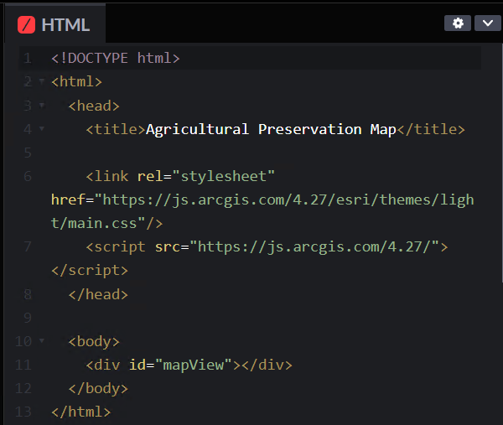
HTML
HTML code for a web map
HTML uses tags to structure and define the content of web pages
Hyper Text Markup Language
tags
head
body

Slide 7
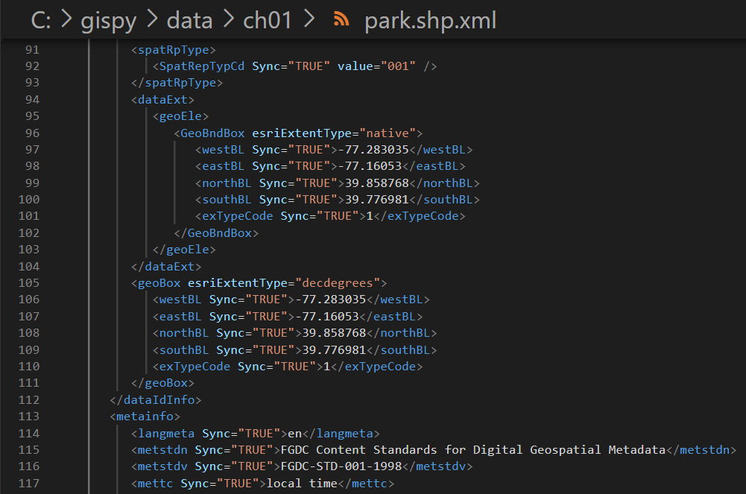
Markup Languages
xml code for a shapefile
"Markup" refers to the set of markup tags that describe and structure the content.
HTML, KML, R markdown, XML,...
Markup language (not programming)
tags

Slide 8


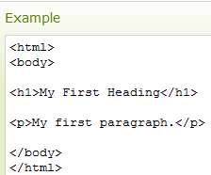
HTML Markup Tags
HTML tags
HTML keywords surrounded by angle brackets:
< keyword >
Tags usually come in pairs.
Tag pairs: opening and closing tags with content in between.
Opening tag Closing tag
< keyword > content goes here </keyword >
Closing tags contain a forward slash at the front.

Slide 9
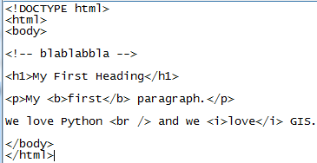
Self-closing tags

Slide 10

HTML comments
To write a comment in html, surround the text by <!-- and -->
<!-- Comments go here -->

Slide 11

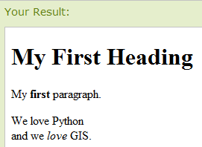
HTML Page Example
<!DOCTYPE html> tells the browser what version of HTML is being used. (This one is for, HTML 5)
Text between <html> and </html> describes the web page.
Text between <body> and </body> is the visible page content.
Text between <!-- and --> is comments.
Text between <h1> and </h1> is displayed as a heading.
Text between <p> and </p> is displayed as a paragraph.
What do <b>…</b> do?
Notes:
<!DOCTYPE html>
<html>
<body>
<!-- blablabbla -->
<h1>My First Heading</h1>
<p>My <b>first</b> paragraph.</p>
We love Python <br /> and we love GIS.
</body>
</html>

Slide 12


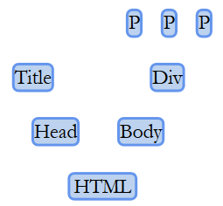













Nested structure of HTML
HTML documents have a tree structure.
Elements "branch out" from the main trunk (the <html></html> tags).
The first two big branches are <head> and <body>.
Branches multiply and become finer as you get to elements like <div>s, <table>s, and text (headers and paragraphs).
<!DOCTYPE html>
<html> <!--The trunk of the tree!-->
<head> <!--Child of html, parent of title, sibling of body-->
<title></title> <!--Immediate child of head, child of head AND html-->
</head>
<body> <!--Child of html, parent of p, sibling of head-->
<div> <!--Immediate child of body, child of body AND html-->
<p>I'm a paragraph.</p>
<p>No, me.</p>
<p>I'm a better paragraph.</p>
</div>
</body>
</html>

Slide 13
HTML tag attributes
Most tags have attributes.
Attributes specify properties of the object.
<keyword attribute_name=value>
Assign attribute values after the keyword inside the opening tag.
<p style="text-align:right"> This is some text in a paragraph. </p>
Multiple attributes can be used at once
<img src="images/stickman.gif" width="24" height="39" alt="Stickman">

Slide 14
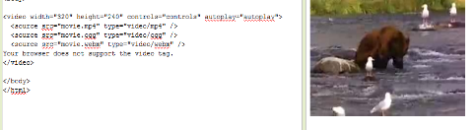
HTML tags sandbox
Browse W3 Schools Tutorial page and click on the “Run” button
Replace the code in the left window.
Click on the “Run” button again, observe the results, & answer the questions.
HTML "Try it yourself" panel
The resulting rendered page

Slide 15
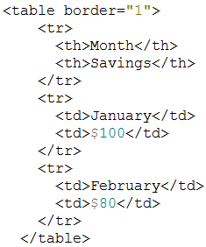

Lessons from HTML sandbox
How to resize an image
How to add a row to a table
How to add/remove table borders
border attribute
How to make a numbered list that starts the numbering at 50.
<ol start="50">
How to make a bulleted list
How to insert a line break
How to create a hyperlink
<a href="http://www.aag.org/" >AAG</a>
<img src="http://blabla/pics-of-kittens-2.jpg" alt="kittens" width ="42" height="42"/>
<br /> tag
destination display text

Slide 16
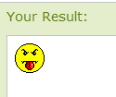


Embedding images
<img> tag
- Defines an image in an HTML page.
Has two required attributes: src and alt.
Other attributes?
Example:
Embed?
Images not actually inserted into an HTML page.
images linked to HTML pages.
<img> tag is a place holder for the referenced image.
smiley.gif must reside where the html resides.
If the image is not local to the webpage, give a URL.
When you make a website for courses, you can use GitHub
Notes:
<img src=“smiley.gif" alt=“Smiley face" width="42" height="42" />

Slide 17
GitHub Web Page
Browse to https://github.com/
Create an account.
Create a project (the project name will be part of your url)
Create a webpage, index.html, that you want to be your “home page”
Upload that into your repo space (use git or click “upload file”)
Click settings
On the settings page, under “GitHub Pages”:
Use the Select source drop-down menu to select your GitHub Pages publishing source.
Choose master branch or gh-pages or some other subdirectory that you have created; This must be the location of your index.html page.
Click Save
Note: it will say something like this:
“Your site is published at: http://username.github.io/projectName/”
That is your website’s base url.
Browse to this url to see your index.html page.
Notes:
More info here:
https://help.github.com/articles/configuring-a-publishing-source-for-github-pages/

Slide 18
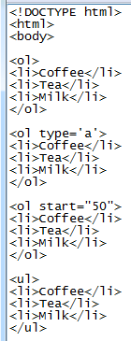
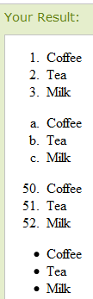
Lists
Wrap <ol> and </ol> around an ordered (numbered or lettered) list.
Wrap <ul> and </ul> around an unordered (bulleted) list.
Wrap <li> and </li> around each list item.
Useful attributes
type and start
Notes:
<!DOCTYPE html>
<html>
<body>
<ol>
<li>Coffee</li>
<li>Tea</li>
<li>Milk</li>
</ol>
<ol type='a'>
<li>Coffee</li>
<li>Tea</li>
<li>Milk</li>
</ol>
<ol start="50">
<li>Coffee</li>
<li>Tea</li>
<li>Milk</li>
</ol>
<ul>
<li>Coffee</li>
<li>Tea</li>
<li>Milk</li>
</ul>

Slide 19
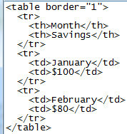
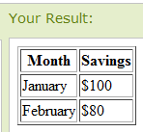
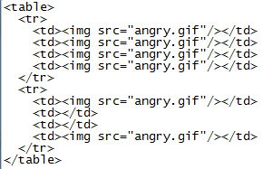
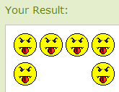
Tables
Wrap <table> and </table> around a table.
Wrap <tr> and </tr> around each row.
Wrap <td> and </td> around each table data cell.
Can also be used to arrange data on the page with borders turned off.
Notes:
<table border="1"> <tr> <th>Month</th> <th>Savings</th> </tr> <tr> <td>January</td> <td>$100</td> </tr>
<tr> <td>February</td> <td>$80</td> </tr> </table>
<table>
<tr>
<td><img src="angry.gif"/></td>
<td><img src="angry.gif"/></td>
<td><img src="angry.gif"/></td>
<td><img src="angry.gif"/></td>
</tr>
<tr>
<td><img src="angry.gif"/></td>
<td></td>
<td></td>
<td><img src="angry.gif"/></td>
</tr>
</table>

Slide 20

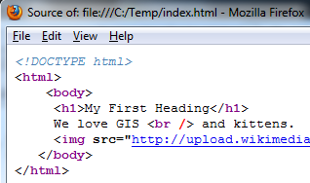
HTML spacing and indentation
Not required for the Web Browser to read it correctly.
But what will this HTML page look like?
What will this HTML page look like?

Slide 21
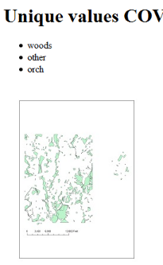
Writing HTML with python
Suppose you want to process data and displays the resulting map on a web page.
HTML is just a text file containing tags and ending in html or htm.
Can use Python file i/o to write dynamic HTML.

Slide 22
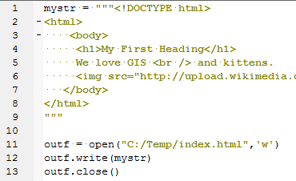
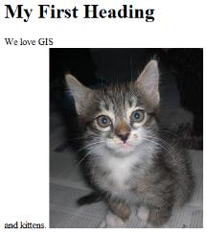
Creating an HTML file with Python
Create an html string. Wrap html string in triple """ quotes to preserve indentation. (Lines 1-9)
Open (for writing) a file with an html extension. (Line 11)
Write the html string to the open file. (Line 12)
Close the html file. (Line 13)
View html output file in browser.
Notes:
#writeSimpleHTML.py
mystr = """<!DOCTYPE html>
<html>
<body>
<h1>My First Heading</h1>
We love GIS <br /> and kittens.
<img src="http://upload.wikimedia.org/wikipedia/commons/thumb/1/1b/Persian_Cat_(kitten).jpg/250px-Persian_Cat_(kitten).jpg" alt="kitten">
</body>
</html>
"""
outf = open("C:/Temp/index.html",'w')
outf.write(mystr)
outf.close()

Slide 23
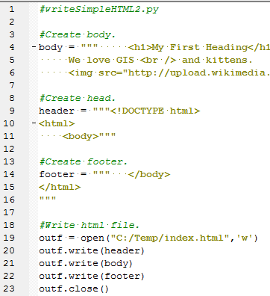
Building the HTML
For more complex HTML…
Build related parts of the html separately (e.g. header, body, footer).
Use variables and string formatting, as needed.
Then write parts to file in correct order.
Notes:
#writeSimpleHTML2.py
header = """<!DOCTYPE html>
<html>
<body>"""
body = """ <h1>My First Heading</h1>
We love GIS <br /> and kittens.
<img src="http://upload.wikimedia.org/wikipedia/commons/thumb/1/1b/Persian_Cat_(kitten).jpg/250px-Persian_Cat_(kitten).jpg" alt="kitten">"""
footer = """ </body>
</html>
"""
outf = open("C:/Temp/index.html",'w')
outf.write(header)
outf.write(body)
outf.wrote(footer)
outf.close()

Slide 24
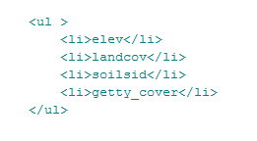
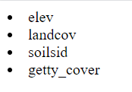
Python list to HTML list
rasts = [u'elev', u'landcov', u'soilsid', u'getty_cover']
Notes:
# printHTMLList.py
# Purpose: Call a function that converts
# a Python list to an HTML list.
def python2htmlList(myList, listType, attrs=''):
'''Convert a Python list to HTML list.
For example, convert [rast1,rast2] to:
<ul>
<li>rast1</li>
<li>rast2</li>
</ul>
'''
# Wrap items in item tags.
htmlItems = ['<li>' + str(item) + '</li>' for item in myList]
# Join the item list into a string with a line break after each item.
itemsString = '''\n '''.join(htmlItems)
# Wrap the string of items in the list tag.
htmlList = f'''
<{listType} {attrs}>
{itemsString}
</{listType}>
'''
return htmlList
rasts = [u'elev', u'landcov', u'soilsid', u'getty_cover']
htmlList = python2htmlList(rasts, 'ul')
print(htmlList)
htmlList2 = python2htmlList(rasts, 'ol')
print(htmlList2)
htmlList3 = python2htmlList(rasts, 'ol', 'type="a"')
print(htmlList3)

Slide 25
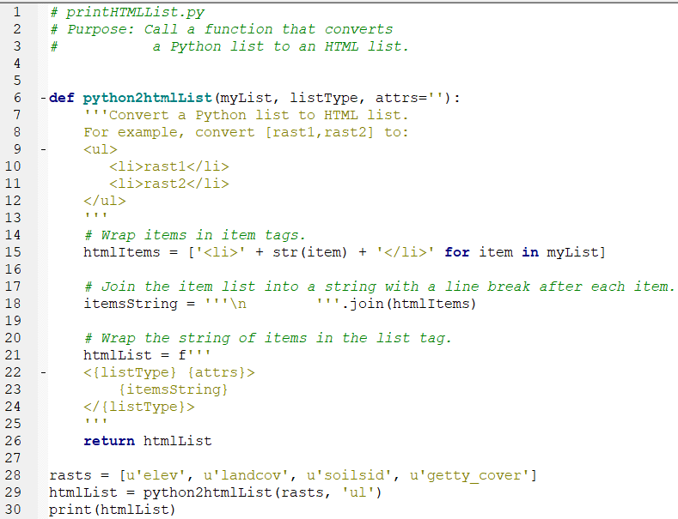
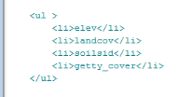
Python list to HTML list
OUTPUT:
Notes:
# printHTMLList.py
# Purpose: Call a function that converts
# a Python list to an HTML list.
def python2htmlList(myList, listType, attrs=''):
'''Convert a Python list to HTML list.
For example, convert [rast1,rast2] to:
<ul>
<li>rast1</li>
<li>rast2</li>
</ul>
'''
# Wrap items in item tags.
htmlItems = ['<li>' + str(item) + '</li>' for item in myList]
# Join the item list into a string with a line break after each item.
itemsString = '''\n '''.join(htmlItems)
# Wrap the string of items in the list tag.
htmlList = f'''
<{listType} {attrs}>
{itemsString}
</{listType}>
'''
return htmlList
rasts = [u'elev', u'landcov', u'soilsid', u'getty_cover']
htmlList = python2htmlList(rasts, 'ul')
print(htmlList)
htmlList2 = python2htmlList(rasts, 'ol')
print(htmlList2)
htmlList3 = python2htmlList(rasts, 'ol', 'type="a"')
print(htmlList3)

Slide 26
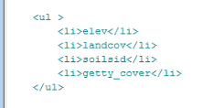
Python list to HTML list
Notes:
# printHTMLList.py
# Purpose: Call a function that converts
# a Python list to an HTML list.
def python2htmlList(myList, listType, attrs=''):
'''Convert a Python list to HTML list.
For example, convert [rast1,rast2] to:
<ul>
<li>rast1</li>
<li>rast2</li>
</ul>
'''
# Wrap items in item tags.
htmlItems = ['<li>' + str(item) + '</li>' for item in myList]
# Join the item list into a string with a line break after each item.
itemsString = '''\n '''.join(htmlItems)
# Wrap the string of items in the list tag.
htmlList = f'''
<{listType} {attrs}>
{itemsString}
</{listType}>
'''
return htmlList
rasts = [u'elev', u'landcov', u'soilsid', u'getty_cover']
htmlList = python2htmlList(rasts, 'ul')
print(htmlList)
htmlList2 = python2htmlList(rasts, 'ol')
print(htmlList2)
htmlList3 = python2htmlList(rasts, 'ol', 'type="a"')
print(htmlList3)

Slide 27
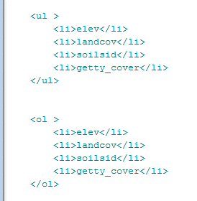
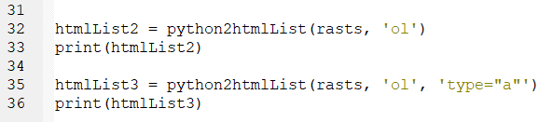
Python list to HTML list
Notes:
# printHTMLList.py
# Purpose: Call a function that converts
# a Python list to an HTML list.
def python2htmlList(myList, listType, attrs=''):
'''Convert a Python list to HTML list.
For example, convert [rast1,rast2] to:
<ul>
<li>rast1</li>
<li>rast2</li>
</ul>
'''
# Wrap items in item tags.
htmlItems = ['<li>' + str(item) + '</li>' for item in myList]
# Join the item list into a string with a line break after each item.
itemsString = '''\n '''.join(htmlItems)
# Wrap the string of items in the list tag.
htmlList = f'''
<{listType} {attrs}>
{itemsString}
</{listType}>
'''
return htmlList
rasts = [u'elev', u'landcov', u'soilsid', u'getty_cover']
htmlList = python2htmlList(rasts, 'ul')
print(htmlList)
htmlList2 = python2htmlList(rasts, 'ol')
print(htmlList2)
htmlList3 = python2htmlList(rasts, 'ol', 'type="a"')
print(htmlList3)

Slide 28
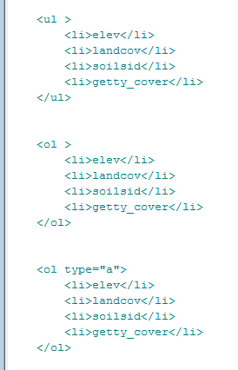
Python list to HTML list
Notes:
# printHTMLList.py
# Purpose: Call a function that converts
# a Python list to an HTML list.
def python2htmlList(myList, listType, attrs=''):
'''Convert a Python list to HTML list.
For example, convert [rast1,rast2] to:
<ul>
<li>rast1</li>
<li>rast2</li>
</ul>
'''
# Wrap items in item tags.
htmlItems = ['<li>' + str(item) + '</li>' for item in myList]
# Join the item list into a string with a line break after each item.
itemsString = '''\n '''.join(htmlItems)
# Wrap the string of items in the list tag.
htmlList = f'''
<{listType} {attrs}>
{itemsString}
</{listType}>
'''
return htmlList
rasts = [u'elev', u'landcov', u'soilsid', u'getty_cover']
htmlList = python2htmlList(rasts, 'ul')
print(htmlList)
htmlList2 = python2htmlList(rasts, 'ol')
print(htmlList2)
htmlList3 = python2htmlList(rasts, 'ol', 'type="a"')
print(htmlList3)

Slide 29
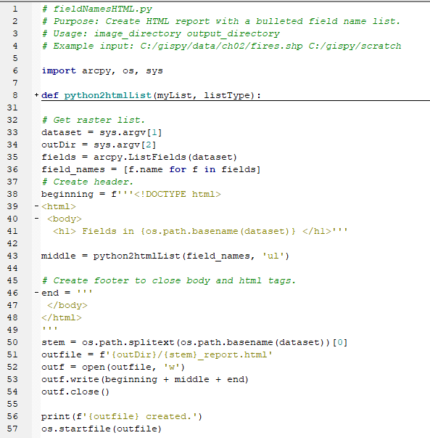
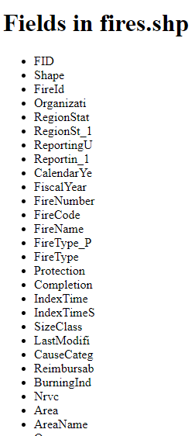
Use variables for dynamic content
Notes:
# fieldNamesHTML.py
# Purpose: Create HTML report with a bulleted field name list.
# Usage: image_directory output_directory
# Example input: C:/gispy/data/ch02/fires.shp C:/gispy/scratch
import arcpy, os, sys
def python2htmlList(myList, listType):
'''Convert a Python list to HTML list.
For example, convert [rast1,rast2] to:
<ul>
<li>rast1</li>
<li>rast2</li>
</ul>
'''
# Wrap items in item tags.
htmlItems = ['<li>' + item + '</li>' for item in myList]
# Join the item list into a string with a line break after each item.
itemsString = '''\n '''.join(htmlItems)
# Wrap the string of items in the list tag.
htmlList = f'''
<{listType}>
{itemsString}
</{listType}>
'''
return htmlList
# Get raster list.
dataset = sys.argv[1]
outDir = sys.argv[2]
fields = arcpy.ListFields(dataset)
field_names = [f.name for f in fields]
# Create header.
beginning = f'''<!DOCTYPE html>
<html>
<body>
<h1> Fields in {os.path.basename(dataset)} </h1>'''
middle = python2htmlList(field_names, 'ul')
# Create footer to close body and html tags.
end = '''
</body>
</html>
'''
stem = os.path.splitext(os.path.basename(dataset))[0]
outfile = f'{outDir}/{stem}_report.html'
outf = open(outfile, 'w')
outf.write(beginning + middle + end)
outf.close()
print(f'{outfile} created.')

Slide 30
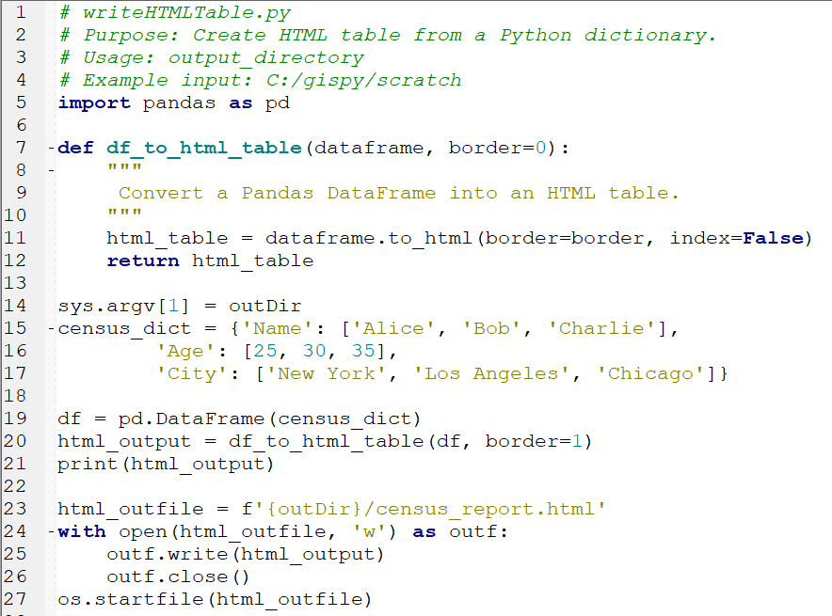
Python dictionary
to HTML Table
Notes:
# writeHTMLTable.py
# Purpose: Create HTML table from a Python dictionary.
# Usage: output_directory
# Example input: C:/gispy/scratch
import pandas as pd
def df_to_html_table(dataframe, border=0):
"""
Convert a Pandas DataFrame into an HTML table.
"""
html_table = dataframe.to_html(border=border, index=False)
return html_table
sys.argv[1] = outDir
census_dict = {'Name': ['Alice', 'Bob', 'Charlie'],
'Age': [25, 30, 35],
'City': ['New York', 'Los Angeles', 'Chicago']}
df = pd.DataFrame(census_dict)
html_output = df_to_html_table(df, border=1)
print(html_output)
html_outfile = f'{outDir}/census_report.html'
with open(html_outfile, 'w') as outf:
outf.write(html_output)
outf.close()
os.startfile(html_outfile)

Slide 31
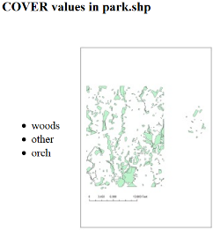
In class – Writing HTML
Save the linked script in C:/gispy/scratch
Run the script as-is and view the output html page.
Modify the code to:
Create a bulleted list of unique values for a field (3 functions in the code will help)
Insert an image in the page (use the img tag setting src to the jpeg)
Remove the table border.
Create a dynamic header (use the h3 tag)

Slide 32
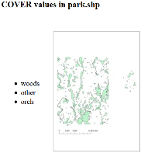
Creating HTML script modifications
## Get values for the given field
fullList = getFieldValues(baseDir + fc, fieldName)
## Get unique values for the given field
uniqueValueList = getUniqueListValues(fullList)
## Create HTML bullet list from the unique value list.
htmlList = python2htmlList(uniqueValueList, "ul")
## Write code to create a string for an html image tag
imageCode = '<img src ="{0}" alt="map of the {1}">'.format(image,fieldName)
<table border=“0"> ## Removes the table border.
header = """<!DOCTYPE html>
<html>
<body>
<h3>{0} values in {1}</h3> ## HTML header string.
""".format(fieldName, baseName) ## Place vars. inside parens. for header
Notes:
#writeUniqueValuesHTML.py
import arcpy, os
inputDir = "C:/Temp/"
fc = "COVER63p.shp"
fieldname = "COVER"
image = "COVER63p.jpg"
#Create HTML body - a bulleted raster list
#Make html bullet list:
#..<ul>
# <li>item1</li>
# <li>item2</li>
#..</ul>
#Get unique values list
arcpy.env.workspace = inputDir
sc = arcpy.SearchCursor(fc)
valueList = [row.getValue(fieldname)for row in sc]
uniqueValueSet = set(valueList)
uniqueValueList = list(uniqueValueSet)
# Join list with </li>\n <li>
listItems = """</li>\n <li>""".join(uniqueValueList)
#Wrap in items in ul tag (and add the first li which is missing).
body = """ <ul>\n <li>{0}\n </ul>
<img src="{1}" alt="{1}">
""".format(listItems, image)
#Create header with title
header = """<!DOCTYPE html>
<html>
<body>
<h1> Unique values in {0} field {1}: </h1>
""".format(fc, fieldname)
#Create footer to close body and html tags
footer ="""
</body>
</html>
"""
outf = open("C:/Temp/DataReport.html",'w')
outf.write(header + body + footer)
outf.close()

Slide 33
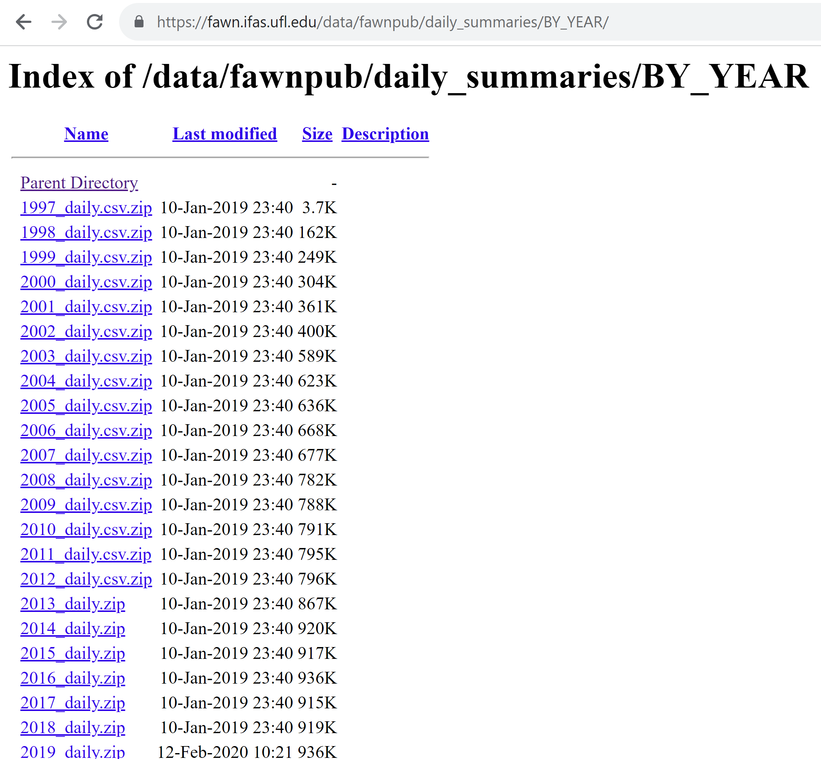
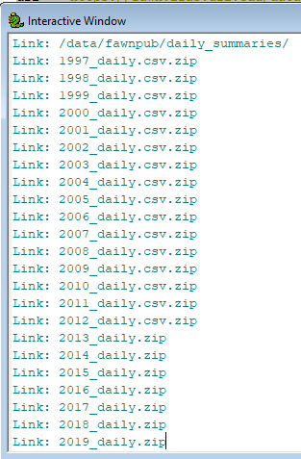
Python can scrape geospatial data from HTML
# listWeatherData.py
# Purpose: Read and print the links in an HTML data page.
import bs4
import requests
import sys
# Fetch the HTML file contents.
url = "https://fawn.ifas.ufl.edu/data/fawnpub/daily_summaries/BY_YEAR/"
response = requests.get(url)
contents = response.text
response.close()
# Create a soup object from the HTML contents.
soup = bs4.BeautifulSoup(contents)
# Find all the hyperlinks in the page.
linkTags = soup.findAll("a")
# Print each hyperlink reference.
for linkTag in linkTags:
print(f"Link: {linkTag['href']}")
FAWN data hosting webpage
Python output

Slide 34


HTML in a nutshell
Tags, attributes and contents between the tags structure and define the content of web pages and present web maps.
Create HTML with Python: write .html text file with f-strings
Parse HTML with Python with bs4

