Slide 1
Background concepts
Conditional statements
Decision-making syntax
Boolean Expressions
Logical operators
Comparison operators
New concepts
arcpy Describe object
GIS data types and other data properties

Slide 2

Decision making with Describe objects
Dr. Tateosian
Photo credit: Credit James Wheeler
Notes:
"Welcome, everyone! In this video, we’re going to explore the ArcPy Describe object and how it can enhance decision-making in GIS workflows."

Slide 3
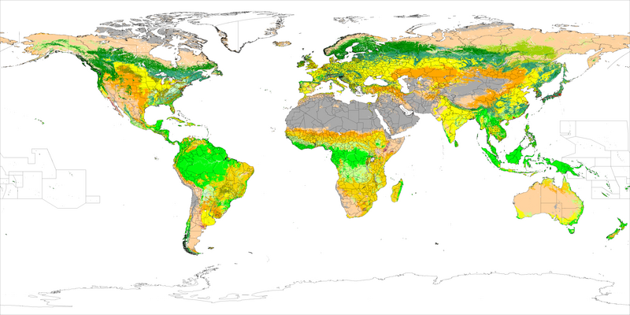
What is the Arcpy Describe Object?
Allows us to extract information about various data elements in GIS, such as feature classes, rasters, tables, or workspaces.
C:/gipsy/scratch
Feature class
Polygon
No M value
No z value
Notes:
Let’s start by answering the question: what exactly is the Describe object? In simple terms, the Describe object allows us to extract information about various data elements in GIS, such as feature classes, rasters, tables, or workspaces. By accessing the metadata, we can learn about the structure and properties of datasets—think of it as a sneak peek behind the scenes of your GIS data.

Slide 4
Why Describe?
Getting information about the geometry type, format, spatial reference, data extent can help you to…
Choose appropriate analysis methods,
Ensure data compatibility,
Automate processes by dynamically adapting to different datasets

Slide 5

Practical example 1: Choose analytic method
Determine if a dataset has points before calculating distance.
Notes:
Suppose you are working on a project that calculates the distances between charging stations. Before driving in the wrong direction, you can use the Describe object to check if your dataset is composed of points, lines, or polygons. If the shape type is 'polygon' or 'polyline', distance calculations might not be appropriate, and you’ll need to adjust your approach. This is where Describe helps in making informed choices.

Slide 6
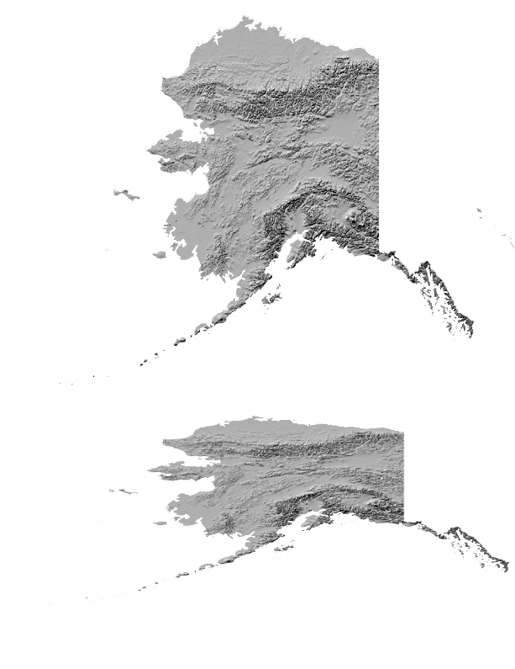
Practical example 2: Validate data compatibility
Determine if a datasets have the same projection before performing overlay operations.
Notes:
Or suppose you are performing some overlay operations with multiple datasets. They need to share the same spatial reference. The Describe object allows you to check and compare the coordinate systems of your layers so you can ensure that the data aligns perfectly.

Slide 7
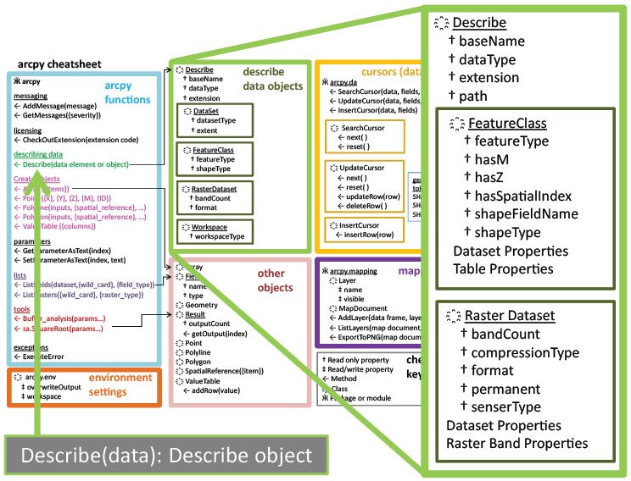
Describe Object
desc = arcpy.Describe("C:/gispy/data/ch09/getty_rast")
Describe object
Data element to be described
Notes:
The Describe method is in the left column of the cheatsheet, and the object it returns is represented by the green box.
You create a describe object for a dataset by passing it in as an argument.

Slide 8

Simple example 1: Identify geometry type
import arcpy
# Define the path to your dataset
fc = "C:/gispy/data/ch09/trails.shp"
# Get the Describe object
desc = arcpy.Describe(fc)
# Print the geometry type
print(f"Geometry type: {desc.shapeType}")
Geometry type: Polyline
Notes:
Let’s start with a simple but essential task: identifying the geometry type of a dataset. Knowing whether you’re dealing with points, lines, or polygons is critical for choosing the right analysis tools.
Here’s a Python example using the Describe object to find out whether our dataset contains points, lines, or polygons.
We can use this to determine how to proceed with spatial analysis, depending on the shape type of the dataset.

Slide 9
Simple example 2: Check the spatial reference
import arcpy
fc = "C:/gispy/data/ch09/trails.shp"
desc = arcpy.Describe(fc)
# Get spatial reference
spatial_ref = desc.spatialReference
# Print spatial reference details
print(f"Spatial Reference: {spatial_ref.name}")
print(f"Type: {spatial_ref.type}")
print(f"EPSG Code: {spatial_ref.factoryCode}")
Spatial Reference: 'North_America_Albers_Equal_Area_Conic'
Type: 'Projected'
EPSG Code: 102008

Slide 10
Real-world application: Clip analysis
import arcpy
arcpy.env.workspace = "C:/gispy/scratch"
input_fc = "input_dataset.shp"
clip_fc = "clip_dataset.shp"
# Get the spatial reference names of both datasets.
desc_input = arcpy.Describe(input_fc)
desc_clip = arcpy.Describe(clip_fc)
sr_input = desc_input.spatialReference.name
sr_clip = desc_clip.spatialReference.name
# Compare the spatial reference names.
if sr_input != sr_clip:
# Reproject the clip dataset to match the input dataset's spatial ref.
reprojected_clip = "reprojected_clip.shp"
arcpy.management.Project(clip_fc,
reprojected_clip,
desc_input.spatialReference)
clip_fc = reprojected_clip # Use the reprojected clip dataset
# Perform the Clip operation
output_fc = "clipped_output.shp"
arcpy.analysis.Clip(input_fc, clip_fc, output_fc)
print(f"{arcpy.env.workspace}/{output_fc} created.")

Slide 11
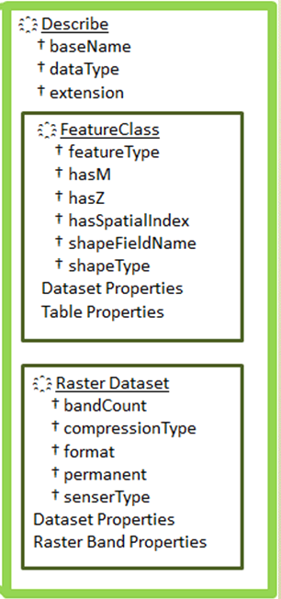











Available properties depend on data type
>>> import arcpy
>>> cat_pic = 'C:/gispy/data/ch09/jack.jpg'
>>> desc1 = arcpy.Describe(cat_pic)
>>> desc1.dataType 'RasterDataset'
>>> desc1.format 'JFIF'
>>> battlefield = 'C:/gispy/data/ch11/tester.gdb/park'
>>> desc2 = arcpy.Describe(battlefield)
>>> desc2.format
Traceback ...
RuntimeError: describe method: Format does not exist
>>> desc2.dataType
'FeatureClass'
>>> desc2.shapeType
'Polygon'
>>> desc2.hasZ
False
Notes:
>>> import arcpy
>>> myfile = 'C:/gispy/data/ch09/park.shp'
>>> desc2 = arcpy.Describe(myfile)
>>> desc2.format
Traceback (most recent call last): File "<interactive input>", line 1, in ?
RuntimeError: describe method: Format does not exist
>>> desc2.shapeType
'Polygon‘
>>> desc2.HasOID
True
>>> desc2.dataType
‘Shapefile'

Slide 12


Several properties are always available
>>> import arcpy
>>> cat_pic = 'C:/gispy/data/ch09/jack.jpg'
>>> desc1 = arcpy.Describe(cat_pic)
>>> desc1.dataType
All datasets have a baseName,
datatype, extension, path,
and other properties

Slide 13
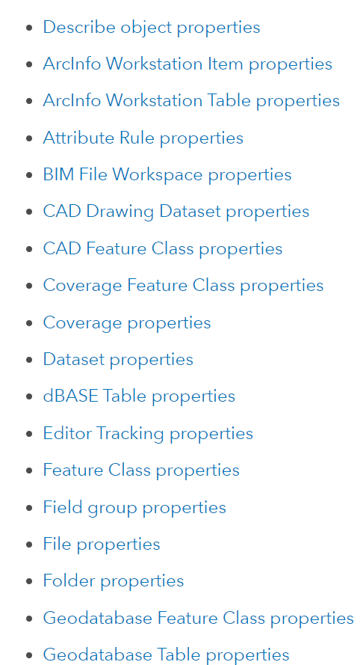
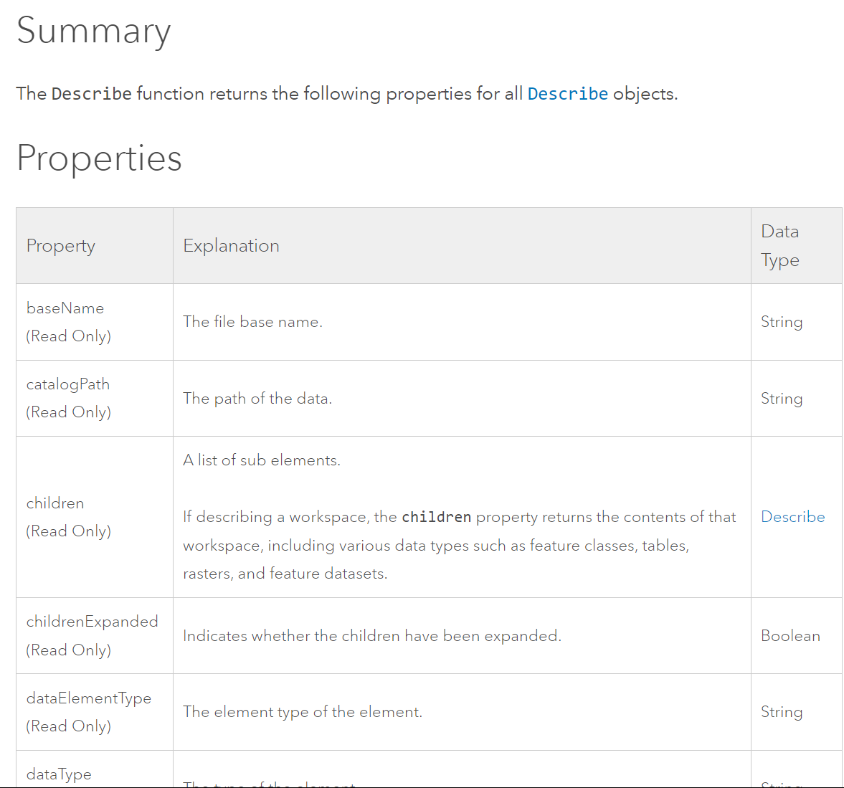



How to tell what properties are available?
Describe object online help
In a web search engine (such as Google), search for arcpy describe object
Notes:
You maybe wondering how to tell what properties are available.
You can search online for "arcpy describe object"
There you'll find a list of the properties that are common to all datasets.
There's a link from the summary page to a page that contains a list of all the datatypes.
You can click on any one of these to see its properties. For example if we click on the feature class properties

Slide 14
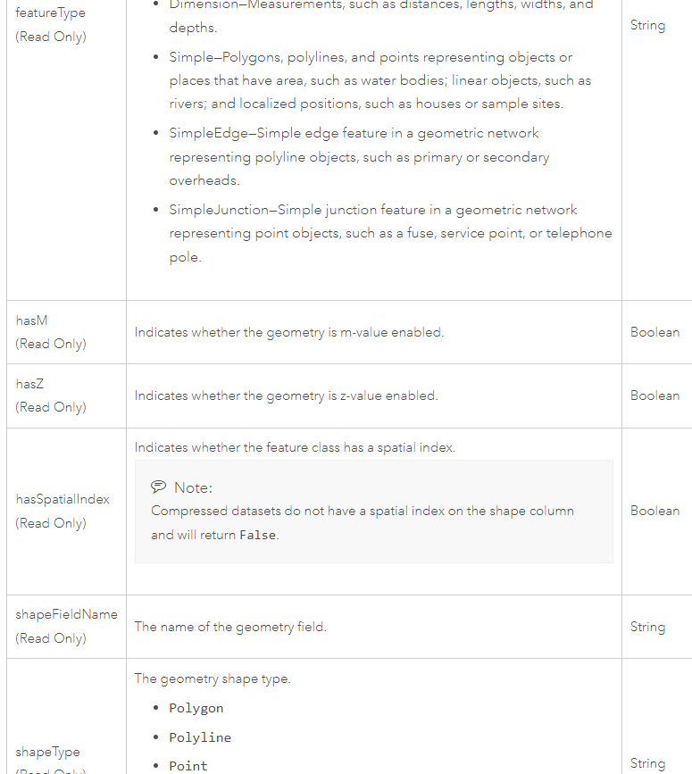
Feature class properties
Notes:
… we see a table of feature class properties.

Slide 15
Selection Syntax
Convert the pseudocode to Python
Python conditional keywords: if, elif, else
Use a Describe object to get the shapeType
Pseudocode
GET shapefile from user
GET shape type (Hint: Use 2 Python lines)
IF shape type is Polygon THEN PRINT shape is polygon
ELSE IF shape type is Polyline THEN PRINT shape is polyline
ELSE
PRINT shape is not polyline or polygon ENDIF
Python code
import arcpy, sys
mydata = sys.argv[1]
dsc = arcpy.Describe(mydata)
shapeType = dsc.shapeType
if shapeType == "Polygon":
print("Shape is polygon")
elif shapeType == "Polyline":
print("Shape is polyline")
else:
print("Shape is not polyline \
or polygon")

Slide 16
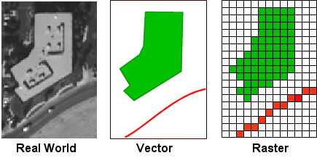
arcpy Describe objects can get this information
arcpy Describe objects can always provide dataType.
But other properties are dynamic.
Depending on the data type, the Describe object could also have a shape type or a format
Notes:
Remember how rasters don't have a shape type? Instead they have a format. But shapefiles do not have a format property.
The properties that a describe object has depend on the data type!

Slide 17
Using Describe properties with caution
Previous slide
import arcpy, sys
mydata = sys.argv[1]
dsc = arcpy.Describe(mydata)
shapeType = dsc.ShapeType
if shapeType == "Polygon":
print("Shape is polygon")
elif shapeType == "Polyline":
print("Shape is line")
else:
print("Shape is not \ polyline or polygon")
More cautiously
import arcpy, sys
mydata = sys.argv[1]
dsc = arcpy.Describe(mydata)
if dsc.dataType == "ShapeFile":
shapeType = dsc.ShapeType
if shapeType == "polygon":
print("Shape is polygon")
elif shapeType == "Polyline":
print("Shape is line")
else:
print("Shape is not \
polyline or polygon")

Slide 18
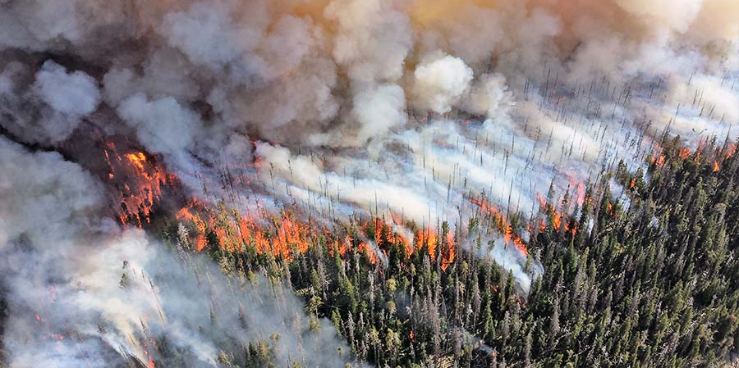
Scenario: Wildfire Risk Assessment
A government agency is assessing wildfire risk across a large region.
They receive mixed data types such as:
Point data Locations of fire incidents or weather stations.
Line data Roads and utility lines.
Polygon data Vegetation or land cover classifications.
Raster data Satellite imagery or Digital Elevation Models (DEMs).
Notes:
In most GIS applications, multiple different types of GIS data are used in concert together to explore complex questions.
For example, to conduct wildfire risk assessment, a government agency may build a tool to process
point datasets of fire incidents,
polyline datasets of utility lines,
polygons datasets of vegetation,
tiffs of satellite imagery,
and
ESRI GRID files of elevation models.

Slide 19







Scenario: Wildfire Risk Assessment
A government agency is assessing wildfire risk across a large region.
They receive mixed data types such as:
Point data Locations of fire incidents or weather stations.
Line data Roads and utility lines.
Polygon data Vegetation or land cover classifications.
Raster data Satellite imagery or Digital Elevation Models (DEMs).
Notes:
Notice that we're talking about 2 different types of data (vector and raster). A dataset's datatype is something we can find out with Python.

Slide 20
Scenario: Wildfire Risk Assessment
A government agency is assessing wildfire risk across a large region.
They receive mixed data types such as:
Point data Locations of fire incidents or weather stations.
Line data Roads and utility lines.
Polygon data Vegetation or land cover classifications.
Raster data Satellite imagery or Digital Elevation Models (DEMs).
Notes:
Even within those two different data types, we're breaking it down further.
We're distinguishing between the shape types for the vector data
And we're distinguishing between the formats for the rasters.

Slide 21

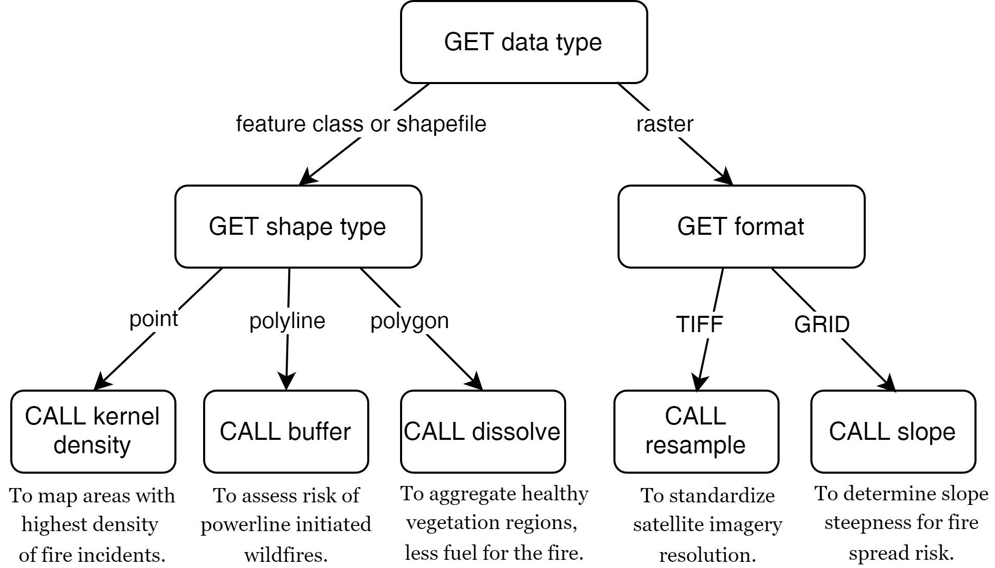









Wildfire risk assessment example
import arcpy, sys
input_data = sys.argv[1]
output_data = sys.argv[2]
# Describe the dataset
desc = arcpy.Describe(input_data)
data_type = desc.dataType
# If it's a feature class or shapefile dataset
if data_type in ['FeatureClass', 'Shapefile']:
shape_type = desc.shapeType
if shape_type == 'Point':
arcpy.analysis.PointDensity(input_data, output_data)
elif shape_type == 'Polyline':
arcpy.analysis.Buffer(input_data, output_data, "0.5 kilometers")
elif shape_type == 'Polygon':
arcpy.management.Dissolve(input_data, output_data)
# If it's a raster dataset...
elif data_type == 'RasterDataset':
format = desc.format
if format == 'TIFF':
arcpy.management.Resample(input_data, output_data, ...)
elif format == 'GRID':
arcpy.sa.Slope(input_data, output_data)
Notes:
On the right we have the workflow diagram for this scenario. The corresponding code is on the left. The circled number show where the workflow diagram pieces appear in the code.

Slide 22
Raster preparation tool
Different procedure for vector/raster/other datatypes.
Different for points/lines/polygon.
Different for TIFs and other formats.
GET data type
feature class
shapefile
raster
other
PRINT
'warning, knuckle head'
GET shape type
GET format
point
line
polygon
other
TIF
other
CALL point
to rast
CALL line
to rast
CALL polygon
to rast
PRINT
Not used
CALL
convert to TIFF

Slide 23
Raster preparation tool
Different procedure for vector/raster/other datatypes.
Different for points/lines/polygon.
Different for TIFs and other formats.
GET data type
feature class
shapefile
raster
other
PRINT
'warning, knuckle head'
GET shape type
GET format
point
line
polygon
other
TIF
other
CALL point
to rast
CALL line
to rast
CALL polygon
to rast
PRINT
Not used
CALL
convert to TIFF

Slide 24
Raster preparation tool
Different procedure for vector/raster/other datatypes.
Different for points/lines/polygon.
Different for TIFs and other formats.
GET data type
feature class
shapefile
raster
other
PRINT
'warning, knuckle head'
GET shape type
GET format
point
line
polygon
other
TIF
other
CALL point
to rast
CALL line
to rast
CALL polygon
to rast
PRINT
Not used
CALL
convert to TIFF

Slide 25
Raster preparation tool
Different procedure for vector/raster/other datatypes.
Different for points/lines/polygon.
Different for TIFs and other formats.
GET data type
feature class
shapefile
raster
other
PRINT
'warning, knuckle head'
GET shape type
GET format
point
line
polygon
other
TIF
other
CALL point
to rast
CALL line
to rast
CALL polygon
to rast
PRINT
Not used
CALL
convert to TIFF

Slide 26

Summing up
How to Describe data with arcpy
Describe properties are dynamic
Use this within branching conditions.

Slide 27
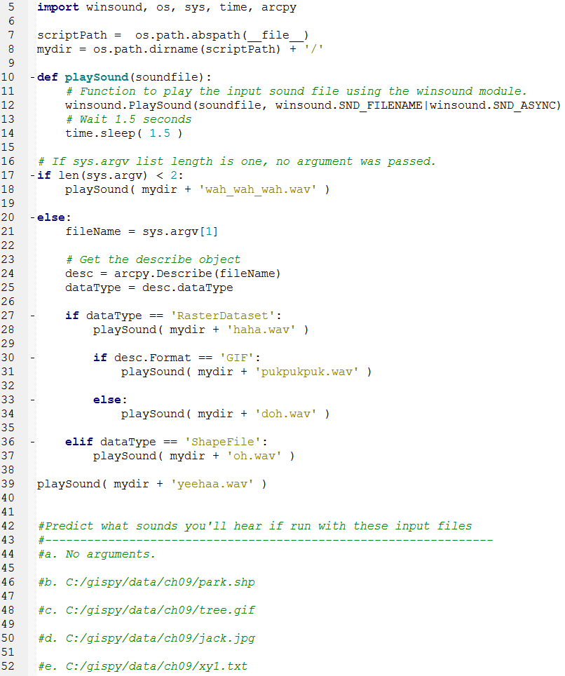
In class – conditionalSound.py

Slide 28
Appendix I

Slide 29
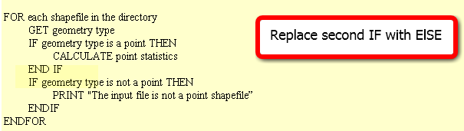
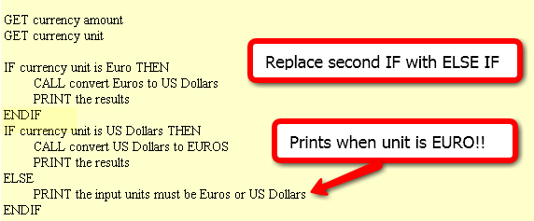
In class – Issues with form! FIX IT
Point statistics
2. Currency conversion
3. Grader
IF average < 60
NULL
ELSE
DO GivePassingGrade
ENDIF

Slide 30
FIX IT
Point statistics
2. Currency conversion
3. It is considered poor form to have a 1-sided IF stmt where the action is on the 'no' or ELSE side. This could (and should) be rewritten to eliminate the NULL 'yes' part. To do that, we change the < to its opposite: >= as follows :
IF average >= 60
DO GivePassingGrade
ENDIF

Slide 31
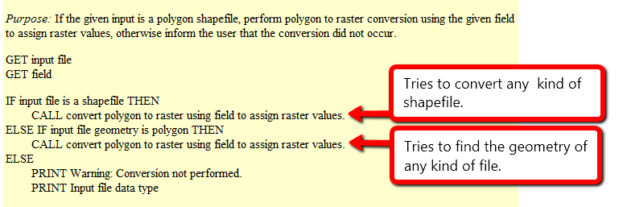
Polygon to raster
Purpose: If the given input is a polygon shapefile, perform polygon to raster conversion using the given field to assign raster values, otherwise inform the user that the conversion did not occur.
What will happen if the input file is…
a polygon shapefile?
convert the data to raster (success)
a point shapefile?
attempt to convert the data to raster, but will fail, since it’s not polygon input but it is a shapefile
a raster file?
attempt to check the geometry of the inputfile and fail, since raster files don’t have a geometry
When does it give a warning?
never

Slide 32
Polygon to raster pseudocode corrected
Instead of else if, use a compound conditional
IF input file is a shapefile AND input file geometry is polygon THEN CALL convert polygon to raster using field to assign raster values.
ELSE PRINT Warning: Conversion not performed. PRINT Input file data type
Moral: TEST ALL CONDITIONS

Slide 33



Distance converter example
Convert miles to km or km to miles and handle user input of 2, 1, or 0 arguments:
Arguments: 50 miles
>>> 50 miles is equivalent to 80.0 kilometers.
Arguments: 100
>>> Warning: No distance unit provided. Assuming input is in miles.
100.0 miles is equivalent to 160.0 kilometers.
Arguments:
>>> Usage: <numeric_distance> <distance_unit(miles or km)>

Slide 34
Distance Conversion Pseudocode
GET numeric dist from args
GET unit from args
IF unit is miles THEN COMPUTE km PRINT results
ELSE COMPUTE miles PRINT results
ENDIF
Add to the pseudocode to handle case of 'no user arguments'.
Add pseudocode to part 1 to handle the '1 argument' case.

Slide 35
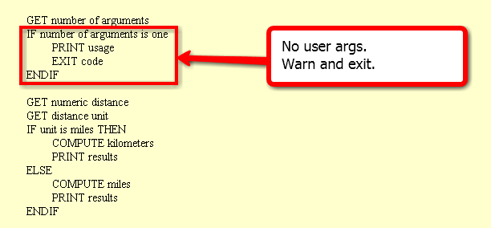
Handle no user arguments case

Slide 36
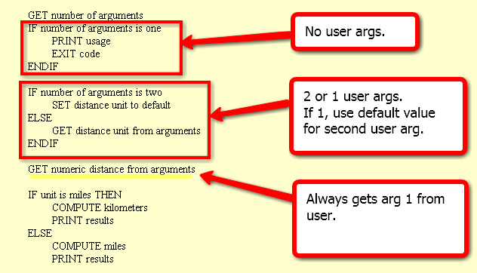
Distance conversion pseudocode
Related code given in examples 9.12 and 9.13 in the book.

Slide 37
Buffer_clip pseudocode
GET number of arguments
IF number of args < 5
PRINT usage EXIT code
ENDIF
SET fire damage
SET park
SET buffer distance
SET workspace
GET number of arguments
IF number of arguments < 4 PRINT usage EXIT code
IF number of args is 4
PRINT warning SET workspace to default
ELSE
SET workspace to last arg
ENDIF
SET fire damage
SET park
SET buffer distance
All or nothing.
How could we make
the last argument (the workspace) optional?

Slide 38
Appendix II

Slide 39
Creating a Describe object
import arcpy
# Set the data element
study_data = 'C:/gispy/data/ch09/trails.shp'
# Call Describe method
desc_obj = arcpy.Describe(study_data)
print(desc_obj)
<geoprocessing describe data object object at 0x0092D2D0>
object.method(arg1)
Describe object
data element to be described

Slide 40
Decision-making in GIS workflows
In environmental monitoring and management various GIS data types (e.g., shapefiles, feature classes, rasters) are used to analyze land cover, pollution levels, or natural resource management.
Notes:
In most GIS applications, multiple different types of GIS data are used in concert together to explore complex questions.

Slide 41
Scenario: Wildfire Risk Assessment
A government agency is assessing wildfire risk across a large region.
They receive mixed data types such as:
Point data Locations of fire incidents or weather stations.
Line data Roads and utility lines.
Polygon data Vegetation or land cover classifications.
Raster data Satellite imagery or Digital Elevation Models (DEMs).
Notes:
For example, to conduct wildfire risk assessment, a government agency may build a tool to process
point datasets of fire incidents,
polyline datasets of utility lines,
polygons datasets of vegetation,
tiffs of satellite imagery,
and
ESRI GRID files of elevation models.

Slide 42
Scenario: Wildfire Risk Assessment
A government agency is assessing wildfire risk across a large region.
They receive mixed data types such as:
Point data Locations of fire incidents or weather stations.
Line data Roads and utility lines.
Polygon data Vegetation or land cover classifications.
Raster data Satellite imagery or Digital Elevation Models (DEMs).
Notes:
Notice that we're talking about 2 different types of data (vector and raster). A dataset's datatype is something we can find out with Python.

Slide 43
Scenario: Wildfire Risk Assessment
A government agency is assessing wildfire risk across a large region.
They receive mixed data types such as:
Point data Locations of fire incidents or weather stations.
Line data Roads and utility lines.
Polygon data Vegetation or land cover classifications.
Raster data Satellite imagery or Digital Elevation Models (DEMs).
Notes:
Even within those two different data types, we're breaking it down further.
We're distinguishing between the shape types for the vector data
And we're distinguishing between the formats for the rasters.

Slide 44
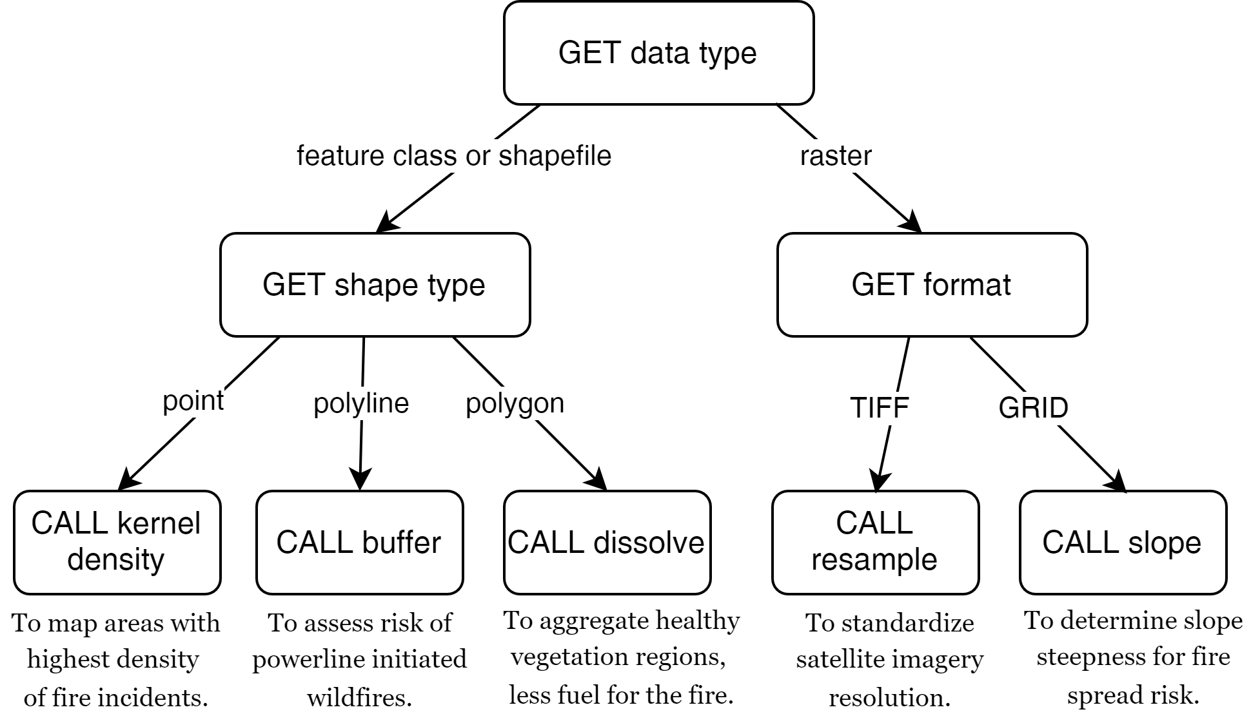
Branching workflow
Notes:
To be able to allow the user to pass in ANY of these datasets as input, the workflow might start by getting the data type.

Slide 45
Branching workflow
Notes:
Then if the datatype is "feature class" or "shapefile", it would need to find out what type of geometry the data is stored in. That is, what type of shapes does it have?

Slide 46
Branching workflow
Notes:
Is it points? polylines? polygons? For each shape type, we want to call a different tool.

Slide 47
Branching workflow
Notes:
If the shapes are points, the workflow calls the kernel density tool to map dense areas of fire incidents.
If the shapes are lines, the workflow buffers these to map the increased risk of fires starting near the powerlines.
If the shapes are polygons, the workflow will call the dissolve tool to aggregate similar vegetative coverings to larger regions to help identify unhealthy areas that fuel the fire.

Slide 48
Branching workflow
Notes:
On the other hand, if the data type is raster (instead of feature class or shapefile),
the workflow would get the dataset's format. Examples of raster formats include GIF, PNG, PDF, TIFF, ESRI GRID and many others.

Slide 49
Branching workflow
Why not
the shape
type?
Notes:
But wait...Why can't we get the shape type of a raster?

Slide 50
Branching workflow
Why not
the shape
type?
Notes:
The answer is, that rasters, unlike feature classes, are not made of vector geometries. Rasters are stored as a grid of cells, so instead of storing polygons, points, and lines, they store a grid of values. In other words, they don't have a shape type because that's not how they store data.

Slide 51
Branching workflow
Notes:
Coming back to our workflow, if the raster format is TIFF, the workflow resamples the raster to create a consistent cell size across rasters.
Finally, if the raster is an ESRI GRID raster, the workflow calls the slope tool to locate steep areas. Steep slopes tend to make fire spreads more quickly.
Note that this is a simplified workflow. For example, just because a raster is an ESRI GRID, doesn't necessarily mean it's a DEM. But we are making assumptions like this for illustration purposes
In this scenario,
Summary of overall workflow:
Input Data Type Identification: The script first determines the type of input data (feature class, shapefile, or raster) and processes it accordingly.
If the input data is Feature Class or Shapefile:
Point Data: If the data is point-based (e.g., fire incidents), the script could call a tool like Kernel Density or Point Density to map areas with the highest density of fire incidents. This helps identify hotspots for further risk management.
Line Data: If the data contains utility lines or roads, a tool like Buffer can be applied to assess areas at risk of powerline-initiated wildfires (e.g., creating a buffer zone around power lines to map high-risk areas).
Polygon Data: For vegetation data, tools like Dissolve can aggregate different vegetation types into larger regions, or the Intersect tool can be used to combine vegetation data with known fire history polygons to identify specific vegetation types that have burned frequently.
If the input is Raster Data:
Satellite Imagery (TIFF): For satellite images, you could use Resample to standardize the resolution across datasets before running analyses like vegetation health monitoring (using NDVI). This is critical for assessing the amount of healthy vegetation, which in turn affects wildfire fuel levels.
Digital Elevation Models (DEMs - GRID): Using the Slope tool, you can generate slope maps to assess terrain steepness. Steep slopes can contribute to the spread of wildfires, and these areas might require special management practices.
Combining Results:
After running individual processes based on data type, the results can be combined (e.g., raster layers and vector layers can be overlaid) to create a comprehensive wildfire risk map.
The workflow could apply additional spatial analysis, such as Weighted Overlay, to combine factors like vegetation health, slope, proximity to power lines, and fire incident density to generate a final wildfire risk assessment map.
Benefits of this Workflow:
Automated Processing: Different datasets arrive in varied formats, and this workflow allows for seamless automation of the correct tool application based on data type. This reduces manual work and ensures consistency in the analysis.
Scalability: The workflow can handle vast datasets and automate processes for different regions or time periods, which is crucial in environmental management where data arrives continuously.
Data Integrity: By checking the format and characteristics of each dataset, the workflow ensures that the right tools are applied, reducing the risk of errors that might arise from processing the wrong data type.
This kind of structured, automated workflow is particularly valuable in agencies that manage large, mixed datasets for disaster response, land management, or resource monitoring.

Slide 52

Branches
Notes:
Nevertheless, to build this workflow in Python, you would need to use conditions and branching.
And you'd need to use arcpy to call tools.

Slide 53
How can Python do this?
How?
How?
How?
Notes:
But how do you get information about a dataset's type using Python?

Slide 54
arcpy Describe objects can get this information
How?
How?
How?
arcpy Describe objects can always provide the data type.
But other properties are dynamic.
Depending on the data type, the Describe object could also have a shape type or a format
Notes:
arcpy Describe objects can ALWAYS provide the data type.
But other Describe object properties are DYNAMIC.

Slide 55
arcpy Describe objects can get this information
How?
How?
How?
arcpy Describe objects can always provide the data type.
But other properties are dynamic.
Depending on the data type, the Describe object could also have a shape type or a format
Notes:
Remember how rasters don't have a shape type? Instead they have a format. But shapefiles do not have a format property.
The properties that a describe object has depend on the data type!

Slide 56
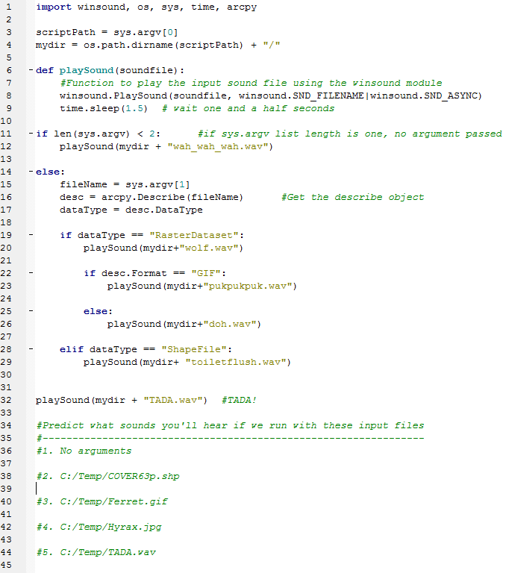
In class – conditionalSound.py (orig)

Slide 57
Buffer_clip… avoid argv index error
Check the list length before indexing it, give feedback, and exit if necessary
use try/except (discuss later)
import sys
listLength = len(sys.argv) # count the number of arguments
if listLength < 5:
print 'Usage: <shapefile to buffer>, <buffer distance>, <shapefile to \ clip>, <the workspace >' # explain the problem to the user
sys.exit(0) # exit the program.
# buffer_clip.py arguments
fireDamage = sys.argv[1]
park = sys.argv[2]
bufferDist = sys.argv[3]
arcpy.env.workspace = sys.argv[4]
# Buffer and clip code below here…

Slide 58
Using if/elif/else
Use if alone when you only want do y if x is true, and you want to continue with the rest of the script in either case.
…
if field_name not in fields: arcpy.addField(filename, field_name)
# Update field values
Use elif to check another conditional statement. Follows if or elif block.
Use else to enact a default action. If none of the previous conditions are true, do what I say. Follows if or elif block.
if shapeType == ‘polygon’:
print 'Shape is polygon'
elif shapeType == ‘line’:
print 'Shape is line'
else:
print 'Shape is not line or polygon'

Slide 59
Ways not to use if, elif
Instead should be
if x == 1:
#do stuff
if x == 2:
#do special stuff
if x == 3:
#do very weird thing
if x == 1:
#do stuff with a
elif x == 2:
#do stuff with b
elif x == 3:
#do stuff with c
elif x == 4:
#do stuff with d
elif x == 5:
#do stuff with e
elif x == 6:
#do stuff with f
…
if x == 1:
#do stuff
elif x == 2
#do special stuff
elif x == 3
#do very weird thing
Don’t use repeated if to check mutually exclusive conditions.
Don’t use a large number of ‘elif’ conditions when consistently testing the same variable’s value and performing the same operation inside.
There are better ways to do this.
Instead should be
using Python
built-in data structure
called a dictionary.
--Dictionaries will be
discussed in a
later lecture.

Slide 60
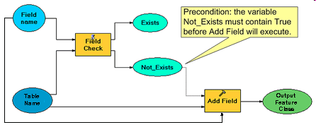
Condition with ‘not’ keyword
Pseudocode
IF field name does not exist THEN CALL Add field ENDIF
CALCULATE FIELD
conditional
statement
Python code
fileName = 'C:/data.shp'
fieldName = 'slope'
fields =['FID', 'rise', 'run']
if fieldName not in fields: arcpy.addField(fileName, fieldName)
print 'New field created.'
arcpy.CalculateField(fileName, fieldName, \ '[rise] / [run]‘)
colon
indent entire if code block (code block = set of related code)
Notes:
#Complete example of code.
import arcpy
fileName = 'C:/Temp/COVER63p.shp'
fieldName = 'Square'
fieldObjs = arcpy.listFields(filename) #we haven’t gone over this yet.
fields=[]
for f in fieldObjs: #we haven’t gone over ‘for’ loops yet.
fields.append(f.name)
if fieldName not in fields:
arcpy.addField(fileName, fieldName)
print 'New field created.'
arcpy.CalculateField(fileName, fieldName, \
'[RECNO]*[RECNO]')
#another way to get the field name list is to use list comprehension:
fields = [f.name for f in fieldObjs]

