Slide 1
WHAT YOU WILL LEARN

Slide 2

GIS PROGRAMMING FUNDAMENTALS (WITH PYTHON)
objectives
requirements
logistics
guidelines
Dr. Tateosian
Center for Geospatial Analytics
North Carolina State University
Notes:
How can you automate GIS workflows to save time and create useful tools? That’s the overarching question this course will address. This is GIS Programming Fundamentals. I’m Dr. Tateosian, the professor for this course. There are also teaching assistants to help. This introductory video discusses course objectives, requirements, logistics, and guidelines.

Slide 3
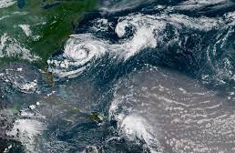




Notes:
Suppose you want to ….
Estimate the likelihood of landslides caused by earthquakes.
Help historians build maps about holocaust victims in Italy.
Visualize the paths of tropical storms.
Or even, plot your own physical activity and sleeping habits over time.

Slide 4
What do we hope to teach
The foundations of programming and Python syntax
Python access to ArcGIS.
Combine data processing and analysis to create a meaningful tool with an easy interface that eliminates tedious manual processing.
Notes:
The foundations of programming and Python syntax
Python access to ArcGIS.
Combine data processing and analysis to create a meaningful tool with an easy interface that eliminates tedious manual processing
The focus of this course is GIS programming through the use of the Python programming language. We will discuss general programming concepts as well as Python syntax. One element we will discuss in depth is the ArcGIS Python library, called arcpy. We will use arcpy as well as standard Python features to process and analyze data.
A key objective for this course is to automate batch processing to enhance workflow efficiency. With Python, large numbers of records, files, and databases can be processed rapidly.

Slide 5
Course learning outcomes
Students will be able to…
interpret basic Python syntax (indentation, context highlighting)
write Python scripts in an integrated development environment (PythonWin)
use Python to construct code using core data structures (strings, lists, …)
call ArcGIS tools with Python (arcpy.buffer…)
handle contingencies within Python (if, else…)
construct basic batch processing Python code (looping)
read/modify data files with Python
create a graphical user interface
do more…
Notes:
These are some of the basic building blocks we will target with this course. But what will you be able to do with all this once you’ve mastered these skills?

Slide 6
Course project examples
Notes:
Let’s look at some exemplary course projects.

Slide 7

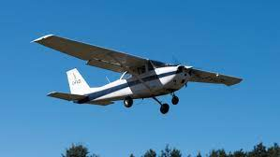
Course project example
Data preparation for Generating NOAA Acoustic Trawl Survey Fish Species Biomass Estimates - Shannon Dolan
Input: NOAA acoustic trawl navigational and cluster csv tables.
Output: Cleaned daytime data for specific species, a map of the data, and an HTML page to show the result.
Recreational Aviation Navigation - Aaron Jones
Input: Departure and destination airports, operational range, planned altitude for the flight.
Output Flight map and HTML page including flight map plan and recommended stops.
727 loc
Notes:
Shannon Dolan used Python to download data from the Web, clean the data, analyze the aquatic species and map the results. In this video, Shannon explains her workflow.

Slide 8
Course project example
Data preparation for Generating NOAA Acoustic Trawl Survey Fish Species Biomass Estimates - Shannon Dolan
Input: NOAA acoustic trawl navigational and cluster csv tables.
Output: Cleaned daytime data for specific species, a map of the data, and an HTML page to show the result.
Recreational Aviation Navigation - Aaron Jones
Input: Departure and destination airports, operational range, planned altitude for the flight.
Output Flight map and HTML page including flight map plan and recommended stops.
727 loc
Notes:
Aaron Jones used Python to create flight maps for recreational airplanes. In this video he demonstration how to run the tool.
Our students apply this course material at their workplaces and in their research projects. Morelli and Bouton took this course a few semesters ago. Morelli’s final project developed a process to simplify overly complex postal code polygons using variable grid sizes. Bouton’s final project automated a process for ground water contamination analysis that had previously been performed painstakingly by hand.
Both of these projects process and automatically map data and create HTML Webpages to display the results. Near the end of the semester, students submit two videos, part 1 to describe the problem they have tackled and their approach, part 2 to demonstrate the tool that was created. We’ll look at Morelli’s part 1 and Bouton’s part 2 to hear what they have to say about their work.
These excellent projects used 400 and 700 lines of code, respectively. Their code is reusable and portable, so they can share it with colleagues. As the semester progresses, you should be thinking about how you might apply programming in your workplace or research or to work with some data that interests you.

Slide 9
Updates and reading

Slide 10
ArcMap to ArcGIS Pro & Python 2 to Python 3
Noticeable differences
mapping in ArcGIS
Python 2: arcpy.mapping....
Python 3: arcpy.mp....
Script tools look different.
Printing
Python 2: print "hello"
Python 3: print("hello")
Prioritizing semantic differences
Some videos // slides may contain old-style print statements
Notes:
This course focuses on Python in general and the use of arcpy to run ArcGIS Pro analysis. Not too long ago, we were all using ArcMap. But that software has been deprecated. Along with the change to ArcGIS Pro came a change in Python from Python 2 to Python 3.
As this change applies to this course, there are 3 really noticeable differences:
First, since Pro uses Project documents instead of Map Documents, the corresponding Python library changed from the "mapping" module to the "mp" module. The course slides and videos now share lots of the snazzy new functionalilty of the mp module.
2nd, Script tool interfaces enable you to make graphical user interfaces for ARCGIS. The interface you use to create script tool have a rather different looking layout, though most of the underlying functionality is the same.
The third difference is the print statements. In Python 2 parentheses were optional. In Python 3 they are REQUIRED. This means minor changes everywhere...
As I strive to update all the resources provided with this course, I must prioritize certain things over others. That means, you may see some old-style print statements in some of the videos and slides. Please keep in mind that in order for this code to run, you would need to add parentheses around the item being printed.

Slide 11

Textbook readings
Selected readings from an updated (Python 3) version of Tateosian, Laura. Python For ArcGIS. Cham, Switzerland: Springer, 2015.
These reading will be provided as PDF documents linked to the course Moodle page.
The electronic version of this textbook available through the library is Python 2 and uses ArcMap, so please refer to the chapters linked in Moodle instead, unless otherwise notified.
Caution: If you read ahead, you might outpace me as I work to update the chapters this semester.
2. Selected readings from: Zandbergen, Paul A. Python Scripting for ArcGIS Pro. Redlands, CA, USA: Esri Press, 2020.
Notes:
This semester, we'll be using Python 3 and ArcGIS Pro.
The textbook usually used for this course -- Python for ArcGIS – has Python 2. For this reason, I will be posting Python 3 versions of the selected readings from this book.
These will be PDF documents linked to the course Moodle pages.
Please refer to these instead of the book available through the library.
Now if you read ahead, you might outpace me as I work to update all the print statements and slight variations in the code that might occur between Python 2 and Python 3. Just keep that in mind if you plan to work ahead.
We will also use one or two chapters from the Zandbergen book, Python Scripting for ArcGIS. But you do not need to purchase this book, as I will provide these pieces via PDF.
#The textbook is available for sale online; an electronic version is available to NC State students for free through the library website. The pdf formatting is more reliable than the eBook (which is altered by the browser window size).
#The data and sample script need to be downloaded for this course http://go.ncsu.edu/gispy
Be sure the unzipped file appears as shown here.

Slide 12
Data and sample scripts
Download the data and sample scripts from http://go.ncsu.edu/gispy
Notes:
One more thing... we'll still be using data and sample script that go with the Python for ArcGIS textbook. These materials have been updated for Python 3. You will see instructions in the first assignment for downloading and unzipping these files so that the course materials and homework assignments will use a consistent path.
If you have any questions about this or the updates described in this video, please let me know. I hope you are excited to learn Python 3!

Slide 13
GRADING AND EXPECTATIONS

Slide 14





What to expect
“Although the lectures provided a nice introduction to the material, I definitely learned to code best by reading the textbook and working through assignments (I think this is just the nature of coding).”
--Anonymous student on course eval.
Notes:
This comment from an anonymous student on the course evaluation explains how to succeed in the course.
“Although the lectures provided a nice introduction to the material, I definitely learned to code best by reading the textbook and working through assignments (I think this is just the nature of coding).”
It’s a good idea to read the book, then watch the lectures with a pencil and paper, work through the in-class activities interleaved with the videos, some are by hand and some are computer based--and then try the homework.

Slide 15
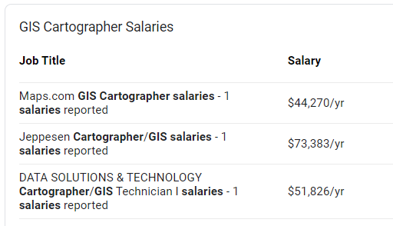
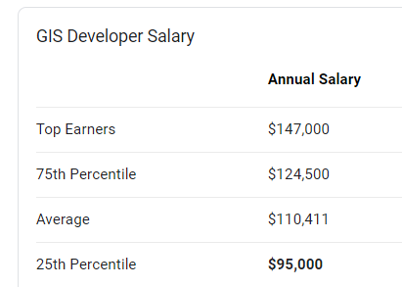
Put more in, expect more
Sources: Glassdoor and ZipRecruiter
Notes:
The concepts presented in this course can help you land a better job, but it takes many hours of practice to learn to plan workflows and implement them efficiently.
You won’t be a software developer with just one programming course, but successful students will definitely have an advantage in the job market.
There’s a reason developer jobs pay more. Learning to program is challenging and it requires a very hands-on approach. This is why lessons are reinforced with in-class exercises and numerous homework assignments. The scripting homework assignments will be challenging. The lessons are cumulative and you will need to apply elements of the first week’s lesson to every subsequent lesson. This means putting the new material together with the old material to solve the homework problems. Quizzes assist with internalizing the material.
Expect to work hard and spend a lot of time on this coursework. If you master these skills, it’s a solid foundation. GIS jobs that require this knowledge pay more than the jobs that don’t.

Slide 16




Grading
30%
40%
4-5 timed quizzes (30%)
Homework (40%)
Python scripts (10 pts each)
Python tutorials (4 pts each)
Moodle exercises (~21 pts each)
Project (25%)
Participation (5%)
Piazza message board usage
Participation in help sessions
Lecture questions
Python notebooks
25%
5%
Notes:
Course grades will be computed based on quizzes, homework, projects, and participation.
[click]
Quizzes, worth 30% of the grade, will cover the required readings and lectures to reinforce the concepts therein. Individual quiz instructions indicate the book chapters to which they correspond. Quizzes are open-notebook, but timed, so plan to review before taking the quizzes so that you are able to complete them in the time available. Each timed quiz has an accompanying practice quiz. Practice quizzes can be used to test yourself before taking the real quiz. Practice quiz questions are not the same as those on the actual timed quizzes, but they will give you a sense of question style and the pacing you will need to complete the timed quiz.

Slide 17
Grading
30%
40%
4-5 timed quizzes (30%)
Homework (40%)
Python scripts (10 pts each)
Python tutorials (4 pts each)
Moodle exercises (~21 pts each)
Project (25%)
Participation (5%)
Piazza message board usage
Participation in help sessions
Lecture questions
Python notebooks
25%
5%
Notes:
Homework, worth 40% of the grade, generally consist of Python scripts, Python tutorial lessons, and Moodle exercises. Each Python script is worth 10 points. Python tutorial lessons are generally worth 4 points each. Moodle exercise points range between 10 and 50 (median 21 points). This depends on the number of questions in an exercise. So, let’s back up. Moodle exercises--Moodle refers to these as “quizzes” but we refer to these as Moodle “exercises”, because they do not need to be completed in one sitting and the time to work on them is only limited by the opening date and the due date. They become available 4 days before the homework deadline. For Moodle exercises, you can start them, save your work and return to continuing working on a different day. Moodle exercises just need to be submitted by the homework deadline.
The project proposals (preliminary and revised) are also part of the homework points, 10 points each.

Slide 18
Grading
30%
35%
4-5 timed quizzes (30%)
Homework (40%)
Python scripts (10 pts each)
Python tutorials (4 pts each)
Moodle exercises (~21 pts each)
Project (25%)
Participation (5%)
Piazza message board usage
Participation in help sessions
Lecture questions
Python notebooks
25%
5%
Notes:
The final project, worth 25% of the grade. The final project should apply course concepts to a particular geospatial application area of your choice.

Slide 19
Final Project Instructions
Stage 1: Preliminary project proposal (~week 10)
Feedback
Stage 2: Project progress (~week 13)
Feedback
Stage 3: Final project submission (1st day of finals week)
Notes:
The projects often involve filtering raw data, performing geospatial analysis, and visualizing the results.
The project is developed in three stages. You’ll submit proposal 2/3 of the way through the semester. We’ll give you some feedback.
Later, you’ll submit your progress—You should have running code and a working interface by this time. We’ll provide additional feedback.
The final version of the project is then due during final exam week.

Slide 20
Grading
30%
35%
4-5 timed quizzes (30%)
Homework (40%)
Python scripts (10 pts each)
Python tutorials (4 pts each)
Moodle exercises (~21 pts each)
Project (25%)
Participation (5%)
Piazza message board usage
Participation in help sessions
Lecture questions
Python notebooks
25%
5%
Notes:
Participation, worth 5% will be based on Piazza message board usage, participation in help sessions, and lecture questions. Participation in these will be measured as follows:
Piazza message board usage: You must pose at least one question or do a checking for each of the 9 homeworks.
Participation in help sessions: You must participate in at least one class help-session during the semester. We can meet by appointment if the timing of the regular help sessions doesn’t work.
Lecture questions: Questions in videos and Most of the course videos have embedded questions. Distance education students must complete all of these questions. So long as earnest attempts are made, wrong answers do not result in point deduction, rather, points are awarded based on participation. (*Students in the 001 section will be attending synchronous class meetings. These students must participate in “in-class” activities to fulfill this requirement, but are not required to review the recorded videos.)

Slide 21
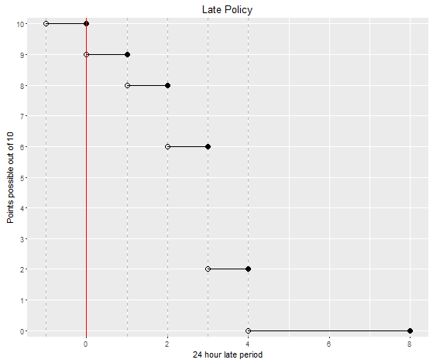
Late homework
penalty =10*2^{(r-1)}% where r is the number of
24-hour periods late.
Deadline(D) D+24hrs D+48hrs D+72hrs D+96hrs
Notes:
The points that can be earned for late submissions drops exponentially. For example, an exercise with 10 points submitted more than 48 hours past the deadline (and less than or equal to 72 hours past the deadline) can only earn a maximum of 6 points and it keeps dropping.

Slide 22
Late homework
penalty =10*2^{(r-1)}% where r is the number of
24-hour periods late.
“Lateness” applies to each homework item separately.
Deadline(D) D+24hrs D+48hrs D+72hrs D+96hrs
Notes:
If you’re going to be late, submitting the parts that are complete will help your grade. “Lateness” is applied to each homework item separately. So, if you have completed, say, 3 of the 4 Python scripts by the due date, submit the 3 completed scripts on time. We can see dates of submission for separate parts, so only the fourth script would then be marked as late if you submit it late.

Slide 23
Academic integrity
Material challenging -> utilize teaching staff help. Otherwise, homework assignments must be completed alone.
University policy is strict. Read the NCSU policy overview and Sections 8 and 9 of the Code of Student Conduct linked to the syllabus.
Building fundamental skills in this class. Group work not allowed unless specified.
Study groups can discuss code from in-class exercises, slides, and assigned reading, but not from homework.
Not allowed:
Copying.
Talking someone through the solution.
If you need more help go to office hours, Skype with TAs, or use private posts on the message board.
Otherwise, the work you submit for homework must be entirely your own.
Notes:
Like always in computer programming courses, we want you to do your own work and not borrow things from other people’s code or brains. So we really do emphasize that you should read and pay attention to the academic integrity policies. In-class activities are considered group work so you can collaborate on these. Homework, quizzes, and projects are not group work, so you must only submit your own work. If you’re not certain about something, ask the instructors.
We know the material can be challenging, so you should take advantage of the teaching staff help. Use office hours and the message board to interact with the teaching assistants and instructor when you are struggling with the homework. Beyond this, however, students are required to do homework assignments individually.
Study groups may discuss code from in-class exercises, textbook examples, and code from the course slides, but they may not do the homework together. Copying will not be tolerated. The work you submit must be your own. Examples of cheating are: looking at another student's code, writing your program while talking to someone else about it, talking another student through the solution code, allowing others to look at your solution code, posting your code on the Web, obtaining code from a student who is taking GIS 540 or took GIS 540 during a previous semester, and obtaining code from family, friends, colleagues, or others. For homework assignments, code snippets from the examples provided for class and the ArcGIS Resources help pages are expected to be use; However, copying code from other Internet sources is also considered cheating. Sharing code on the message board or in other ways is a violation of the NCSU Code of Student Conduct. If you have any doubts about what is allowed when completing homework assignments, ask the instructor.
This kind of rigor maintains the quality of our graduate program and preserves the value of a degree earned from NC State. Sometimes students get involved in misconduct unintentionally. So, to avoid confusion, the policies are laid out in the syllabus.

Slide 24
GETTING HELP

Slide 25
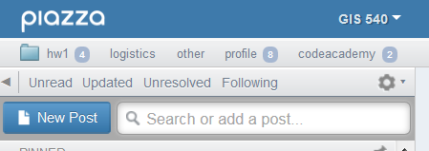
Message board (Piazza)
Post Type: question or note
Post To: public or private (to instructors)
Select folder(s)
Filtering and searching
Notes:
The message board can be reached from Moodle using your unity login. Piazza has excellent organizational and filtering features that are not available in Moodle forums. The CEO of Piazza designed the application based on her college experiences in college (https://piazza.com/about/story).

Slide 26
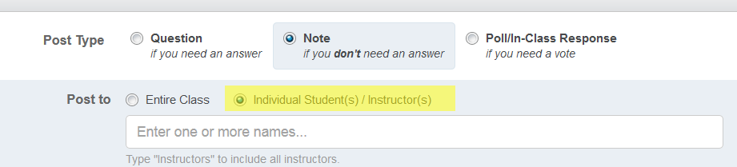
Message board (Piazza)
Post Type: question or note
Post To: public or private (to instructors)
Select folder(s)
Filtering and searching
Notes:
When you start a new post, notice that you need to select the post type, “Question” or “Note”. If what you are posting is NOT a question, be sure to select NOTE.

Slide 27
Message board (Piazza)
Post Type: question or note
Post To: public or private (to instructors)
Select folder(s)
Filtering and searching
Notes:
You also need to select who can see the post. Under ‘post to’, select “Entire Class” or “Individual Students(s)/ Instructor(s). If you need to post a question and share homework code post to “Instructors”. To do this, select the 2nd choice and type “Instructors” in the box.
Outside of personal issues, please do not post to Dr. Tateosian only. In most cases, you should use “Instructors” to alert multiple people about your question.

Slide 28
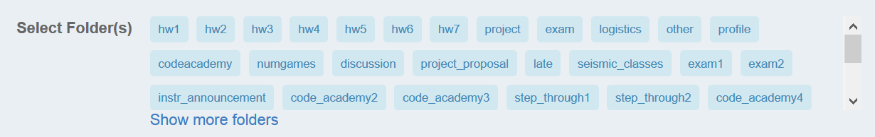
Message board (Piazza)
Post Type: question or note
Post To: public or private (to instructors)
Select folder(s)
Filtering and searching
Notes:
Once you post a message, you must select one or more folders. This tags all messages related to a topic.

Slide 29
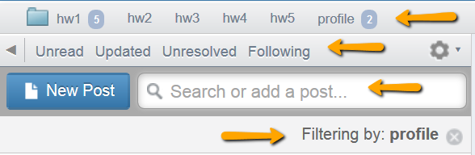
Message board (Piazza)
Post Type: question or note
Post To: public or private (to instructors)
Select folder(s)
Filtering and searching
Notes:
When you’re using the message board, you can also filter the messages by “Unread”, “Updated”, “Unresolved”, or “Following”.

Slide 30
Message board (Piazza)
Post Type: question or note
Post To: public or private (to instructors)
Select folder(s)
Filtering and searching
Notes:
You can filter based on the folders. A “Filtering by” statement will appear below the search box when you’re filtering. To turn off this filtering, use the X to the right of this message.

Slide 31
Message board (Piazza)
Post Type: question or note
Post To: public or private (to instructors)
Select folder(s)
Filtering and searching
Notes:
You can use the search box to create a custom filter.

Slide 32
HELP!
Use the message board
Meet with instructors/TAs

Slide 33
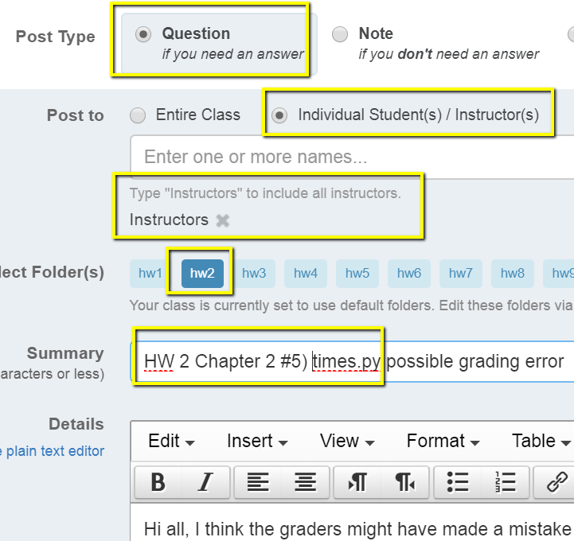
Grade changes
Grades and comments posted in the Moodle gradebook.
Grade change requests must be submitted within one week of being returned.
Submit grade change requests via private (to instructors) note on the message board. Be sure to provide the assignment number and question name and briefly explain the issue.
Our goal is fair grading and we want to correct any errors.
Notes:
Grades and comments will be posted in the Moodle gradebook.
To enhance learning from the homework, it’s very important to review these comments.
If spot something that may need to be changed, ask by posting a message to the instructors on the message board. These questions must be posed within one week of when the grade was posted. Make grade change requests with a private message board post to the instructions.

Slide 34
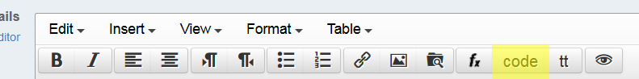
Posting code questions on forums
How to create a minimal, complete, and verifiable example
make questions as specific and focused on one particular problem.
post the error message and what you’re trying to do.
use the chapter where the homework question comes from.
use the ‘code’ button to post code.
enable students to discover mistakes.
Notes:
Asking effective questions on the forums takes practice. This is another skill that you may develop in this course. The speed and utility of responses to coding questions, depends largely on the quality of the question itself. Be specific and clear. Use copy/paste to include any error messages in the question. Specify the homework exercise name and chapter. Use the ‘code’ button to preserve spacing in the code.
If you want to help other students, don’t tell them the answer; Help them discover their mistake themselves. Otherwise, you’re stealing from them the chance to have that ah-ha moment, which is when the learning occurs.

Slide 35
Course schedule
1st Quarter Intro to Python basics, integrated development environments, data structures, ArcGIS API, decision making, looping
2nd Quarter project proposal
Batch processing, debugging, error handling, functions, cursors
3rd Quarter updated proposal
Dictionaries, reading and writing text files, file GUI’s, modules, classes, Mapping with Python
4th Quarter
Reading and writing HTML and KML, script tools, additional modules, project work
Notes:
Here are the course topics grouped into quarters. The materials are cumulative. For example, to read and write files, you need to use Python data structures from week 1.

Slide 36
SOFTWARE
Notes:
You will need to install software for this course. You will find instructions in Moodle with all the details.

Slide 37
Submitting homework scripts
All deadlines are given in EST.
Scripts should be named as specified.
Put your unityID (e.g., jkrowlin) and name in each script.
Don’t zip submissions.
Notes:
If you spot a mistake in the code that you have uploaded and it’s still before the deadline, fix the code and upload it again.
All the deadlines are given in Eastern Standard Time.
At the very beginning of the course, assignments will have some short answer questions. But the vast majority of the homework assignments will be scripts.
Be sure to follow general instructions for the script submissions, so that you don’t lose points in this way.
Name scripts exactly as specified in the exercise in the book. Wrong names cause the graders aggravation because the grading system doesn’t find them.
Include your unityID and name in the header comments of each script you submit. Otherwise we can’t tell whose it is when we have it open.
Don’t zip your submissions. Moodle automatically groups anything you submit in a folder named as your unity id.

Slide 38
ESSENTIAL RESOURCES

Slide 39

Py4All
A tool designed to accompany the textbook, Python for ArcGIS
How to use it:
Watch the Intro to Py4All video
Browse to go.ncsu.edu/py4all
Login with your NCSU unity ID and password
Upload a Python script for feedback.
Can be used iteratively
Upload script to Py4All
Receive feedback
Make modifications
Notes:
One very helpful resource that is available to you is an online tool called Py4All, which has been developed to accompany the Python for ArcGIS textbook. It applies to any exercise in the book in which you write a script.
The main purpose of Py4All is to provide automated feedback and enable students to compare your output to the solution output.
It can be used the script is completed or when you’ve made as much progress as you can, but you’re stuck. It does not replace grading, which the instructors will do. When you’re ready to officially submit a script, do that on Moodle. Py4All is more like a sandbox system to provide automated feedback.
Instead of a grader, think of Py4All as a helping hand when you’re first learning to script. You can use it iteratively by uploading your script, receiving feedback, making modifications, and uploading again to receive additional feedback.
To get started, watch the intro to Py4All video which explains how it works. You will be able login to the Py4All site with your unity id and password once you receive the enrollment key which will be shared on the message board.

Slide 40
Essential Resources
Announcements (“FOLLOW” THESE)
General news and announcements will be posted here.
Syllabus
Guidelines, expectations, and responsibilities for GIS540 participants.
Piazza message board
Post your questions or comments (see the how-to) regarding assignments, software issues, and coding challenges here.
Instructors (a.k.a. Meet the instructor)
Professor and Teaching Assistant names, photos, and office hour arrangements.
Py4All
upload textbook exercise scripts to receive automated feedback, compare your output to the solution output, and use this information to improve the script prior to submitting it for a grade.
gispy.zip
the data and sample scripts to accompany textbook
Course project
Gradebook
Schedule Overview
“hamburger”
Notes:
The Moodle course page contains links to essential course resources.

Slide 41
Essential Resources
Announcements (“FOLLOW” THESE)
General news and announcements will be posted here.
Syllabus
Guidelines, expectations, and responsibilities for GIS540 participants.
Piazza message board
Post your questions or comments (see the how-to) regarding assignments, software issues, and coding challenges here.
Instructors (a.k.a. Meet the instructor)
Professor and Teaching Assistant names, photos, and office hour arrangements.
Py4All
upload textbook exercise scripts to receive automated feedback, compare your output to the solution output, and use this information to improve the script prior to submitting it for a grade.
gispy.zip
the data and sample scripts to accompany textbook
Course project
Gradebook
Schedule Overview
“hamburger”
Notes:
Read any announcements I post in Moodle. Announcements contain information everyone needs to know, including homework feedback and important reminders.

Slide 42
Essential Resources
Announcements (“FOLLOW” THESE)
General news and announcements will be posted here.
Syllabus
Guidelines, expectations, and responsibilities for GIS540 participants.
Piazza message board
Post your questions or comments (see the how-to) regarding assignments, software issues, and coding challenges here.
Instructors (a.k.a. Meet the instructor)
Professor and Teaching Assistant names, photos, and office hour arrangements.
Py4All
upload textbook exercise scripts to receive automated feedback, compare your output to the solution output, and use this information to improve the script prior to submitting it for a grade.
gispy.zip
the data and sample scripts to accompany textbook
Course project
Gradebook
Schedule Overview
“hamburger”
Notes:
This video discussed rules from the syllabus but the syllabus contains more detail. Be sure to read the syllabus to clarify the expectations for the course.

Slide 43
Essential Resources
Announcements (“FOLLOW” THESE)
General news and announcements will be posted here.
Syllabus
Guidelines, expectations, and responsibilities for GIS540 participants.
Piazza message board (HELP!)
Post your questions or comments (see the how-to) regarding assignments, software issues, and coding challenges here.
Instructors (a.k.a. Meet the instructor)
Professor and Teaching Assistant names, photos, and office hour arrangements.
Py4All
upload textbook exercise scripts to receive automated feedback, compare your output to the solution output, and use this information to improve the script prior to submitting it for a grade.
gispy.zip
the data and sample scripts to accompany textbook
Course project
Gradebook
Schedule Overview
“hamburger”
Notes:
Moodle has a link to Piazza just beneath the other Essential Resources. Search for HELP! if you don’t see it right away.

Slide 44

Essential Resources
Announcements (“FOLLOW” THESE)
General news and announcements will be posted here.
Syllabus
Guidelines, expectations, and responsibilities for GIS540 participants.
Piazza message board
Post your questions or comments (see the how-to) regarding assignments, software issues, and coding challenges here.
Instructors (a.k.a. Meet the instructor)
Professor and Teaching Assistant names, photos, and office hour arrangements.
Py4All
upload textbook exercise scripts to receive automated feedback, compare your output to the solution output, and use this information to improve the script prior to submitting it for a grade.
gispy.zip
the data and sample scripts to accompany textbook
Course project
Gradebook
Schedule Overview
“hamburger”
Notes:
Piazza will be our primary platform for interaction with students who are not in the classroom.
But we do enjoy meeting with students when possible, so don’t hesitate to reach out for help. Getting help early in the semester can keep you on track. Since it’s difficult to find a time that is convenient for everyone, we usually try to be flexible by making our office hours by appointment. To arrange an appointment, post a message on Piazza. As always, plan for any requested meeting by preparing specific questions for the meeting so that we can help efficiently.
We can use Zoom for remote meetings. In-person might also be possible, depending on your location and schedule. For remote meetings, we can share desktops Zoom. There is a GIS 540 Zoom meeting set up already so that whenever our meeting occurs, we can just follow the link to a live meeting. You’ll need a microphone or you can join the audio by telephone.
I prefer that you use the Piazza message board to contact the instructors instead of email. If you send emails directly to us with course material questions, we will ask you to post the questions on Piazza so that we have our interactions in one place. In this way, others may be able to learn from your questions too.

Slide 45
Essential Resources
Announcements (“FOLLOW” THESE)
General news and announcements will be posted here.
Syllabus
Guidelines, expectations, and responsibilities for GIS540 participants.
Piazza message board
Post your questions or comments (see the how-to) regarding assignments, software issues, and coding challenges here.
Instructors (a.k.a. Meet the instructor)
Professor and Teaching Assistant names, photos, and office hour arrangements.
Py4All
upload textbook exercise scripts to receive automated feedback, compare your output to the solution output, and use this information to improve the script prior to submitting it for a grade.
gispy.zip
the data and sample scripts to accompany textbook
Course project
Gradebook
Schedule Overview
“hamburger”
Notes:
You can find a link to Py4All under Essential Resources on Moodle.

Slide 46
Essential Resources
Announcements (“FOLLOW” THESE)
General news and announcements will be posted here.
Syllabus
Guidelines, expectations, and responsibilities for GIS540 participants.
Piazza message board
Post your questions or comments (see the how-to) regarding assignments, software issues, and coding challenges here.
Instructors (a.k.a. Meet the instructor)
Professor and Teaching Assistant names, photos, and office hour arrangements.
Py4All
upload textbook exercise scripts to receive automated feedback, compare your output to the solution output, and use this information to improve the script prior to submitting it for a grade.
gispy.zip
the data and sample scripts to accompany textbook
Course project
Gradebook
Schedule Overview
Notes:
There is also a link to the gispy.zip file. If, for any reason, you already have a copy of gispy, it’s safest to download a fresh one, as I do update this periodically.

Slide 47
Essential Resources
Announcements (“FOLLOW” THESE)
General news and announcements will be posted here.
Syllabus
Guidelines, expectations, and responsibilities for GIS540 participants.
Piazza message board
Post your questions or comments (see the how-to) regarding assignments, software issues, and coding challenges here.
Instructors (a.k.a. Meet the instructor)
Professor and Teaching Assistant names, photos, and office hour arrangements.
Py4All
upload textbook exercise scripts to receive automated feedback, compare your output to the solution output, and use this information to improve the script prior to submitting it for a grade.
gispy.zip
the data and sample scripts to accompany textbook
Course project
Gradebook
Schedule Overview
“hamburger”
Notes:
There is a link to information about the course project.

Slide 48
Essential Resources
Announcements (“FOLLOW” THESE)
General news and announcements will be posted here.
Syllabus
Guidelines, expectations, and responsibilities for GIS540 participants.
Piazza message board
Post your questions or comments (see the how-to) regarding assignments, software issues, and coding challenges here.
Instructors (a.k.a. Meet the instructor)
Professor and Teaching Assistant names, photos, and office hour arrangements.
Py4All
upload textbook exercise scripts to receive automated feedback, compare your output to the solution output, and use this information to improve the script prior to submitting it for a grade.
gispy.zip
the data and sample scripts to accompany textbook
Course project
Gradebook
Schedule Overview
Notes:
There’s a link to GRADES at the top of the Moodle page. Check to be sure you can see it.
Once we grade your scripts, we will post individualized comments that you can only see in the gradebook (not under the ‘assignment’ page).

Slide 49
Essential Resources
Announcements (“FOLLOW” THESE)
General news and announcements will be posted here.
Syllabus
Guidelines, expectations, and responsibilities for GIS540 participants.
Piazza message board
Post your questions or comments (see the how-to) regarding assignments, software issues, and coding challenges here.
Instructors (a.k.a. Meet the instructor)
Professor and Teaching Assistant names, photos, and office hour arrangements.
Py4All
upload textbook exercise scripts to receive automated feedback, compare your output to the solution output, and use this information to improve the script prior to submitting it for a grade.
gispy.zip
the data and sample scripts to accompany textbook
Course project
Gradebook
Schedule Overview
Notes:
Also under essential resources, there’s a link to the Schedule Overview, which provides an at-a-glance overview of the course schedule.

Slide 50


Schedule
TRY IT
Week blocks
Topic 1
Readings
Videos
Slides
In-class exercises
Topic 2
Readings
Videos
…
Homework blocks
Quiz blocks
Links to the quiz
READ → WATCH → TRY IT→ CHECK IT
READ AGAIN → TRY IT
Notes:
Moodle follows this schedule using blocks to organize the materials. Each week has two topics and a homework or quiz.
There are 3 main types of blocks in the schedule. These are week, quiz, and homework blocks. A week block contain the topics for that week and below each topic, you’ll find the related materials. These materials typically include a chapter from the textbook to read, a video to accompany the reading, the slides that are used in the video, and a link to the in-class exercises that are discussed in the video. Homework assignments generally consist of completing tutorial lessons, responding to short answer questions, and writing Python scripts. Quiz blocks contain timed quizzes with a short availability window.
The recommended approach to this course is to first read the required readings. Then watch the video. Pause the video for embedded questions. Try to solve these exercises on your own or with a study group. Then resume the video to listen to the solution. Solutions to the in-class exercises are either on a slide or in the notes section of a slide. When you read the textbook before watching the video, it’s as if you’re hearing it for a second time. This really helps to reinforce the new concepts you’re learning. After cycling through the video watching, trying hands-on exercises, and checking your work, you may want to then look at the related chapter again before attempting the homework. In fact, trying the code you’re looking at in the chapter and testing variations of it is useful for learning syntax. Get in the habit of predicting the output from a line of code. Make a habit of doing this to internalize what you’re learning.

Slide 51

Essential Resources
Announcements (“FOLLOW” THESE)
General news and announcements will be posted here.
Syllabus
Guidelines, expectations, and responsibilities for GIS540 participants.
Piazza message board
Post your questions or comments (see the how-to) regarding assignments, software issues, and coding challenges here.
Instructors (a.k.a. Meet the instructor)
Professor and Teaching Assistant names, photos, and office hour arrangements.
Py4All
upload textbook exercise scripts to receive automated feedback, compare your output to the solution output, and use this information to improve the script prior to submitting it for a grade.
gispy.zip
the data and sample scripts to accompany textbook
Course project
Gradebook
Schedule Overview
“hamburger”
Notes:
Finally, Bookmark the Moodle page, as this will be your primary landing spot for this course.

Slide 52

Moodle navigation
Click the hamburger to expand or collapse the navigation bands on the left –hand side.
“hamburger”

Slide 53


Notes:
Please let us know if you have any questions as you navigate the course website.

Slide 54

Welcome!

Slide 55
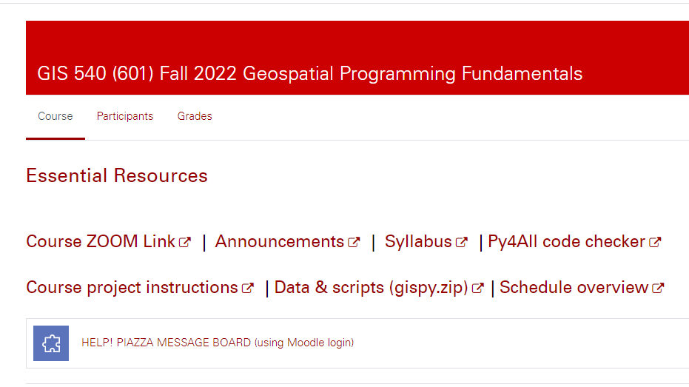

Slide 56
Software you need to install
ArcGIS Pro
DO NOT install Python (it is already installed with ArcGIS)
PythonWin
Python is automatically installed with ArcGIS
PythonWin is not.
Test if PythonWin is installed correctly
Type this at the prompt in the PythonWin Interactive Window:
import arcpy
If you don’t get an error message, you’ve got it.
PyCharm is another easy IDE has some advantages over PythonWin (e.g., tabbed script windows and immediate tab completion) but has a steeper learning curve than PythonWin
VS Code
We will use this to run Python notebooks when we run them outside of ArcGIS Pro
Notes:
We are currently using ArcGIS Pro version 2.8, 2.9 should be fine as well.
Loom is useful for taking screen shots and recording videos to illustrate forum questions. You may also use it to record your final project videos. Be sure to find a microphone, so you’re not scrambling for that at the end of the semester.
Instructions linked to Moodle walk through the installation of PythonWin, PyScripter, PyCharm, VS Code. Python itself is automatically installed when ArcGIS is installed. Do not install Python again. If your import arcpy test fails in one of the IDEs, you probably installed them under another version of Python or you’re pointing to a different interpreter.

