Slide 1

Introduction to File handling with Pandas
GIS540 | Laura Tateosian
Notes:
Hurricanes, air pollution, forest fires, urban sprawl, ocean plastics, politics, traffic jams, and pandemics. So many of our modern challenges is geospatial and so much of our big data is geospatial.

Slide 2
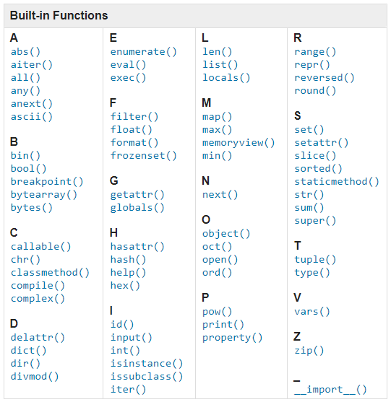
File reading and writing

Slide 3
File writing using open() / close ()
file_name = r"Q:\diary.txt"
text = "Dear Diary, Today I wrote some Python scripts! They were so terrific. You wouldn't believe it."
outf = open(file_name, 'w')
outf.write(text)
outf.close()

Slide 4
File writing (with... as)
file_name = r"Q:\diary.txt"
text = "Dear Diary, Today I wrote some Python scripts! They were so terrific. You wouldn't believe it."
with open(file_name, 'w') as outf:
outf.write(text)
with ... as releases locks if an exception is thrown before the file object is closed.

Slide 5
File reading
file_name = r"Q:\diary.txt"
with open(file_name, 'r') as inf:
file_contents = inf.read()
print(file_contents)
Dear Diary, Today I wrote some Python scripts! They were so terrific. You wouldn't believe it.

Slide 6

File handling approaches
Built-in open function for unstructured content
Pandas for structured text
in many formats (e.g., csv,
Excel, json, html, etc.)

Slide 7
Opening data with Pandas
import pandas as pd
odf = pd.read_csv('../data/bat.csv',skiprows=2)
odf['SPECIES']

Slide 8
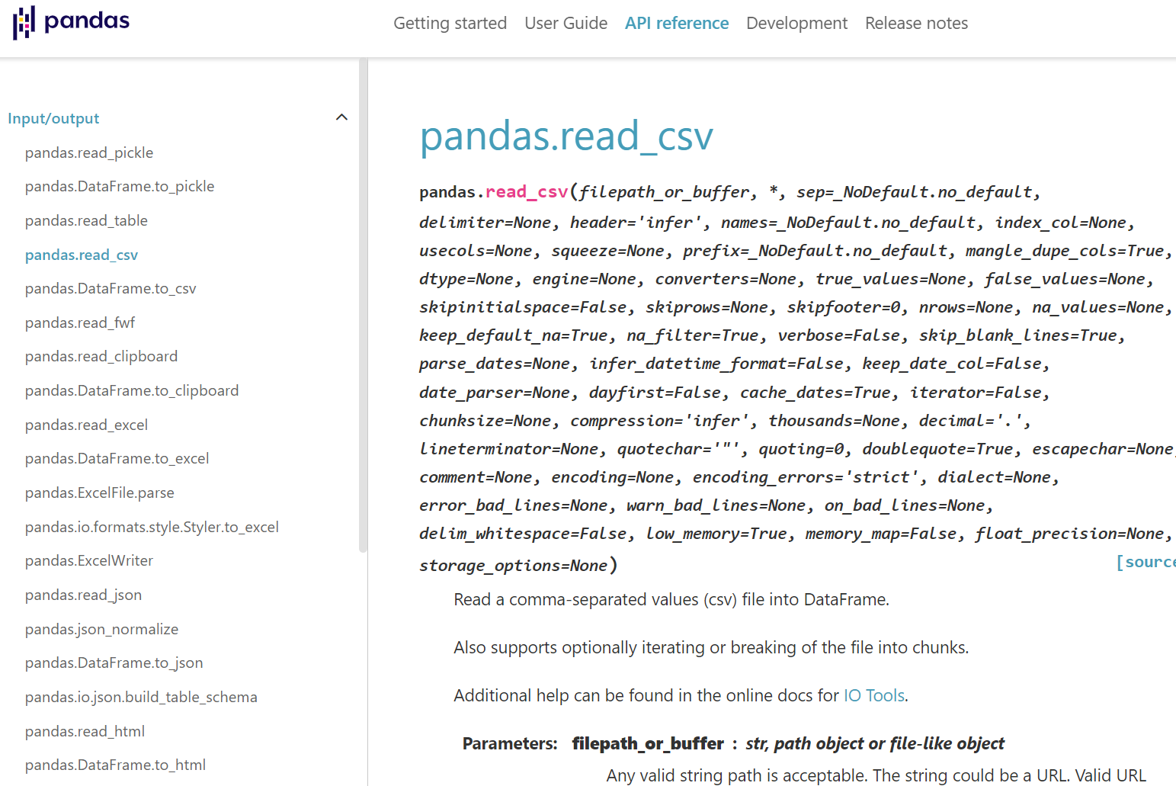
https://pandas.pydata.org/docs/reference/api/pandas.read_csv.html

Slide 9
Getting to know your data with Pandas
import pandas as pd
df = pd.read_csv('../data/weather.csv')
print(df.head()) # Top 10 records
print(df.columns) # Column names
print(df.shape) # Dimensions

Slide 10
Pandas data structures
Dataframe Series
Date
Time
Animal
Date
Time
Animal
import pandas as pd
df = pd.read_csv('../data/pet_adoption.csv')
dates = df['Date']

Slide 11
Series brace and dot syntax
import pandas as pd
df = pd.read_csv('../data/weather.csv')
temps = df['Temperature']
# OR
temps = df.Temperature

Slide 12
Pandas Boolean Indexing
import pandas as pd
df = pd.read_csv('../data/pet_adoption.csv')
df["Animal"] == "cat"
0 True
1 False
2 False
3 True
4 False
df[df["Animal"] == "cat"]
Date Time Animal
0 1/1/2023 0900 cat
3 9/2/2022 1200 cat

Slide 13
Compound Pandas Boolean Conditions
Python logical operator | Pandas operator symbol
and | &
or | |
not | ~
import pandas as pd
df = pd.read_csv('../data/weather.csv')
snow = df[(df["Temperature"] <= 33) & (df["Precip"] == "high")]
no_beach_trip = df[(df["Wind speed"] > 13) | (df["Temperature"] < 17)]

Slide 14
Pandas series string methods
Examples: upper(), lower(), supper(), slower(), isnumeric(), replace(), split(), contains(), find(), findall()
import pandas as pd
df = pd.read_csv('../data/pet_adoption.csv')
# Boolean index series
df["Animal"].str.startswith("kit")
# Get a dataframe of the records where this is true.
kit_df = df[df["Animal"].str.startswith("kit")]

Slide 15
Frequency and sorting
df["Animal"].value_counts()
dog 3250
cat 832
kittens 480
df["Animal"].sort_values()
Date Time Animal
0 1/1/2023 0900 cat
3 9/2/2022 1200 cat
8 5/1/2022 0900 cat
9 6/2/2021 1200 cat
...

Slide 16
Writing to csv
import pandas as pd
df = pd.read_csv('../data/weather.csv')
warm = df[df["Temperature"] >= 70]
warm.to_csv('../data/warm.csv')

Slide 17
Summary
Pandas for structured datasets
Read/write many different file types
Dataframes and Series Pandas data types
Fast access to columns by name
Boolean selection (& | ~)
Frequency and Sorting

Slide 18
Try with a notebook
Download pandas.ipynb & olympics.csv
The notebook includes the Python code to process an Olympics dataset.
Open the notebook in Jupyter Lab (https://jupyter.org/try)
Run the notebook by clicking the Play ( ▶) icon next to each cell, in order, following the prompts.
The results will appear below the cell.

