Slide 1

GIS PROGRAMMING FUNDAMENTALS
(WITH PYTHON)
Dr. Tateosian
objectives
requirements
logistics
guidelines
Notes:
Welcome to GIS Programming Fundamentals. The instructional support consists of the professor, Dr. Tateosian, and two teaching assistants. In this video we will discuss the course objectives, requirements, logistics, and guidelines.

Slide 2
Course topic
GIS programming (through the use of the Python programming language)
  General programming concepts, as well as Python syntax.
  Python language elements for programming ArcGIS.
  Processing/analyzing data.
  Performing batch processing and manipulating map elements.
  ESRI script tools to create graphical user interfaces.
Notes:
The focus of this course is GIS programming through the use of the Python programming language. We will discuss general programming concepts as well as Python syntax. One element we will discuss in depth is the ArcGIS Python library, called arcpy. We will use arcpy as well as standard Python features to process and analyze data.
A key objective for this course is to automate batch processing to enhance workflow efficiency. With Python, large numbers of records, files, and databases can be processed rapidly.

Slide 3
Course learning outcomes
Students will be able to…
  interpret basic Python syntax (indentation, context highlighting)
  write Python scripts in an integrated development environment (PythonWin)
  use Python to construct code using core data structures (strings, lists, …)
  call ArcGIS tools with Python (arcpy.buffer…)
  handle contingencies within Python (if, else…)
  construct basic batch processing Python code (looping)
  read/modify data files with Python
  create a graphical user interface
  do more…
Notes:
These are some of the basic capabilities we will target with this course. Let’s view some sample final projects for a clearer picture of what’s possible when these skills are mastered.

Slide 4


Course project examples
“Gridded Coastline Simplification of Postal Code Polygons”- W. Morelli
Input High vertex count postal polygons, grid size specs.
Output Map and Webpage with simplified postal code polygons, table of vertex counts
“Groundwater contamination analysis for military installations with leaking underground storage tanks” - E. Bouton
Input Tables (CSV format) with water depth measurements (from the field) and lab analysis results.
Output Map and Webpage with automatically generated groundwater elevation contours and BTEX contamination plume surfaces.
400 loc
727 loc
Notes:
Our students apply this course material at their workplaces and in their research projects. Morelli and Bouton took this course a few semesters ago. Morelli’s final project developed a process to simplify overly complex postal code polygons using variable grid sizes. Bouton’s final project automated a process for ground water contamination analysis that had previously been performed painstakingly by hand.
Both of these projects process and automatically map data and create HTML Webpages to display the results. Near the end of the semester, students submit two videos, part 1 to describe the problem they have tackled and their approach, part 2 to demonstrate the tool that was created. We’ll look at Morelli’s part 1 and Bouton’s part 2 to hear what they have to say about their work.
These excellent projects used 400 and 700 lines of code, respectively. Their code is reusable and portable, so they can share it with colleagues. As the semester progresses, you should be thinking about how you might apply programming in your workplace or research or to work with some data that interests you.

Slide 5

Textbook and data
Required textbook: Tateosian, Laura. Python for ArcGIS. Springer, 2015.
  hard copy available for purchase
  electronic version available for free to NCSU students (pdf recommended over eBook)
Download the data and sample scripts from http://go.ncsu.edu/gispy
Notes:
The textbook is available for sale online; an electronic version is available to NC State students for free through the library website. The pdf formatting is more reliable than the eBook (which is altered by the browser window size).
The data and sample script need to be downloaded for this course http://go.ncsu.edu/gispy
Be sure the unzipped file appears as shown here.

Slide 6
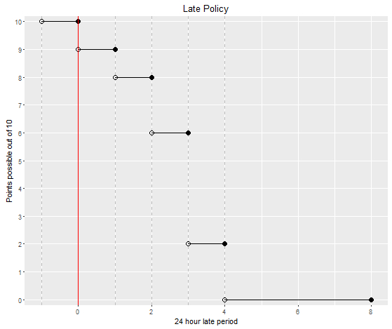
Grading
A midterm exams (30%)
5-6 quizzes (30%)
Project (25%)
Homework (15%)
Homework late policy:
  penalty =10*2^{(r-1)}% where r is the number of 24-hour periods late
Deadline(D) D+24hrs D+48hrs D+72hrs D+96hrs
Notes:
The concepts presented in this course can help you land a better job, but it takes many hours of practice to learn to plan workflows and implement them efficiently.
Learning to program is challenging and it requires a very hands-on approach. This is why lessons are reinforced with in-class exercises and numerous homework assignments. The scripting homework assignments will be challenging. The lessons are cumulative and you will need to apply elements of the first week’s lesson to every subsequent lesson. This means putting the new material together with the old material to solve the homework problems. Quizzes and exams assist with internalizing the material. The grading for this course is based on homework assignments, quizzes, exams, and the final project.
The points that can be earned for late submissions drops exponentially. For example, an exercise with 10 points submitted more than 48 hours past the deadline (and less than or equal to 72 hours past the deadline) can only earn a maximum of 6 points and it keeps dropping.
Expect to work hard and spend a lot of time on this coursework. If you master these skills, it will pay off. The GIS jobs that require this knowledge pay more than the jobs that don’t.

Slide 7
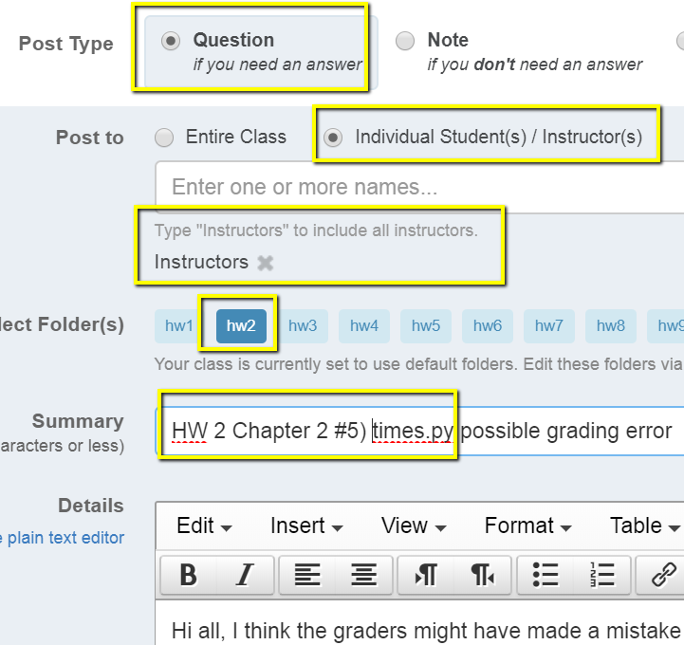
Grade changes
Grades and comments posted in the Moodle gradebook.
Grade change requests must be submitted within one week of being returned.
Submit grade change requests via private (to instructors) note on the message board. Be sure to provide the assignment number and question name and briefly explain the issue.
Our goal is fair grading and we want to correct any errors.
Notes:
Grades and comments will be posted in the Moodle gradebook. This can be accessed from the Moodle website.
To enhance learning from the homework, it’s very important to review these comments. If you don’t understand a feedback comment, post a message to the instructors on the forum asap.
Also, you have just one week from when the grades are posted to request any grade changes. Grade changes requests are made with a private message board post to the instructions.

Slide 8
Academic integrity
Material challenging -> utilize teaching staff help. Otherwise, homework assignments must be completed alone.
University policy is strict. Read the NCSU policy overview and Sections 8 and 9 of the Code of Student Conduct linked to the syllabus.
Building fundamental skills in this class. Group work not allowed unless specified.
Study groups can discuss code from in-class exercises, slides, and assigned reading, but not from homework.
Not allowed:
  Copying.
  Talking someone through the solution.
If you need more help go to office hours, Skype with TAs, or use private posts on the message board.
Otherwise, the work you submit for homework must be entirely your own.
Notes:
We know the material can be challenging, so you should take advantage of the teaching staff help. Use office hours and the message board to interact with the teaching assistants and instructor when you are struggling with the homework.
Beyond this, however, students are required to do homework assignments individually.
Study groups may discuss code from in-class exercises, textbook examples, and code from the course slides, but they may not do the homework together. Copying will not be tolerated. The work you submit must be your own.
Examples of cheating are: looking at another student's code, writing your program while talking to someone else about it, talking another student through the solution code, allowing others to look at your solution code, posting your code on the Web, obtaining code from a student who is taking GIS 540 or took GIS 540 during a previous semester, and obtaining code from family, friends, colleagues, or others. For homework assignments, code snippets from the examples provided for class and the ArcGIS Resources help pages are expected to be use; However, copying code from other Internet sources is also considered cheating. Sharing code on the message board or in other ways is a violation of the NCSU Code of Student Conduct. If you have any doubts about what is allowed when completing homework assignments, ask the instructor.
This kind of rigor maintains the quality of our graduate program and preserves the value of a degree earned from NC State. Sometimes students get involved in misconduct unintentionally. So, to avoid confusion, the policies are laid out in the syllabus.

Slide 9
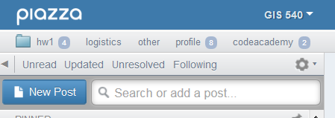
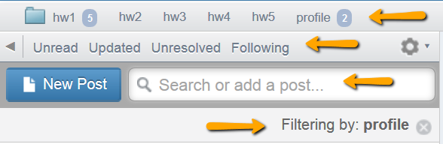
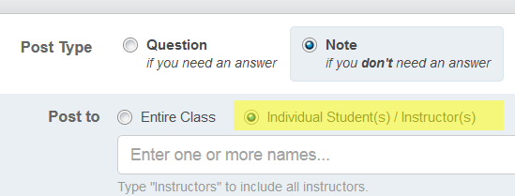
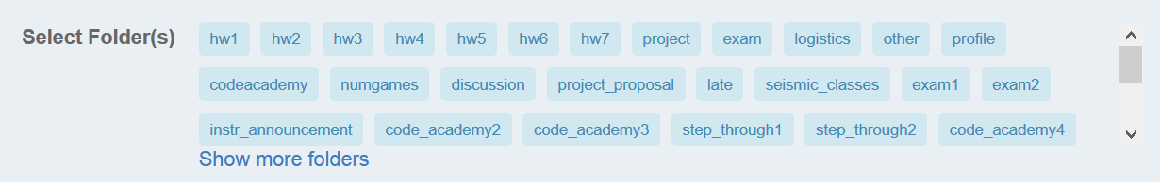
Message board (Piazza)
Post Type: question or note
Post To: public or private (to
instructors)
Select folder(s)
Filtering and searching
Notes:
The message board can be reached from Moodle. Piazza is an indepent platform outside of moodle, which has some really nice organizational and filtering features that are not available in the Moodle forums. Piazza.com is a forum designed for students can ask questions, post points of interest, debate ideas, and connect with other students. The CEO of Piazza designed the application based on her college experiences in college (https://piazza.com/about/story).
When you start a new post, notice that you need to select the post type, “Question” or “Note”. Some homework assignments will be submitted via Piazza. Be sure to select “Note” for these posts.
You also need to select who can see the message. Under ‘post to’, select “Entire Class” or “Individual Students(s)/ Instructor(s). Usually you can post to the entire class. But if you’re posting questions that contain homework code or solutions or you’re contesting a graded, post to “Instructors” by selecting the 2nd choice and typing “Instructors” in the box. Don’t post to Dr. Tateosian only-- unless it’s some kind of private medical matter. Post course-related questions to “Instructors”, so the teaching assistants are notified of the post. In other words, post to “Instructors” so that more than one person is alerted to the post.
When you post a message, you’re required to select one or more folders. We sometimes refer to these as tags. It provides a way to select all messages related to a topic. For example, when you post your Profile, select the ‘profile’ folder. Then when the messages are filtered by “profile”, your message will be found.
When you’re using the message board, you can also filter the messages by “Unread”, “Updated”, “Unresolved”, or “Following”.
Additionally, you can use the search box to create a custom filter. A “Filtering by” statement appears below the search box when you’re filtering in some way. To turn off this filtering, use the X to the right of this message.

Slide 10
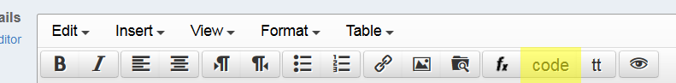
Posting code questions on forums
how to create a minimal, complete, and verifiable example
make questions as specific and focused on one particular problem.
post the error message and what you’re trying to do.
use the chapter where the homework question comes from.
use the ‘code’ button to post code.
enable students to discover mistakes.
Notes:
Asking effective questions on the forums takes practice. This is another skill that you may develop in this course. The speed and utility of responses to coding questions, depends largely on the quality of the question itself. Be specific and clear. Use copy/paste to include any error messages in the question. Specify the homework exercise name and chapter. Use the ‘code’ button to preserve spacing in the code.
If you want to help other students, don’t tell them the answer; Help them discover their mistake themselves. Otherwise, you’re stealing from them the chance to have that ah-ha moment, which is when the learning occurs.

Slide 11
Course schedule
1st Quarter
Intro to Python basics, PythonWin development environment, data structures, ArcGIS API, decision making, looping
2nd Quarter EXAM I project proposal
Batch processing, debugging, error handling, functions, cursors
3rd Quarter updated proposal
Dictionaries, reading and writing text files, file GUI’s, modules, classes, Mapping
with Python
4th Quarter EXAM II
Reading and writing HTML and KML, script tools, additional modules, project work
Notes:
Here are the course topics grouped into quarters. The materials are cumulative. For example, to read and write files, you need to use Python data structures from week 1.

Slide 12
Software you need to install
  ArcGIS
  Jing
  PythonWin
    Python is automatically installed with ArcGIS
    PythonWin is not.
  Test if PythonWin is installed correctly
    Type this at the prompt in the PythonWin Interactive Window:
      import arcpy
    If you don’t get an error message, you’ve got it.
  Pyscripter is another easy to install and use IDE has some advantages over PythonWin (e.g., tabbed script windows and immediate tab completion) but has a slightly steeper learning curve than PythonWin
Notes:
We are currently transitioning from ArcGIS 10.5.1 and 10.6. I don’t anticipate any major changes to the arcpy functionality between the two, so either installation should work.
Jing is useful for taking screen shots and recording videos to illustrate forum questions. You may also use to record your final project videos. Be sure to find a microphone, so you’re not scrambling for that at the end of the semester.
Homework 1 walks through the installation of PythonWin and PyScripter. Python itself is automatically installed when ArcGIS is installed. Do not install Python again. If your import arcpy test fails in PythonWin or PyScripter, you probably installed them under another version of Python that your machine has in a location that is not under the current active ArcGIS install.

Slide 13
Submitting homework scripts
  All deadlines are given in EST.
  Scripts should be named as specified.
  Put your unityID (e.g., jkrowlin) and name in each script.
  Don’t zip submissions.
Notes:
If you spot a mistake in the code that you have uploaded and it’s still before the deadline, fix the code and upload it again.
All the deadlines are given in Eastern Standard Time.
At the very beginning of the course, assignments will have some short answer questions. But the vast majority of the homework assignments will be scripts.
Be sure to follow general instructions for the script submissions, so that you don’t lose points in this way.
Name scripts exactly as specified in the exercise in the book. Wrong names cause the graders aggravation because the grading system doesn’t find them.
Include your unityID and name in the header comments of each script you submit. Otherwise we can’t tell whose it is when we have it open.
Don’t zip your submissions. Moodle automatically groups anything you submit in a folder named as your unity id.

Slide 14

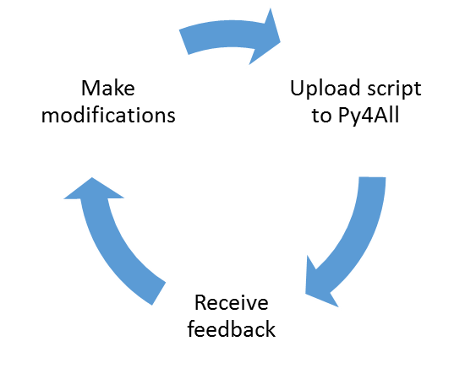
Py4All
A tool designed to accompany the textbook, Python for ArcGIS
How to use it:
  Watch the Intro to Py4All video
  Browse to go.ncsu.edu/py4all
  Login with your NCSU unity ID and password
  Upload a Python script for feedback.
Can be used iteratively
Notes:
One very helpful resource that is available to you is an online tool called Py4All, which has been developed to accompany the Python for ArcGIS textbook. It applies to any exercise in the book in which you write a script.
The main purpose of Py4All is to provide automated feedback and enable students to compare your output to the solution output.
It can be used the script is completed or when you’ve made as much progress as you can, but you’re stuck. It does not replace grading, which the instructors will do. When you’re ready to officially submit a script, do that on Moodle. Py4All is more like a sandbox system to provide automated feedback.
Instead of a grader, think of Py4All as a helping hand when you’re first learning to script. You can use it iteratively by uploading your script, receiving feedback, making modifications, and uploading again to receive additional feedback.
To get started, watch the intro to Py4All video which explains how it works. You will be able login to the Py4All site with your unity id and password once you receive the enrollment key which will be shared on the message board.

Slide 15
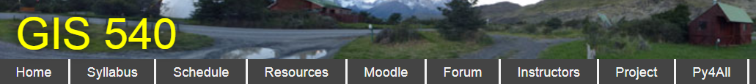
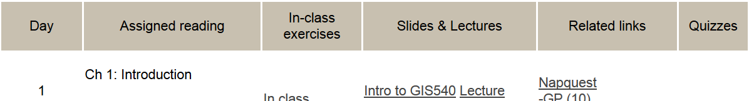
Course Website Tour
(MM/DD)
Notes:
A link in Moodle leads to the webpages that host the content of this course.
Notice the menu along the top of this page with links to home, syllabus, schedule, resources, Moodle, and so forth.
This video discussed some of the rules from the syllabus. Be sure to read the syllabus which fleshes out all the course guidelines.
Next look at the schedule. Each grey or white row of the schedule contains materials pertinent to that day’s lessons. First you see the reading assignment from the book. Next is a link to exercises solved during the class. The slides and video lectures for each day are linked in the next columns. Some related links are posted next. Finally, the quizzes are indicated in the last column.
Bookmark this schedule page, as this will be your primary landing spot for this course.

Slide 16
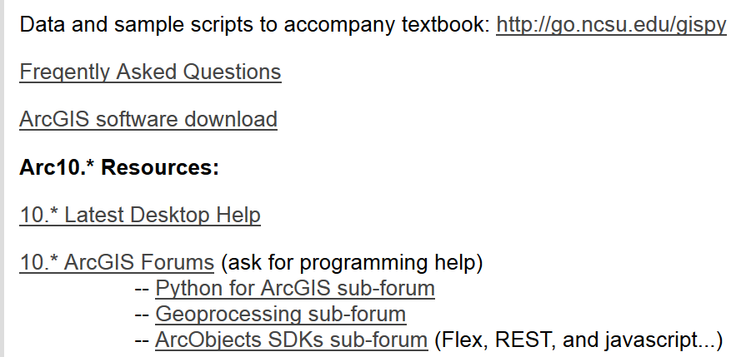
Resources page
Notes:
Under Resources there are links to the textbook data, a FAQ, the NCSU ArcGIS software download, and the ArcGIS help for Python as well as some ArcGIS forums.

Slide 17
Slides & videos
Notes:
Note that links to the lecture videos along with the slides are together in the schedule.

Slide 18
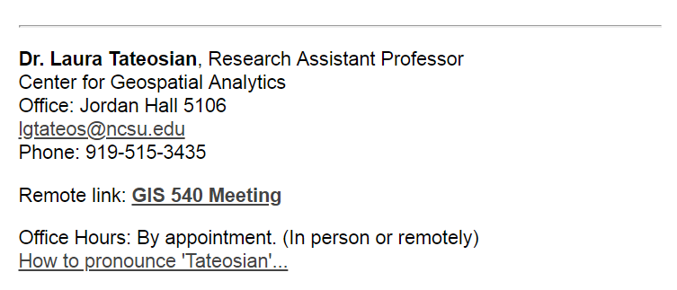
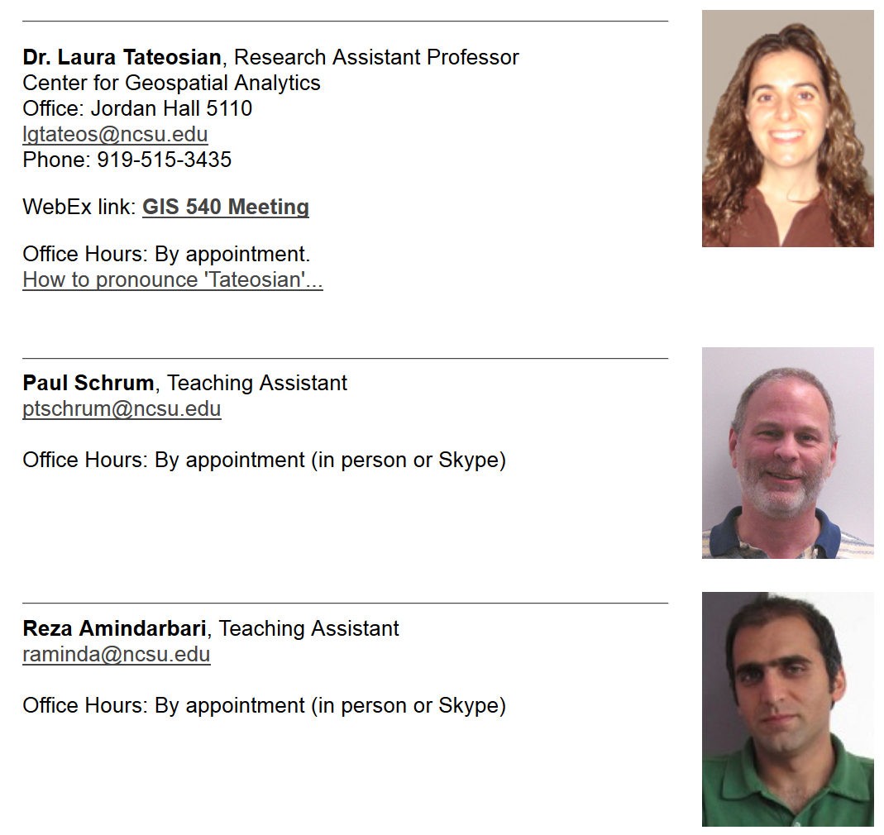


Meeting with instructors
TBA
TBA
Notes:
The forum link is the same as the one on the main Wolfware page, so we’ll move on to the ‘Instructors’ link.
Our office hours are by appointment. We enjoy meeting with students when possible, so don’t hesitate to reach out for help. Getting help early in the semester can keep you on track. To arrange an appointment post a message on Piazza. Prepare specific questions for the meeting so that we can help efficiently.
Office hours can be in-person or remote. We can share desktops using Google Meet or Zoom. There is a GIS 540 Zoom meeting set up already so that whenever our meeting occurs, we can just follow the link to a live meeting. You’ll need a microphone or you can join the audio by telephone.
Though email addresses are listed here, generally the Piazza message board should be used instead of email. If you send emails directly to us with course material questions, we will ask you to post the questions on Piazza so that we have our the interactions in one place. In this way, others may be able to learn from your questions.

Slide 19
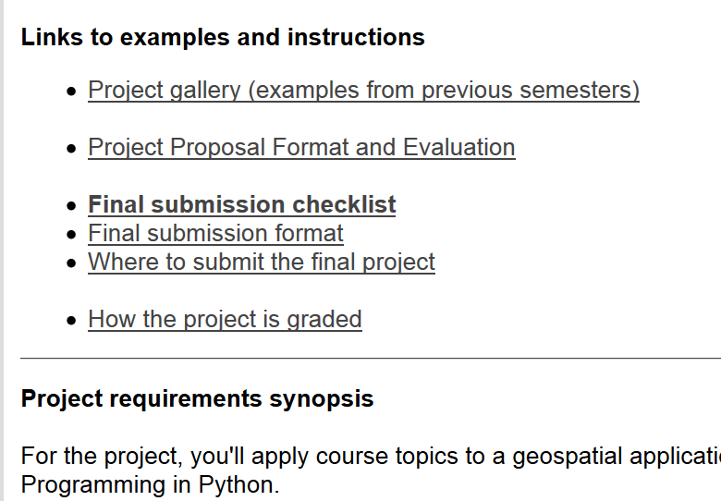
Final Project
Notes:
The project page contains links to important information about the project. From here you can reach the project gallery, where you can see more videos by former students to get ideas for projects.
Also linked are the proposal format and evaluation, the final submission checklist. The final submission format and logistics are also available here. And finally, the grading rubric is linked to this page.
For an brief overview of the project requirements, read the brief “Projects requirements synopsis” on this bottom of this page.

Slide 20
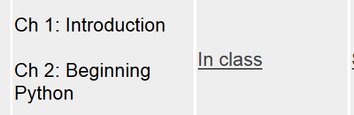
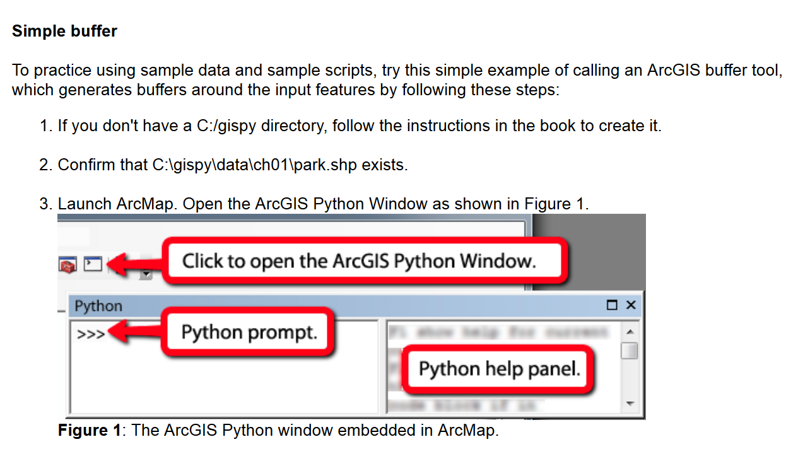
In-class exercise
Notes:
Now we’ve completed the class introduction and we can get to the fun stuff! Let’s return to the schedule and go to the in-class exercise for day 1. In this exercise, we’ll use the ArcGIS Python prompt just to get your feet wet. First, you’ll need to download and unzip data, the gispy.zip file, and place it just under the C drive, so that you have a C:/gispy/data directory. Confirm that C:\gispy\data\ch01\park.shp exists. You may confirm this in ArcCatalog, but then you have to click on the data directory and refresh it, so that the data is not locked by ArcCatalog. If your path looks like this, C:/gispy/gispy/data/ch01/park.shp, you have an extra layer of folders and you need to remove that extra layer. There should be only one gispy in your path. Now you’re ready to launch ArcMap and open the Python window. Next follow the instructions shown in the in-class exercise and answer the questions that arise near the end. We’ll discuss the answers in the next video.

