Slide 1
Tweet this
FOR each folder in the untarred landsat folders
IF folder name starts with LC8 THEN
SET red band to GeoTIFF that ends with band 4
SET blue band to GeoTIFF that ends with band 2
SET NIR band to GeoTIFF that ends with band 5
SET mask to GeoTIFF that ends with cfmask
APPEND to veg_indices list in the order they appear above
ELSE IF folder name starts with LT5 THEN
SET red band to GeoTIFF that ends with band 3
SET blue band to GeoTIFF that ends with band 1
SET NIR band to GeoTIFF that ends with band 4
SET mask to GeoTIFF that ends with band
APPEND to veg_indices list in the order they appear above
END IF
END FOR
Read and interpret the procedure above. In <=200 chars, write sentence to describe it.
Hint, what is repeated in both cases?
Notes:
Answers will vary.
Possible answer 1: For each folder, checks the folder name, sets the raster color bands to the raster ending with the specific bands and adds them to a vegetation index list.
Possible answer 2: For each landset dir, if name LC9*, set R, B, NIR to bands *4, *2, *5, mask *cfmask, else if name *LT5 set R, B, NIR to bands *3, *1, *4, mask *sr_ccloud_qa in case add to list

Slide 2
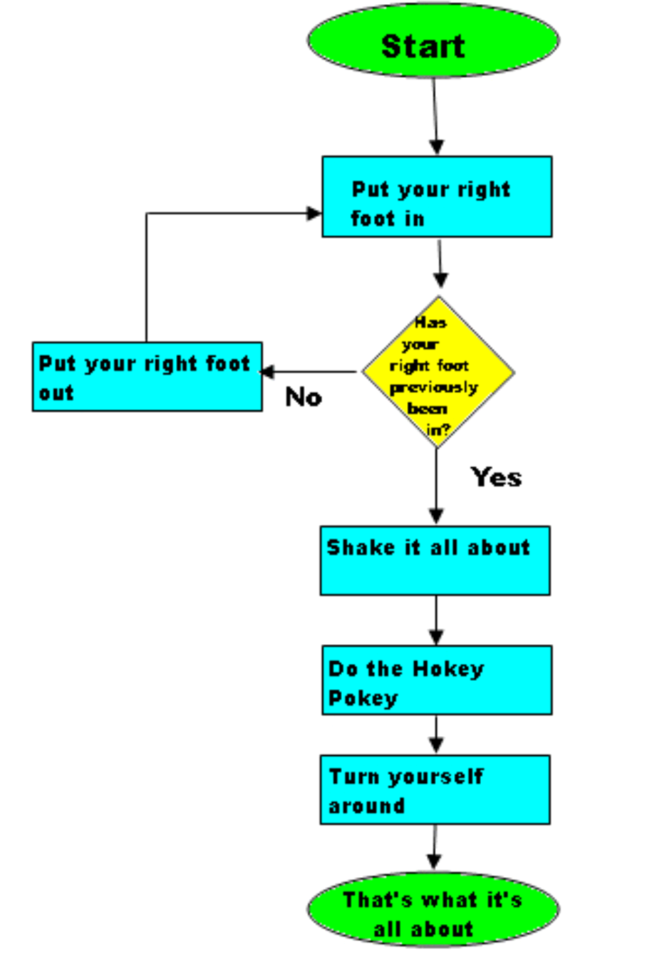
Decision making & the Describe object
Dr. Tateosian
Notes:
myList.append( 4 )
mystr.endswith('shp')
arcpy.env.overwriteOutput = 1
arcpy.compact_management(filename)
rc = arcpy.AverageNearestNeighbor_stats('C://points.shp', 'Euclidean Distance')
a. print rc.outputcount
b. print rc.getOutput(0)

Slide 3
Outline
Conditional statements
Decision-making syntax
Boolean Expressions
Logical operators
Comparison operators
Describing ArcGIS data

Slide 4
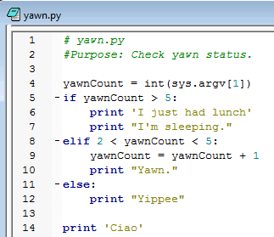
The anatomy of decision-making in Python
keywords if, elif, else
conditional statements
  yawnCount > 5
blocks of code
  print('I just had lunch')
  print("I'm sleeping.")
indentation –IDE helps
dedentation
colon
  if yawnCount > 5:

Slide 5
Syntax for branching
  if <conditional statement 1>:
    print("hi")
  elif <conditional statement 2>:
    print("ho")
  else:
    print("hey")
  if <conditional statement 1>:
    print("hi")
  else:
    print("ho")
  if <conditional statement 1>:
    print("hi")
Pop quiz
How many elif blocks of code can you have?
How many else blocks can go with each if block?
Is the else block required?
Which of these examples always print something?
If conditional statement 1 is true will all of these examples print something?
Give an example for conditional statements 1 and 2 so that ‘ho’ would never be printed? (answer for each box)
  if <conditional statement 1>:
    print("hi")
  elif <condition statement 2>:
    print("ho")
Notes:
How many elif blocks of code can you have?
sky’s the limit, but if you have many, there’s probably a better way to do it…(Google ‘Python dictionary’)
How many else blocks can go with each if block?
at most one
Is the else block required?
No
Which of these examples always print something?
The first two.
If conditional statement 1 is true will all of these examples print something?
Yes, they’ll all print ‘hi’
Give an example for conditonal statements 1 and 2 so that ‘ho’ would never be printed?
cs1: x < 10
cs2: x < 9

Slide 6
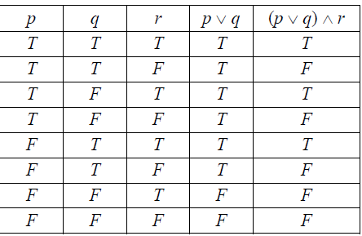
Truth table review
The expression that goes behind the "if" or "elif" in Python is a Boolean expression (a statement which is true or false)
Examples:
  yawnCount > 5
  It's raining
  Today is Friday
  It's raining and today is Friday
That last one is a compound statement using a logical operator "and" to join the two parts.
A familiarity with introductory logic is helpful in writing well formed conditional code.

Slide 7
Boolean Expression
Boolean expression: expression that is either true or false.
A conditional statements consist of Boolean expressions with logical and comparison operators.
'False' in Python:
False
None
0
“”
()
[]
{}
All other numbers, strings,
lists, dictionaries, tuples
evaluate as True
Logical operators
and, or, and not
Comparison operators >, <, <=,>=
!= not equal
== equal

Slide 8
Comparison operators
x > y # x is greater than y
x < y # x is less than y
x >= y # x is greater than or equal to y
x <= y # x is less than or equal to y
x != y # x is not equal to y
x == y # x is equal to y
Assignment (=) versus comparison (==)
>>> x = 5 # assigment statement
>>> y = x
>>> y == x
True
>>> y = x + 1
>>> y == x # comparison statement
False
>>> print(y)
6
>>> print(x)
5

Slide 9
Logical Operators Gotchas 1
Logical operators: and, or, and not.
Statements must be complete on each side of operator.
Example: print when the species is salmon or tuna
if species == 'salmon' or 'tuna':
print(species)
if species == 'salmon' or species == 'tuna':
print(species)
WRONG SOLUTION:
true…
so the entire statement is always true
RIGHT SOLUTION:
Notes:
------------------------------------------------------------
DEMO2: LOGICAL OPERATORS, BOOLEAN EXPRESSIONS and ASSIGNMENT
************************************************************
>>> 5==5
True
>>> 5>0
True
>>> 5<-10
False
>>> s1=''
>>> s2=' '
>>> s1 != s2
True
>>> x = 5
>>> x>0 and x<10
True
>>> 0<x<10
True
>>> True + False + 10
11
>>> False == 0
True
>>> False == 1
False
>>> 'alpha'> 'beta'
False

Slide 10

Logical Operators Gotchas 2
Beware of English language to logic statement conversions
Example: Print the species if it’s not a trout or catfish.
Test cases: cod, trout, and catfish
if species != 'trout' or 'catfish': print(species)
if species != 'trout' or species != 'catfish': print(species)
if species != 'trout' and species != 'catfish':
print(species)
DeMorgan’s law: ~(p or q) ↔ ~p and ~q
Solution?
True all the time! If species is trout, the first statement is not true, but the 2nd one is.
Solution?
Solution?
Notes:
DeMorgan’s law
Logic review: ~(p V q) ↔ ~p and ~q
------------------------------------------------------------
DEMO2: LOGICAL OPERATORS, BOOLEAN EXPRESSIONS and ASSIGNMENT
************************************************************
>>> 5==5
True
>>> 5>0
True
>>> 5<-10
False
>>> s1=''
>>> s2=' '
>>> s1 != s2
True
>>> x = 5
>>> x>0 and x<10
True
>>> 0<x<10
True
>>> True + False + 10
11
>>> False == 0
True
>>> False == 1
False
>>> 'alpha'> 'beta'
False

Slide 11
Branching workflow example
kml preparation tool. Different for vector/raster/other datatypes. Different for points/lines/polygon. Different for TIFs and other formats.
How can I determine what type of data I have?
GET data type
feature class
shapefile
raster
other
PRINT
'warning, knuckle head'
GET shape type
GET format
point
line
polygon
other
TIF
other
CALL point
to kml
CALL line
to kml
CALL polygon
to kml
CALL layer
to kml
CALL
convert to TIFF

Slide 12
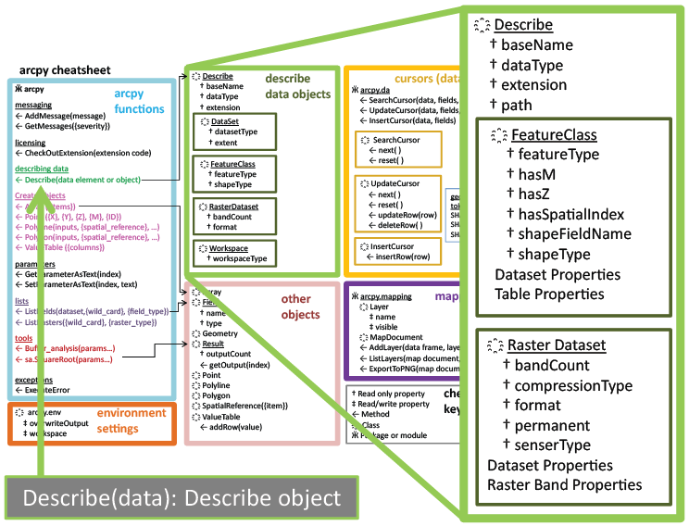

Describe Object
desc = arcpy.Describe(rastfile)

Slide 13
Creating a describe object
>>> # Create geoprocessing objects
>>> import arcpy
>>> # Set the data element
>>> rastfile = 'C:/Temp/raster1'
>>> # Call describe method
>>> dsc = arcpy.Describe(rastfile)
>>> print(dsc )
<geoprocessing describe data object object at 0x0092D2D0>
object.method(arg1,arg2, …)
describe object
data element to be described

Slide 14
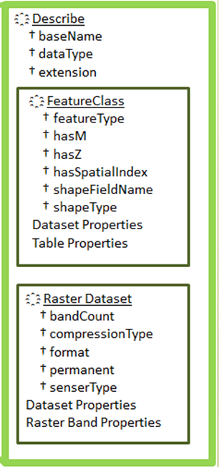
Using a describe object
>>> import arcpy
>>> rastfile = 'C:/Temp/raster1'
>>> dsc = arcpy.Describe(rastfile)
>>> print dsc.dataType
'RasterDataset'
>>> print dsc.format
'IMAGINE image‘
See note view for demo
Notes:
>>> import arcpy
>>> file = 'C:/Temp/COVER63p.shp'
>>> dsc = arcpy.Describe(file)
>>> dsc.Format
Traceback (most recent call last): File "<interactive input>", line 1, in ?
RuntimeError: describe method: Format does not exist
>>> dsc.ShapeType
u'Polygon‘
>>> dsc.HasOID
True
>>> dsc.DatasetType
‘Shapefile'

Slide 15
Selection Syntax
Convert the pseudocode to Python
Python conditional keywords: if, elif, else
Use a describe object to get the shapeType
Python
import arcpy
mydata = "C:/Temp/data.shp"
dsc = arcpy.Describe(mydata)
shapeType = dsc.shapeType
  if shapeType == "Polygon":
    print("Shape is polygon")
  elif shapeType == "Polyline":
    print("Shape is line")
  else:
    print("Shape is not line or polygon")
Pseudocode
GET shapefile
GET shape type
IF shape type is polygon THEN
PRINT shape is polygon
ELSE IF shape type is line THEN
PRINT shape is line
ELSE
PRINT shape isn’t line or polygon
ENDIF

Slide 16
Using describe with caution
Previous slide
import arcpy
mydata = "C:/Temp/data.shp"
dsc = arcpy.Describe(mydata)
shapeType = dsc.ShapeType
  if shapeType == "Polygon":
    print("Shape is polygon")
  elif shapeType == "Polyline":
    print("Shape is line")
  else:
    print("Shape is not \
    line or polygon")
More cautiously
import arcpy
mydata = "C:/Temp/data.shp"
dsc = arcpy.Describe(mydata)
if dsc.dataType == "ShapeFile":
shapeType = dsc.ShapeType
    if shapeType == "polygon":
    print("Shape is polygon")
  elif shapeType == "Polyline":
    print("Shape is line")
  else:
    print("Shape is not \
    line or polygon")

Slide 17
Summing up
Topics discussed
    Conditional statements
    Decision-making syntax
    Boolean Expressions
    Logical operators
    Comparison operators
    Describing ArcGIS data
Coming up
    Looping
Additional topics
    Tools that make selections
    Select by attributes
    Compound vs. nested conditions
    Testing conditions
    Using os module to check for files

Slide 18
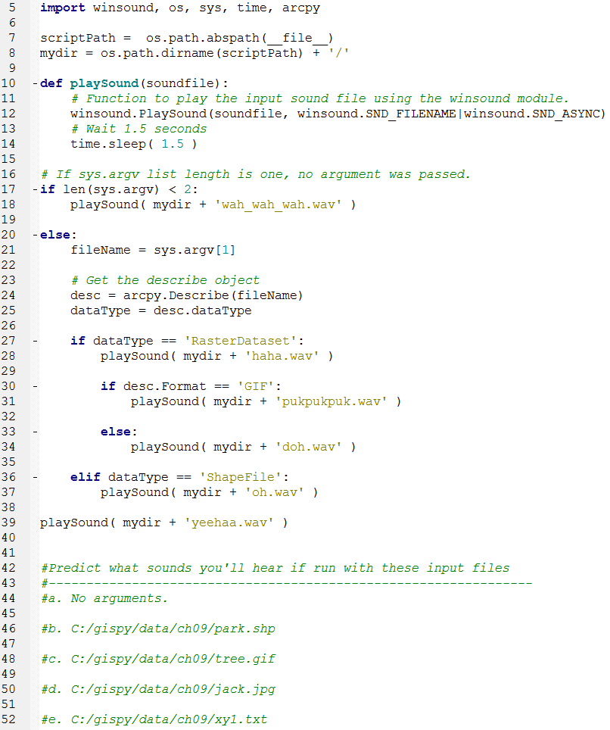
In class – conditionalSound.py

Slide 19
Appendix I

Slide 20
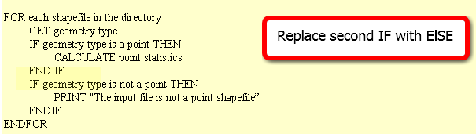
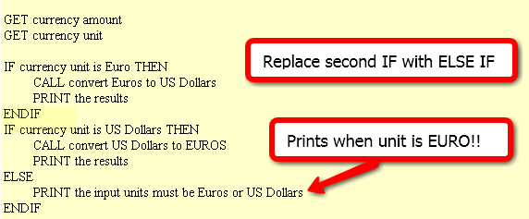
In class – Poor form! FIX IT
Point statistics
2. Currency conversion
3. Grader
  IF average < 60
  NULL
  ELSE
  DO GivePassingGrade
  ENDIF

Slide 21
FIX IT
Point statistics
2. Currency conversion
3. It is considered poor form to have a 1-sided IF stmt where the action is on the 'no' or ELSE side. This could (and should) be rewritten to eliminate the NULL 'yes' part. To do that, we change the < to its opposite: >= as follows :
IF average >= 60
DO GivePassingGrade
ENDIF

Slide 22
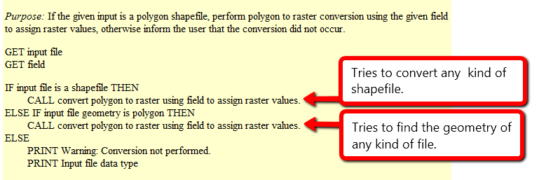
Polygon to raster
Purpose: If the given input is a polygon shapefile, perform polygon to raster conversion using the given field to assign raster values, otherwise inform the user that the conversion did not occur.
What will happen if the input file is…
  a polygon shapefile?
  convert the data to raster (success)
  a point shapefile?
  attempt to convert the data to raster, but will fail, since it’s not polygon input but it is a shapefile
  a raster file?
  attempt to check the geometry of the inputfile and fail, since raster files don’t have a geometry
When does it give a warning?
  never

Slide 23
Polygon to raster pseudocode corrected
Instead of else if, use a compound conditional
IF input file is a shapefile AND input file geometry is polygon THEN
CALL convert polygon to raster using field to assign raster values.
ELSE
PRINT Warning: Conversion not performed.
PRINT Input file data type
Moral: TEST ALL CONDITIONS

Slide 24



Distance converter example
Convert miles to km or km to miles and handle user input of 2, 1, or 0 arguments:
Arguments: 50 miles
>>> 50 miles is equivalent to 80.0 kilometers.
Arguments: 100
>>> Warning: No distance unit provided. Assuming input is in miles.
100.0 miles is equivalent to 160.0 kilometers.
Arguments:
>>> Usage: <numeric_distance> <distance_unit(miles or km)>

Slide 25
Distance Conversion Pseudocode
GET numeric dist from args
GET unit from args
IF unit is miles THEN
COMPUTE km
PRINT results
ELSE
COMPUTE miles
PRINT results
ENDIF
Add to the pseudocode to handle case of 'no user arguments'.
Add pseudocode to part 1 to handle the '1 argument' case.

Slide 26
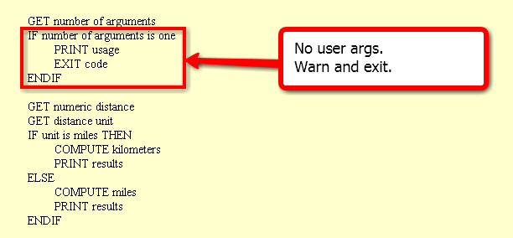
Handle no user arguments case

Slide 27
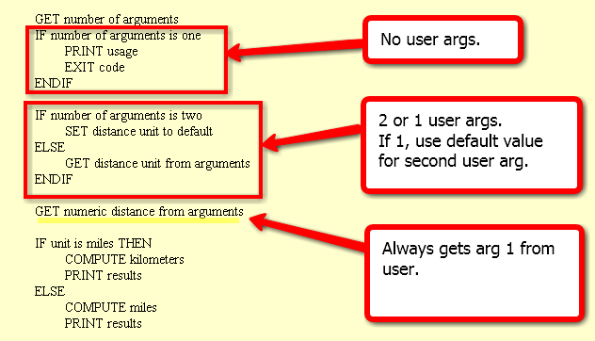
Distance conversion pseudocode
Related code given in examples 9.12 and 9.13 in the book.

Slide 28
Buffer_clip pseudocode
GET number of arguments
IF number of args < 5
PRINT usage
EXIT code
ENDIF
SET fire damage
SET park
SET buffer distance
SET workspace
GET number of arguments
IF number of arguments < 4
PRINT usage
EXIT code
IF number of args is 4
PRINT warning
SET workspace to default
ELSE
SET workspace to last arg
ENDIF
SET fire damage
SET park
SET buffer distance
All or nothing.
How could we make
the last argument (the workspace) optional?

Slide 29
Appendix II

Slide 30
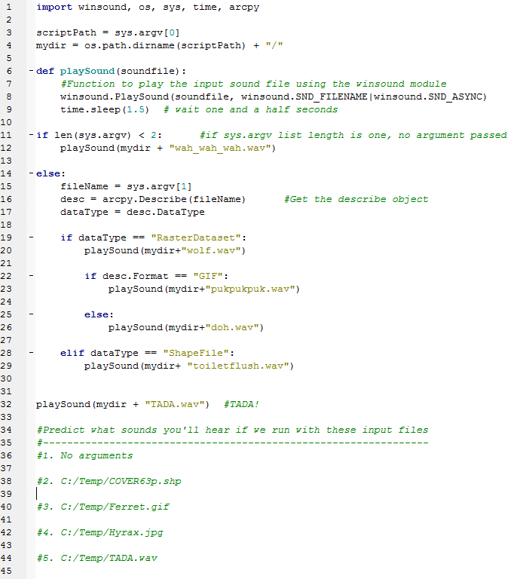
In class – conditionalSound.py (orig)

Slide 31
Buffer_clip… avoid argv index error
Check the list length before indexing it, give feedback, and exit if necessary
use try/except (discuss later)
import sys
listLength = len(sys.argv) # count the number of arguments
if listLength < 5:
print 'Usage: <shapefile to buffer>, <buffer distance>, <shapefile to \
clip>, <the workspace >' # explain the problem to the user
sys.exit(0) # exit the program.
# buffer_clip.py arguments
fireDamage = sys.argv[1]
park = sys.argv[2]
bufferDist = sys.argv[3]
arcpy.env.workspace = sys.argv[4]
# Buffer and clip code below here…

Slide 32
Using if/elif/else
Use if alone when you only want do y if x is true, and you want to continue with the rest of the script in either case.
  …
  if field_name not in fields:
  arcpy.addField(filename, field_name)
  # Update field values
Use elif to check another conditional statement. Follows if or elif block.
Use else to enact a default action. If none of the previous conditions are true, do what I say. Follows if or elif block.
  if shapeType == ‘polygon’:
      print 'Shape is polygon'
      elif shapeType == ‘line’:
      print 'Shape is line'
    else:
      print 'Shape is not line or polygon'

Slide 33
Ways not to use if, elif
Instead should be
if x == 1:
#do stuff
if x == 2:
#do special stuff
if x == 3:
#do very weird thing
if x == 1:
#do stuff with a
elif x == 2:
#do stuff with b
elif x == 3:
#do stuff with c
elif x == 4:
#do stuff with d
elif x == 5:
#do stuff with e
elif x == 6:
#do stuff with f
…
if x == 1:
#do stuff
elif x == 2
#do special stuff
elif x == 3
#do very weird thing
Don’t use repeated if to check mutually exclusive conditions.
Don’t use a large number of ‘elif’ conditions when consistently testing the same variable’s value and performing the same operation inside.
There are better ways to do this.
Instead should be
using Python
built-in data structure
called a dictionary.
--Dictionaries will be
discussed in a
later lecture.

Slide 34
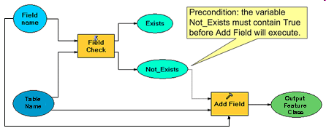
Condition with ‘not’ keyword
Pseudocode
IF field name does not exist THEN
CALL Add field
ENDIF
CALCULATE FIELD
conditional
statement
Python code
fileName = 'C:/data.shp'
fieldName = 'slope'
fields =['FID', 'rise', 'run']
if fieldName not in fields:
arcpy.addField(fileName, fieldName)
print 'New field created.'
arcpy.CalculateField(fileName, fieldName, \ '[rise] / [run]‘)
colon
indent entire if code block
(code block = set of related code)
Notes:
#Complete example of code.
import arcpy
fileName = 'C:/Temp/COVER63p.shp'
fieldName = 'Square'
fieldObjs = arcpy.listFields(filename) #we haven’t gone over this yet.
fields=[]
for f in fieldObjs: #we haven’t gone over ‘for’ loops yet.
fields.append(f.name)
if fieldName not in fields:
arcpy.addField(fileName, fieldName)
print 'New field created.'
arcpy.CalculateField(fileName, fieldName, \
'[RECNO]*[RECNO]')
#another way to get the field name list is to use list comprehension:
fields = [f.name for f in fieldObjs]

