Slide 1

GIS PROGRAMMING FUNDAMENTALS (WITH PYTHON)
Dr. Tateosian
objectives
requirements
logistics
guidelines
Notes:
Welcome to GIS Programming Fundamentals. The instructional support consists of the professor, Dr. Tateosian, and two teaching assistants. In this video we will discuss the course objectives, requirements, logistics, and guidelines.

Slide 2
Course topic
GIS programming (through the use of the Python programming language)
General programming concepts, as well as Python syntax.
Python language elements for programming ArcGIS.
Processing/analyzing data.
Performing batch processing and manipulating map elements.
ESRI script tools to create graphical user interfaces.
Notes:
The focus of this course is GIS programming through the use of the Python programming language. We will discuss general programming concepts as well as Python syntax. One element we will discuss in depth is the ArcGIS Python library, called arcpy. We will use arcpy as well as standard Python features to process and analyze data.
A key objective for this course is to automate batch processing to enhance workflow efficiency. With Python, large numbers of records, files, and databases can be processed rapidly.

Slide 3
Course learning outcomes
Students will be able to…
interpret basic Python syntax (indentation, context highlighting)
write Python scripts in an integrated development environment (PythonWin)
use Python to construct code using core data structures (strings, lists, …)
call ArcGIS tools with Python (arcpy.buffer…)
handle contingencies within Python (if, else…)
construct basic batch processing Python code (looping)
read/modify data files with Python
create a graphical user interface
do more…
Notes:
These are some of the basic capabilities we will target with this course. Let’s view some sample final projects for a clearer picture of what’s possible when these skills are mastered.

Slide 4


Course project examples
“Gridded Coastline Simplification of Postal Code Polygons”- W. Morelli
Input High vertex count postal polygons, grid size specs.
Output Map and Webpage with simplified postal code polygons, table of vertex counts
“Groundwater contamination analysis for military installations with leaking underground storage tanks” - E. Bouton
Input Tables (CSV format) with water depth measurements (from the field) and lab analysis results.
Output Map and Webpage with automatically generated groundwater elevation contours and BTEX contamination plume surfaces.
400 loc
727 loc
Notes:
Our students apply this course material at their workplaces and in their research projects. Morelli and Bouton took this course a few semesters ago. Morelli’s final project developed a process to simplify overly complex postal code polygons using variable grid sizes. Bouton’s final project automated a process for ground water contamination analysis that had previously been performed painstakingly by hand.
Both of these projects process and automatically map data and create HTML Webpages to display the results. Near the end of the semester, students submit two videos, part 1 to describe the problem they have tackled and their approach, part 2 to demonstrate the tool that was created. We’ll look at Morelli’s part 1 and Bouton’s part 2 to hear what they have to say about their work.
These excellent projects used 400 and 700 lines of code, respectively. Their code is reusable and portable, so they can share it with colleagues. As the semester progresses, you should be thinking about how you might apply programming in your workplace or research or to work with some data that interests you.

Slide 5
Textbook and data
Required textbook: Tateosian, Laura. Python for ArcGIS. Springer, 2015.
hard copy available for purchase
electronic version available for free to NCSU students (pdf recommended over eBook)
Download the data and sample scripts from http://go.ncsu.edu/gispy
Notes:
The textbook is available for sale online; an electronic version is available to NC State students for free through the library website. The pdf formatting is more reliable than the eBook (which is altered by the browser window size).
The data and sample script need to be downloaded for this course http://go.ncsu.edu/gispy
Be sure the unzipped file appears as shown here.

Slide 6





What to expect
“Although the lectures provided a nice introduction to the material, I definitely learned to code best by reading the textbook and working through assignments (I think this is just the nature of coding).”
--Anonymous student on course eval.
Notes:
This comment from an anonymous student on the course evaluation explains how to succeed in the course.
“Although the lectures provided a nice introduction to the material, I definitely learned to code best by reading the textbook and working through assignments (I think this is just the nature of coding).”
It’s a good idea to read the book, then watch the lectures with a pencil and paper, work through the in-class activities interleaved with the videos, some are by hand and some are computer based--and then try the homework.

Slide 7
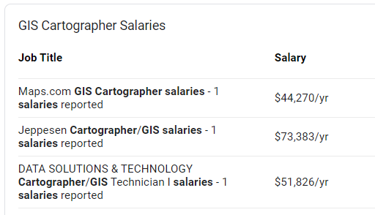
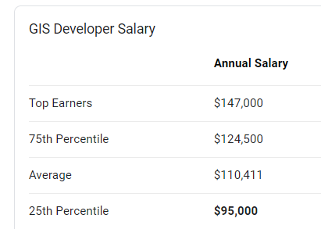
Put more in, expect more
Sources: Glassdoor and ZipRecruiter
Notes:
The concepts presented in this course can help you land a better job, but it takes many hours of practice to learn to plan workflows and implement them efficiently.
You won’t be a software developer with just one programming course, but successful students will definitely have an advantage in the job market.
There’s a reason developer jobs pay more. Learning to program is challenging and it requires a very hands-on approach. This is why lessons are reinforced with in-class exercises and numerous homework assignments. The scripting homework assignments will be challenging. The lessons are cumulative and you will need to apply elements of the first week’s lesson to every subsequent lesson. This means putting the new material together with the old material to solve the homework problems. Quizzes assist with internalizing the material.
Expect to work hard and spend a lot of time on this coursework. If you master these skills, it’s a solid foundation. GIS jobs that require this knowledge pay more than the jobs that don’t.

Slide 8




Grading
30%
40%
4-5 timed quizzes (30%)
Homework (40%)
Python scripts (10 pts each)
Python tutorials (4 pts each)
Moodle exercises (~21 pts each)
Project (25%)
Participation (5%)
Piazza message board usage
Participation in help sessions
Lecture questions
25%
5%
Notes:
Course grades will be computed based on quizzes, homework, projects, and participation.
[click]
Quizzes, worth 30% of the grade, will cover the required readings and lectures to reinforce the concepts therein. Individual quiz instructions indicate the book chapters to which they correspond. Quizzes are open-notebook, but timed, so plan to review before taking the quizzes so that you are able to complete them in the time available. Each timed quiz has an accompanying practice quiz. Practice quizzes can be used to test yourself before taking the real quiz. Practice quiz questions are not the same as those on the actual timed quizzes, but they will give you a sense of question style and the pacing you will need to complete the timed quiz.

Slide 9
Grading
30%
40%
4-5 timed quizzes (30%)
Homework (40%)
Python scripts (10 pts each)
Python tutorials (4 pts each)
Moodle exercises (~21 pts each)
Project (25%)
Participation (5%)
Piazza message board usage
Participation in help sessions
Lecture questions
25%
5%
Notes:
Homework, worth 40% of the grade, generally consist of Python scripts, Python tutorial lessons, and Moodle exercises. Each Python script is worth 10 points. Python tutorial lessons are generally worth 4 points each. Moodle exercise points range between 10 and 50 (median 21 points). This depends on the number of questions in an exercise. So, let’s back up. Moodle exercises--Moodle refers to these as “quizzes” but we refer to these as Moodle “exercises”, because they do not need to be completed in one sitting and the time to work on them is only limited by the opening date and the due date. They become available 4 days before the homework deadline. For Moodle exercises, you can start them, save your work and return to continuing working on a different day. Moodle exercises just need to be submitted by the homework deadline.
The project proposals (preliminary and revised) are also part of the homework points, 10 points each.

Slide 10
Grading
30%
35%
4-5 timed quizzes (30%)
Homework (40%)
Python scripts (10 pts each)
Python tutorials (4 pts each)
Moodle exercises (~21 pts each)
Project (25%)
Participation (5%)
Piazza message board usage
Participation in help sessions
Lecture questions
30%
5%
Notes:
The final project, worth 25% of the grade applies course concepts to a particular geospatial application area of your choice (or select a predefined project). The final submission will include:
--A write-up describing the project, the Python scripts, data, and so forth, and 2 short project presentations.
Design development will occur incrementally over the course of the semester.
1st you will identify an application domain and target datasets that requires Python manipulation. 2nd, you will be required to develop a clear proposal describing your input and desired output and workflow to get from the input to the output.
3rd, you will submit a revised proposal. This proposal must be updated based on the previous feedback and include additional plans. At this point, you will also submit a piece of code and a working graphical user interface to show your progress.
Finally, the project culminates with a presentation delivered via videos at the end of the semester. At this point, you’ll submit the final working project and all the supporting files and documentation.

Slide 11
Grading
30%
35%
4-5 timed quizzes (30%)
Homework (40%)
Python scripts (10 pts each)
Python tutorials (4 pts each)
Moodle exercises (~21 pts each)
Project (25%)
Participation (5%)
Piazza message board usage
Participation in help sessions
Lecture questions
30%
5%
Notes:
Participation, worth 5% will be based on Piazza message board usage, participation in help sessions, and lecture questions. Participation in these will be measured as follows:
Piazza message board usage: Students must pose at least one question to a student question for each of the 9 homeworks.
Participation in help sessions: Participation in at least one class help-session during the semester. If you can’t fit our regular help sessions in your schedule, you can also schedule an appointment to check in with us and that will count for this category.
Lecture questions: Most of the course videos have embedded questions. Distance education students must complete all of these questions. So long as earnest attempts are made, wrong answers do not result in point deduction, rather, points are awarded based on participation. (*Students in the 001 section will be attending synchronous class meetings. These students must participate in “in-class” activities to fulfill this requirement, but are not required to review the recorded videos.)

Slide 12
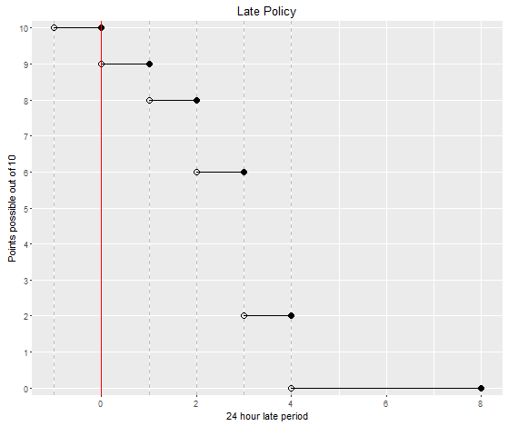
Late homework
penalty =10*2^{(r-1)}% where r is the number of 24-hour periods late.
“Lateness” applies to each homework item separately.
Deadline(D) D+24hrs D+48hrs D+72hrs D+96hrs
Notes:
The points that can be earned for late submissions drops exponentially. For example, an exercise with 10 points submitted more than 48 hours past the deadline (and less than or equal to 72 hours past the deadline) can only earn a maximum of 6 points and it keeps dropping.
[click]
If you’re going to be late, submitting the parts that are complete will help your grade. “Lateness” is applied to each homework item separately. So, if you have completed, say, 3 of the 4 Python scripts by the due date, submit the 3 completed scripts on time. We can see dates of submission for separate parts, so only the fourth script would then be marked as late if you submit it late.

Slide 13
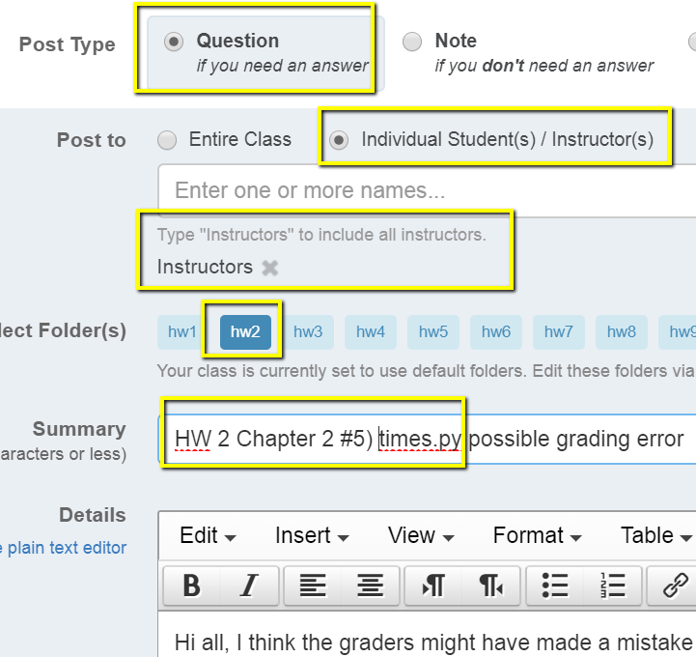
Grade changes
Grades and comments posted in the Moodle gradebook.
Grade change requests must be submitted within one week of being returned.
Submit grade change requests via private (to instructors) note on the message board. Be sure to provide the assignment number and question name and briefly explain the issue.
Our goal is fair grading and we want to correct any errors.
Notes:
Grades and comments will be posted in the Moodle gradebook. This can be accessed from the Moodle website.
To enhance learning from the homework, it’s very important to review these comments. If you don’t understand a feedback comment, post a message to the instructors on the forum asap.
Also, you have just one week from when the grades are posted to request any grade changes. Grade changes requests are made with a private message board post to the instructions.

Slide 14
Academic integrity
Material challenging -> utilize teaching staff help. Otherwise, homework assignments must be completed alone.
University policy is strict. Read the NCSU policy overview and Sections 8 and 9 of the Code of Student Conduct linked to the syllabus.
Building fundamental skills in this class. Group work not allowed unless specified.
Study groups can discuss code from in-class exercises, slides, and assigned reading, but not from homework.
Not allowed:
Copying.
Talking someone through the solution.
If you need more help go to office hours, Skype with TAs, or use private posts on the message board.
Otherwise, the work you submit for homework must be entirely your own.
Notes:
We know the material can be challenging, so you should take advantage of the teaching staff help. Use office hours and the message board to interact with the teaching assistants and instructor when you are struggling with the homework. Beyond this, however, students are required to do homework assignments individually.
Study groups may discuss code from in-class exercises, textbook examples, and code from the course slides, but they may not do the homework together. Copying will not be tolerated. The work you submit must be your own. Examples of cheating are: looking at another student's code, writing your program while talking to someone else about it, talking another student through the solution code, allowing others to look at your solution code, posting your code on the Web, obtaining code from a student who is taking GIS 540 or took GIS 540 during a previous semester, and obtaining code from family, friends, colleagues, or others. For homework assignments, code snippets from the examples provided for class and the ArcGIS Resources help pages are expected to be use; However, copying code from other Internet sources is also considered cheating. Sharing code on the message board or in other ways is a violation of the NCSU Code of Student Conduct. If you have any doubts about what is allowed when completing homework assignments, ask the instructor.
This kind of rigor maintains the quality of our graduate program and preserves the value of a degree earned from NC State. Sometimes students get involved in misconduct unintentionally. So, to avoid confusion, the policies are laid out in the syllabus.

Slide 15
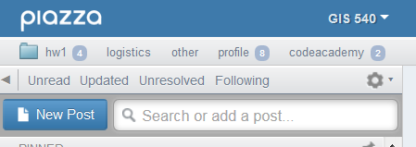
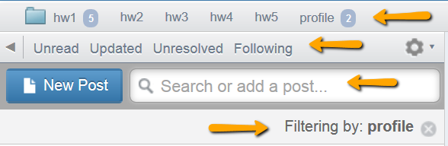
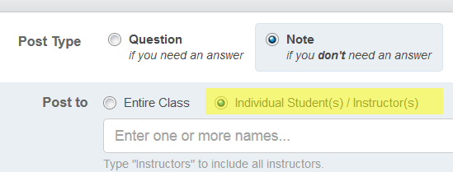
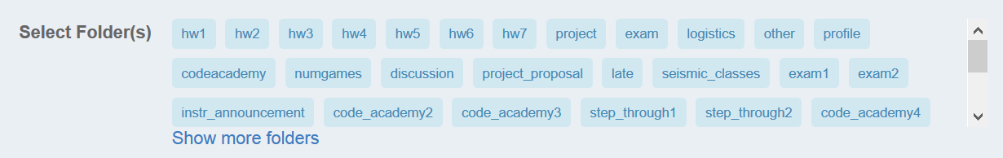
Message board (Piazza)
Post Type: question or note
Post To: public or private (to instructors)
Select folder(s)
Filtering and searching
Notes:
The message board can be reached from Moodle. Piazza is an independent platform outside of moodle, which has some really nice organizational and filtering features that are not available in the Moodle forums. Piazza.com is a forum designed for students can ask questions, post points of interest, debate ideas, and connect with other students. The CEO of Piazza designed the application based on her college experiences in college (https://piazza.com/about/story).
When you start a new post, notice that you need to select the post type, “Question” or “Note”. Some homework assignments will be submitted via Piazza. Be sure to select “Note” for these posts.
You also need to select who can see the message. Under ‘post to’, select “Entire Class” or “Individual Students(s)/ Instructor(s). Usually you can post to the entire class. But if you’re posting questions that contain homework code or solutions or you’re contesting a graded, post to “Instructors” by selecting the 2nd choice and typing “Instructors” in the box. Don’t post to Dr. Tateosian only-- unless it’s some kind of private medical matter. Post course-related questions to “Instructors”, so the teaching assistants are notified of the post. In other words, post to “Instructors” so that more than one person is alerted to the post.
When you post a message, you’re required to select one or more folders. We sometimes refer to these as tags. It provides a way to select all messages related to a topic. For example, when you post your Profile, select the ‘profile’ folder. Then when the messages are filtered by “profile”, your message will be found.
When you’re using the message board, you can also filter the messages by “Unread”, “Updated”, “Unresolved”, or “Following”.
Additionally, you can use the search box to create a custom filter. A “Filtering by” statement appears below the search box when you’re filtering in some way. To turn off this filtering, use the X to the right of this message.

Slide 16
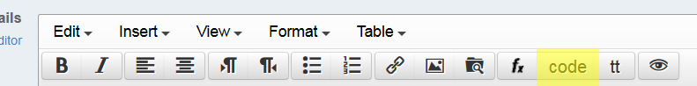
Posting code questions on forums
how to create a minimal, complete, and verifiable example
make questions as specific and focused on one particular problem.
post the error message and what you’re trying to do.
use the chapter where the homework question comes from.
use the ‘code’ button to post code.
enable students to discover mistakes.
Notes:
Asking effective questions on the forums takes practice. This is another skill that you may develop in this course. The speed and utility of responses to coding questions, depends largely on the quality of the question itself. Be specific and clear. Use copy/paste to include any error messages in the question. Specify the homework exercise name and chapter. Use the ‘code’ button to preserve spacing in the code.
If you want to help other students, don’t tell them the answer; Help them discover their mistake themselves. Otherwise, you’re stealing from them the chance to have that ah-ha moment, which is when the learning occurs.

Slide 17
Course schedule
1st Quarter Intro to Python basics, PythonWin development environment, data structures, ArcGIS API, decision making, looping
2nd Quarter project proposal
Batch processing, debugging, error handling, functions, cursors
3rd Quarter updated proposal
Dictionaries, reading and writing text files, file GUI’s, modules, classes, Mapping with Python
4th Quarter
Reading and writing HTML and KML, script tools, additional modules, project work
Notes:
Here are the course topics grouped into quarters. The materials are cumulative. For example, to read and write files, you need to use Python data structures from week 1.

Slide 18
Software you need to install
ArcGIS
Jing
DO NOT install Python (it is already installed)
PythonWin
Python is automatically installed with ArcGIS
PythonWin is not.
Test if PythonWin is installed correctly
Type this at the prompt in the PythonWin Interactive Window:
import arcpy
If you don’t get an error message, you’ve got it.
Pyscripter is another easy to install and use IDE has some advantages over PythonWin (e.g., tabbed script windows and immediate tab completion) but has a slightly steeper learning curve than PythonWin
Notes:
We are currently using ArcGIS Desktop version 10.7. Versions 10.6 or 10.5 should be fine as well. We will also get some exposure to ArcGIS Pro. I’ll return to this in a moment. But the majority of the work will still be in Desktop.
Jing is useful for taking screen shots and recording videos to illustrate forum questions. You may also use to record your final project videos. Be sure to find a microphone, so you’re not scrambling for that at the end of the semester.
Homework 1 walks through the installation of PythonWin and PyScripter. Python itself is automatically installed when ArcGIS is installed. Do not install Python again. If your import arcpy test fails in PythonWin or PyScripter, you probably installed them under another version of Python that your machine has in a location that is not under the current active ArcGIS install.

Slide 19
Software you need to install cont’d
ArcGIS Pro
Do not install Python 3.* manually. Python 3.* will be installed automatically with ArcGIS Pro.
PyCharm is another easy to install.
These will only be used for preliminary exposure this semester.
Caution! Unless otherwise stated, homework assignments must be written in Python 2.* for submission. If a script runs in Python 3, but not in Python 2, this will impact the grade.
Notes:
This semester, we will also install ArcGIS Pro and PyCharm. ArcGIS Pro uses Python 3. The installation instructions show how to use PyCharm for ArcGIS Pro’s installation of Python. Again, don’t install Python 3 separately. This will be automatically installed with ArcGIS Pro. We are installing ArcGIS Pro and PyCharm to provide some basic exposure to this software and so that you can explore changes between Python 2 and Python 3.
We will still be working primarily in ArcGIS Desktop and Python 2.
Just to be very clear: The Python homework will be graded using Python 2. This means that you must use Python 2 syntax, otherwise your code may not run when we try to grade it. If your code doesn’t run for us in Python 2, this will result in a loss of points.
For the program in which you run your code, the course examples will use PythonWin. If you want to use an IDE other than PythonWin as your primary IDE, that is acceptable, so long as you have it set up to test your code in Python 2. Be sure to test code in Python 2 before submitting it and beware that there may be some quiz questions and assignments that will require some knowledge of how PythonWin works.

Slide 20
Submitting homework scripts
All deadlines are given in EST.
Scripts should be named as specified.
Put your unityID (e.g., jkrowlin) and name in each script.
Don’t zip submissions.
Notes:
If you spot a mistake in the code that you have uploaded and it’s still before the deadline, fix the code and upload it again.
All the deadlines are given in Eastern Standard Time.
At the very beginning of the course, assignments will have some short answer questions. But the vast majority of the homework assignments will be scripts.
Be sure to follow general instructions for the script submissions, so that you don’t lose points in this way.
Name scripts exactly as specified in the exercise in the book. Wrong names cause the graders aggravation because the grading system doesn’t find them.
Include your unityID and name in the header comments of each script you submit. Otherwise we can’t tell whose it is when we have it open.
Don’t zip your submissions. Moodle automatically groups anything you submit in a folder named as your unity id.

Slide 21

Py4All
A tool designed to accompany the textbook, Python for ArcGIS
How to use it:
Watch the Intro to Py4All video
Browse to go.ncsu.edu/py4all
Login with your NCSU unity ID and password
Upload a Python script for feedback.
Can be used iteratively
Upload script to Py4All
Receive feedback
Make modifications
Notes:
One very helpful resource that is available to you is an online tool called Py4All, which has been developed to accompany the Python for ArcGIS textbook. It applies to any exercise in the book in which you write a script.
The main purpose of Py4All is to provide automated feedback and enable students to compare your output to the solution output.
It can be used the script is completed or when you’ve made as much progress as you can, but you’re stuck. It does not replace grading, which the instructors will do. When you’re ready to officially submit a script, do that on Moodle. Py4All is more like a sandbox system to provide automated feedback.
Instead of a grader, think of Py4All as a helping hand when you’re first learning to script. You can use it iteratively by uploading your script, receiving feedback, making modifications, and uploading again to receive additional feedback.
To get started, watch the intro to Py4All video which explains how it works. You will be able login to the Py4All site with your unity id and password once you receive the enrollment key which will be shared on the message board.

Slide 22


Course Resources
Announcements (“FOLLOW” THESE)
General news and announcements will be posted here.
Syllabus
Guidelines, expectations, and responsibilities for GIS540 participants.
Piazza message board
Post your questions or comments (see the how-to) regarding assignments, software issues, and coding challenges here.
Instructors (a.k.a. Meet the instructor)
Professor and Teaching Assistant names, photos, and office hour arrangements.
Py4All
upload textbook exercise scripts to receive automated feedback, compare your output to the solution output, and use this information to improve the script prior to submitting it for a grade.
gispy.zip:
the data and sample scripts to accompany textbook
Course project
Gradebook
“hamburger”
Notes:
The Moodle course page contains links to the course resources.
---
I’ll quickly step through these links now so you’ll be aware of these resources. Be sure to read any announcements I post in Moodle. Announcements will contain information everyone needs to know, including our feedback to students and other important reminders.
---
This video discussed rules from the syllabus but the syllabus contains more detail. Be sure to read the syllabus to clarify the expectations for the course.
---
We already discussed the message board. Moodle has a link to Piazza.
---
Piazza will be our primary platform for interaction with students who are not in the classroom.
We enjoy meeting with students when possible, so don’t hesitate to reach out for help. Getting help early in the semester can keep you on track. Since it’s difficult to find a time that is convenient for everyone, we try to be flexible by making our office hours by appointment. To arrange an appointment, post a message on Piazza. As always, plan for any requested meeting by preparing specific questions for the meeting so that we can help efficiently.
Information about remote meeting tools can be found under the instructors link. In-person might also be possible, depending on your location and schedule. For remote meetings, we can share desktops using Google Meet or Zoom. There is a GIS 540 Zoom meeting set up already so that whenever our meeting occurs, we can just follow the link to a live meeting. You’ll need a microphone or you can join the audio by telephone.
I prefer that you use the Piazza message board to contact the instructors instead of email. If you send emails directly to us with course material questions, we will ask you to post the questions on Piazza so that we have our the interactions in one place. In this way, others may be able to learn from your questions too.
---
We already discussed the automated feedback tool. Moodle has a link to Py4All.
---
There is also a link to the gispy.zip file. If, for some reason, you already have a copy of gispy, please download a fresh one, as I do update this periodically.
---
There is a link to information about the course project. We’ll get back to that in a moment.
---
The gradebook won’t have much information at this point, as you’re just starting the course. But be sure you know how to navigate to this. Along with numeric scores, we will be posting comments as feedback for the scripts you submit. If you can’t see a link to the gradebook on the left side of your page. You need to click on the hamburger (that’s what some call the symbol with the three horizontal lines) It should be in the upper right corner of the page. This toggles a left panel open and closed.
---
Finally Bookmark the Moodle page, as this will be your primary landing spot for this course.
Please pause the video now and verify that you can locate each of these resources on the course website. Please let us know if you are unable to find any of them.

Slide 23


Schedule
TRY IT
Week blocks
Topic 1
Readings
Videos
Slides
In-class exercises
Topic 2
Readings
Videos
…
Homework blocks
Quiz blocks
Links to the quiz
READ → WATCH → TRY IT→ CHECK IT
READ AGAIN → TRY IT
Notes:
Also on the Moodle course page, you’ll find the schedule. The schedule blocks specify topics, materials, and activities for each week of the course. Each block is outlined in a grey box. Click on the block titles to see the details.
There are 3 main types of blocks in the schedule. These are week, quiz, and homework blocks. A week block contain the topics for that week and below each topic, you’ll find the related materials. These materials typically include a chapter from the textbook to read, a video to accompany the reading, the slides that are used in the video, and a link to the in-class exercises that are discussed in the video. Homework assignments generally consist of completing tutorial lessons, responding to short answer questions, and writing Python scripts. Quiz blocks contain timed quizzes with a short availability window.
The strategic approach to this course is to first read the required readings. Then watch the video. Pause the video when questions are posed or in-class exercises are introduced. Try to solve the in-class exercises on your own. Then resume the video to listen to the solution. Solutions to the in-class exercises are either on a slide itself or in the notes section of the slide. When you read the textbook before watching the video, it’s as if you’re hearing it for a second time. This really helps to reinforce the new concepts you’re learning. After cycling through the video watching, trying the in-class exercises, and checking your work, you may want to then look at the related chapter again before attempting the homework. In fact, trying the code you’re looking at in the chapter and testing variations of it can be a really useful technique for learning syntax. I can’t emphasize too much how important it is to get in the habit of predicting the output you will get from a line of code. Making a habit of doing this will set you up to excel as a programmer.

Slide 24
Final Project Instructions
Preliminary project proposal (~week 10)
Feedback
Revised project proposal (~week 13)
Feedback
Final project submission (1st day of finals week)
Notes:
As mentioned earlier, students complete a project for this course and there is a link to information about the project on the course page. Instructions for the project, including requirements and evaluation for each stage are on the linked page.
The project can be an opportunity for students to apply what they've learned in the course to a problem that has arisen in their workplace or research. As you saw in the examples near the beginning of this video, the projects often involve filtering raw data, performing geospatial analysis, and visualizing the results.
The project is developed in three stages. A preliminary proposal is submitted about 2/3 of the way through the semester. Feedback on the proposal is provided. Then, a revised proposal is collected. This will include updates based on the feedback, additional plans, and a progress report on the current state of the project. Feedback is given again. The final version of the project is then due during final exam week.
For an brief overview of the project requirements, read the brief “Projects requirements synopsis” to learn more.
The first required submission for the project is a preliminary proposal due in the second half of the semester as specified in the schedule in a homework assignment.

Slide 25
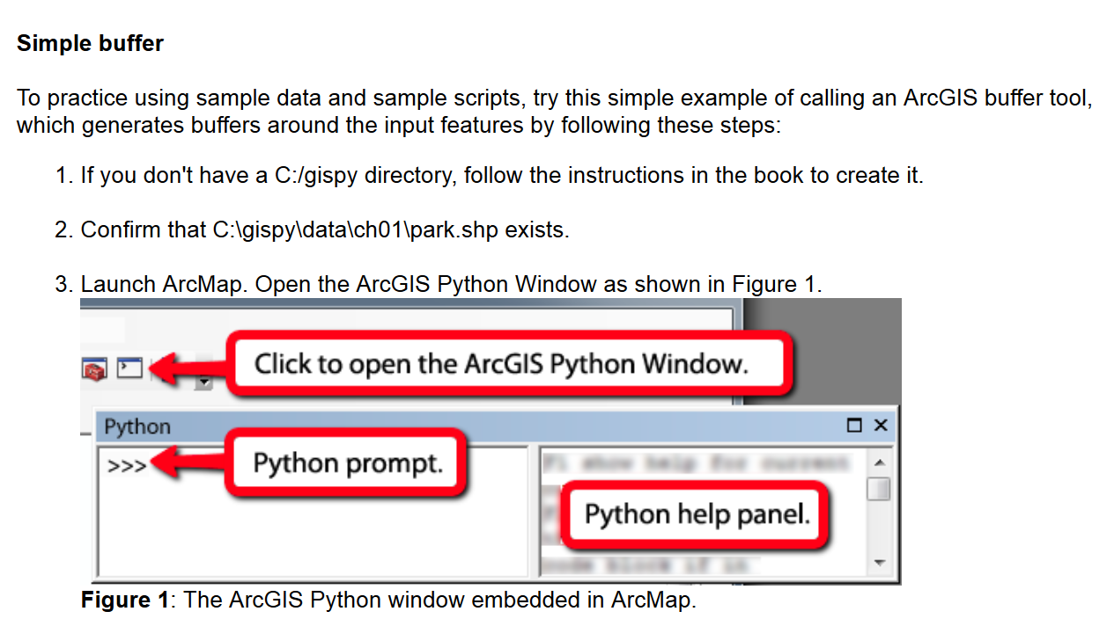
In-class exercise
Week 1 (in the course schedule on the website)
In-class exercises
C:/gispy/gispy/data/ch01/park.shp
Notes:
Now we’ve completed the class introduction and we can get to the fun stuff! Let’s return to the schedule and go to the in-class exercise for day 1. In this exercise, we’ll use the ArcGIS Python prompt just to get your feet wet. First, you’ll need to download and unzip data, the gispy.zip file, and place it just under the C drive, so that you have a C:/gispy/data directory. Confirm that C:\gispy\data\ch01\park.shp exists. You may confirm this in ArcCatalog, but then you have to click on the data directory and refresh it, so that the data is not locked by ArcCatalog. If your path looks like this, C:/gispy/gispy/data/ch01/park.shp, you have an extra layer of folders and you need to remove that extra layer. There should be only one gispy in your path. Now you’re ready to launch ArcMap and open the Python window. Next follow the instructions shown in the in-class exercise and answer the questions that arise near the end. We’ll discuss the answers in the next video.

