Slide 1

User-defined modules
  Usage
  Appending to sys.path
  Reload modules
  Built-in variable: __name__
Dr. Tateosian
Notes:
This video presents the main concepts for user-defined modules. Specifically, it discusses how these can facilitate code reuse, how to import them using the system path, how to refresh the import with the reload button, and how to use the built-in name variable to write testing suites within the module.
A user-defined module is simply a Python script. It’s a script in which you place code to be reused by multiple other scripts. For example, you could write an election module which contains election-related functions, such as functions for calculating district counts, scraping voter registration data from the Web and calculating voter registration statistics. You might want to get the voter registration statistics from the Python script you are writing to experiment with redistricting. At the same time, you might have another project that is making income choropleths and you want to overlay the voter registration statistics on the map you generate. As long as your voter registration statistics function is in your election module, you could “import election” from either of these and then call election.getRegistrationStatistics to get the information you want. In this scenario, the user-defined module, election.py, is making code reuse possible, by storing this function for any script to call.

Slide 2
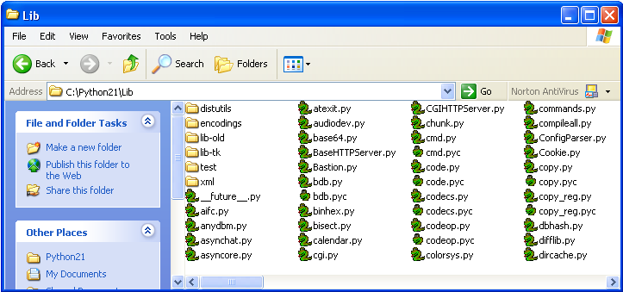
Standard modules
A module is a file containing Python definitions and statements
Python comes with a library of standard modules
Examples: datetime, math, os, random, sys, time …
You can make your own. (But don’t use standard module names for your own modules).
List of standard modules: http://docs.python.org/modindex.html

Slide 3
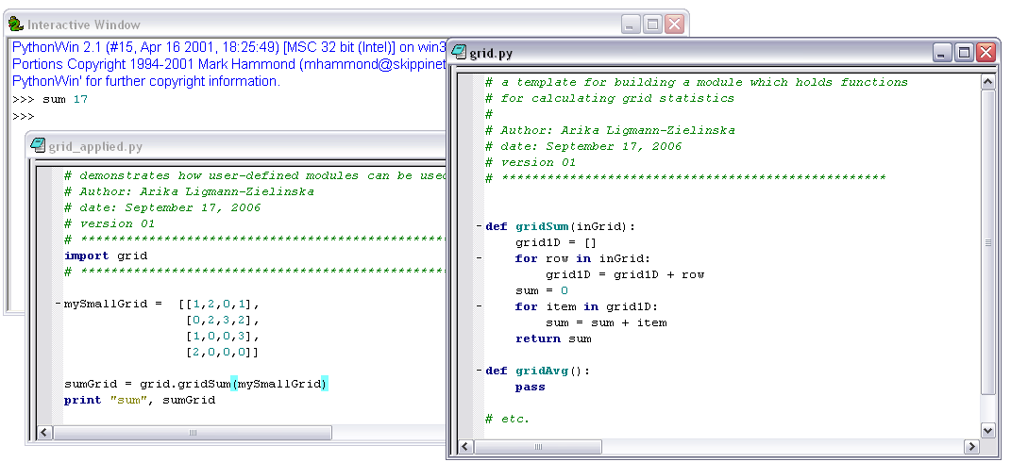
Define and use your own modules
script name: grid.py
module name: grid
script name
module name
a user-defined module with matrix operations

Slide 4
Using your own modules
General format:
import moduleName
moduleName.procedureName(arg1, arg2,...)
To refer to
this procedure
1. import the module
2. call procedure using module name
import grid
grid.gridSum(mySmallGrid)

Slide 5
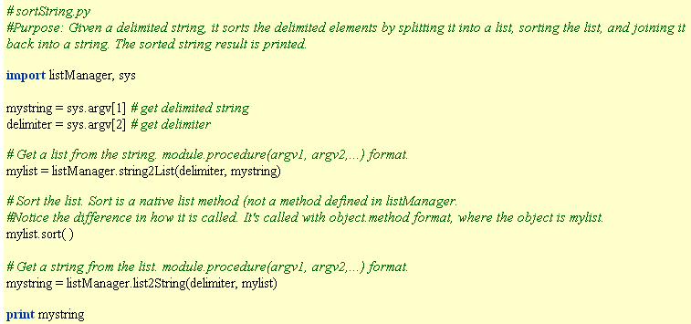
Import u.d.-module and call functions
import listManager
listManager.list2String(delimiter, mylist)

Slide 6
Where to put your modules
Python stores a list of directories to search for modules and files.
>>> import sys
>>> sys.path
['C:\\Program Files\\ArcGIS\\bin', 'C:\\WINDOWS\\system32\\python24.zip', 'C:\\checkdir\\to_read', 'C:\\Python24\\DLLs', 'C:\\Python24\\lib‘]
sys.path is a Python list.
>>> sys.path.append(“C:/myModules”)
>>> sys.path
['C:\\Program Files\\ArcGIS\\bin', 'C:\\WINDOWS\\system32\\python24.zip', 'C:\\checkdir\\to_read', 'C:\\Python24\\DLLs', 'C:\\Python24\\lib‘, ‘C:/myModules’]

Slide 7

reload( )
Each module is only imported once per interpreter session.
If you change your support modules:
  you must restart the interpreter
  or, if it’s just one module you want to test interactively, use reload(moduleName)
  Reload is a built-in function.
Example:
  reload(listManager)
  same as clicking when your focus is on listManager

Slide 8
In class – user-defined modules
sortString.py (our main script)
listManager.py (our user-defined module)
Copy both from in-class page and save in both C:/gispy/scratch
sortString.py calls one of the listManager functions.
Run sortStrings.py (it breaks—fix it)
Add more code to sortStrings as instructed.

Slide 9
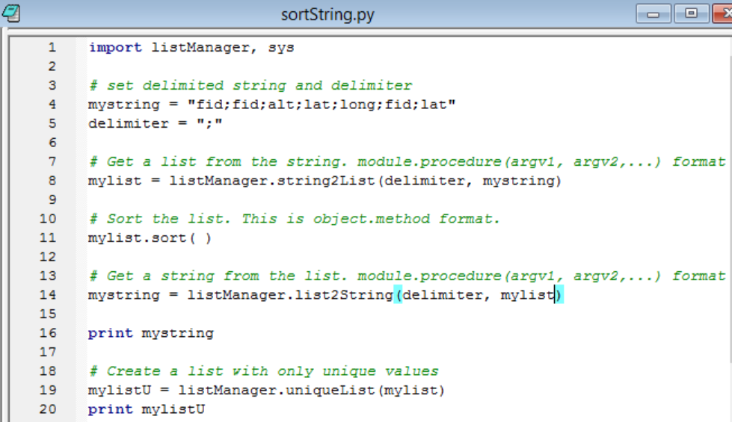
In class followup sortString.py
import listManager
listManager.method(args…)

Slide 10
When you import a module…
When you import listManager, the code in listManager is executed.
It’s very much like executing the script directly with an IDE.
If you add print(“Hehe”) to listManager.py outside of the procedure definitions, when you import listManager, Hehe will be printed.
The import also creates a listManager.pyc file. If listManager.pyc already exists, the file will not be reloaded, unless you force it to reload.
If all the code in listManager is executed when it’s imported, you can’t include statements in listManager that are only meant for testing your procedure definitions. But there’s a way around this problem…

Slide 11
Using the __name__ variable
__name__ is a built-in string variable
__name__ is set to “__main__” when running the script as the ‘main’ file
__name__ is set to the name of the Python module when it’s being imported from another script .
For example:
  __name__ == “listManager” is True when sortString imports listManager
  __name__ == "__main__” is True when listManager is run from directly in PythonWin.
Place condition if __name__ == "__main__” after all procedure definitions.
Then use it to test a support module as an independent script, by placing code inside this conditional block.
if __name__ == "__main__":
import sys
print string2List(sys.argv[2], sys.argv[1])
Does not run when listManager is imported by sortString

Slide 12
Example of using __name__ variable
# listManager.py
def string2List(delimiter, s):
….
def uniqueList(L):
….
def list2String(delimiter, L):
….
if __name__ == "__main__":
import sys
print string2List(sys.argv[2], sys.argv[1])
Don’t need dot notation because
calling procedure from inside the
same module.
Two underscore characters.

Slide 13
Summing up
Topics discussed
    User-defined module for code re-use
    Must import, then use dot notation
    Append sys.path before importing
    reload button & function
    __name__ == "__main__"
Up next
    User-defined classes

