Slide 1
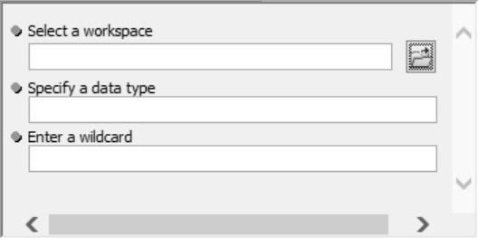
ArcGIS Script Tool Basics
Relationship [Script Tool⬄Python script]
How to create script tools and buttons
Printing with script tools
Dr. Tateosian
Notes:
A graphical user interface (or GUI for short), is a way to prompt users to provide the arguments needed for a script, so that they don't need to learn to run a Python script directly in an IDE or install an IDE. This slide shows a GUI that was created by an ArcGIS Script Tool to accept 3 user arguments. ArcGIS Script Tools are a means for you, the programmer, to create graphical user interfaces for your Python scripts without having to learn about the complex libraries that are available for GUI development.
This video introduces ArcGIS Script Tools, there relationship with the Python scripts they are built for, how to create them, and how to use them.
If you learn enough about Script Tools and their cousins, Python Toolboxes, you can make dynamic interfaces that can really help your users run your scripts more effectively.

Slide 2
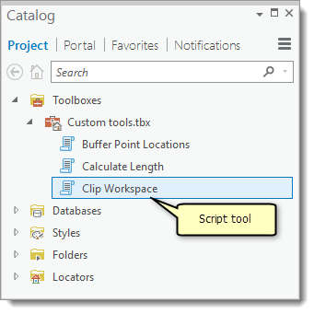
What’s a ‘script tool’?
A custom GUI that points to a Python script.
TkFileDialog
+ Pro: Browse to files/directories
+ Pro: Good for simple apps.
+ Pro: No arcpy needed.
-- Con: only input type files/directories.
-- Con: Can’t get more than one file/directory at a time.
Other GUI libraries: wxPython, PyQT…
+ Pro: Powerful/flexible.
+ Pro: No arcpy needed.
-- Con: Complex to learn
Script tools
+ Pro: Easy to create.
+ Pro: Can get many data types as input, include ArcGIS proprietary.
+ Pro: Can get more than one input at a time.
-- Con: ArcGIS required. And need to know ArcGIS really well.
-- Con: Some limitations (e.g., can’t make a wizard? Limited available widgets).

Slide 3
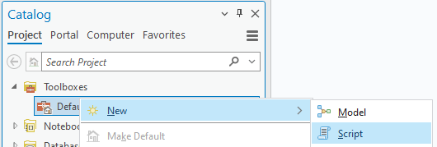
Create a script tool
To create a script tool, you need three things:
A Python script.
A toolbox.
A list of desired script parameters and their types.
Steps:
1. Create a project.
2. In a toolbox, right-click > New > Script

Slide 4
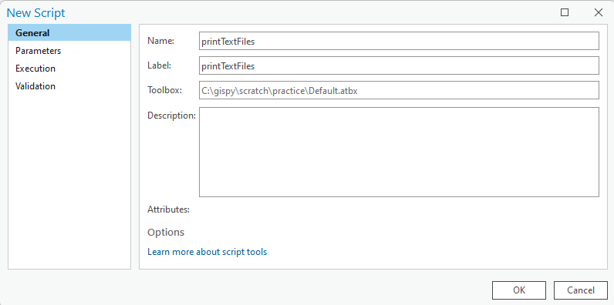
Activity – Create a script tool
Three things you need:
A Python script (provided this time).
A custom toolbox (you make it).
A list of desired script parameters and their types. (this one doesn’t need any parameters.)

Slide 5
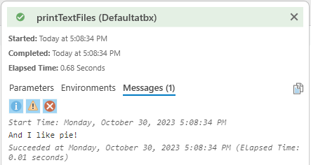
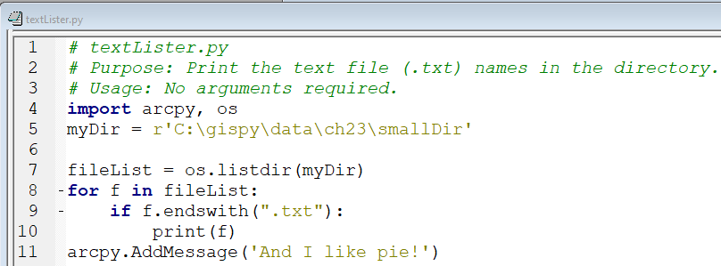
Activity follow-up
Where did ‘and I like pie!’ come from?
Why don't the text files appear in the Messages panel?
Notes:
# textLister.py
# Purpose: Print the text file (.txt) names in the directory.
# Usage: No arguments required.
import arcpy, os
myDir = r'C:\gispy\data\ch23\smallDir'
fileList = os.listdir(myDir)
for f in fileList:
if f.endswith(".txt"):
print(f)
arcpy.AddMessage('And I like pie!'))

Slide 6
Printed output
Message printed with Python's print function…
Print in IDE consoles.
Do not display in the geosprocessing Messages pane.
print("Hello") # doesn't display in the Messages pane
Message printed with the arcpy.AddMessage method
Print in the geosprocessing Messages pane
Do not display in IDE consoles.
arcpy.AddMessage("Hi") # doesn't print in PythonWin Interactive Window
Notes:
Import arcpy
def printArc(message):
'''Print message for script tool and standard output.'''
print message
arcpy.AddMessage(message)
printArc('foo')
dist = 5
unit = 'miles'
myMessage = '{0} {1}'.format(dist, unit)
printArc(myMessage)

Slide 7
Printing from a script tool.
1
2
3
4
5
6
7
8
9
10
11
12
import arcpy
def printArc(message):
'''Print message for script tool & standard output.'''
print(message)
arcpy.AddMessage(message)
myMessage = "Hello, Script Tool"
printArc(myMessage)
Notes:
Import arcpy
def printArc(message):
'''Print message for script tool and standard output.'''
print message
arcpy.AddMessage(message)
printArc('foo')
dist = 5
unit = 'miles'
myMessage = '{0} {1}'.format(dist, unit)
printArc(myMessage)

Slide 8
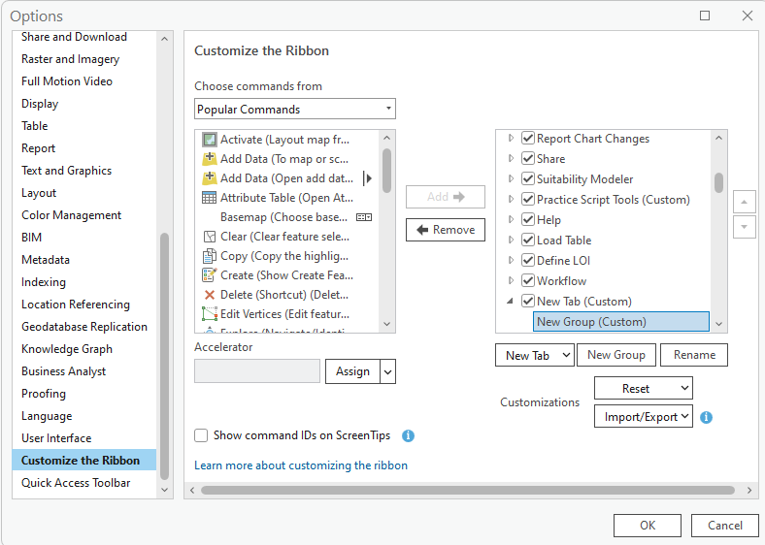
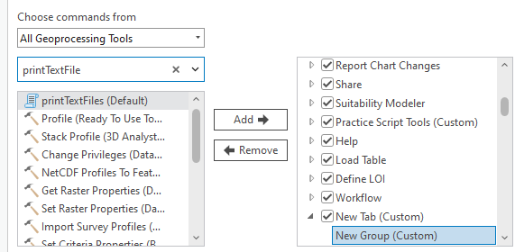
Adding script tool button to a project
To create a button on in ArcGIS Pro toolbar to launch a script tool
Project > Options
Scroll down and select "Customize the Ribbon" (in the left panel)
On the right, select "New Tab"
Rename your new tab and group as desired.
On the left, under "Choose commands from," select "All geoprocessing tools".
Search for your new script tool in the search box. Select it.
Make sure your new group is selected on the right and click "Add→"
Click OK and go back to your project to see the new tab.
Notes:
https://www.youtube.com/watch?v=l2oPX3LJeDw
This is fyi, in case you want to do this for your own environment. But we are discussing this slide in class because, the button will not come along when you share your project. This customization only changes the current computer's setup.

Slide 9
Script tools in memory
Script Tools are pointers to Python scripts.
If you move the Python script it points to and don't change the script path in the Script Tool properties, it will no longer work!
Script Tools do NOT appear in Windows File Explorer folders. They are part of a .atbx file.
To share a Script Tool, you must copy the .atbx file and the script AND the script must be in the SAME relative position it was when set up.
Script tools are just a GUI interface for scripts.

Slide 10
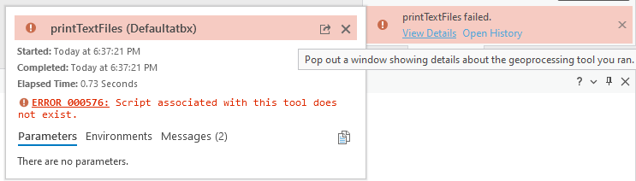
Activity - Break a script tool
Right click on the 'printTextFiles' script tool, select 'Properties...', and then select the 'Source' tab. Note the Python script specified by the 'Script file' path on this tab ('C:\gispy\scratch\textLister.py'). Close the script tool properties by clicking 'OK'.
Browse to 'textLister.py' and open it. Add another message to 'textLister.py' and save the script: arcpy.AddMessage('***I like kale***!')
Double click on the script tool to run it again. Do you see a change?
Rename 'textLister.py' to 'textLister2.py' and run the script tool again. What happens?
Rename the script back to its original name, 'textLister.py' and run the script tool again. Is it working? Why?
Now make a directory 'C:\gispy\scratch\breakStuff' and move 'textLister.py' down into it. Run the script tool again. What happens?
Copy the toolbox to your 'Documents' directory. Run the script tool again. Does it work? Why?
Move textLister.py to the 'Documents' directory. Run the script tool again. Does it work? Why?

Slide 11
Script tool concepts to remember
Script Tools do not appear in Windows File Explorer. They are part of a toolbox (atbx) file.
Since a script tool points to a script, you can change the script and see the updates immediately when you run the tool.
If you rename, move, or remove the underlying script, the script tool will be broken.
For portability, copy the toolbox and the script maintaining the relative path.
Script tools don't have a debugger, so it's important to test Python scripts thoroughly outside the script tool.
A simple way to maintain relative paths is to set up the script tools and scripts in the same project directory and share that entire directory.

Slide 12
Summing up
Topics discussed
Script tools
GUI front end for scripts
Create script tool
Print from a script tool (print & arcpy.AddMessage)
Use relative paths & maintain them
Up next
Script tools parameters
Additional topics
wxPython, PyQT

