Slide 1
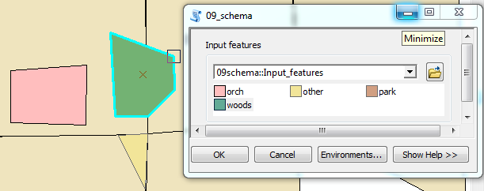
Script Tool Parameters Part 2
Default values
Draw input features
Filters for restricting input
Edit tool help
Dr. Tateosian

Slide 2
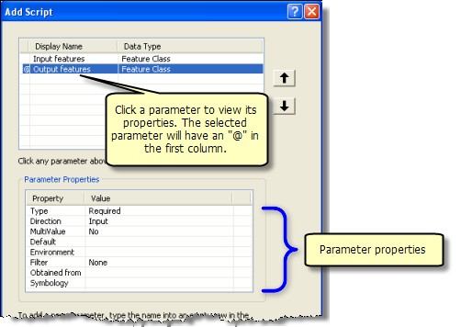
Setting script tool parameters
Property | Description
✓ Type | (Required, Optional, or Derived). Derived: user does not enter a value for the parameter. Derived types are always output parameters.
✓ Direction | (Input or Output). If Type is Derived, direction is always set to Output.
✓ Multivalue | Yes, if you want to accept a list of values.
Default or Schema | The default value for the parameter. When the parameter data type is either feature set or record set, Default is replaced with Schema.
Environment | To set the default value of a parameter to an environment setting.
Filter | Restrict the values to be entered. 6 types of filters. Filter type depends on the data type.
Obtained from | For derived output parameters, ‘Obtained from’ can be set to the parameter containing the definition of the output. For input parameters, ‘Obtained from’ is set to the parameter containing the information needed for input.
Symbology | Use a layer file (.lyr) to set output symbology.

Slide 3
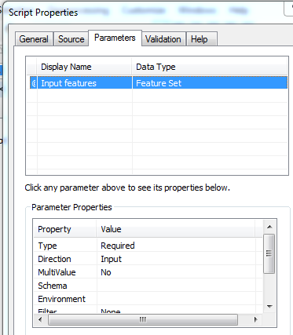
Default or Schema
Property | Description
Type | Required, Optional, or Derived.
Direction | Input or Output.
Multivalue | Yes, if you want to accept a list of values.
Default or Schema | The default value for the parameter. When the parameter data type is either feature set or record set, Default is replaced with Schema.
Environment | To set the default value of a parameter to an environment setting.
Filter | Restrict the values to be entered. 6 types of filters. Filter type depends on the data type.
Obtained from | For derived output parameters, ‘Obtained from’ can be set to the parameter containing the definition of the output. For input parameters, ‘Obtained from’ is set to the parameter containing the information needed for input.
Symbology | Use a layer file (.lyr) to set output symbology.

Slide 4
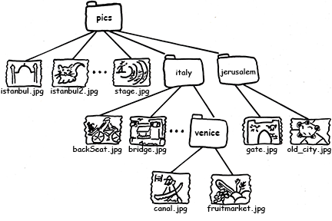
Relative path review
relative path of a file
  - Gives its position relative to
  another file.
  - Doesn't need to start with a
  drive name.
E.g., from 'backSeat.jpg’ there are several types of relative positions:
Same directory: For files in the same directory as 'backSeat.jpg', the relative path is simply the name of the other file.
Relative path: 'bridge.jpg'
Subdirectory: 'backSeat.jpg' resides in the 'C:/gispy/data/ch12/pics/italy/' directory. To refer to files in any subdirectories, the relative path lists the directories that fall below this one.
Relative path: 'venice/canal.jpg‘
Up or up-and-over directories: To climb upward in the hierarchy, you can use two dots.
Relative path: '../istanbul.jpg'
The double dots take the path up out of the 'italy' directory to the next level up, which is the 'pics' directory. Relative paths have to follow the lines connecting the file in the tree. To reference 'old_city.jpg' from 'backSeat.jpg', you have to climb out of 'italy' again using and then step down into the 'jerusalem' directory.
Relative path: '../jerusalem/old_city.jpg'.

Slide 5
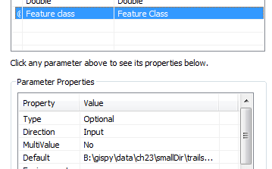
Relative paths for default values
When default data values are specified, relative paths should be used whenever possible
Paths should be specified relative to the position of the toolbox
Example1 Toolbox C:\projects\code\coolTools.tbx
  Raster absolute path C:\projects\data\trees.tiff
  Relative path to raster from toolbox (use this!)
  ..\data\trees.tiff
Example 2
Toolbox B:\gispy\sample_scripts\ch23\08_defaultVals.tbx
Shapefile absolute path B:\gispy\data\ch23\smallDir\trails.shp
Relative path to shapefile from toolbox (use this!)
  ..\..\data\ch23\smallDir\trails.shp
The script tool shows a full path, but it updates when moved!
  When you set it up:
  When you look at it again, shows a full path:
  When you move the tbx, the path changes:

Slide 6
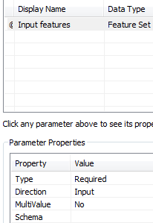
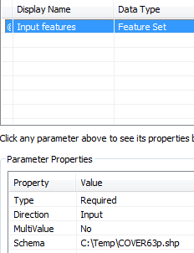
Using feature sets as input
Must set a schema, else you can not make a selection.
Setting a schema determines geometry type.
Can also determine attributes (such as land cover)
Depending on the speed of your computer, it may take a moment for the symbology display to populate
.lyr

Slide 7
Ways to use feature set input widget
(Draw) “Input features”
  Click on the feature icon
  Click on the map to create feature vertices.
  Double-click to complete a vertex.
  Click on the map again to add another feature (if desired).

Slide 8
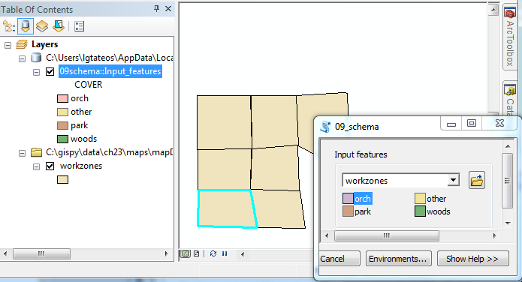
Ways to use feature set input widget
2. Select features from a map layer
  Use the combobox pull down arrow to select a map layer
  Click on the desired feature(s) in the map.

Slide 9
Setting Script Tool parameters
Property | Description
✓ Type | Required, Optional, or Derived.
✓ Direction | Input or Output.
✓ Multivalue | Yes, if you want to accept a list of values.
✓ Default or Schema | The default value for the parameter. When the parameter data type is either feature set or record set, Default is replaced with Schema.
Environment | To set the default value of a parameter to an environment setting.
Filter | Restrict the values to be entered. 6 types of filters. Filter type depends on the data type.
Obtained from | For derived output parameters, ‘Obtained from’ can be set to the parameter containing the definition of the output. For input parameters, ‘Obtained from’ is set to the parameter containing the information needed for input.
Symbology | Use a layer file (.lyr) to set output symbology.

Slide 10
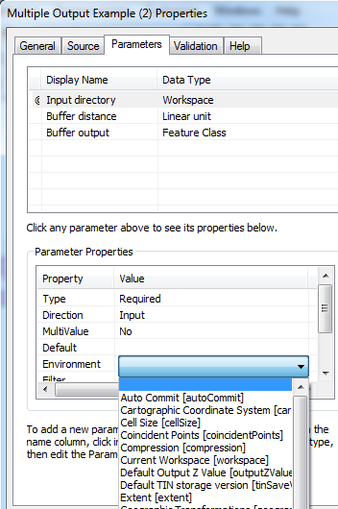
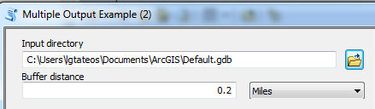
Using default environment values
To get the default value from and environment setting
Default Parameter Property hard-coded.
Environment Parameter Property applies ArcMap settings

Slide 11
Setting Script Tool parameters
Property | Description
✓ Type | Required, Optional, or Derived.
✓ Direction | Input or Output.
✓ Multivalue | Yes, if you want to accept a list of values.
✓ Default or Schema | The default value for the parameter. When the parameter data type is either feature set or record set, Default is replaced with Schema.
Environment | To set the default value of a parameter to an environment setting.
Filter | Restrict the values to be entered. 6 types of filters. Filter type depends on the data type.
Obtained from | For derived output parameters, ‘Obtained from’ can be set to the parameter containing the definition of the output. For input parameters, ‘Obtained from’ is set to the parameter containing the information needed for input.
Symbology | Use a layer file (.lyr) to set output symbology.

Slide 12
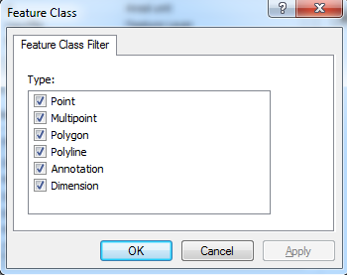
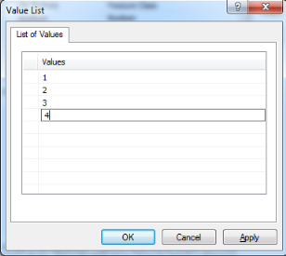
Filter parameter
Filter type | Values
Value List | A list of string or numeric values. Used with String, Long, Double, and Boolean parameter data types.
Range | A minimum and maximum value. Used with Long and Double data types.
Feature Class | A list of allowable feature class types: "Point", "Multipoint", "Polyline", "Polygon", "MultiPatch", "Sphere", "Annotation", "Dimension". More than one value can be supplied to the filter.
File | A list of file suffixes. Example: "txt; e00; ditamap".
Field | A list of allowable field types: "Short", "Long", "Single", "Double", "Text", "Date", "OID", "Geometry", "Blob", "Raster", "GUID", "GlobalID", "XML". More than one value can be supplied to the filter.
Workspace | A list of allowable workspace types: "File System", "Local Database", or "Remote Database". More than one value can be supplied.
Select data type (filter type choices automatically updated)
Select filter type
Specify choice with GUI.

Slide 13
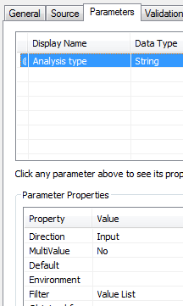

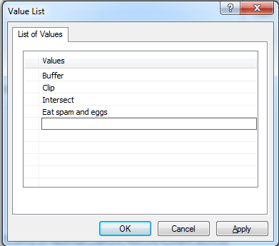
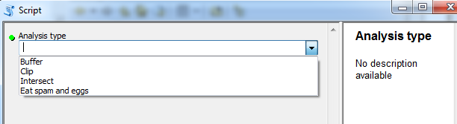
Filter Value List
This widget is a ‘combobox’
-- a combination of a drop-down list and an editable textbox, allowing the user to either type a value directly into the control or choose from a list of existing options by scrolling.

Slide 14
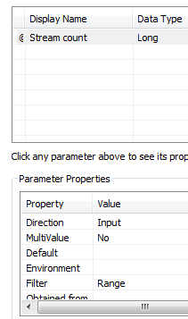
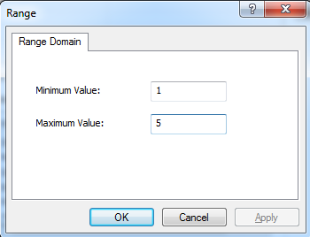
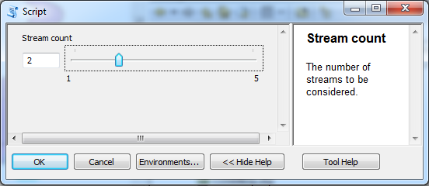
Filter Range
A Long data type range creates a ‘slider’ widget with a box.
A Double data type range creates a box only; an is thrown if a value outside the range is entered.

Slide 15
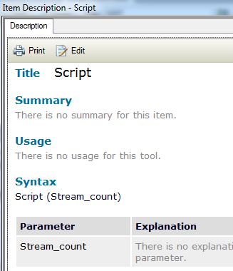
Editing Tool Help
Right click on Script Tool ->
Item Description…-> Edit

Slide 16
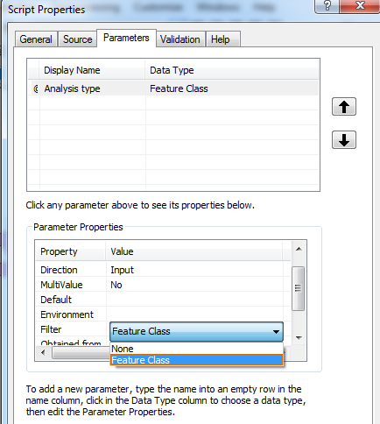
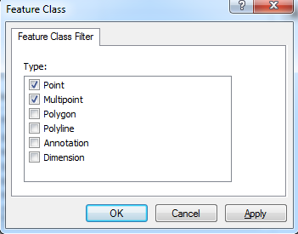
Filter feature class
If the Data Type is Feature Class, you can restrict the geometry with a filter.

Slide 17
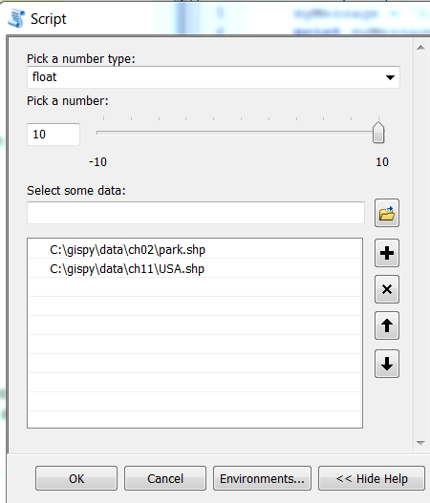
In class – Use filters
Write a script that prints the index and value of the arguments that it receives.
Create a script tool in C:\gispy\scratch and use filters to allow the user to:
  Choose float or integer from a combobox.
  Choose a value between [-10, 10].
  Choose one or more polygon feature classes. Set the default value as the relative path to park.shp in the chapter 2 data directory in gispy.
Printed output should look something like this:
Argument 0: C:\printArgs.py
Argument 1: float
Argument 2: -4
Argument 3: C:\gispy\ch02\data\park.shp;C:\gispy\data\ch11\USA.shp

Slide 18
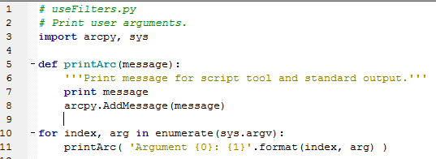
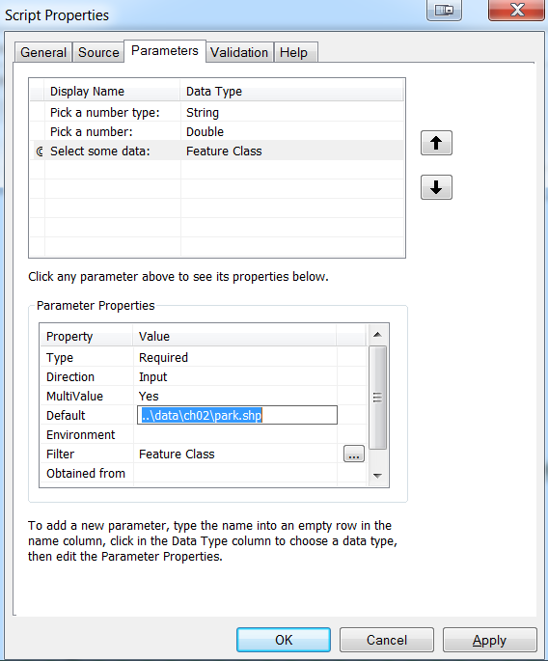
In class – Use filters follow-up

Slide 19
Summing up
Topics discussed
  Default value approaches:
    Hard-coded
    Relative paths
    Based on Environment settings
  Schema with ‘feature set’ (or ‘record set’) data type:
    Specify a .lyr file
  Filters:
    value, range, feature class, field, file, workspace
  Edit tool help
    Right click on Script Tool -> Item Description…-> Edit
Up next
    Setting script tool parameters part 3 (Obtained from, Symbology)
Notes:
thanks for pic from http://twi-star.blogspot.com/2009/11/central-park-remember-me-set-stalking.html

