Slide 1
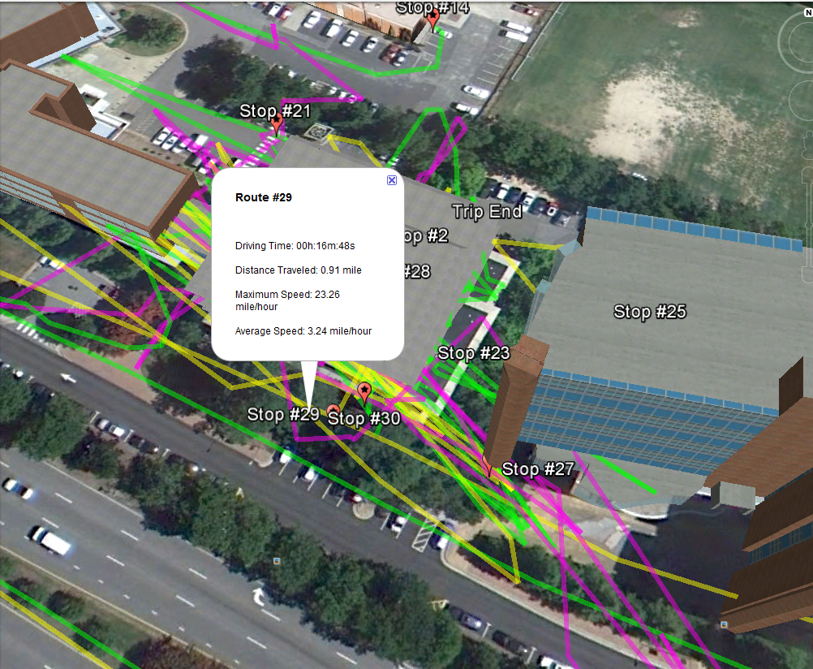
Working with HTML
Introduction markup languages
HTML syntax (tags, images, lists, tables)
Writing HTML with Python

Slide 2
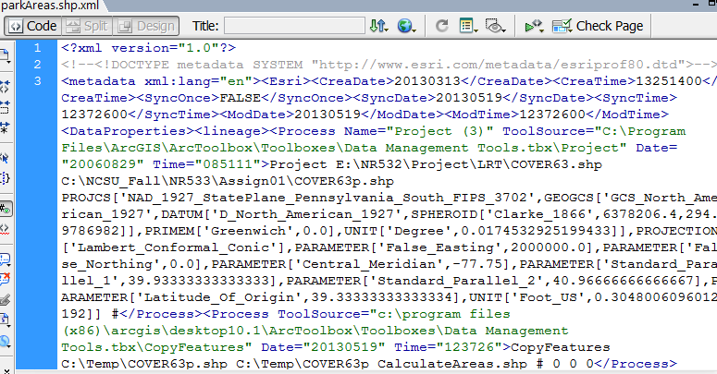
HTML
Why it’s useful for GIS analyists…
  Web mapping
  Web presence (GIST Portfolio)
  Scrape data from the web
  Parse KML/XML
  Create web pages with Python
Stands for
  Hyper Text Markup Language
markup language (not programming)
A markup language is a set of markup tags
  Other markup languages: xml, kml,…
HTML uses markup tags to describe web pages

Slide 3
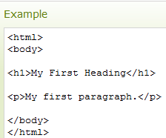
HTML (Markup) Tags
HTML tags
  Keywords surrounded by angle brackets like <html>.
  Usually come in pairs like <p> and </p>.
tag pairs
  First tag in a pair is the start tag, the second tag is the end tag.
  Start and end tags are also called opening tags and closing tags.
  Closing tags contain a slash at the front.
  Example: </p>
Some tags have attributes.
  Example: <ol start="50">

Slide 4
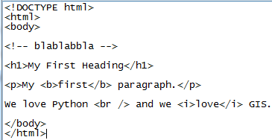
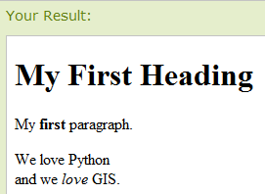
HTML Page Example
<!DOCTYPE html> tells the browser what version of HTML is being used. (This one is for, HTML 5)
Text between <!-- and --> is comments.
Text between <html> and </html> describes the web page.
Text between <body> and </body> is the visible page content.
Text between <h1> and </h1> is displayed as a heading.
Text between <p> and </p> is displayed as a paragraph.
What do <b>…</b> do? And <br>?
Notes:
<!DOCTYPE html>
<html>
<body>
<!-- blablabbla -->
<h1>My First Heading</h1>
<p>My <b>first</b> paragraph.</p>
We love Python <br /> and we love GIS.
</body>
</html>

Slide 5
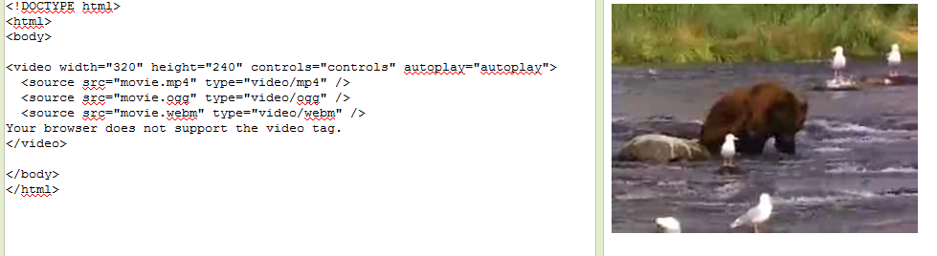
In class – HTML tags
Browse HTML 5 Tutorial page and click on the “Run” button
Replace the code in the left window
Click on the “Run” button again, observe the results, & answer the questions.

Slide 6
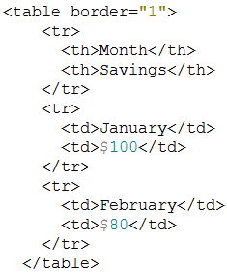

Lessons from HTML exercise
How to resize an image
How to add a row to a table
How to add/remove table borders
border attribute
How to make a numbered list that starts the numbering at 50.
<ol start="50">
How to make a bulleted list
How to insert a line break
How to create a hyperlink
<a href="http://www.aag.org/" >AAG</a>
<img src="http://blabla/pics-of-kittens-2.jpg" alt="kittens" width ="42" height="42"/>
<br /> tag
destination display text

Slide 7
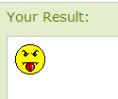


Embedding images
<img> tag
  - Defines an image in an HTML page.
  Has two required attributes: src and alt.
  Other attributes?
  Example:
Embed?
  Images not actually inserted into an HTML page.
  images linked to HTML pages.
  <img> tag is a place holder for the referenced image.
  smiley.gif must reside where the html resides.
  If the image is not local to the webpage, give a URL.
  When you make a website for courses, you can use GitHub
Notes:
<img src=“smiley.gif" alt=“Smiley face" width="42" height="42" />

Slide 8
GitHub Web Page
Browse to https://github.com/
Create an account.
Create a project (the project name will be part of your url)
Create a webpage, index.html, that you want to be your “home page”
Upload that into your repo space (use git or click “upload file”)
Click settings
On the settings page, under “GitHub Pages”:
  Use the Select source drop-down menu to select your GitHub Pages publishing source.
  Choose master branch or gh-pages or some other subdirectory that you have created; This must be the location of your index.html page.
  Click Save
  Note: it will say something like this:
  “Your site is published at: http://username.github.io/projectName/”
  That is your website’s base url.
  Browse to this url to see your index.html page.
Your NCSU website url: http://www4.ncsu.edu/~unityid/
Notes:
More info here:
https://help.github.com/articles/configuring-a-publishing-source-for-github-pages/

Slide 9
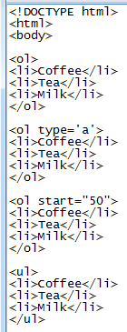
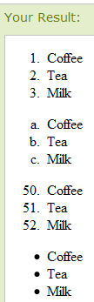
Lists
Wrap <ol> and </ol> around an ordered (numbered or lettered) list.
Wrap <ul> and </ul> around an unordered (bulleted) list.
Wrap <li> and </li> around each list item.
Useful attributes
  type and start
Notes:
<!DOCTYPE html>
<html>
<body>
<ol>
<li>Coffee</li>
<li>Tea</li>
<li>Milk</li>
</ol>
<ol type='a'>
<li>Coffee</li>
<li>Tea</li>
<li>Milk</li>
</ol>
<ol start="50">
<li>Coffee</li>
<li>Tea</li>
<li>Milk</li>
</ol>
<ul>
<li>Coffee</li>
<li>Tea</li>
<li>Milk</li>
</ul>

Slide 10
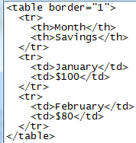
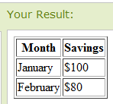
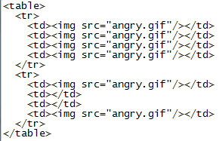
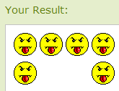
Tables
Wrap <table> and </table> around a table.
Wrap <tr> and </tr> around each row.
Wrap <td> and </td> around each table data cell.
Can also be used to arrange data on the page with borders turned off.
Notes:
<table border="1">
<tr>
<th>Month</th>
<th>Savings</th>
</tr>
<tr>
<td>January</td>
<td>$100</td>
</tr>
<tr>
<td>February</td>
<td>$80</td>
</tr>
</table>
<table>
<tr>
<td><img src="angry.gif"/></td>
<td><img src="angry.gif"/></td>
<td><img src="angry.gif"/></td>
<td><img src="angry.gif"/></td>
</tr>
<tr>
<td><img src="angry.gif"/></td>
<td></td>
<td></td>
<td><img src="angry.gif"/></td>
</tr>
</table>

Slide 11

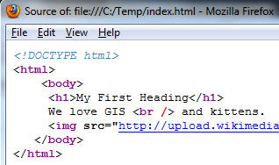
HTML spacing and indentation
Not required for the Web Browser to read it correctly.
But what will this HTML page look like?
What will this HTML page look like?

Slide 12
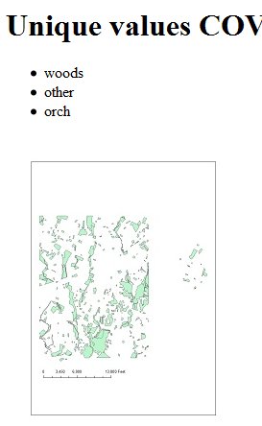
Writing HTML with python
Suppose you want to process data and displays the resulting map on a web page.
HTML is just a text file containing tags and ending in html or htm.
Can use Python file i/o to write dynamic HTML.

Slide 13
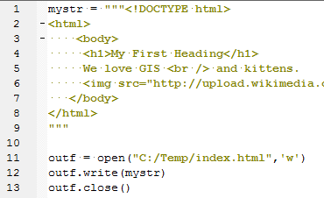
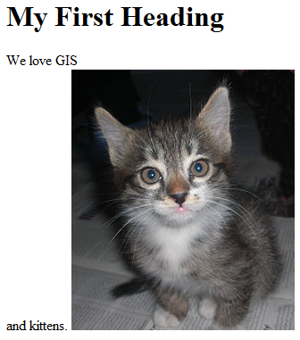
Creating an HTML file with Python
  Create an html string. Wrap html string in triple """ quotes to preserve indentation. (Lines 1-9)
  Open (for writing) a file with an html extension. (Line 11)
  Write the html string to the open file. (Line 12)
  Close the html file. (Line 13)
  View html output file in browser.
Notes:
#writeSimpleHTML.py
mystr = """<!DOCTYPE html>
<html>
<body>
<h1>My First Heading</h1>
We love GIS <br /> and kittens.
<img src="http://upload.wikimedia.org/wikipedia/commons/thumb/1/1b/Persian_Cat_(kitten).jpg/250px-Persian_Cat_(kitten).jpg" alt="kitten">
</body>
</html>
"""
outf = open("C:/Temp/index.html",'w')
outf.write(mystr)
outf.close()

Slide 14
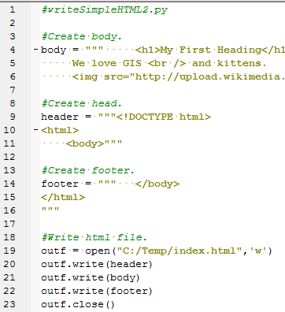
Building the HTML
For more complex HTML…
Build related parts of the html separately (e.g. header, body, footer).
Use variables and string formatting, as needed.
Then write parts to file in correct order.
Notes:
#writeSimpleHTML2.py
header = """<!DOCTYPE html>
<html>
<body>"""
body = """ <h1>My First Heading</h1>
We love GIS <br /> and kittens.
<img src="http://upload.wikimedia.org/wikipedia/commons/thumb/1/1b/Persian_Cat_(kitten).jpg/250px-Persian_Cat_(kitten).jpg" alt="kitten">"""
footer = """ </body>
</html>
"""
outf = open("C:/Temp/index.html",'w')
outf.write(header)
outf.write(body)
outf.wrote(footer)
outf.close()

Slide 15
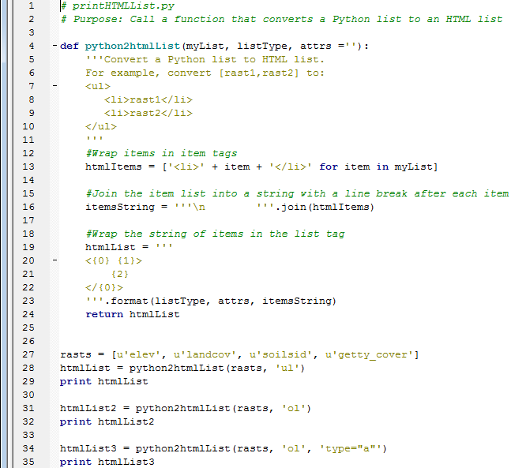
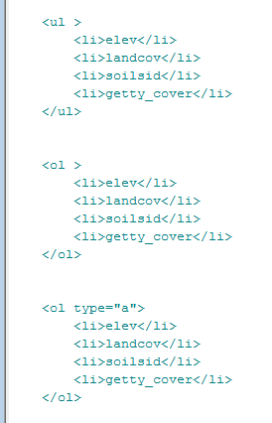
Building HTML lists from Python lists

Slide 16
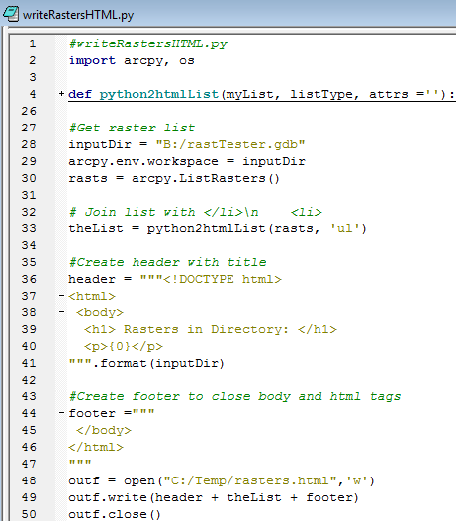
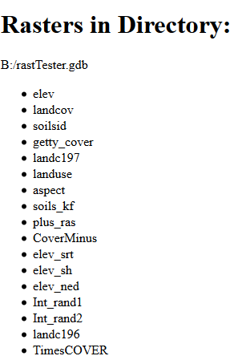
Using variables for dynamic content

Slide 17
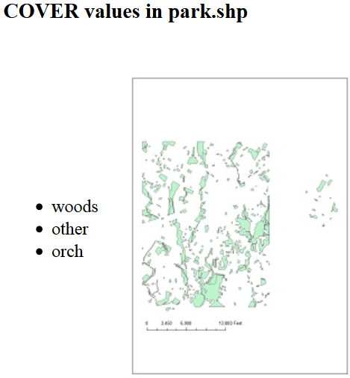
In class – Writing HTML
Save the linked script in C:/gispy/scratch
Run the script as-is and view the output html page.
Modify the code to:
  Create a bulleted list of unique values for a field (3 functions in the code will help)
  Insert an image in the page (use the img tag setting src to the jpeg)
  Remove the table border.
  Create a dynamic header (use the h3 tag)

Slide 18
Creating HTML script modifications
## Get values for the given field
fullList = getFieldValues(baseDir + fc, fieldName)
## Get unique values for the given field
uniqueValueList = getUniqueListValues(fullList)
## Create HTML bullet list from the unique value list.
htmlList = python2htmlList(uniqueValueList, "ul")
## Write code to create a string for an html image tag
imageCode = '<img src ="{0}" alt="map of the {1}">'.format(image,fieldName)
<table border=“0"> ## Removes the table border.
header = """<!DOCTYPE html>
<html>
<body>
<h3>{0} values in {1}</h3> ## HTML header string.
""".format(fieldName, baseName) ## Place vars. inside parens. for header
Notes:
#writeUniqueValuesHTML.py
import arcpy, os
inputDir = "C:/Temp/"
fc = "COVER63p.shp"
fieldname = "COVER"
image = "COVER63p.jpg"
#Create HTML body - a bulleted raster list
#Make html bullet list:
#..<ul>
# <li>item1</li>
# <li>item2</li>
#..</ul>
#Get unique values list
arcpy.env.workspace = inputDir
sc = arcpy.SearchCursor(fc)
valueList = [row.getValue(fieldname)for row in sc]
uniqueValueSet = set(valueList)
uniqueValueList = list(uniqueValueSet)
# Join list with </li>\n <li>
listItems = """</li>\n <li>""".join(uniqueValueList)
#Wrap in items in ul tag (and add the first li which is missing).
body = """ <ul>\n <li>{0}\n </ul>
<img src="{1}" alt="{1}">
""".format(listItems, image)
#Create header with title
header = """<!DOCTYPE html>
<html>
<body>
<h1> Unique values in {0} field {1}: </h1>
""".format(fc, fieldname)
#Create footer to close body and html tags
footer ="""
</body>
</html>
"""
outf = open("C:/Temp/DataReport.html",'w')
outf.write(header + body + footer)
outf.close()

Slide 19
Summing up
Topics discussed
    HTML syntax
    tags
      a, img, ol, ul, li, td, tr, br, pre, &nbsp;…
      paired tags
      tag names, attribute names, attribute values, contents
    Write HTML with Python
      write text file
      use string ‘format’ method
Up next
    Parsing HTML (BeautifulSoup)
Additional topics
    many more tags, css, javascript

Slide 20
In class – HTML spacing
Copy text from htmlSpacing.txt into left Window and observe results in right window.
Look at how blank spaces between words in html are interpreted.
Use <pre></pre>, <br>, and &nbsp; tags to modify spacing.
<pre></pre> --- preformatting
<br> -- line break
&nbsp; -- blankspace

Slide 21
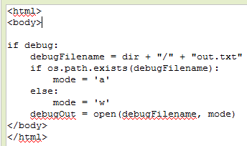

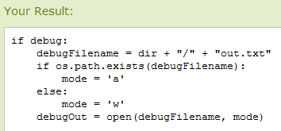
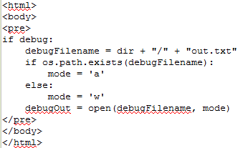
How to preserve spacing
The <pre> </pre> tag
Stands for preformatted.

Slide 22
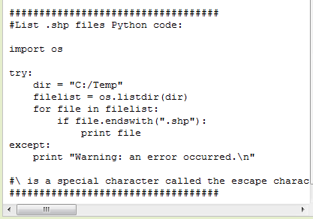

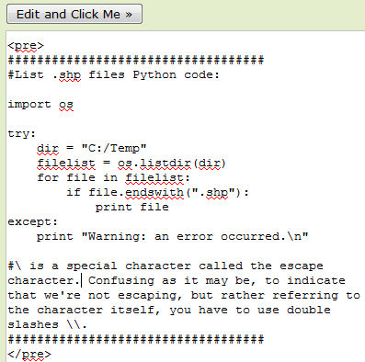
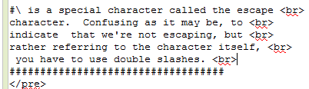
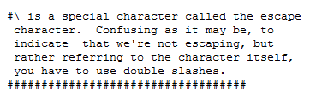
Preformatting stomps on word wrap
Scrolling madness!
Use line break tag <br> to wrap the text.

