Slide 1

Python dictionaries
  What are they?
  Syntax
  Methods
  Dictionaries with looping
Dr. Tateosian

Slide 2
Review – write a line of code for each
Create an empty Python list named mylist.
Append 8 and 5 to your new list.
Set x to the second item in your list by using list indexing.
Check if 3 is in your list.
Loop through your list and print each item.
(solutions in note view)
Notes:
Create an empty Python list named mylist.
mylist = [ ]
Append 8 and 5 to your new list.
mylist.append(8)
mylist.append(5)
--or–
mylist.extend([8, 5])
Set x to the second item in your list by using list indexing.
x = mylist[1]
Check if 3 is in your list.
3 in mylist
Loop through your list and print each item.
for item in mylist:
print item

Slide 3
Warming up for dictionaries
Describe Webster’s dictionary
  a book alphabetically listing the words and their meanings
How can you find a specific record in an attribute table?
  each record has a field which has unique values, a key
Native Python data types?
  strings, lists, …
  and dictionaries

Slide 4
Ways not to use if, elif
Instead should be
if x == 1:
#do stuff
if x == 2:
#do special stuff
if x == 3:
#do very weird thing
if x == 1:
#do stuff with a
elif x == 2:
#do stuff with b
elif x == 3:
#do stuff with c
elif x == 4:
#do stuff with d
elif x == 5:
#do stuff with e
elif x == 6:
#do stuff with f
…
if x == 1:
#do stuff
elif x == 2
#do special stuff
elif x == 3
#do very weird thing
Don’t use repeated if to check mutually exclusive conditions.
Don’t use a large number of ‘elif’ conditions when consistently testing the same variable’s value and performing the same operation inside.
Instead should be
using Python
dictionary.

Slide 5
Dictionaries
Built-in data type, like strings, tuples, & lists.
A collection of items like lists, but…
Each item is a pair: key:value
  myD = {0:“woods”, 1:“park”, 2:“orch”}
Each key is unique, like an FID.
Used to store a value with some key and extract the value given the key

Slide 6

First, review list syntax
Create an list
--create an empty list:
  mylist = []
--a list containing 1,2, and ‘bla’
  mylist = [1,2,’bla’]
Add ‘foo’ to an existing list
  mylist.append(‘foo’)
Remove an instance of ‘bla’ from the list
  mylist.remove(‘bla’)
Get the third item in the list
  x = mylist[2]
Check if 3 is in the list
  3 in mylist
What’s the name for this
type of action?
indexing

Slide 7
Dictionary syntax
Create a dictionary
--create an empty dictionary:
  >>> myD = {}
  >>> myD
  {}
  --create an dictionary with items 0:"woods", 5:"park", and "foo":"orch"
  >>> myD = {0:'woods', 5:'park', 'foo':'orch'}
  >>> myD
  {0: 'woods', 5: 'park', 'foo': 'orch'}
Add the item 10:“lake“ to myD (an existing dictionary)
  >>> myD[10] = 'lake'
  {0: 'woods', 10: 'lake', 'foo': 'orch', 5: 'park'}
Check if myD has an item with a key of ‘foo’. There a 2 ways to do this:
  >>> 'foo' in myD
  True
  >>> myD.has_key('fooee') #Deprecated better to use ‘in’
  False

Slide 8


More syntax (get item & delete item)
Get the value of the item which has key 5
  >>> myD = {0:"woods", 5:"park", "foo":"orch"}
  >>> val1 = myD[5]
  >>> val1
  'park'
Get the value of the item which has key “foo”
  >>> val2 = myD[“foo”]
  >>> val2
  'orch'
What will val3 be?
  >>> val3 = myD[2]
  There are 3 items in the dictionary… with zero-based indexing, why doesn’t this give the 3rd item?
Delete the dictionary item which has key 5
  >>> del myD[5]
>>> myD
{0: 'woods', 'foo': 'orch'}
(use access-by-key syntax)
  # Looks like indexing but it’s NOT
  5:"park“ is NOT necessarily the 6th item!
  # Again…not indexing!
  For dictionaries always remember to use a KEY in the square braces, not an index.

Slide 9
Add item vs. modify existing item
Dictionary items can be added in 2 ways:
  when the dictionary is created:
    >>> myD = {0:'woods', 5:'park', 'foo':'orch'}
    >>> myD
    {0: 'woods', 5: 'park‘, 'foo': 'orch‘}
  individually after the dictionary has already been created:
    >>> myD[10] = 'lake' # access-by-key syntax
    >>> myD
    {0: 'woods', 10: 'lake', 'foo': 'orch', 5: 'park'}
Modifying items looks just like #2. Only difference is using a key that is already in the dictionary
  >>> myD[5] = 'hurray!' # access-by-key syntax
  >>> myD
  {0: 'woods', 10: 'lake', 'foo': 'orch', 5: 'hurray!'}

Slide 10
Freqently used dictionary methods
keys() returns a list of all the keys in the dictionary in arbitrary order
has_key() provides the same functionality as the keyword in.
values() returns a list of the values in the dictionary.
items() returns a list of the items (the key-value pairs) in the dictionary.
  >>> myD = {0:'woods', 5:'park', 'foo':'orch'}
  >>> myD.keys()
  [0, 'foo', 5]
  >>> myD.has_key(5)
  True
  >>> myD.has_key('5')
  False
  >>> myD.values()
  ['woods', 'orch', 'park']
  >>> myD.items()
  [(0, 'woods'), ('foo', 'orch'), (5, 'park')]

Slide 11
In class – Explore dictionaries
Type statements from the in class page in the Interactive Window and answer the questions.
What does myD2 = {} do?
Explain the difference between what happened when you typed myD[1] = "other" and when you typed myD[3] = "lake".
Explain the difference between myList[2] and myD[2].
Write a line of code to add an item with key "London" and value "Heathrow" into myD.
Write a line of code to add an item with key "beer" and value ["Bass", "Corona", "Dunkle"] to myD.
Write a line of code to append "Pale Ale" list whose key is "beer".
Set the value of x to "5 hrs". Write a line of code to add an item with key "sleep" and value a list containing one item, x.
(solutions in note view)
Notes:
creates an empty dictionary named myD2.
myD[1] = "other" modified the item which has key 1.
myD[3] = "lake” added a new item to the dictionary.
myList[2] is indexing into a list. It returns the 3rd item in the list.
myD[2] returns the value of the dictionary item with key of 2. But this dictionary doesn’t have one, so it returns an error.
myD[“London”] = “Heathrow”
myD[“beer”] = ["Bass", "Corona", "Dunkle"]
myD[“beer”].append(“Pale Ale”)
x = “5 hrs”
myD[“sleep”] = [x]

Slide 12
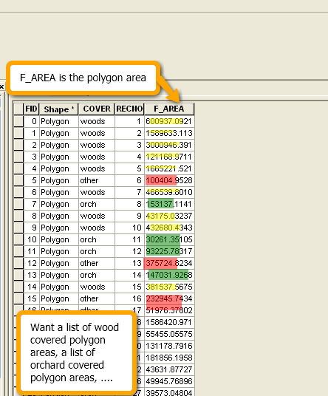
Dictionaries and attribute tables
Good data type for storing info. from GIS attribute tables.
Simple example - collect FID:COVER items
sc = arcpy.da.SearchCursor('park.shp', ['FID', 'COVER'])
myD = {}
for row in sc:
ID = row[0]
coverType = row[1]
myD[ID] = coverType
del sc

Slide 13
Conditional statement for dictionary creation
In the previous example keys guaranteed to be unique (because FID is unique)
If key values from input to dictionary is not guaranteed to be unique, must use a conditional statement for cases “key in dictionary” and “key not in dictionary”
In this way, the code can do something different for these 2 cases.
--For example, create a new dictionary entry and initialize the value to 1
or add 1 to the existing value for that item.
Frequency example below:
  Collects the frequency of cover types in a dictionary
  Each item is coverType:frequency
sc = arcpy.da.SearchCursor('park.shp', ['COVER'])
myD = {}
for row in sc:
key = row[0]
if key in myD:
myD[key] = myD[key] + 1
else:
myD[key] = 1
del sc
>>> print myD
{'woods':9, 'orch':3, 'other':3}
Notes:
>>> print myD
{“woods”:9, “orch”:3,”other:3}

Slide 14
Python lists in dictionaries
dictionary values can be any Python data type
  numbers, strings, lists, dictionaries…
Example below:
  A dictionary to store COVER types and their areas.
  Each item is coverType:listOfAreas
myD = {
'woods': [600937, 1589633,…]
'orch': [153137.114187, …]
'other': [100404, 375724, …]
'park': …
}
myD could be used to calculate statistics about the areas associated with cover types. (mean, std dev, variance, etc.)
To create myD, use conditional statements…

Slide 15
Using lists as dictionary values
To create a dictionary from an attribute table and collect lists of multiple items from one field based on another field, use lists and conditional statements…
If the key is already in the table, append the value to the list.
If not, create a new list by surrounding the value with square braces and assigning this to the dictionary item with that key.
# If the key is already in the list, append.
if key in myD:
myD[key].append(value)
else: # Otherwise create a new list
myD[key] = [value]

Slide 16
Example using lists in a dictionary
Create a dictionary to store COVER types & their
areas. Each item is coverType:listOfAreas
import arcpy
arcpy.env.workspace = 'C:/Temp'
fields = ['COVER', 'F_AREA']
myD = { }
sc = arcpy.da.SearchCursor('park.shp', fields)
for row in sc:
cover = row[0]
area = row[1]
if cover in myD:
# if this cover type is already a key in the dictionary,
# append its list of polygon areas
myD[cover].append(area)
else:
# else, create a new list by putting the polygon area in square
# braces & assigning it to the dict. with the COVER key.
myD[cover] = [area]
del sc
>>> print myD
{'woods': [600937, 1589633,…]
'orch': [153137.114187, …]
'other': [100404, 375724, …]
'park': … }

Slide 17
Summing up
Topics discussed
    built-in dictionaries
    Access by key, not by index.
    Update/add/delete dictionary items
    has_key
    Listing keys, values, items
    dictionaries with looping
    Using dictionaries with arcpy cursors
Up next
    Reading & writing text files
Additional topics
    Dictionaries vs. elif

Slide 18

Appendix

Slide 19
In class – on a piece of paper…
Create a dictionary where the keys are 3 classmates and the values are their favorite beverage.
Iterate through the keys in the dictionary, printing them
Iterate through the keys in the dictionary, printing the key and the value
bevD = {“Tim”:“Sambucus”, “Paul”:“Red Bull”, “Rahul”:”vodka”}
#One solution
for person in bevD:
print person
for person in bevD:
print person, bevD[person]
#Another solution
for person in bevD.keys():
print person
for person, drink in bevD.items():
print person, drink

Slide 20
DrinkDict.py
Create a dictionary where drinks are the key and a list of people who favor that drink are the value, by completing the code in the given script. The existing code uses the built-in raw_input function to prompt you for 10 people's names and favorite drinks. Example output:
{ ‘tea’: [’Lani‘, ’Josh‘],
’water‘: [’Stew‘, ‘Mike’],
'beer': [’Ginger', ’Steph', ’Latonia', ’Brendan'],
'sweet tea': [’Brian', ’Steph']
}
myD={}
for i in range(10):
name = raw_input("Name:")
drink = raw_input(name +"'s fav. drink:")
# insert dictionary code here.

Slide 21
DrinkDict.py solution
d={}
for i in range(10):
name = raw_input("Name:")
drink = raw_input(name +"'s fav. drink:")
if drink in d:
d[drink].append(name)
else:
d[drink] = [name]

Slide 22
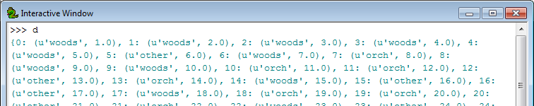
In class - table2dict.py
Create a search cursor for shapefiles.
Build a dictionary with FID as the key and a tuple of the non-shape fields as the value.
Dictionary item format is uniqueID: (field1,field2, …)
Example input ‘COVER63p.shp’ has output:

Slide 23
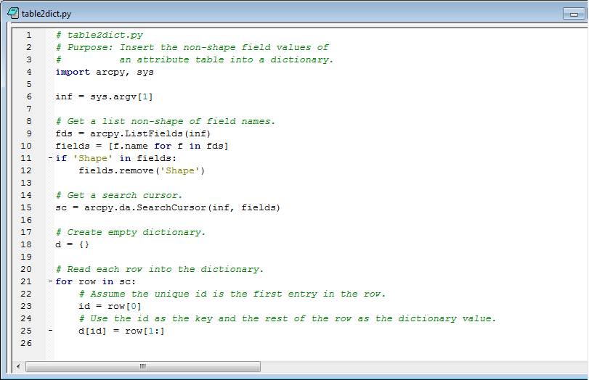
table2dict.py

