Slide 1


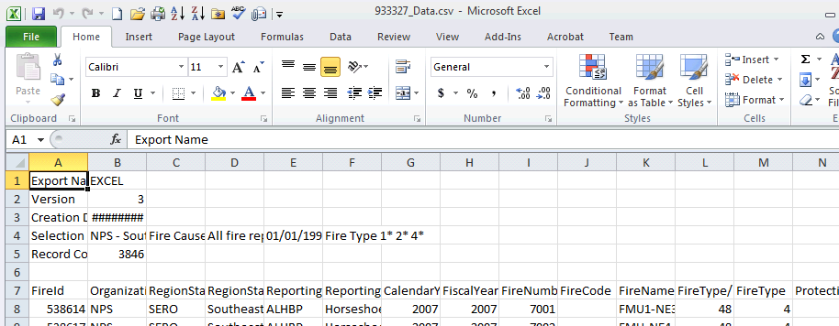
Reading/writing text files (file i/o)
Open & close files
File objects (a Python data type)
File opening modes
Read and write methods
Reading in a FOR-loop
Dr. Tateosian
Notes:
Reading and writing text files, also often referred to as file i/o for input and output, is an important programming cability in most any field, but is certainly important for the data rich field of GIS. There are many different formats of data. People make data entry mistakes. Devices sometimes use custom recording formats. And sometimes you may need to read data that is not tabular with your code. You may also want to write logs or reports with your code. Even tabular data may pose road blocks for arcpy data access cursors if the arcgis table requirements are not met. For example, the field names may contain spaces or the the data may have metadata above the line that contains the fields.
You'll only have to learn a few new functions to start reading and writing data. Most of the challenge of file i/o lies in processing the data that is read or putting the data to be written into the desired format.

Slide 2
Method / function / operation ? – In Class
a. split
b. pop
c. slicing
d. join
e. rstrip
int
keys
string method?
or
list method?
or
dictionary method?
or
built-in function?
or
string operation?
or
list operation?
Notes:
For file i/o you often need to use some built-in functions, some string, list, and file methods, and some operations. So it’s worthwhile to review this terminology with some examples. Can you identify which of the items on the left are string methods, list methods, dictionary methods, built-in functions, string operations, or list operations?

Slide 3
Method / function / operation ? – In Class Solution
split
string method
b. pop
list method
c. slicing
string or list operation
d. join
string..takes a list argument
e. rstrip
string method
f. int
built-in function, takes string arg
g. keys
dictionary method
Examples
myString.split(“\t”)
myList.pop()
myStr[:-4] myList[1:5]
“;”.join(mylist)
myStr.rstrip()
int(myStr)
myDict.keys( )
Notes:
a. split – string method
b. pop –list method
c. slicing – string or list operation
d. join –string..takes a list argument
e. rstrip – string method
int –built-in function, takes a string argument
keys – dictionary method

Slide 4


Opening a file
open is a built-in Python function.
Demo: in notes…
Two required parameters:
open(name, mode, {buffering})
Returns a file object…
Notes:
DEMO: FILE HANDLING
**********************
>>> tinyFile = open("tinyFile.txt", "w")
>>> tinyFile.write("We love Python programming")
>>> tinyFile.close()
>>> import os
>>> os.getcwd()
>>> # go to the current working directory to find and open the file
>>> # you usually want to provide the full path for file location
>>> f = open(r"C:\gispy\scratch\tinyFile.txt", "w")
>>> f.write("I love Python")
>>> f.close()
>>> # now go to C:\gispy\scratch and find the file
>>> # opening a file which already exists
>>> f = open(r"C:\gispy\scratch\tinyFile.txt", "r")
>>> f.readlines()
['I love Python']
>>> f.close()
>>> f = open(r"C:\gispy\scratch\tinyFile.txt", "r")
>>> f.read(5)
'I lov'
>>> f.close()
>>> f = open(r"C:\gispy\scratch\tinyFile.txt", "r")
>>> line = f.readline()
>>> f.close()
>>> print line
I love Python
>>> line
'I love Python'
>>> # if a file does not exist...
>>> f = open(r"C:\gispy\scratch\tinyFli.dxt", "r")
FileNoteFoundError: [Errno 2] No such file or directory: 'C:\gispy\scratch\tinyFli.dxt'
>>> f = open(r"C:\gispy\scratch\tinyFile.txt", "r")
>>> f.read(6)
'I love'
>>> f.read()
' Python'
>>> f.close()
>>> # another example:
>>> f = open(r"C:\gispy\scratch\3D.txt", "w")
>>> f.write("length\nheight\nwidth\n")
>>> f.close()
>>> # now open the file in windows...
>>> # and now read back the content:
>>> f = open(r"C:\gispy\scratch\3D.txt", "r")
>>> f.readlines()
['length\n', 'height\n', 'width\n']
>>> f.close()
>>> # or
>>> f = open(r"C:\gispy\scratch\3D.txt", "r")
>>> content = f.read()
>>> f.close()
>>> print content
length
height
width
>>> content
'length\nheight\nwidth\n‘
f = open(r"C:\gispy\scratch\3D.txt", "r")
for row in f:
print row

Slide 5

File Management in Python
file is a built-in data type in Python.
You put data into a file to store it permanently
Files are like digital books:
A book is your permanent repository of facts (data)
  To use a book, you must open it
  Then you can either read from it or write in it
  When you are done – you close the book
open -> read or write -> close

Slide 6
Opening & Closing a file
To open a file use built-in function, open
file_object = open("C:/gispy/scratch/data.txt", "w")
The open function returns a file object.
>>> type(file_object)
<class '_io.TextIOWrapper'>
Use the file object...
file_object.write("NC\nSC\nGA")
When you are done, close the file object (or use with...as when you open it).
file_object.close()
Notes:
import datetime
import os
# Find the product of two numbers.
x = 4
y = 5
product = x*y
# Write the results in a file and report.
log = r"C:\gispy\scratch\project_log.txt"
fout = open(log, "w")
fout.write(f"The product is {product}.")
# Get the current date and time and report it.
now = str(datetime.datetime.now())
fout.write(f"The process completed at {now}.")
fout.close( )
# View the file.
os.startfile(log)

Slide 7
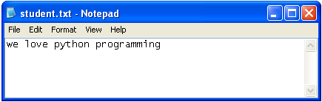
Opening a file for writing
If a file does not exist, it will be created
>>> myFile = open("student.txt", 'w')
>>> myFile.write("we love python programming")
>>> myFile.close()
If a file exists, it will be overwritten
>>> import os
>>> os.path.isfile(‘C:\\Temp\\student.txt’)
True

Slide 8
Opening a file for reading or writing
Built-in Python function open()
Takes 2 arguments: filename, mode
myFile = open("student.txt", 'w')
Returns a file object
Depending on the mode, the file object has write or read methods
Example: myFile.write("we love python")
object.method(argument1, argument 2, …)

Slide 9
File object modes (2nd argument)
myFile = open("student.txt", "w")
ASCII text modes
"r" read only
  "w" write only
  "a" append
  "r+" both reading and writing
Append b for binary modes (e.g., zipfiles)
  "rb" read binary
  "wb" write binary
mode

Slide 10
In class - Exploring file objects
Type the given lines of code in the Interactive Window and then answer the questions.
Why does f.write(2) fail?
Why does f.write(mylist) fail?
Describe an easy way to write each item in mylist on its own line in a file.
What happens when you open an existing file in "w" mode and write things in it?
Explain why f.write("a\nbcd\ne\nf\ng") results in a multiline file.
What is the difference between readline, read(2), and readlines?
What does seek(0) do?
Give an example of when an FileNoteFoundError exception is thrown.

Slide 11
In class - Exploring file object solutions
1. Why does f.write(2) fail?
The write method requires string input.
2. Why does f.write(mylist) fail?
The write method requires string input.
3. Describe an easy way to write each item in mylist on its own line in a file.
mystring = "\n".join(mylist)
f.write(mystring)
4. What happens when you open an existing file in "w" mode and write things in it?
The file is overwritten. To append instead, use "a" mode when opening the file.
Notes:
The write method requires string input.
The write method requires string input.
mystring = “\n”.join(mylist)
f.write(mystring)
The file is overwritten. To append instead, use ‘a’ mode when opening the file.
f.write('a\nbcd\ne\nf\ng') The string itself contains newline characters \n
readline() reads one line.
read(2) reads 2 characters.
readlines() reads the remaining lines in the file.
7. seek(0) moves the file reading cursor back to the beginning of a file open for reading.
8. FileNoteFoundError are thrown when code tries to open a non-existent file for reading.

Slide 12
In class - Exploring file object solutions cont'd
5. Explain why f.write("a\nbcd\ne\nf\ng") results in a multiline file.
f.write("a\nbcd\ne\nf\ng") The string itself contains newline characters \n
6. What is the difference between readline, read(2), and readlines?
readline() reads one line.
read(2) reads 2 characters.
readlines() reads the remaining lines in the file.
7. What does seek(0) do?
seek(0) moves the file reading cursor back to the beginning of a file open for reading.
8. Give an example of when an FileNoteFoundError exception is thrown.
FileNoteFoundError are thrown when code tries to open a non-existent file for reading.
Notes:
The write method requires string input.
The write method requires string input.
mystring = “\n”.join(mylist)
f.write(mystring)
The file is overwritten. To append instead, use ‘a’ mode when opening the file.
f.write("a\nbcd\ne\nf\ng') The string itself contains newline characters \n
readline() reads one line.
read(2) reads 2 characters.
readlines() reads the remaining lines in the file.
7. seek(0) moves the file reading cursor back to the beginning of a file open for reading.
8. FileNoteFoundError are thrown when code tries to open a non-existent file for reading.

Slide 13
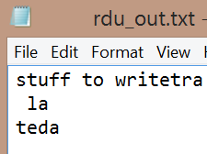
File object write methods
If it is created with 'w'…
outf = open("C:/Temp/rdu_out.txt", "w")
outf.write(“stuff to write”) # Write a string to the file.
# No implicit carriage return.
outf.writelines( [“tra\n ”, “la\n”, “te”, “da” ] )
# Write a list of strings to the file.
# No implicit carriage return.
outf.close() # Close the file.

Slide 14
File object read methods
If it is created with 'r'…
inf = open("C:/Temp/rdu_forest.txt", "r")
inf.read() # Read the rest of the file into a single string.
inf.read(5) # Read the next five characters.
inf.readline() # Read the next line.
inf.readlines() # Read all remaining lines.
# Returns a list of strings.
inf.seek(5) # Move to position 5 in the file.
inf.tell() # Tell you the current file position.
inf.close() # Close the file.

Slide 15
Reading a file
A file (for reading) opens only if it exists, otherwise an FileNoteFoundError is thrown
  >>> myFile = open("student.dxt", 'r')
  Traceback (most recent call last):
  File "<interactive input>", line 1, in ?
  FileNoteFoundError: [Errno 2] No such file or directory: 'student.dxt‘
There are several methods for reading a file
read() Returns a string.
read(5) Returns a string.
readline() Returns a string.
readlines() Returns a list of strings.

Slide 16
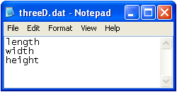
Read empty string means end of file
>>> f = open(“C:/threeD.dat", 'w')
>>> f.write("length\nwidth\nheight")
>>> f.close()
>>> newF = open("threeD.dat", 'r')
>>> newF.readlines()
['length\n', 'width\n', 'height']
>>> newF.readline()
''
>>>
>>> newF.close()
The system “remembers” where you stopped reading.
If there is nothing more, the readline returns an empty string.

Slide 17
File with numbers
Write argument must be a string. Cast numbers to string.
>>> f = open("C:/temp/test.txt", 'w')
>>> x = 2
>>> f.write(x)
Traceback (most recent call last):
File "<interactive input>", line 1, in ?
TypeError: argument 1 must be string or read-only character buffer, not int
>>> f.write(str(x))
>>> f.close()
Everything reads in as strings. Must cast numbers to float or int after reading from text file when using for numerical operation.
>>> f = open("C:/temp/test.txt", 'r')
>>> y = f.readline()
>>> z = y + 3
Traceback (most recent call last):
File "<interactive input>", line 1, in ?
TypeError: cannot concatenate 'str' and 'int' objects
>>> z = int(y) + 3
>>> z
5

Slide 18
Reading and looping
What if you want to loop through all the remaining lines in a file?
Like an arcpy data access cursor, a file object is its own iterator
Loop directly on file object
infile = open("C:/threeD.dat", "r")
for line in infile:
print(line)
infile.close()
~OR~
store data in list & then loop. More efficient if looping on the input more than once.
infile = open("C:/threeD.dat", "r")
contents = infile.readlines() # get list of lines in the file
infile.close()
for line in contents:
print(line)
>>> length
width
height

Slide 19
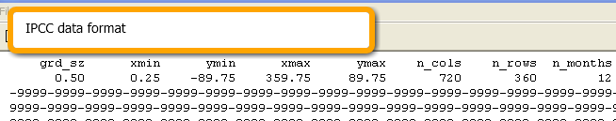
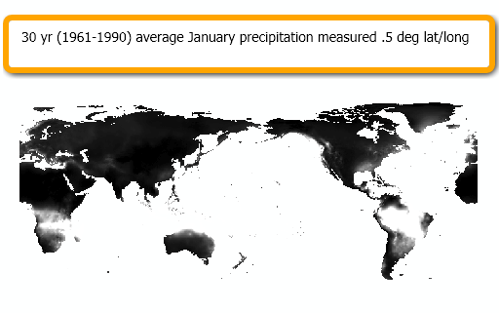
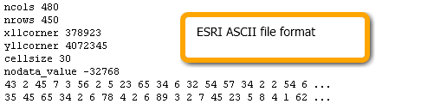
File i/o for reformatting data
Often useful to read a text file, modify the format and write a new text file with the modified format.
Example:
  Intergovernmental Panel on Climate Change
  http://www.ipcc-data.org/obs/get_30yr_means.html
  30yr avg monthly weather conditions
  mean temperature, cloud cover,…
  Need to convert IPCC data format to ESRI ASCII format for importing as raster.
Read IPCC and write ESRI format
CALL ASCII to raster tool

Slide 20
Match methods (a-f) to the input/output (1-6).
Hint: More than one method may apply.
‘6’ → 6
[1,2,3,4] → [1,2,3]
“123\t\n” → “123”
“a\tb\tc” → [“a”,”b”,”c”]
[‘a’,’b’,’c’,’d’,’e’] →[‘a’,’b’,’d’,’e’]
[‘a’,’b’,’c’,’d’,’e’] → “a b c d e”
a. split
b. pop
c. slice
d. join
e. rstrip
f. int

Slide 21
Matching – In Class Solution
f
b, c
e
a
b
d
‘6’ → 6
[1,2,3,4] → [1,2,3]
“123\t\n” → “123”
“a\tb\tc” → [“a”,”b”,”c”]
[‘a’,’b’,’c’,’d’,’e’] →[‘a’,’b’,’d’,’e’]
[‘a’,’b’,’c’,’d’,’e’] → “a b c d e”
a. split
b. pop
c. slice
d. join
e. rstrip
f. int

Slide 22
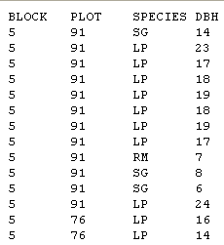
In class – rdu_forest1.py part 1
RDU Forest data: Block, plot, species, and d.b.h (tree diameter at breast height)
Write a script to read the data and write it back out to another file.

Slide 23
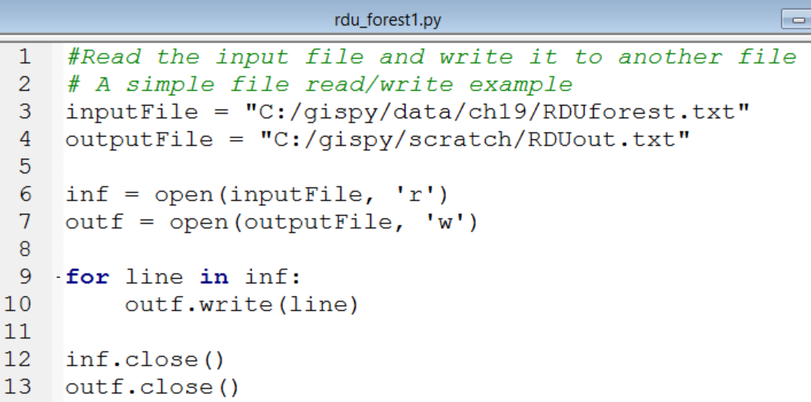
In class – rdu_forest1.py solution
open-open-read-write-close-close
What about modify?
open-open-read-modify-write-close-close
Notes:
Most processes require some modification of the input to create the output file.

Slide 24
Pseudocode for most common file i/o
open-open-read-modify-write-close-close
SET the input and output file names
IF the input file exists:
OPEN the input and output files.
FOR EACH line in the input file:
MODIFY the line.
WRITE the modified line to the output file.
END FOR
CLOSE the input and output files.
ENDIF

Slide 25
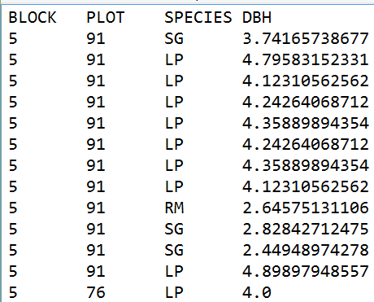
In class – rdu_forest2.py part 2
DBH has was calculated incorrectly. It should be the square root of the recorded value.
Add code to rdu_forest1.py to make this modification. Hint: The built-in math module has a sqrt function. E.g., math.sqrt(16)

Slide 26
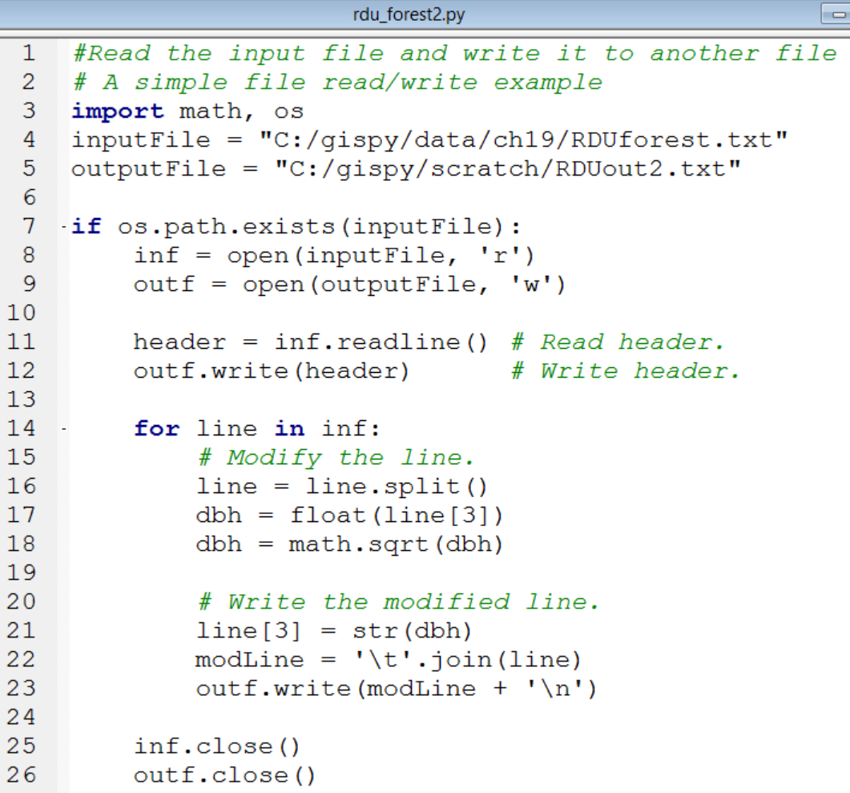
In class – rdu_forest2.py part 2 Solution
open-
open-
read header-
write header-
read-
modify-
write-
close-
close

Slide 27
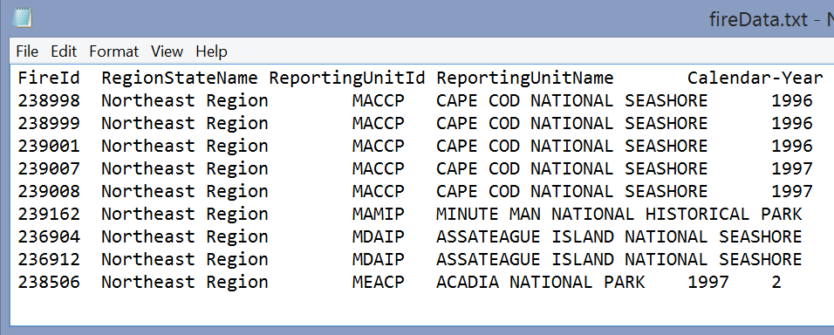
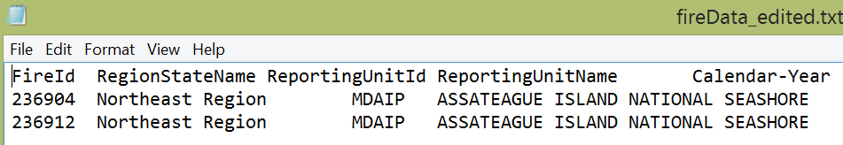
Delete rows
open-open-read-check row-maybe write-close-close

Slide 28
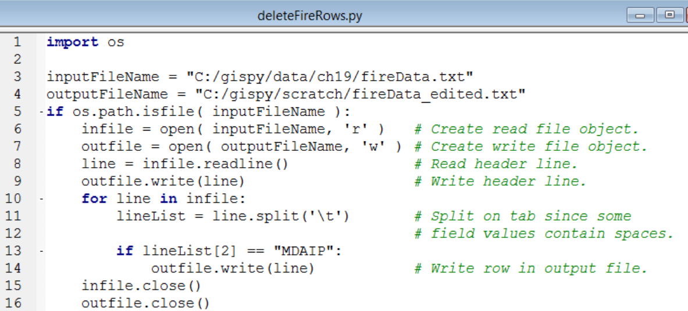
Delete rows
Write all rows except the ones you want to delete

Slide 29
Split and pop review – In Class
‘\t’ represents a tab
myLine is a string of tab separated values
>>> myLine = '5\t91\tSG\t14\n‘
>>> print myLine
5 91 SG 14
Write one or more lines of code to get the 3rd value in myLine. In our example, the value is SG.
Suppose myList = [1,5,8,2]
  What does myList.pop() return in this example?
  What does myList.pop() do?

Slide 30
Split and pop review – In Class Solution
>>> myLine = '5\t91\tSG\t14\n'
>>> print myLine
5 91 SG 14
Write one or more lines of code to get the 3rd value in myLine. In our example, the value is SG.
lineList = myLine.split('\t')
print lineList[2]
2. Suppose myList = [1,5,8,2]
  What does myList.pop() return in this example?
  What does myList.pop() do?
It returns 2.
It pops the last item off a list and returns its value.
Notes:
lineList = myLine.split(‘\t’)
print lineList[2]
It returns 2.
It pops the last item off a list and returns its value.

Slide 31
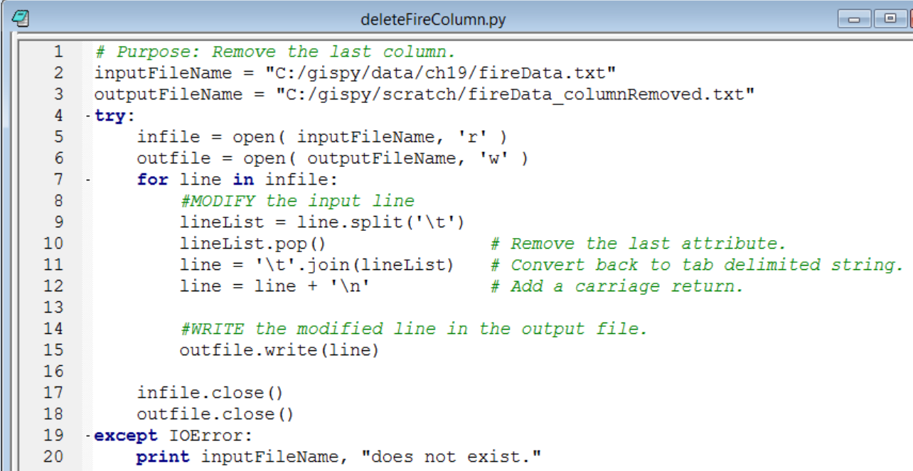
Delete the last column
Get each row
Modify the row to remove the last row entry
Write each row

Slide 32
In class – rdu_forest parts 3 and 4, deletions
Delete rows. Modify rdu_forest1.py to read "C:/gispy/data/ch19/RDUforest.txt" and write it to RDUout3.txt deleting all of the records that are not Loblolly pines (species LP). Hint: Instead of thinking in terms of deleting, think about what you DO want to write.
Delete a column. Modify rdu_forest1.py to read "C:/gispy/data/ch19/RDUforest.txt" and write it to rdu_out4.txt. This time, delete the plot column.

Slide 33
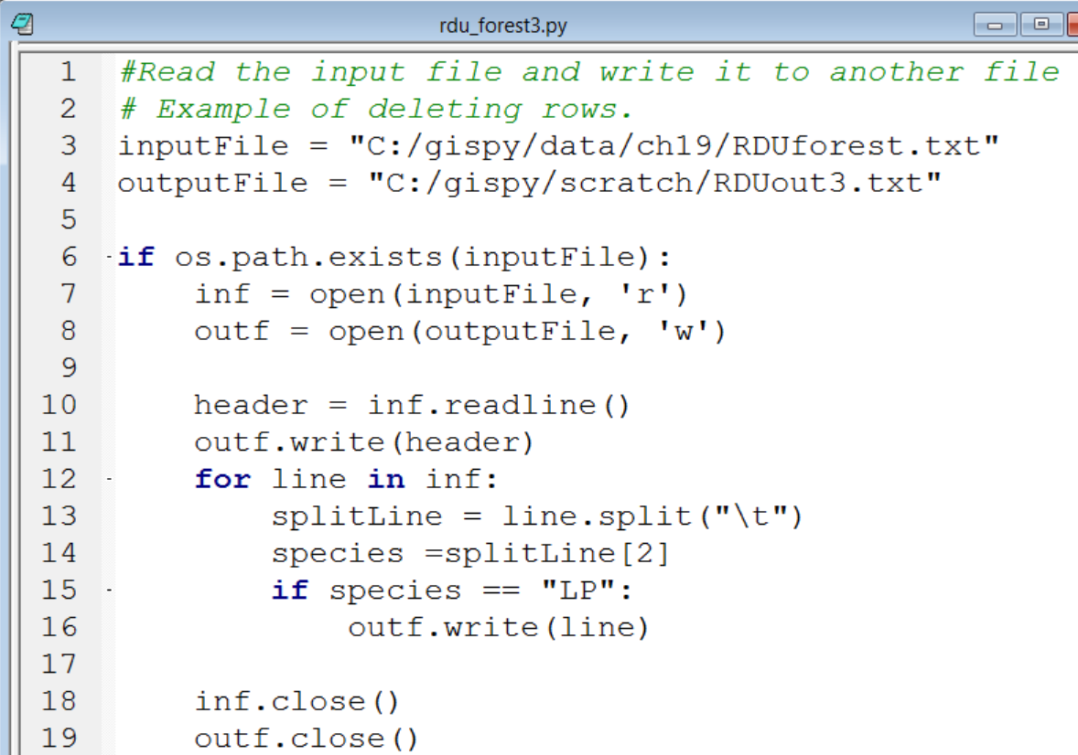
In class – rdu_forest part3 delete rows solution

Slide 34
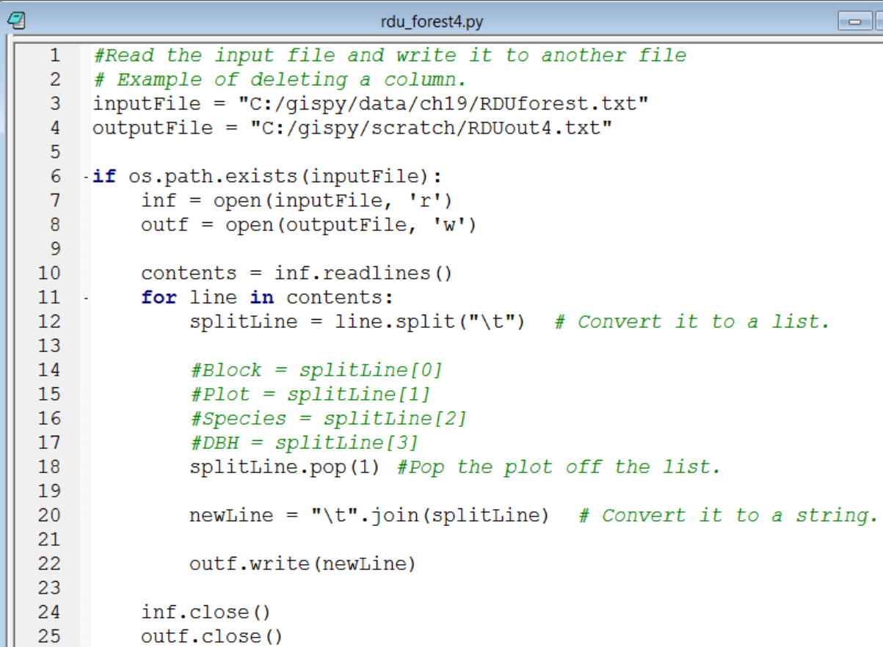
In class – rdu_forest4.py part4 delete a column solution

Slide 35
The with statement
  # poemReader.py
  f = open('C:/gispy/data/ch19/poem.txt', 'r')
  contents = f.read()
  print(contents + 1) # Throws a TypeError exception
  f.close()
Unclosed file is bad.
with...as ensures file closes. …
# poemReaderV2.py
with open('C:/gispy/data/ch19/poem.txt', 'r') as f:
print(f.read())
print(contents + 1)

Slide 36
Summing up
Topics discussed
    Built-in open() functions
    file objects (a Python data type)
    read/write mode
    text/binary mode
    write(), read(), readlines(), readline()
    FileNoteFoundError exception
    closing files
    Reading files with FOR-loops
Up next
    ArcGIS Script Tools
Additional topics
    Pickling

Slide 37
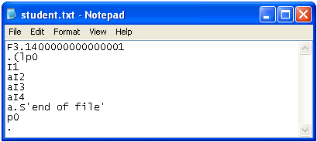
Appendix: Pickling
The argument of the ‘write’ function has to be a string
To write a number to a file you have to convert it to a string. Thus, everything in a file becomes a string
To preserve original data types within a file, use pickling
>>> import pickle
>>> f = open("student.txt", "w")
>>> pickle.dump(3.14, f)
>>> pickle.dump([1,2,3,4], f)
>>> f.close()
>>> pickFile = open("student.txt", "r")
>>> item1 = pickle.load(pickFile)
>>> item1
3.1400000000000001
>>> item2 = pickle.load(pickFile)
>>> item2
[1, 2, 3, 4]
>>> type(item1)
<type 'float‘
>>>> type(item2)
<type 'list‘
>>>> pickFile.close()
Demo 12

