Slide 1

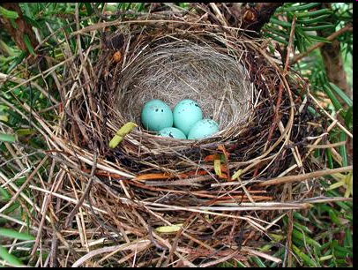

Additional Looping Topics
List comprehension
Nested looping concepts
Built-in iteration functions
enumerate
zip
os.walk
Dr. Tateosian

Slide 2
Python List comprehension
Create a list from another list.
[<Field object at 0x1b4bc2b0[0xac6acf8]>, <Field object at 0x1b4bc270[0xac6acb0]>,
<Field object at 0x1b4bc2f0[0xac6aa28]>, <Field object at 0x1b4bc170[0xac6a2c0]>]
['FID', 'Shape', 'COVER', 'RECNO']
Why do this?
Get a list of field names from a list of field objects.
Replace the spaces in a list of field names with underscores.
Prepend the file path to a list of file names.
com·pre·hen·sion 1: the act of grasping with the intellect 2: the process of comprising (being made up of)

Slide 3
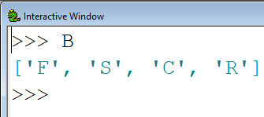
Less efficient looping approach
Make a list, B, of the first initials of each item in A
A = ['FID', 'Shape', 'COVER', 'RECNO']
B = [ ]
for item in A: temp = item[0]
B.append(temp)
Approach:
1. Make an empty list, B.
2. Loop over each item in list A.
3. Derive a value.
4. Append derived value to list B.

Slide 4


Practice the looping approach
1. Make a list, y, of the first initials of each item in x
x = ['FID', 'Shape', 'COVER', 'RECNO']
y = [ ]
for i in x: temp = i[0]
y.append(temp)
Print(y)
2. Make a list, z, of the length of each string in x
x = ['FID', 'Shape', 'COVER', 'RECNO']
z = [ ]
for i in x:
temp = len(i)
z.append(temp)
print(z)

Slide 5

List comprehension syntax
[ expression for var in originalList ]
Make a list, y, of all caps string of each item in x.
x = ['FID', 'Shape', 'COVER', 'RECNO']
#for loop technique
y = [ ]
for i in x:
temp = i.upper()
y.append(temp)
# list comprehension
y = [ i.upper() for i in x ]
`
expression that uses i

Slide 6
In class - list comprehension
>>> x = ['FID', 'Shape', 'COVER', 'RECNO']
>>> y = [ i[:3] for i in x ]
What does y look like?
['FID', 'Sha', 'COV', 'REC']
Make an all lowercase version of x
>>> y = [ i.lower() for i in x ]
>>> y
['fid', 'shape', 'cover', 'recno']
Make a list in which all C’s are replaced with D’s.
>>> y = [ i.replace("C","D") for i in x]
>>> y
['FID', 'Shape', 'DOVER', 'REDNO']

Slide 7
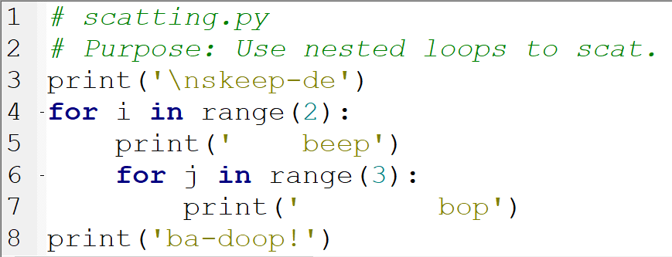
What will this script print?
skeep-de beep bop bop bop beep bop bop bop ba-doop!
Notes:
skeep-de beep bop bop bop beep bop bop bop ba-doop!

Slide 8
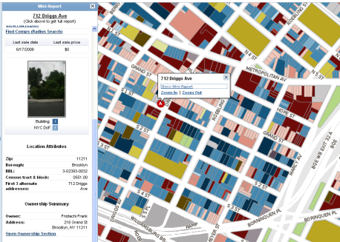
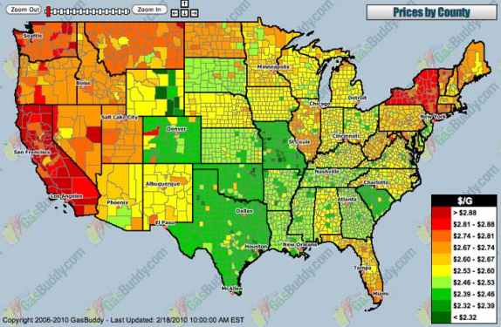
When are nest loops useful?
Use nested loops when for hierarchical structures.
Example: Get the value of each building on each parcel of land.
Hierarchy:
Parcels contain buildings.
Suppose there are n parcels and the average number of buildings is m.
How many values to calculate?
Ans: n*m
Other examples:
Notes:
Find the area each county in each state in each region
Read each line in each file in a directory
Count each word in each line in each file in each subdirectory in a directory
Read the name of each friend of each of your fb friends
How many ‘layers’ of nesting in each example?
What hierarchical relationships exist?
3 layers (county, state, region) regions contain states, states contain counties
3 layers (line, file, directory) directories contain files, files contain lines.
4 layers (word, line, file, subdirectory) subdirectories contain files, files contain lines, lines contain words
2 layers (fiends, friends of friends) friends have their own friends lists.
FOR EACH FILE in the directory:
FOR each

Slide 9

More hierarchical structures
Find the area of each county in each state in each region.
Read the name of each friend of each of your Friendface friends.
Count each word in each line in each file in each subdirectory in a directory.
Read each line in each file in a directory.
Which of these examples has 4 layers of nesting?

Slide 10
Nested loop pseudocode
Update entire calender.
FOR each month of the year FOR each week of the month FOR each day of the week write important events ENDFOR ENDFOR ENDFOR
Print each row of each table in the current directory. Which loop should be inside?
FOR each table in the directory FOR each row in the table PRINT the row ENDFOR ENDFOR

Slide 11
In class - Use a nested FOR loops to print: 10 11 12 20 21 22 30 31 32 40 41 42 50 51 52
0 1 2
10 20 30 40 50
for y in range(3):
print(y, end=' ')
for x in range(10, 60, 10):
print(x, end=' ')

Slide 12
In class - Use a nested FOR loops to print: 10 11 12 20 21 22 30 31 32 40 41 42 50 51 52
0 1 2
10 20 30 40 50
for x in range(10, 60, 10):
for y in range(3):
print(x+y, end=' ')
for y in range(3):
print(y, end='')
for x in range(10, 60, 10):
print(x, end=' ')

Slide 13
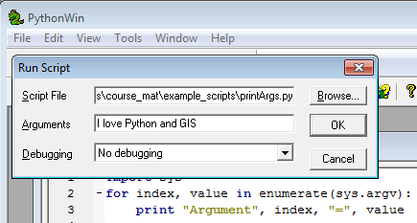
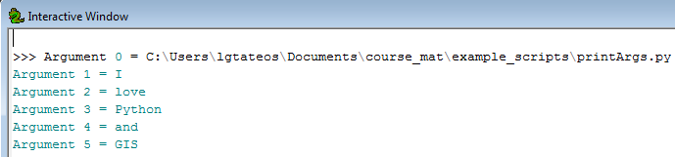
Built-in ‘enumerate’ function
Get the value AND the index as you loop through a list.

Slide 14
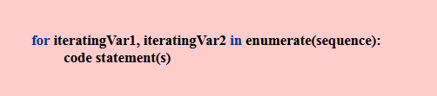
‘enumerate’ syntax
Loop through sequences and get the value & the index
Returns an iterator with 2 items:
current index and current value
Example:
import sys
for index, value in enumerate(sys.argv):
print(“Argument”, index, “=“, value)

Slide 15

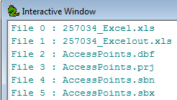
Print each index & val
>>> x = ['FID', 'Shape', 'COVER', 'RECNO']
for num, thing in enumerate(x):
print(num, thing)
Use os.listdir() and enumerate to print a numbered list of files in C:/Temp
import os
files = os.listdir(“C:/Temp”)
for index, value in enumerate(files):
print(“File”, index, “:”, value)

Slide 16
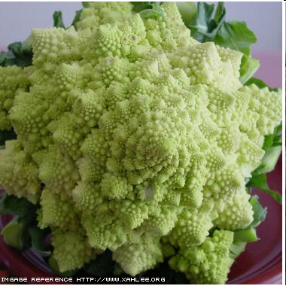
os.walk()
Does a recursive descent down a directory tree, stopping in each subdirectory to perform user-coded actions.
Returns three lists: a list of root directories, a list of directories that live in the corresponding root, and a list of files that live in the corresponding root
for root, dirs, files in os.walk( mydir ):
print(root, dirs, files)

Slide 17
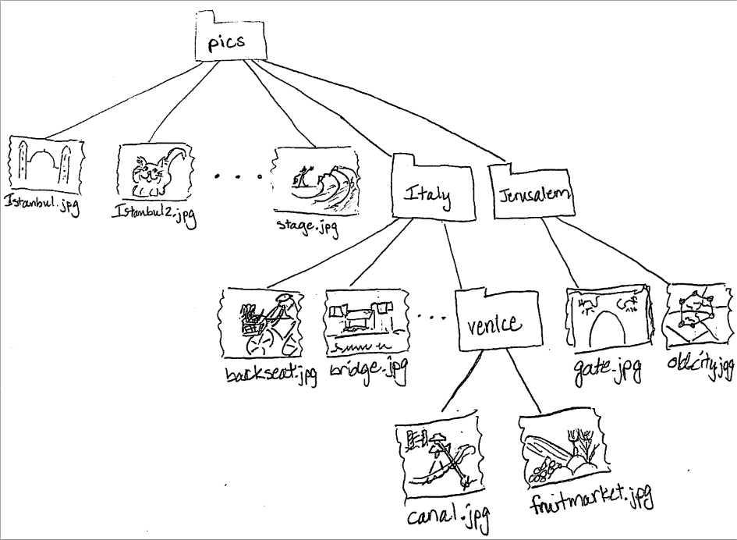
C:/pics ['italy', 'jerusalem'] ['istanbul.jpg', 'istanbul2.jpg', 'marbleRoad.jpg', 'spice_market.jpg', 'stage.jpg'] C:/pics\italy ['venice'] ['backSeat.JPG', 'bridge.JPG', 'ct.JPG', 'florence.JPG'] C:/pics\italy\venice [] ['canal.JPG', 'fruitMarket.JPG'] C:/pics\jerusalem
[]
['gate.JPG', 'old_city.JPG']
for root, dirs, files in os.walk( mydir ):
print(root) print(dirs) print(files)
print()

Slide 18
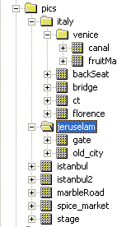
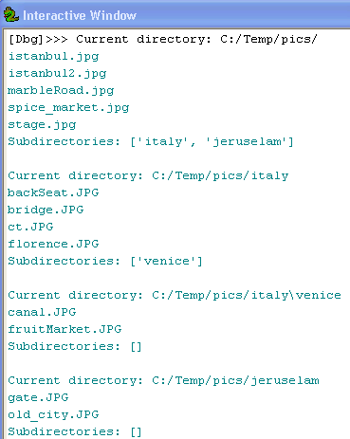
os.walk pics example
import os
mydir = "C:/Temp/pics/"
for root, dirs, files in os.walk( mydir ):
print("Current directory: " + root)
for picname in files:
print(picname)
print("Subdirectories: " + dirs + '\n')

Slide 19
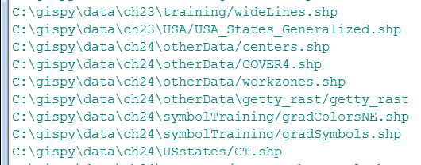
Basic geoprocessing with os.walk
import arcpy, os mydir = "C:/Temp" #Walk through directories for root, dirs, files in os.walk( mydir): for f in files: # do stuff to current file print(root + "/"+ f )
f only holds the filename,
so you have to add root if
you need the full path!

Slide 20
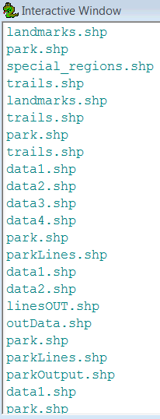
Basic gp using workspace setting
import arcpy, os mydir = "C:/Temp" #Walk through directories for root, dirs, files in os.walk( mydir): arcpy.env.workspace = root for f in files: # do gp stuff on current file arcpy.Delete_management(f)
print(f)
f only holds the file name,
so you need to update the
workspace each time!

Slide 21
The arcpy.da.Walk method
Signature:
arcpy.da.Walk (top, {topdown}, {onerror}, {followlinks}, {datatype}, {type})
The idea...optionally specify datatype and type
import arcpy
for root,dirs,files in arcpy.da.Walk('C:/pics',datatype='RasterDataset',type='GIF'):
arcpy.env.workspace = root
for f in files:
arcpy.Delete_management(f)
print('{0} has been deleted'.format(rast))
Currently breaks in case of GRID Raster input and can’t write to gdb.
Built on os.walk; might as well use that along with arcpy.List…
import arcpy,os
for root, dirs, files in os.walk('C:/pics'):
arcpy.env.workspace = root
rasts = arcpy.ListRasters('*', 'GIF')
for rast in rasts:
arcpy.Delete_management(rast)
print('{0} has been deleted'.format(rast))
keyword arguments (not positional arguments)

Slide 22
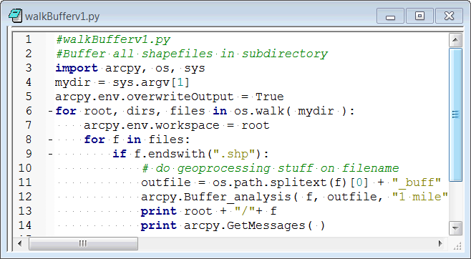
Modify this script
Currently, it buffers those feature classes that end in ‘.shp’
Modify it so that it buffers all feature classes, not just Shapefiles
Replace the endswith condition with a List method call.

Slide 23
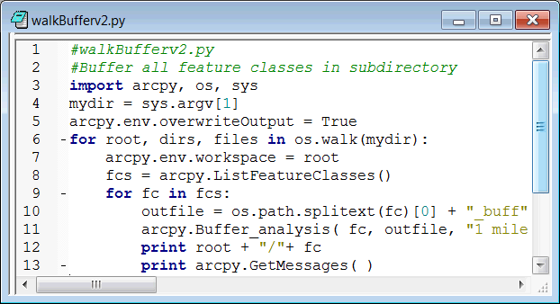
Buffer all feature classes
Notes:
Notes from testing in ArcGIS 10.1:
At this time, there seems to be a bug in writing output to the file geodatabase, so you may need to wait until the next service pack to use this version of the script.
One workaround would be to check the workspace type and if it’s not a folder, send the output elsewhere.

Slide 24
The built-in ‘zip’ function
Combine multiple lists (or other sequences) into a list of tuples. >>> a = 'word' >>> b = 'awoi' >>> zip(a,b) [('w', 'a'), ('o', 'w'), ('r', 'o'), ('d', 'i')]
Differing sequence types and items can be combined. >>> myList = ['apples', [6 , 2], 3.8, ('H','E')] >>> zip(a, myList) [('w', 'apples'), ('o', [6, 2]), ('r', 3.8), ('d', ('H', 'E'))]
Any number of sequences can be used. >>> c = 'wapp‘ >>> d = 'ipie‘ >>> zip(a,b,c,d) [('w', 'a', 'w', 'i'), ('o', 'w', 'a', 'p'), ('r', 'o', 'p', 'i'), ('d', 'i', 'p', 'e')]
If the sequences lengths differ, the output uses the shorter length.
>>> fieldNames = ['FID', 'Shape', 'COVER'] >>> fieldTypes = ['OID', 'Geometry', 'String', 'Float'] >>> zip(fieldNames,fieldTypes) [('FID', 'OID'), ('Shape', 'Geometry'), ('COVER', 'String')]
list
tuples

Slide 25
Use ‘zip’ with looping
# Example 1: Pair cities and countries.
cities = ['Milan', 'Paris', 'Quebec', 'Rio', 'Tokyo'] countries = ['Italy', 'France', 'Canada', 'Brazil']
for theCity, theCountry in zip( cities, countries): print("City: {0}\tCountry: {1} ".format(theCity,theCountry))
City: Milan Country: Italy
City: Paris Country: France
City: Quebec Country: Canada
City: Rio Country: Brazil
# Example 2: Get a list of points in the cube.
xValues = ['0.5', '0.2', '0.1', '0.46', '0.5', '1.00', '-0.5']
yValues = ['0.2', '-3.6', '0.0', '0.3', '0.8', '0', '2.5'] zValues = ['0.4', '-0.6', '1.2', '0.1', '1.2', '0', '0.2']
inCube = [] #List of points in the 1x1x1 cube with corners at (0,0,0) and (1,1,1)
for x, y, z in zip(xValues, yValues, zValues):
x, y, z = ( float(x), float(y), float(z) )
if 0<=x<=1 and 0<=y<=1 and 0<=z<=1:
inCube.append((x,y,z))
print('Points in the 1x1x1 cube:\n{0}'.format(inCube))
Points in the 1x1x1 cube: [(0.5, 0.2, 0.4), (0.46, 0.3, 0.1), (1.0, 0.0, 0.0)]

Slide 26
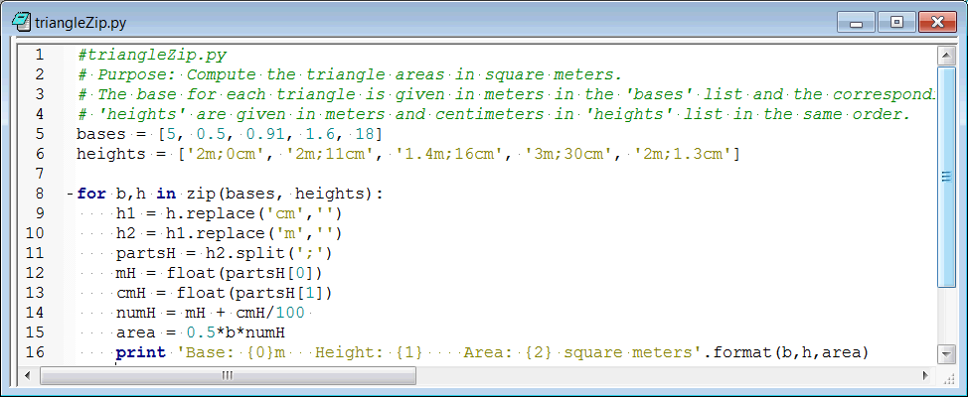
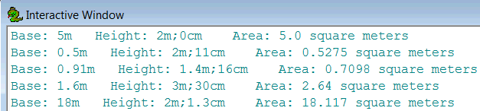
triangleZip Example

Slide 27
Summing up
Topics discussed
List comprehensions
The built-in Enumerate method
Nested looping
The built-in zip function
os.walk (arcpy.da.Walk)
Up next
Error handling
Additional topics
Using the string ‘join’ method to avoid looping

Slide 28
Appendix

Slide 29
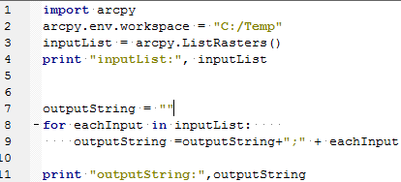


Use ‘join’ to avoid the loop
Problem: need to collect string names in a semicolon delimited string. One solution:
Better solution: String join method
Predict the value of mystring:
To get a delimited string from a list, use the string ‘join’ method.
Notes:
'1bla2bla3'

Slide 30
In class – Replace loop with list comprehension
How would you check if a shapefile has a field named 'COVER‘ ( in 9.3)?
import arcpy
fc = “C:/Temp/COVER63p.shp”
fs = arcpy.ListFields( fc )
for f in fs:
if f.Name == “COVER”:
#Set the value for the field and exit loop
print(“Field ‘COVER’ found.”)
Notes:
>>> import arcpy
>>> fc = "C:/Temp/COVER63p.shp"
>>> x = arcpy.ListFields( fc )
>>> y = [ i.name for i in x]
>>> if “COVER” in y:
print “Field ‘COVER’ found.”

Slide 31
Use a loop to print 0 1 2
y = 0
while y <= 2:
print y,
y = y + 1
x = 10
while x <= 50:
print x,
x = x + 10
for y in range(0, 3):
print(y, end="")
Use a loop to print 10 20 30 40 50
for x in range(10, 60, 10):
print(x, end="")

Slide 32
Use a WHILE loop to print: 10 11 12 20 21 22 30 31 32 40 41 42 50 51 52
y = 0
while y <= 2:
print(y, end="")
y = y + 1
0 1 2
x = 10
while x <= 50:
print(x, end="")
x = x + 10
10 20 30 40 50
x = 10
while x <= 50:
y = 0
while y <= 2:
print x + y
y = y + 1
x = x + 10
Notes:
x = 10
while x <= 50:
y = 0
while y <= 2:
print x + y,
y = y + 1
x = x + 10

Slide 33
In class – Modify this pseudocode to:
Print each value in each row of each table in the current directory
FOR each table in the directory FOR each row in the table PRINT the row ENDFOR ENDFOR
FOR each table in the directory FOR each row in the table
FOR each value in the row PRINT the value
ENDFOR ENDFOR
ENDFOR

Slide 34
In class – write in pseudocode
For each shapefile in a directory, print the value of each field for each row of the shapefile
FOR each shapefile in the directory FOR each row in the shapefile table
FOR each field in the row PRINT the value
ENDFOR ENDFOR
ENDFOR
Notes:
import arcpy
arcpy.env.workspace = "C:/Temp"
myfc = arcpy.ListFeatureClasses()
for fc in myfc:
print fc
sc = arcpy.SearchCursor(fc)
fields = arcpy.ListFields(fc)
for row in sc:
if row.FID < 5: # only printing first few
for field in fields:
print " ", field.name, ":" , row.getValue(field.name)
print "\n"
34

Slide 35
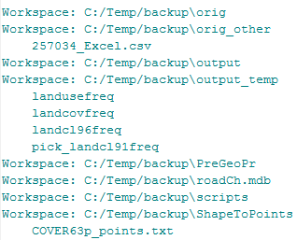
In class – Nested tables
For each table in each workspace in a directory, print the file name of the table.
FOR each workspace in the directory FOR each table in the workspace PRINT the table name ENDFOR
ENDFOR
Notes:
import arcpy
arcpy.env.workspace = "C:/Temp/backup"
ws = arcpy.ListWorkspaces("*", "Access")
for workspace in ws:
arcpy.env.workspace = workspace
rasters = arcpy.ListTables()
for r in rasters:
print r
35

Slide 36
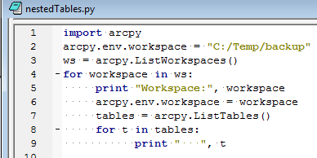
In class – nestedTables.py
For each table in each workspace in a directory, print the file name of the table.
FOR each workspace in the directory FOR each table in the workspace PRINT the table name ENDFOR
ENDFOR
Notes:
import arcpy
arcpy.env.workspace = "C:/Temp/backup"
ws = arcpy.ListWorkspaces("*", "Access")
for workspace in ws:
arcpy.env.workspace = workspace
rasters = arcpy.ListTables()
for r in rasters:
print r
36

Slide 37
In class – lineLength.py
Some rules of thumb in good programming practice
Procedures should be no longer than 75 lines of code (see without scrolling)
Code should have no more than 5 levels of indentation (such as nested looping)
No single line of code should exceed 80 chars. – easier for human reading capability and allows reader to have multiple windows open simultaneously
Task: Check the length of each line in each Python file in a directory and each of its subdirectory in a directory
What lists are involved? How many levels of nesting?
List of lines
List of Python files
List of subdirectories

