Slide 1

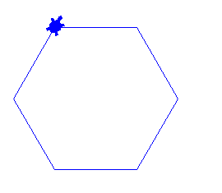
도전문제
import turtle
t = turtle.Turtle()
t.shape("turtle")
t.color("blue")
t.forward(100)
t.right(60)
t.forward(100)
t.right(60)
t.forward(100)
t.right(60)
t.forward(100)
t.right(60)
t.forward(100)
t.right(60)
t.forward(100)

Slide 2
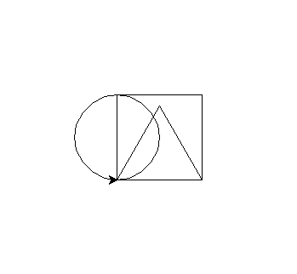
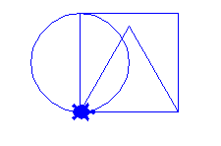
도전문제2
import turtle
t = turtle.Turtle()
t.shape("turtle")
t.color("blue")
t.circle(50)
t.forward(100)
t.left(90)
t.forward(100)
t.left(90)
t.forward(100)
t.left(90)
t.forward(100)
t.left(90)
t.forward(100)
t.left(120)
t.forward(100)
t.left(120)
t.forward(100)
t.left(120)

