Slide 1
Install Julia/Jupyter via Conda

Slide 2
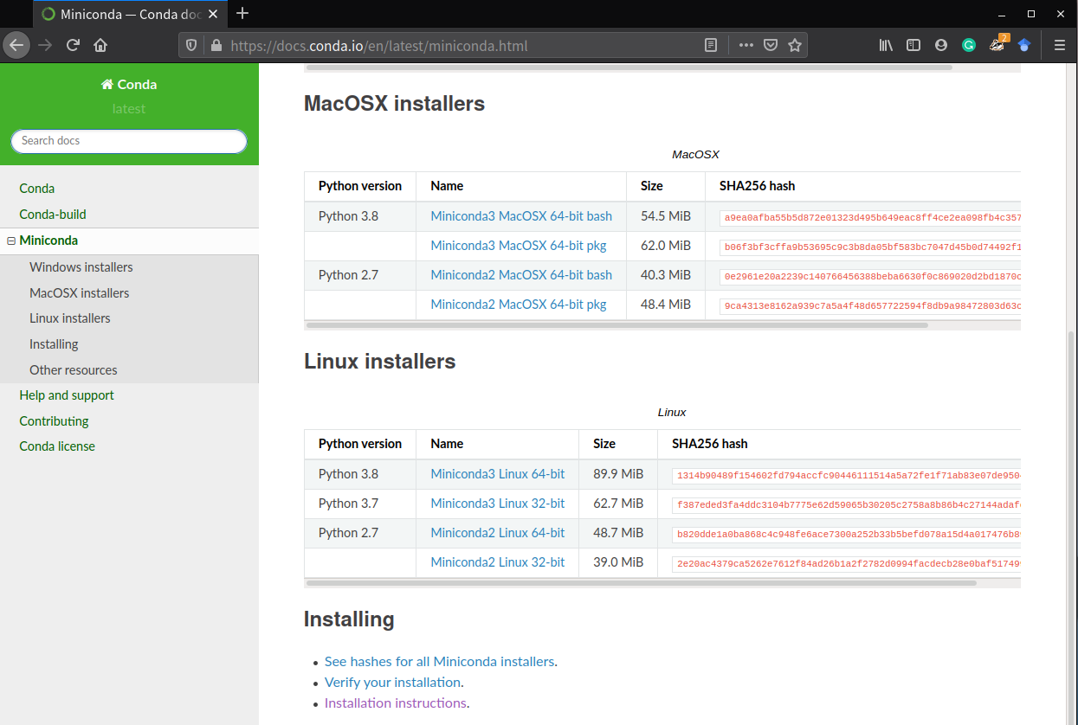
Download conda
https://docs.conda.io/en/latest/miniconda.html
Recommended
Almost all current laptops/desktops run 64-bit system
Python 2 is deprecated and no longer maintained

Slide 3
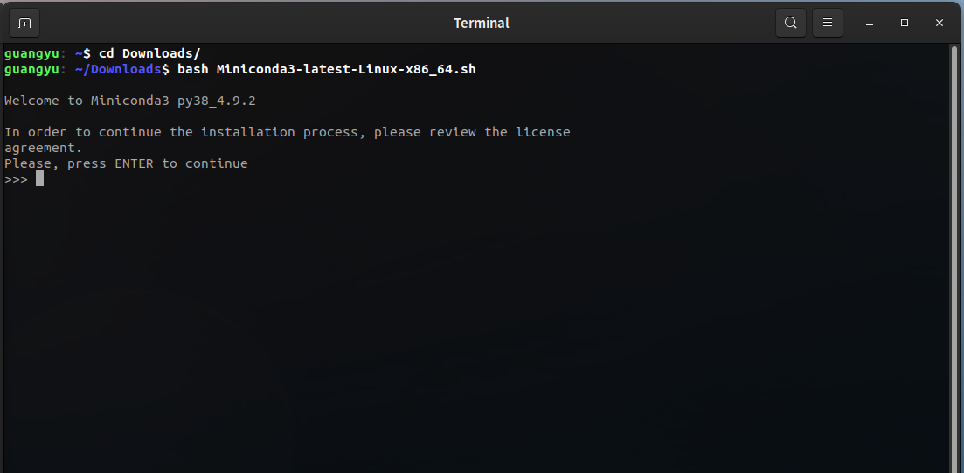
Run Installer
Launch terminal app and entering the directory of downloaded installer
In my case, it’s Downloads/
Type bash <the name of downloaded file.sh> to run the installer
Press ENTER to continue

Slide 4
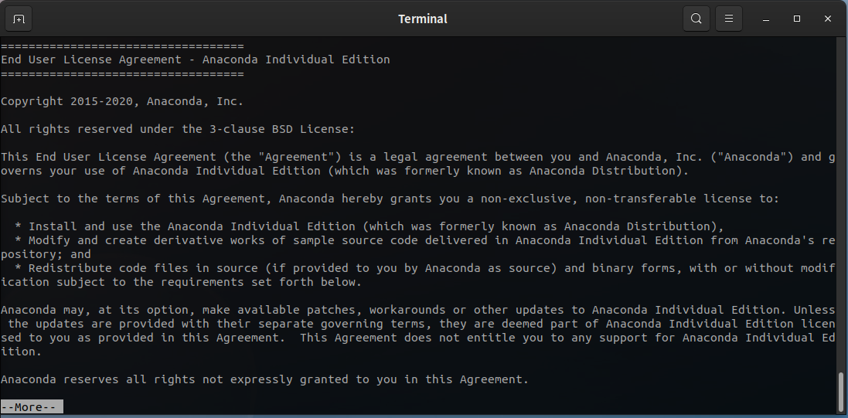
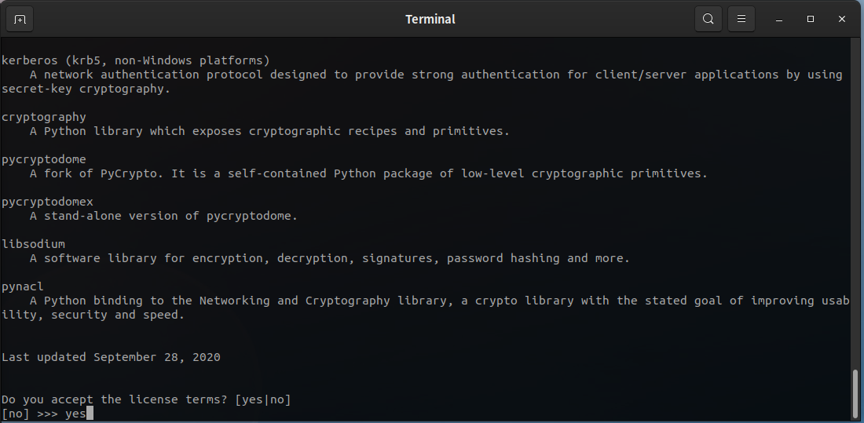
Accept license
When this page show up, hold ENTER or CTRL+D to scroll down to the bottom
Answer yes to accept the license and proceed

Slide 5
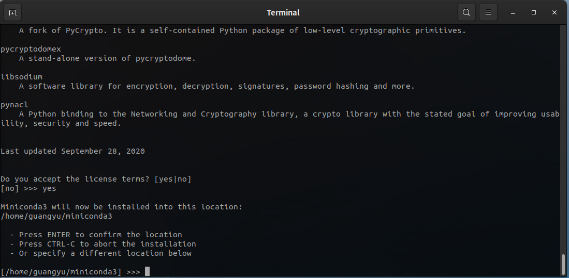
Choose install directory
Press ENTER to continue; this will install miniconda to the default location (<your home directory>/miniconda3)

Slide 6
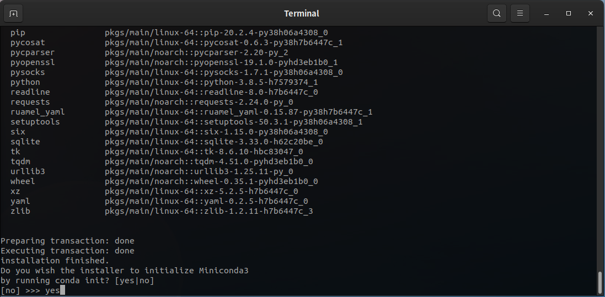
Initialize conda
Answer yes. This will finish installation.

Slide 7
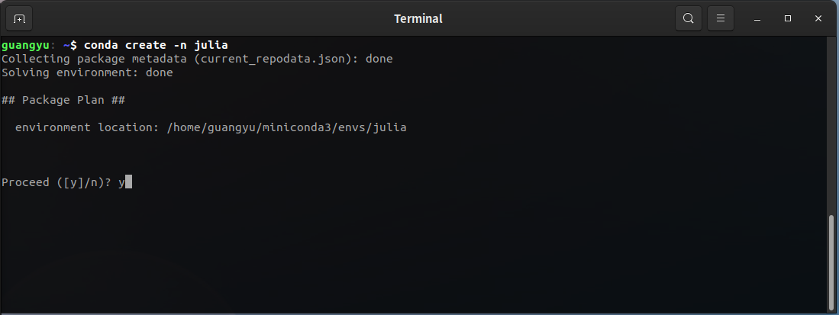
Create a conda environment for Julia
CLOSE AND RELAUNCH TERMINAL
Type conda create -n julia to create a new environment named `julia`. You can choose any preferred name; answer ‘y’ when prompted.
As a convention, names should only contain letters (a-z, A-Z), digits (0-9), underscore (_), dot (.) and dash (-).
In addtion:
Must start with letters, digits or underscore
Space is very discouraged
It is couraged to use only small letters or only capitals

Slide 8
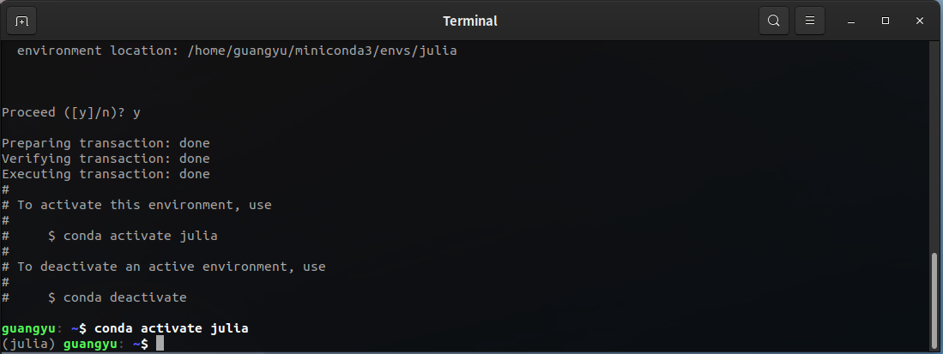
Activate the environment just created
Type conda activate julia to activate the environment we just created.
Type conda deactivate can deactivate the current environment at any time.
This indicates successful activation

Slide 9
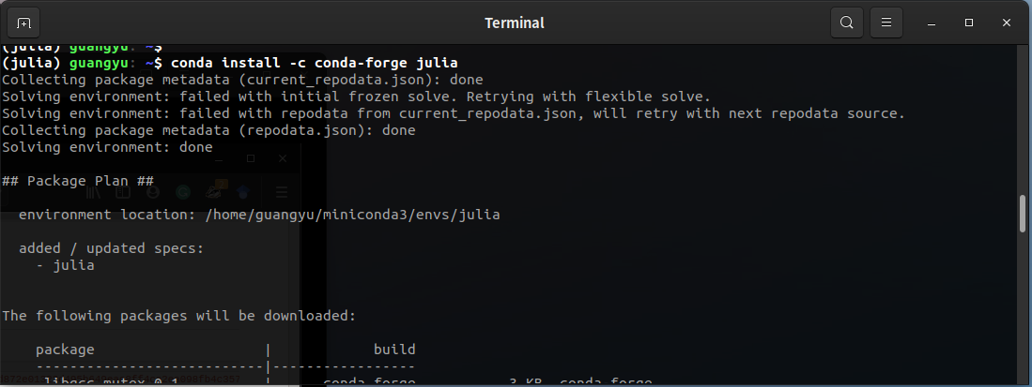
Install Julia
Make sure environment `julia` is activated
Type conda install -c conda-forge julia to install julia into this environment; answer ‘y’ when promted.
This also indicates the currently active environment

Slide 10
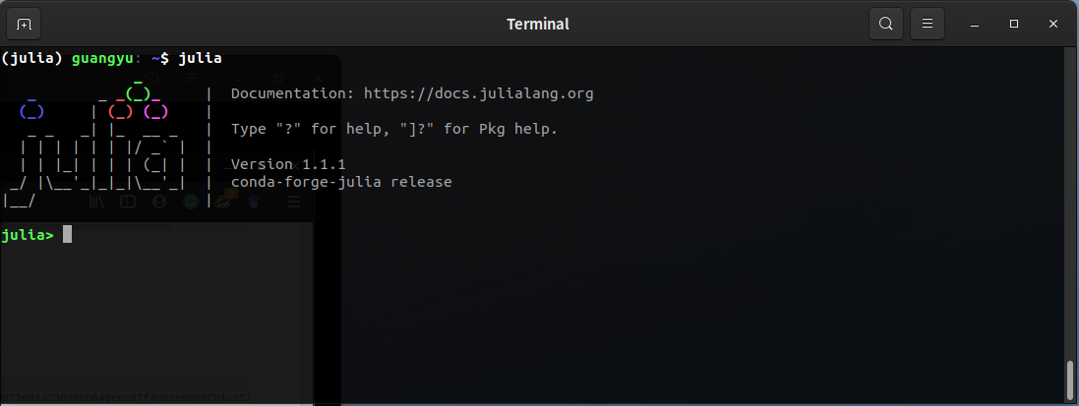
Launch Julia interactive session
Make sure environment `julia` is activated
Type julia to launch the program; you’ll now in REPL
Must be launched in the environment where julia is installed

Slide 11
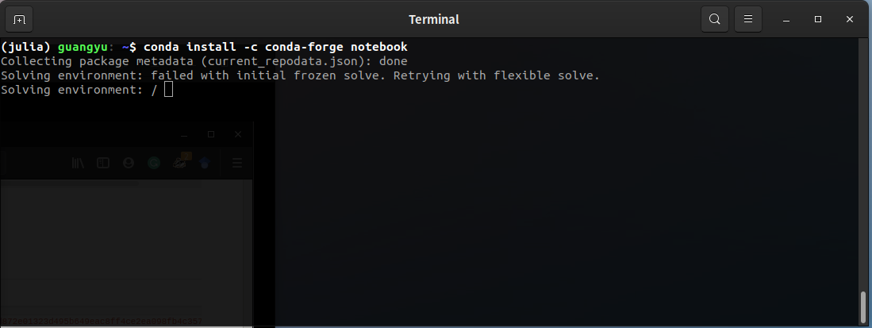
Install Jupyter notebook
Make sure environment `julia` is activated
Type conda install -c conda-forge notebook to install classic Jupyter notebook into this environment
This also indicates the currently active environment

Slide 12
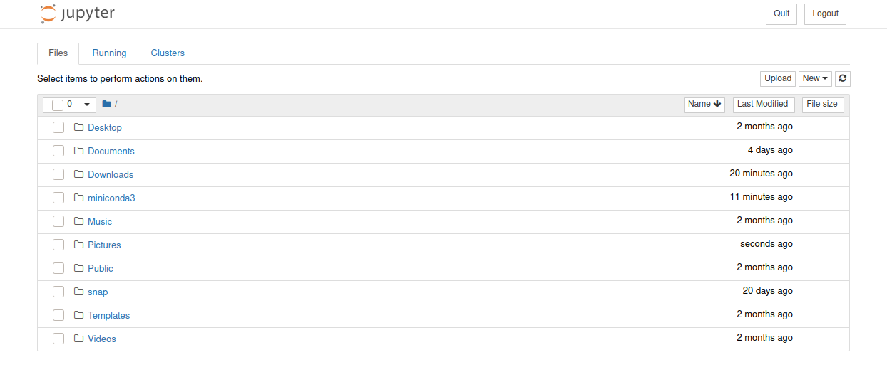
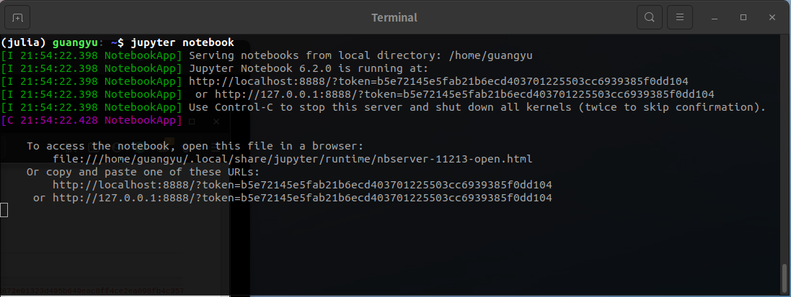
Launch Julia interactive session
Make sure environment `julia` is activated
Type jupyter notebook to launch the notebook
Must be launched in the environment where jupyter is installed
A browser session will be auto-launched,
serving as the Jupyter notebook interface.

