Slide 1
Dynamic Matching Algorithms for Homelessness Reduction
CSE REU Final Presentation
Luke Guerdan¹, Sanmay Das², & Chien-Ju Ho²
¹ Department of EECS, University of Missouri-Columbia
^{2.} CSE Department, Washington University in St. Louis

Slide 2
Overview
1.
Background & Motivation
Methods
Problem Formulation
Online-Dual Assignment Algorithm
Experiments
Online-Dual Performance
Stress Tests & Failure Cases
Examining Dual Variables
Discussion

Slide 3
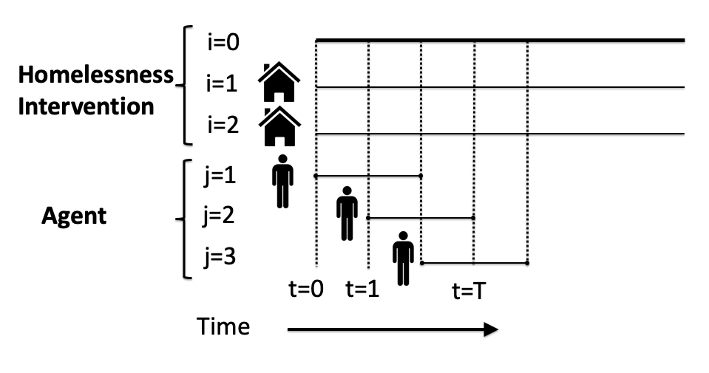
The Homelessness Dynamic Matching Problem
Each resource-agent pair has a match quality
How much will the agent benefit from this particular intervention?
Each intervention has:
Each agent has:
Arrival models:
A use duration
Potentially multiple copies
An arrival time
A wait interval (same across agents)
Alternating Arrivals
Stochastic
Adversarial

Slide 4
Offline vs. Online Formulations
Online Formulation
Present arrival
Future agent arrivals and match qualities are not known.
Utility = .32
Offline Formulation
Utility = .91
Future agent arrivals and match qualities are known.
Future arrival

Slide 5
Research Questions & Objectives
Previous Work
This Work
How to make near-optimal online matches without knowledge of the future?
How to model homeless matching in a linear program formulation?
Incorporate online homeless matching into a linear program formulation.
Develop an online assignment policy from this formulation.
Model resources returning to the market after a use period.
Incorporating Compatible Pairs in Kidney Exchange (Li, Z., Lieberman, K., Macke, W., Carrillo, S., Ho, C., Wellen, J., & Das)
Online Task Assignment in Crowdsourcing Markets (S., Ho, & Vaughan, J)
Allocating interventions based on counterfactual predictions: A case study on homelessness services (Kube, A., Das, S., & Fowler)

Slide 6
Overview
2.
Background & Motivation
Methods
Problem Formulation
Online-Dual Assignment Algorithm
Experiments
Online-Dual Performance
Stress Tests & Failure Cases
Simulating Dual Variables
Discussion

Slide 7
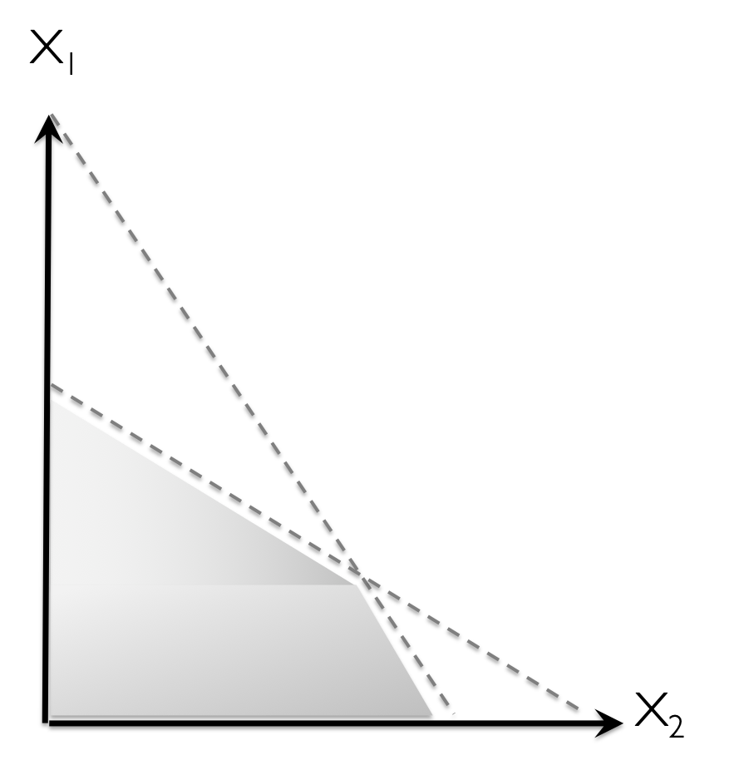
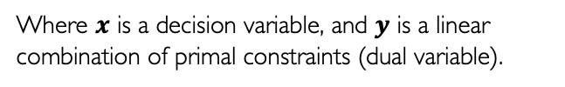
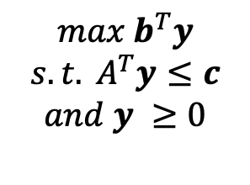

Linear Programming
Goal: optimize a linear objective function subject to linear equality and inequality constraints.
Dual
Primal
Any primal lp has an equivalent dual
$$max b^{T}y$$
$$s.t.{ A}^{T}y≤c$$
$$and y ≥0$$
$$min c^{T}x$$
$$s.t. Ax≥b$$
$$and x ≥0$$
Where $x$ is a decision variable, and $y$ is a linear combination of primal constraints (dual variable).
Feasible region
Notes:
Explain general idea behind these approaches and their drawbacks

Slide 8
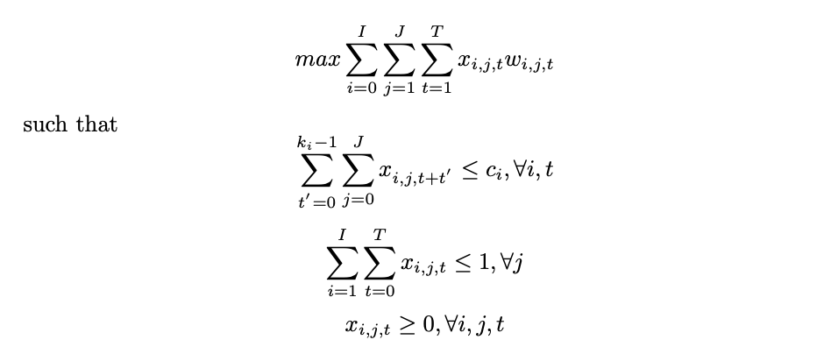



Problem Formulation
Primal Linear Program
$∈ℜ. M$atch quality
$$such that$$
$∈\left\{0,1\right\}.$Binary match variable
Agents
j=1
j=2
j=1
j=2
j=1
j=2
j=1
j=2
i=0
i=0
i=0
i=0
Resources
i=1
i=1
i=1
i=1
i=2
i=2
i=2
i=2
t=1
t=1
t=1
t=1
Time
Notes:
Explain general idea behind these approaches and their drawbacks

Slide 9
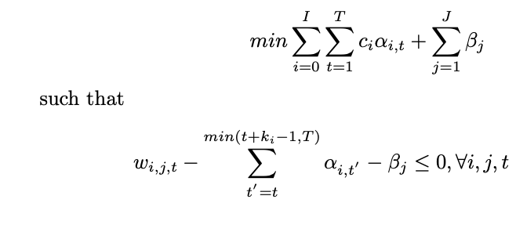





Problem Formulation
Primal Linear Program
Dual Linear Program
$∈ℜ. M$atch quality
$∈\left\{0,1\right\}.$Binary match variable
$$such that$$
$$such that$$
Dual: Resource use over time
Dual: Agent quality
Directly solving the primal is infeasible. How to derive an online dual assignment strategy based on these offline formulations?
Notes:
Explain general idea behind these approaches and their drawbacks

Slide 10

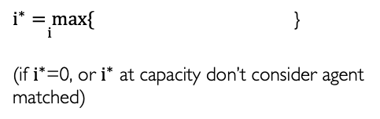

Online-Dual Assignment Algorithm
Primal-Dual Relationship
Online Dual Assignment Algorithm
Strong Duality Theorem: If either the primal or dual has a finite optimal value, then so does the other, the optimal values coincide, and optimal solutions to both P and D exist.
For each non-matched, available agent in each round, allocate to:
$\underset{i}{i^{∗}=max}{\{}$ }
(if $i^{∗}$=0, or $i^{∗}$ at capacity don’t consider agent matched)
Complementary Slackness: Assuming strong duality, if a variable is positive, then the associated dual constraint must be binding. If a constraint fails to bind, the associated variable must be zero
Comparison: Greedy Assignment Algorithm
For each non-matched, available agent in each round, allocate to the available resource such that:
$∗($ ) $=0$
$\underset{i}{i^{∗}=max}{\{}$ }
When the dual term is zero, assignment should occur.
Notes:
Explain general idea behind these approaches and their drawbacks

Slide 11
Overview
3.
Background & Motivation
Methods
Problem Formulation
Online-Dual Assignment Algorithm
Experiments
Online-Dual Performance
Stress Tests & Failure Cases
Simulating Dual Variables
Discussion

Slide 12
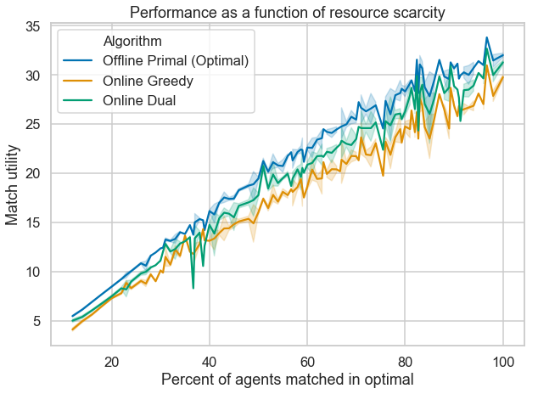
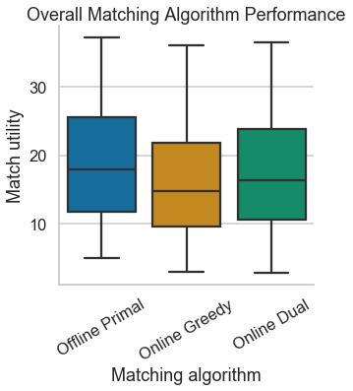
Online-Dual Performance Comparison (Optimal Dual)
*
*t(5119) = 5119; P < 1.58 e-19
60 agents, 2 resource types, 4 round wait time, 5120 simulations

Slide 13
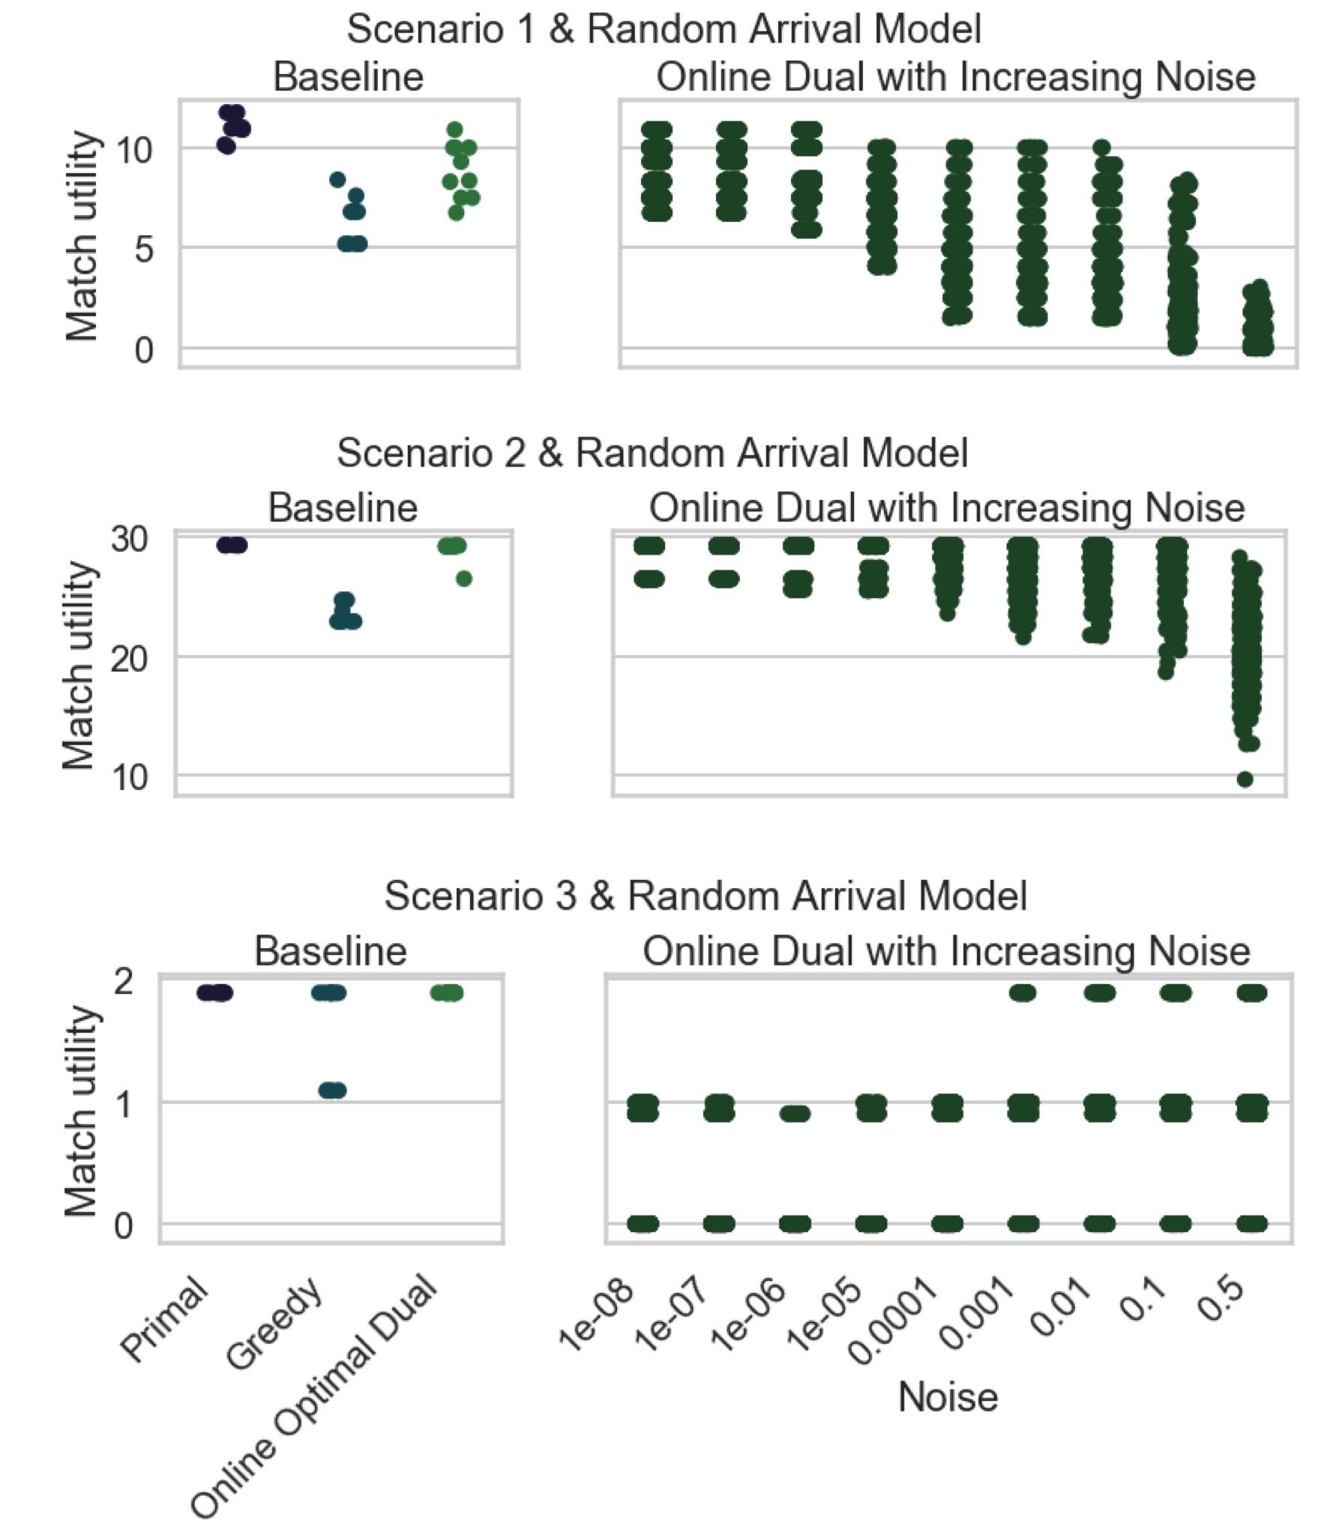
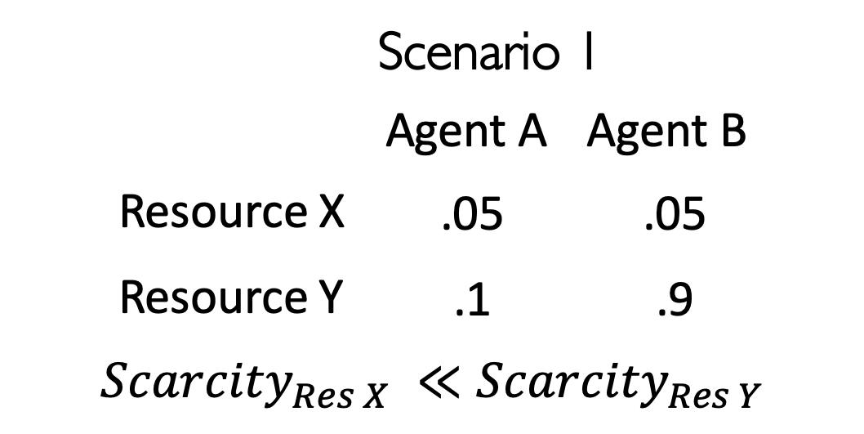
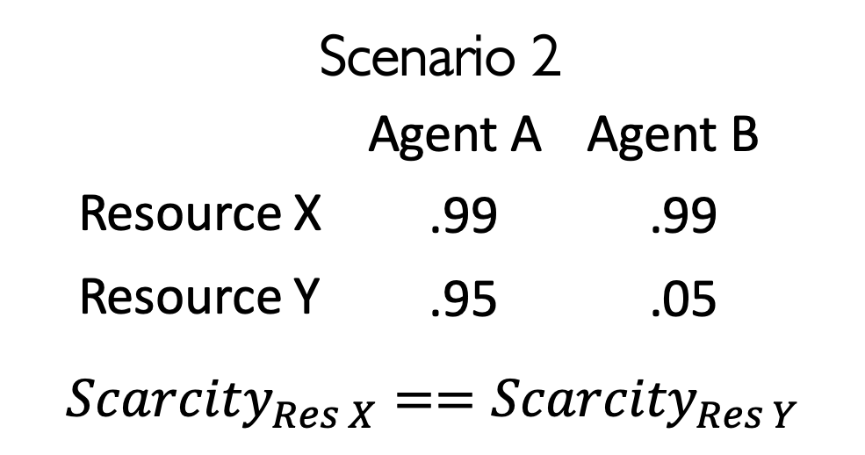
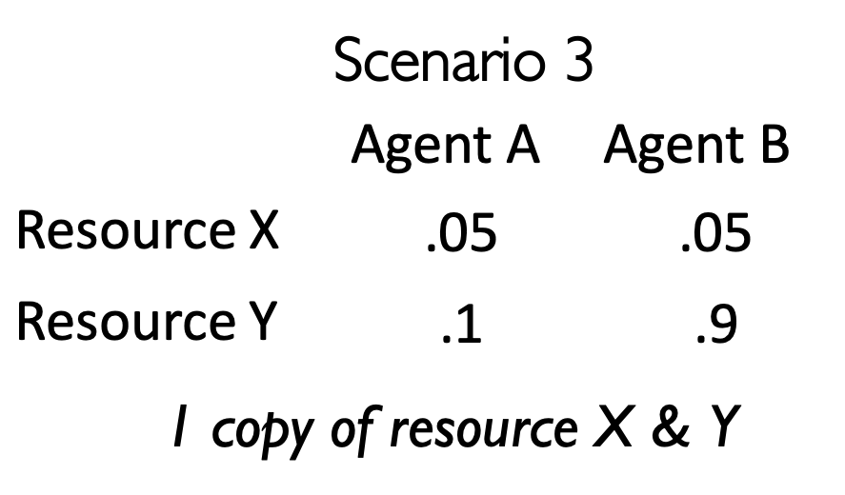
Stress Tests and Failure Cases
In practice, we don’t have access to optimal duals. How does online-dual assignment perform as noise increases?
How does online / greedy assignment compare in adversarial scenarios?
Offline
(%)
Notes:
Explain general idea behind these approaches and their drawbacks

Slide 14
Understanding Alpha Duals
We now need a method for predicting alpha dual variables, without knowing the future.
Intuition:
- Linked with resource use over time.
- Alpha duals are related to the number of available resource copies.
20 simulations

Slide 15
Simulating Alpha Duals
Match utility
Scenario 1
One simple approach:
Run many simulations of agent arrivals and average optimal duals. Use these for allocation in a new scenario
Performs surprisingly well in some instances, not in all.
Match utility
Scenario 2
Match utility
Scenario 3
30 agents, 2 round wait time
50 average simulations, 30 test simulations
Notes:
Explain general idea behind these approaches and their drawbacks

Slide 16
Discussion
This Work
Future Work
Incorporates dynamic homeless matching into a linear program formulation.
Develops an online assignment policy from this formulation.
Models resources returning to the market after a use period.
Will further investigate issues arising from the current formulation.
Will further develop methods for predicting alpha dual variables.
Will incorporate real-world housing intervention data.
The alpha sum term allows for a non-unique dual solution, causing ties in online assignment

Slide 17
Thank you!
Any questions?

