Slide 1
Wikipedia -Clickstream
Laxmi Amulya Gundala
CS 564 – Visualization Techniques
Final Project

Slide 2
Data description:
Wikipedia Clickstream data is available for January and February of 2015, February, March, April and August of 2016. I will be using February 2016 dataset. Each consists of 4 columns. First 2 columns give information about user navigation from ‘prev’ page to ‘curr’ page. Third column tells about the type of navigation:
Link: wiki-article to wiki-article through links existing in the page.
Other: wiki-article to wiki-article through a search box i.e., no direct page links between them.
External: some search engine like google, yahoo or any external website to wiki-article.
The forth column, give the information about number of hits from ‘prev’ page to ‘curr’ page.
The data for the project is filtered from February 2016 ‘External’ type of pages where users navigated from pages like ‘Facebook’, ‘Google’, ‘Bing’ etc.
Notes:
https://meta.wikimedia.org/wiki/Research:Wikipedia_clickstream
https://figshare.com/articles/Wikipedia_Clickstream/1305770

Slide 3
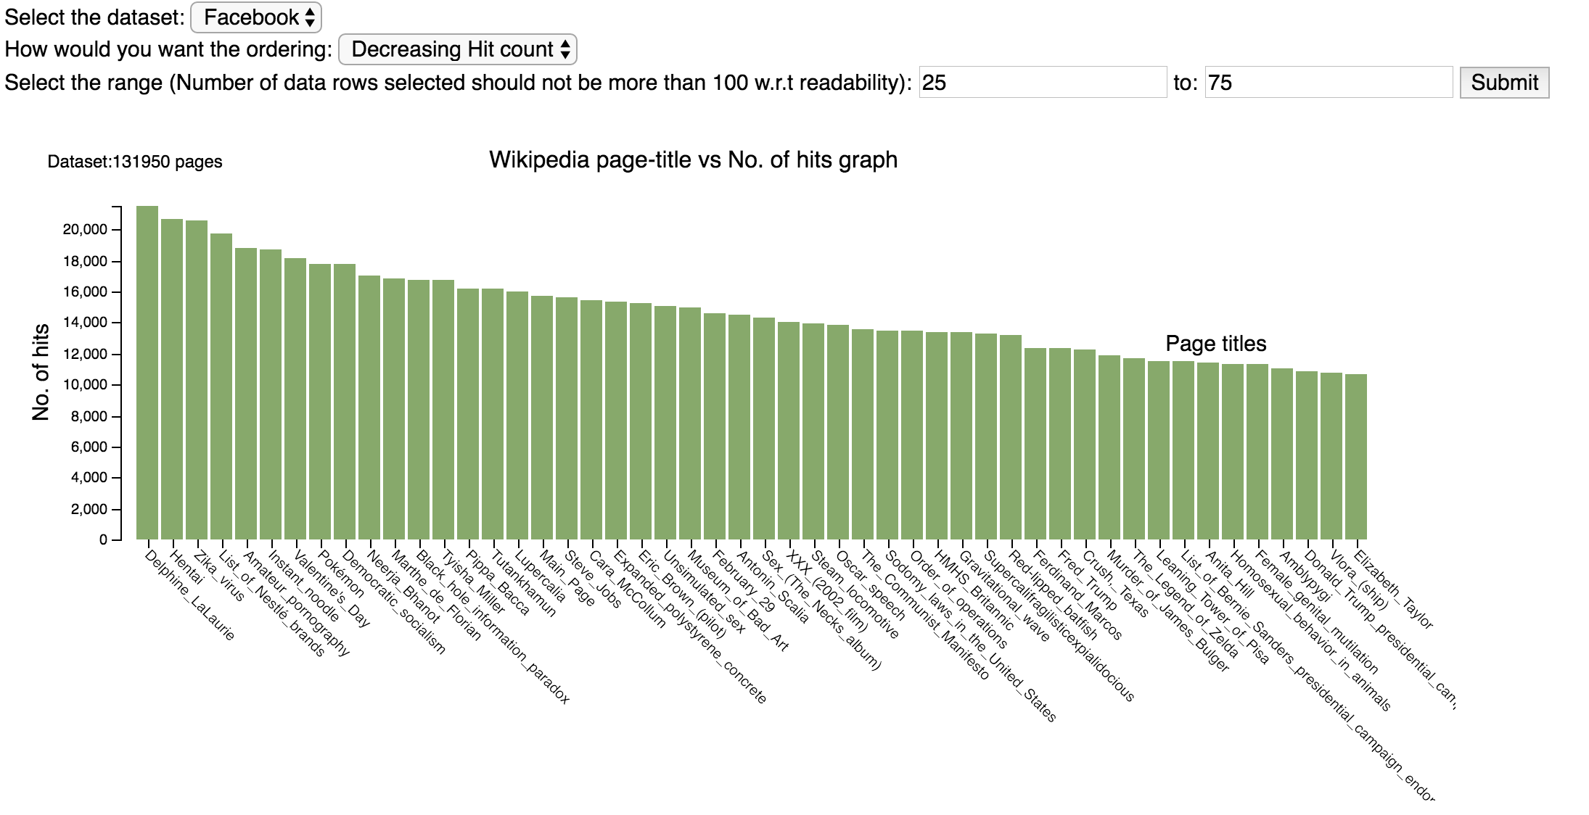

Slide 4
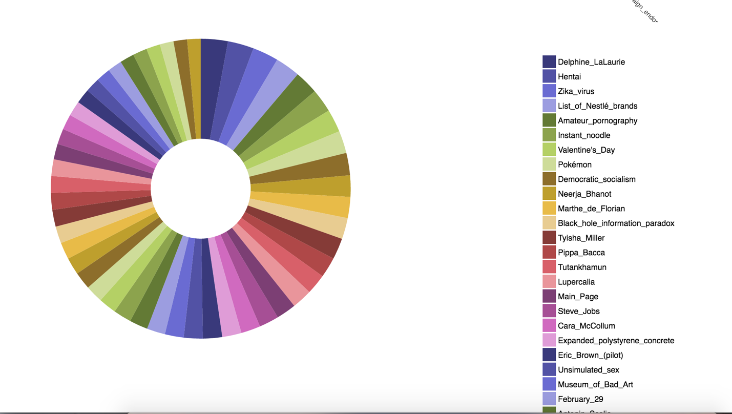

Slide 5
Future Enhancements:
More datasets from different ‘types’ in February can be added.
More months of 2016 can be included for visualization.
A scroll bar can be added for legend, as it is using more space on the web page.
Multiple diagrams (bar charts) can be included for different datasets so as to compare hit count of various pages with different ‘prev’ pages like Google, Facebook, Bing etc.

