Slide 1
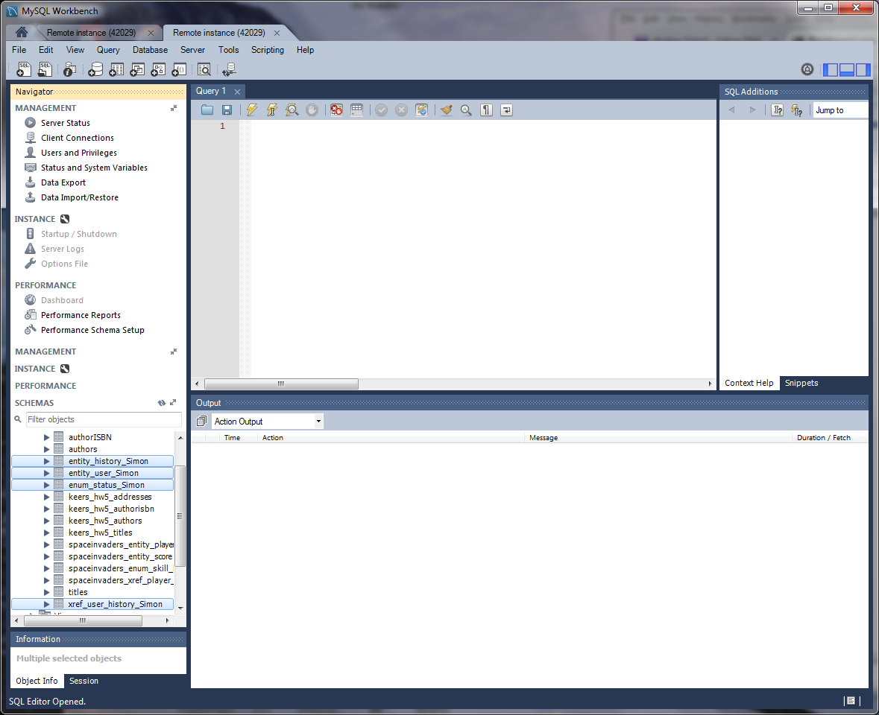
My personal project Simon game tables

Slide 2
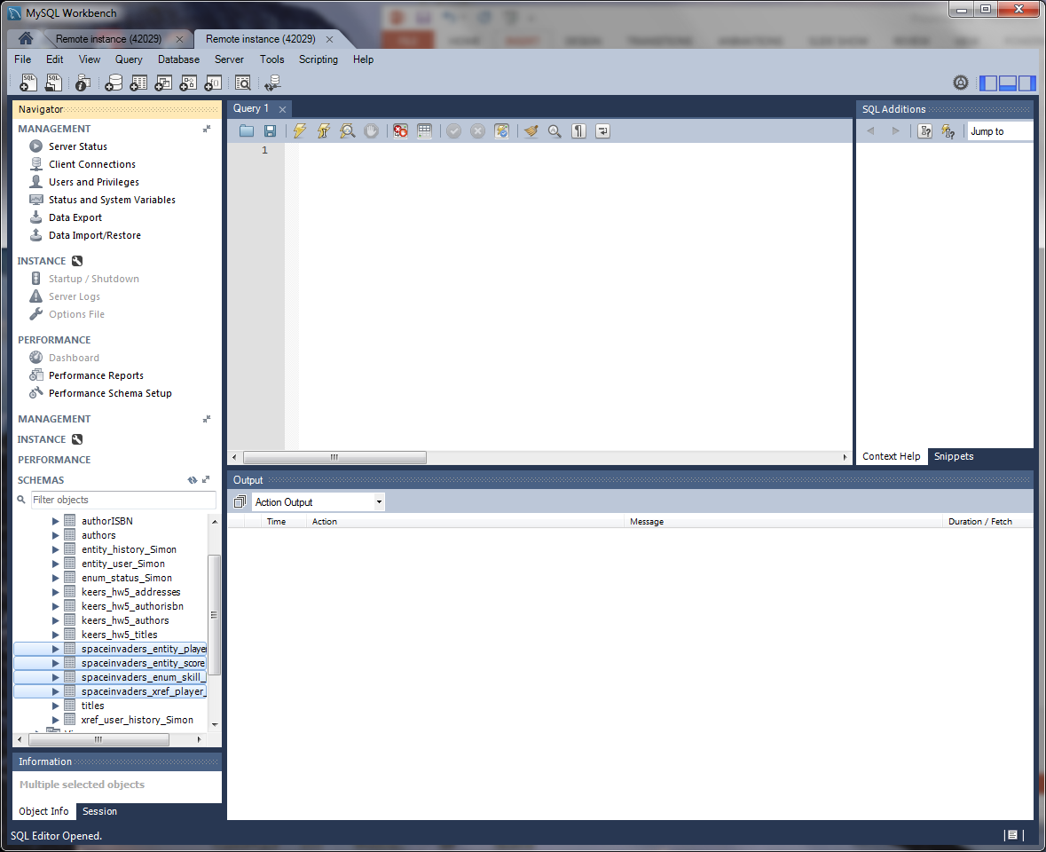
Group project Space Invaders tables

