Slide 1
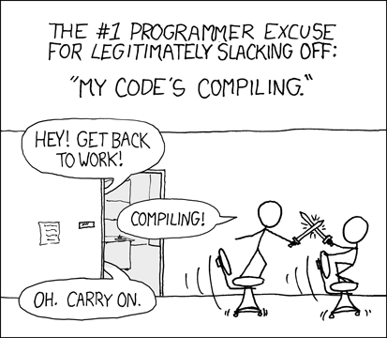

Slide 2
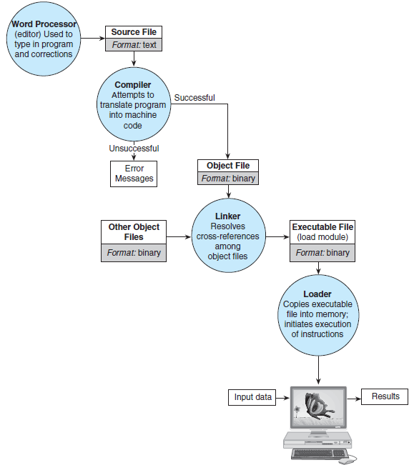
Figure 1.11 Entering, Translating, and Running a High-Level Language Program

Slide 3
Object files
use .o extension
-c flag in gcc only compiles, does not link
running gcc on object files will link them
gcc file1.o file2.o
warning: -o does not make object files! -c does.

Slide 4
Makefiles
Once we have many .c files, which should be recompiled?
a Makefile consists of rules (saying what depends on what) that make follows to recompile any changed code.
first rule is default target (final executable, for us)
target: dependencies
what to do (how to build target)
warning: tab is required

Slide 5
exe: student.o student_prog.o
gcc -o exe student.o student_prog.o
student_prog.o: student_prog.c student.h
gcc -c student_prog.c -Wall
student.o: student.c student.h
gcc -c student.c -Wall
exe depends on student.o and student_prog.o
student_prog.o depends on student_prog.c and student.h
student.o depends on student.c and student.h

Slide 6
Makefiles
can run with specific targets
make mytarget
clean should clean up directory by removing object and executables
make clean
can use variables

