Slide 1
Computer Science as a Career Path Chapter 0
Problem Solving & Program Design in C
Eighth Edition
Jeri R. Hanly & Elliot B. Koffman

Slide 2
Chapter Objectives
To learn why computer science may be the right field for you
To become familiar with different computer disciplines and related college majors
To find out about career opportunities

Slide 3
Is Computer Science for You?
Are you ---
comfortable with technology?
a problem solver?
a good communicator?
imaginative?

Slide 4
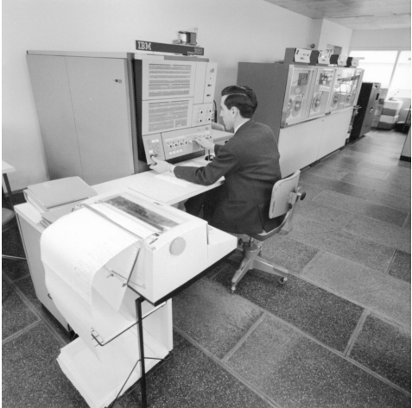
Old Technology
Figure 0.1 IBM introduced the system/360 family of business mainframe computers in 1964. ( © 2012 akg-images/Paul/almasy.Newscom.Unauthorized use not permitted.)

Slide 5
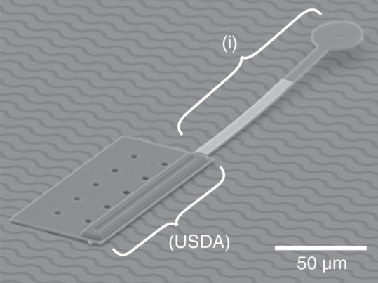
New Technology
Figure 0.3 Scanning-electron micrograph of a microrobot .
(© 2013 The International Journal of Robotics Research.)

Slide 6
Computer Majors
Computer Science
designing and implementing useful software
devising new ways to use computers
developing effective ways to solve computing problems

Slide 7
Computer Majors
Computer Engineering
designing the actual computing devices
study of hardware, software and communications
customized blend of electrical engineering and computer science

Slide 8
Computer Majors
Information Systems
integrating technology into businesses and enterprises
manage information in an efficient and secure manner
generating, processing and distributing information
focus is on business and organizational principles

Slide 9
Computer Majors
Information Technology
emphasis on technology
working with computer systems to ensure they work properly and are:
secure
upgraded
maintained
replaced as appropriate

Slide 10
Computer Majors
Software Engineering
developing and maintaining large software systems
integrating the theory of computer science and mathematics with the practical engineering principles developed for physical objects

Slide 11
Mixed Disciplinary Majors
Bioinformatics
Artificial Intelligence
Computer Forensics
Cryptology
Mechatronics

Slide 12
Mixed Disciplines
Multi discipline teams including computer science are used to solve challenging problems such as
the human genome project
environmental monitoring
AIDS vaccine research
clean fuels
predicting weather disasters

Slide 13
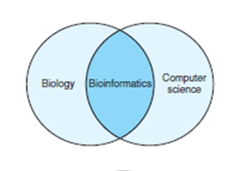
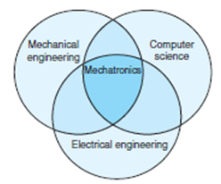
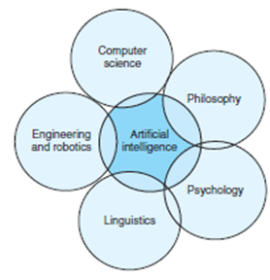
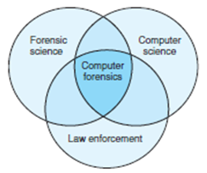
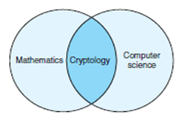
Figure 0.2 Illustrations of the overlapping fields within mixed disciplinary majors.

Slide 14
Career Opportunities
Computer and Information Research Scientist
Computer Programmer
Computer Support Specialist
Computer Systems Analyst
Database Administrator
Information Security Analyst

Slide 15
Career Opportunities
Web Developer
Computer Network Architect
Network and Computer Systems Administrator
Software Developer
Computer Hardware Engineer

Slide 16
Wrap Up
There is a demand for women and minorities in computer-related fields.
For a student starting studies in the field, career opportunities that will be available upon graduation may not have even been imagined yet.

