Slide 1
Overview of Computers and Programming Chapter 1
Problem Solving & Program Design in C
Eighth Edition
Jeri R. Hanly & Elliot B. Koffman

Slide 2
Memory
memory cell
an individual storage location in memory
address of a memory cell
the relative position of a memory cell in the computer’s main memory
contents of a memory cell
the information stored in a memory cell, either a program instruction or data

Slide 3
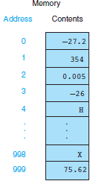
Figure 1.4 1000 Memory Cells in Main Memory

Slide 4
Memory
stored program concept
a computer’s ability to store program instructions in main memory for execution
byte
the amount of storage required to store a single character
bit
a binary digit, a 0 or a 1

Slide 5
Figure 1.5 Relationship Between a Byte and a Bit
Bit
00101100
Byte

Slide 6
Computer Software
Operating System
Application Software
Computer Languages
Executing a Program

Slide 7
Operating System
operating system (OS)
software that controls interaction of user and computer hardware and that manages allocation of computer resources
booting a computer
loading the operating system from disk into memory

Slide 8
Computer Languages
machine language
binary number codes understood by a specific CPU
assembly language
mnemonic codes that correspond to machine language instructions
high-level language
machine-independent programming language that combines algebraic expressions and English symbols

Slide 9
Computer Languages
compiler
software that translates a high-level language program into machine language
source file
file containing a program written in a high-level language; the input for a compiler
syntax
grammar rules of a programming language
object file
file of machine language instructions that is the output of a compiler

Slide 10
Computer Languages
linker
software that combines object files and resolves cross-references to create an executable machine language program
integrated development environment (IDE)
software package combining a word processor, compiler, linker, loader, and tools for finding errors

Slide 11
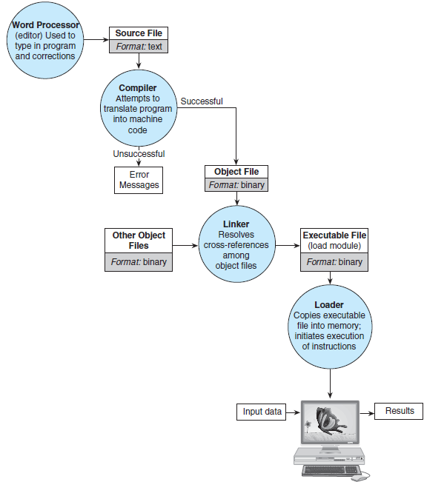
Figure 1.11 Entering, Translating, and Running a High-Level Language Program

Slide 12
Executing a Program
input data
the data values that are scanned by a program
program output
the lines displayed by a program

