Slide 1
Structure and Union Types Chapter 10
Problem Solving & Program Design in C
Eighth Edition
Jeri R. Hanly & Elliot B. Koffman

Slide 2
Chapter Objectives
To learn how to declare a struct data type which consists of several data fields, each with its own name and data type
To understand how to use a struct to store data for a structured object or record
To learn how to use dot notation to process individual fields of a structured object
To learn how to use structs as function parameters and to return function results
To understand the relationship between parallel arrays and arrays of structured objects

Slide 3
User-Defined Structure Types
record
a collection of information about one data object
structure type
a data type for a record composed of multiple components
hierarchical structure
a structure containing components that are structures

Slide 4
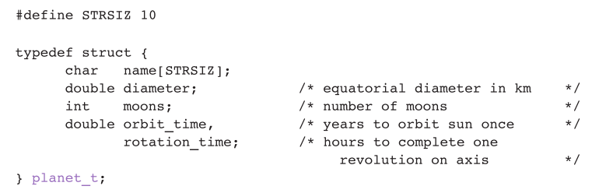
User-Defined Structure Types
Name: Jupiter
Diameter: 142,800 km
Moons: 16
Orbit time: 11.9 years
Rotation time: 9.925 hours

Slide 5
User-Defined Structure Types
Another syntax:
struct Planet {
char name[70];
double diameter;
int moons;
double orbit_time,
rotation_time;
};
// in a function
struct Planet p1, p2;

Slide 6
User-Defined Structure Types
Name: Jupiter
Diameter: 142,800 km
Moons: 16
Orbit time: 11.9 years
Rotation time: 9.925 hours
I will always use this syntax

Slide 7
Individual Components of a Structured Data Object
direct component selection operator
a period placed between a structure type variable and a component name to create a reference to the component
planet_t p1;
p1.moons = 10;
printf(“p1 has %d moons\n”, p1.moons);

Slide 8
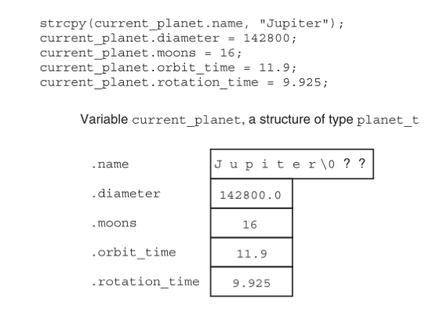

Slide 9
Structure Data Type as Input and Output Parameters
When a structured variable is passed as an input argument to a function, all of its component values are copied into the components of the function’s corresponding formal parameter.

Slide 10
Structure Data Type as Input and Output Parameters
When such a variable is used as an output argument, the address-of operator must be applied in the same way that we would pass output arguments of the standard types char, int, and double.

Slide 11
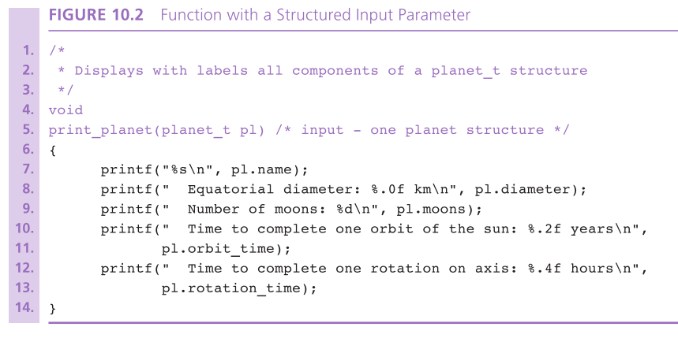

Slide 12
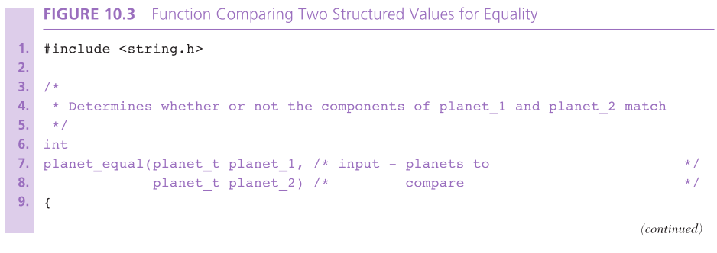
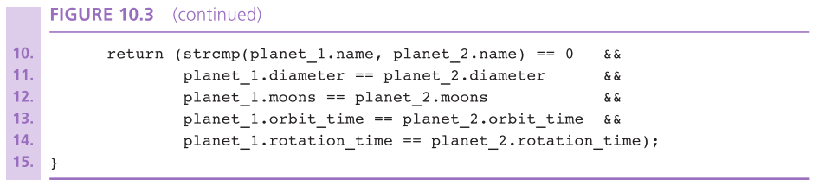

Slide 13
Structure Data Type as Input and Output Parameters
indirect component selection operator
the character sequence -> placed between a pointer variable and a component name creates a reference that follows the pointer to a structure and selects the component

Slide 14
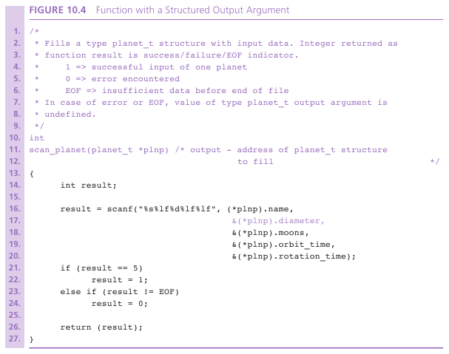

Slide 15
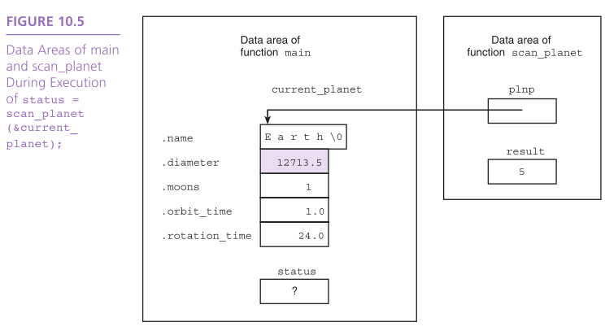

Slide 16
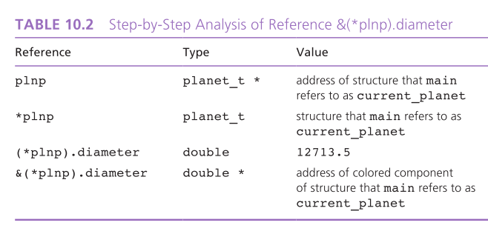

Slide 17
Functions Whose Result Values are Structured
A function that computes a structured result can be modeled on a function computing a simple result.
A local variable of the structure type can be allocated, fill with the desired data, and returned as the function result.

Slide 18
Functions Whose Result Values are Structured
The function does not return the address of the structure as it would with an array result.
Rather, it returns the values of all components.

Slide 19
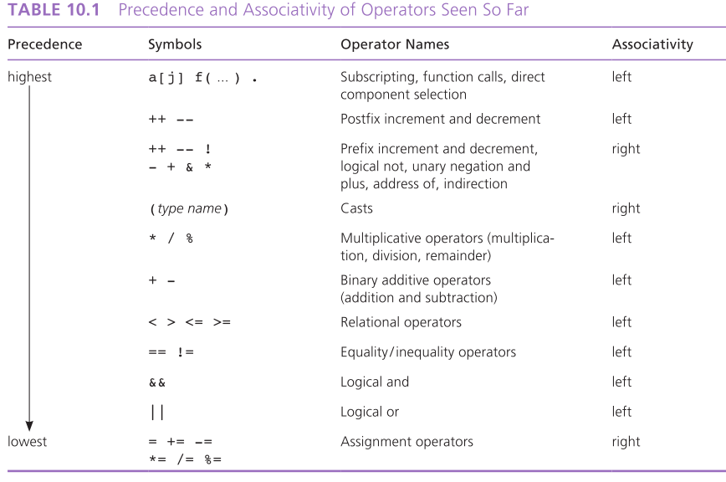

Slide 20
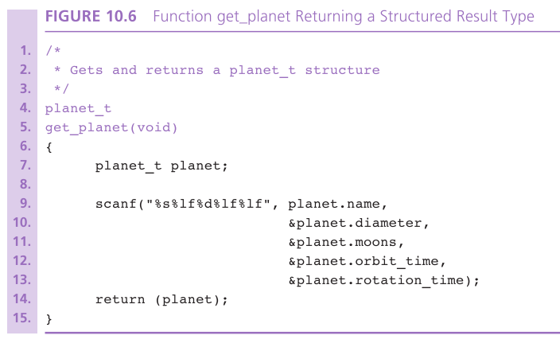

Slide 21
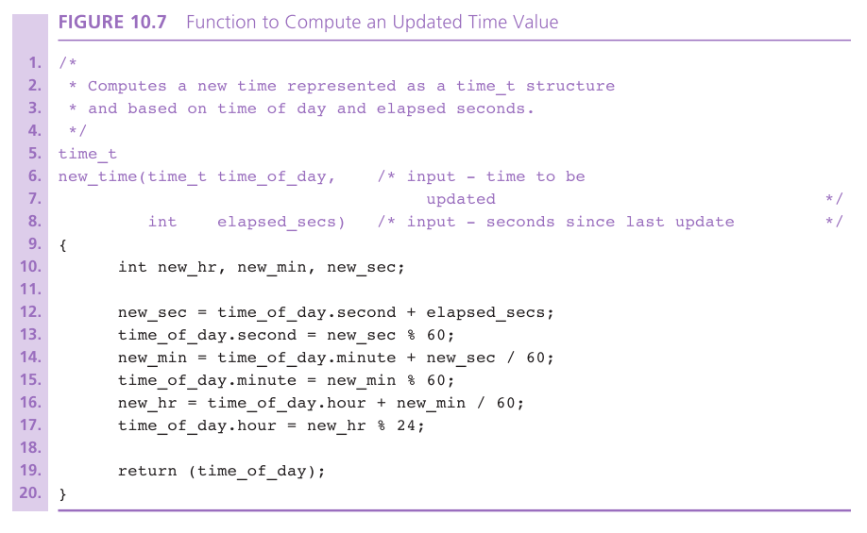

Slide 22
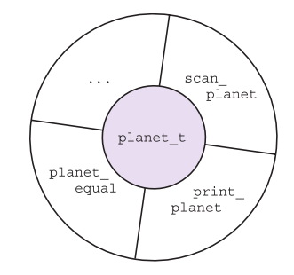
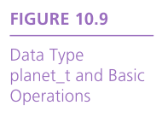
Problem Solving with Structure Types
abstract data type (ADT
a data type combined with a set of basic operations

Slide 23
Header files: defining the interface
#include<stdio.h>
versus
#include"class.h"
Angle brackets versus quotes tells compiler where to look for the file
Gets copied in by preprocessor and then compiled in the .c file
A .h file is never in the compile command
gcc –o exe –Wall program.c

Slide 24
.c files: the implementation
Contain C code
Do get compiled separately
Are linked after compilation to form the executable
gcc –o exe –Wall program.c funcs.c

Slide 25
Header guards
We don’t want to include headers multiple times, but they may reference one another
Solution: header guards
#ifndef FILENAME_H
#define FILENAME_H
/* ... Declarations here ... */
#endif

