Slide 1
Text and Binary File Pointers Chapter 11
Problem Solving & Program Design in C
Eighth Edition
Jeri R. Hanly & Elliot B. Koffman

Slide 2
Chapter Objectives
To learn about streams in C and their relationship to files and standard input and output devices
To review how scanf, fscanf and printf, fprintf are used to read and write characters to text files
To learn about escape sequences and their use in format strings

Slide 3
Chapter Objectives
To review file pointer variables and learn how to use functions that process them to make a backup copy of a text file
To learn about binary files and understand the differences between binary and text files

Slide 4
Input/Output Files
text file
a named collection of characters saved in secondary storeage
input (output) stream
continuous stream of character codes representing textual input (or output) data

Slide 5
The keyboard and Screen as Text Streams
stdin
system file pointer for keyboard’s input stream
stdout, stderr
system file pointers for screen’s output stream

Slide 6
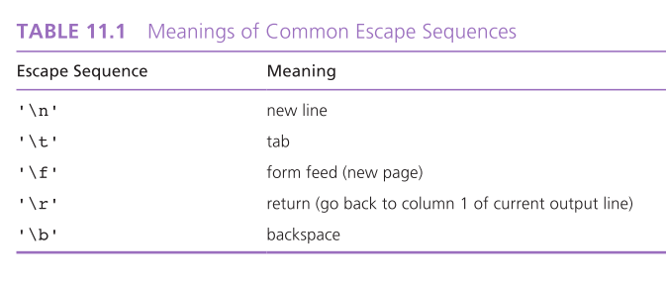

Slide 7
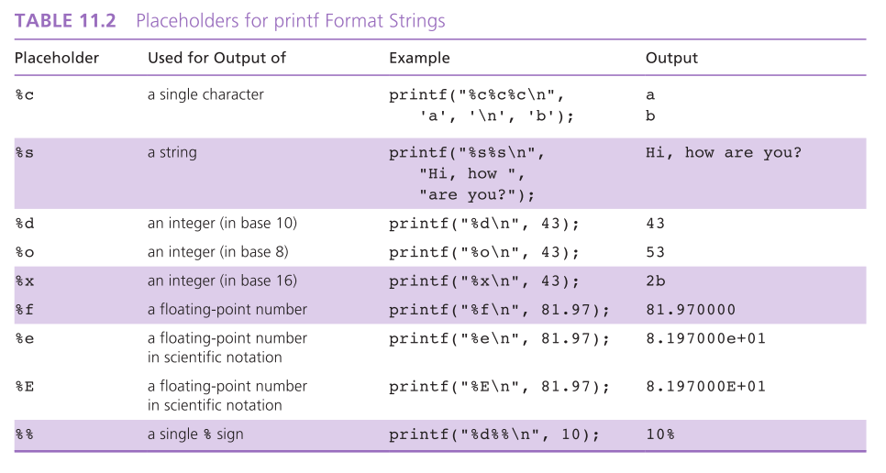

Slide 8
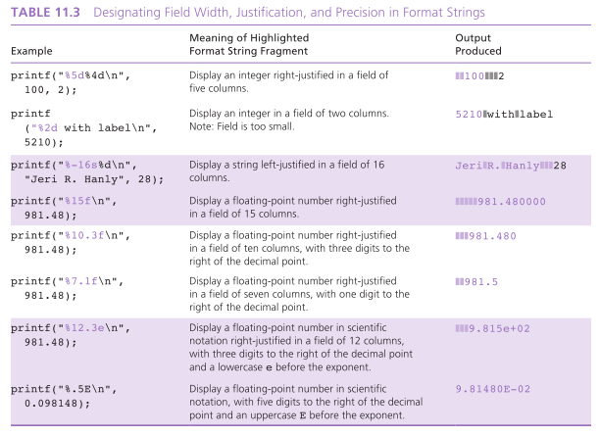

Slide 9
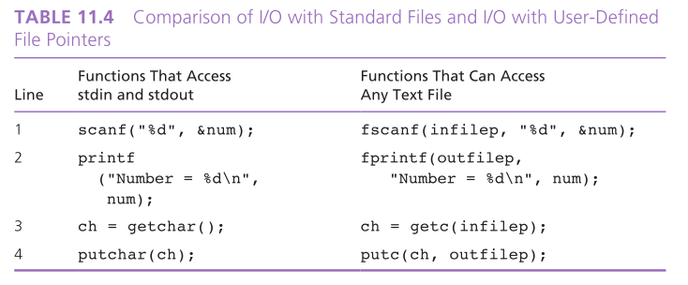

Slide 10
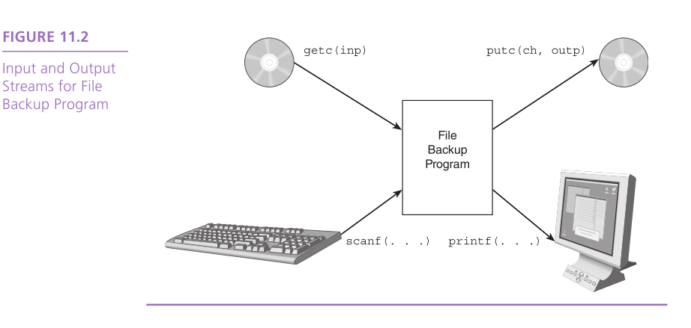

Slide 11
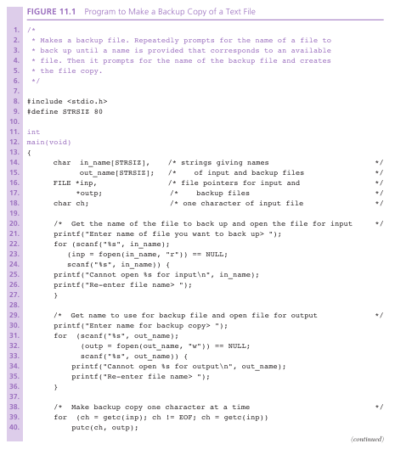

Slide 12
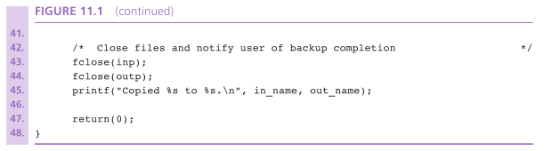

Slide 13
Binary Files
binary file
a file containing binary numbers that are the computer’s internal representation of each file component
sizeof
operator that finds the number of bytes used for storage of a data type

Slide 14
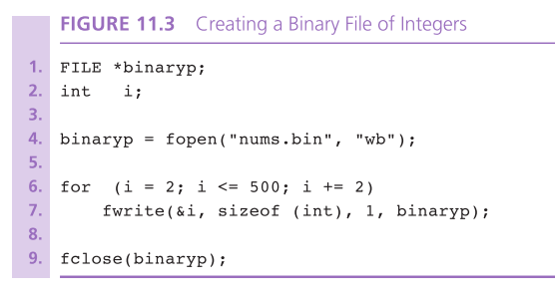

Slide 15
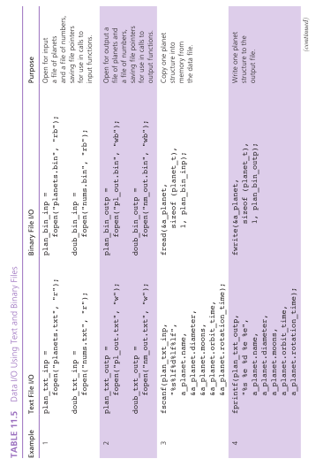

Slide 16
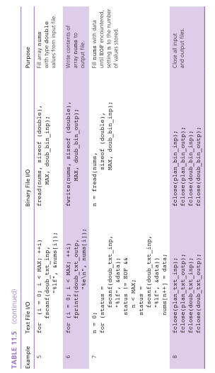

Slide 17
Database Inquiry
Case Study

Slide 18
Problem
Periphs Plus is a mail-order computer supply company that maintains its inventory as a computer file in order to facilitiate answering questions regarding that database. For example:
What printer stands that cost less than $100 are available?
What product has the code 5241?
What type of data cartridges are available?

Slide 19
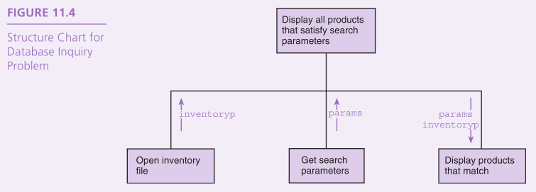
Design
Initial Algorithm
Open inventory file.
Get search parameters.
Display all products that satisfy the search parameters.

Slide 20
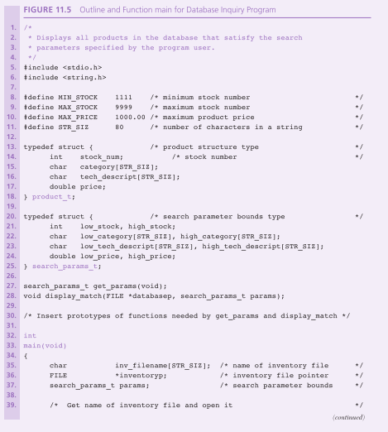

Slide 21
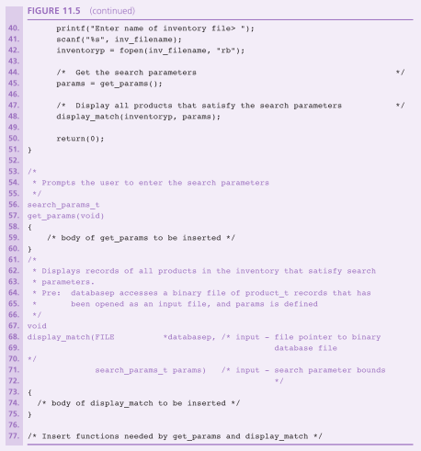

Slide 22
Algorithm for get_params
Initialize params to permit widest possible search.
Display menu and get response to store in choice.
Repeat while choice is not ‘q’
Select appropriate prompt and get new parameter value.
Display menu and get response to store in choice.
Return search parameters.

Slide 23
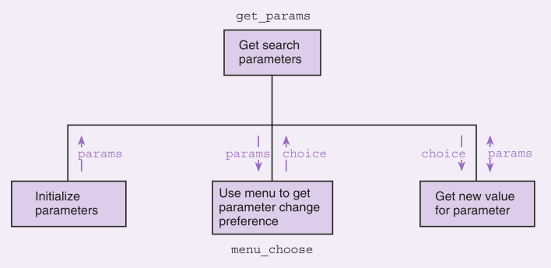
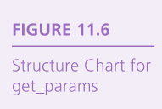

Slide 24
Algorithm for display_match
Initialize no_matches to true (1).
Advance to the first record whose stock number is within range.
while the current stock number is still in range repeat
if the search parameters match
Display the product and set no_matches to false (0).
Get the next product record.
If there are no product matches
Print a no products available message.

Slide 25
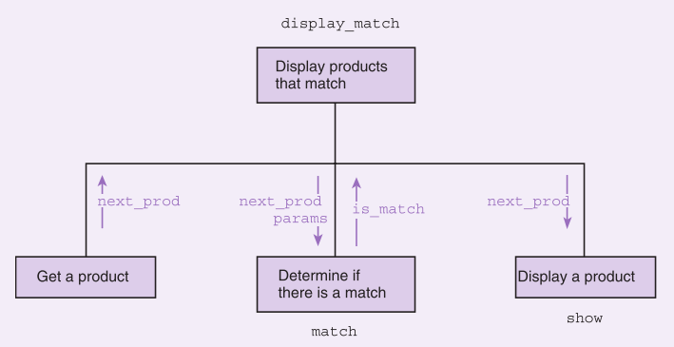
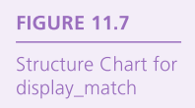

Slide 26
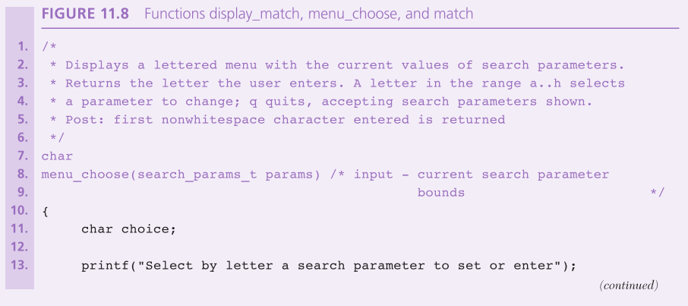

Slide 27
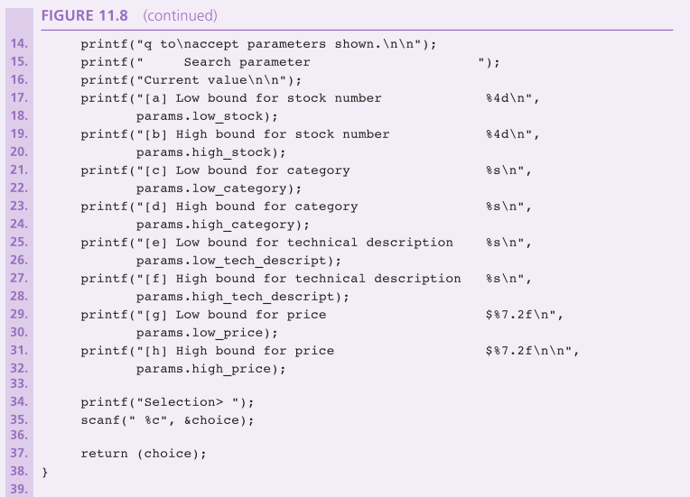

Slide 28
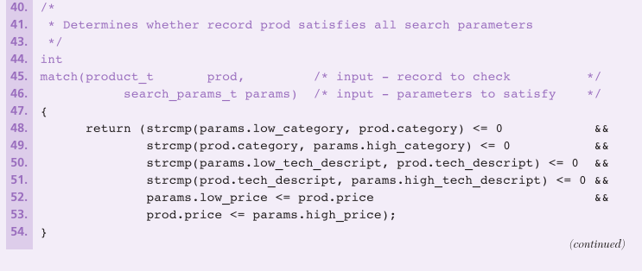

Slide 29
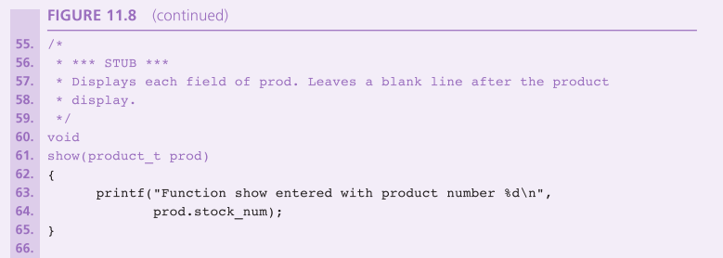

Slide 30
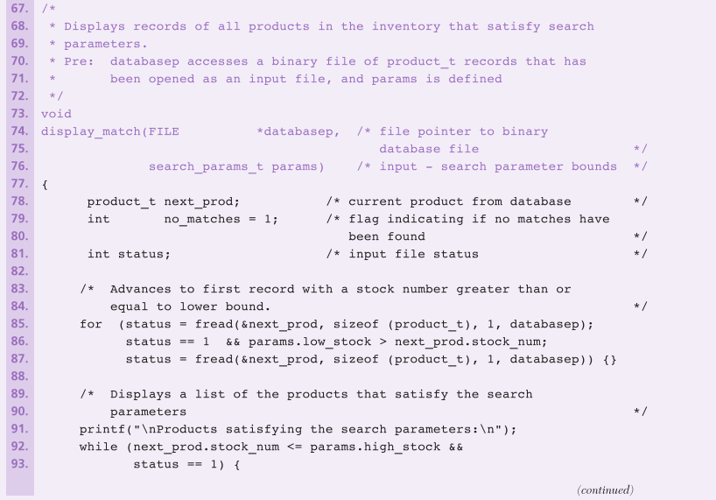

Slide 31
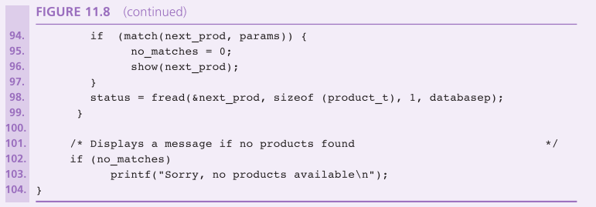

Slide 32
Wrap Up
Text files are continuous streams of character codes that can be viewed as broken into lines by the newline character.
Processing text files requires the transfer of sequences of characters between main memory and disk storage.
Binary files permit storage of information using a computer’s internal data format.

