Slide 1
Programming in the Large Chapter 12
Problem Solving & Program Design in C
Eighth Edition
Jeri R. Hanly & Elliot B. Koffman

Slide 2
Chapter Objectives
To learn how procedural abstraction help the programmer separate concerns about what a function does from the details of how to code the function
To understand how data abstraction enables us to describe what information is stored in an object and what operations we want to perform on the object without knowing the specifics of how the object’s information is organized and represented

Slide 3
Chapter Objectives
To learn how to create your own personal library with a separate header file and implementation file and to understand what should be stored in each file
To understand the purpose of different storage classes in C
To learn how to use conditional compilation to prevent multiple declarations of the identifiers in a header file

Slide 4
Chapter Objectives
To learn how to use multidimensional arrays for storing tables of data
To learn how to declare parameters for function main and how to pass data such as file names through command-line arguments
To learn how to define macros with parameters and understand what happens when a macro is expanded

Slide 5
Using Abstraction to Manage Complexity
procedural abstraction
separation of what a function does form the details of how the function accomplishes its purpose
data abstraction
separation of the logical view of a data object (what is stored) from the physical view (how the information is stored)

Slide 6
Using Abstraction to Manage Complexity
information hiding
protecting the implementation details of a lower-level module from direct access by a higher-level module
encapsulate
packaging as unit a data object and its operators

Slide 7
Personal Libraries
header file
text file containing the interface information about a library needed by a compiler to translate a program system that uses the library or by a person to understand and use the library

Slide 8
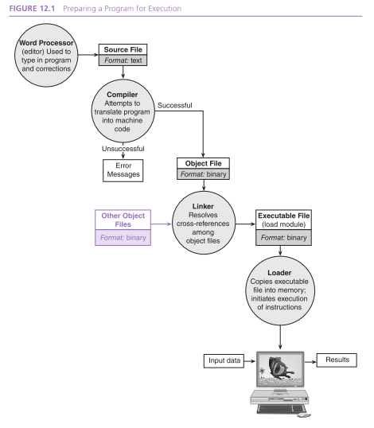

Slide 9
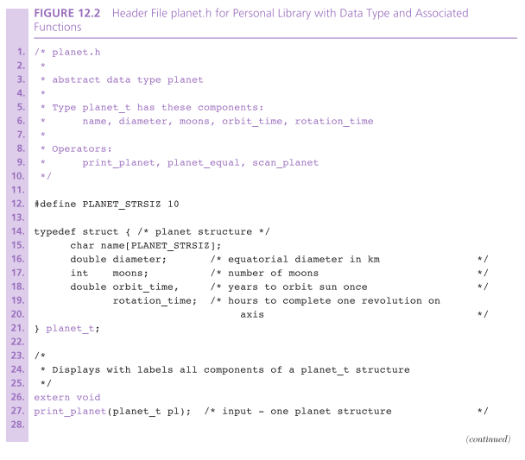

Slide 10
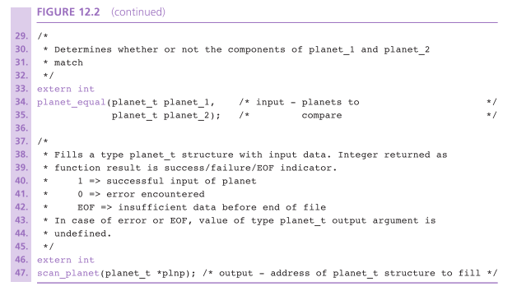

Slide 11
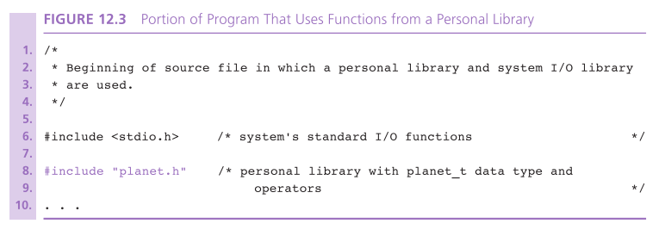
This library belongs to the programmer.

Slide 12
Personal Libraries
implementation file
file containing the C source code of a library’s functions and any other information needed for compilation of these functions

Slide 13
Steps for Creation
C1
create a header file containing the interface information for a program needing the library
C2
create an implementation file containing the code of the library functions and other details of the implementation that are hidden from the user program
C3
compile the implementation file
this step must be repeated any time either the header file or the implementation file is revised

Slide 14
Steps for Use
U1
include the library’s header file in the user program through an #include directive
U2
after compiling the user program, include both its object file and the object file created in C3 in the command that activates the linker

Slide 15
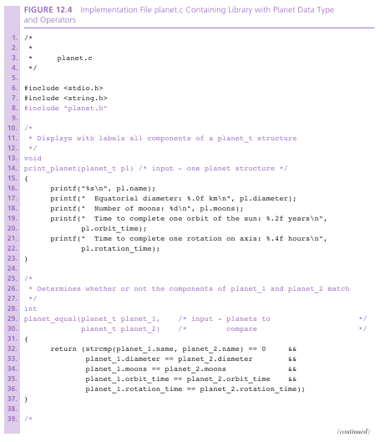

Slide 16
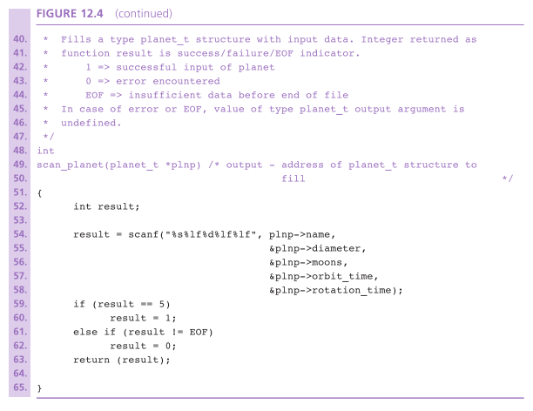

Slide 17
Storage Classes
auto
default storage class of function parameters and local variables
storage is automatically allocated on the stack at the time of a function call and deallocated when the function returns
extern
storage class of names know to the linker

Slide 18
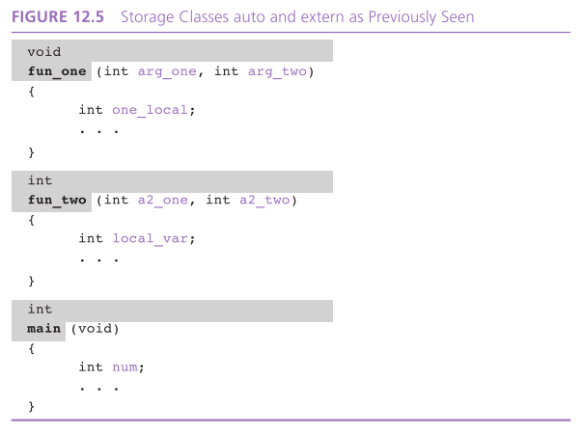

Slide 19
Storage Classes
global variable
a variable that may be accessed by many functions in a program
static
storage class of variables allocated only once, prior to program execution
register
storage class of automatic variables that the programmer would like to have store in registers

Slide 20
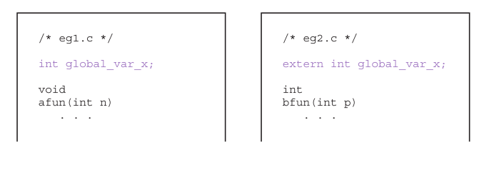
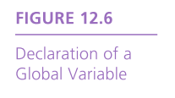

Slide 21
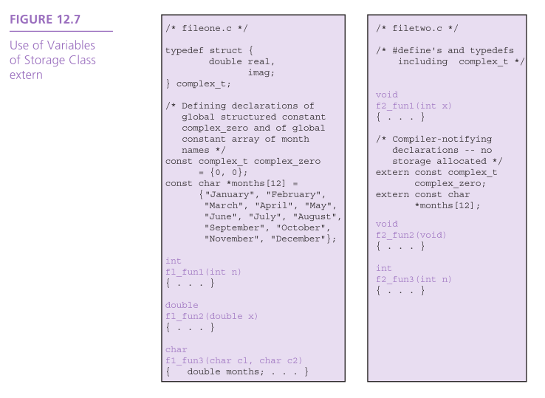

Slide 22
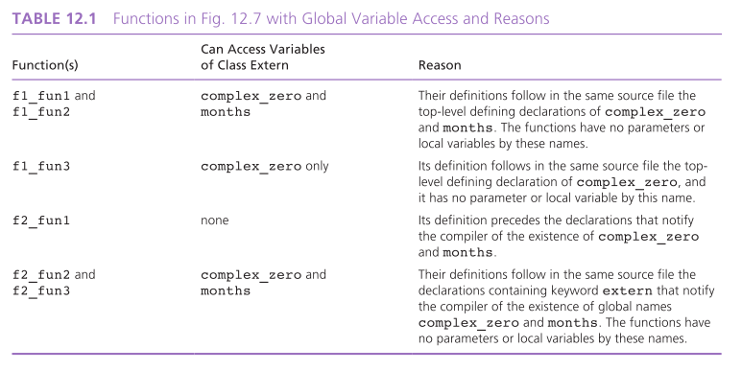

Slide 23
Modifying Functions for Inclusion in a Library
When building a personal library based on functions originally developed for use in a specific context, usually some modifications are advisable.
A library function should be as general as possible.
Examine all constants to see whether they could be replaced by input parameters

Slide 24
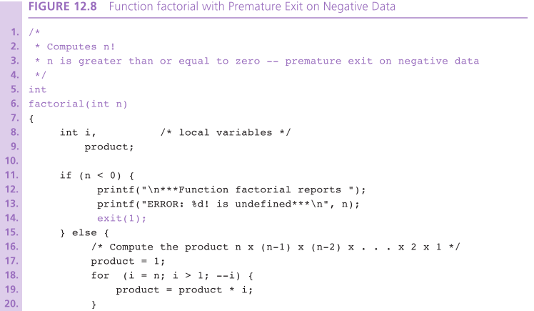


Slide 25
exit function
C’s exit function from the standard library stdlib can be used in situation where we need to terminate execution prematurely.
Calling exit with the argument 1 indicates that some failure led to the exit.
Calling exit with the argument 0 implies no such failure, just as a 0 returned from main indicates successful function completion.

Slide 26
Conditional Compilation
C’s preprocessor recognizes commands that allow the user to select parts of a program to be compiled and parts to be omitted.

Slide 27
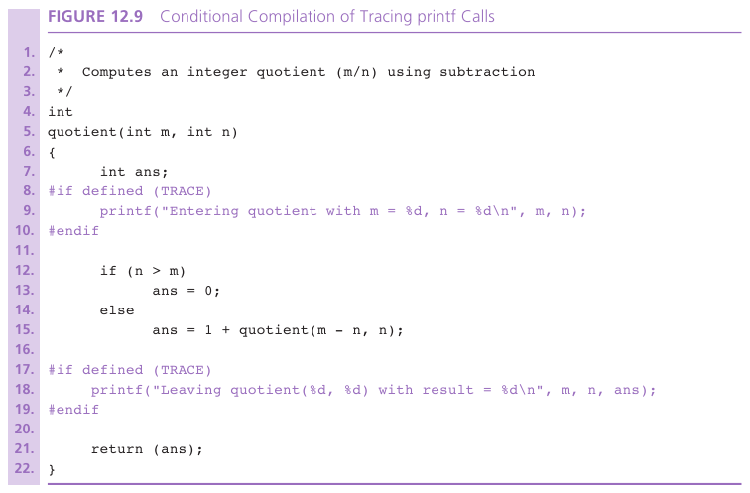

Slide 28
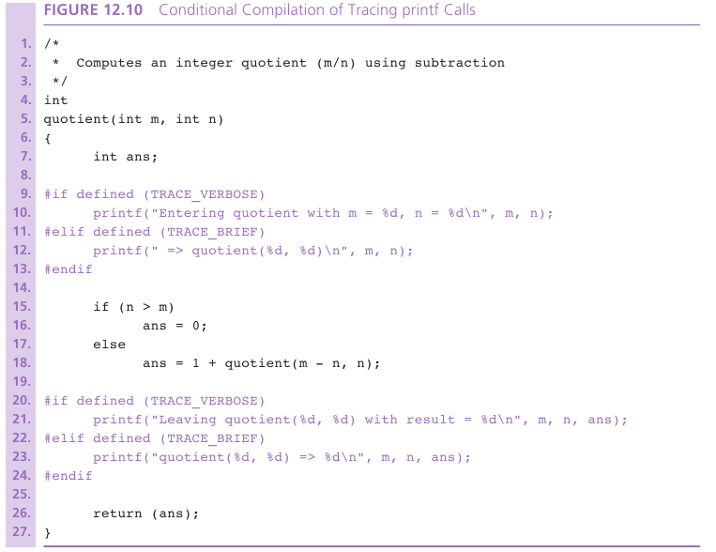

Slide 29
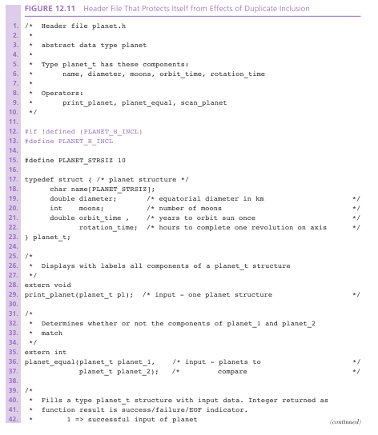

Slide 30
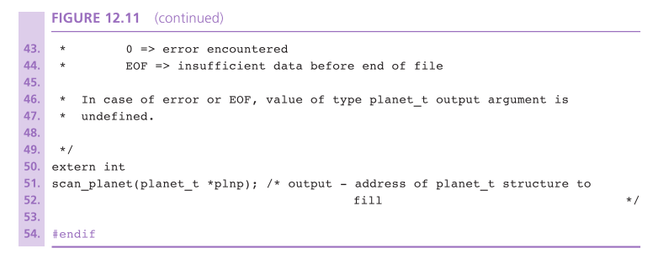

Slide 31
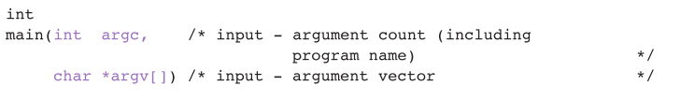
Arguments to function main
command-line arguments
options specified in the statement that activated a program

Slide 32
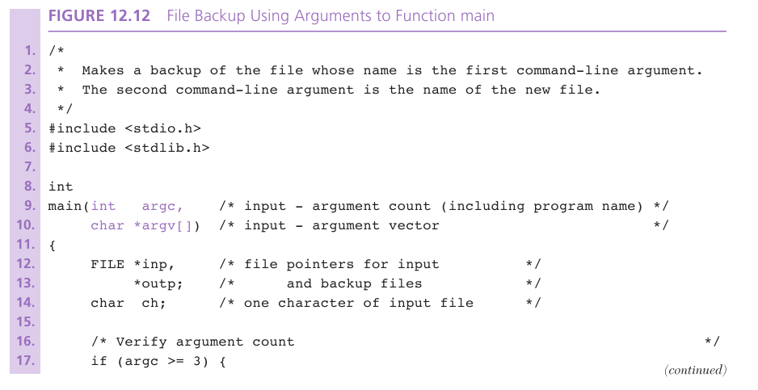

Slide 33
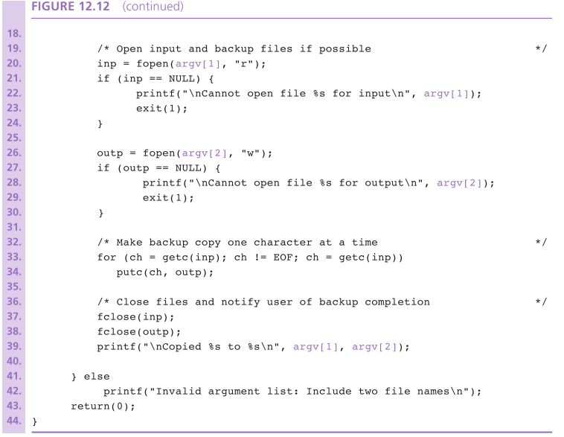

Slide 34
Defining Macros with Parameters
macro
facility for naming a commonly used statement or operation
macro expansion
process of replacing a macro call by its meaning

Slide 35
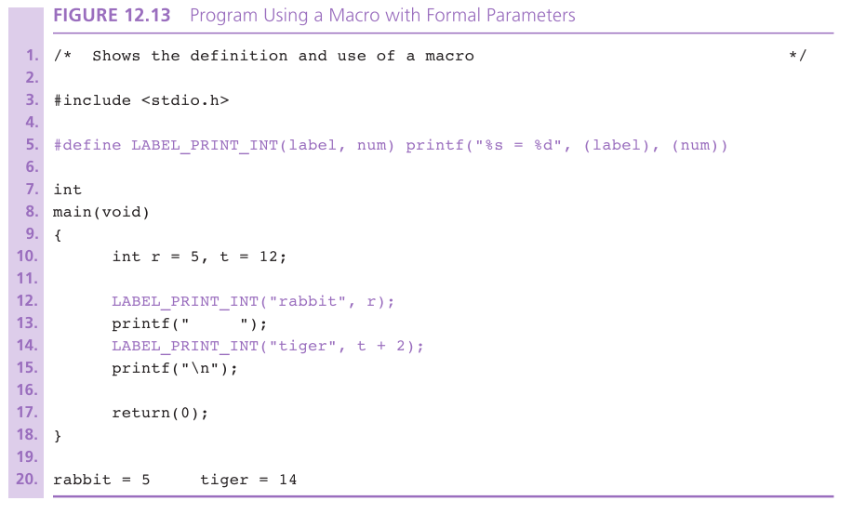

Slide 36
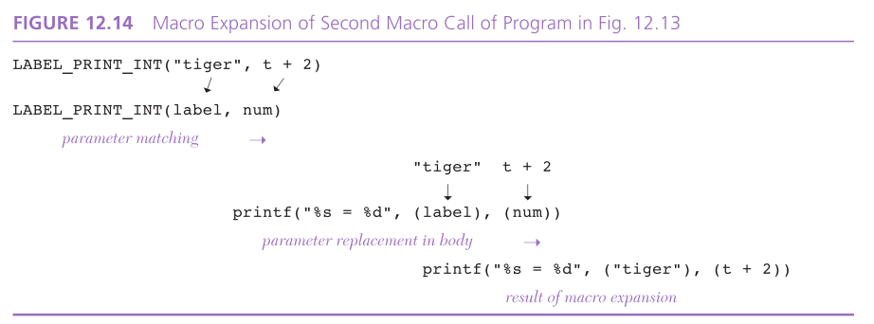

Slide 37
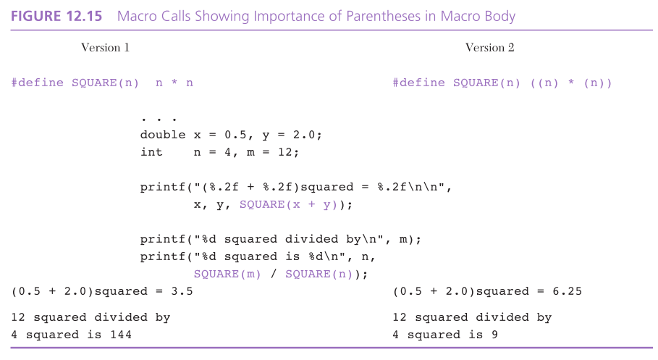

Slide 38
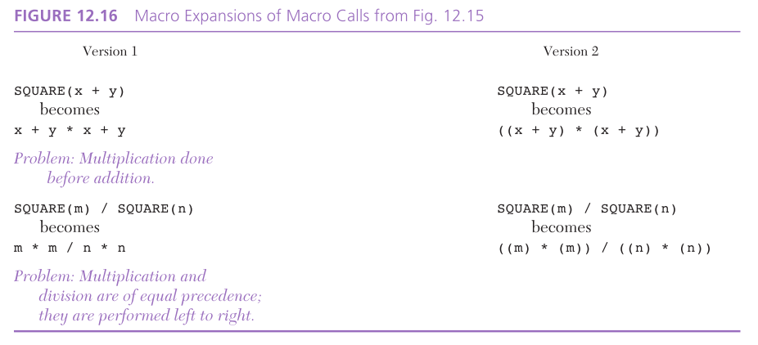

Slide 39
Wrap Up
C’s facility for creating a personal library provides a means of encapsulating an abstract data type.
Dividing a library definition into a header file and an implementation file provides a natural separation of the description of what the library functions do from how they do it.
Defining a macro gives a name to a frequently used statement or operation.
The exit function allows premature termination of program execution.

Slide 40
Wrap Up
Conditional compilation provides a means of customizing code for different implementations and of creating library header files that protect themselves from duplicate inclusion.
Designing function main with parameters argc and argv allows the use of command-line arguments.
Library functions must have meaningful names, have clearly defined interfaces, and be as independent as possible from globally defined constants.

