Slide 1
Multiprocessing Using Processes and Threads Chapter 14
Problem Solving & Program Design in C
Eighth Edition
Jeri R. Hanly & Elliot B. Koffman

Slide 2
Chapter Objectives
To understand about processes, multitasking, and multiprocessing
To learn how to use pipes for interprocess communications
To understand the role of mutual exclusion locking (mutex) in process synchronization
To simulate the producer/consumer model using multiple processes

Slide 3
Terminology
multitasking
dividing a program into tasks that operate independently of one another
linear programming
writing a sequence of program instructions in which each instruction depends on the completion of the previous instruction
parallel programming
execution of multiple programs at the same time

Slide 4
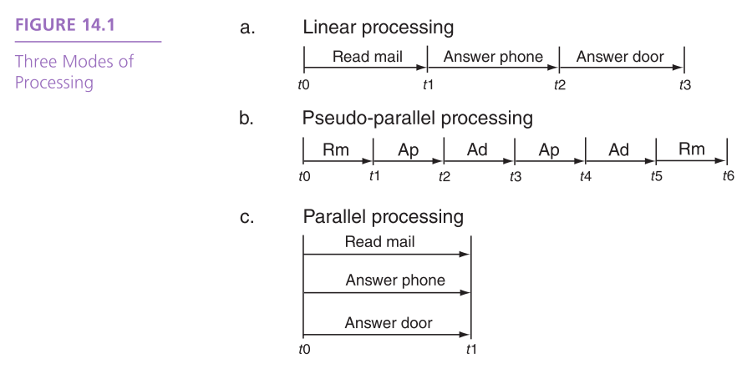

Slide 5
Terminology
time-sharing
performing parallel programming by allocating to each system user a portion of the available CPU time
preemptive multitasking
stopping the execution of a running program by the hardware interrupt system, allowing another program to access the CPU

Slide 6
Terminology
pseudo-parallelism
a situation in which programs appear to be running in parallel at the same time although they are actually taking turns sharing the CPU
time slice
the amount of CPU time allocated to each program in a parallel programming environment

Slide 7
Terminology
context switch
the process of switching from one process to another accomplished by saving the state information for the currently executing process, which will become idle, and loading the saved state information for a currently idle process, which will resume execution
concurrent programming
writing sets of program instructions that can execute at the same time independently of one another

Slide 8
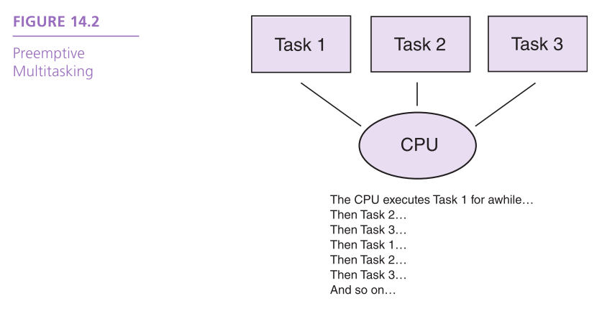

Slide 9
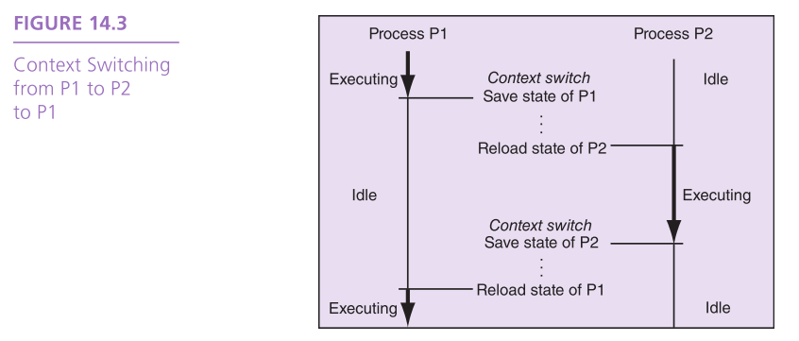

Slide 10
Processes
process ID
a unique identifier given to a process by the operating system
child process
a new process that is created by a currently executing process (the parent process)
parent process
the currently executing process that has created one or more new child processes

Slide 11
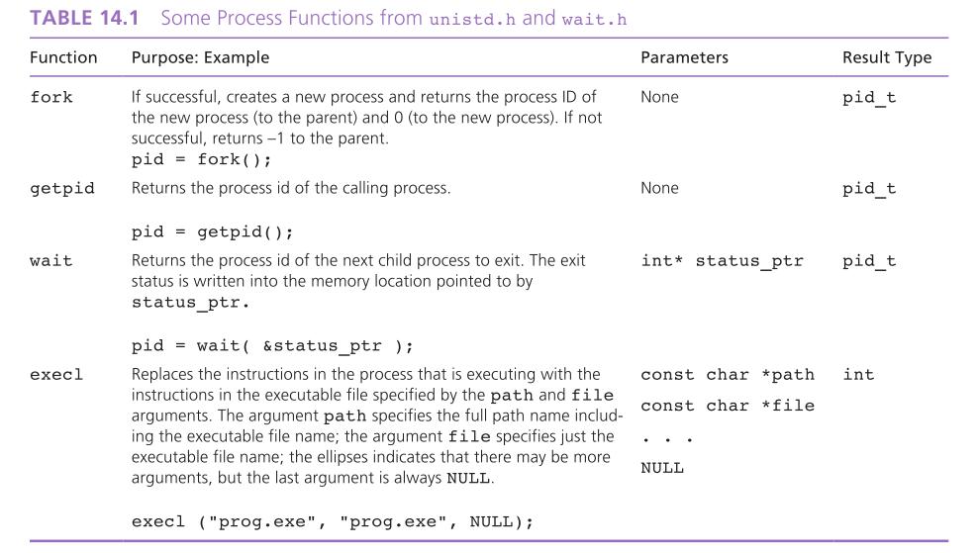

Slide 12
Processes
zombie
a child process that has exited but whose parent process has not yet retrieved its exit status
defunct process
a child process that has exited but whose parent process has not yet retrieved its exit status

Slide 13
Interprocess Communications and Pipes
interprocess communications
the exchange of information between processes that are running on the same CPU and that have a common ancestor
pipe
a form of interprocess communications that consists of two file descriptors, one opened for reading and the other opened for writing

Slide 14
Interprocess Communications and Pipes
half-duplex pipe
a pipe which can send information only in one direction
full-duplex pipe
a pipe which can send information in both directions at the same time

Slide 15
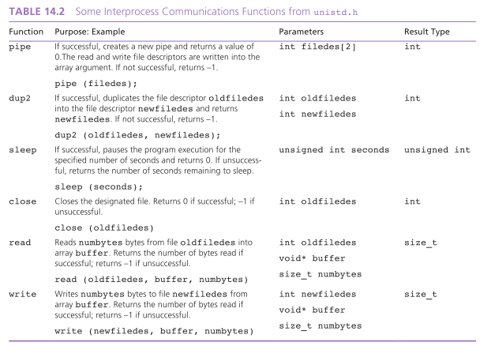

Slide 16
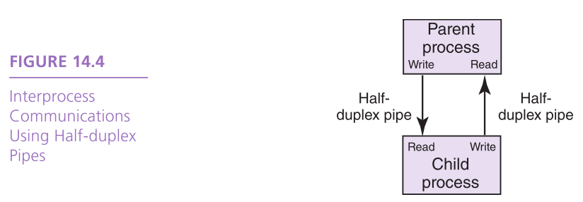

Slide 17
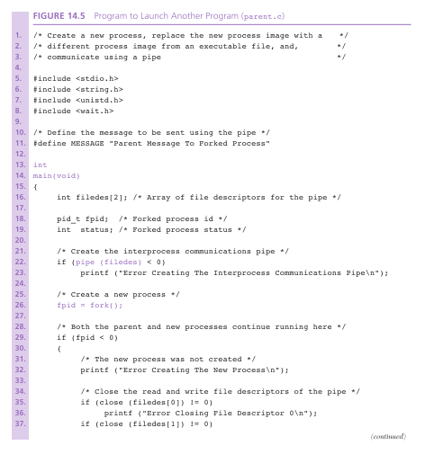

Slide 18
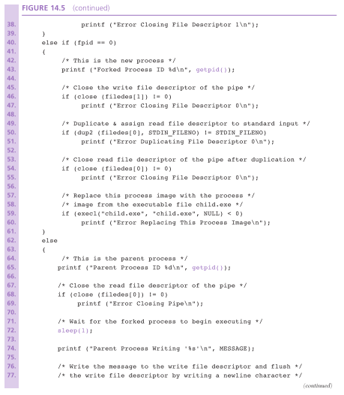

Slide 19
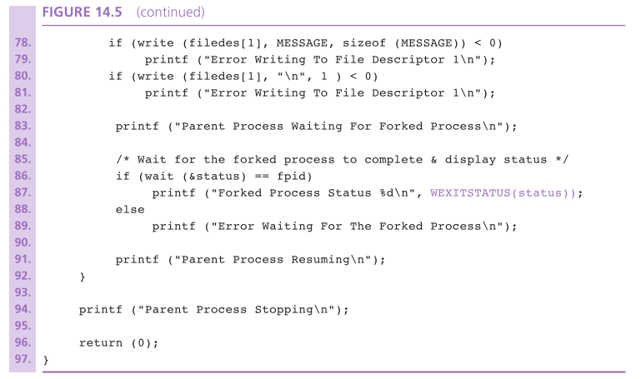

Slide 20
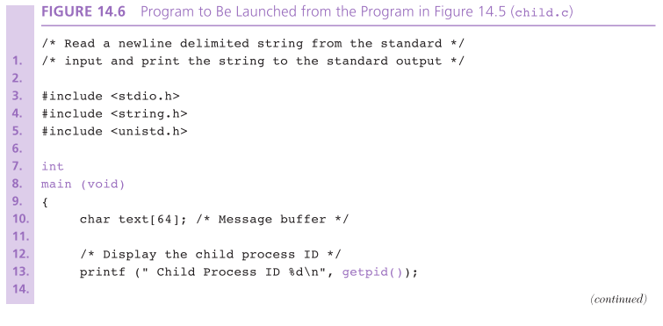

Slide 21
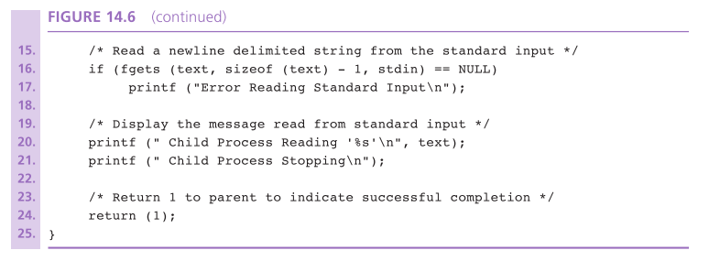

Slide 22
Threads
thread
one process among a set of cooperating subprocesses that run within the same process image and memory context and share the process-related resources with each other
thread of control
the currently executing thread

Slide 23
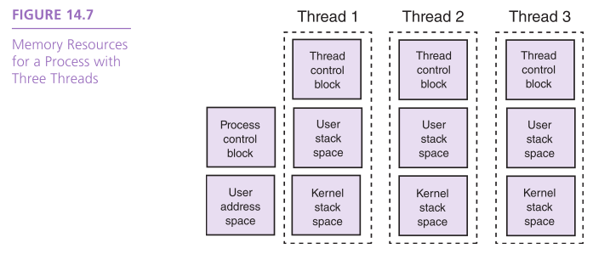

Slide 24
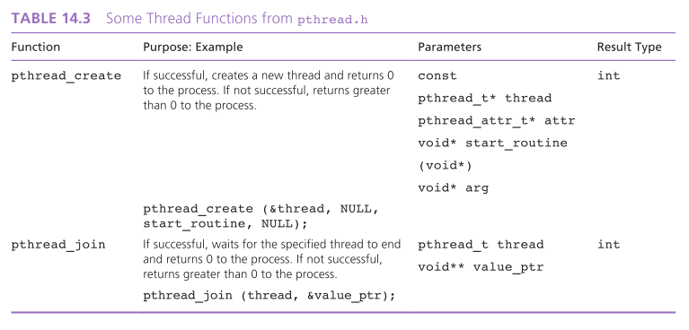

Slide 25
Thread Synchronization
data inconsistency
data errors arising because one thread accesses a shared resource while another thread is in the process of modifying it

Slide 26
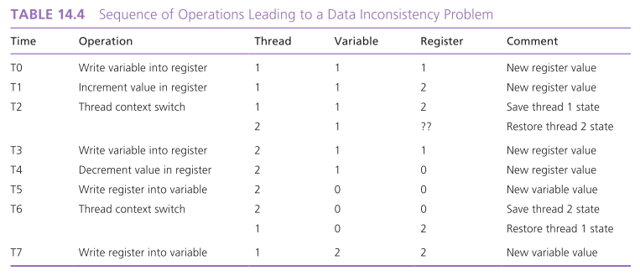

Slide 27
Mutual Exclusion Locking
mutual exclusion locking
accomplished thread synchronization by using a lock and release mechanism to restrict access to the shared resources to one thread at any given moment

Slide 28
Mutual Exclusion Locking
mutex
a particular form of mutual exclusion locking that utilizes a variable which can only be locked or released by one thread at a time
a thread must attempt to lock the mutex variable before accessing a shared resource, and it must release it after accessing the shared resource

Slide 29
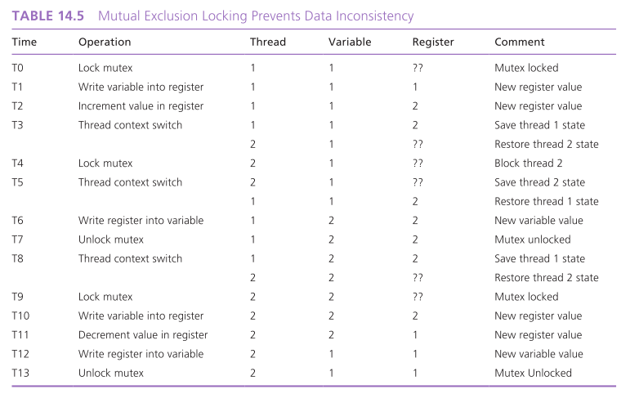

Slide 30
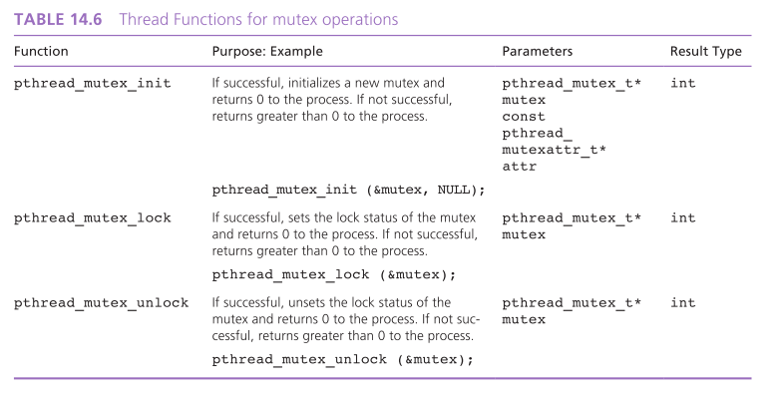

Slide 31
Deadlocks
Synchronization locks, such as a mutex, can cause threads to deadlock when they are not used properly.
deadlock
a situation in which a thread is blocked (cannot execute) because it is attempting to lock a mutex that is already locked by another thread that will never release the mutex lock

Slide 32
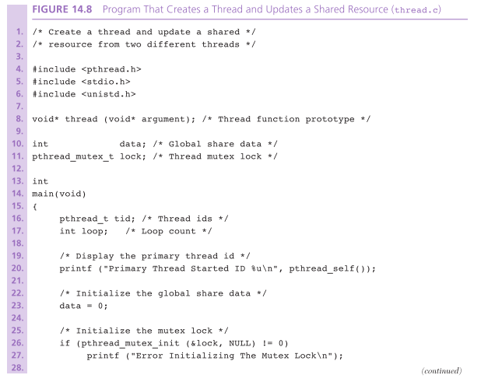

Slide 33
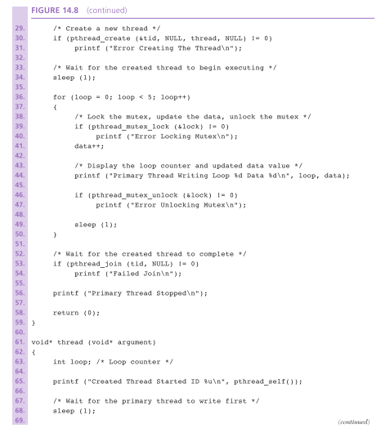

Slide 34
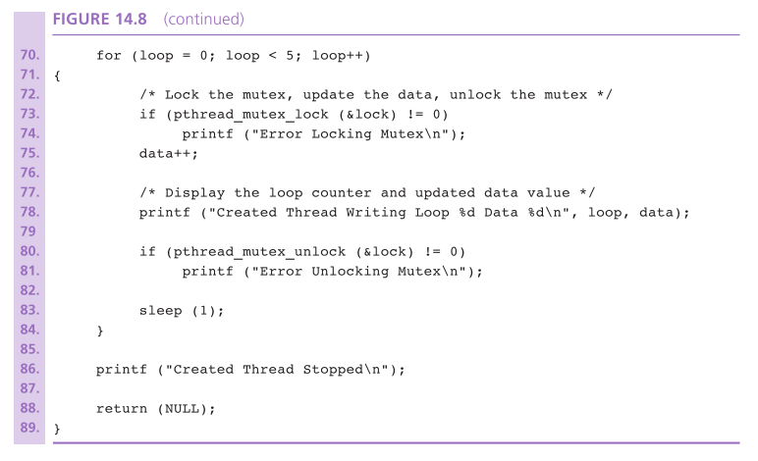

Slide 35
Threads Illustrated
producer thread
a thread that creates a resource that is consumed by other threads
consumer thread
a thread that receives a resource that is produced by another thread

Slide 36
The Producer/Consumer Model
Case Study

Slide 37
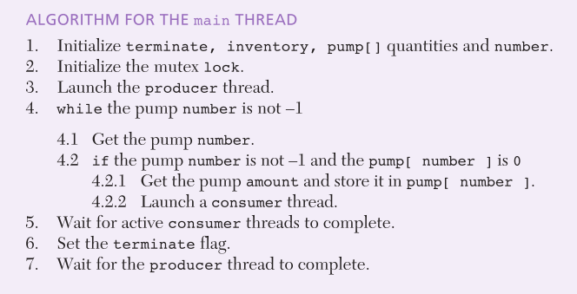
Design

Slide 38
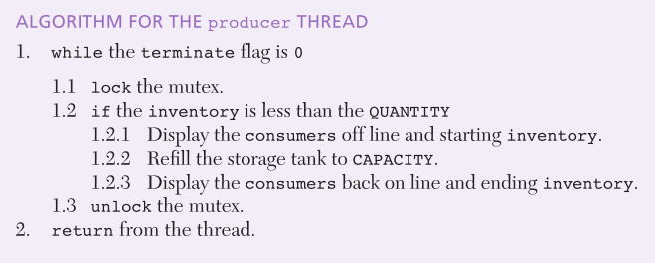
Design

Slide 39
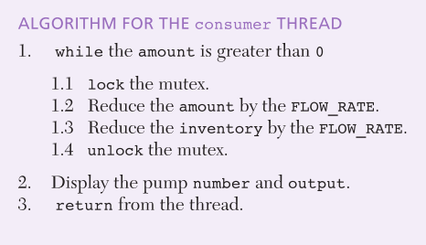
Design

Slide 40
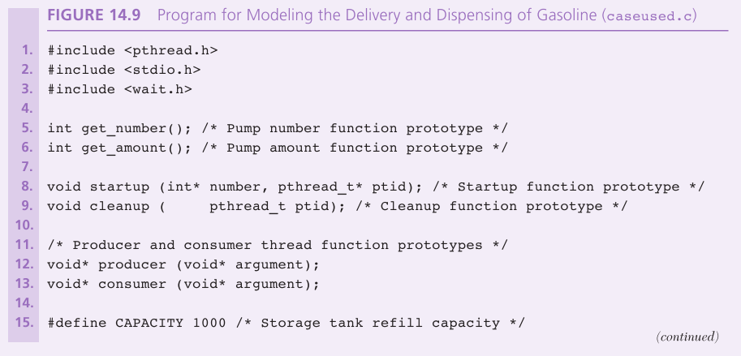

Slide 41
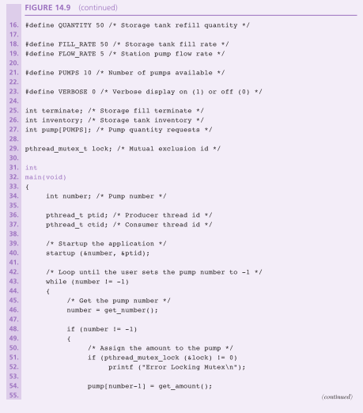

Slide 42
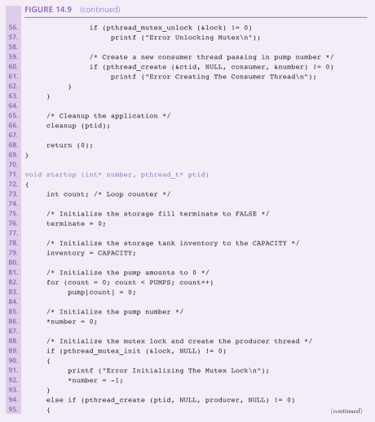

Slide 43
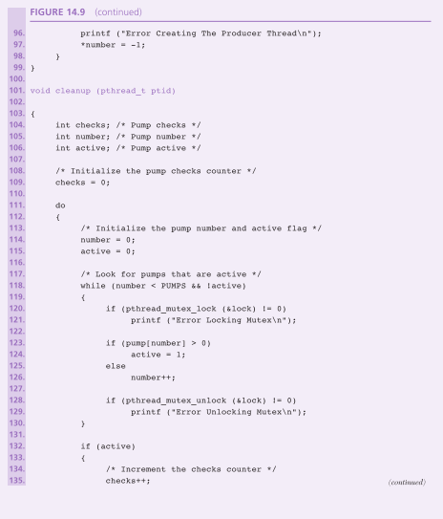

Slide 44
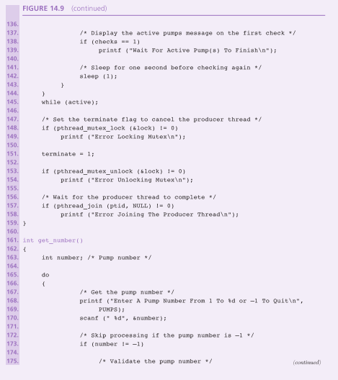

Slide 45
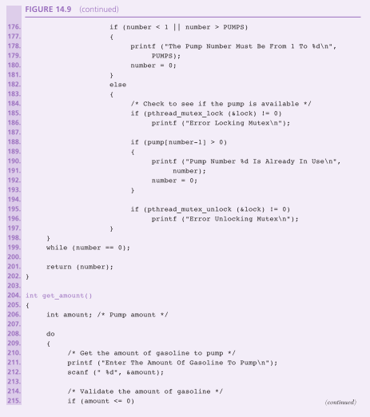

Slide 46
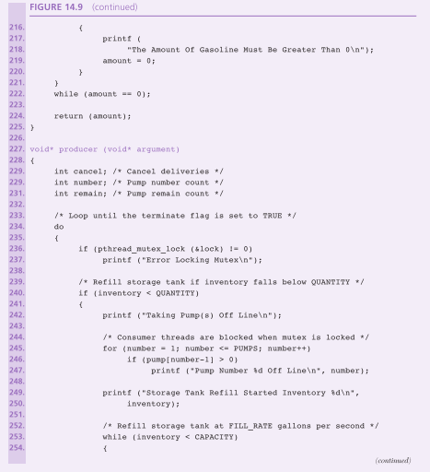

Slide 47
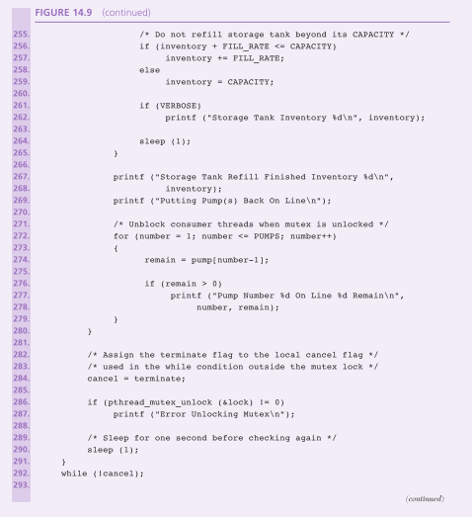

Slide 48
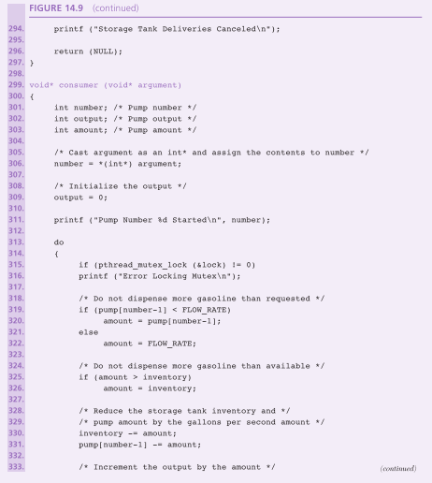

Slide 49
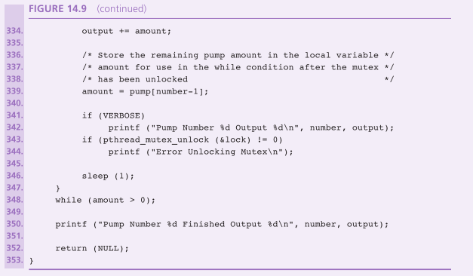

Slide 50
Wrap Up
Multitasking is a way for a single user to run many programs at the same time on a single CPU while still allowing the user to maintain control over the CPU.
Preemptive multitasking is a way to preempt a running program with the hardware interrupt system and instructing the CPU to run another program.
Concurrent programming involves writing sets of program instructions that can execute at the same time independently of one another.

