Slide 1
On to C++ Chapter 15
Problem Solving & Program Design in C
Eighth Edition
Jeri R. Hanly & Elliot B. Koffman

Slide 2
Chapter Objectives
To learn about C++ control structures, input and output operators, and function parameters
To understand how to do object-oriented programming in C++

Slide 3
Terminology
object oriented programming (OOP)
a methodology that creates programs composed of semiautonomous agents called objects
polymorphism
giving a single name to behaviors that are operationally different but conceptually the same

Slide 4
C++ Standard Input/Output
output stream
an output destination for a continuous stream of characters
insertion operator (<<)
an operator that inserts characters in an output stream
extraction operator (>>)
an operator that takes values from an input stream for storage in variables

Slide 5
Reference Parameters
value parameters
a parameter into which the value of the corresponding actual argument is stored, so the function/operator has its own copy of the argument value
reference parameter
a parameter into which the address of the corresponding actual argument is stored, so the function/operator can refer to the original copy of the argument

Slide 6
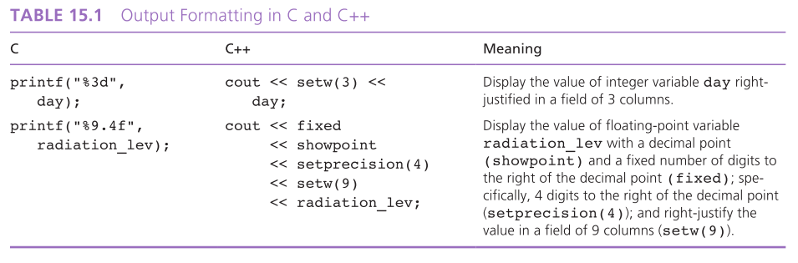
Output Formatting

Slide 7
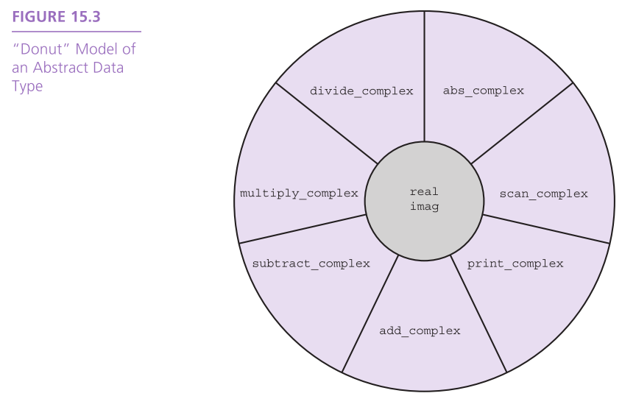

Slide 8
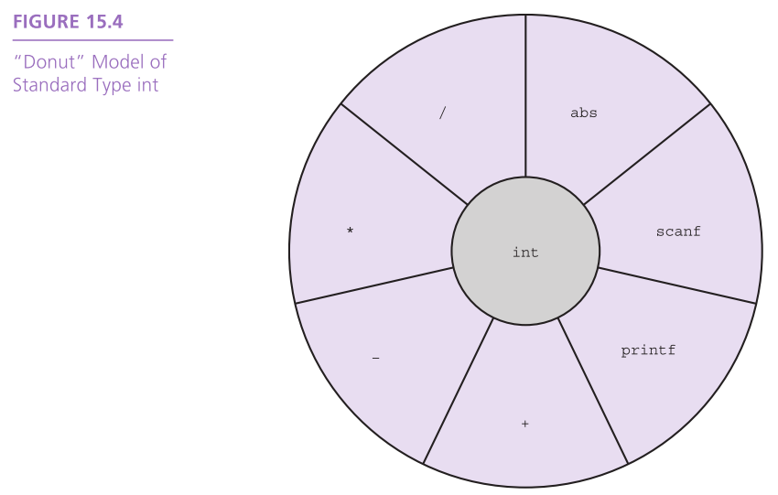

Slide 9
C++ Language Support for OOP
Class definition
the class definition facility allows you to group together the data structure and the operations of the ADT, and it permits you to define automatic conversion from one data type to another
Operator overloading
C++ lets you define how operators should be evaluated when applied to new data types, so a complex number class can include definitions of arithmetic and input/output operators

Slide 10
C++ Language Support for OOP
Function overloading
C++ permits multiple definitions of a function as long as each has a unique signature.
signature
a combination of a function or operator’s name and its parameter (operand) types

Slide 11
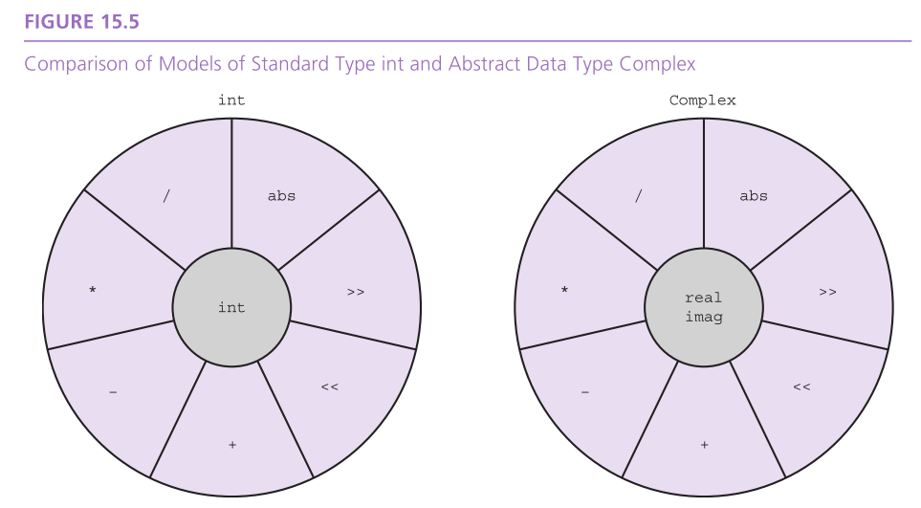

Slide 12
Class Names and Constructors
default constructor
a constructor that requires no arguments
overloading
using the same name for several different functions or operators in a single scope

Slide 13
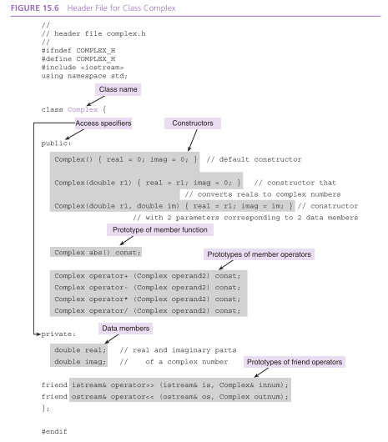

Slide 14
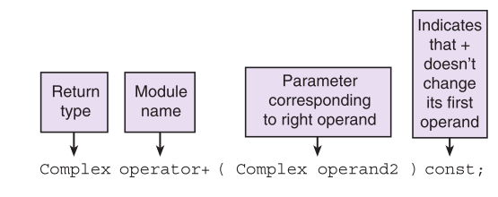

Slide 15
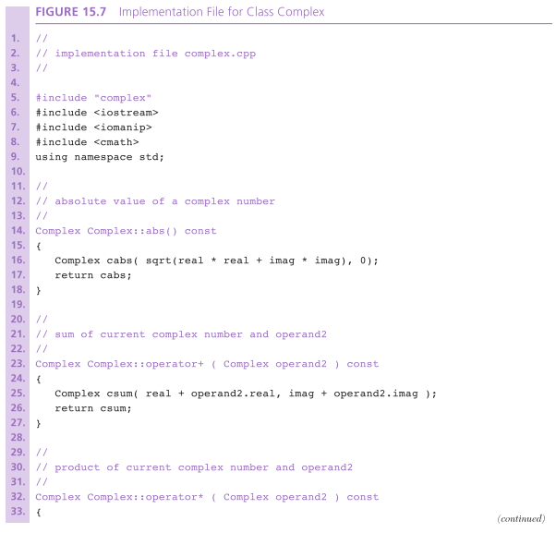

Slide 16
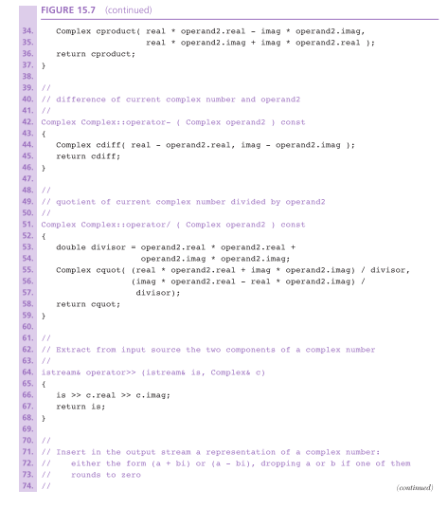

Slide 17
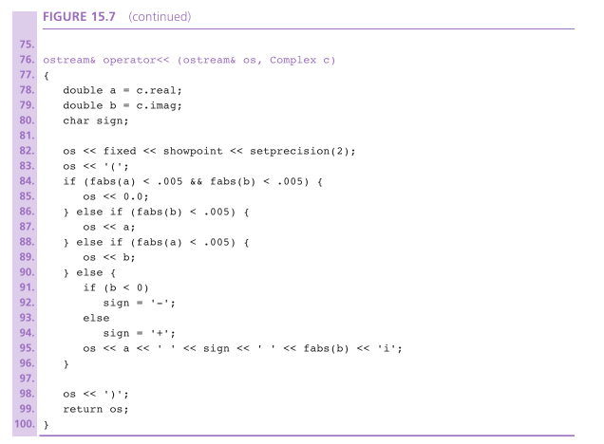

Slide 18
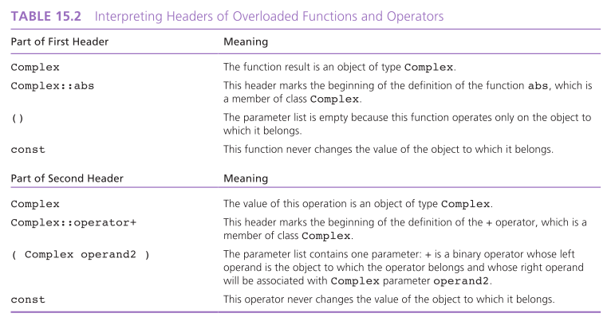

Slide 19
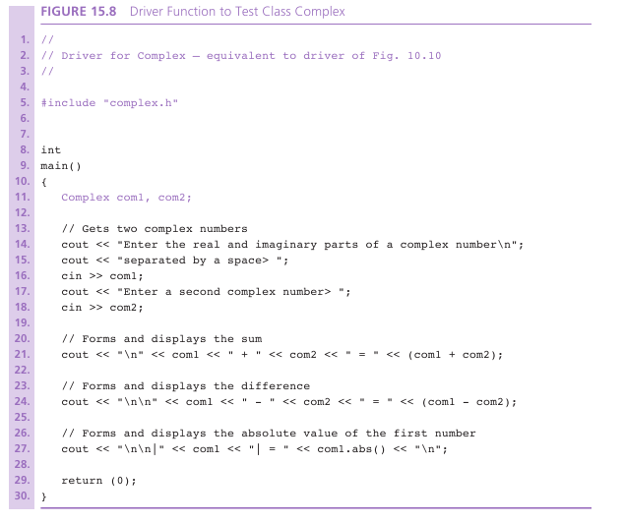

Slide 20
Data Members
The attributes or components of an object are implemented as class data members.
Each data member is declared just as if it were a separate variable.
If a member function or operator needs to refer to the data members of the current object, it simply uses the component name.

Slide 21
Data Members
friend
a nonmember operator or function given permission to access the private members of a class
Private members are accessible to all member functions and constructors, the code units that refer to these members by name.
Additional code units can be given access to private members by designating them as friends of the class.

Slide 22
Wrap Up
An object is a semiautonomous agent that encapsulates both attributes (data) and behaviors (functions and operators).
C++ does standard input and output by using the input extraction (>>) and output insertion (<<) operators.
The C++ iostream library associates the output stream cout with the screen and the input stream cin with the keyboard

Slide 23
Wrap Up
C++ permits multiple definitions of a single operator or function name, provided that the list of parameter/operand types is unique for each definition.
C++ uses the same control structures as C
if, if-else, switch, while, for, do-while
A C++ class is a type of object that has all the same collections of attributes and behaviors.

Slide 24
Wrap Up
C++ object attributes are implemented as class data members whose accessibility is usually private – that is accessible ony to class members and friends.
C++ object behaviors and services are implemented as class member operators and function.
All classes provide the service of construction, which allows declaration and initialization of objects.
C++ overloaded operators can be implemented as members of a class when the first operand is an object of that class.

