Slide 1
Overview of C Chapter 2
Problem Solving & Program Design in C
Eighth Edition
Jeri R. Hanly & Elliot B. Koffman

Slide 2
Chapter Objectives
To become familiar with the general form of a C program and the basic elements in a program
To appreciate the importance of writing comments in a program
To understand the use of data types and the differences between the data types int, double, and char
To know how to declare variables

Slide 3
Chapter Objectives
To understand how to write assignment statements to change the value of variables
To learn how C evaluates arithmetic expressions and how to write them in C
To learn how to read data values into a program and to display results
To understand how to write format strings for data entry and display

Slide 4
Chapter Objectives
To learn how to use redirection to enable the use of files for input/output
To understand the differences between syntax errors, run-time errors, and logic errors, and how to avoid them and to correct them

Slide 5
C
A high-level programming language
Developed in 1972 by Dennis Ritchie at AT&T Bell Labs
Designed as the language to write the Unix operating system
Resembles everyday English
Very popular

Slide 6
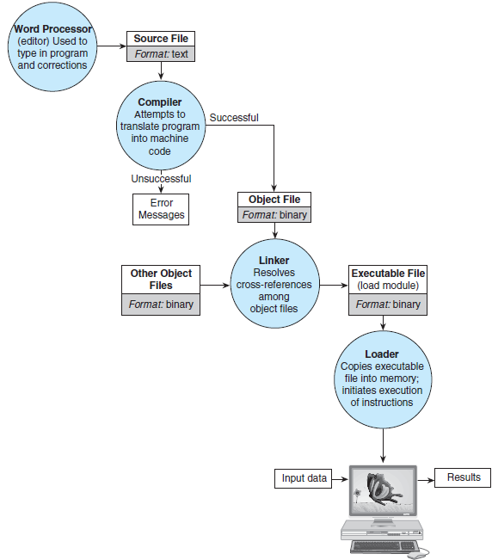
Figure 1.11 Entering, Translating, and Running a High-Level Language Program

Slide 7
Language Elements
preprocessor
a system program that modifies a C program prior to its compilation
library
a collection of useful functions and symbols that may be accessed by a program
each library has a standard header file whose name ends with the symbols “.h”
stdio.h

Slide 8
Language Elements
preprocessor directive
a C program line beginning with # that provides an instruction to the preprocessor
#include <stdio.h>
#define KMS_PER_MILE 1.609

Slide 9
Language Elements
constant macro
a name that is replaced by a particular constant value before the program is sent to the compiler
#define KMS_PER_MILE 1.609
constant macro
constant
kms = KMS_PER_MILE * miles;

Slide 10
Language Elements
comment
text beginning with /* and ending with */ that provides supplementary information but is ignored by the preprocessor and compiler
for single-line comments, can use // (introduced in C99)
/* Get the distance in miles */
// Get the distance in miles

Slide 11
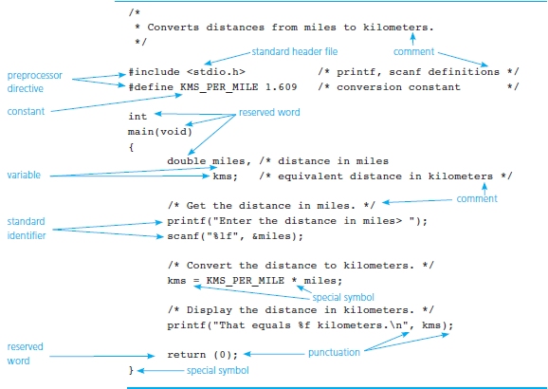
Figure 2.1 C Language Elements in Miles-to-Kilometers Conversion Program

Slide 12
Function main
Every C program has a main function.
These lines mark the beginning of the main function where program execution begins.
int main (void)

Slide 13
Function main
declarations
the part of a program that tells the compiler the names of memory cells in a program
executable statements
program lines that are converted to machine language instructions and executed by the computer

Slide 14
Variable Declarations
variable
a name associated with a memory cell whose value can change
variable declarations
statements that communicate to the compiler the names of variables in the program and the kind of information stored in each variable

Slide 15
Variable Declarations
C requires you to declare every variable used in a program.
A variable declaration begins with an identifier that tells the C compiler the type of data store in a particular variable.
int hours;
double miles;

Slide 16
Data Types
int
a whole number
435
double
a real number with an integral part and a fractional part separated by a decimal point
3.14159
char
an individual character value
enclosed in single quotes
‘A’, ‘z’, ‘2’, ‘9’, ‘*’, ‘!’

Slide 17
Executable Statements
Follow the declarations in a function.
Used to write or code the algorithm and its refinements.
Are translated into machine language by the compiler.
The computer executes the machine language version.

Slide 18
Executable Statements
assignment statement
an instruction that stores a value of a computational result in a variable
kms = KMS_PER_MILE * miles;

Slide 19
Executable Statements
Assignment is not the same as an algebraic equation.
The expression to the right of the assignment operator is first evaluated.
Then the variable on the left side of the assignment operator is assigned the value of that expression.
sum = sum + item;

Slide 20
The printf Function
Displays a line of program output.
Useful for seeing the results of a program execution.
printf(“That equals %f kilometers. \n”, kms);

Slide 21
The printf Function
function argument
enclosed in parentheses following the function name
provides information needed by the function
printf(“That equals %f kilometers. \n”, kms);
function name

Slide 22
The printf Function
format string
in a call to printf, a string of characters enclosed in quotes, which specifies the form of the output line
printf(“That equals %f kilometers. \n”, kms);

Slide 23
The printf Function
print list
in a call to printf, the variables or expressions whose values are displayed
placeholder
a symbol beginning with % in a format string that indicates where to display the output value
printf(“That equals %f kilometers. \n”, kms);

Slide 24
Formatting Numbers in Program Output
field width
the number of columns used to display a value
No. of decimal places
When formatting doubles, you may indicate the total field width needed and the number of decimal places desired.
printf(“Your result equals %5.1f kilometers. \n”, kms);

Slide 25
Let’s write a C program
That stores an int, double, and char variable, and prints them all out.

Slide 26
Placeholders in format string
Placeholder | Variable Type | Function Use
%c | char | printf/scanf
%d | int | printf/scanf
%f | double | printf
%lf | double | scanf

Slide 27
The scanf Function
Copies data from the standard input device (usually the keyboard) into a variable.
scanf(“%lf”, &miles);
scanf(“%c%c%c”, &letter_1, &letter_2, &letter_3);
Must pass address of variable to store using the addressof operator (&)

Slide 28
The return Statement
Last line in the main function.
Transfers control from your program to the operating system.
The value 0 indicates that your program executed without an error.
return (0);

Slide 29
Arithmetic Operators
Arithmetic Operator | Meaning | Example
+ | addition | 5 + 2 is 7 5.0 + 2.0 is 7.0
– | subtraction | 5 – 2 is 3 5.0 – 2.0 is 3.0
* | multiplication | 5 * 2 is 10 5.0 * 2.0 is 10.0
/ | division | 5.0 / 2.0 is 2.5 5 / 2 is 2
% | remainder | 5 % 2 is 1

Slide 30
Type casting
converting an expression to a different type by writing the desired type in parentheses in front of the expression
int x = 5;
double y = (double) x;

Slide 31
Rules for Evaluating Expressions
Parentheses rule
all expression must be evaluated separately
nested parentheses evaluated from the inside out
innermost expression evaluated first
Operator precedence rule
unary +, - first (setting sign)
*, /, % next
binary +, - last
Note prefix and postfix increment/decrement!
++a and --a are executed before value is used
a++ and a-- are executed after value is used

Slide 32
Rules for Evaluating Expressions
Right Associativity
Unary operators in the same subexpression and at the same precedence level are evaluated right to left.
Left Associativity
Binary operators in the same subexpression and at the same precedence lever are evaluated left to right.

Slide 33
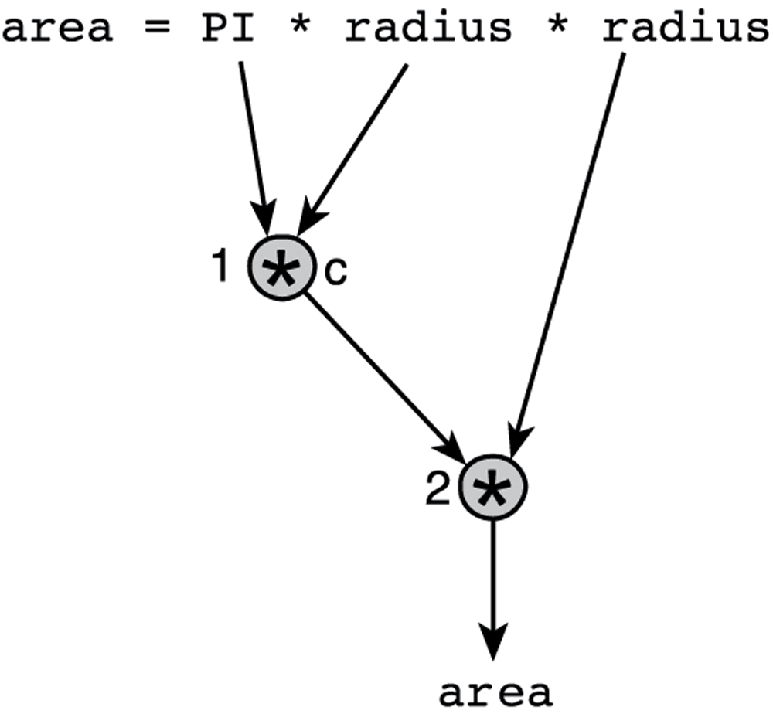
Figure 2.9 Evaluation Tree for area = PI * radius * radius;

Slide 34
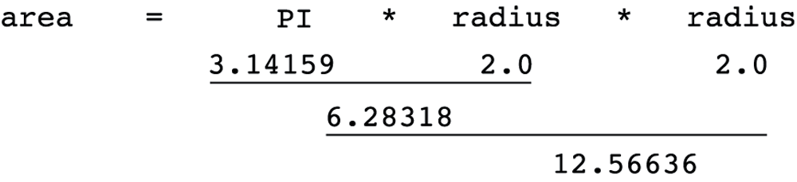
Figure 2.10 Step-by-Step Expression Evaluation

Slide 35
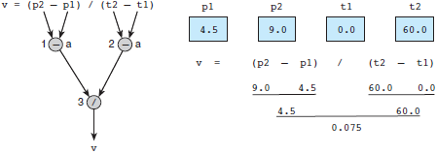
Figure 2.11 Evaluation Tree and Evaluation for v = (p2 - p1) / (t2 - t1);

Slide 36
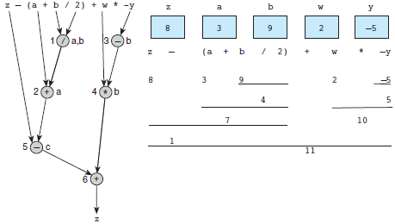
Figure 2.12 Evaluation Tree and Evaluation for z - (a + b / 2) + w * -y

Slide 37
Common Programming Errors
debugging
removing errors from a program
syntax error
a violation of the C grammar rules
detected during program translation (compilation)
run-time error
an attempt to perform an invalid operation
detected during program execution
logic errors
an error caused by following an incorrect algorithm

Slide 38
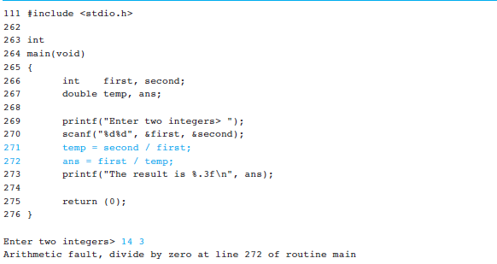
Figure 2.17
A Program with a Run-Time Error

Slide 39
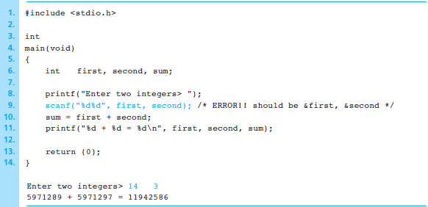
Figure 2.19
A Program That Produces Incorrect Results Due to & Omission

Slide 40
Wrap Up
Every C program has preprocessor directives and a main function.
The main function contains variable declarations and executable statements.
C’s data types enable the compiler to determine how to store a value in memory and what operations can be performed on that value.

