Slide 1
Top-Down Design with Functions Chapter 3
Problem Solving & Program Design in C
Eighth Edition
Jeri R. Hanly & Elliot B. Koffman

Slide 2
Chapter Objectives
To learn about functions and how to use them to write programs with separate modules
To understand the capabilities of some standard functions in C
To understand how control flows between function main and other functions
To learn how to pass information to functions using input arguments
To learn how to return a value from a function

Slide 3
Top-Down Design
top-down design
a problem solving method
first, break a problem up into its major subproblems
solve the subproblems to derive the solution to the original problem

Slide 4
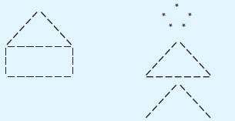
Figure 3.9 House and Stick Figure

Slide 5
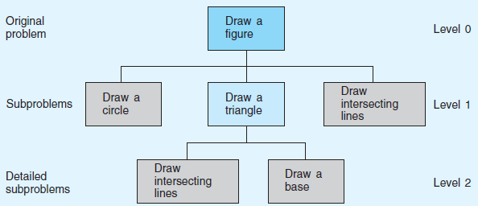
Figure 3.10 Structure Chart for Drawing a Stick Figure

Slide 6
Functions Call Statement (Function Without Arguments)
Syntax
fname();
Example:
draw_circle();
Interpretation
the function fname is called
after fname has finished execution, the program statement that follows the function call will be executed

Slide 7
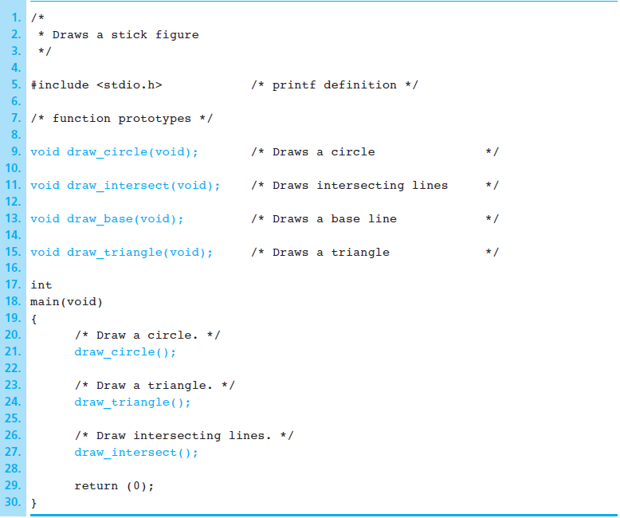
Figure 3.11
Function Prototypes and Main Function for Stick Figure

Slide 8
Function Prototype (Function Without Arguments)
Syntax
ftype fname(void);
Example:
void draw_circle(void);
Interpretation
the identifier fname is declared to be the name of a function
the identifier ftype specifies the data type of the function result

Slide 9
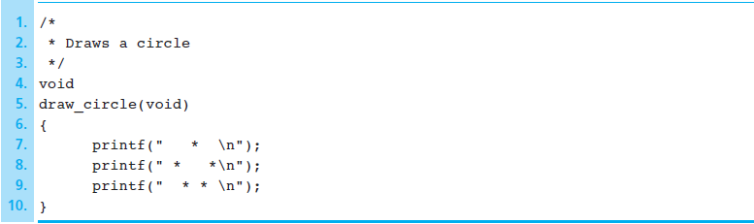
Figure 3.12 Function draw_circle

Slide 10
Function Definitions (Function Without Arguments)
Syntax
ftype
fname(void)
{
local declarations
executable statements
}

Slide 11
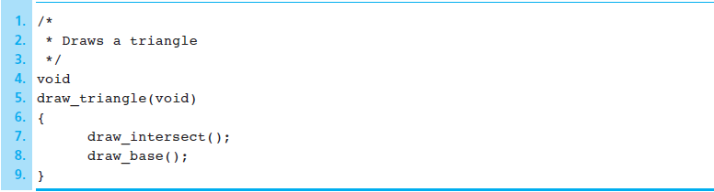
Figure 3.13 Function draw_triangle

Slide 12
Advantages of Using Function Subprograms
procedural abstraction
a programming technique in which a main function consists of function calls and each function is implemented separately
reuse of function subprograms
functions can be executed more than once in a program

Slide 13
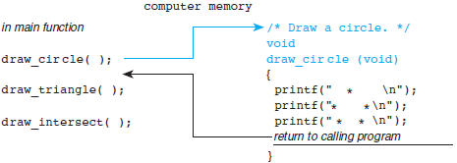
Figure 3.15 Flow of Control Between the main Function and a Function Subprogram

Slide 14
Functions with Input Arguments
input argument
arguments used to pass information into a function subprogram
output argument
arguments used to return results to the calling function

Slide 15
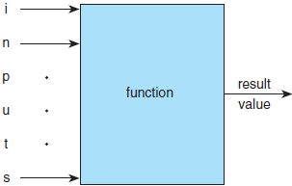
Figure 3.18 Function with Input Arguments and One Result

Slide 16
Functions with Multiple Arguments Argument List Correspondence
The number of actual arguments used in a call to a function must be the same as the number of formal parameters listed in the function prototype.
Each actual argument must be of a data type that can be assigned to the corresponding format parameter with no unexpected loss of information.

Slide 17
Functions with Multiple Arguments Argument List Correspondence
The order of arguments in the lists determines correspondence.
The first actual argument corresponds to the first formal parameter.
The second actual argument corresponds to the second form parameter.
And so on…

Slide 18
Library Functions
code reuse
reusing program fragments that have already been written and tested
C standard libraries
many predefined functions can be found here
stdio.h
math.h
Note: must use –lm flag to compile when using math library
For example, gcc –o exe –Wall my_c_program.c -lm

Slide 19
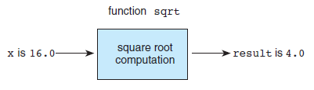
Figure 3.6 Function sqrt as a “Black Box”

Slide 20
C Math Library Functions
Examples
abs(x)
ceil(x)
log(x)
sin(x)
sqrt(x)

Slide 21
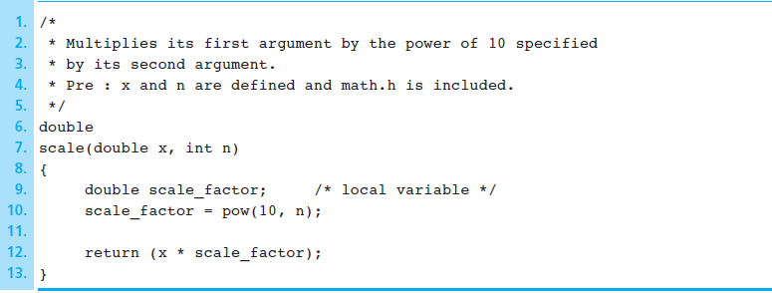
Figure 3.23 Function scale

Slide 22
Wrap Up
Code reuse is good.
When possible, develop your solution from existing information.
Use C’s library functions to simplify mathematical computations.
You can write functions with none, one, or multiple input arguments.
Functions can only return one value.

