Slide 1
Selection Structures: if and switch Statements Chapter 4
Problem Solving & Program Design in C
Eighth Edition
Jeri R. Hanly & Elliot B. Koffman

Slide 2
Chapter Objectives
To become familiar with the three kinds of control structures: sequence, selection, and repetition
To understand compound statements
To learn how to compare numbers and characters
To learn how to use the relational, equality, and logical operators to write expressions that are true or false

Slide 3
Chapter Objectives
To learn how to write selection statements that choose between two alternatives in a program using the if statement
To learn how to implement decisions tin algorithms using the if statement
To understand how to select among more than two alternatives by nesting if statements
To learn how to use the switch statement as another technique for selecting among multiple alternatives

Slide 4
Control Structures
control structure
a combination of individual instructions into a single logical unit with one entry point and one exit point
compound statement
a group of statements bracketed by { and } that are executed sequentially

Slide 5
Compound Statement
{
statement;
statement;
.
.
.
statement;
}

Slide 6
Control Structures
selection control structure
a control structure that chooses among alternative program statements
?

Slide 7
Conditions
an expression that is either false
represented by 0
or true
usually represented by 1
rest_heart_rate > 75

Slide 8
Relational and Equality Operators
Operator | Meaning | Type
< | less than | relational
> | greater than | relational
<= | less than or equal to | relational
>= | greater than or equal to | relational
== | equal to | relational
!= | not equal to | equality

Slide 9
Logical Operators
logical expressions
an expression that uses one or more of the logical operators
&& (and)
|| (or)
! (not)

Slide 10
Logical Operators
logical complement (negation)
the complement of a condition had the value 1 (true) when the condition’s value is 0 (false)
the complement of a condition has the value 0 (false) when the condition’s value is nonzero (true)
! (0 <= n && n <= 100)

Slide 11
Operator Precedence
Operator | Precedence
function calls | highest (evaluated first)
! + - & (unary operator)
* / %
+ -
< <= >= >
== !=
&&
||
= | lowest (evaluated last)

Slide 12
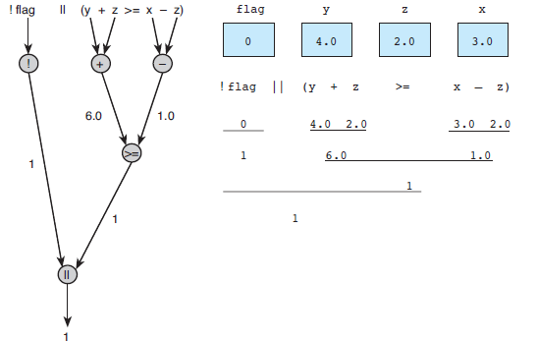
Figure 4.1 Evaluation Tree and Step-by-Step Evaluation for !flag || (y + z >= x - z)

Slide 13
Short-Circuit Evaluation
stopping evaluation of a logical expression as soon as its value can be determined
(div != 0 && (num % div == 0))

Slide 14
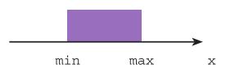
Figure 4.2
Range of True Values for min <= x && x <= max

Slide 15
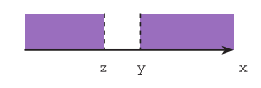
Figure 4.3
Range of True Values for z > x || x > y

Slide 16
Comparing Characters
Expression | Value
‘9’ >= ‘0’ | 1 (true)
‘a’ < ‘e’ | 1 (true)
‘B’ <= ‘A’ | 0 (false)
‘Z’ == ‘z’ | 0 (false)
‘a’ <= ‘A’ | System dependent
‘a’ <= ch && ch <= ‘z’ | 1 (true) if ch is a lowercase letter

Slide 17
The if-statement
making decisions

Slide 18
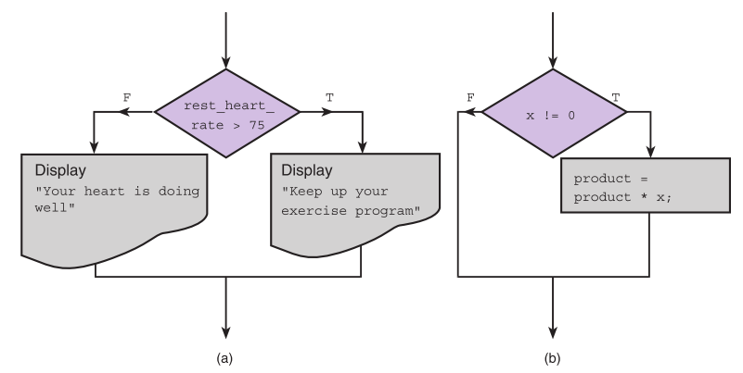
Figure 4.4 Flowcharts of if Statements with (a) Two Alternatives and (b) One Alternative

Slide 19
if-statement with one alternative
if (x != 0) product = product * x;

Slide 20
if-statement with two alternatives
if (rest_heart_rate > 75) printf(“Keep up your exercise program!\n”);
else
printf(“Your hear is doing well!\n”);

Slide 21
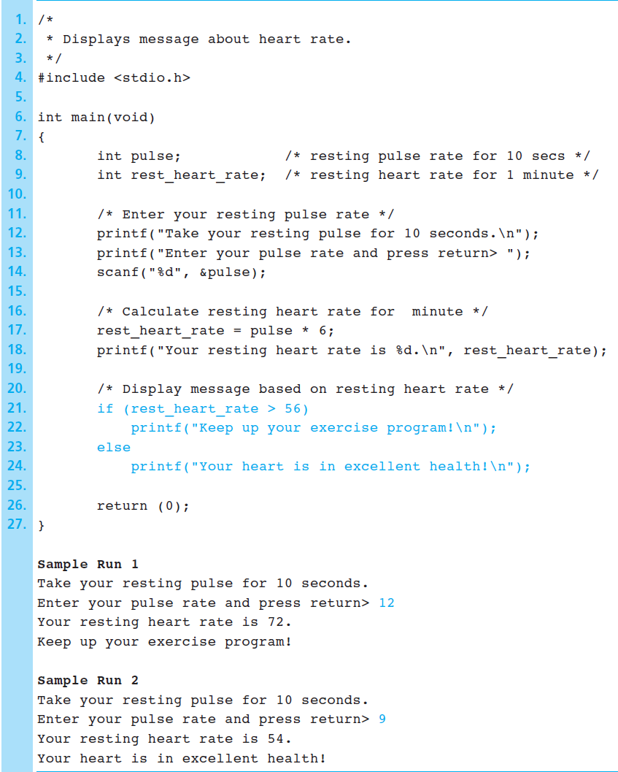
Figure 4.5 Program Using an if statement for selection

Slide 22
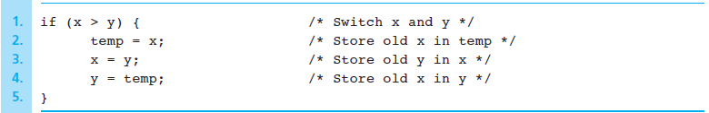
Figure 4.6 if Statement to Order x and y

Slide 23
Water Bill Problem
Case Study

Slide 24
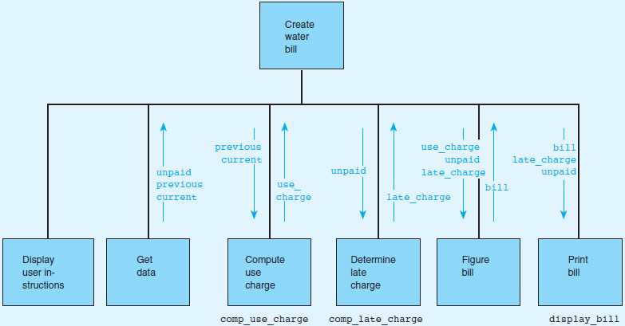
Figure 4.7 Structure Chart for Water Bill Problem

Slide 25
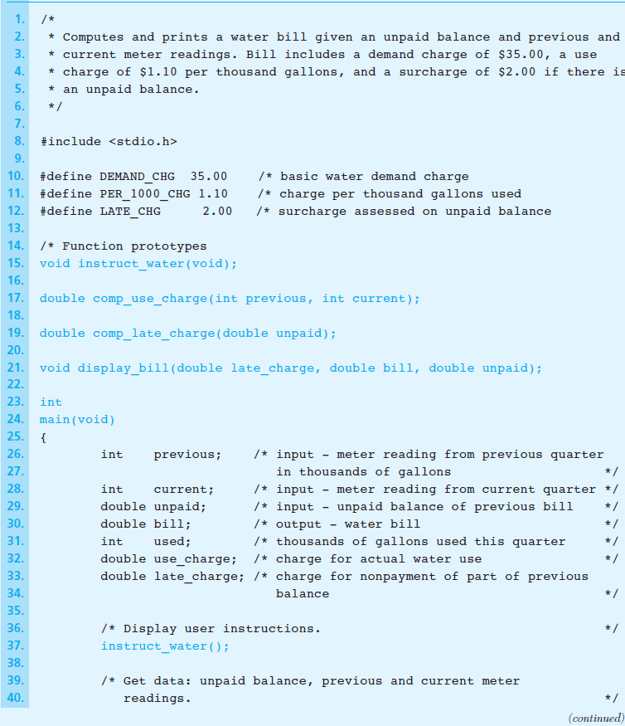
Figure 4.8 Program for Water Bill Problem

Slide 26
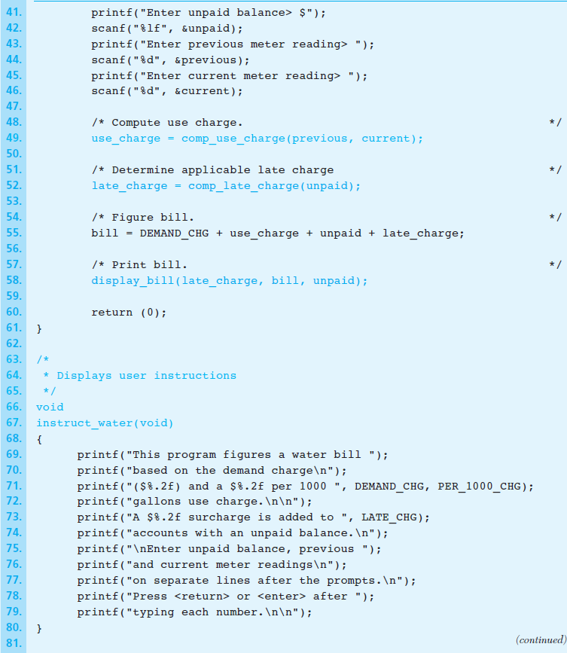
Figure 4.8 Program for Water Bill Problem (cont.)

Slide 27
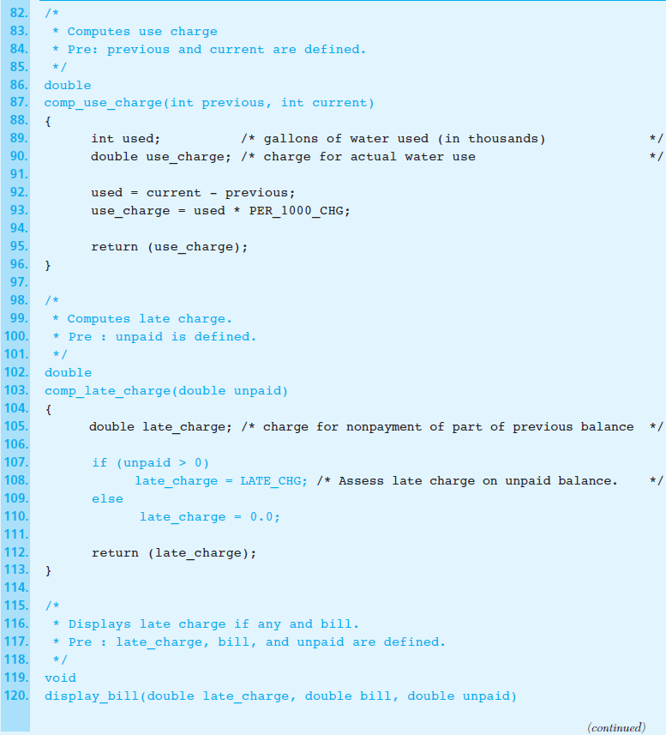
Figure 4.8 Program for Water Bill Problem (cont.)

Slide 28
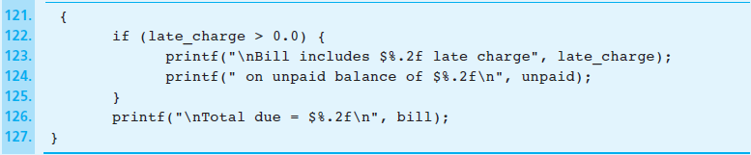
Figure 4.8 Program for Water Bill Problem (cont.)

Slide 29
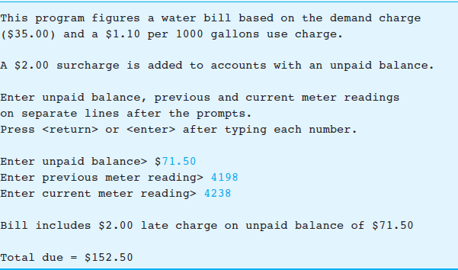
Figure 4.9 Sample Run of Water Bill Program

Slide 30
Program Style
Consistent Use of Names in Functions
Cohesive Functions
a function that performs a single operation
Using Constant Macros to Enhance Readability and Ease Maintenance

Slide 31
Water Bill with Conservation Requirements
Case Study

Slide 32
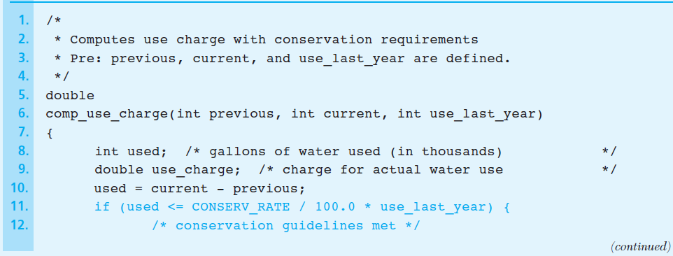
Figure 4.10 Function comp_use_charge Revised

Slide 33
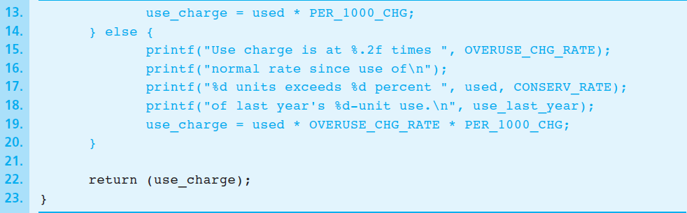
Figure 4.10 Function comp_use_charge Revised (cont.)

Slide 34
Nested if-statement
an if statement with another if statement as its true task or its false task
if (x > 0)
num_pos = num_pos + 1
else
if (x < 0)
num_neg = num_neg + 1
else /* x equals 0 */
num_zero = num_zero + 1

Slide 35
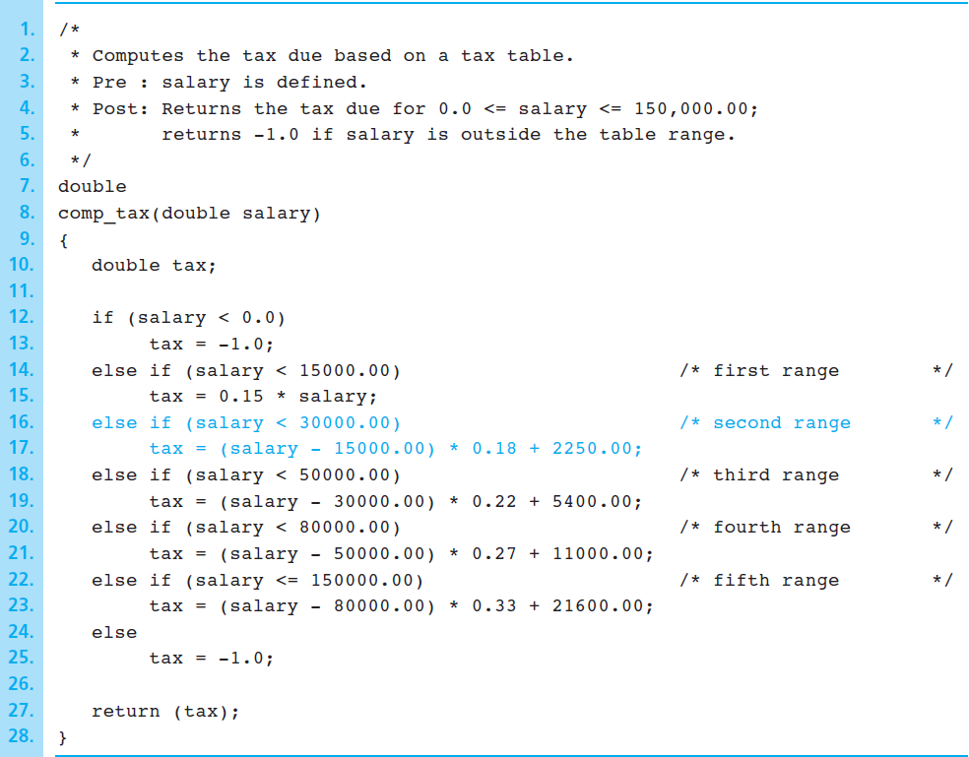
Figure 4.11 Function comp_tax

Slide 36
Nested if-statements with more than one variable
if (road_status == ‘S’)
if (temp > 0) {
printf(“Wet roads ahead\n”);
printf(“Stopping time doubled\n”);
} else {
printf(“Icy roads ahead\n”);
printf(“Stopping time quadrupled\n”);
}
else
printf(“Drive carefully!\n”)

Slide 37
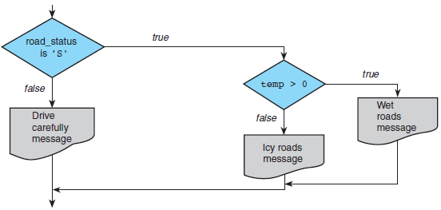
Figure 4.12 Flowchart of Road Sign Decision Process

Slide 38
The switch statement
also used to select one of several alternatives
useful when the selection is based on the value of
a single variable
or a simple expression
values may of type int or char
not double
controlling expression

Slide 39
Syntax
switch (controlling expression) {
label set₁
statements₁
break;
label set₂
statements₂
break;
.
.
.
label set_{n}
statements_{n}
break;

Slide 40
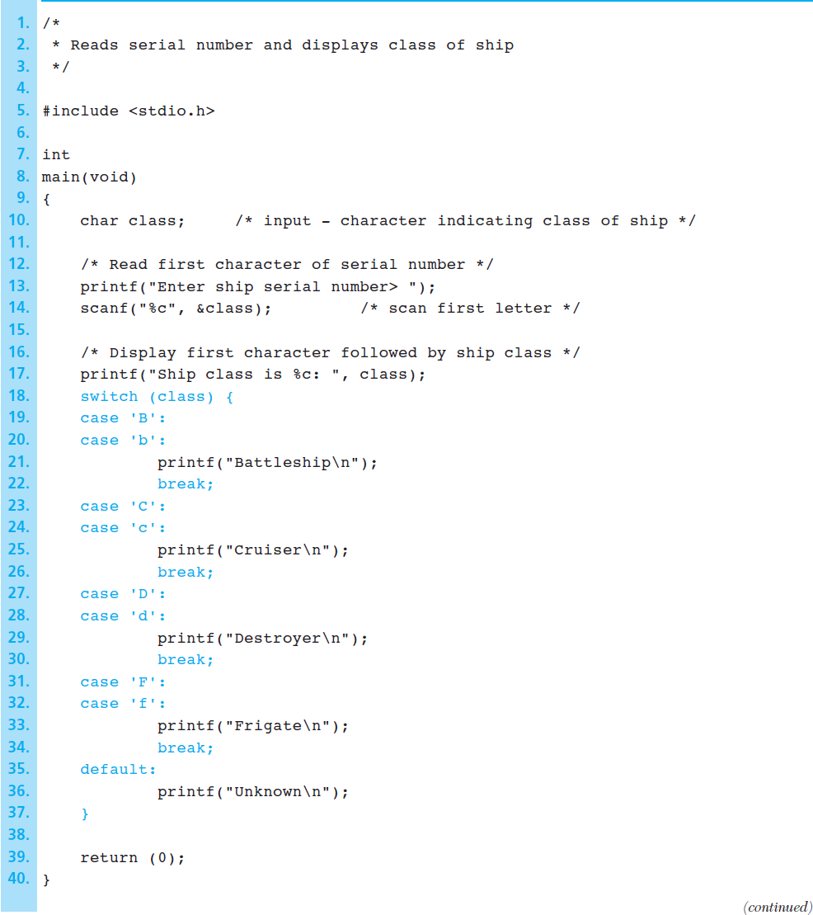
Figure 4.13 Program Using a switch Statement for Selection

Slide 41
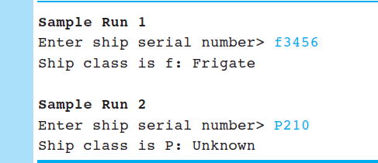
Figure 4.13 Program Using a switch Statement for Selection (cont.)

Slide 42
Wrap Up
Use control structures to control the flow of statement execution in a program.
Use selection control structures to represent decisions in an algorithm.
Nested if statements are common in C and are used to represent decisions with multiple alternatives.
The switch statement implements decisions with several alternatives where the alternative selected depends on the value of a variable or (controlling) expression.

