Slide 1
Repetition and Loop Statements Chapter 5
Problem Solving & Program Design in C
Eighth Edition
Jeri R. Hanly & Elliot B. Koffman

Slide 2
while Statement Syntax
while (loop repetition condition)
statement;
/* display N asterisks. */
count_star = 0
while (count_star < N) {
printf(“*”);
count_star = count_star + 1;
}

Slide 3
Increment and Decrement Operators
counter = counter + 1 count += 1 counter++
counter = counter - 1 count -= 1 counter--

Slide 4
Compound assignment
Operator | Definition
+ | addition
- | subtraction
* | multiplication
/ | division
% | remainder
Can do these too:
+=
-=
*=
/=
%=

Slide 5
Increment and Decrement Operators
side effect
a change in the value of a variable as a result of carrying out an operation

Slide 6
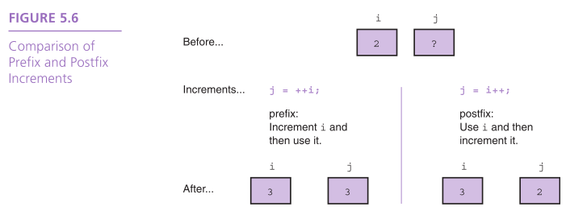

Slide 7
The for Statement Syntax
for (initialization expression;
loop repetition condition;
update expression)
statement;
/* Display N asterisks. */
for (count_star = 0;
count_star < N;
count_star += 1)
printf(“*”);

Slide 8
do-while Statement
For conditions where we know that a loop must execute at least one time
Get a data value
If data value isn’t in the acceptable range, go back to step 1.

Slide 9
do-while Syntax
We will talk more about the output of scanf next time
do
statement;
while (loop repetition condition);
/* Find first even number input */
do
status = scanf(“%d”, &num);
while (status > 0 && (num % 2) != 0);

Slide 10
Nested Loops
Loops may be nested just like other control structures
Nested loops consist of an outer loop with one or more inner loops
Each time the outer loop is repeated, the inner loops are reentered, their loop control expressions are reevaluated, and all required iterations are performed

Slide 11
Chapter Objectives
To understand why repetition is an important control structure in programming
To learn about loop control variables and the three steps needed to control loop repetition
To learn how to use the C for, while, and do-while statements for writing loops and when to use each statement type
To learn how to accumulate a sum or a product within a loop body

Slide 12
Chapter Objectives
To learn common loop patterns such as counting loops, sentinel-controlled loops, and flag-controlled loops
To understand nested loops and how the outer loop control variable and inner loop control variable are changed in a nested loop
To learn how to debug programs using a debugger
To learn how to debug programs by adding diagnostic output statements

Slide 13
Repetition in Programs
loop
a control structure that repeats a group of steps in a program
loop body
the statements that are repeated in the loop

Slide 14
Comparison of Loop Kinds
counting loop
we can determine before loop execution exactly how many loop repetitions will be needed to solve the problem
while, for
sentinel-controlled loop
input of a list of data of any length ended by a special value
while, for

Slide 15
Comparison of Loop Kinds
endfile-controlled loop
input of a single list of data of any length from a data file
while, for
input validation loop
repeated interactive input of a data value until a value within the valid range is entered
do-while
general conditional loop
repeated processing of data until a desired condition is met
while, for

Slide 16
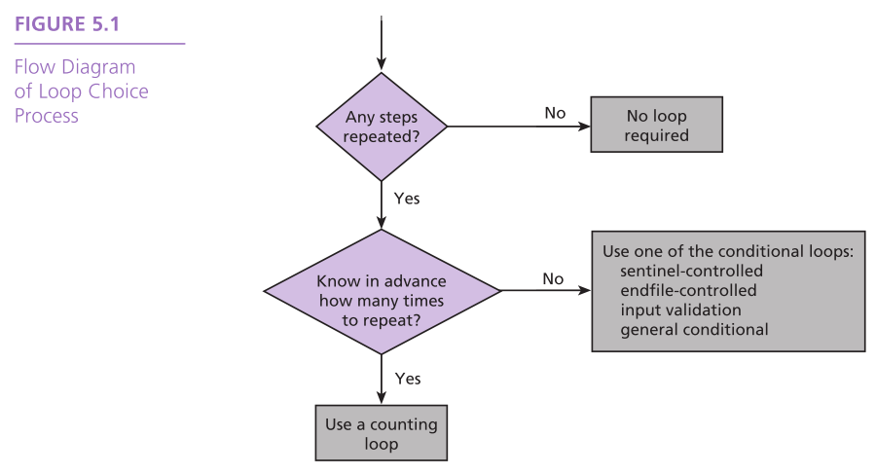

Slide 17
Counting Loops
counter-controlled loop
a.k.a. counting loop
a loop whose required number of iterations can be determined before loop execution begins
loop repetition condition
the condition that controls loop repetition

Slide 18
Counting Loops
loop control variable
the variable whose value controls loop repetition
infinite loop
a loop that executes forever

Slide 19
while Statement Syntax
while (loop repetition condition)
statement;
/* display N asterisks. */
count_star = 0
while (count_star < N) {
printf(“*”);
count_star = count_star + 1;
}

Slide 20
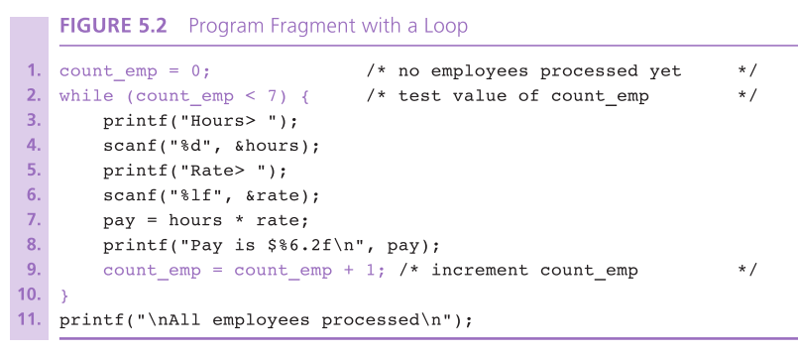

Slide 21
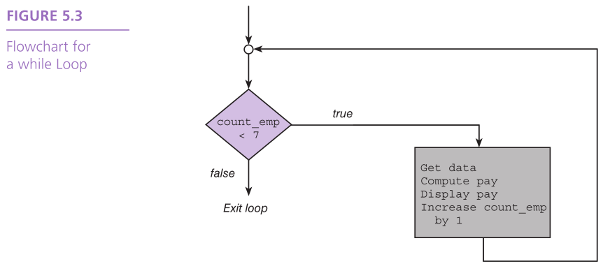

Slide 22
Computing a Sum or Product in a Loop
accumulator
a variable used to store a value being computed in increments during the execution of a loop

Slide 23
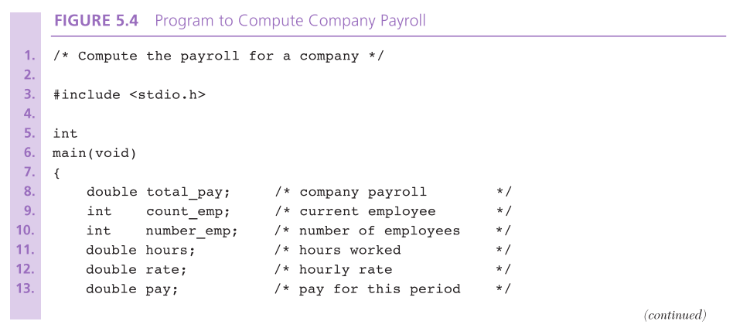

Slide 24
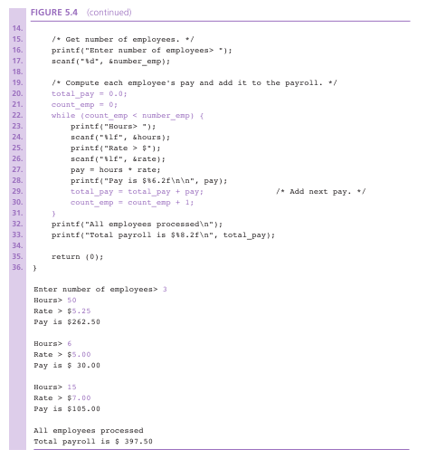

Slide 25
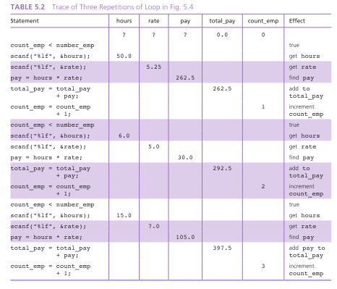

Slide 26
General Conditional Loop
Initialize loop control variable.
As long as exit condition hasn’t been met
Continue processing

Slide 27
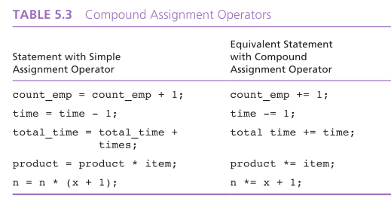

Slide 28
Loop Control Components
initialization of the loop control variable
test of the loop repetition condition
change (update) of the loop control variable
the for loop supplies a designated place for each of these three components

Slide 29
The for Statement Syntax
for (initialization expression;
loop repetition condition;
update expression)
statement;
/* Display N asterisks. */
for (count_star = 0;
count_star < N;
count_star += 1)
printf(“*”);

Slide 30
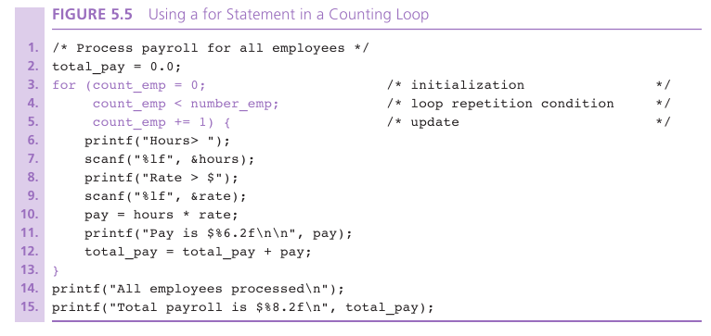

Slide 31
Increment and Decrement Operators
counter = counter + 1 count += 1 counter++
counter = counter - 1 count -= 1 counter--

Slide 32
Increment and Decrement Operators
side effect
a change in the value of a variable as a result of carrying out an operation

Slide 34
Computing Factorial
loop body executes for decreasing value of i from n through 2
each value of i is incorporated in the accumulating product
loop exit occurs when i is 1

Slide 35
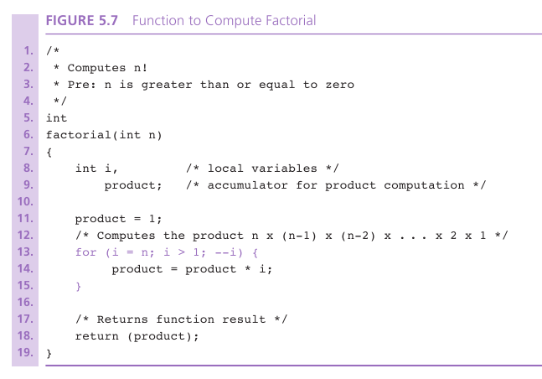

Slide 36
Conditional Loops
used when there are programming conditions when you will not be able to determine the exact number of loop repetitions before loop execution begins

Slide 37
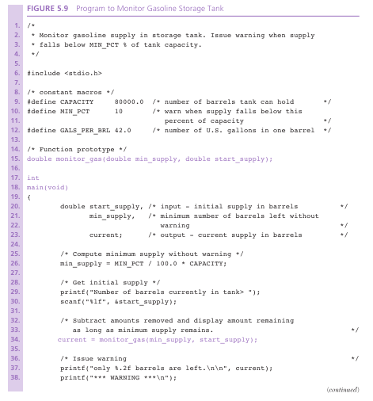

Slide 38
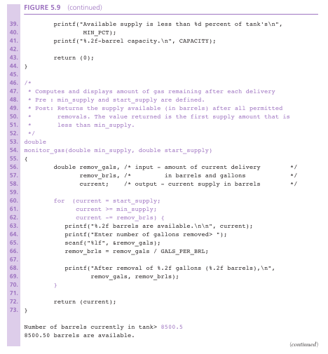

Slide 39
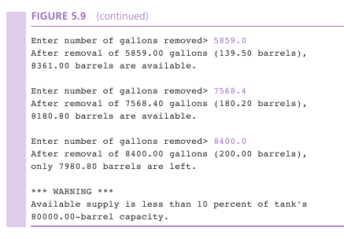

Slide 40
Loop Design
Sentinel-Controlled Loops
sentinel value: an end marker that follows the last item in a list of data
Endfile-Controlled Loops
Infinite Loops on Faulty Data

Slide 41
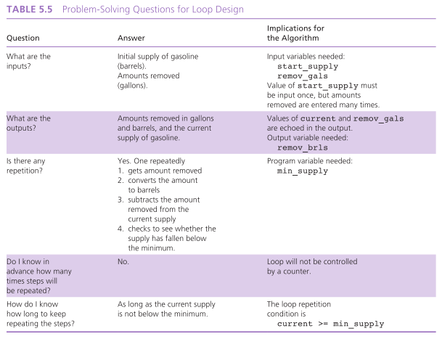

Slide 42
Sentinel Loop Design
Correct Sentinel Loop
Initialize sum to zero.
Get first score.
while score is not the sentinel
Add score to sum.
Get next score

Slide 43
Sentinel Loop Design
Incorrect Sentinel Loop
Initialize sum to zero.
while score is not the sentinel
Get score
Add score to sum.

Slide 44
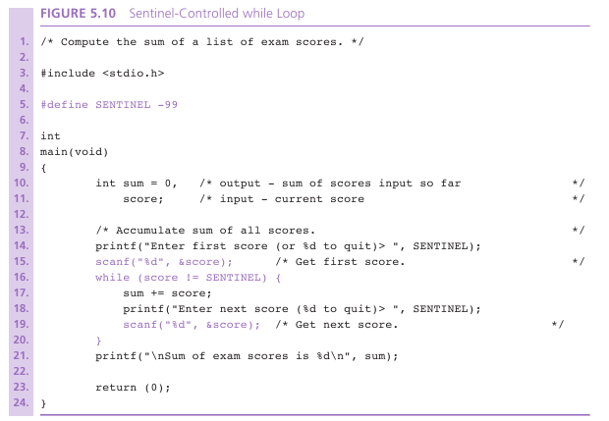

Slide 45
Endfile-Controlled Loop Design
Get the first data value and save input status
while input status does not indicate that end of file has been reached
Process data value
Get next data value and save input status

Slide 46
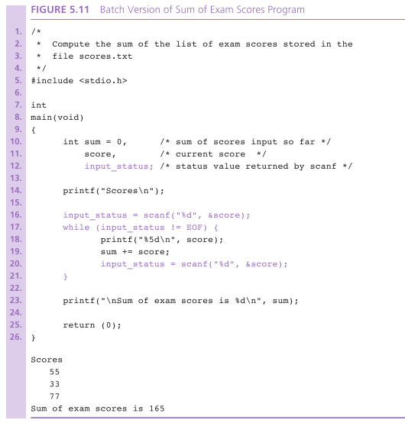

Slide 47
Nested Loops
Loops may be nested just like other control structures
Nested loops consist of an outer loop with one or more inner loops
Each time the outer loop is repeated, the inner loops are reentered, their loop control expressions are reevaluated, and all required iterations are performed

Slide 48
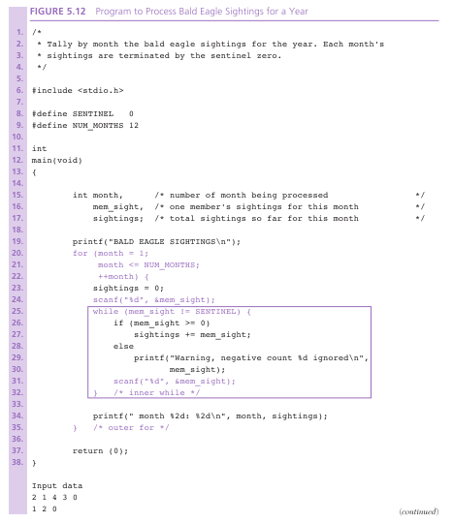

Slide 49
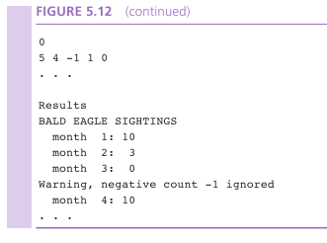

Slide 50
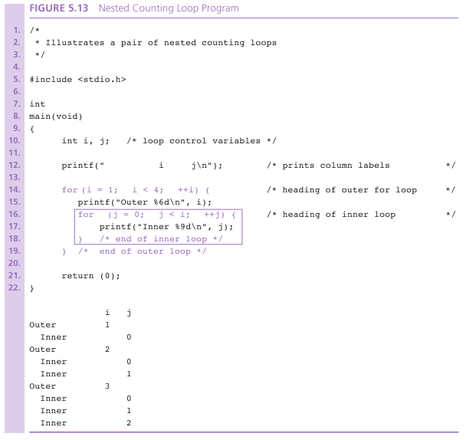

Slide 51
do-while Statement
For conditions where we know that a loop must execute at least one time
Get a data value
If data value isn’t in the acceptable range, go back to step 1.

Slide 52
do-while Syntax
do
statement;
while (loop repetition condition);
/* Find first even number input */
do
status = scanf(“%d”, &num);
while (status > 0 && (num % 2) != 0);

Slide 53
Flag-Controlled Loops for Input Validation
Sometimes a loop repetition condition becomes so complex that placing the full expression in its usual spot is awkward
Simplify the condition by using a flag
flag
a type int variable used to represent whether or not a certain event has occurred
1 (true) and 0 (false)

Slide 54
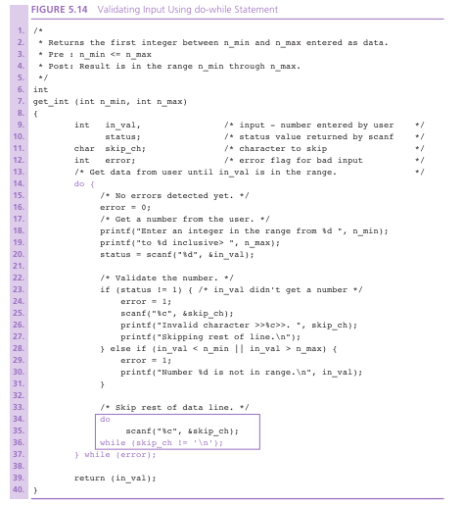

Slide 55
Off-by-One Loop Errors
A fairly common logic error in programs with loops is a loop that executes on more time or one less time than required.
If a sentinel-controlled loop performs an extra repetition, it may erroneously process the sentinel value along with the regular data.
loop boundaries
initial and final values of the loop control variable

Slide 56
Wrap Up
Use a loop to repeat steps in a program
Frequently occuring loops
counter-controlled loop
sentinel-controlled loop
Other useful loops
endfile-controlled loop
input validation loop
general conditional loop

